Slide 1
Considerations to facilitate the survey and alignment of the HL-LHC
D. Missiaen – 13/06/2014

Slide 2
Agenda
Introduction to alignment techniques
Reserved space for Survey
The CERN Co-ordinates System
Integration mock-ups
Alignment data
Fiducials
Adjustment systems
Drawings
Conclusions

Slide 3
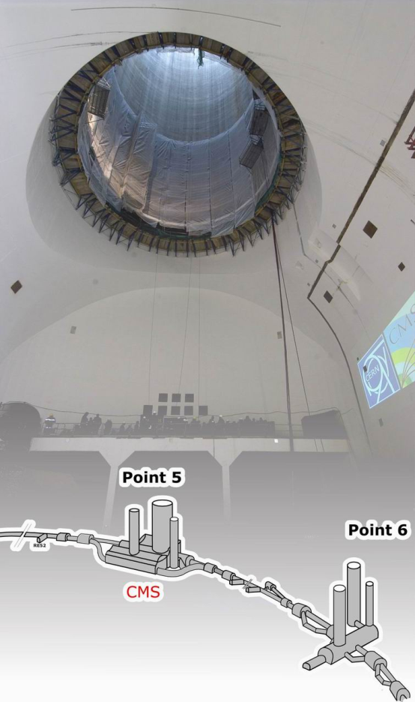
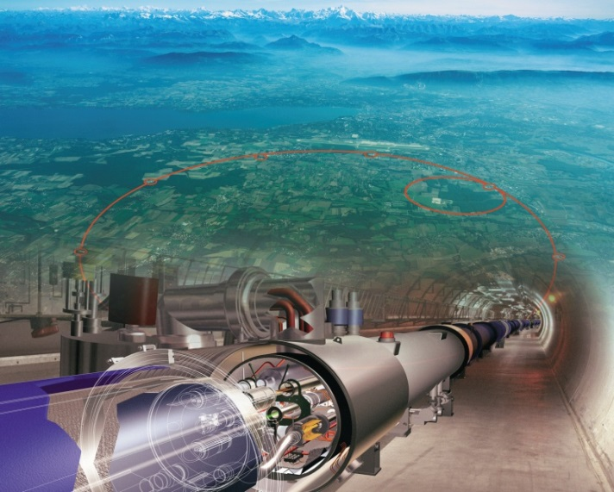
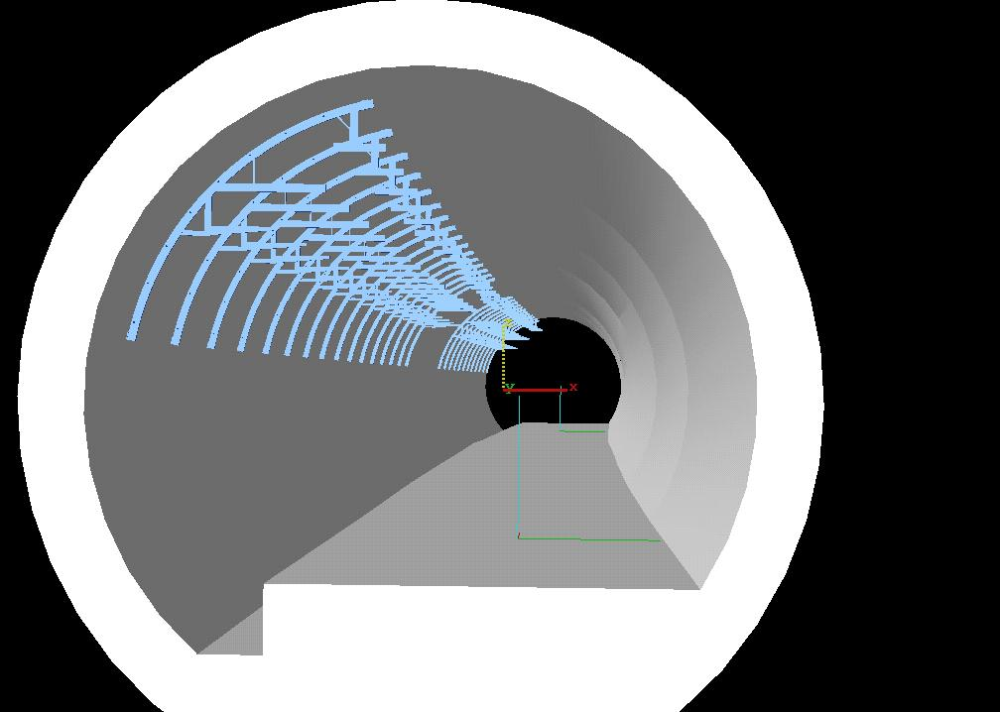
Introduction
A surface network is determined using GPS measurements
The geodetic network is transfered to a tunnel reference network down in tunnel and is used to:
  mark on the floor

Slide 4
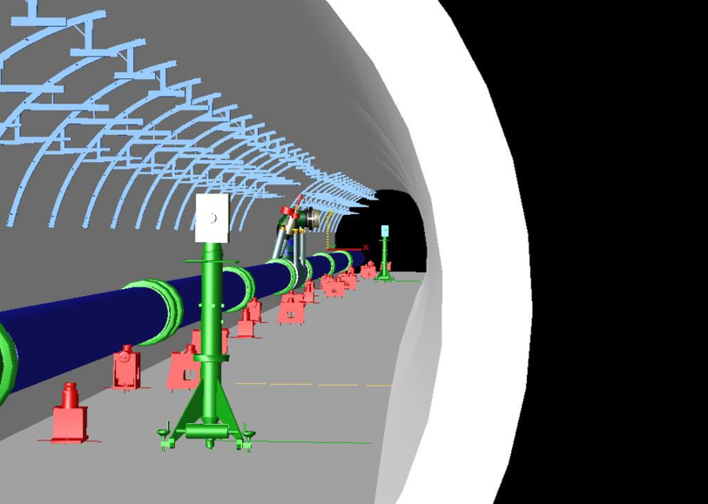
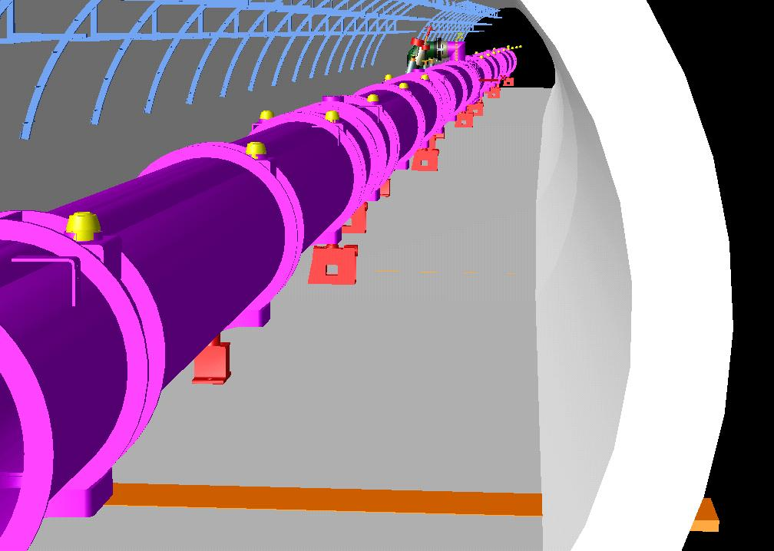
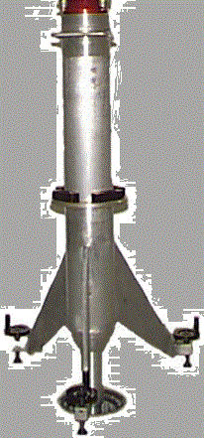
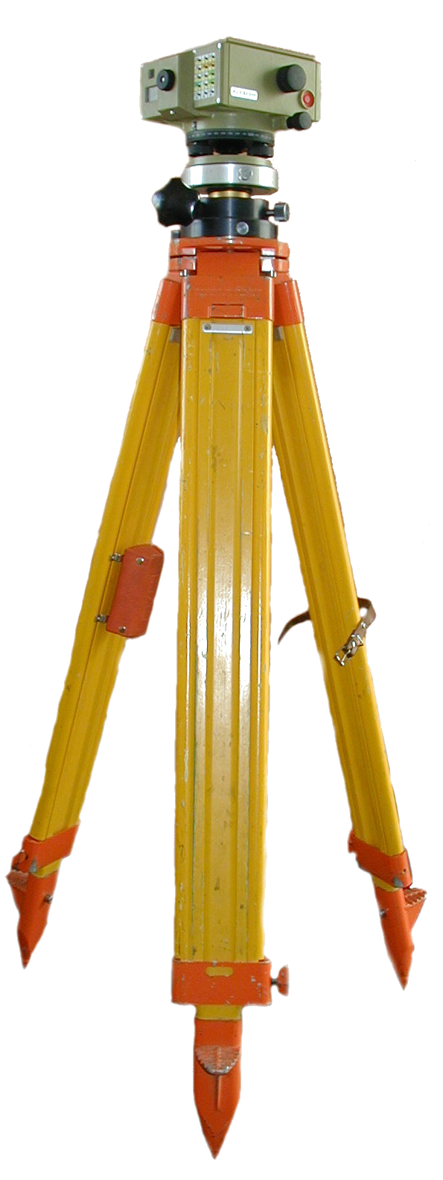
Alignment techniques
  Pre-align the jacks
  align the magnets to an absolute position
    Vertical
    horizontal

Slide 5
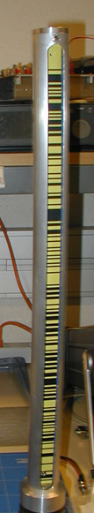
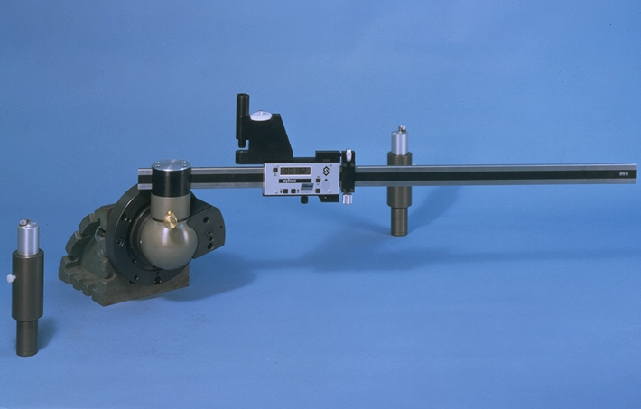
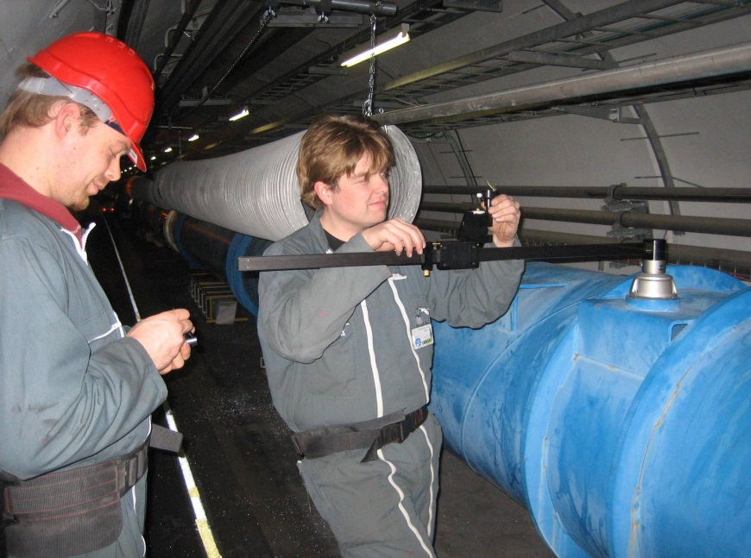
Alignment techniques
  Final alignment of magnets to a relative position
    Vertical
    horizontal

Slide 6
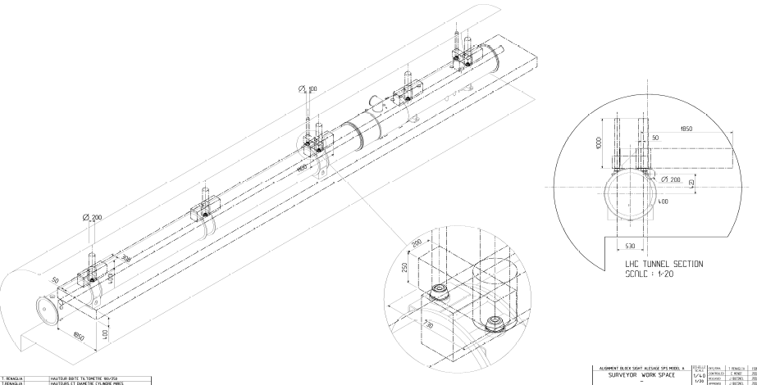
Reserved space for Survey
  To realise these measurements/alignments a reserved work space has been defined at the beginning of the LHC project
  CDD number LHCGIMSA0014

Slide 7
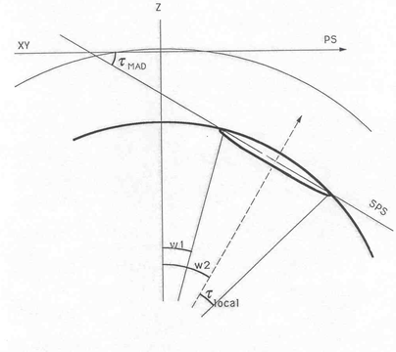
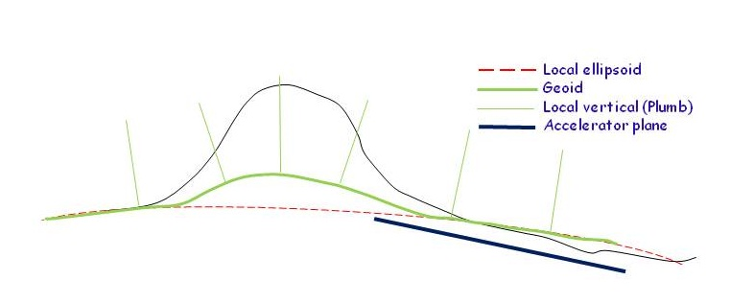
The CERN Co-ordinates System
Cartesian XYZ at the PS epoch
A spherical model was introducal at the time of the SPS and a new coordinate H (w.r.t the sphere)
The sphere has been replaced by an ellipsoid for LEP/LHC
A geoid as was included to take into account the deviation of the local vertical
Z ≠ H + 2000 (except in P0)
Z
H

Slide 8
Integration mock-ups
Tunnels are know most of the time in XYH and not in XYZ
CAD models are realised in xyz (cartesian)
Therefore it is not possible to go straight away from XYH to xyz
A local cartesian model has to be defined for each area to be modelized (the covered zone cannot exceed 200m for a precision better than 1 mm)
  All the LHC pts are done, many SPS pts as well, new studies and projects also
  Ask SU for a local system when needed

Slide 9
Alignment data
The theoretical data for the alignement are coming from the physicists through a MADx file given in the CERN Co-ordinate System (XYZ)
It could also come from the LAYOUT database
It should be available before the alignment
Z
P0
Y
X

Slide 10
Positioning in space
6 DoF : 3 angles and 3 translations
As the reference axis for the alignment is not anymore accessible in the tunnel, alignment targets are used :the fiducials
A component is completely defined by 2 fiducials and
  A reference surface for the roll angle
  Or a 3rd fiducial
T
Z
S
Y
X
MADx (E)
MADx (S)
R

Slide 11
Fiducials
  The magnet co-ordinate system
  SU needs the r, s and t values in the local cartesian magnet co-ordinate system w.r.t MADx points
T
t
r
S
MADx (E)
s
MADx (S)
R

Slide 12
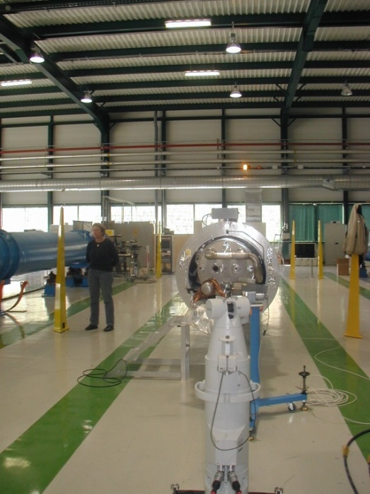
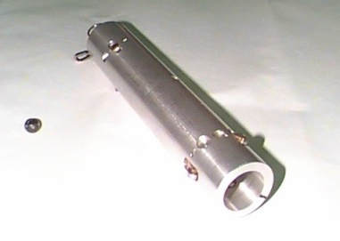
Fiducials
  These info should be given most by the drawings of the equipment owner
  It could be done as well by the metrology lab
  In some cases the fiducialisation is done by SU, it was the case for all the LHC cryo-magnets

Slide 13
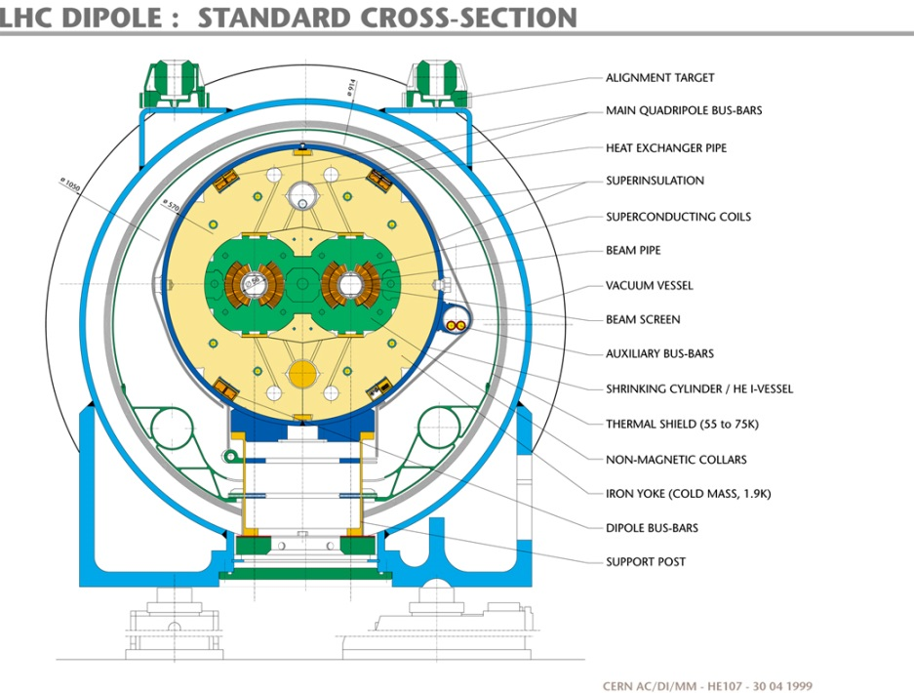
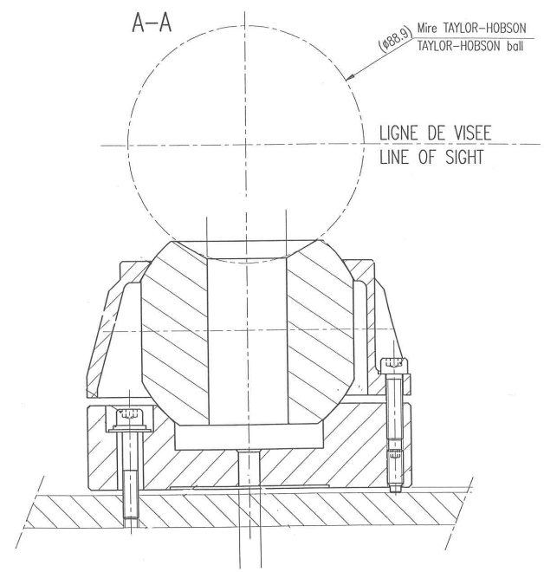
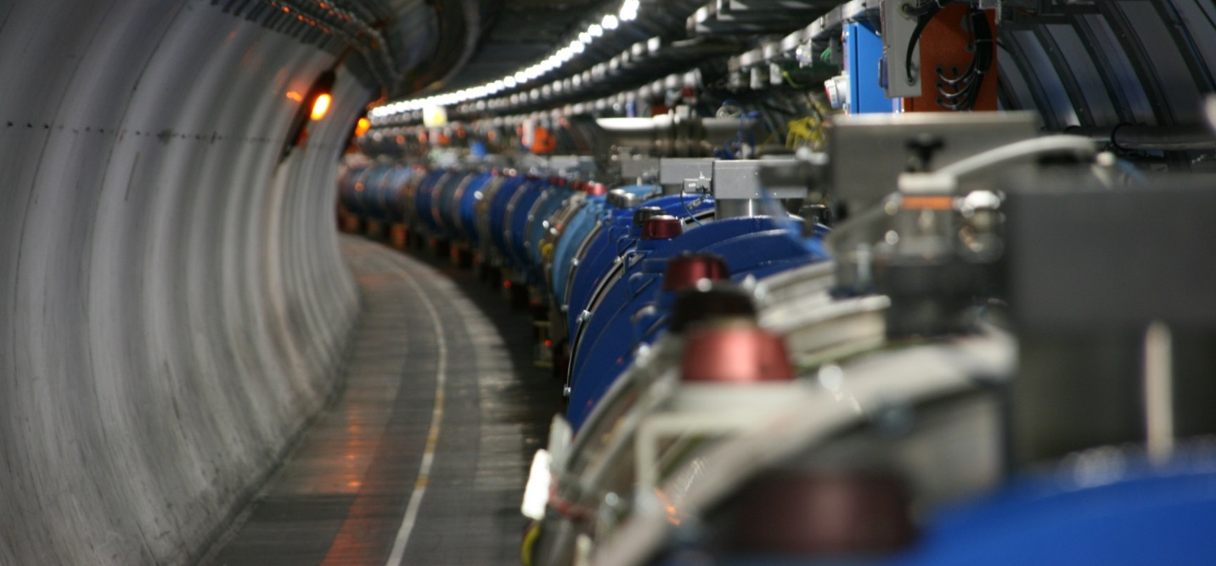
Fiducials
  The CERN centring system : cup, sphere and cap
  LHCGIMSA0001, 0003, 0004, 0005

Slide 14
Mechanical supporting system
Two functions
  It has to support the components
  To allow the adjustment
The object to be aligned has to be supported on 3 points only
The support should be stable and rigid, fixed strongly to the floor
The accuracy of the system has to be adapted to the precision of the adjustment requested. (As an example BPM systems don’t allow better than 0.1 mm)

Slide 15
Mechanical adjustment system
The adjustments (V and H) have to be independent the one from the other
  We should not destroy the V adjustment when realising the H one and vice versa
The displacements should be done in the measurement planes and not w.r.t the slopes
  The supports should be installed vertically
  Double horizontal plates in the slopes
The position of the adjustment screws is determined taking into account the position of the fiducials

Slide 16
Mechanical adjustment system
The adjustment ranges should be sufficient to cope with the uncertainties of the marking of the floor, drilling, installation, manufacturing (supports and components), and future re-adjustments.
  +/- 20mm in radial, long. and height is mandatory
  foresee some shimings in case the floor is irregular
Ergonomy : think about the accessibility and manipulation of the screws

Slide 17
Classical example in a slope
Points MAD
Brown shim to recuperate the floor slope
Green shim to recuperate the slope of the magnet
Yellow support is vertical
The adjustment of height and roll angle is located below the H translation plate
Horizontal adjustment plate
H
Floor marking
E
17

Slide 18
Case of (LHC) tilted magnets
E can be between 0 and 8mm depending on roll
H
E
Beam axis
18
18

Slide 19
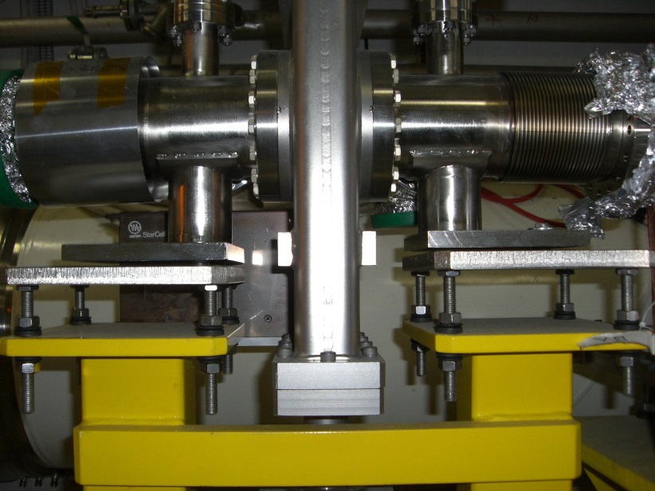
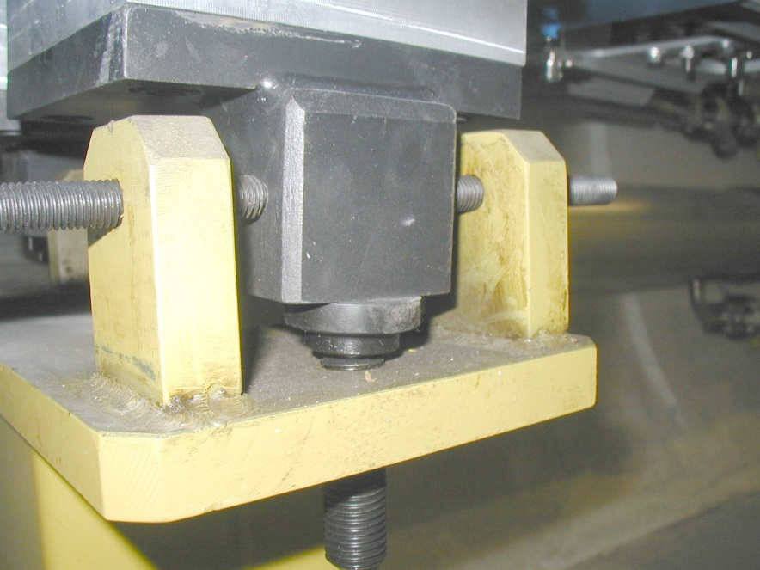
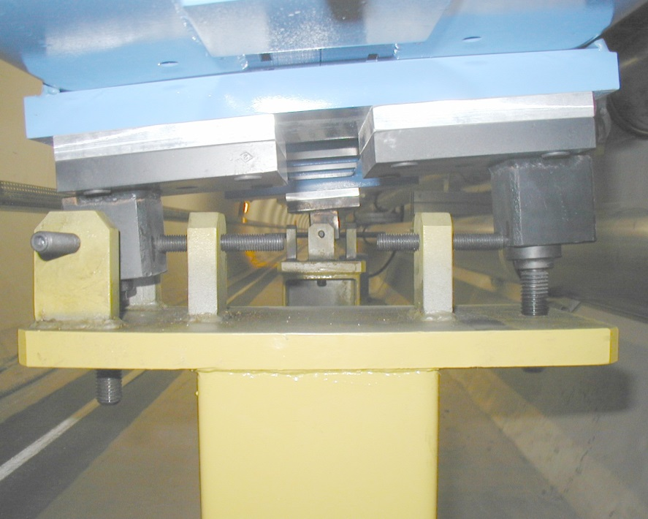
Some bad examples (LHC and transfer lines)

Slide 20
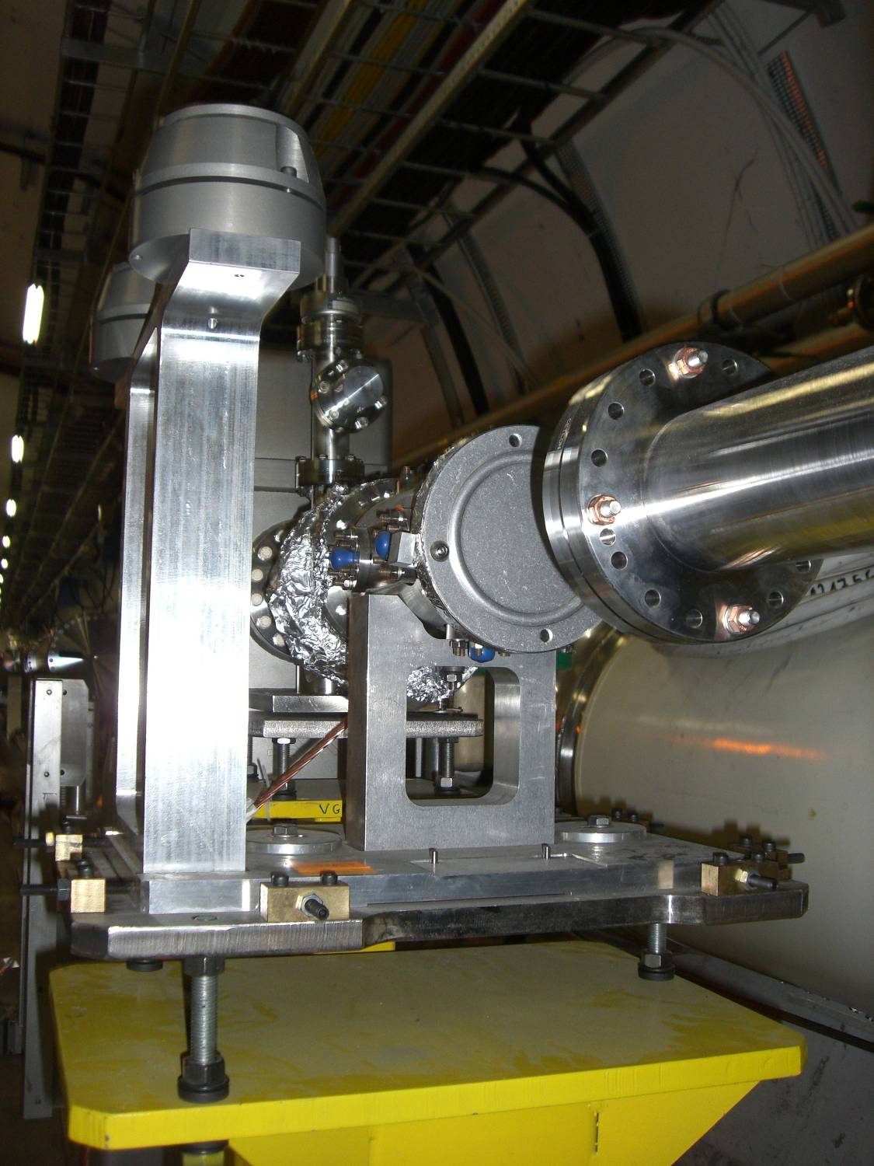
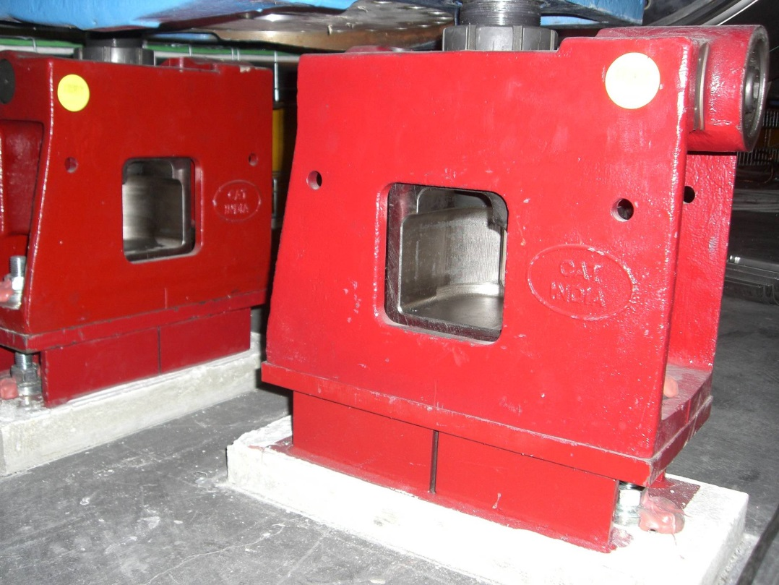
Some good examples (LHC)

Slide 21
Drawings
Floor marking
  SU is marking on the floor the MADx pt (E and S) which are the projection along the local vertical
  The psotion of supports and therefore the drilling has to take into account the slope and the roll angle effect
  Drilling pts are therefore not systematically symmetrical with respect to MADx points
d
Average beam line marked on the floor
d2
d
d1
Magnet without tilt
Magnet with important tilt

Slide 22
Drawings
Points MAD
Floor marking
  E = H*tang(pente)
  H=0.50m and slope =0.014mrd E= 7mm, which is significative for the ranges of adjustment ~15mm
  Drilling pts are therefore not systematically symmetrical with respect to MADx points
H
Floor marking
E
22

Slide 23
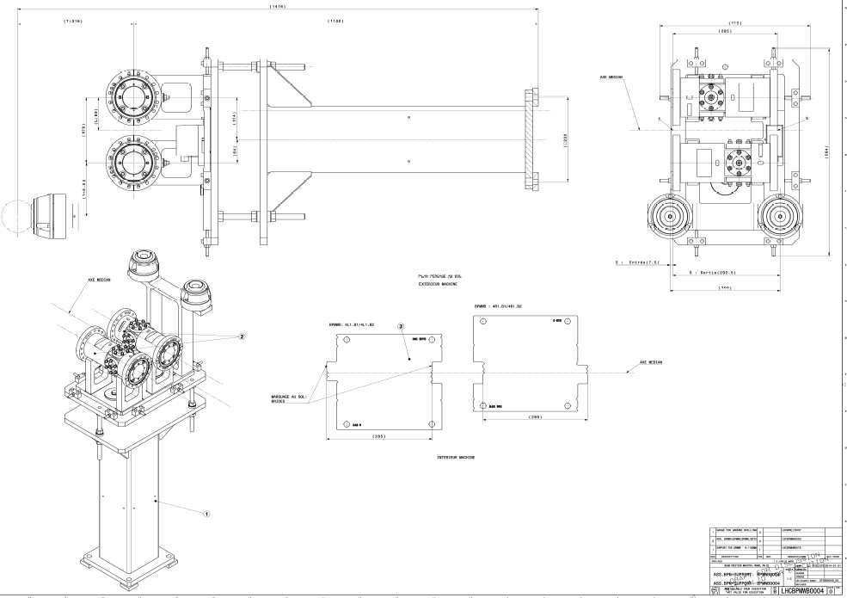
Drawings
Where are the MADx points ??

Slide 24
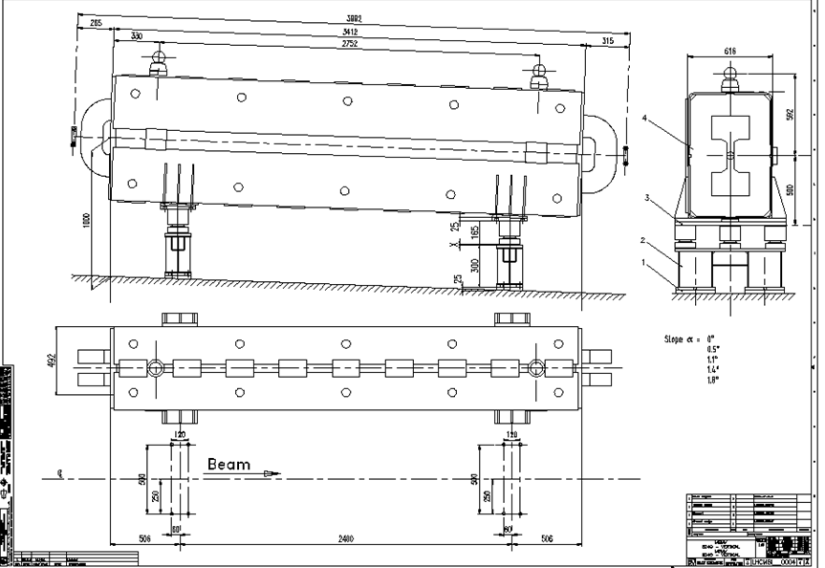
Drawings

Slide 25
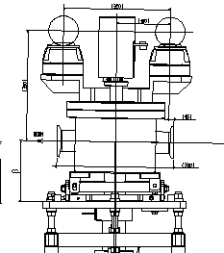
Drawings
Points MADX missing
Position of fiducials wrt to MADx pts doen’t exists even if the symmetry axis is mentionned
Beam direction opposite to the convention
Beam points missing

Slide 26
Conclusions
For the CATIA models, be aware that CERN Co-ordinates System is NOT cartesian
  Ask SU for a local cartesian system when needed
  Z ≠ H + 2000m
For the design of the supporting/adjustment system and fiducials, please refer to the rules that I have presented
Anytime you design an equipment/owner, if it needs to be aligned pls contact SU
Don’t forget to leave the Survey work space free of obstacles

