Slide 1
Best Practices for ALARA
C. Adorisio and S. Roesler
on behalf of DGS-RP
HL-LHC Standards and Best Practices Workshop
CERN, June 13, 2014

Slide 2
Outline
1. Reminder – legal constraints
2. Optimization during design
3. Dose rate outlook until 2035
Limitation
Optimization / ALARA
Radiological quantities to be assessed
Design criteria
Methodology
Example (LHC collimators)
Design options for ALARA
Optimizing material selection (ActiWiz)
Operational scenario
LS1 & comparison with measurements
Evolution until LS3
Predictions for HL-LHC until 2035

Slide 3
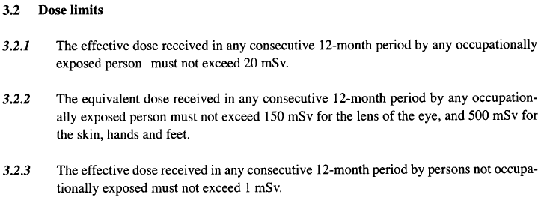
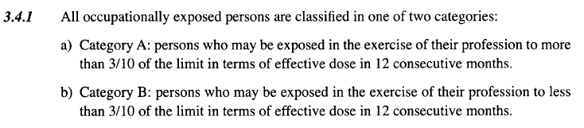
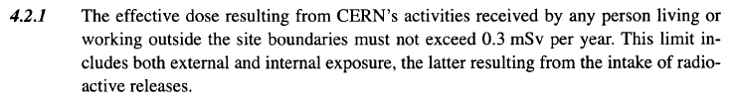
Safety Code F – Limitation
Design and operation !
Radiation Workers
Category A: 20 mSv / yr
Category B: 6 mSv / yr
Others
1 mSv / yr
Environment
0.3 mSv / yr

Slide 4
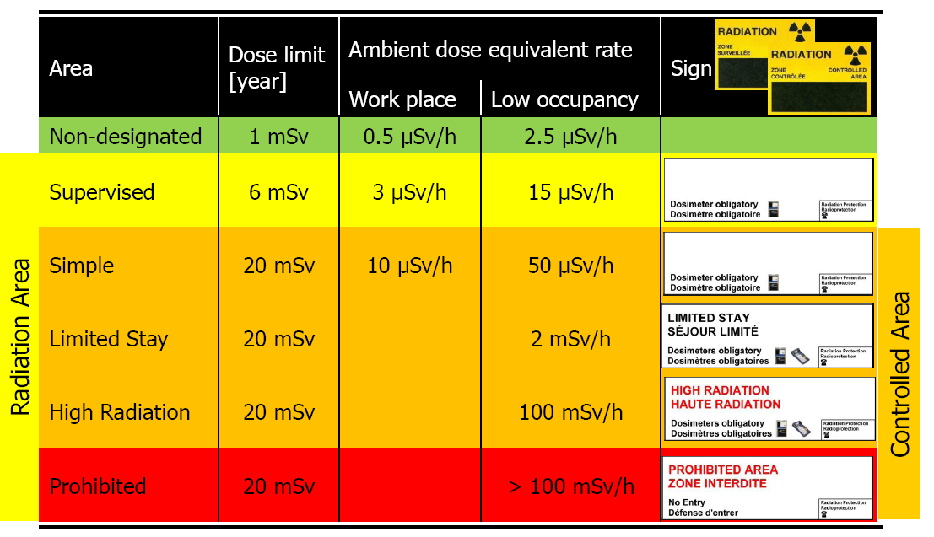
Safety Code F – Limitation
Total number of working hours per year: 2000 hours
(example: Supervised Area 3 µSv/h × 2000 h = 6 mSv)
Low-occupancy: < 20% of working time

Slide 5
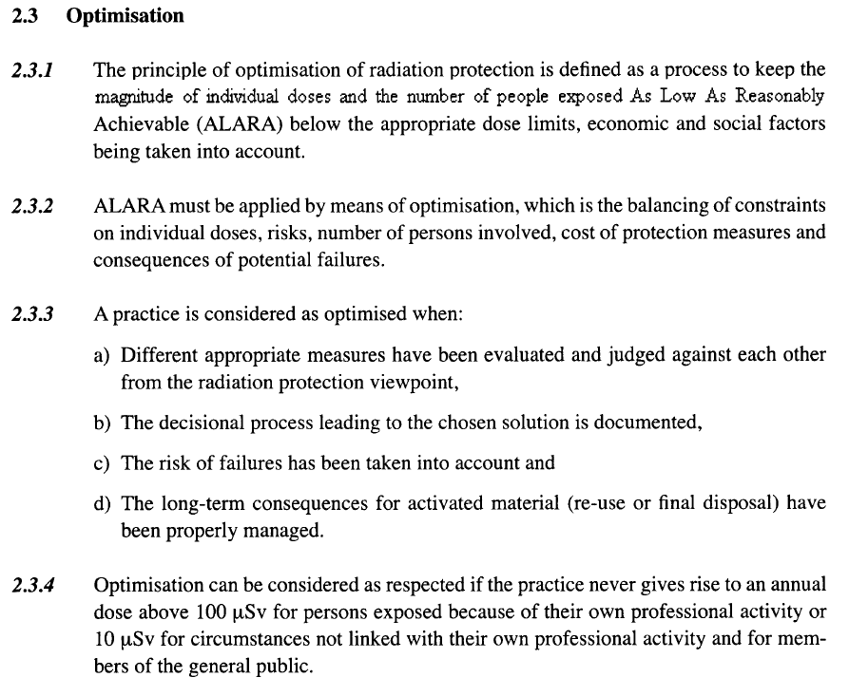
Safety Code F – Optimization (ALARA)
Design and operation !
Workers on CERN site
100 µSv / yr
Outside of CERN (environment)
10 µSv / yr

Slide 6
Safety Code F – Limitation / Optimization
On CERN sites
Outside of CERN
Radiation
Workers
Other
Workers
Population
Limits
6 / 20 mSv / yr 1 mSv /yr 300 µSv / yr
Optimization / ALARA to be demonstrated
Optimization
thresholds
100 µSv / yr 100 µSv / yr 10 µSv / yr
Optimized (by definition)

Slide 7
Radiological quantities
  Periods of beam operation
  dose equivalent to personnel by stray radiation in accessible areas
  (example: dose in counting rooms of LHC experiments during operation)
  activation of effluents and air and their release into the environment as well as the resulting
  annual dose to the reference groups of the population
  (example: dose to reference group in the vicinity of LHC Point 1 after LS3)
  dose equivalent to personnel and environment in case of abnormal operation or accidents
  (examples: dose in counting rooms of LHC experiments during full beam loss, dose impact of fire)
2. Beam-off periods
  radioactivity induced by beam losses in beam-line components and related residual dose
  equivalent rates (example: dose equivalent rate maps in the UX and LSS)
  individual and collective doses to personnel during interventions on activated beam-line components
  or experiments (example: predictions of individual and collective dose for magnet exchange)
Decommissioning
  radionuclide inventory for waste disposal

Slide 8
Optimization during design
On CERN sites
Outside of CERN
Radiation
Workers
Other
Workers
Population
Limits
6 / 20 mSv / yr 1 mSv /yr 300 µSv / yr
Prompt radiation:
Dose equivalent to personnel
involved in activity of the area
Residual radiation:
Individual and collective doses
to personnel during interventions
Design criterion: 2 mSv/intervention/year
Optimization
thresholds
100 µSv / yr 100 µSv / yr 10 µSv / yr
Prompt radiation:
Annual dose to personnel not
involved in activity of the area
Prompt and residual radiation:
Annual dose to reference
group of population

Slide 9
Intervention doses – Methodology
Calculation of residual dose rate maps
Calculation of individual and collective intervention doses
Revision of design and/or work scenario
for cooling times typical for interventions on the respective component
based on nominal operational parameters
definition of geometry and materials as detailed as needed (and available)
based on as realistic as possible work scenarios, including locations, duration, number of
persons involved,..
identification of cooling times below which work will be impossible
(design criterion: 2 mSv/intervention/year)
communication of results and constraints to equipment groups
start with work steps that give highest individual or collective doses
consider optimization measures (distance, tooling, material choices, etc.)
identify if remote handling is possible
Start of iteration:
New design ? Step 1
Revised work scenario ? Step 2

Slide 10
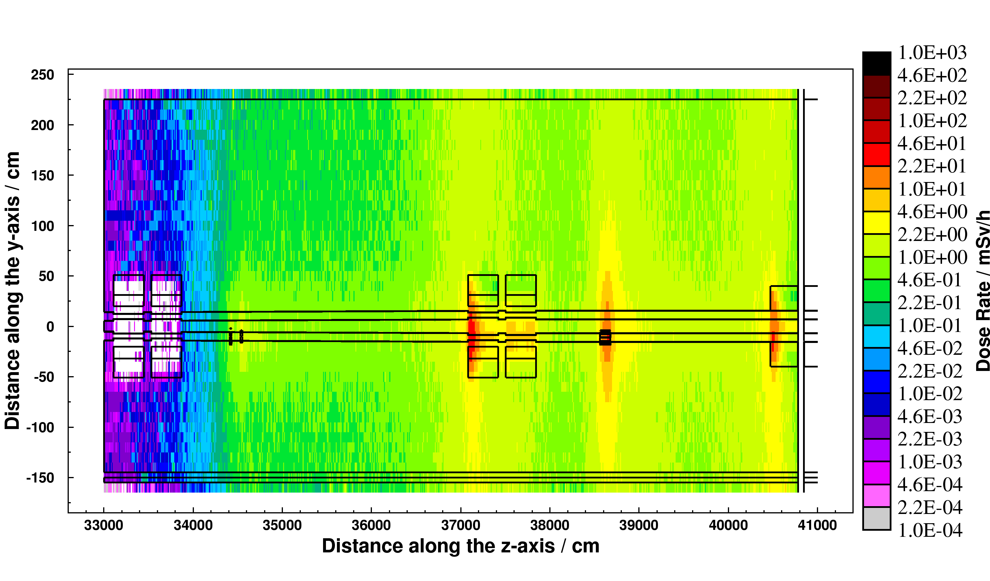
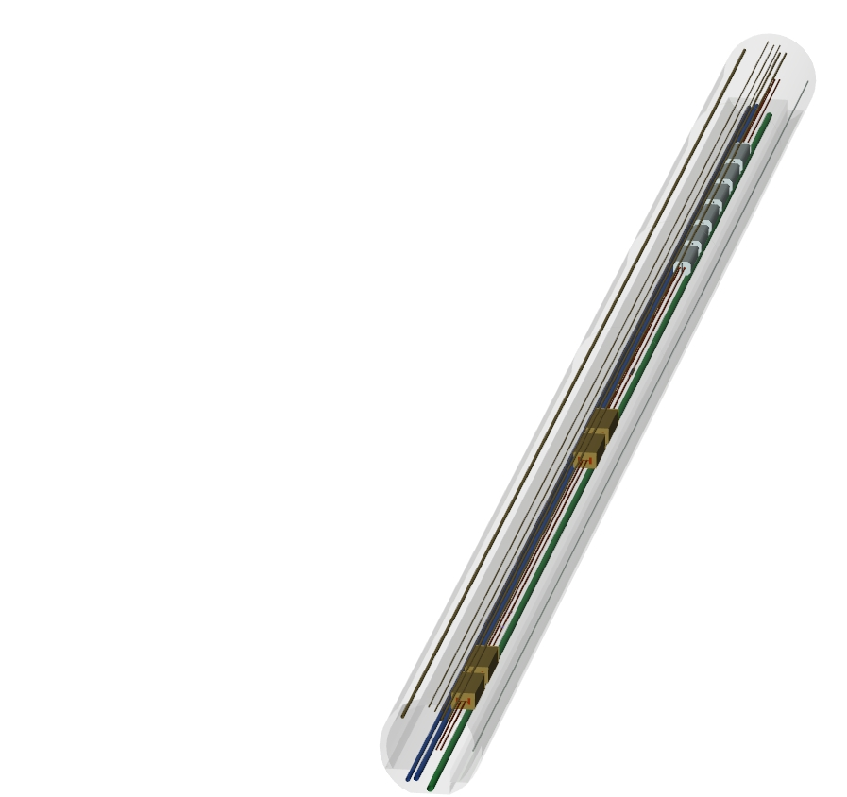
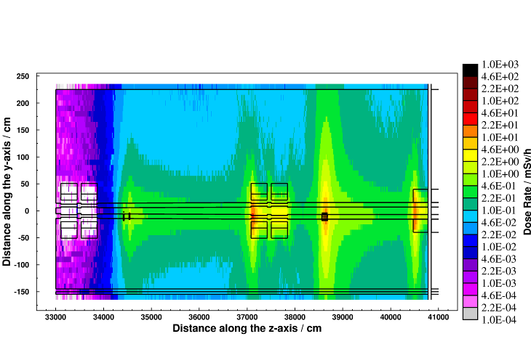
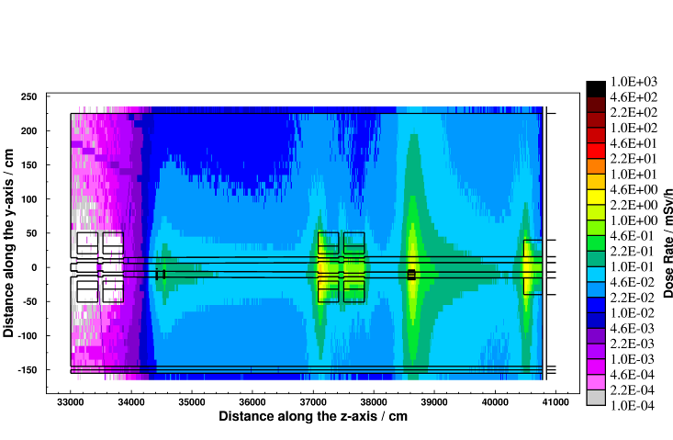
Intervention doses – Example: LHC collimators
Cooling time
Residual dose rate (mSv/h)
after one year of operation
at nominal intensity
8 hours
Aisle: 0.5-2mSv/h
Close: 2-20mSv/h
1 week
Aisle: 0.1-0.5mSv/h
Close: 0.5-5mSv/h
4 months
Aisle: 0.01-0.1mSv/h
Close: 0.1-1mSv/h

Slide 11
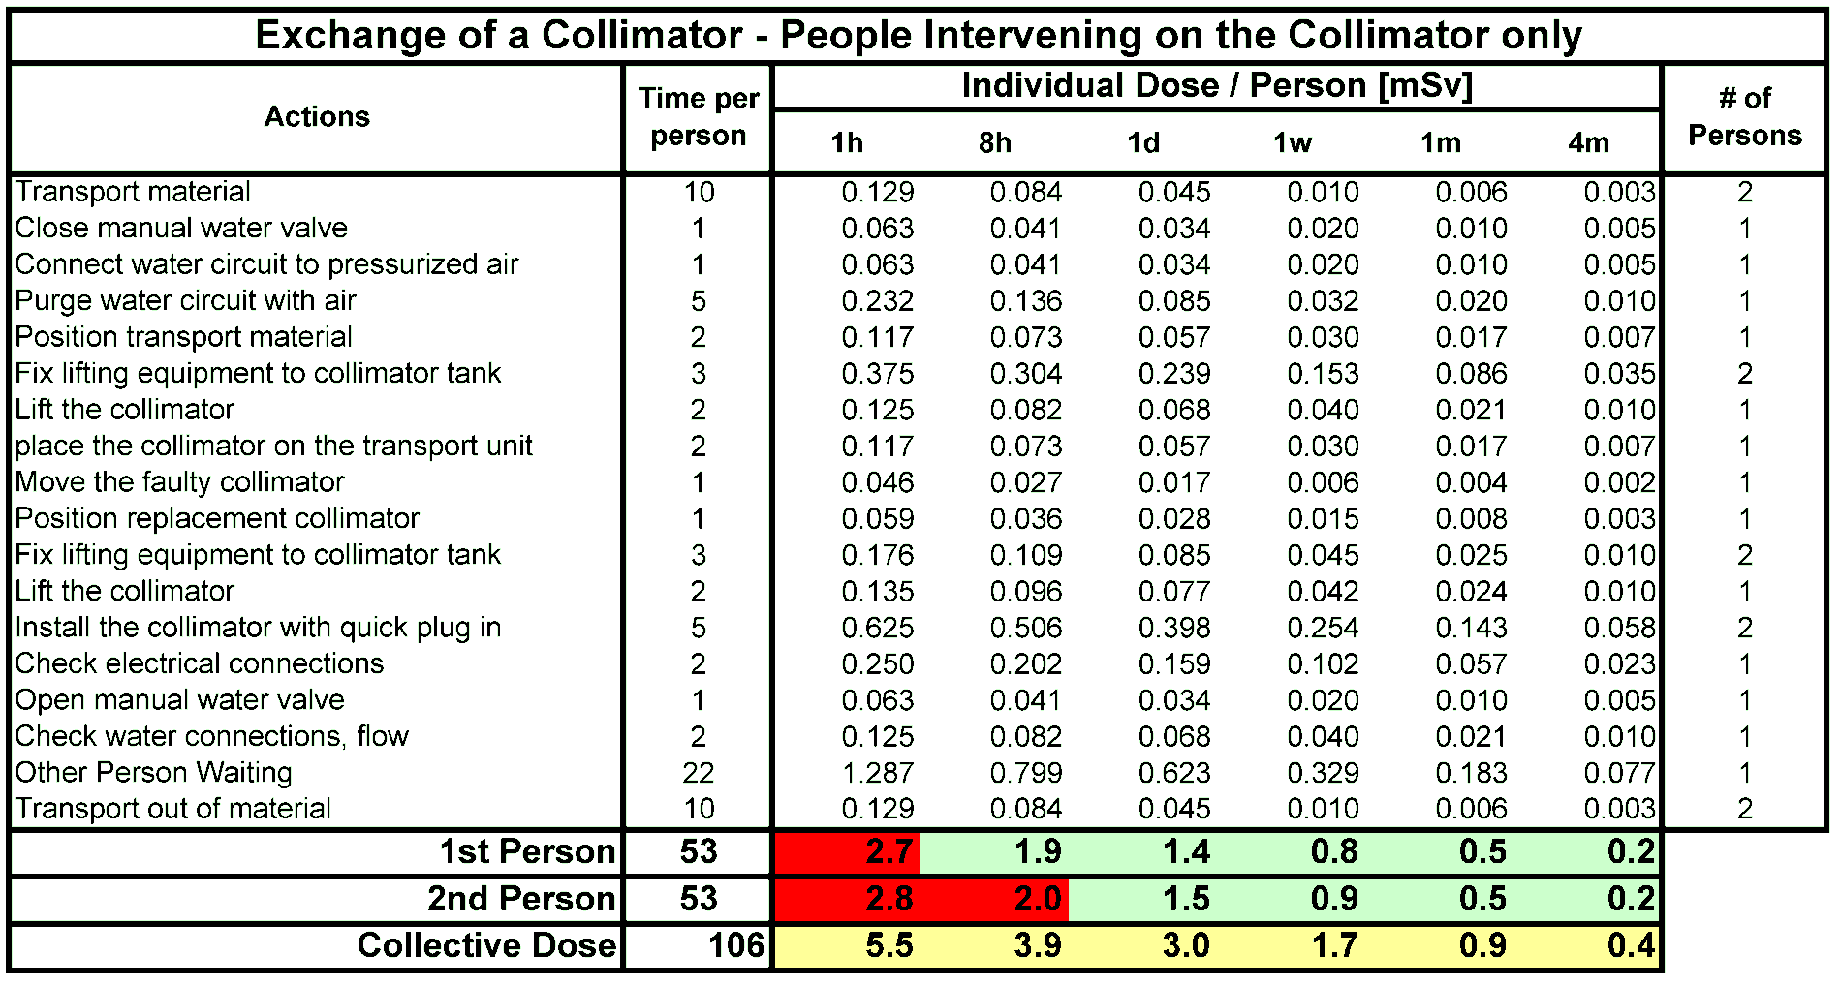
Intervention doses – Example: LHC collimators
1. Work by collimation team

Slide 12
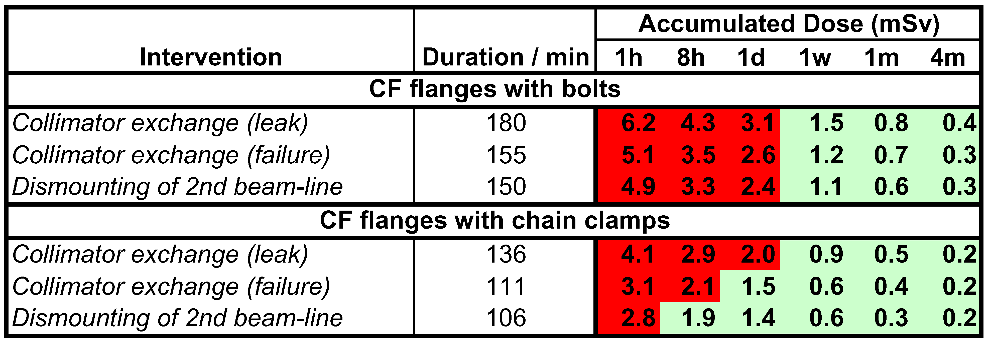
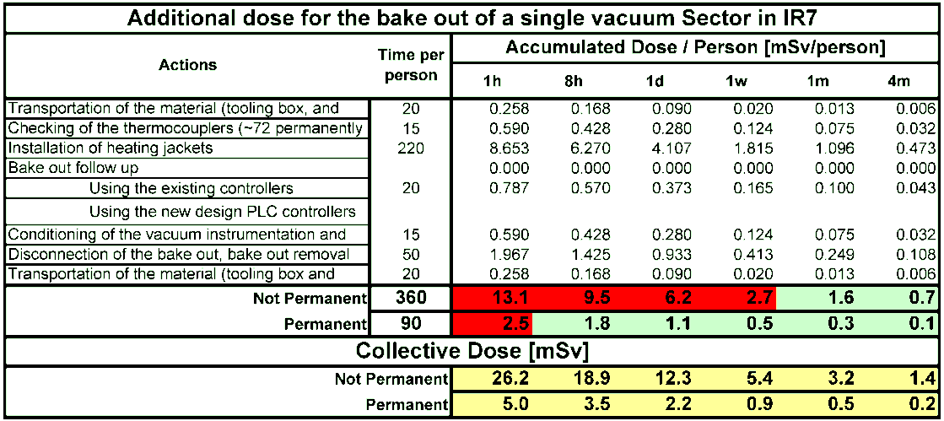
Intervention doses – Example: LHC collimators
2. Work by vacuum team
using vacuum connections with chain clamps reduces the individual dose by almost 40%
a permanent bake-out equipment lowers the individual and collective dose by a factor of five

Slide 13
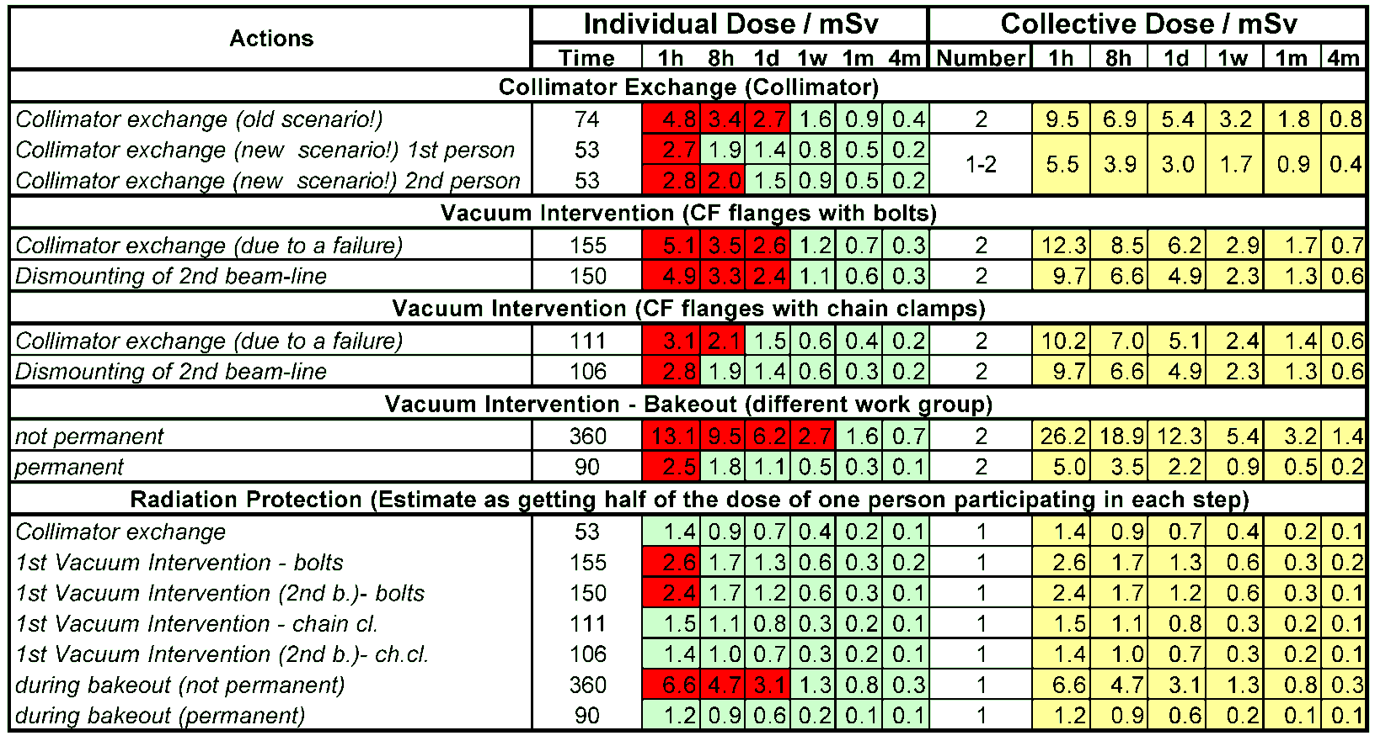
Intervention doses – Example: LHC collimators
4. Summary of work of all involved groups
Conclusions:
minimum waiting time at least one week
use of quick-connect flanges necessary
installation of permanent bake-out equipment is important

Slide 14
Optimization during design – Design Options
Material choice
  Low activation properties to reduce residual doses and minimize radioactive waste
  (optimization with ActiWiz code, see below)
  Avoid materials for which no radioactive waste elimination pathway exists (e.g., highly
  flammable metallic activated waste)
  Radiation resistant
Optimized handling
  Easy access to components that need manual intervention (e.g., valves, electrical connectors)
  or complex manipulation (e.g., cables)
  Provisions for fast installation/maintenance/repair, in particular, around beam loss areas
  (e.g., plugin systems, quick-connect flanges, remote survey, remote bake-out)
  Foresee easy dismantling of components
Limitation of installed material
  Install only components that are absolutely necessary, in particular in beam loss areas
  Reduction of radioactive waste

Slide 15
Optimization during design – Material choice
Goal:
Minimize doses received by personnel during maintenance and repair
Reduce downtime due to faster access and less restrictions for manipulation
Reduce costs for waste disposal
Consider radiological hazards in the choice of construction materials
Tool to optimize material choices:
ActiWiz
(Authors: C.Theis and Helmut Vincke)
Computer code based on a risk model using pre-calculated FLUKA results. Considers external exposure
and radioactive waste disposal
Provides radiological hazard assessment for arbitrary materials within a few seconds
Catalogue, produced with ActiWiz, listing pre-processed risk factors for typical accelerator construction
materials as well as natural elements
Web-based catalogue (ActiWeb) allowing user friendly comparison of pre-processed materials
Materials not available in the catalogue can be processed with ActiWiz
Web-site: https://actiwiz.web.cern.ch/

Slide 16
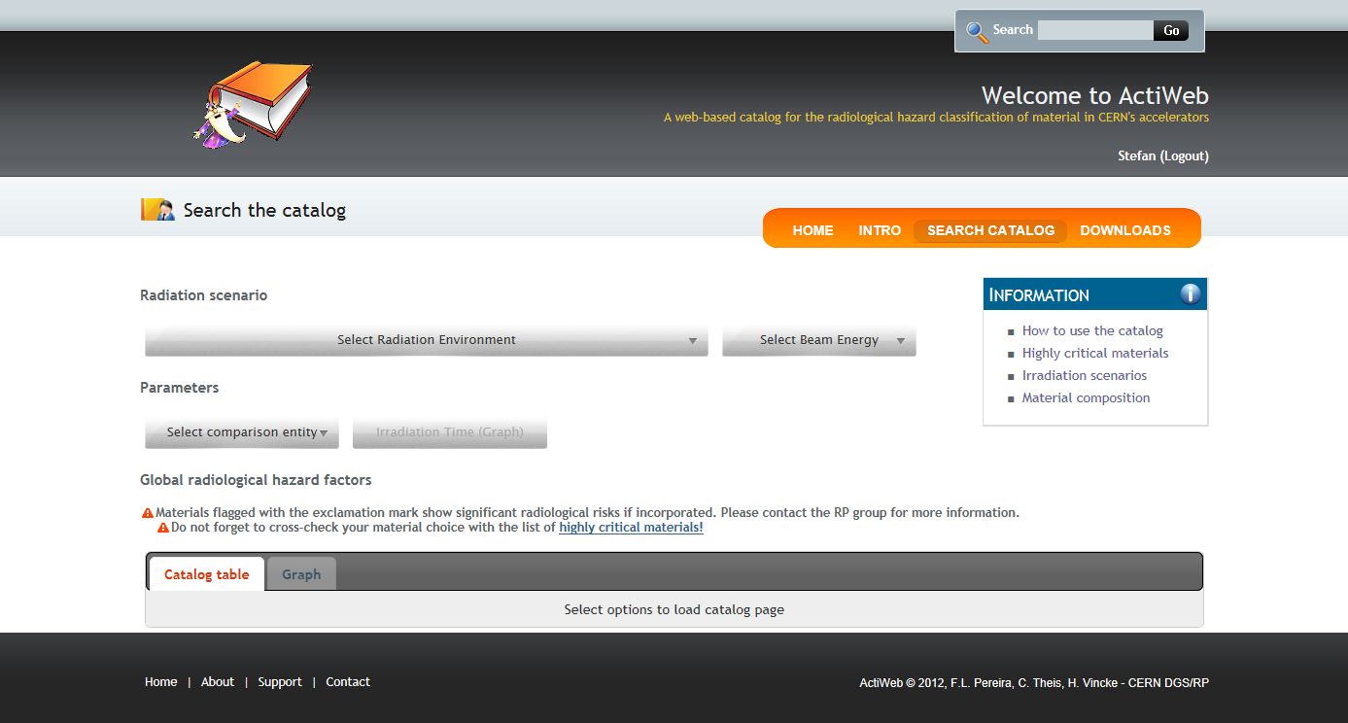
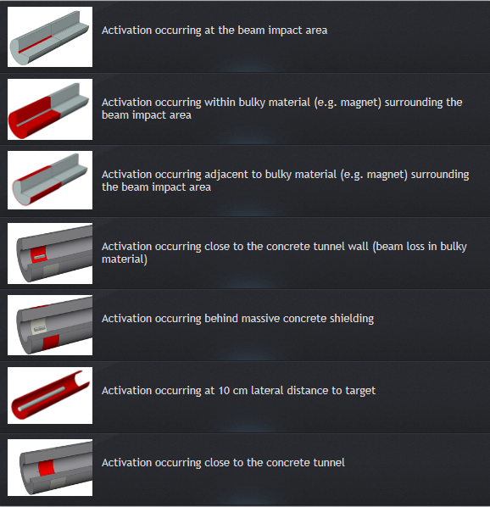

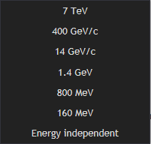
Optimization during design – ActiWiz

Slide 17
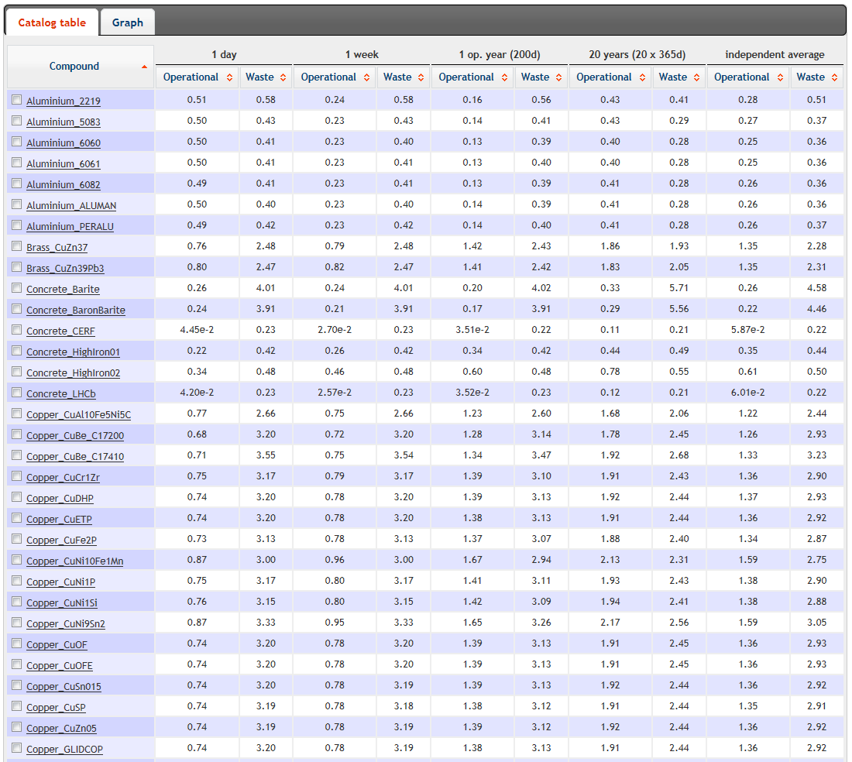
Optimization during design – ActiWiz

Slide 18
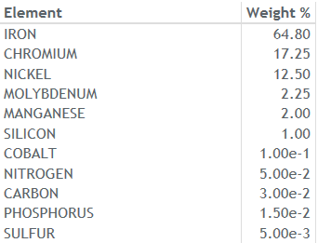
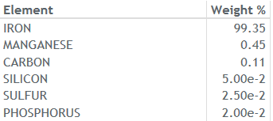
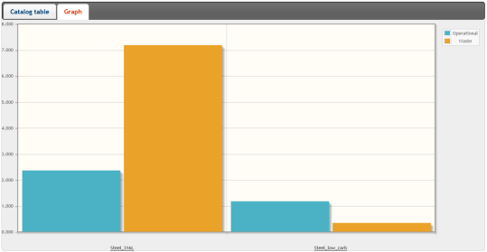
Optimization during design – ActiWiz
Steel 316L
Cast iron
Main contributors:
⁶⁰Co (61%) produced on Cobalt
⁵⁴Mn (37%) produced on Iron
Main contributor:
⁵⁴Mn produced on Iron
7.2
2.4
1.2
0.34
20 years irradiation
2 years cooling
Dose rate
Activity
Dose rate
Activity

Slide 19
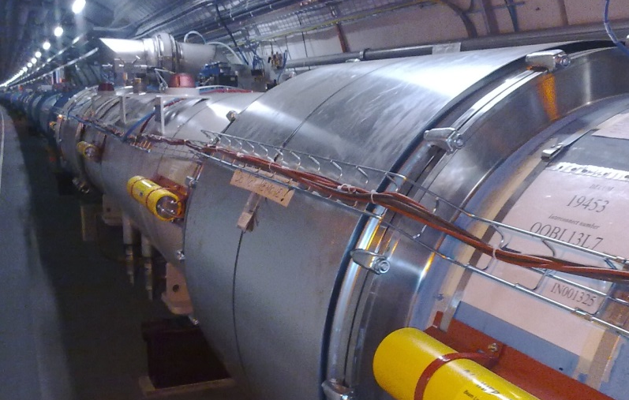
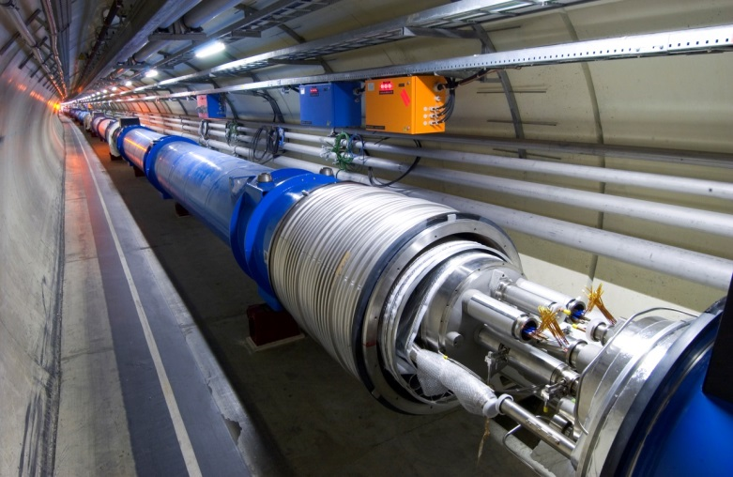
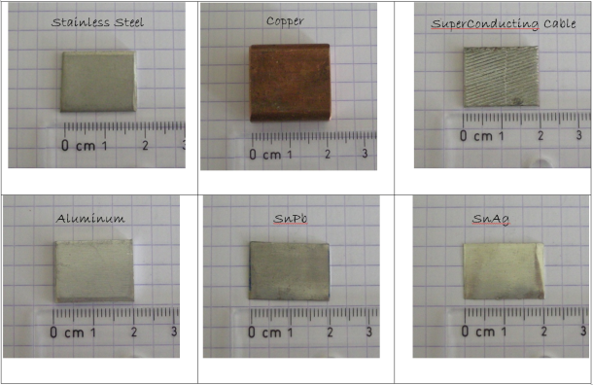
Monitoring of activation – Material samples
Example: interconnections
Thermal screen: aluminum
M-pipe: stainless steel
Bus bar: copper
Superconducting cable:
mainly copper, niobium,
titanium
- samples put in plastic bags and attached to the outside
of interconnections
- in total 148 bags at most critical and representative
positions
Solder: tin-silver (old)
tin-lead (new)

Slide 20
Operational scenario
 | Year of LHC Operation | Peak / levelled luminosity [cm⁻²s⁻¹] | Integrated luminosity [fb⁻¹]
 | ≤2012 | 0.8E+34 | 30
LS1
 | 2015 | 1.45E+34 | 35
 | 2016 | 1.65E+34 | 50
 | 2017 | 1.75E+34 | 50
LS2
 | 2019 | 2.0E+34 | 25
 | 2020 | 2.0E+34 | 60
 | 2021 | 2.0E+34 | 60
LS3
 | 2024 | 5.0E+34 | 150
 | 2025 | 5.0E+34 | 250
 | 2026 | 5.0E+34 | 250
LS4
 | 2028 | 5.0E+34 | 200
 | 2029 | 5.0E+34 | 250
 | 2030 | 5.0E+34 | 250
LS5
 | 2032 | 5.0E+34 | 200
 | 2033 | 5.0E+34 | 250
 | 2034 | 5.0E+34 | 250
 | 2035 | 5.0E+34 | 250
Source: S.Myers, RLIUP Workshop

Slide 21
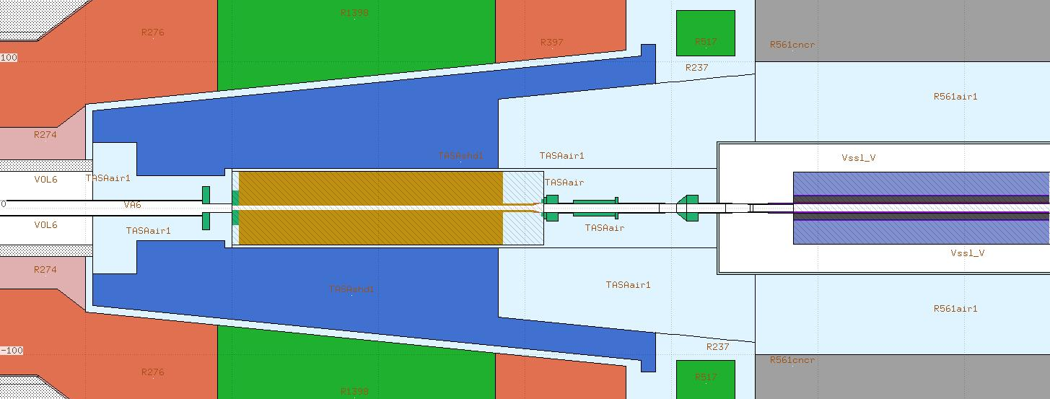
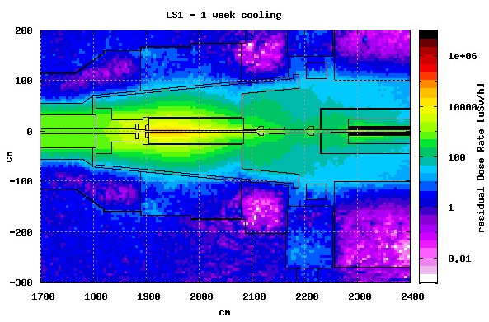
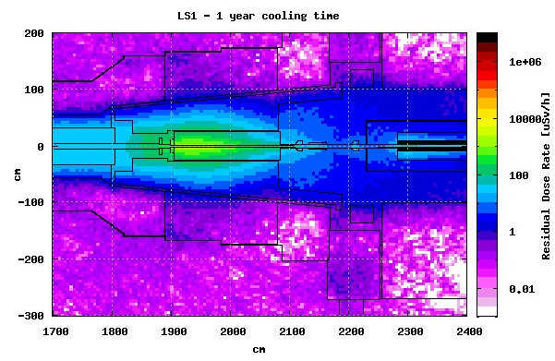
Dose rates – LS1
Example: TAS at Point 5
FLUKA geometry: courtesy FLUKA team

Slide 22
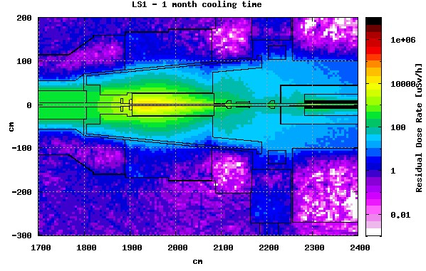
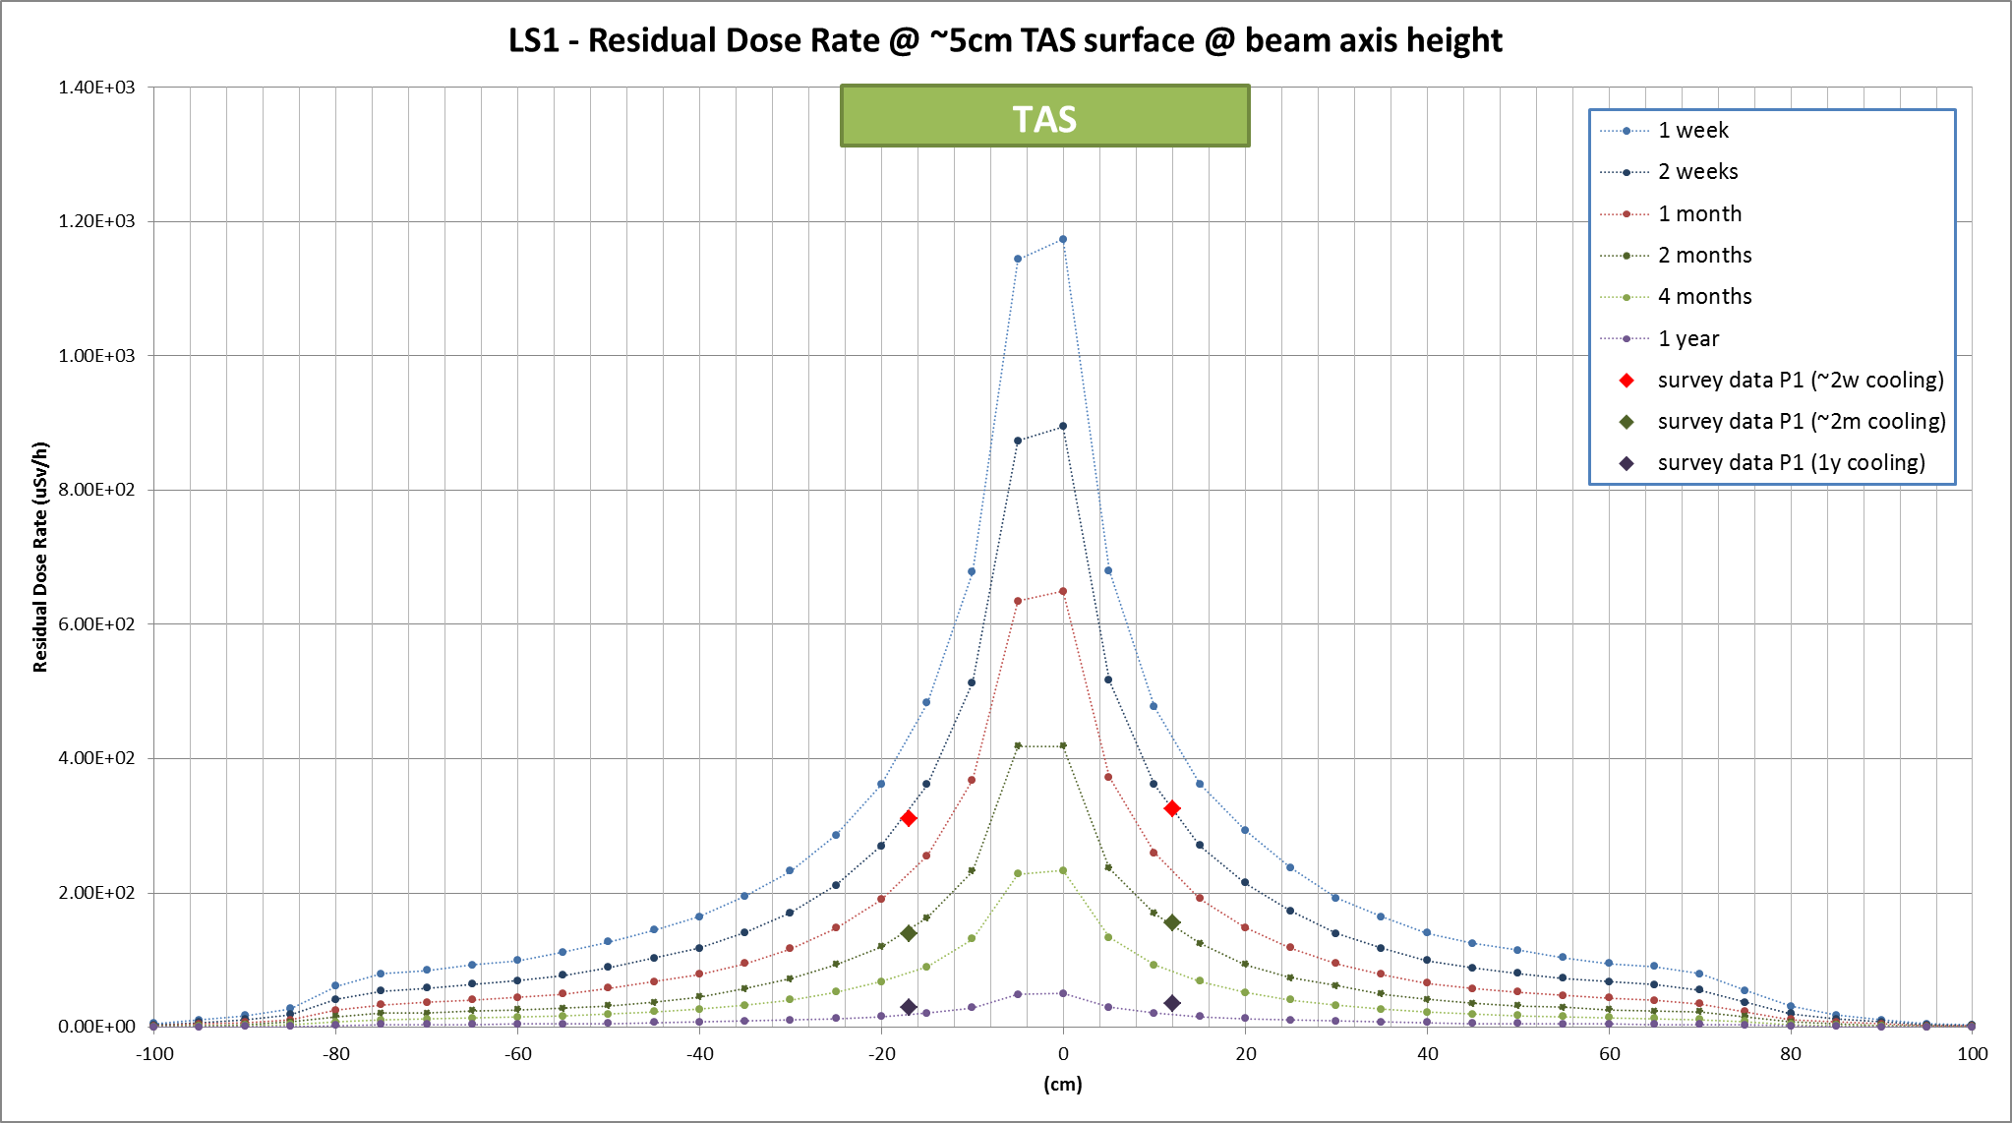
Dose rates – LS1
Example: TAS at Point 5

Slide 23
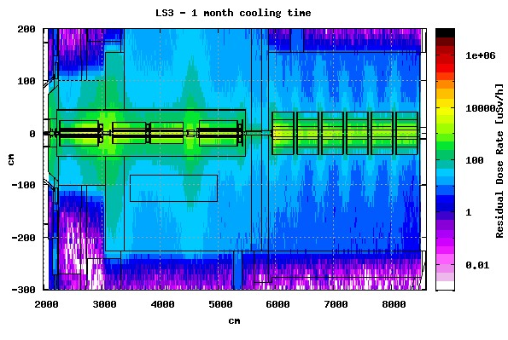
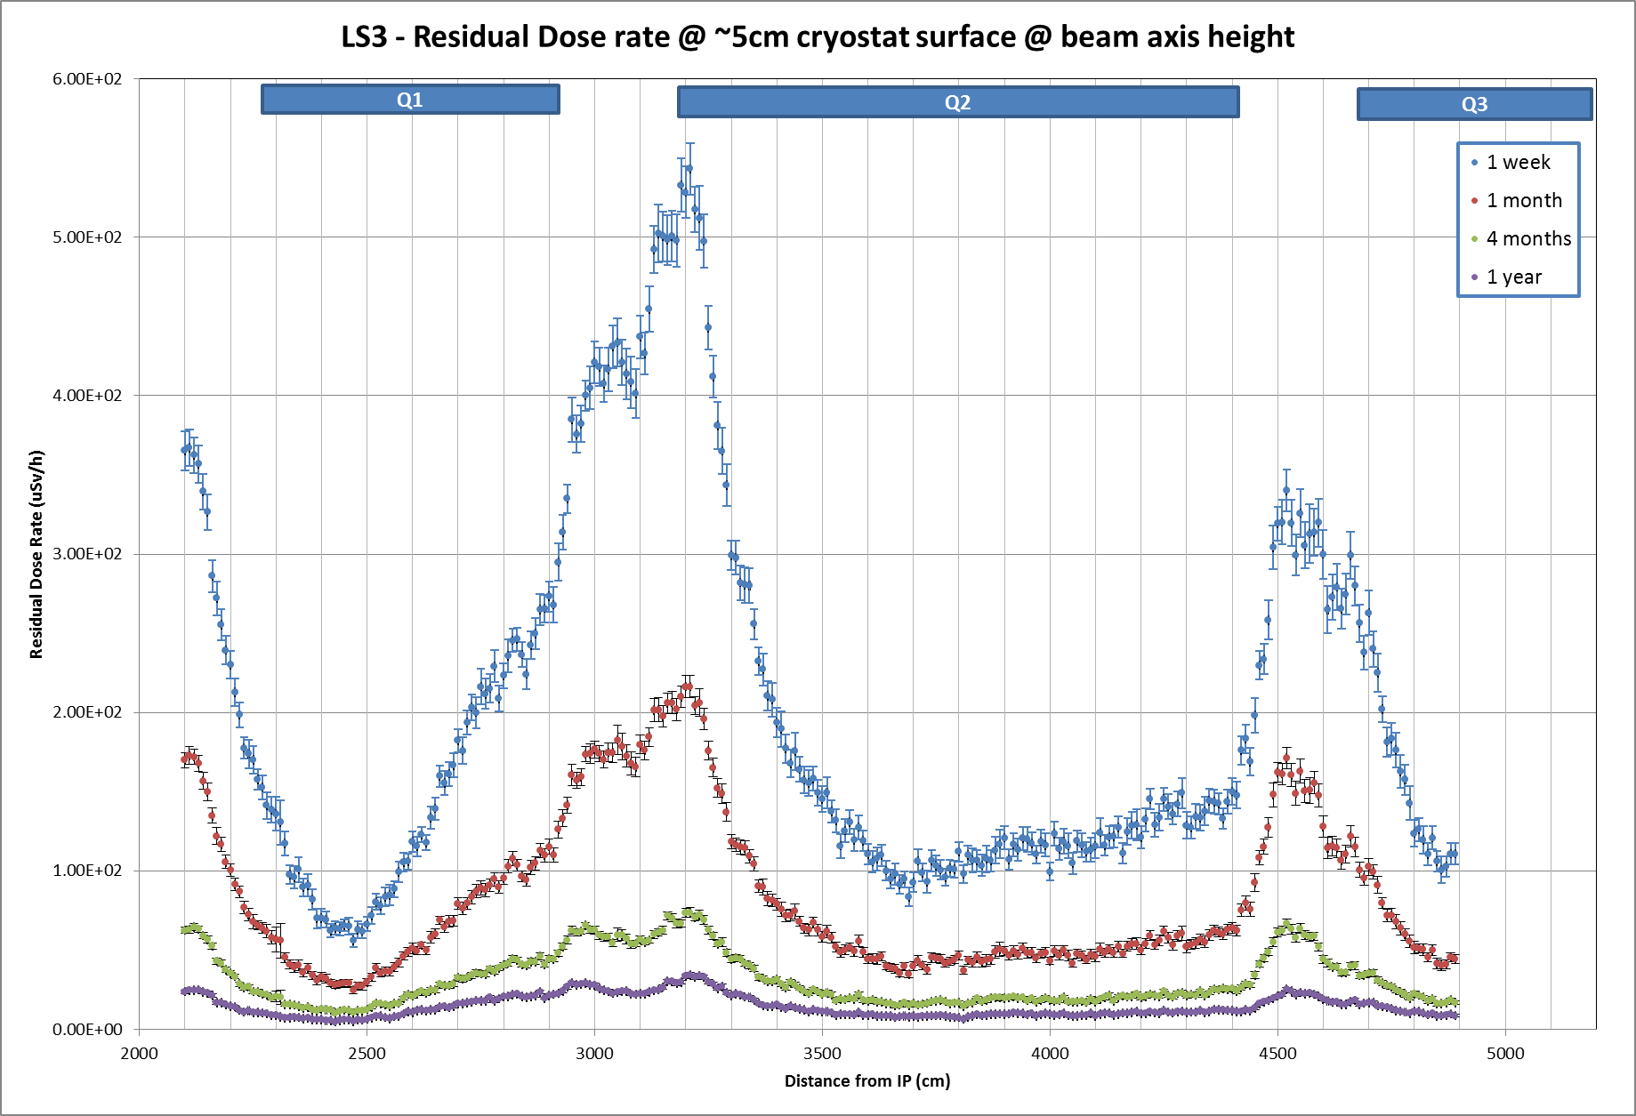
Dose rates – LS3
Example: Triplet at Point 5
cooling time dependence
FLUKA geometry:
courtesy FLUKA team
500 µSv/h
200 µSv/h

Slide 24
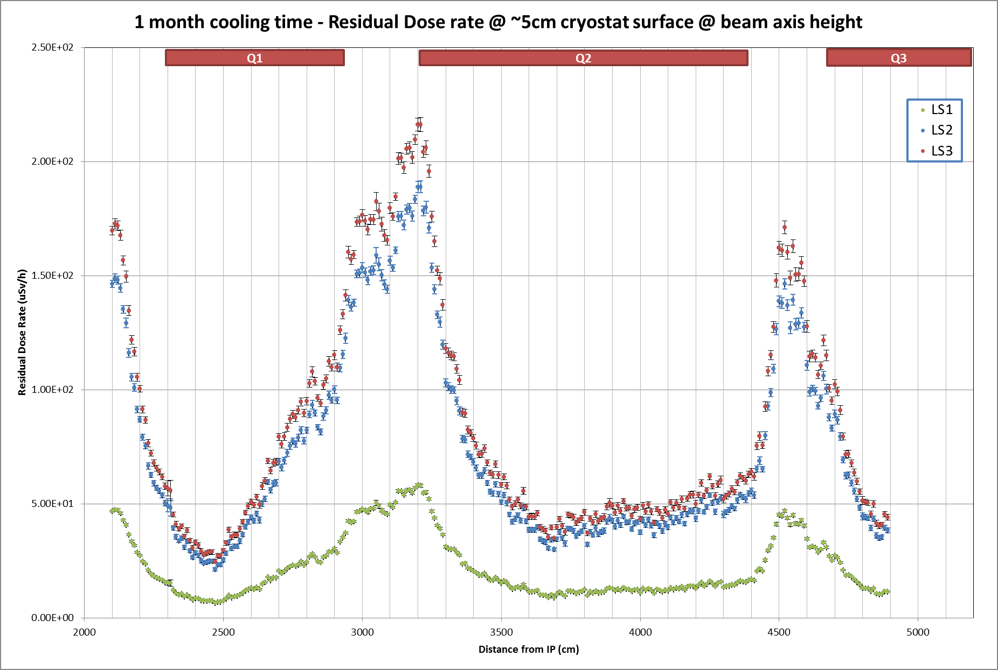
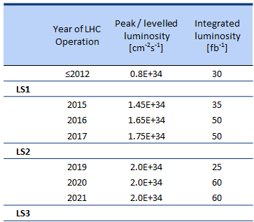
Dose rates – Evolution
Example: Triplet at Point 5
one month of cooling
200 µSv/h
4.0
LS3
LS2
50 µSv/h
LS1
Factors LS3 / LS1
Luminosity: 2.5
Energy: 0.7

Slide 25
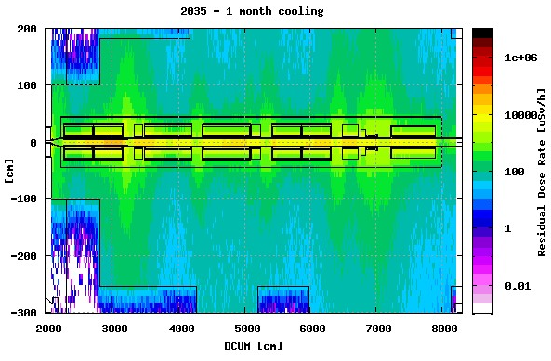
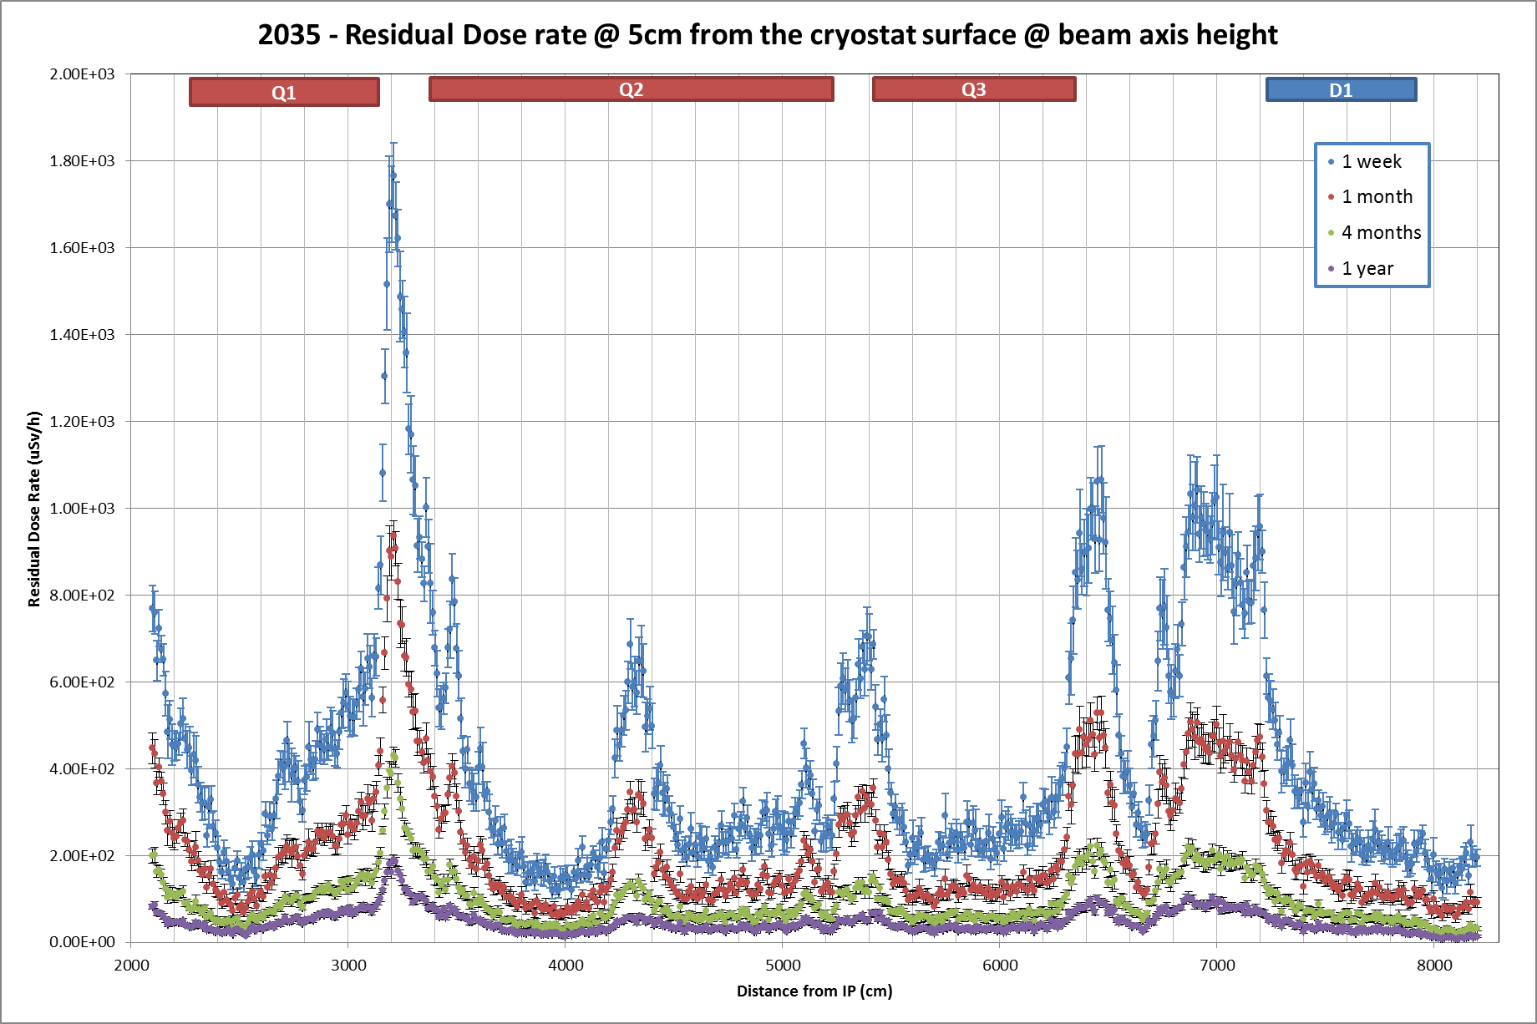
Dose rates – 2035
Example: HL-LHC Triplet at Point 1
cooling time dependence
FLUKA geometry:
courtesy FLUKA team
1.8 mSv/h
1 mSv/h

Slide 26
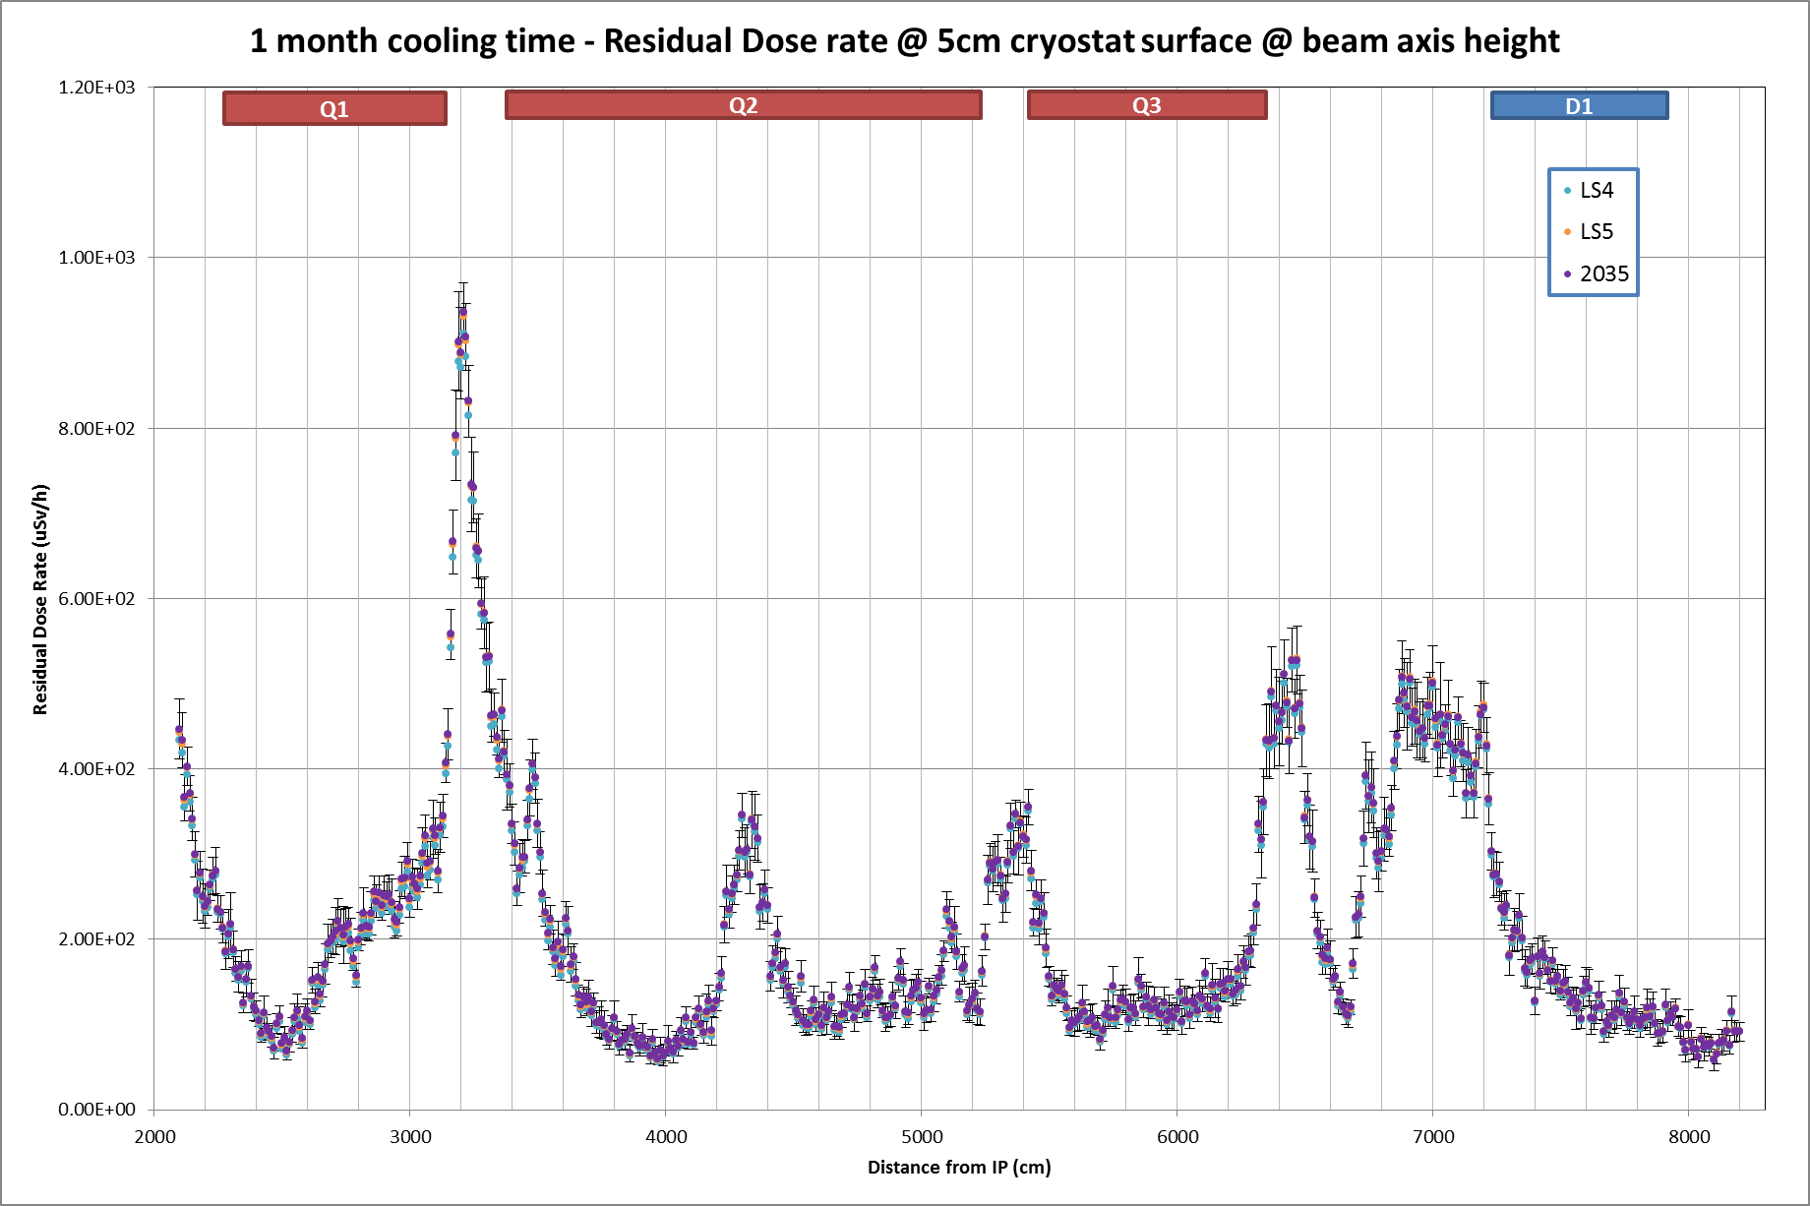

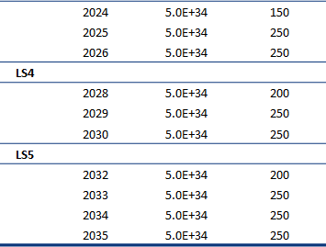
Dose rates – 2035
Example: HL-LHC Triplet at Point 1
one month of cooling
1 mSv/h
400 µSv/h

Slide 27
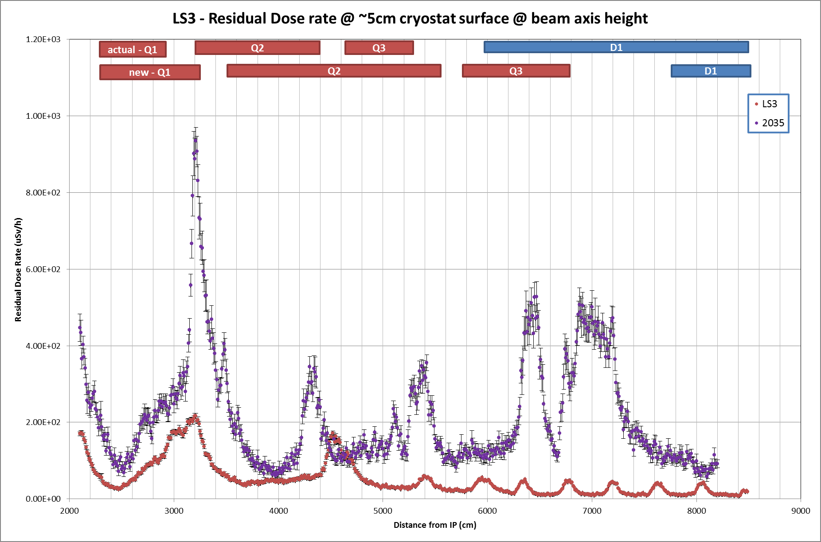
Dose rates – LS3 vs. 2035
1 mSv/h
one month of cooling
2035
200 µSv/h
LS3

Slide 28
Summary
Optimization / ALARA is a legal requirement and starts with the design of a facility. A wide range of options, tools and models is available to achieve this goal.
Optimization of the design is applied since many years for the LHC.
The residual dose rate increase until LS3 depends on operational scenario, cooling time and material and is about a factor of 4 for the above mentioned conditions.
Residual doses beyond LS3 depend (in addition) strongly on the new layout of installed components. Thus, scaling factors can only be reliably given for sections of the accelerator or experiments that will not change in LS3.
Updated residual dose rate results are available for the present LSS1/5 and are being computed for the HL-LHC upgrade (thanks to the FLUKA team for sharing inputs!).

Slide 29
Additional information

Slide 30
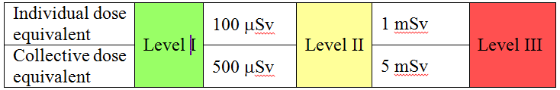
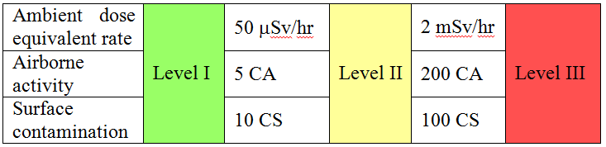
Optimization during operation – ALARA procedure
Radiation Workers
6 / 20 mSv / yr
CERN dose objective: operational periods 2 mSv / yr
long shutdowns 3 mSv / yr
Detailed work-and-dose planning
ALARA committee
ALARA categories for
individual interventions
Primary criteria
Secondary criteria
100 µSv / yr

