Slide 1
Fluid systems and components for general use
C. Parente (Technical Quality Officer)
O. Pirotte (TE-CRG-ME)
HL-LHC Standards and Best Practices Workshop (11-13 June 2014)

Slide 2
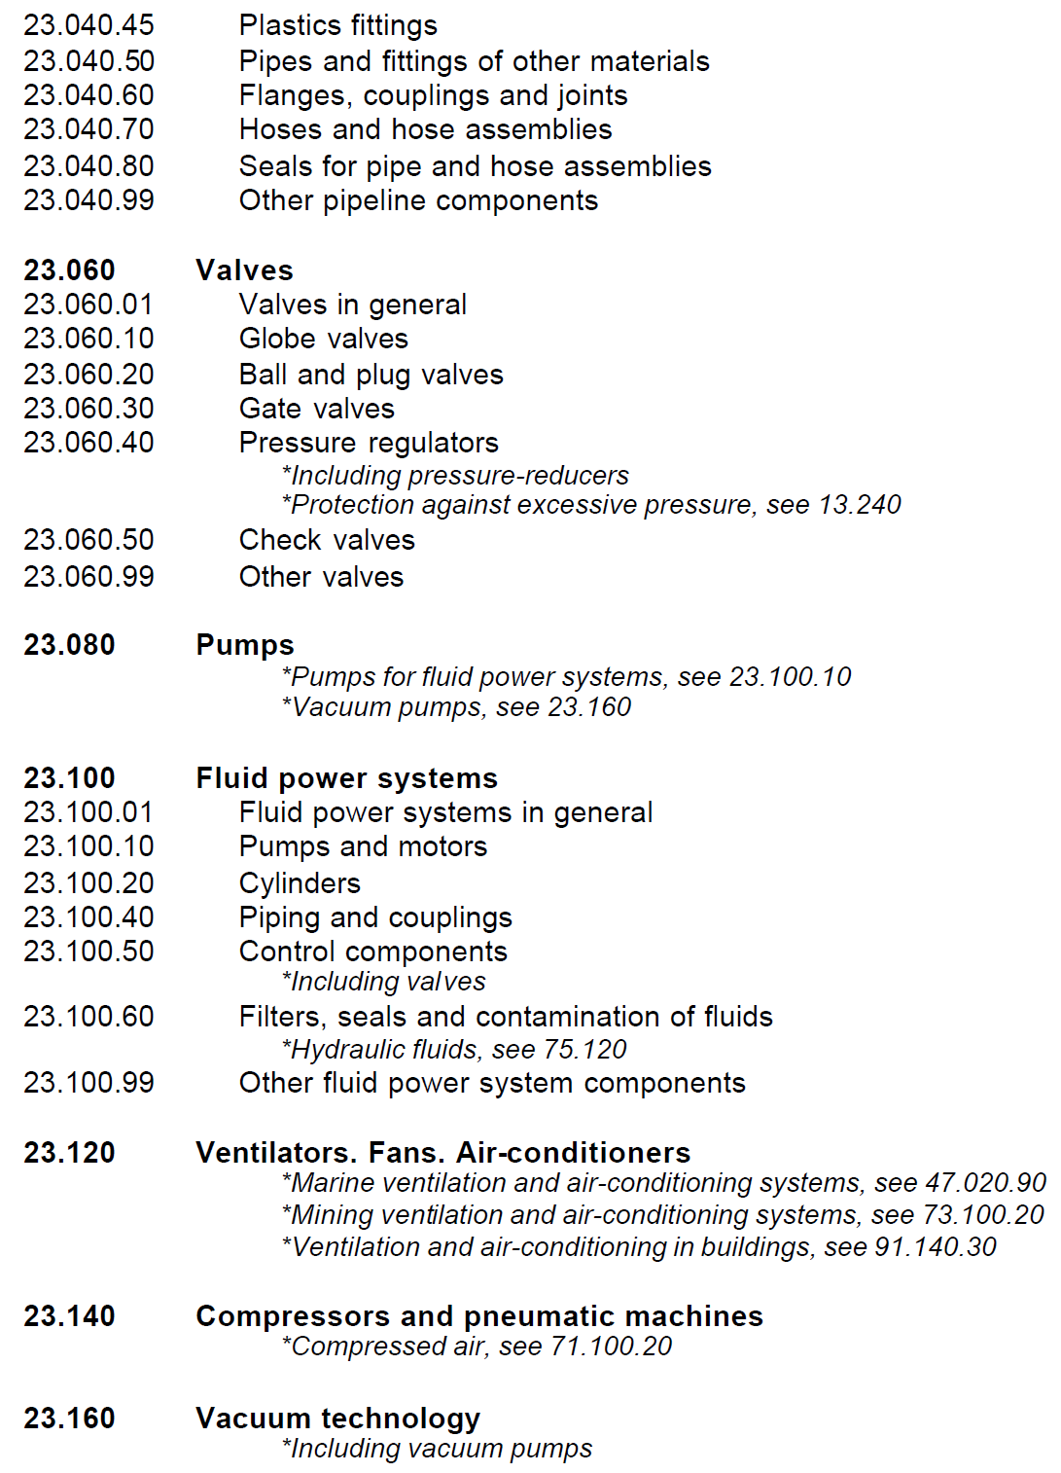
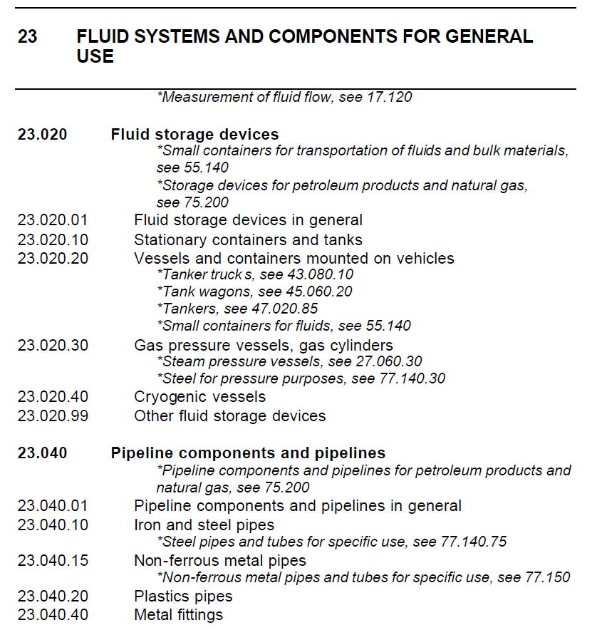
Field global overview
Source: INTERNATIONAL CLASSIFICATION FOR STANDARDS, 2005 (ISO)

Slide 3

Identified specific groups
Fluid systems and components for general use
Fluid storage devices
Gas pressure vessels, gas cylinders
Pipeline components and pipelines
Hose and hose assemblies
Iron and steel pipes
Vacuum technology
Metal fittings
Flanges, couplings and joints
Valves
Cryogenic equipment
Pipeline components and pipelines in general
Global overview
EDMS: 1376815

Slide 4
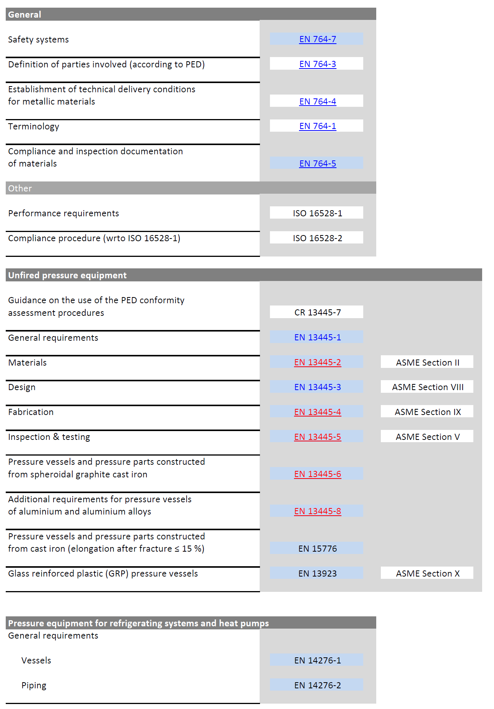
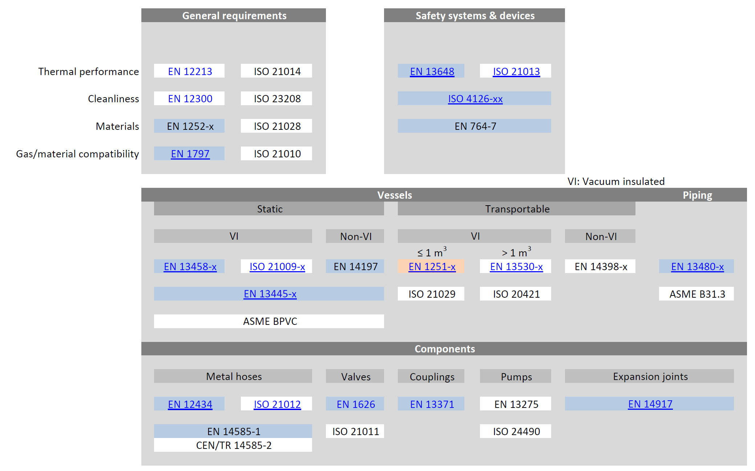
Fluid storage devices
Pressure vessels
Cryogenic equipment
ASME BPVC

Slide 5
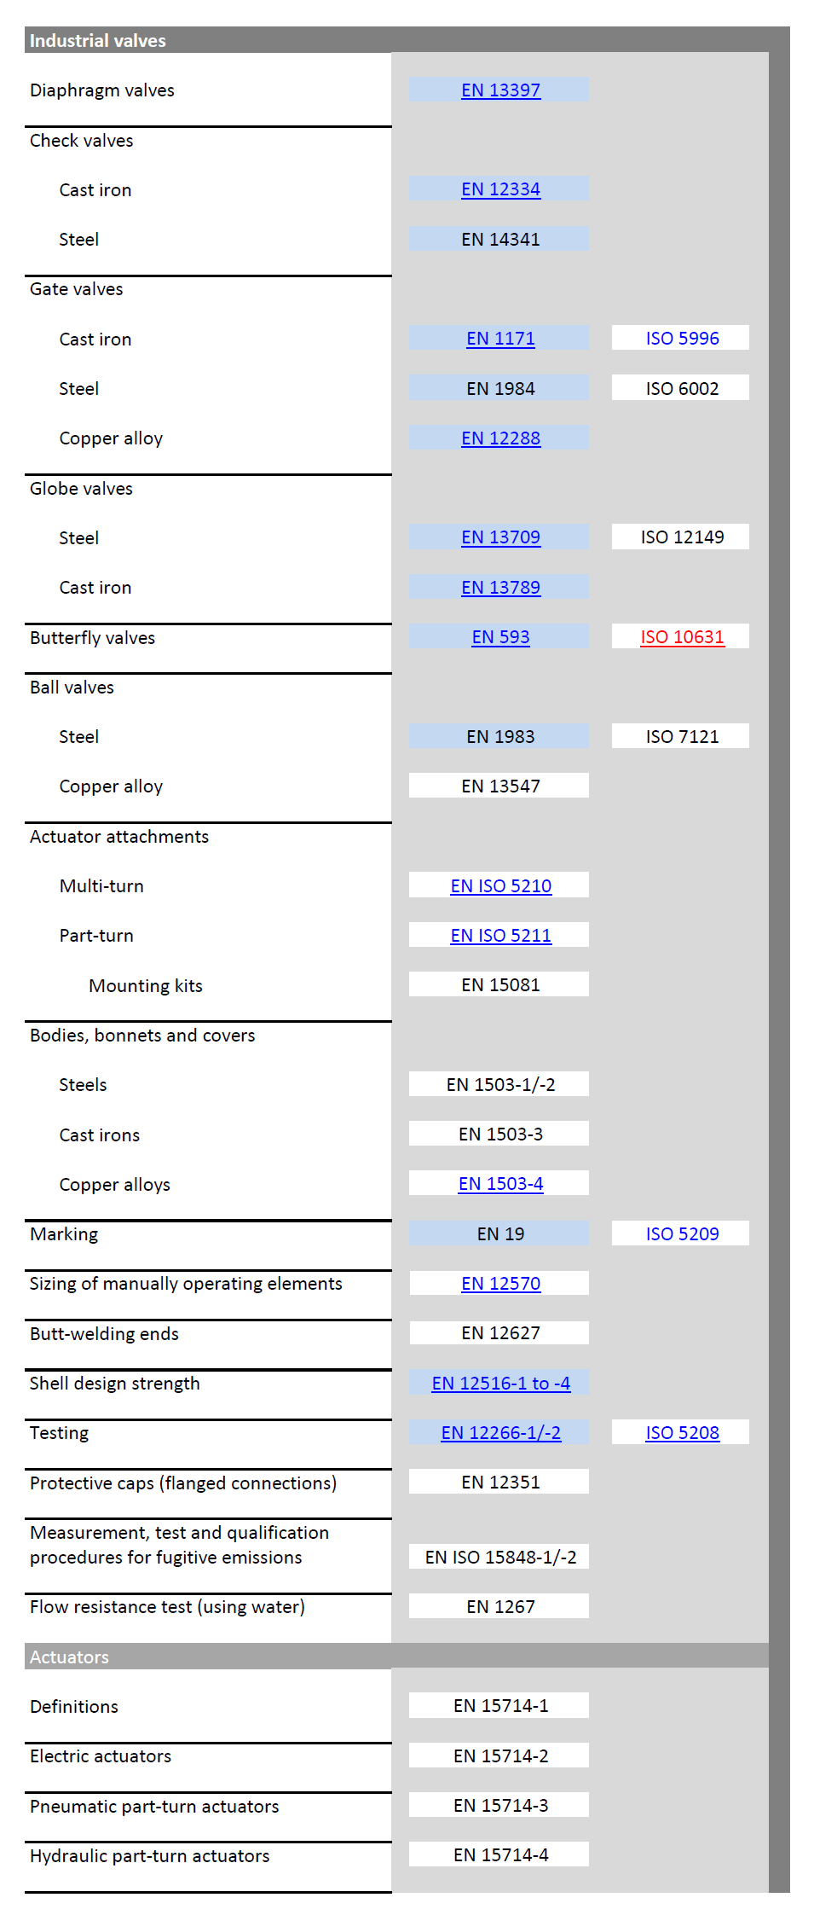
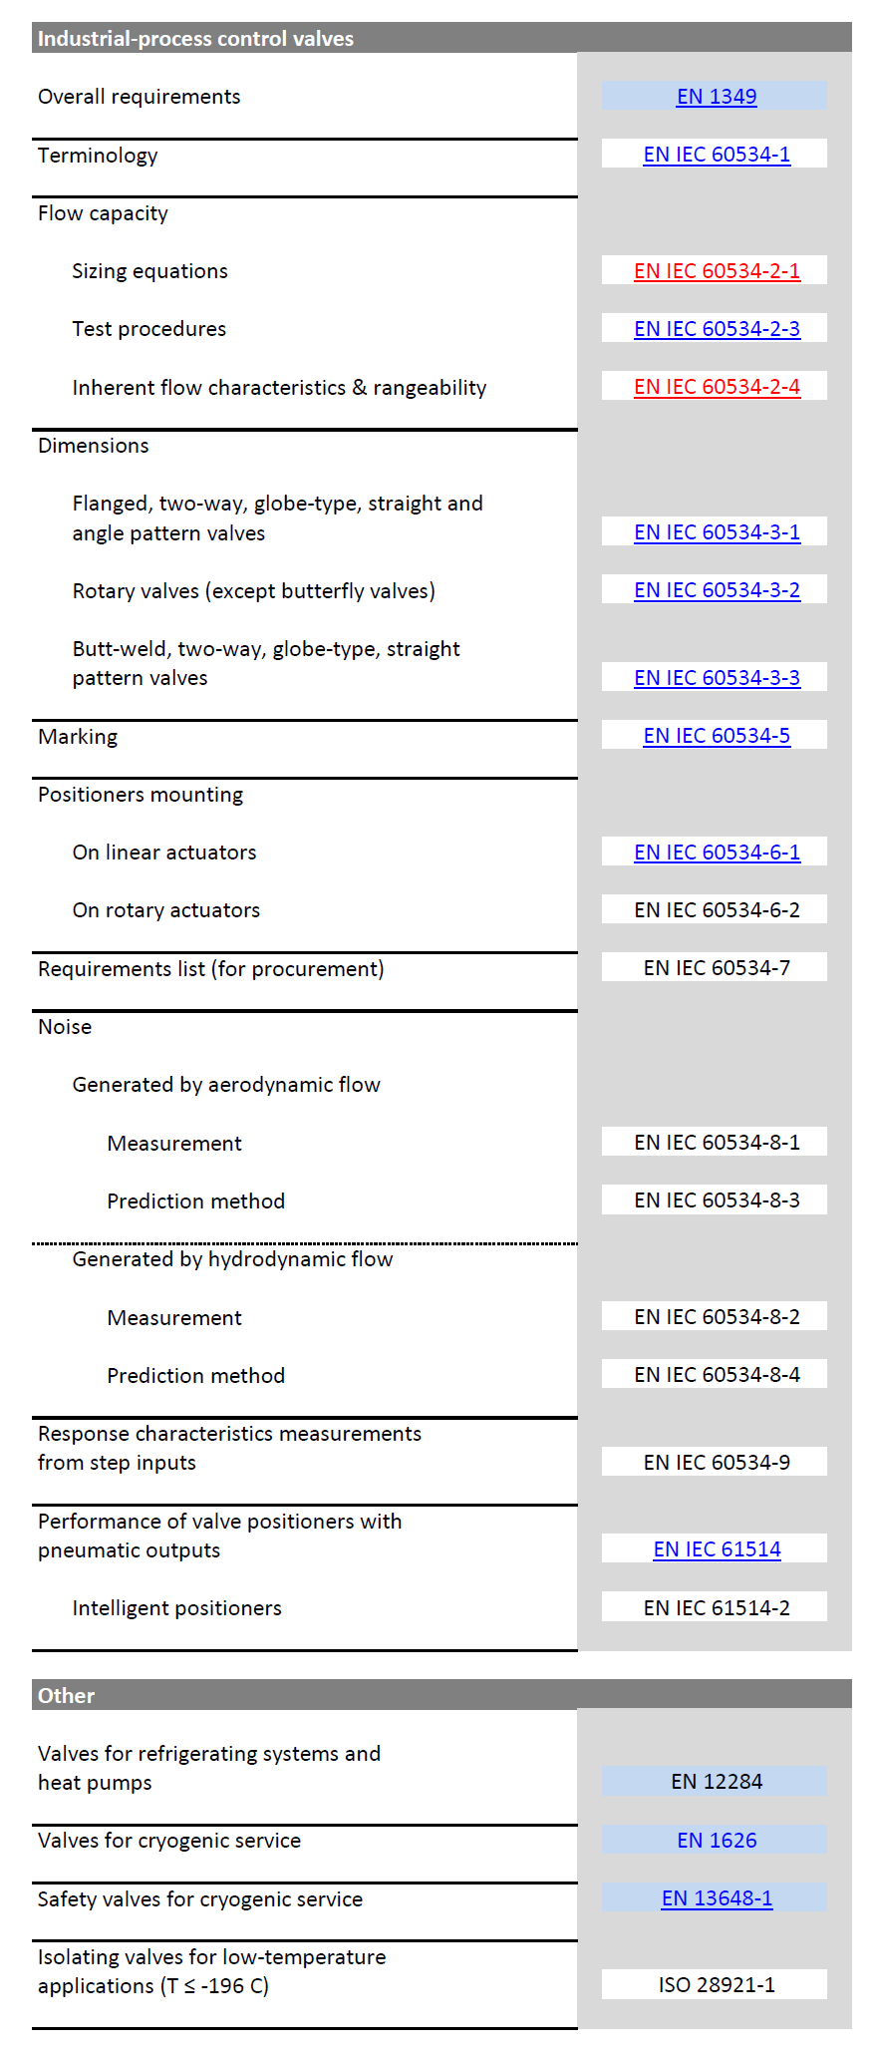
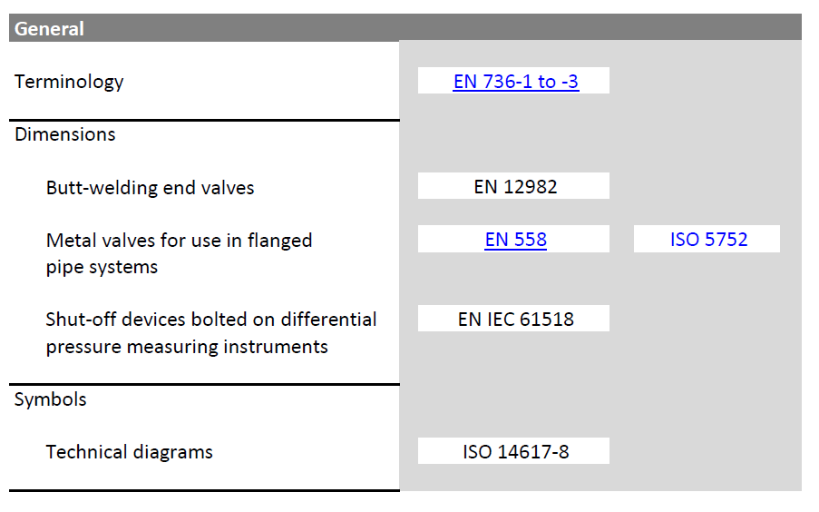

Valves

Slide 6
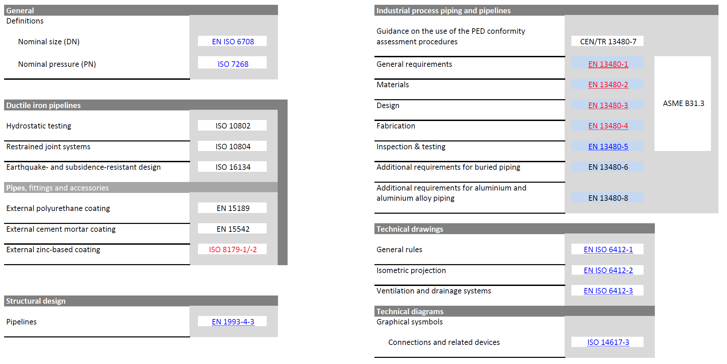
Pipeline components and pipelines (2/4)
General

Slide 7
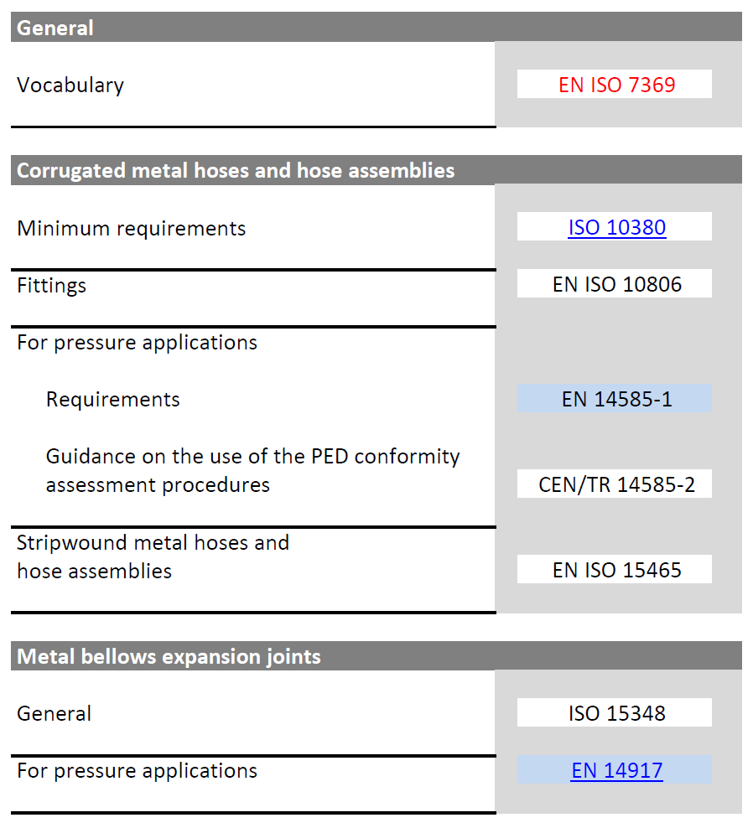
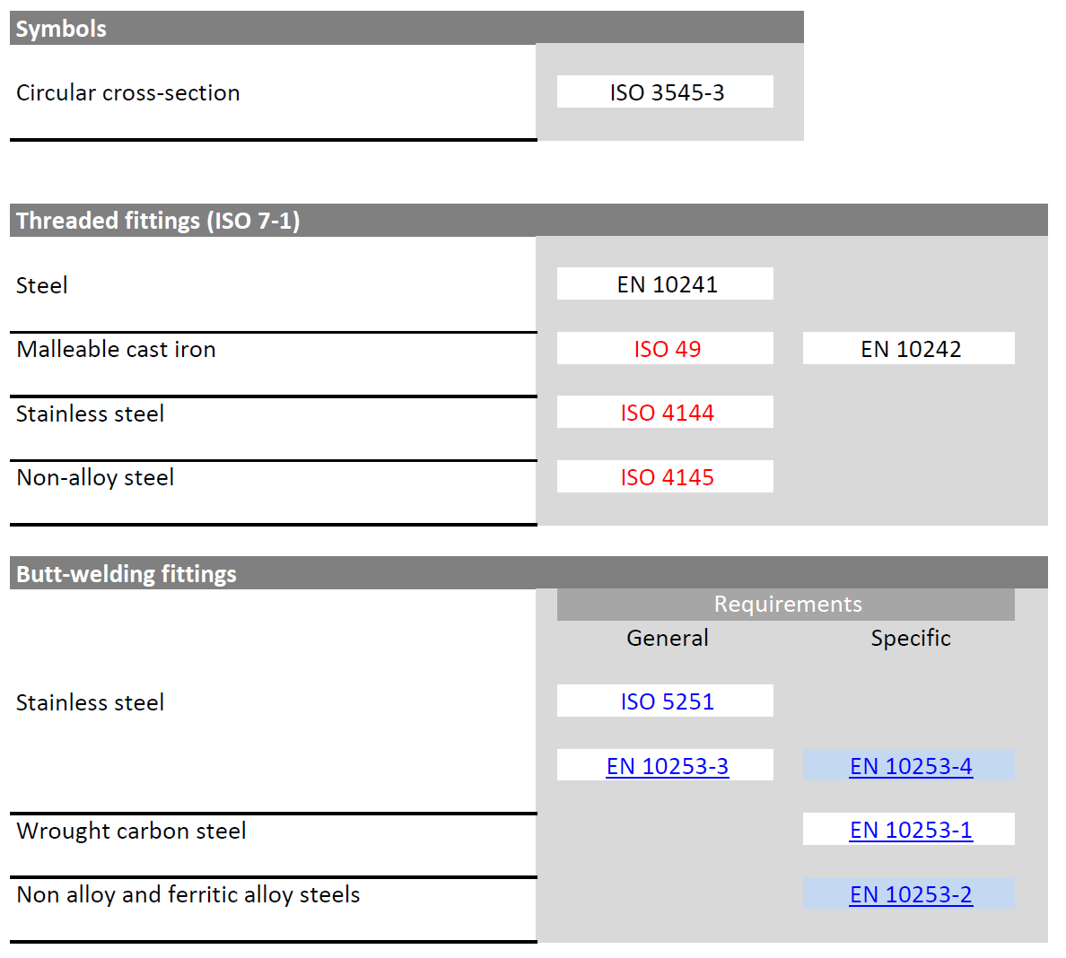
Pipeline components and pipelines (3/4)
Hose & hose assemblies
Metal fittings

Slide 8
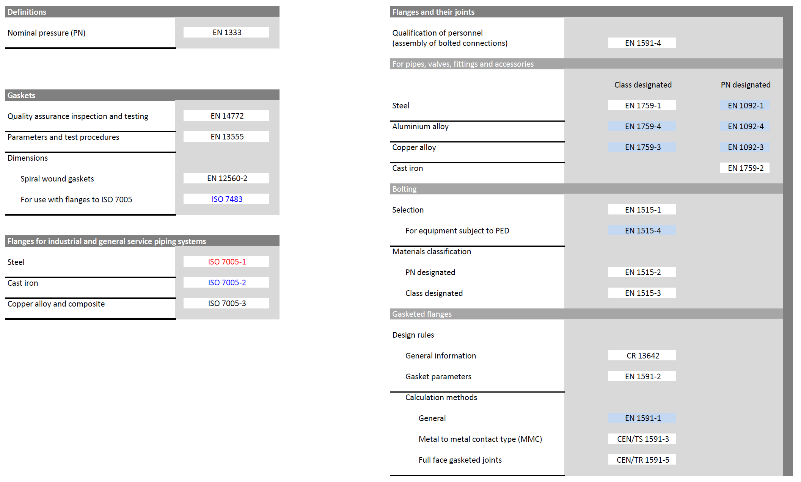
Pipeline components and pipelines (4/4)
Flanges, couplings & joints

Slide 9
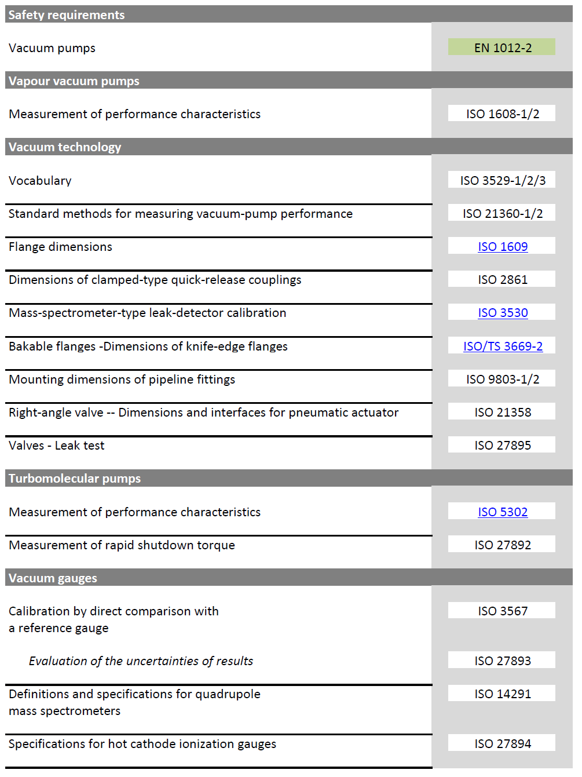
Vacuum technology

Slide 10
Which technical subjects, within the fluid systems field, should be covered by standards?
Notes:
Based on the presented groups and sub-groups of standards, when should standards be imposed (constraints) and for which fields?

Slide 11
International versus European/National standards – Which standards should be preferably chosen (for different technical subjects), and why?
Subjects | Standards preferably chosen | Why?
Notes:
For the different identified fields (question #1) what are the standards that should be chosen (based on their specified requirements and importance for the project)

Slide 12
Which technical subjects are not, or only partially, covered by standards?
Subjects | Not covered/missing
Notes:
Which fields and what is not covered, or is missing?

Slide 13
What other questions should be addressed?
Notes:
Any other questions….

Slide 14
Thank you for your collaboration !

