Slide 1

HL-LHC 3D Models
HL-LHC Standards and Best Practices Workshop
June 11th 2014
Jean-Pierre Corso - CERN
EDMS:1388902 v.1

Slide 2
Outline
LHC Tunnel : Slope, Tilt
Visualization Convention (reference axes)
3D model position in space
DCUM
Typical Sections
Models CAD formats

Slide 3
LHC Tunnel : Slope, Tilt…
The LHC is using the tunnel excavated for the LEP in 1985.
This tunnel is NOT horizontal !
The machine is like a circle turned by 1,4%
~120m
1,4 %

Slide 4
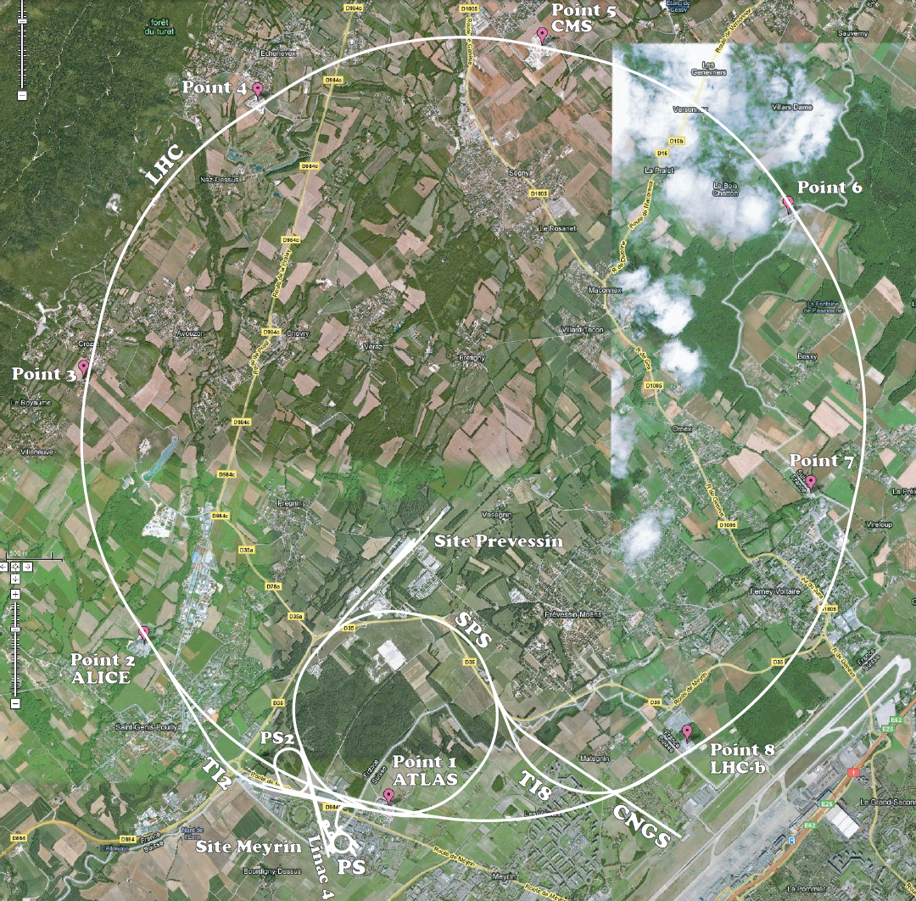
The LHC from the space
~445m sealevel
~330m sealevel

Slide 5
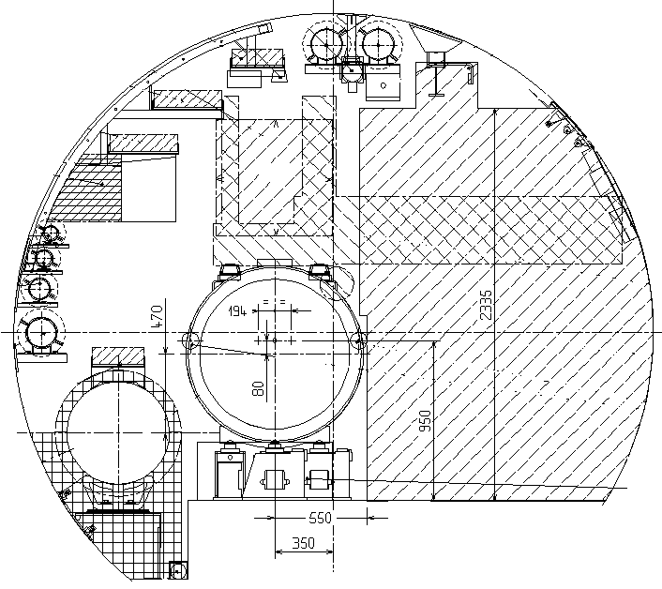
LHC Tunnel : Slope, Tilt…
The tunnel Section stays strictly horizontal everywhere along the 27km,
and magnets are positioned in the plane created by the circle, each element of the machine will have at a certain point its own slope and its own tilt…

Slide 6
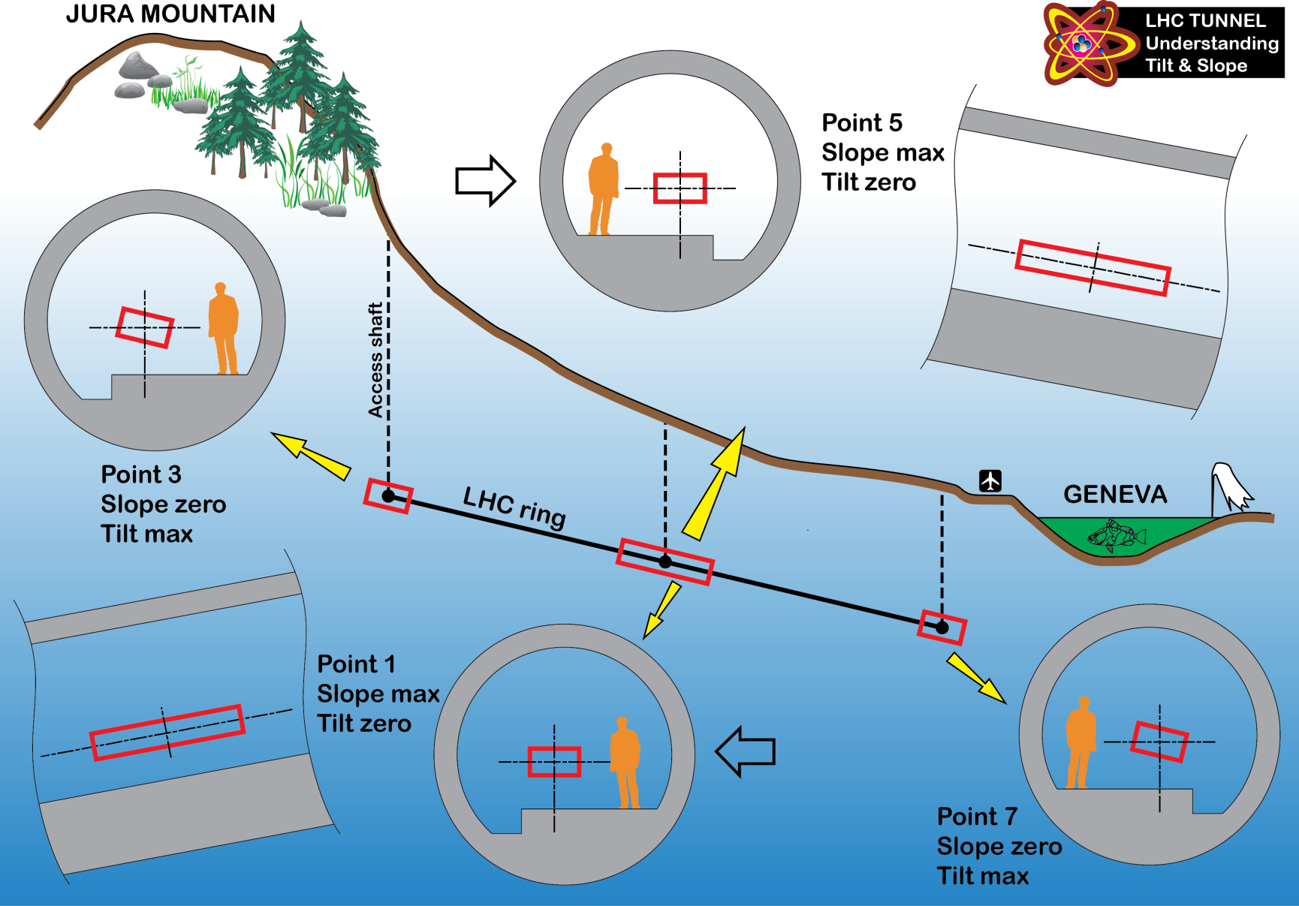
LHC Tunnel : Slope, Tilt…
A.Kosmicki

Slide 7
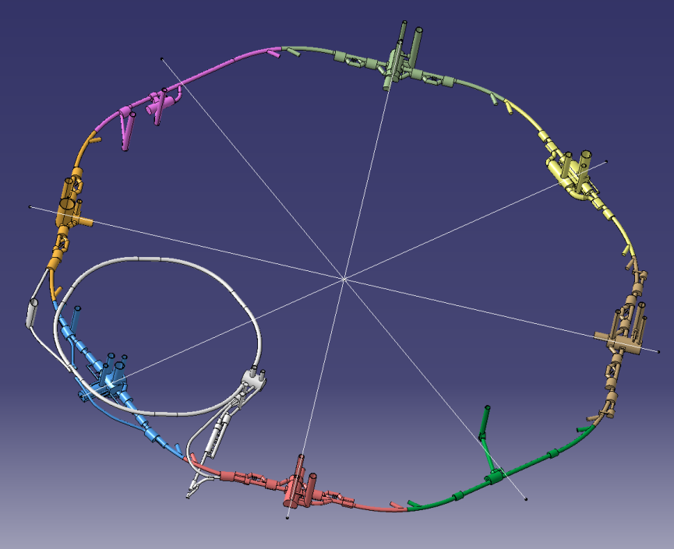
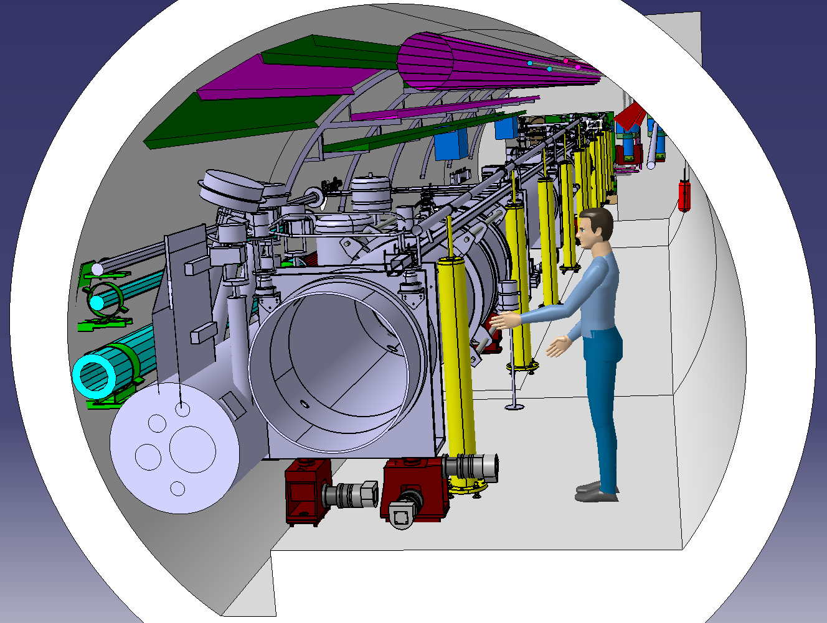
Visualization Convention
Everywhere along the 27km, if you look at the LHC machine, you might consider following postulates:
You look
  from Ring Center
  Above the machine
The reference is the medium beam axis
  Xaxis towards Ring Center
  Yaxis towards Beam downstream(*)
  Zaxis upward
(*) or following DCUM increase, i.e. on the right
A section of the tunnel is always shown “from left” looking downstream

Slide 8
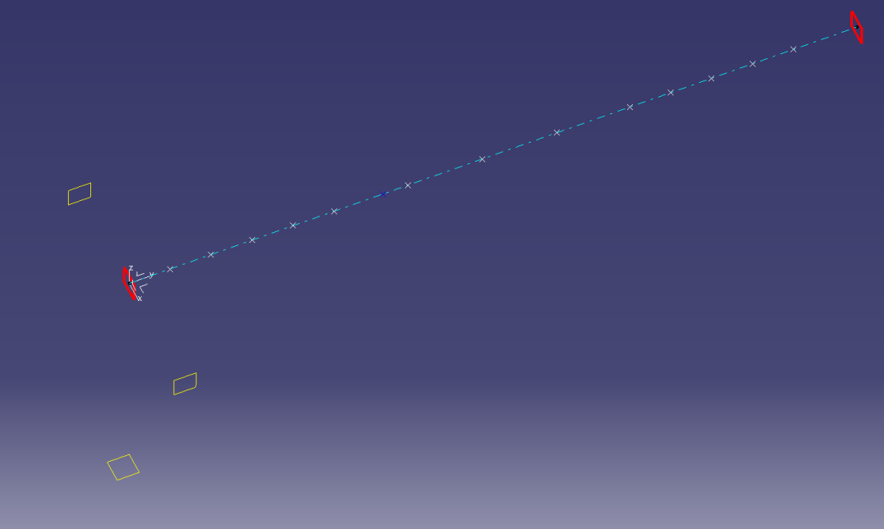
3D model position in space
To be integrated properly, every element must be provided to our designers positioned within this rule:
The reference of the model(0,0,0) located on the Beam Axis, start plane upstream
The referential axis like this:
  Xaxis towards you
  Yaxis towards Beam downstream
  Zaxis upward
Like this, each model can be handled by all technical offices with the same referential.
Z
Y
X

Slide 9
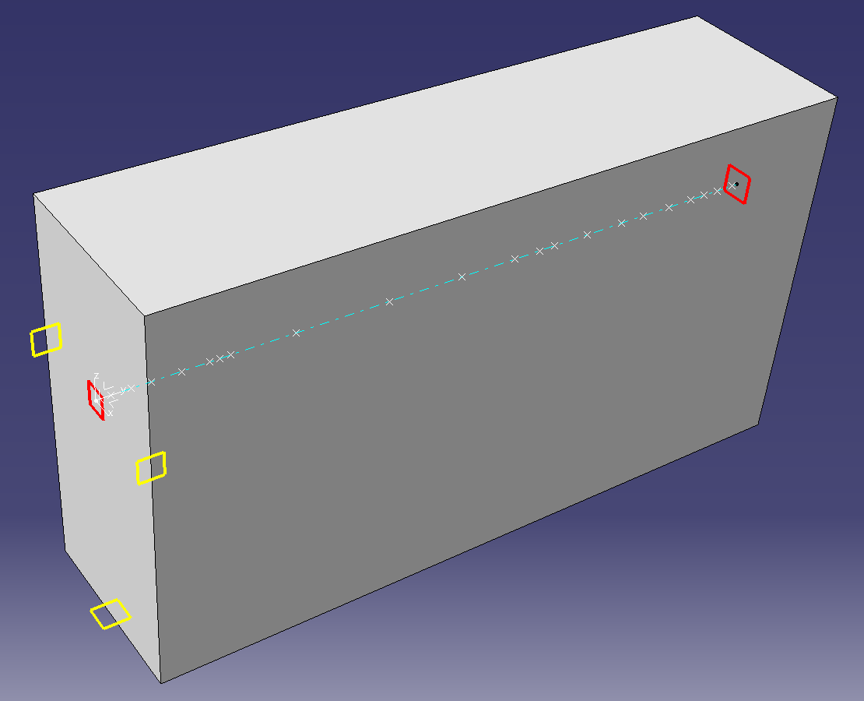
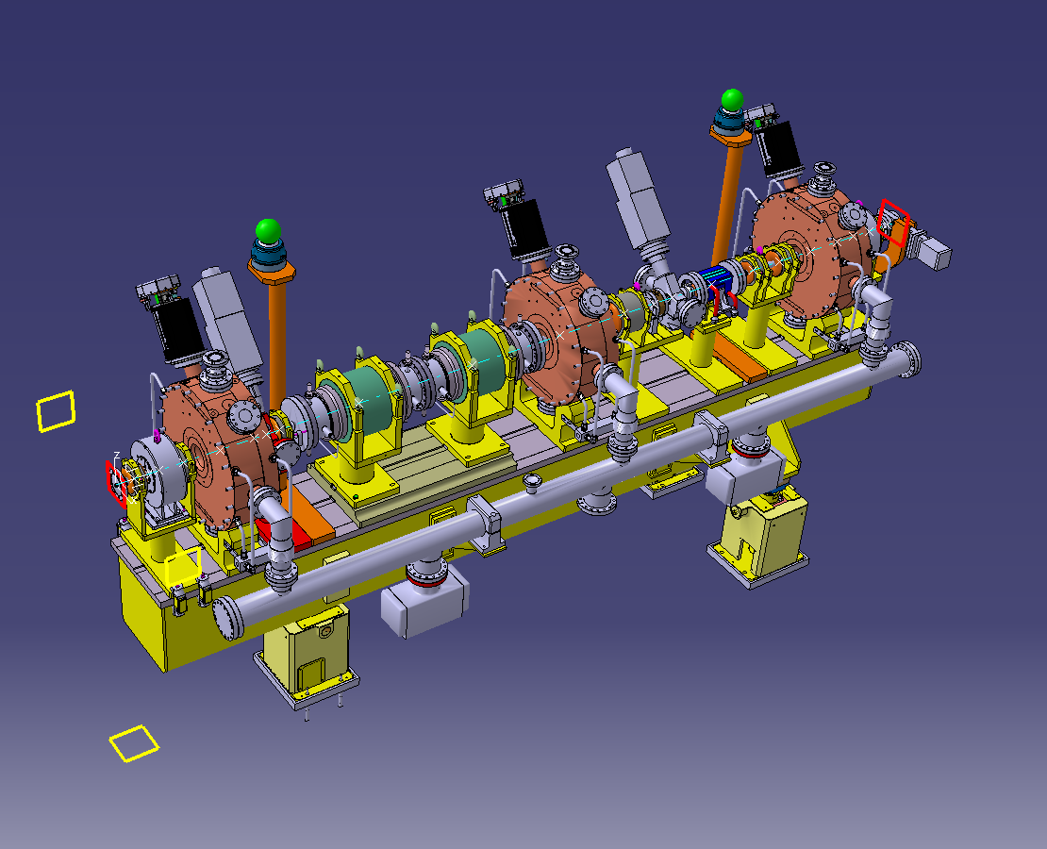
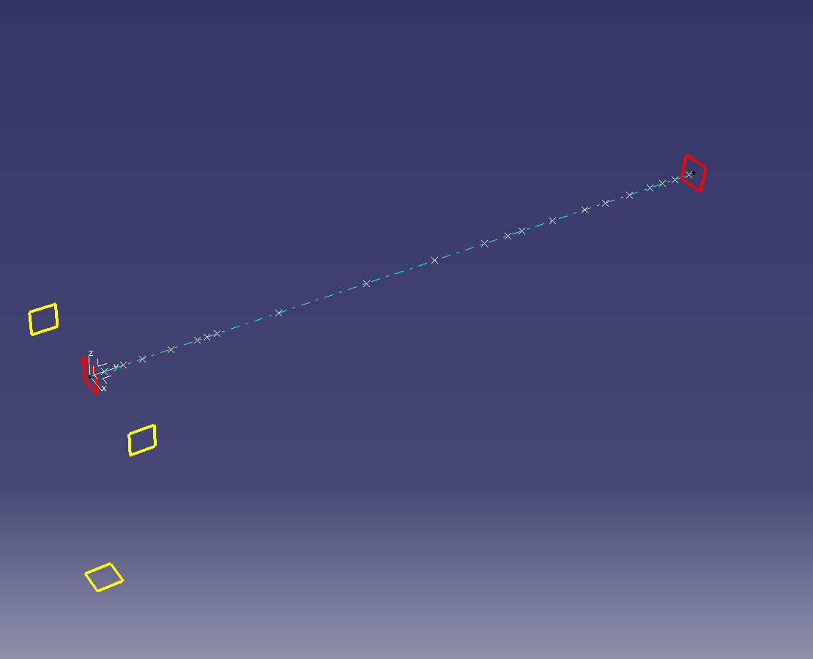
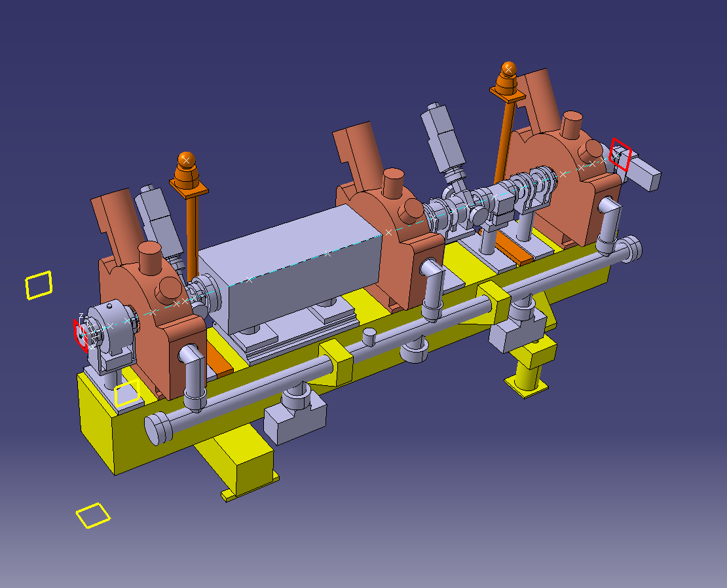
3D model position in space
Example of the Chopper line assembly of the Linac4 :
MEBT Simplified
MEBT Envelope
MEBT Skeleton
MEBT Detailed

Slide 10
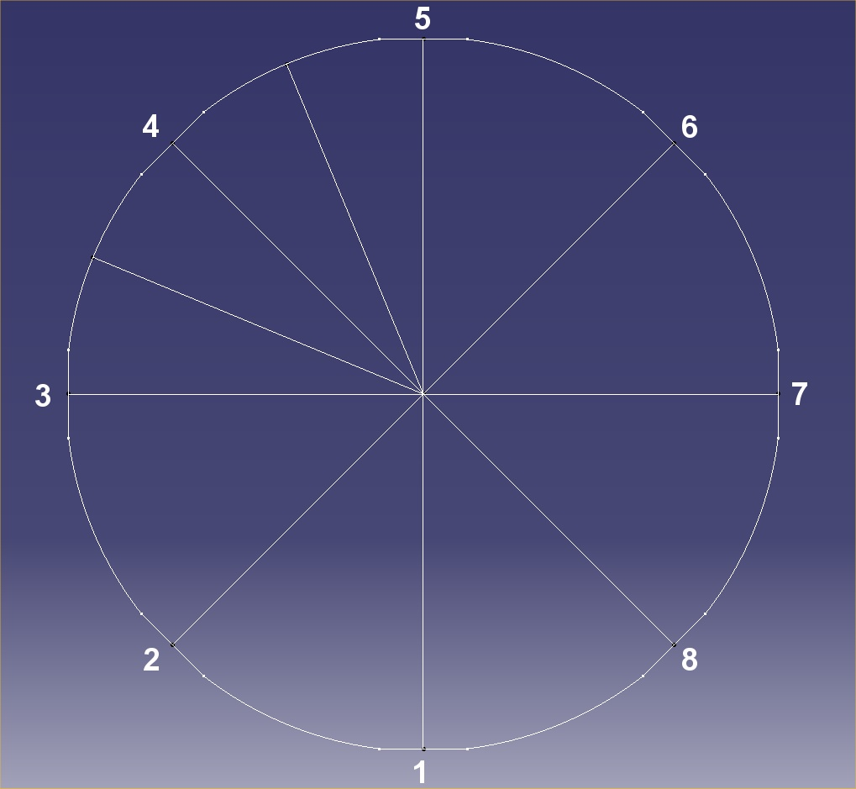
About DCUM…
Point α example
i know the DCUM:
Where am i ???
DCUM / IP1
(9688 m)
IP1

Slide 11
Typical Sections
The LHC is composed of 2 main type of tunnels :
  Long Straight Sections [LSS] (~4km)
  Arcs (~23km)

Slide 12
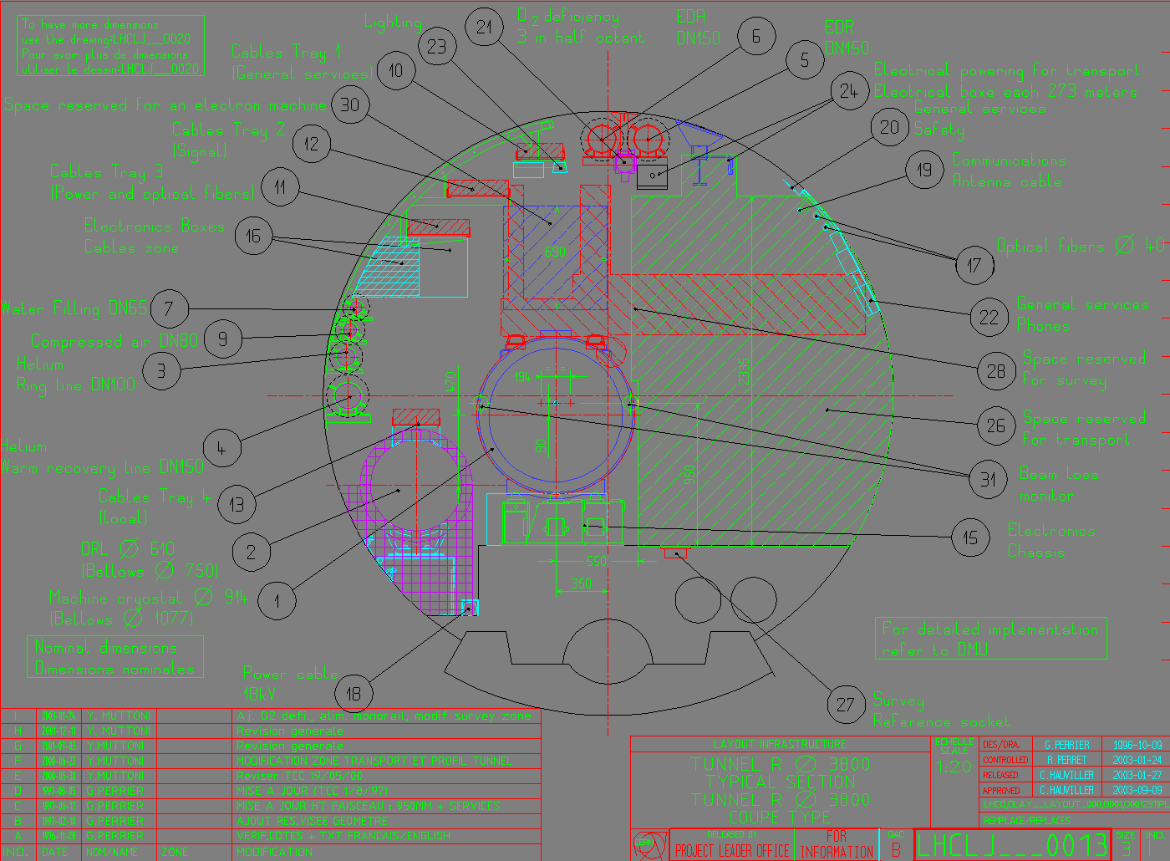
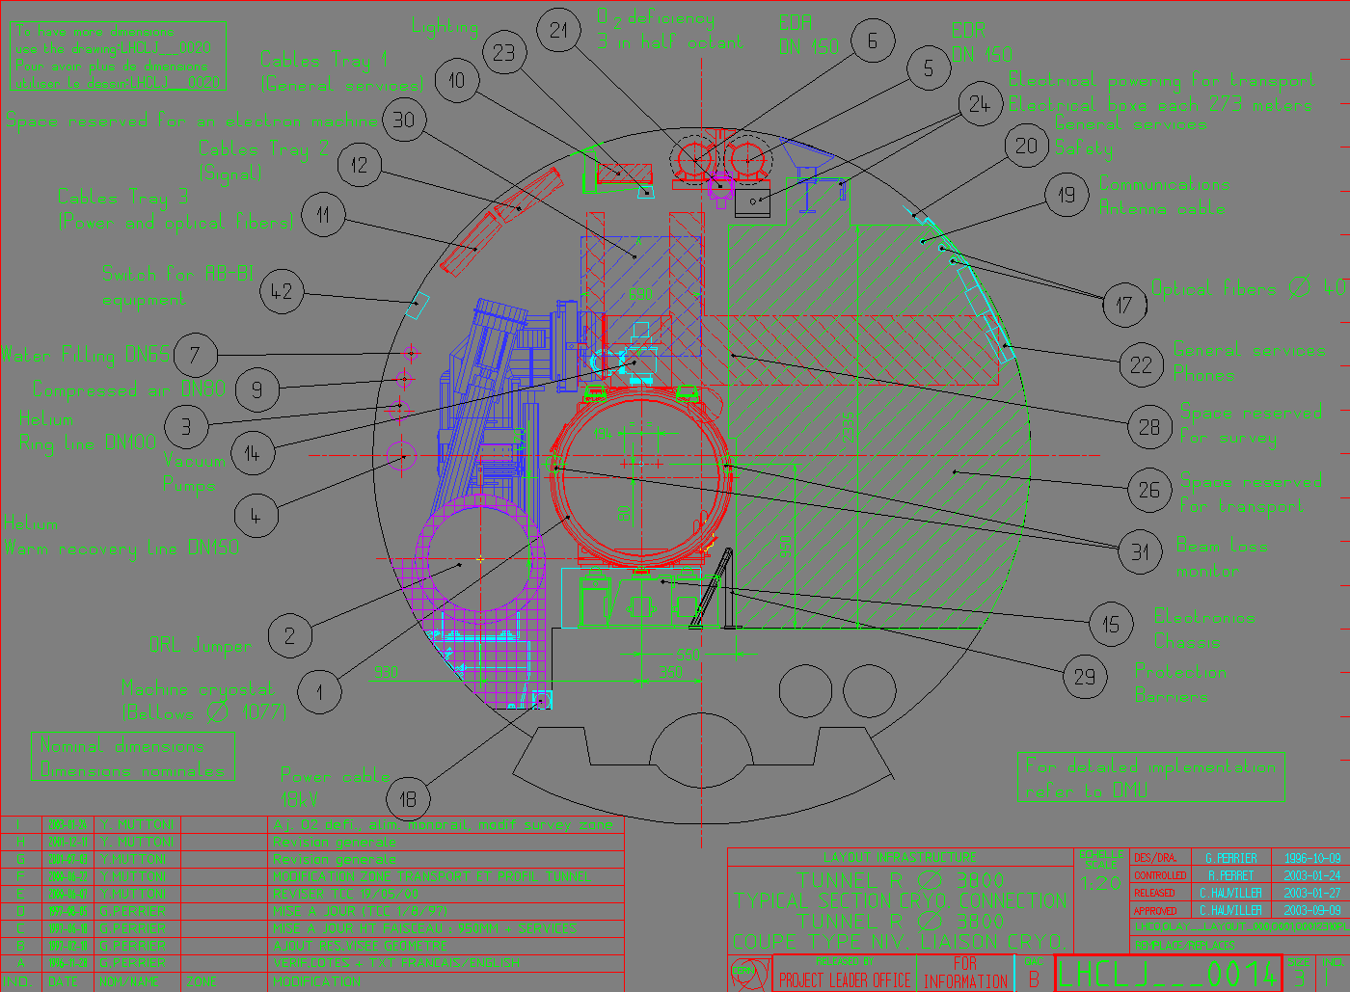
Typical Sections
Arcs can be summarized with ONLY THIS:

Slide 13
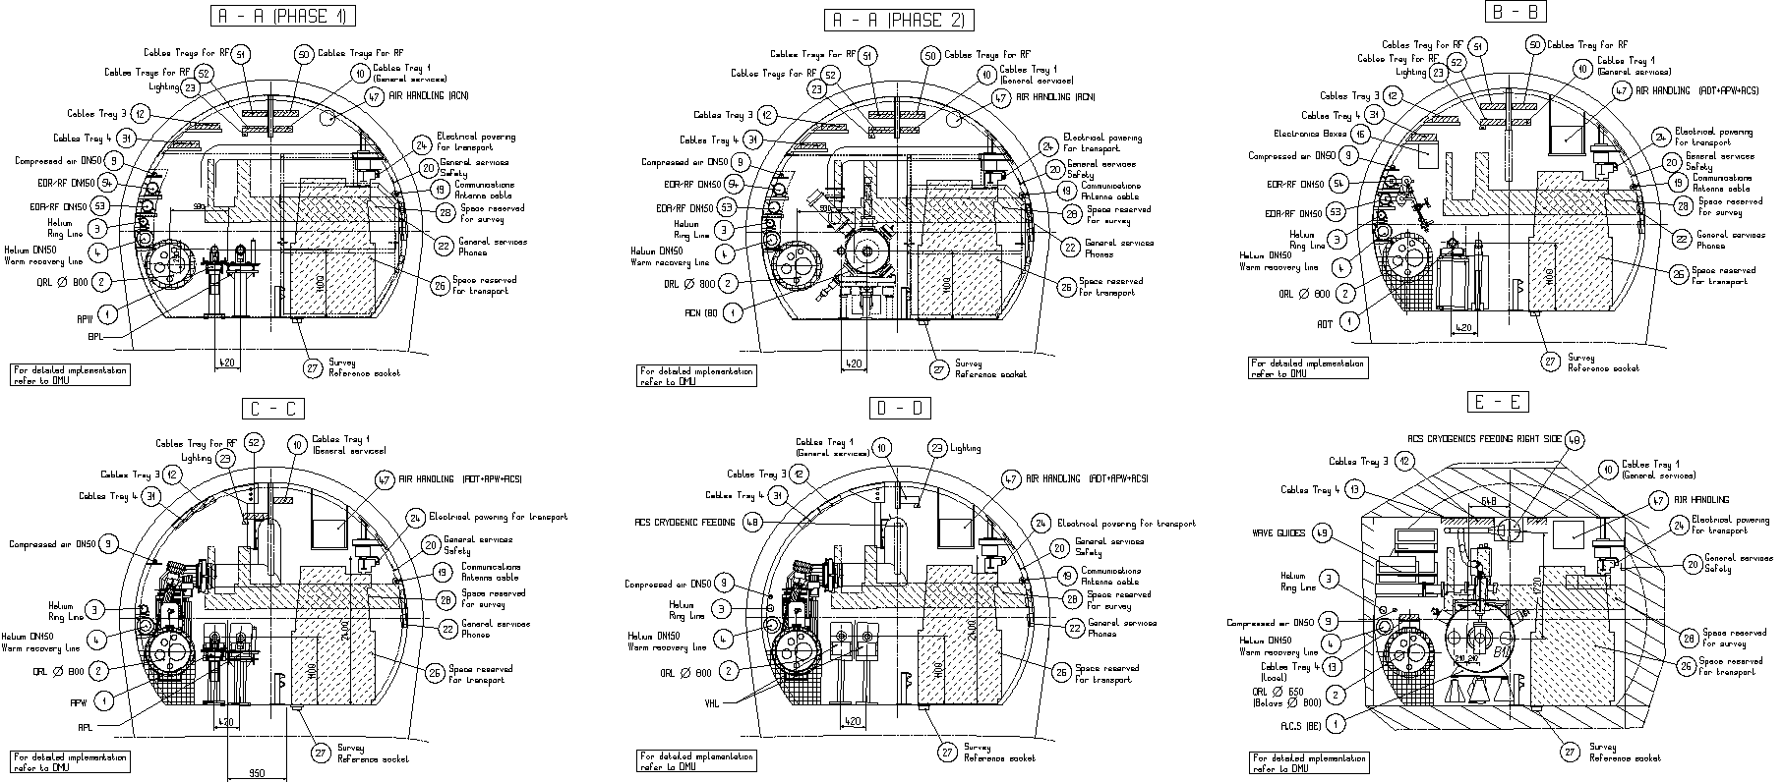
Typical Sections
Long Straight Sections need more particular Sections…
and 3D !

Slide 14
Typical Sections
Some portions of the tunnel are already reserved for dedicated Services, as Transport or Survey
QRL has its own area behind the machine
Pipes and cables stand behind the machine, over the QRL
Safety equipements are on the wall close to passage
And the concrete is foreseen not to move…

Slide 15
CAD Models Formats
CERN designers use CATIA V5 (DS)
STEP files are recommended as alternative
For others, contact us !
en-mef-int-admin@cern.ch
Thanks for your attention
EDMS:1388902 v.1

