Slide 1
New safety rules at the ISOLDE hall
.
Magdalena Kowalska

Slide 2
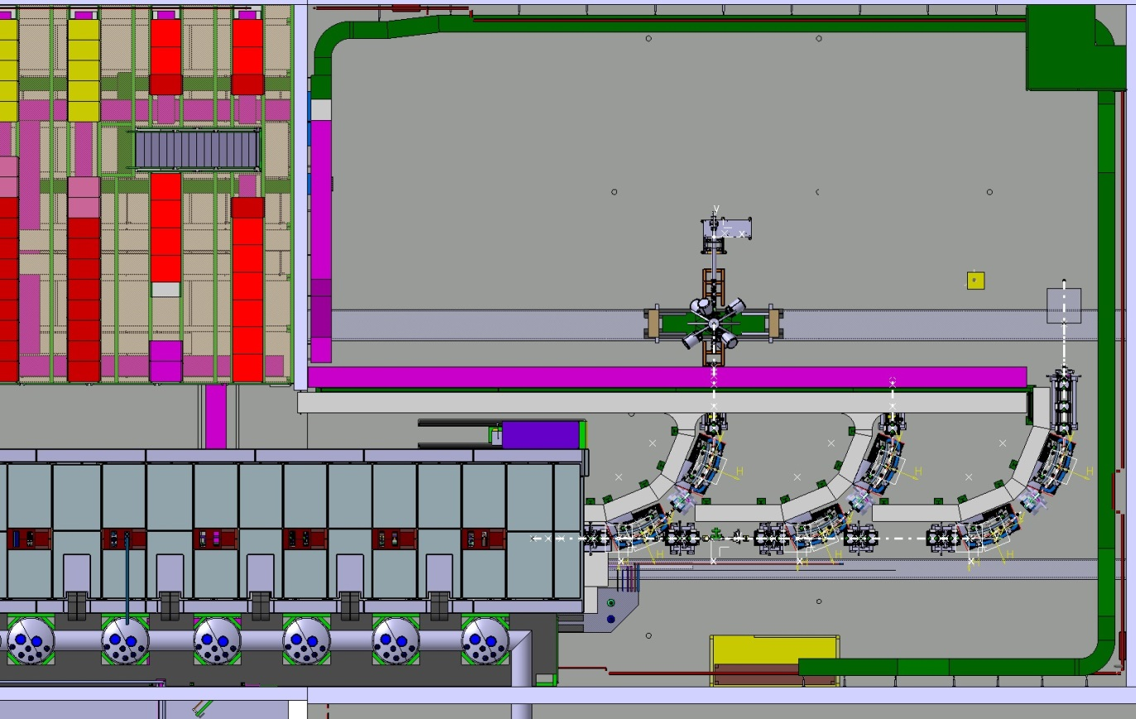
General safety
ISOLDE hall to be divided in 2 parts: until end of 2014 due to HIE-ISOLDE work:
Access for physicists only from the Jura side: access recorded in dosimeter
Access to hall extension will require separate assess rights.
Moving of equipment (e.g. LN₂ dewars) through should be coordinated with Erwin Siesling and will require safety shoes and helmets.
Low-energy area: discussions ongoing about the possibility of waiving the requirement for safety shoes and helmets.
Worksite; special access

Slide 3
Dosimeters
July 1st 2014: ISOLDE changes from RP supervised to RP simple controlled area:
  This means that access will be registered in the dosimeter not the CERN card
  No temporary dosimeters will be accepted to enter the facility.
  All permanent dosimeters should be given back to the dosimetry service and there will be flexibility in getting them back.
To get the permanent dosimeter:
  Present a form signed by their institute, which replaces the medical certificate (to be ready now)
  follow an ISOLDE on-line RP course (to be ready in May)
  follow a 2-hour practical training session (on Tuesdays and Fridays in Prevessin or at ISOLDE premises)
Bldg. 508 will host several DAQ rooms located outside the RP-area

Slide 4
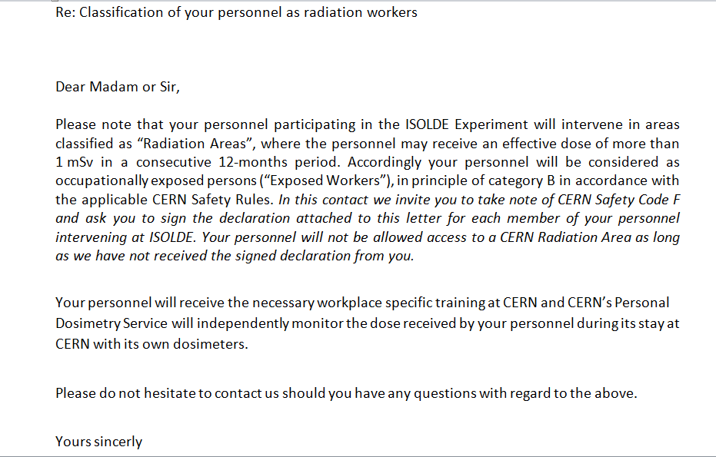
RP letter to institutes

Slide 5
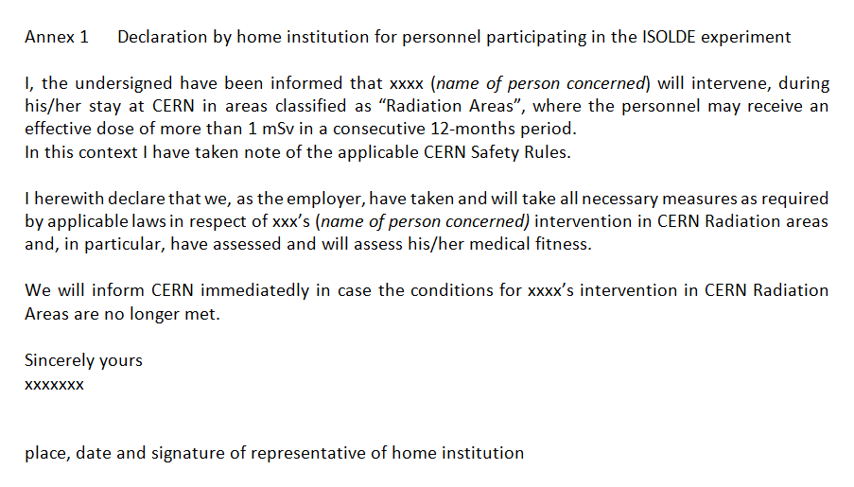
RP form: draft

