Slide 1
Space for Nicole
Maria J. G. Borge & Magdalena Kowalska

Slide 2
Status NICOLE
NICOLE: reporting done in the meeting October 2013
      A new proposal submitted in October 2013
      Ask for a new setting at the ISOLDE Hall
      New Collaboration lead by: Taka Ohtsubo & Miroslav Veskovic
Decision in the 68th ISCC meeting:
  The new NICOLE collaboration, lead by T. Ohtsubo and M. Veskovic, has submitted a proposal to the INTC and have requested space at the ISOLDE hall. The committee decides to discuss this matter at the next ISCC if the proposal is approved by the INTC.
  Nov13: new NICOLE proposal accepted, but a clarification letter about neutron background requested
The NICOLE Collaboration has an approved experiment with 12 shifts pending.

Slide 3
Space and alternative locations for NICOLE
Nov 13: NICOLE fridge repaired in UK; fridge back at ISOLDE – waiting to be mounted
Answer to M. Veskovic’s concern about lack of space on the mezzanine to manipulate the fridge:
“We have looked at alternative locations and the only beamline available for a fixed setup like NICOLE is the line next to CRIS, where the HV platform was. At present there is however not much space at this position, but you are welcome to check with CRIS (responsible Kieran Flanagan) whether it can be accommodated differently".
We are not aware that CRIS was contacted.
Dec13: NICOLE’s spokesperson, M. Veskovic comes to ISOLDE to discuss space at and below mezanine
Mar14: T. Ohtsubo comes to prepare fridge reinstallation
May14(?): NICOLE team plans to test the fridge

Slide 4
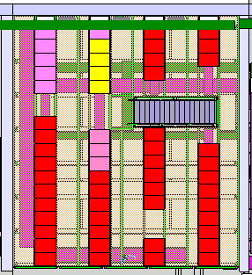
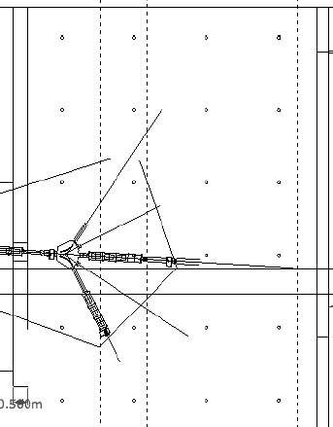
Agreed solution:
mezzanine
Ground floor
Red – NICOLE equipment from mezzanine
NICOLE cupboards (tbc)
IDS
IDS
DAQ
table
140cm
140cm
power for NICOLE
He system
130cm
80cm
87cm
Future TAS DAQ area
racks
pumps
Hie-ISOLDE cables down
from mezzanine
NICOLE
fridge
Spare for dewars
No racks 60 cm around opening
Linac tunnel

