Slide 1


Status of the ISOLDE DAQ
Jan Kurcewicz
CERN PH-SME
69th ISOLDE Collaboration Committee meeting, 31 March 2014

Slide 2
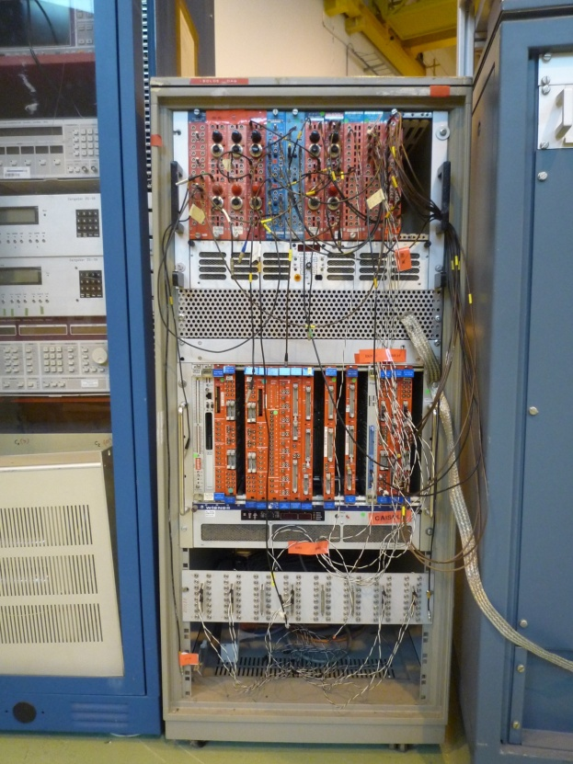
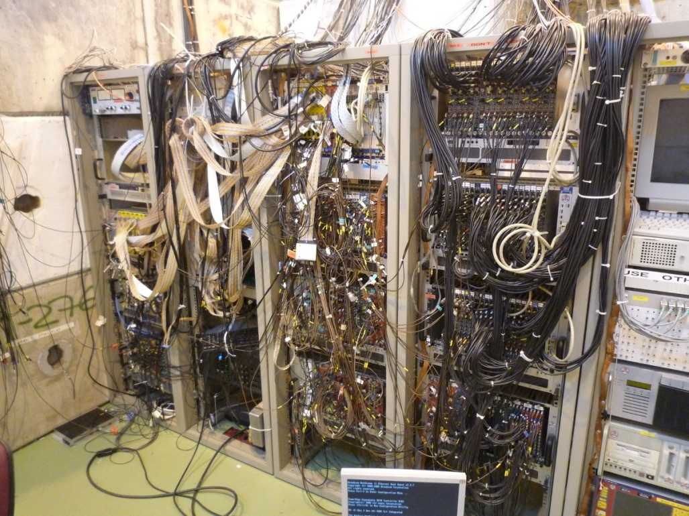
ISOLDE DAQ systems - overview
Different DAQ solutions available for ISOLDE experiments:
Modular electronics: VME, CAMAC, PCIe, uTCA-based systems
Other (Digital oscilloscope, MCA…)
Traditional analogue chain approach
Digital pulse processing

Slide 3
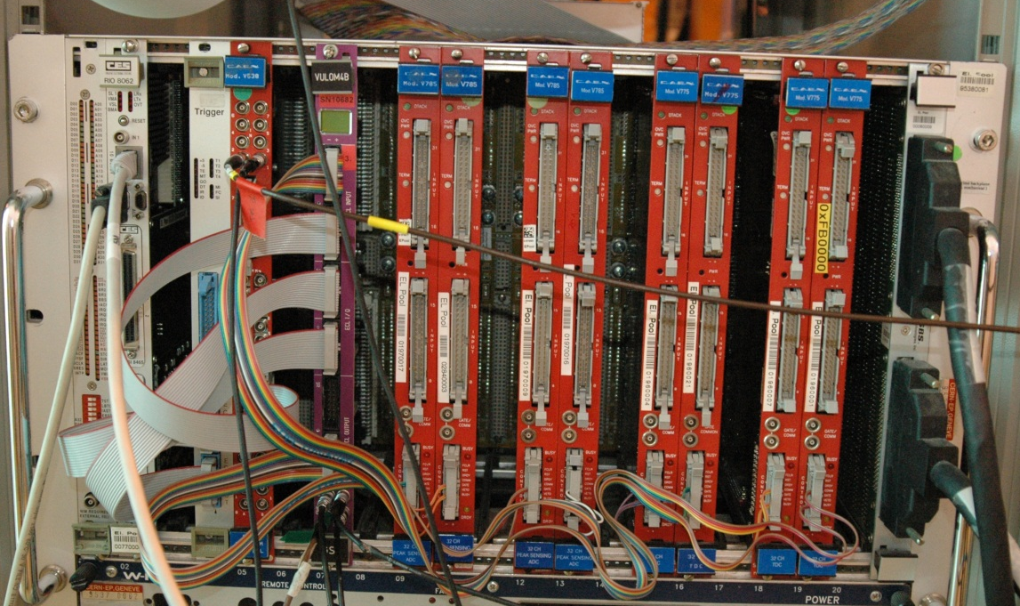
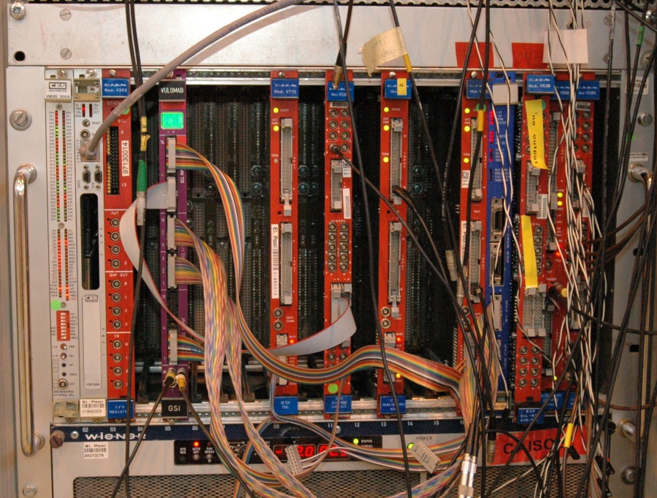
ISOLDE DAQ systems - MBS
Standard ISOLDE VME-based system
MBS DAQ system from GSI (N. Kurz et al.).
CES RIO2 processor
CAEN v775 TDCs and v785 peak sensing ADCs
TRIVA trigger synchronization module, VULOM+TRLO2 firmware for trigger logics.
Well established within collaboration
NEW!
busies
triggers
triggers
busies
gates
gates
T1, Tebis
T1, Tebis

Slide 4
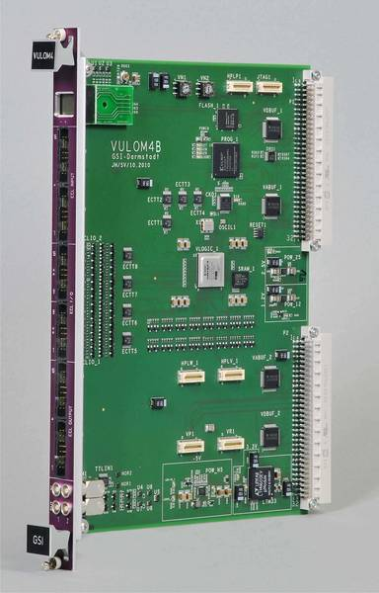
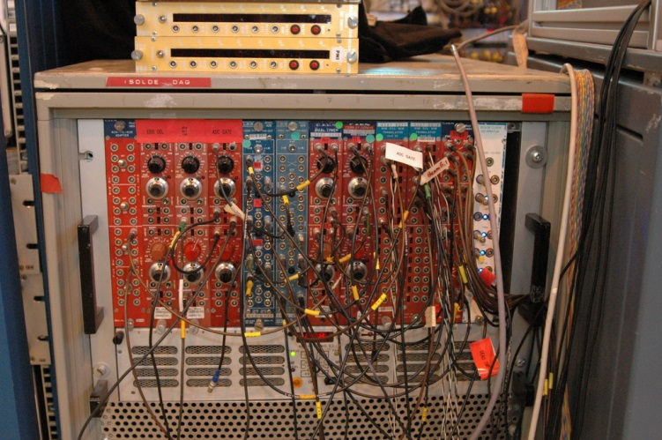
VULOM – VME Universal Logic Module
1NIM crate Trigger logic reduced to single VME board
TRLO2 - trigger logic firmware (H. Johansson et al.)
VULOM - VME Universal Logic Module (J. Hoffman et al.)
(C) Photo: GSI

Slide 5
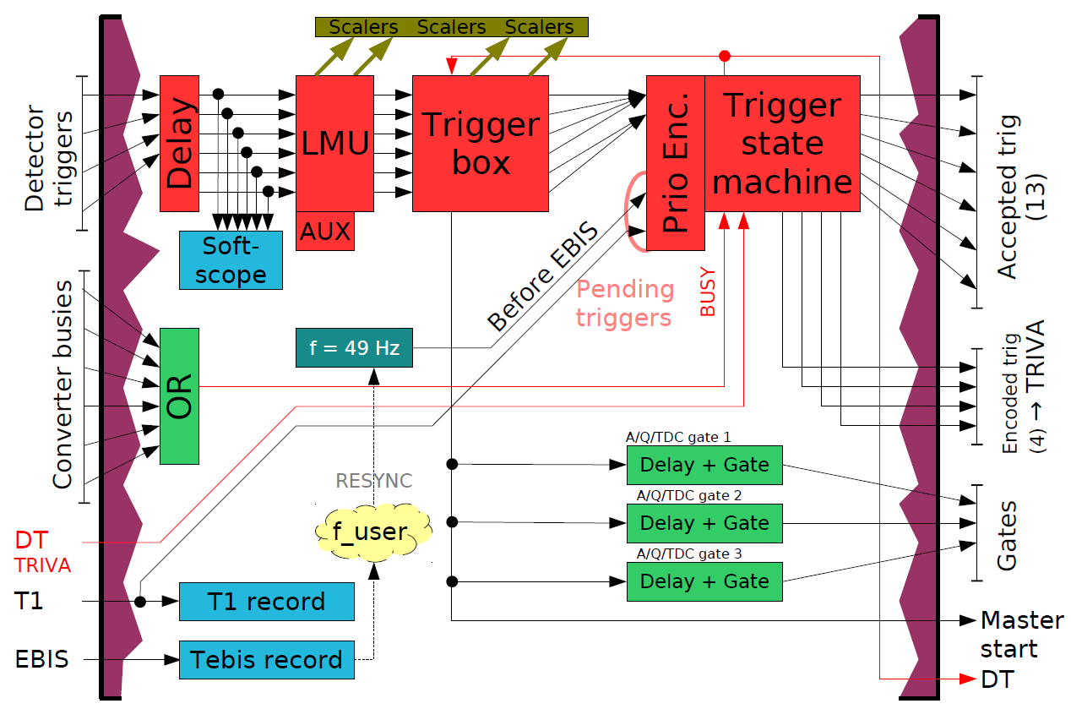
VULOM – VME Universal Logic Module
(C) Fig: H. Johansson

Slide 6
VULOM – VME Universal Logic Module
COMMAND(wiring)
{
/* TRIVA connections. */
DEADTIME_IN(1) = triva_DT;
triva_trig1 = ENCODED_TRIG(1);
triva_trig2 = ENCODED_TRIG(2);
triva_trig3 = ENCODED_TRIG(3);
triva_trig4 = ENCODED_TRIG(4);
GATE_DELAY(4) = triva_DT;
delay(4) = 1000 ns;
stretch(4) = 0 ns;
…
}
/* ADC 1, 2, 3 */
user_gate1 = ECL_OUT(1), ECL_OUT(2), ECL_OUT(3);
user_delay1 = 100 ns;
user_stretch1 = 5000 ns;
…
Trigger Logic to be set via simple config file
(C) Fig: H. Johansson

Slide 7
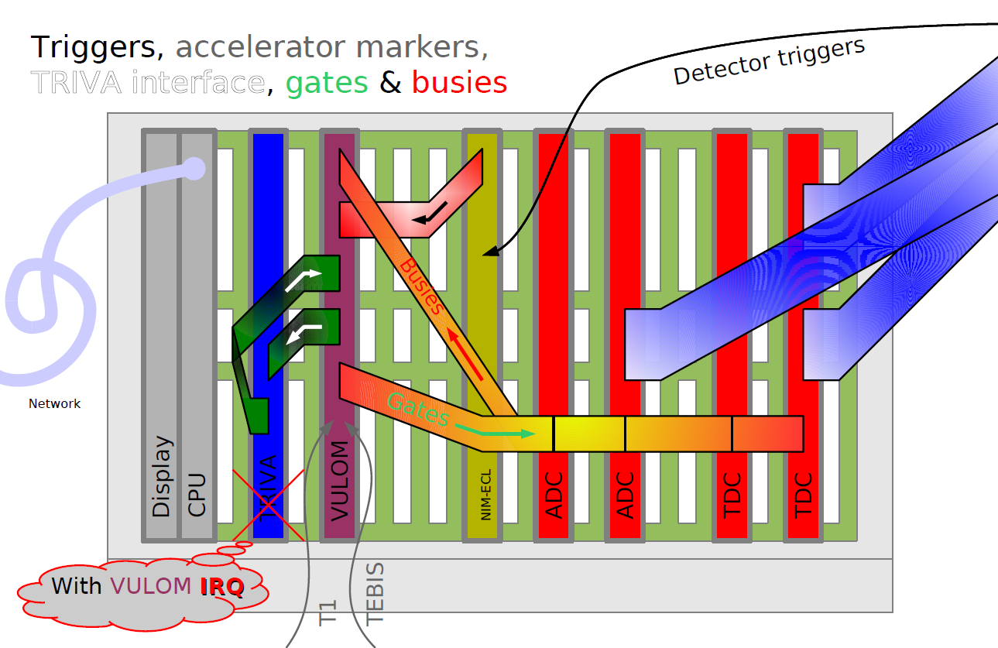
VULOM – VME Universal Logic Module
(C) H. Johansson

Slide 8
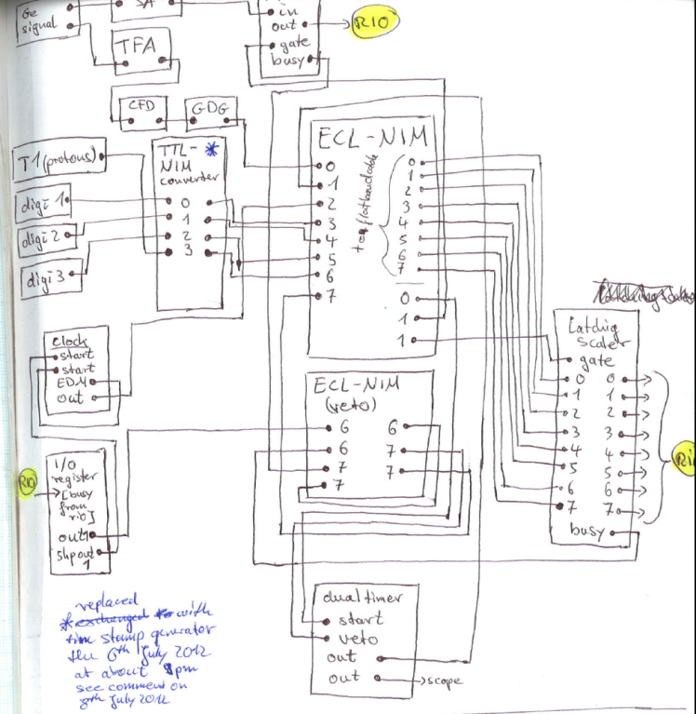
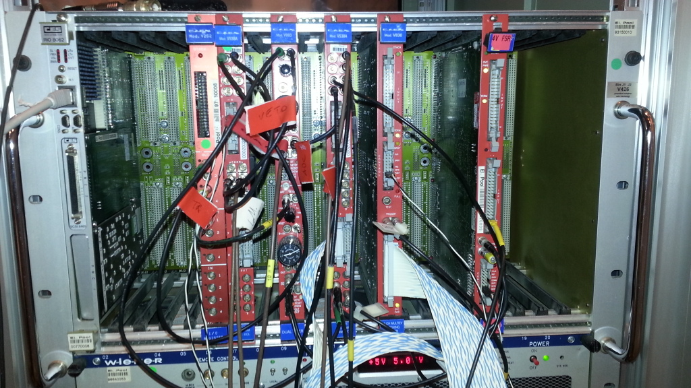
ISOLDE DAQ systems - minidaq
mini VME DAQ, CES RIO2 processor + ADC + scaler, up to 32 ch
no TRIVA/VULOM
only one trigger (veto by busy or I/O register during read-out)
produces MBS-like data stream
ADC and scaler operate in multi-event mode
Trigger
Busy
Gate
Gate
Busy

Slide 9
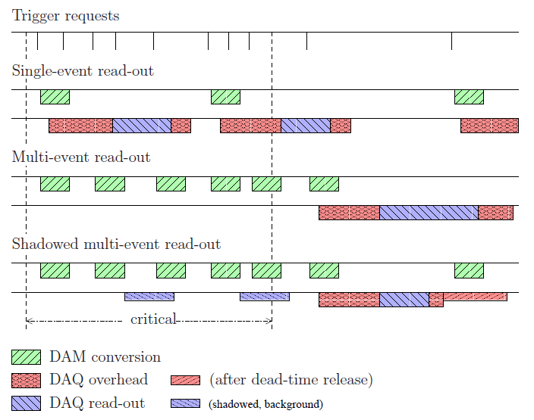
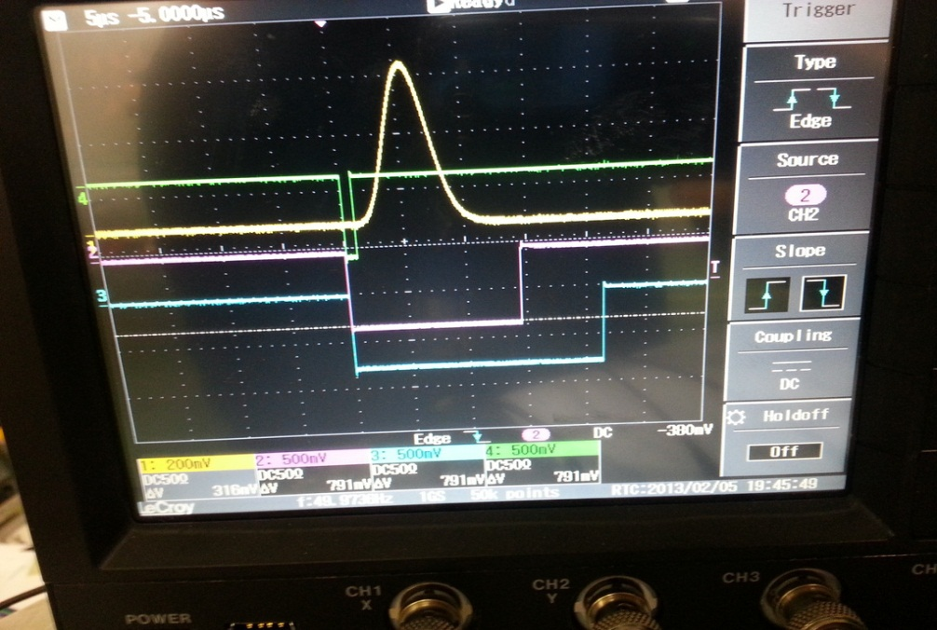
Multi-event read-out for MBS
Dead-time = conversion+read-out time
ADC and scaler operate in multi-event mode (otherwise: ~1 event per EBIS pulse)
Buffer size: 32 events (ADC/TDC), ~1000 (scaler)
Both MBS and minidaq can be run in multi-event read-out mode
(VME bus: 1us/word)
(C)Fig: H. Johansson
Notes:
9/26/13

Slide 10
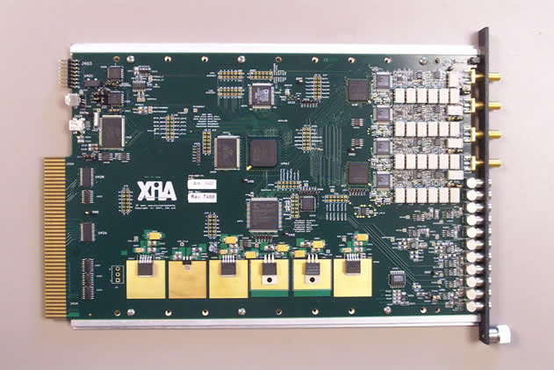
DGF4C – DAQ system (digiDAQ)
Digital Gamma Finder (DGF) is a pulse processor with capabilities for measuring both energy and pulse shape
Common clock distribution
40 MHz sampling rate (rev. D, E) → 80 MHz (rev. F). Upgrade presently being done.
12-bit (rev. D), 14-bit (rev. E) ADCs
For >5 kHz significant dead-time in LMD mode (long read-out)
Figs: xia.com

Slide 11
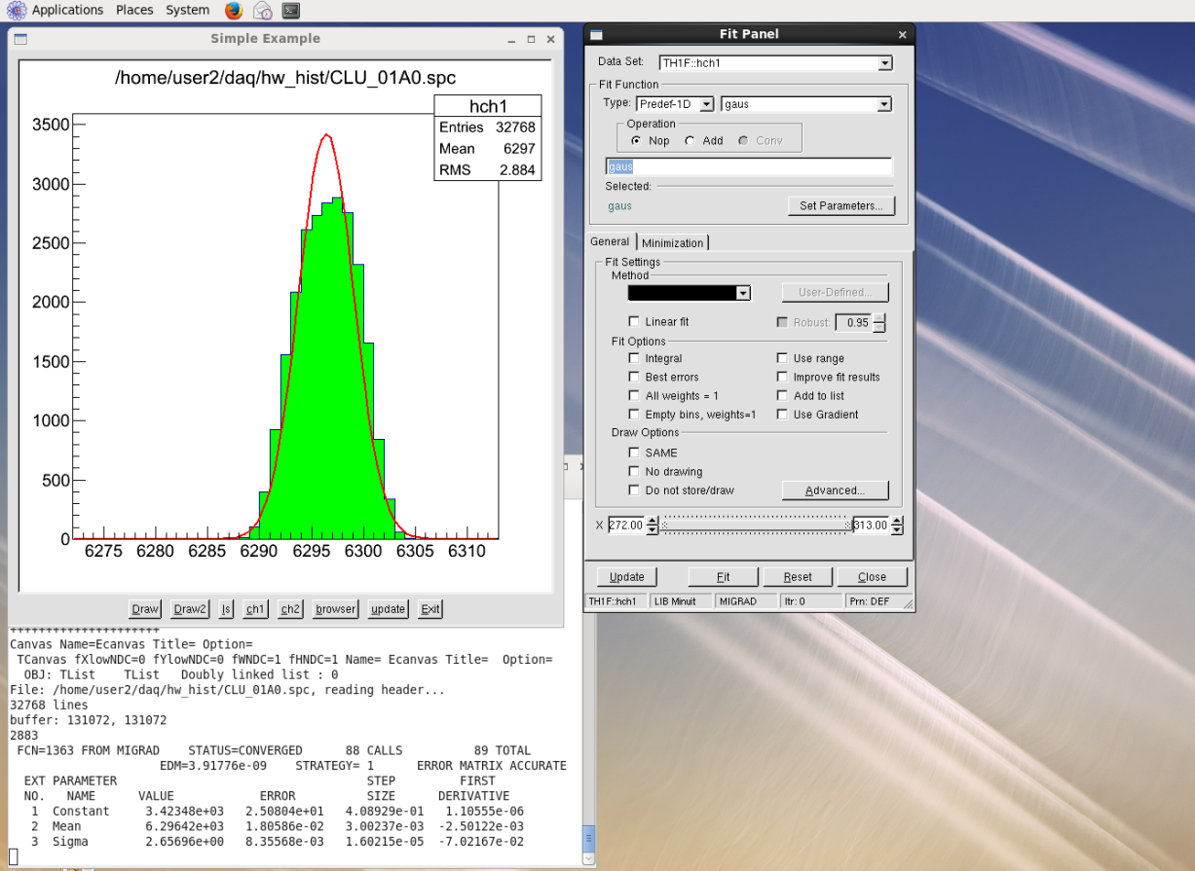
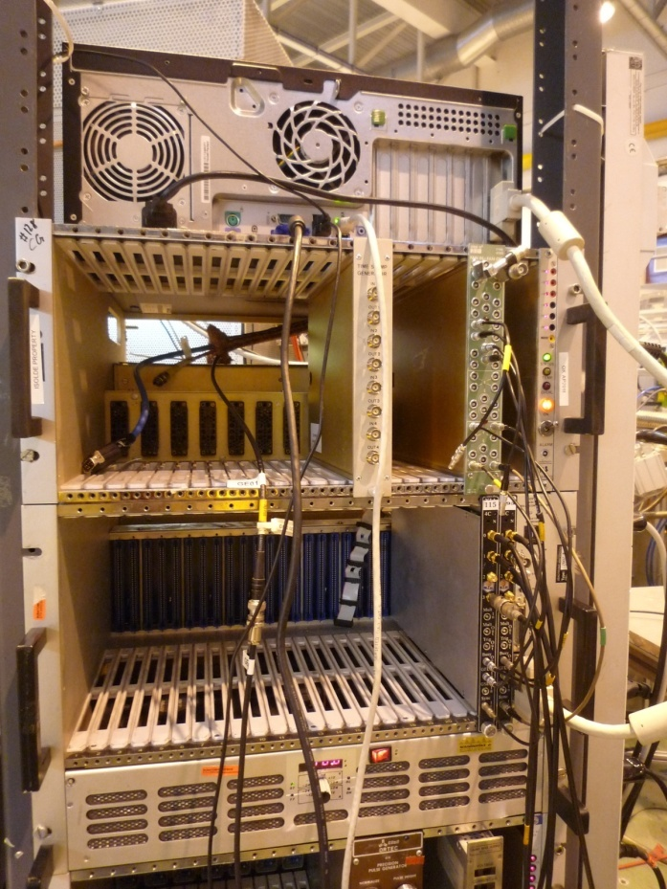
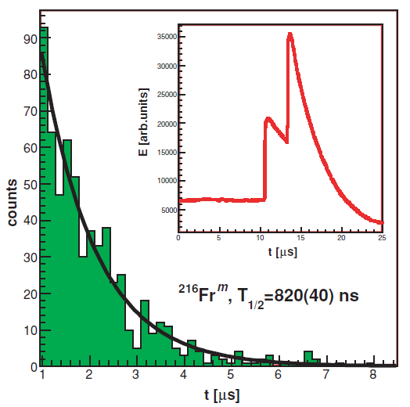
DGF4C - DAQ system (digiDAQ)
XIA DGF4c-based system (CRIS, ISOLTRAP, MB, NICOLE, others)
DAQ based on MB collector code (N. Warr, G. Simpson),
can also write MBS buffers (testing phase…)
Online monitoring using cne/ROOT software,
Offline analysis based on ROOT is also available
(T. Cocolios, K. Lynch, G. Simpson)

Slide 12
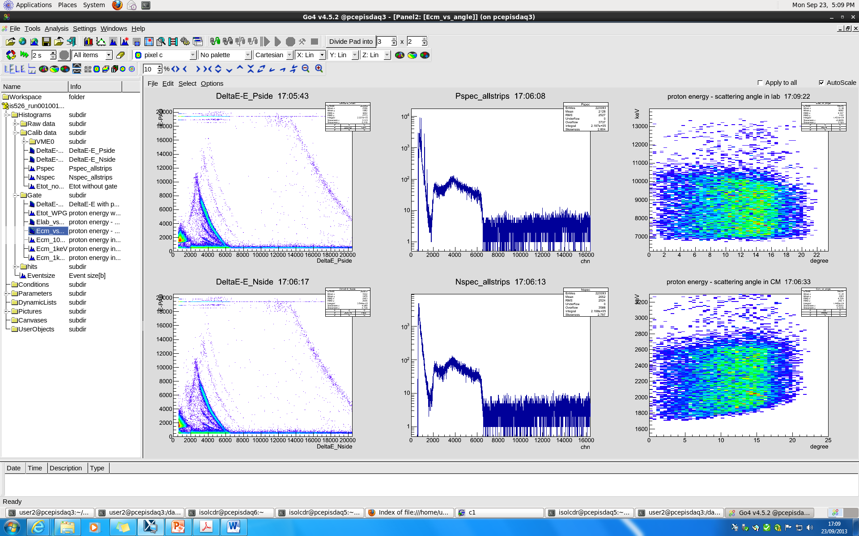
MBS – online GUI GO4 (IS526)
IS526 data

Slide 13
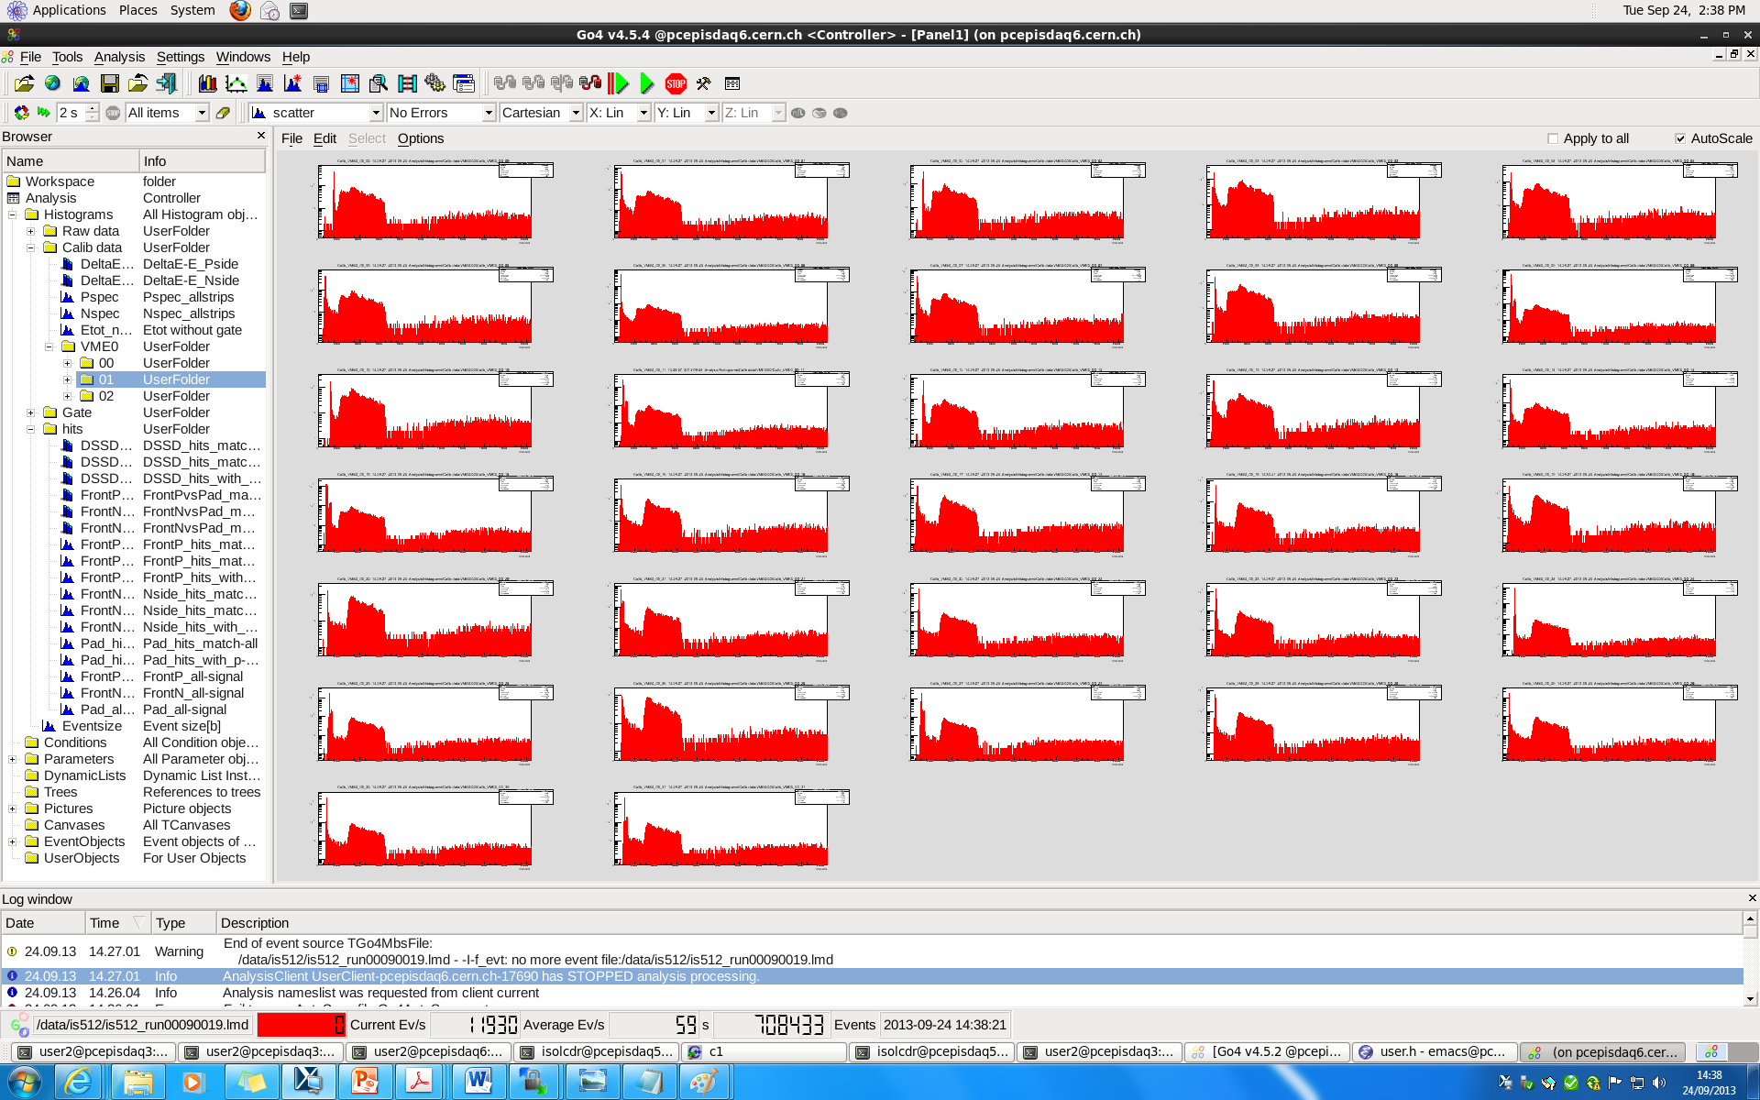
GO4 - View panel, IS526

Slide 14
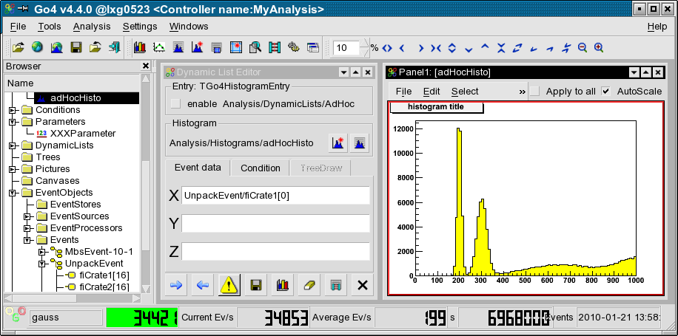
GO4 – Dynamic list editor
Adding histograms and conditions online from event data
Drag

Slide 15
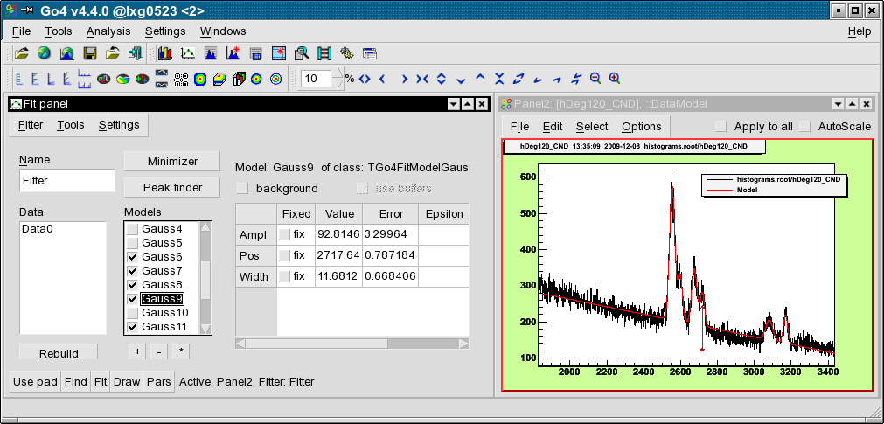
GO4 – Fit panel
Interactive peak finding and fitting. Save fitter for use in macro macros
Can handle any TH1 objects (from files NOT necessarily created with Go4)

Slide 16
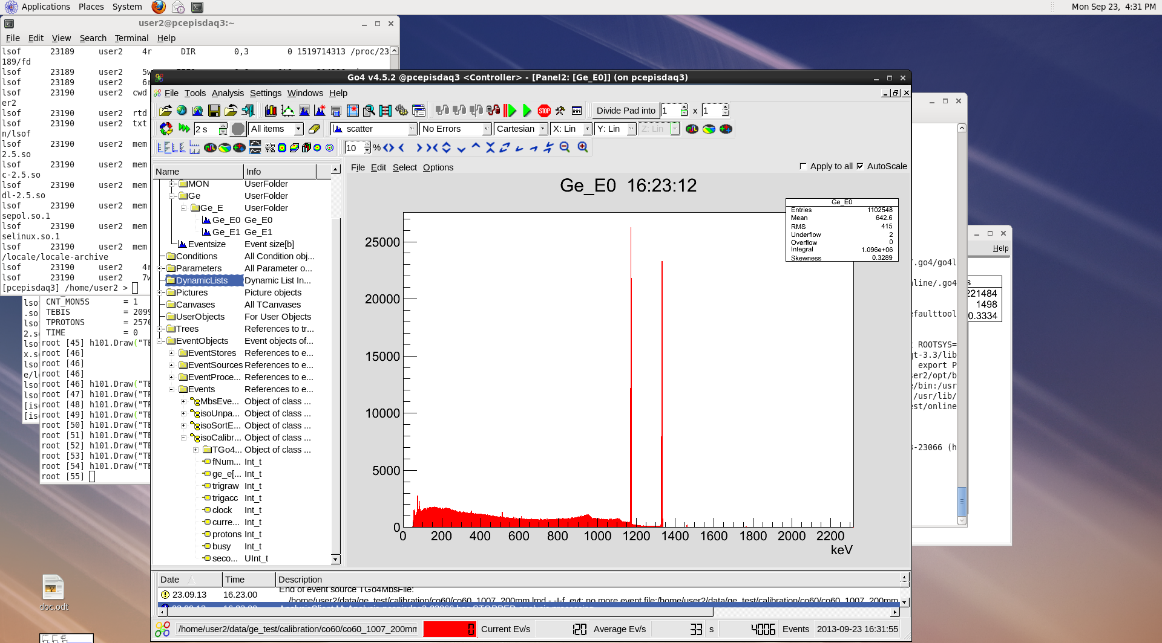
Minidaq – online GUI Go4

Slide 17
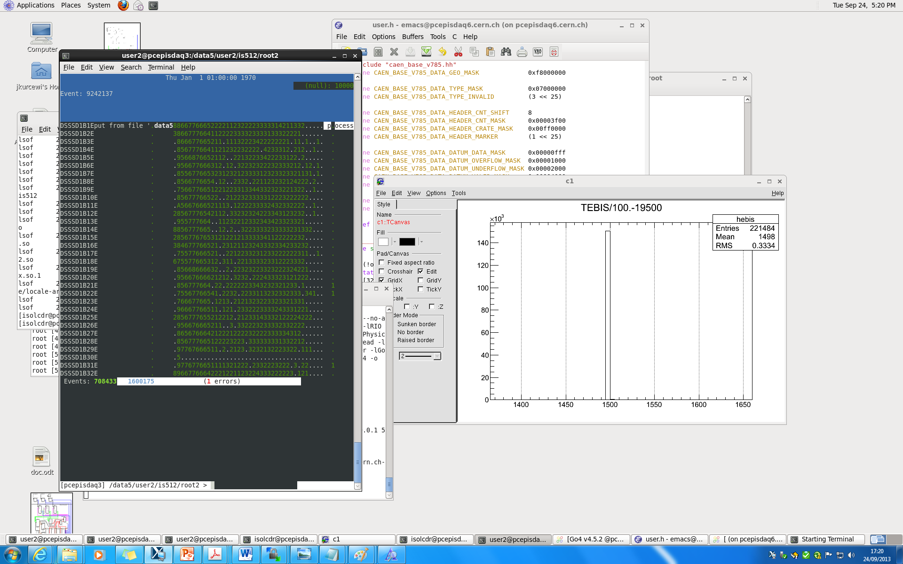
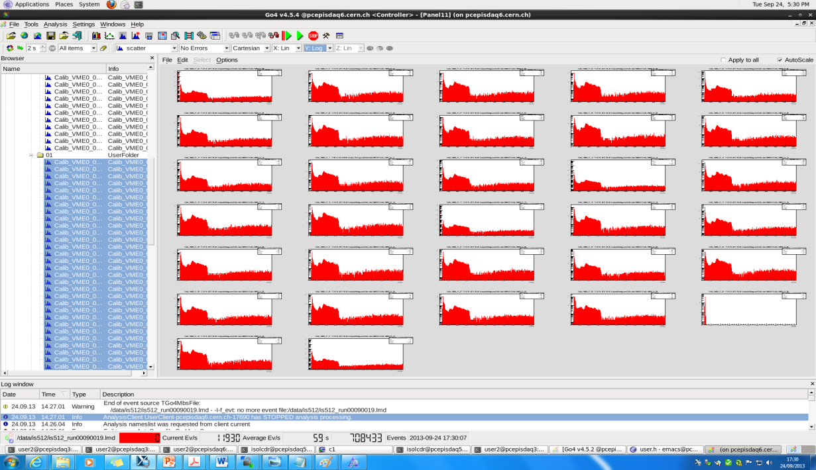
ucesb - unpack & check every single bit
Tool to do rather quick checks of event-based data produced in e.g. nuclear physics
experiments, installed on ISOLDE DAQ computers
Built-in data formats: LMD (MBS), EBYEDATA (Daresbury MIDAS), PAX(KVI), HADES…
Data structures → (parser) → C++ code (can handle any type of data)
Simple but effective on-line data monitoring
[pcepisdaq3] /data5/user2/is512/root2 > ~/is512_unp/is512 is512_run00090019.lmd --watcher=DSSSD1B*E
GO4
ucesb
http://fy.chalmers.se/~f96hajo/ucesb/

Slide 18
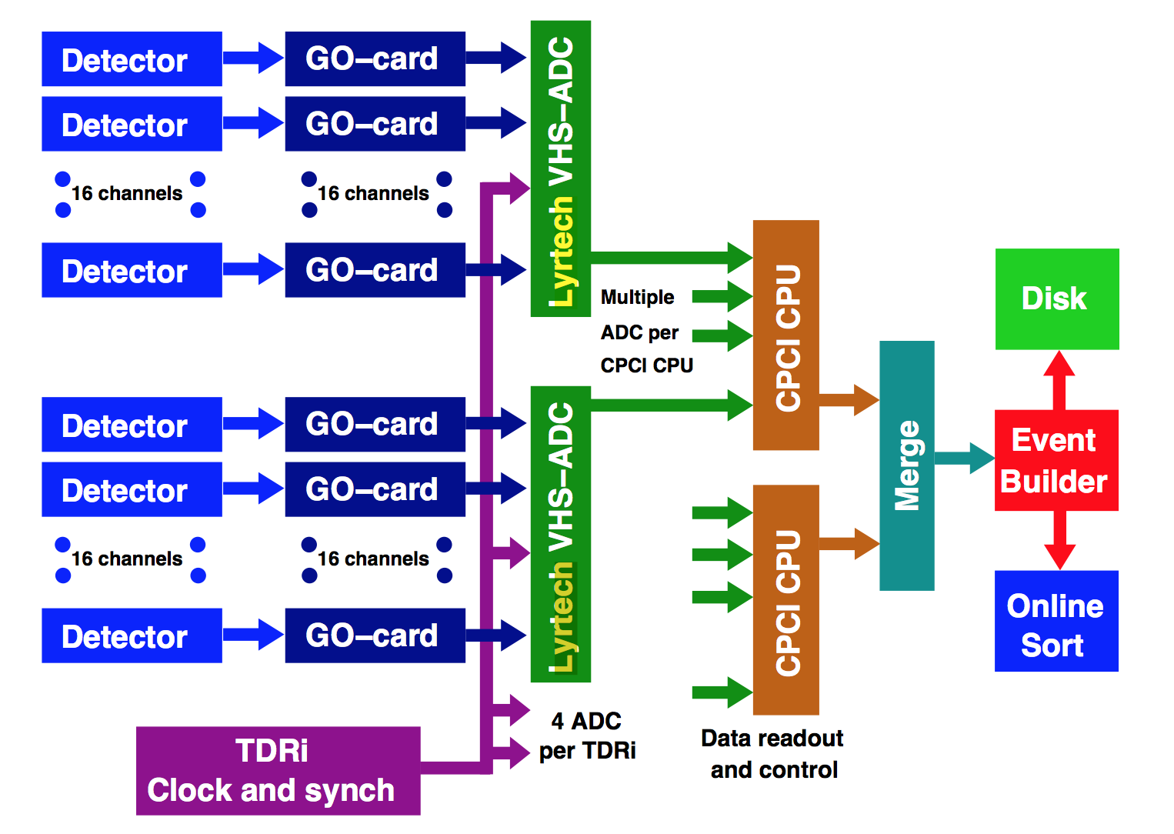
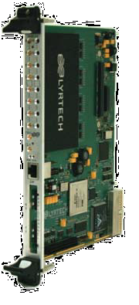
TDR - DAQ for IDS
TDR – Total Data Readout (Daresbury, UK), widely used at JYFL, chosen for ISOLDE IDS - phase I.
Channels are read out asynchronously in singles mode and each data item is time-stamped with an external clock .
Event building and analysis has to be done entirely in the software post-processing the data stream.
VHS-ADC : 8 ch, 105 MSPS, 14-bit ADC (virtex4 FPGA) - could be available on loan from JYFL
Capable to handle rates ~30kHz/ch (DC beam)

Slide 19
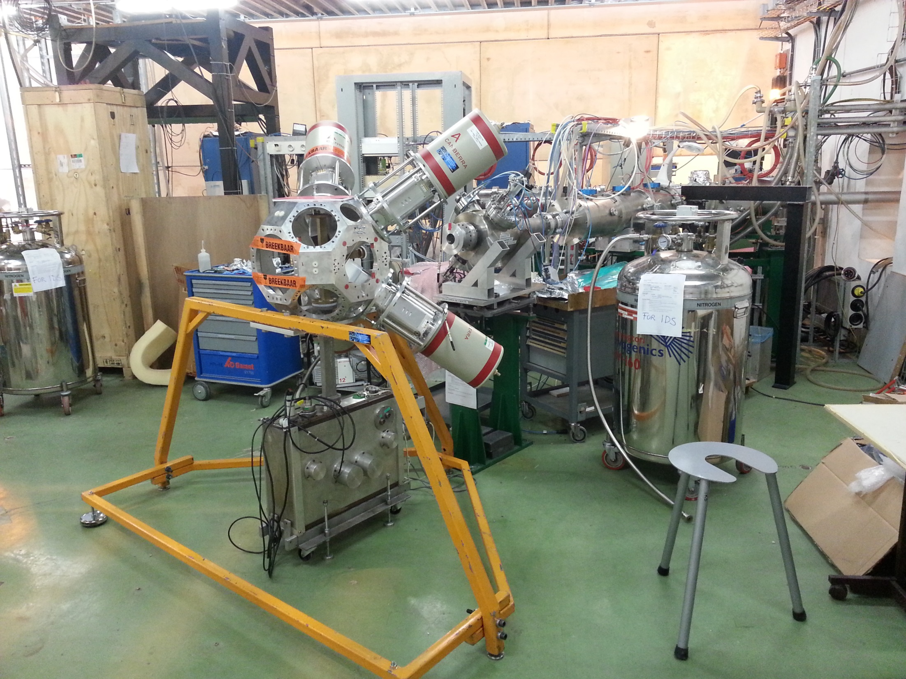
TDR - DAQ for IDS
HPGe: 19 ch (max 25, phase II)
LaBr3: 12 ch
Plastic: 3 ch
Si: 64 ch
Total: 98 ch (112 ch available)
+ ISOLDE status (T1, T2, tape, laser…)

Slide 20
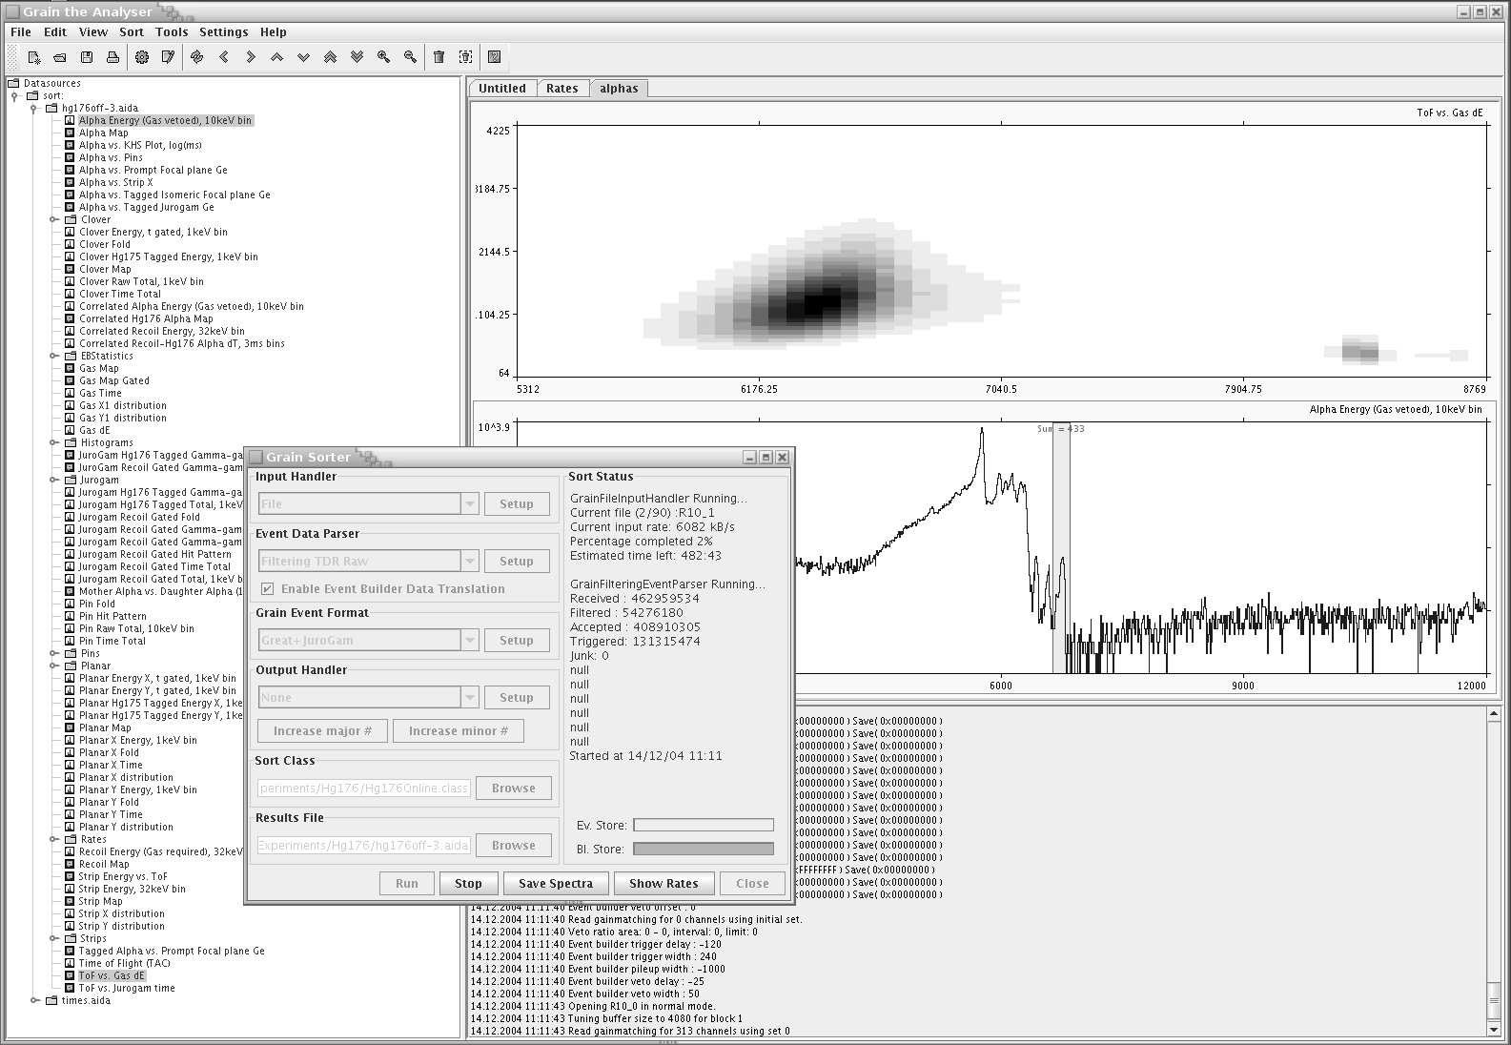

GRAIN – data analysis software
GRAIN - data analysis framework developed at JYU to be used with the novel Total Data Readout (TDR) data acquisition system.
A flexible and efficient event parser and the accompanying software framework written entirely in Java.
P. Rahkila, Grain - A Java Data Analysis System for Total Data Readout Nucl. Instr. and Meth. A 595, 637 (2008)
https://trac.cc.jyu.fi/projects/grain

Slide 21
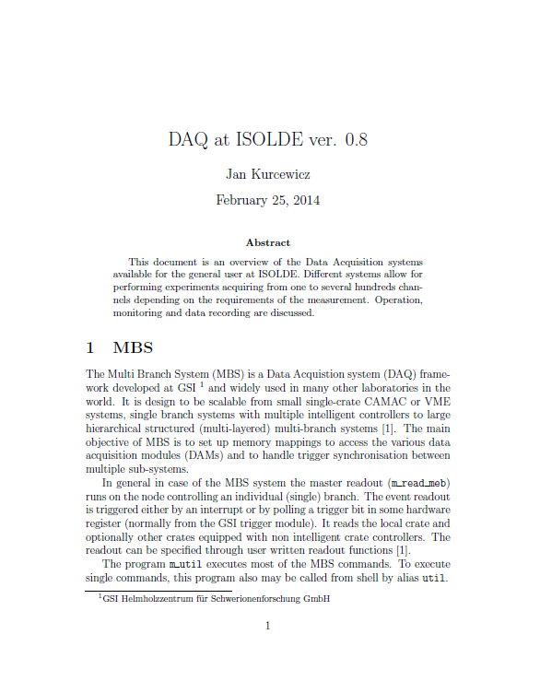
Summary
Available systems:
MBS: 2 nodes (up to 128ch)
Minidaq: 1 node (up to 32ch)
Digidaq: 1 node (up to 8ch)
TDR (future): 1 node (112/n8ch)
Statistics for 2012:
MBS: i83, is476, is512, is526, is545 [total: 220GB]
Minidaq: is541 [total 20GB]
Digidaq: is537, is471, CRIS development [total: 30GB]
/afs/cern.ch/user/j/jkurcewi/public/doc/daq_isolde.pdf
Notes:
9/26/13

Slide 22

Acknowlegment
Håkan T. Johansson (Chalmers University of Technology, Sweden)
Joakim Cederkäll (Lund University, Sweden)
Hossein Khozani (CERN-PH, Switzerland)‎
Momo Mukai‎ (University of Tsukuba, Japan)
Nobuaki Imai (KEK, Japan)
IS512/526 teams
This work is supported by ENSAR

Slide 23
Template

