Slide 1


ISOLDE: Status report building 508
69th ISCC meeting
CERN, 31 March 2014
Erwin Siesling, Magda Kowalska

Slide 2
Outline
  Status new building 508:
  Progress on the construction
  Building layout (final)
  Progress on infrastructure
  Costs and timeline

Slide 3
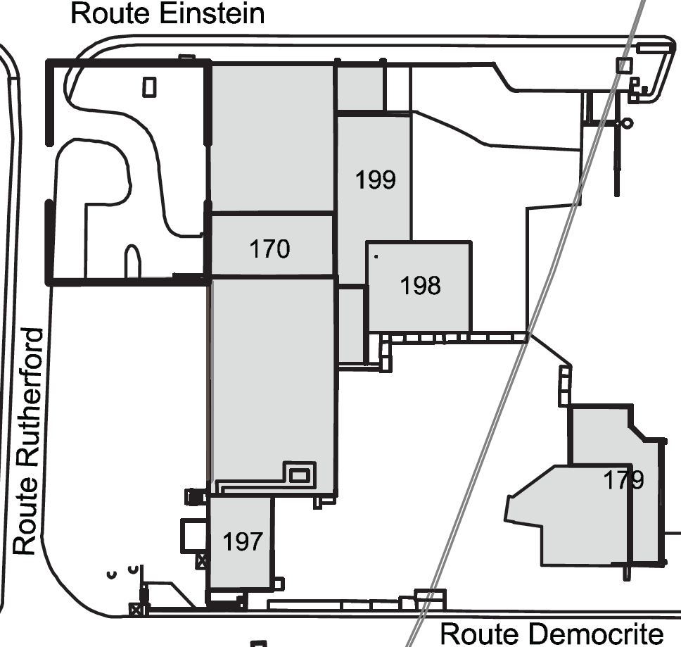
New building 508
Reserved for TSR
New user facilities building 508
(replacing 507, 115, 601)
ISOLDE experimental hall
New ISOLDE Control Room, 1st floor 508
508
Target zone and separators area
water station
Present ISOLDE Control Room, basement 197

Slide 4
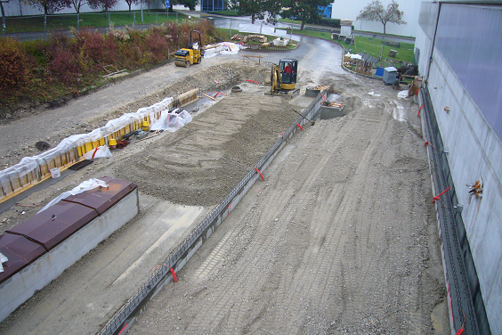
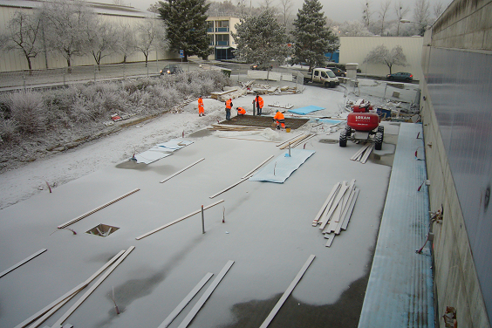
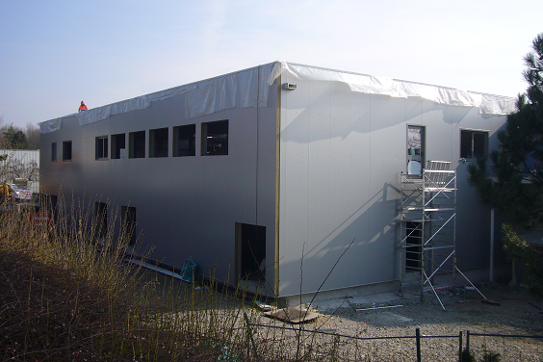
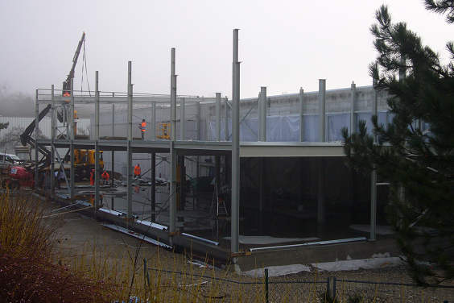
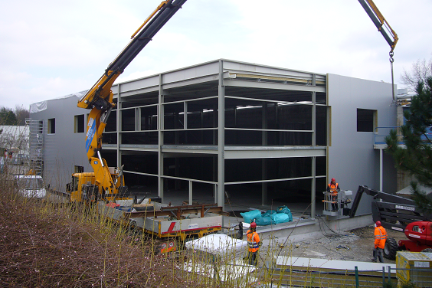
Progress
Progress during the winter:
Preparation of the terrain November
Pouring of the concrete floor (with disconnected workshop floor) December
Installation of the metal structure Feb-March
Installation of the isolated walls March
Ongoing: Installation of the windows and doors & inner walls

Slide 5
Building Layout
Building 508 layout:
Light metal structure with 2 concrete floors: Total surface 864m2
Ground floor (only accessible from within the classified area): 432 m2
- Solid state, Laser labs and workshop
First floor (accessible outside the classified area): 432m2
- Data Acquisition rooms
- Meeting room/Visitors Center
- Kitchen
- Isolde Control Room

Slide 6
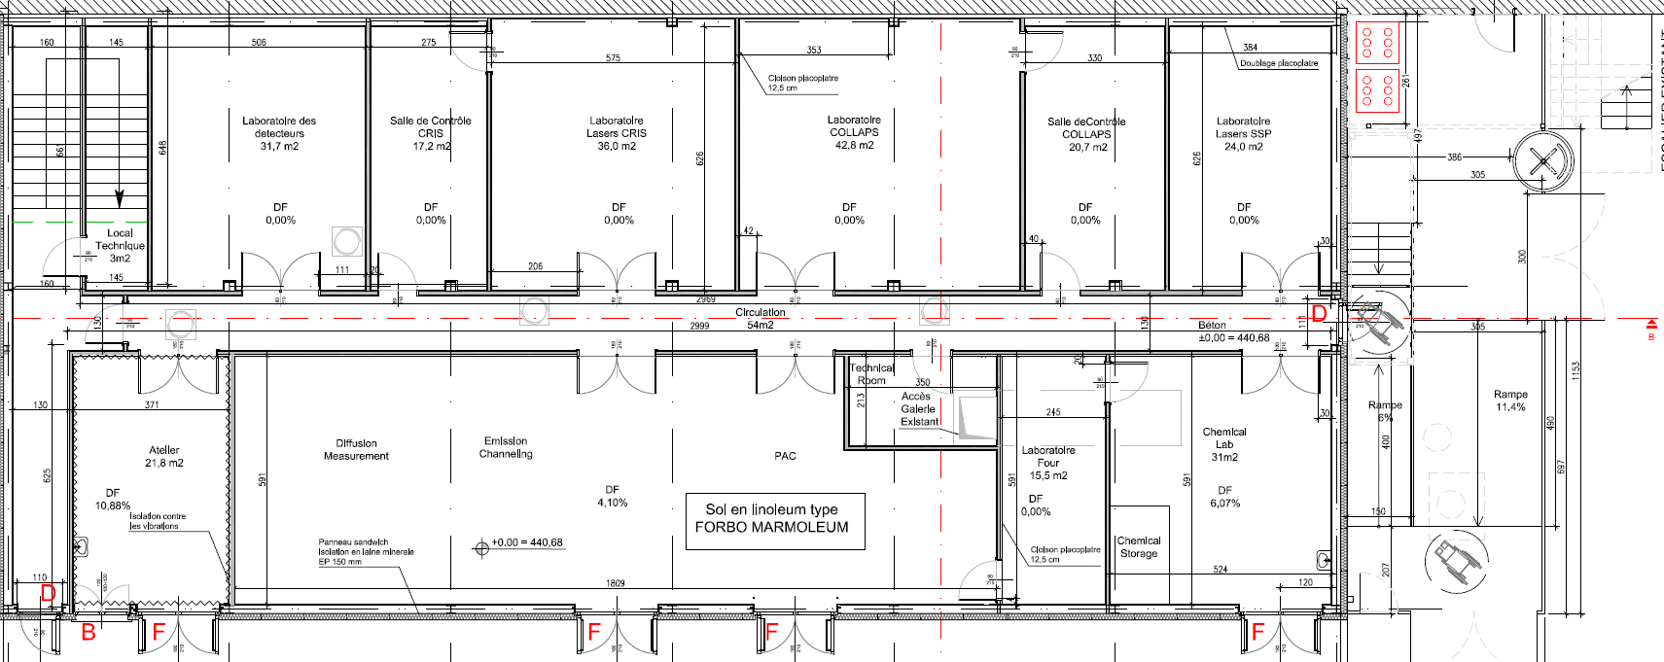






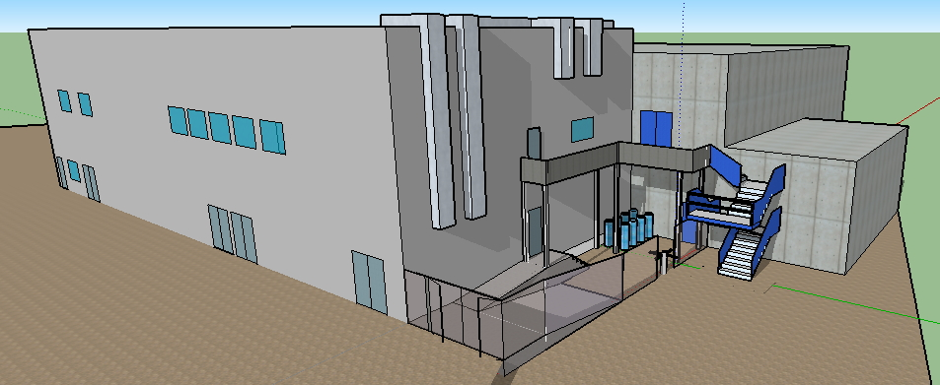







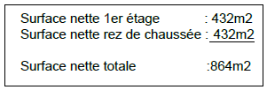
Layout 508
Ground floor B508:
Access 1st floor
Controlled Access ground floor
and Isolde hall
Access 1st floor

Slide 7
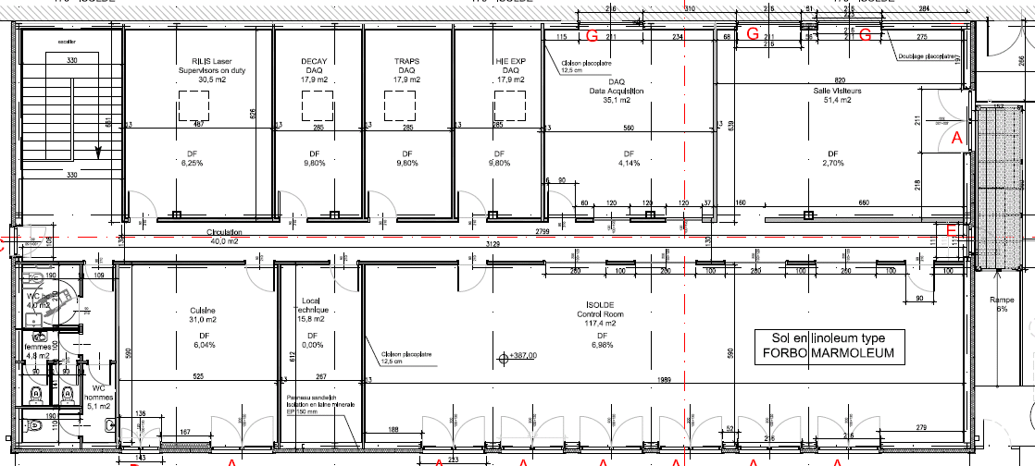









Layout 508
1st floor B508:
Access 1st floor
Access 1st floor
Courtesy Eliseo Perez-Duenas GS/SE

Slide 8
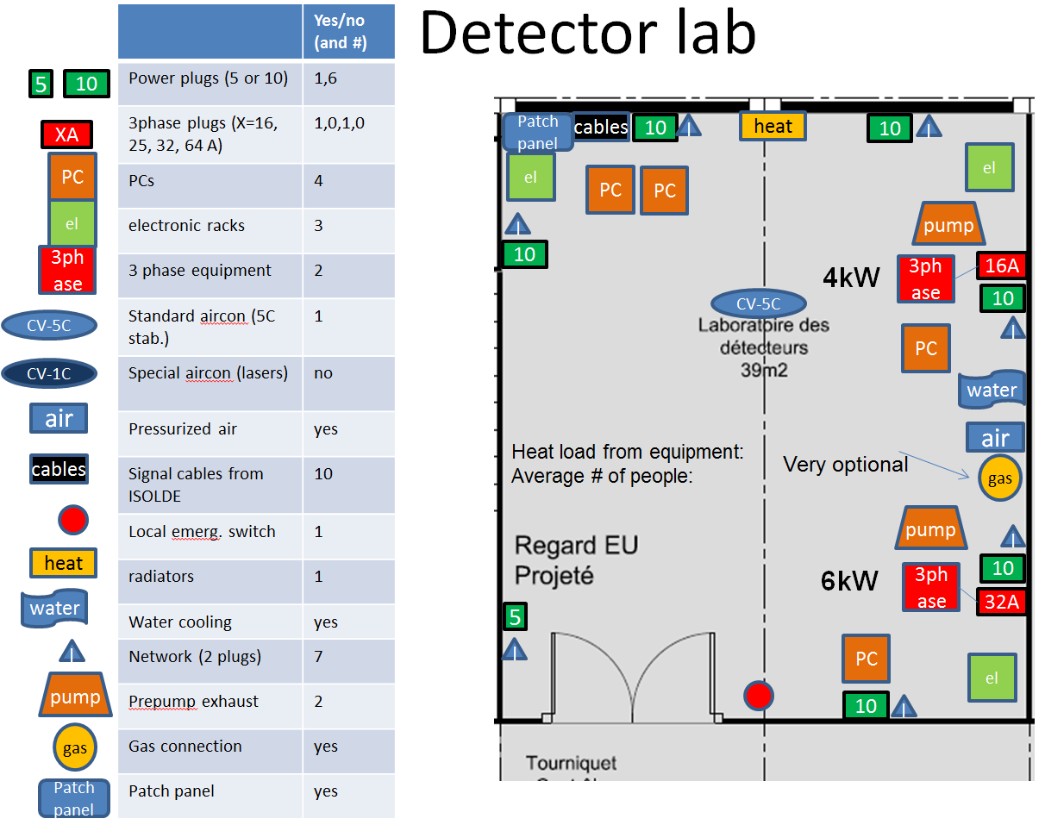
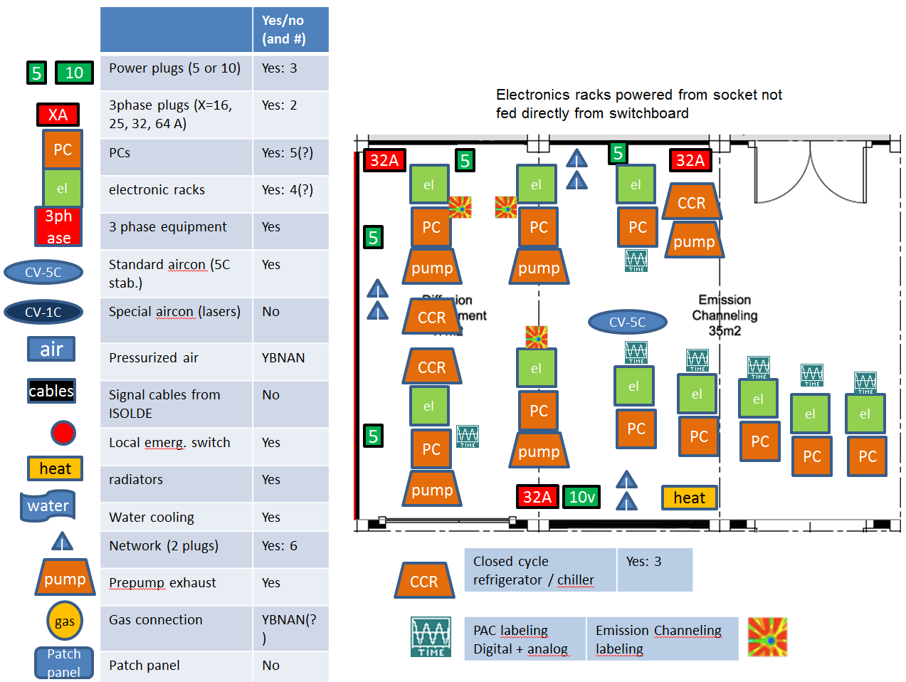
Infrastructure 508
Infrastructure:
Needs for the users have been collected by Maria and Magda
Implementation by the different groups and contractors ongoing (EL, CV, IT)
Finalized plans with regard to infrastructure to be ready asap (Urgent!)
Courtesy Magda Kowalska

Slide 9
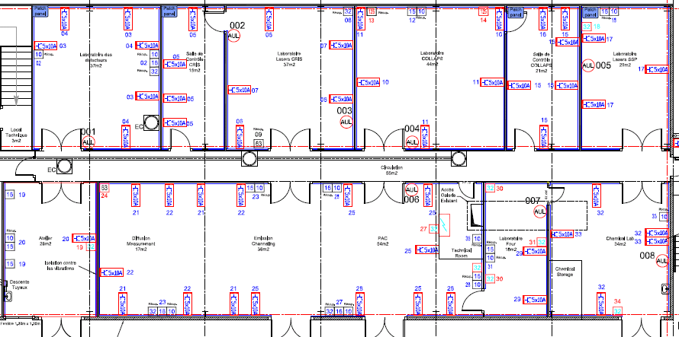
Infrastructure 508
Electricity:
- Latest iterations user needs: 200kW
- Waiting for estimate of Cooling& Ventilation needs: 130, 170, or 220kW

Slide 10
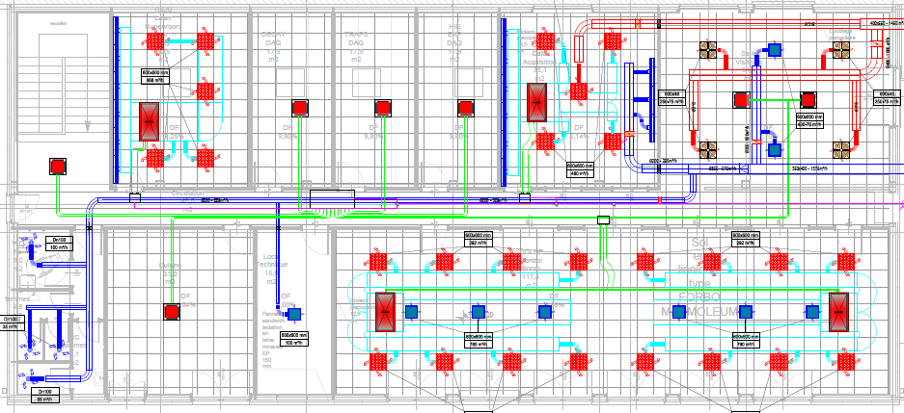
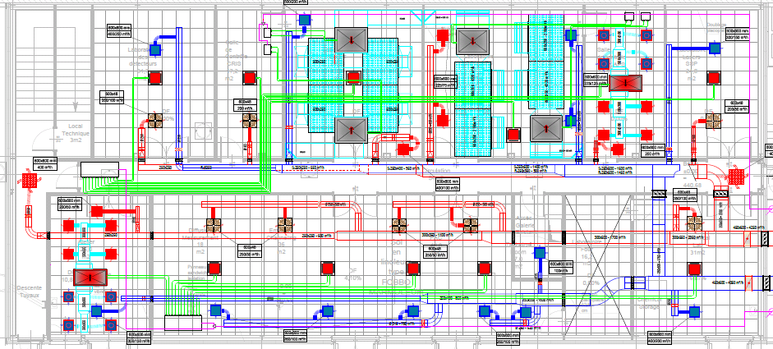
Infrastructure 508
Cooling and ventilation:
The proposed solution by the contractor contains two HVAC (Heating Ventilation and Air Conditioning) systems based on a refrigerant liquid:
  General system for the whole building + Technical cooling for the ground floor labs
=> too expensive and requires new electrical design (=delays), suggestion:
  Keep general system for the building as proposed
  Technical cooling: Re-use available chilled water and install fan-coils; 4x7kW fan-coils (1 SSP, 2 COLLAPS, 1 CRIS) as used before in B507
Status: waiting for a price estimate

Slide 11
Costs and Timeline
Costs:
Total costs building 508 (incl. services):
estimate 2MCHF Exact costs HVAC awaiting
Timeline:
Building ready April 2014
Infrastructure ready June 2014
Installation controlled access June 2014
Installations users as of July 2014 (Move of the ICR during shutdown 2014/15)
Milestone: Protons to Isolde 10 July 2014;
physics start 21 July

