Slide 1


HIE-ISOLDE
Status of the works at the ISOLDE hall
(and service buildings)
69th ISCC meeting
CERN, 31 March 2014
Erwin Siesling for the HIE ISOLDE integration team

Slide 2
Outline
  Status Report HIE Installation March 2014:
  Progress since the last ISCC meeting in Oct ’13
  What to expect for this year
  Have there been or are there any (new) delays
  Are we on track with regard to the planning

Slide 3
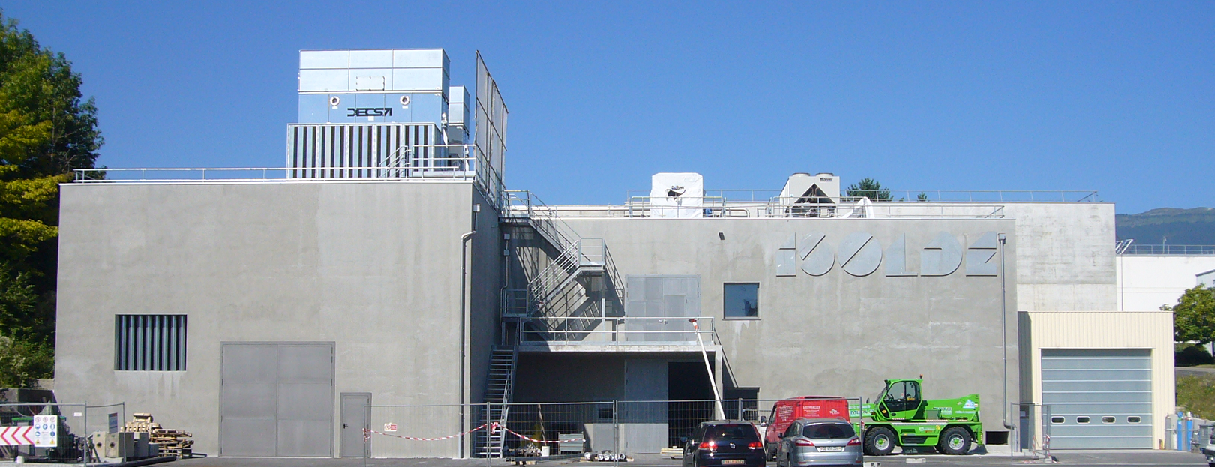
HIE ISOLDE installation progress

Slide 4
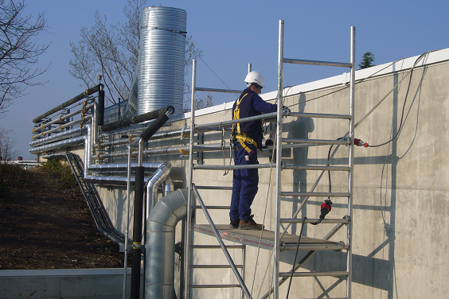
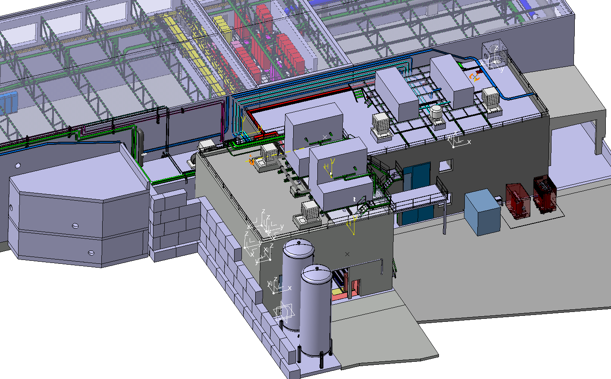
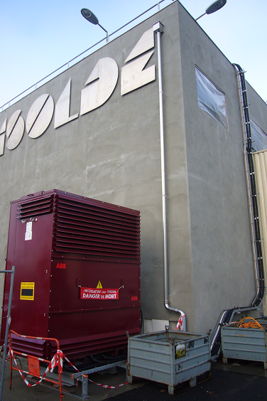
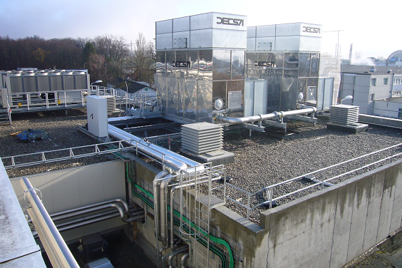
Outdoor progress
Cooling & ventilation:
Tubing finishing. Pressure tests done. Isolation of demineralized and chilled water tubes is finishing. Cooling towers operational. Roof extractors installed. CV cabling done.
EL systems: 440 V transformer installed, tested and cabled

Slide 5
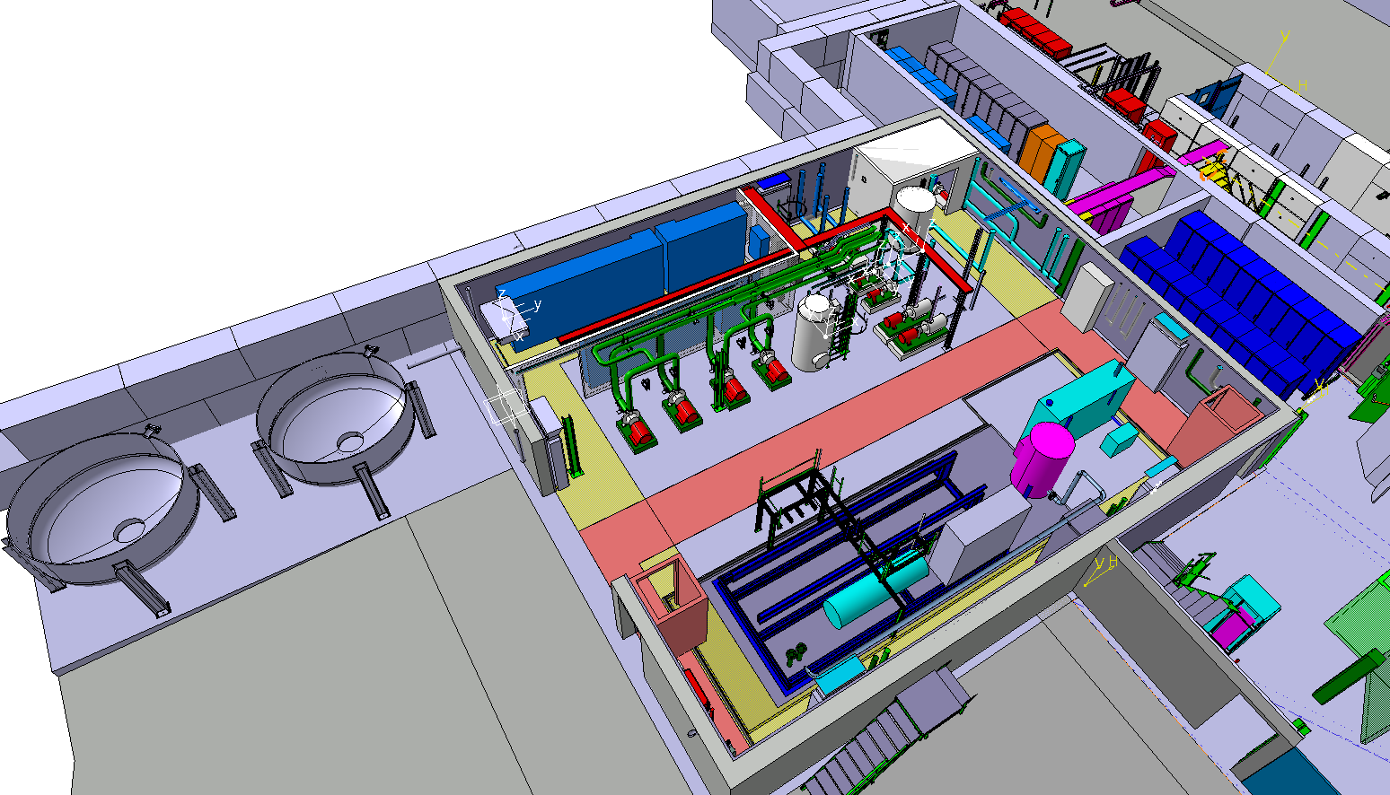
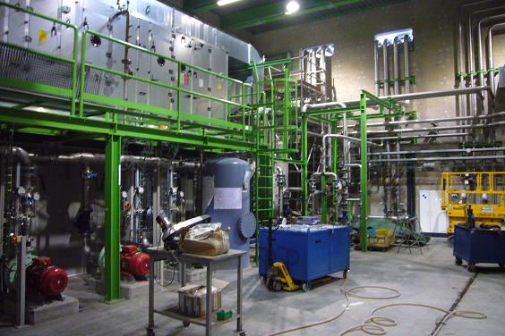
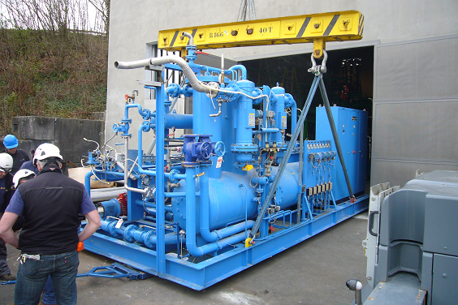
Compressor building 198
Cooling & Ventilation:
CV water and HVAC installation finished. Tests demineralized water ongoing.
Cryo System:
Cryo tubing installation chilled water done.
Compressors installation prepared: Compressor skit/frame arrived

Slide 6
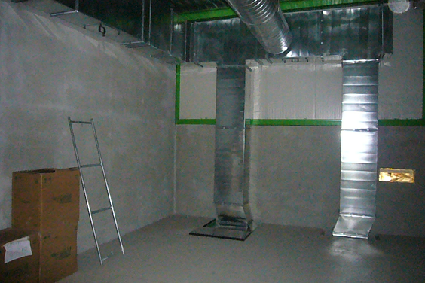
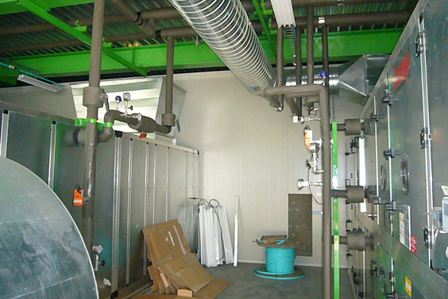
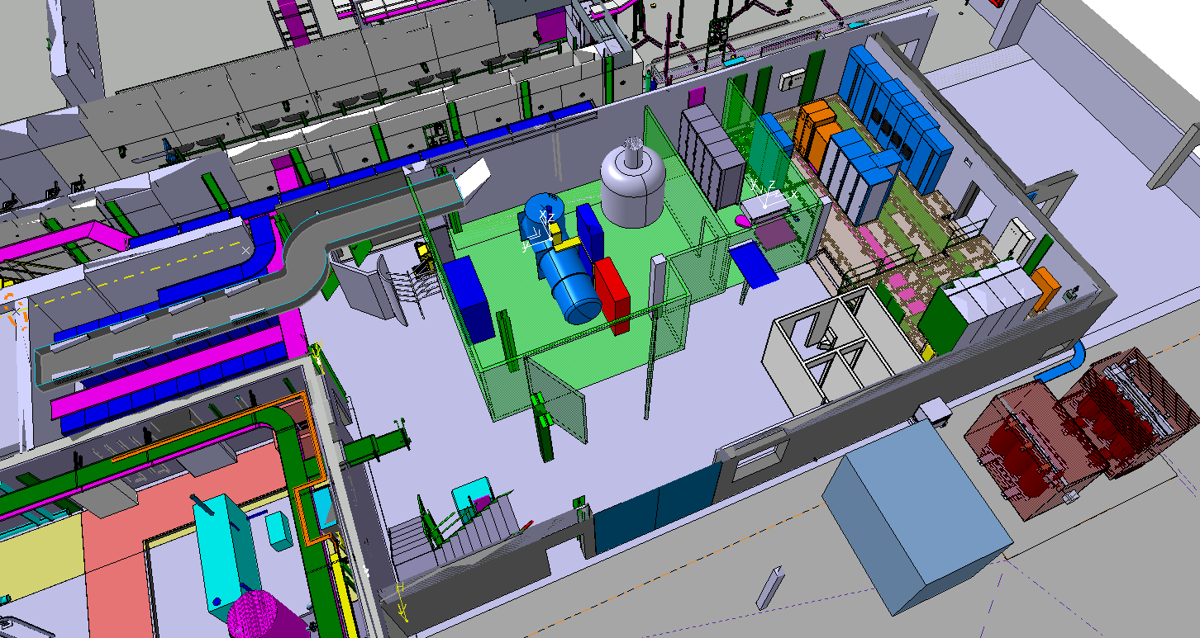
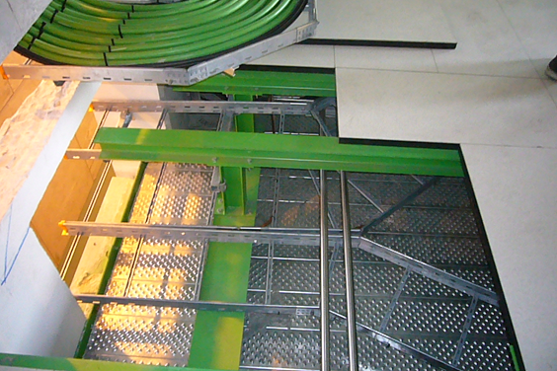
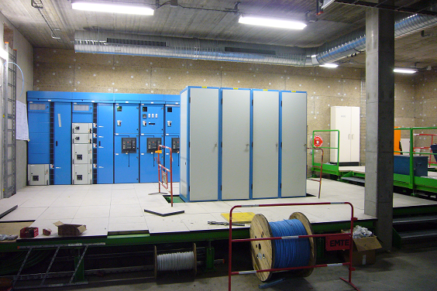
Cold Box building 199
EL and CV systems:
Power distribution racks in place. Racks & cabling ongoing. Air ducts all in place. HVAC units installed and tubing done.

Slide 7
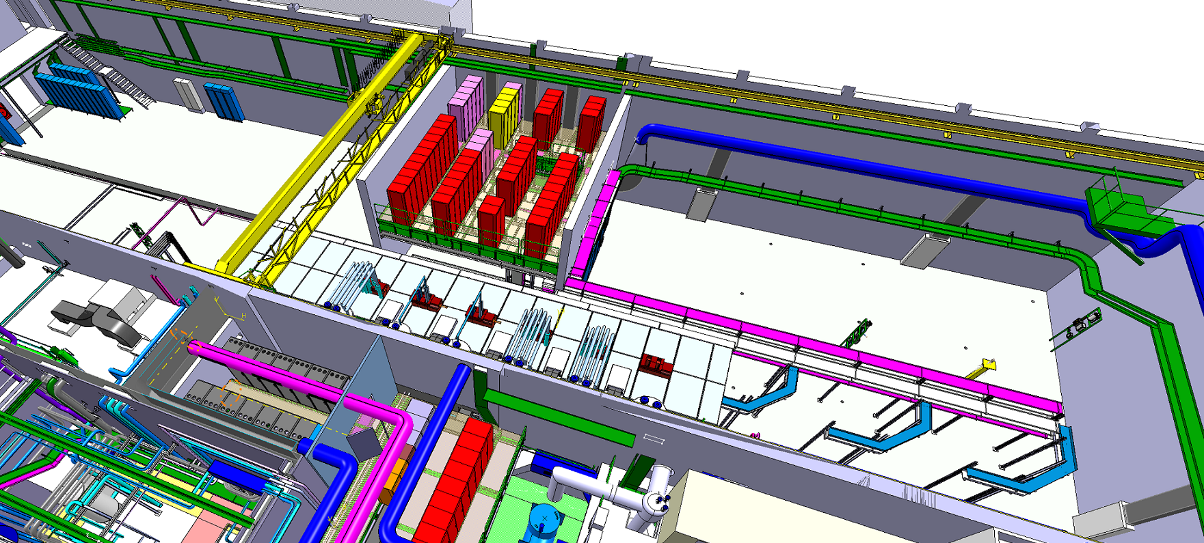
ISOLDE hall 170
S. Maridor
ISOLDE hall 170:
Civil engineering, metal structures, cooling and ventilation, cabling and equipment installation

Slide 8
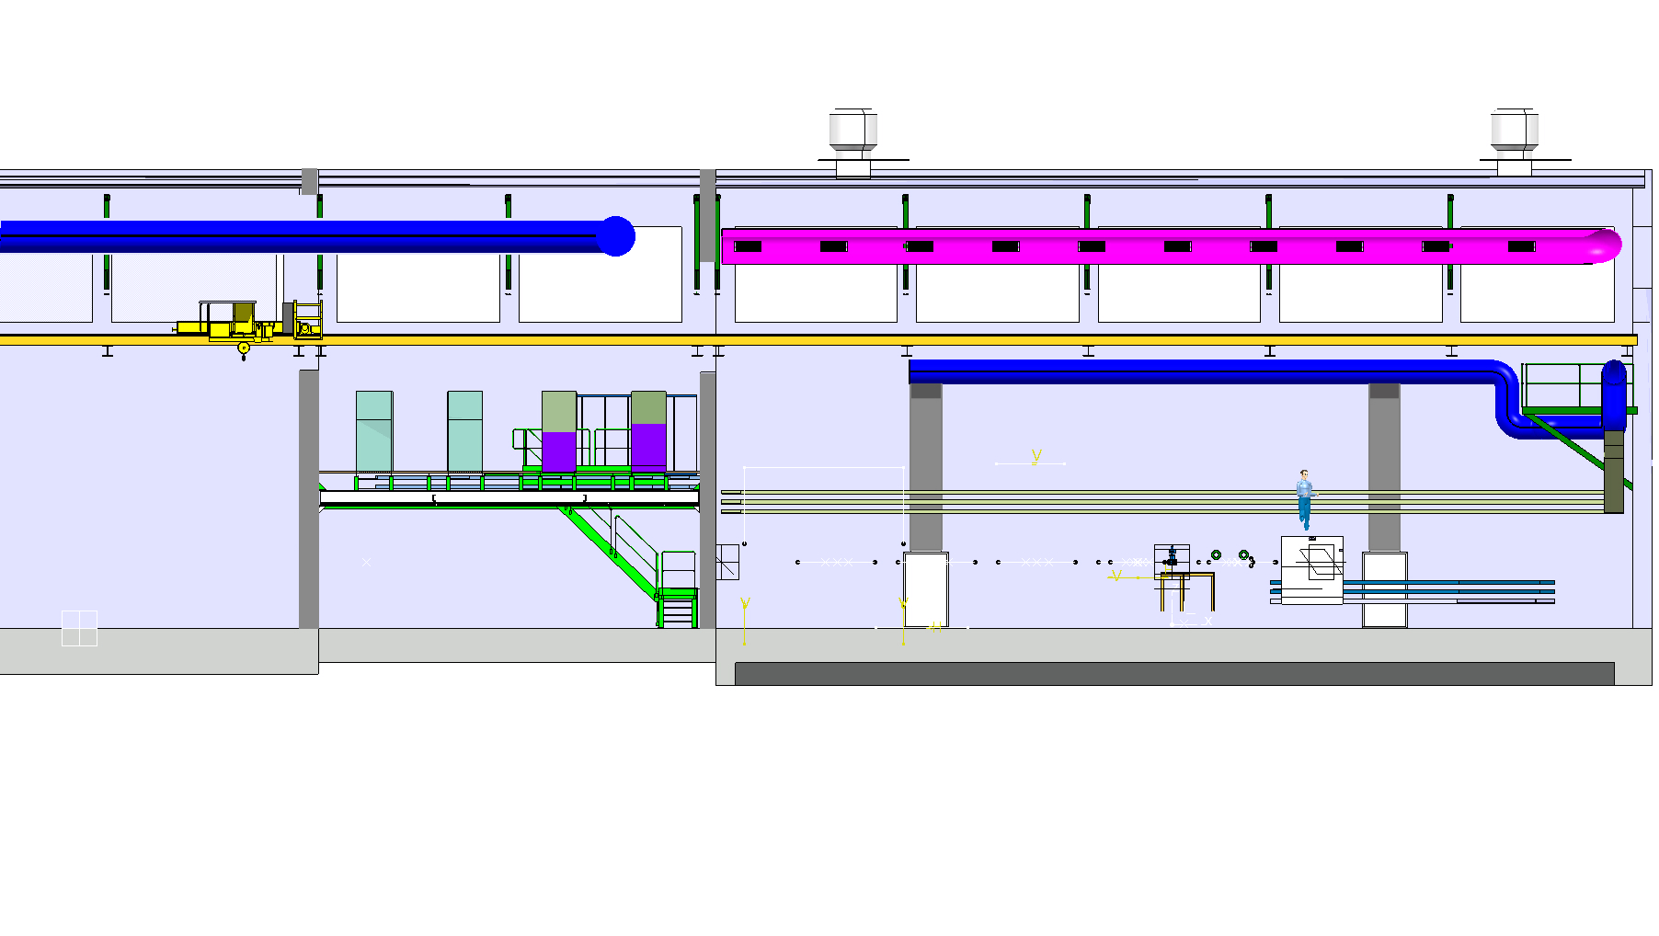
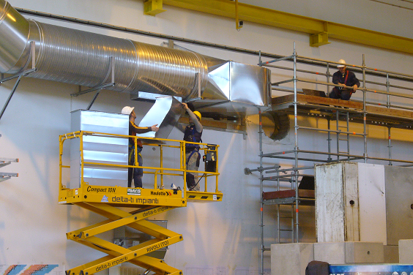
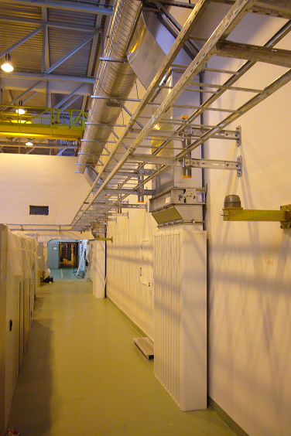
Hall 170 ventilation systems
New ducts
platform
New diffusers
1st extension
2nd extension
ISOLDE hall 170: Ventilation ducts in place (remaining platform)

Slide 9
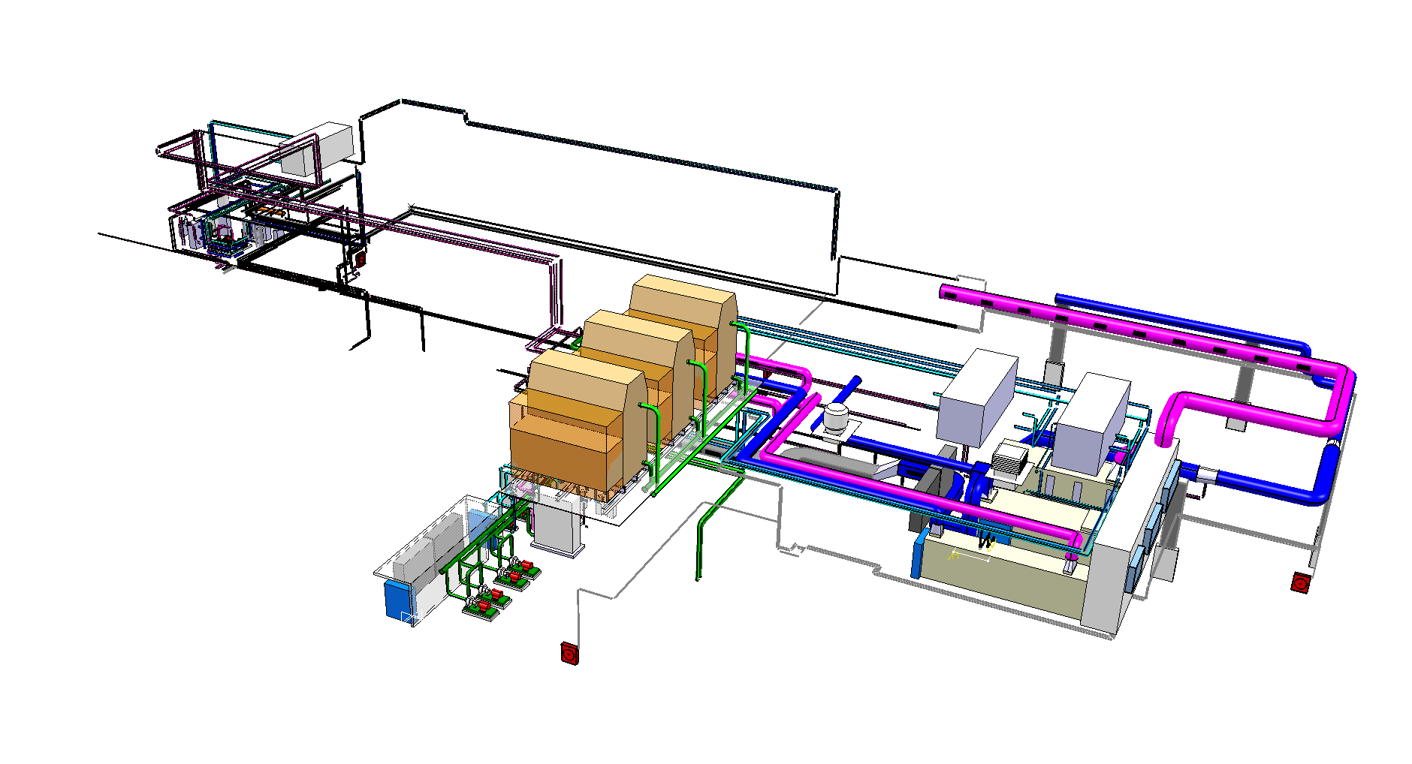
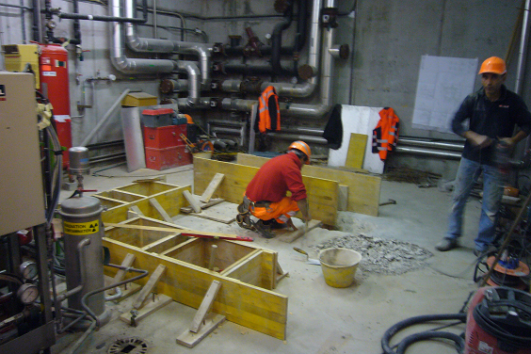
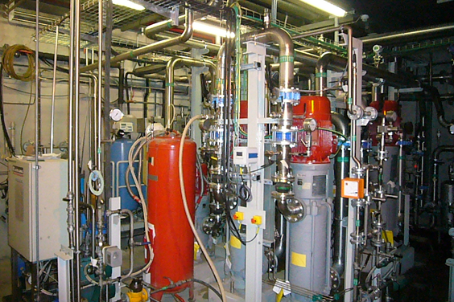
Hall 170 Cooling system
Experimental hall 170
B. 198 compressor building
B. 199 cold box building
S. Maridor
ISOLDE water station:
Tests and commissioning for 27C demi water finishing – water cooling system operational 10 April. In time for ISOLDE Low Energy start-up.
Operational date has been relaxed slightly (14 March to 10 April) in agreement with ISOLDE Technical and Physics coordination – start up Low E not hampered.

Slide 10
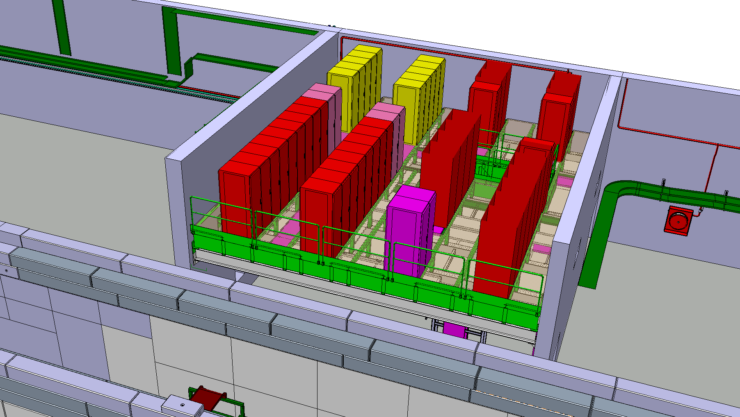
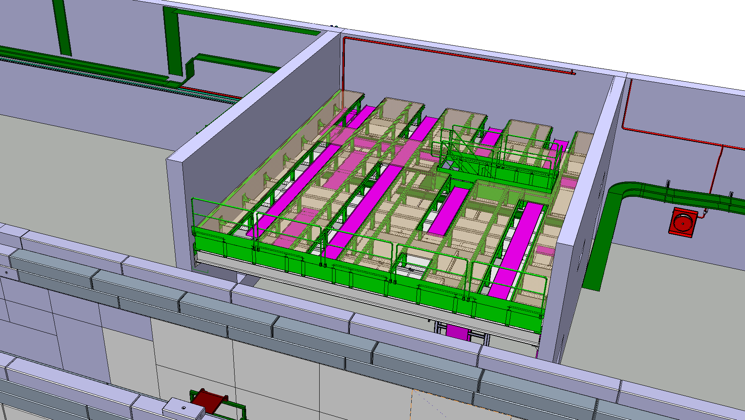
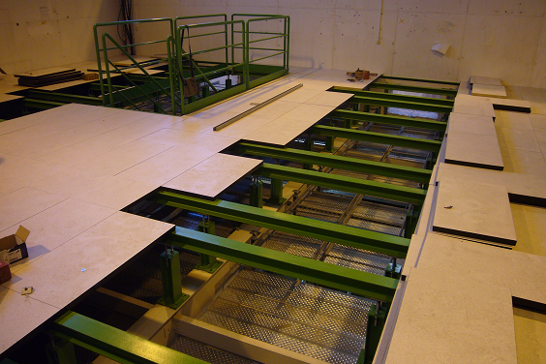
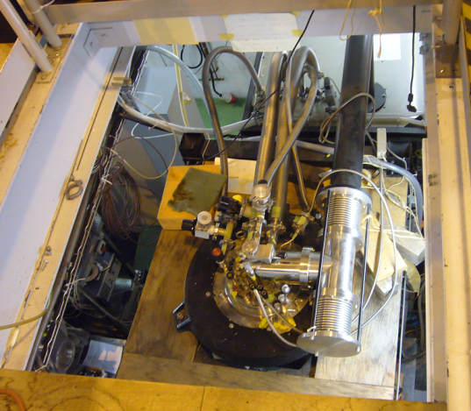
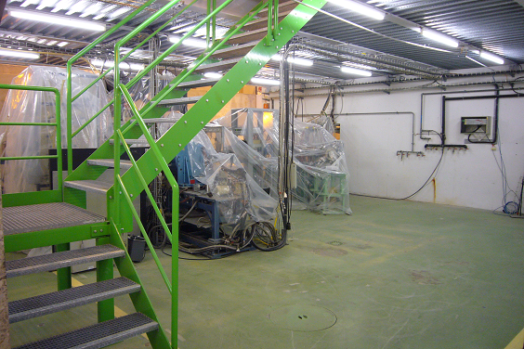
Metal structures Hall 170
Access to Nicole
S. Maridor
Rack platform:
Modification of the future rack platform done. Cable trays installation finishing – cabling will follow
Equipment (EPC, BI, WIC) to arrive as of September

Slide 11
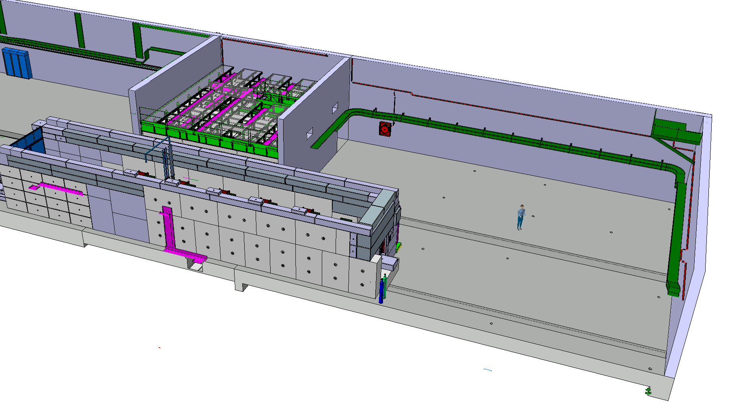
Metal structures Hall 170
ISOLDE hall 170: Metal structures
HEBT carrying structure for cable trays and infrastructure being installed

Slide 12
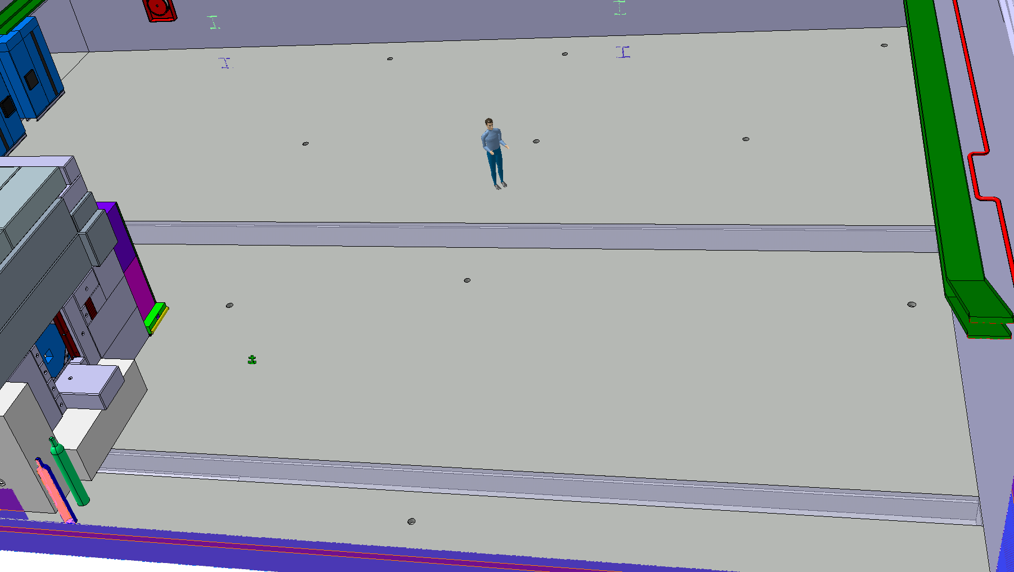
Metal structures Hall 170
S. Maridor
ISOLDE hall 170: Metal structures
HEBT carrying structure for cable trays and infrastructure being installed

Slide 13
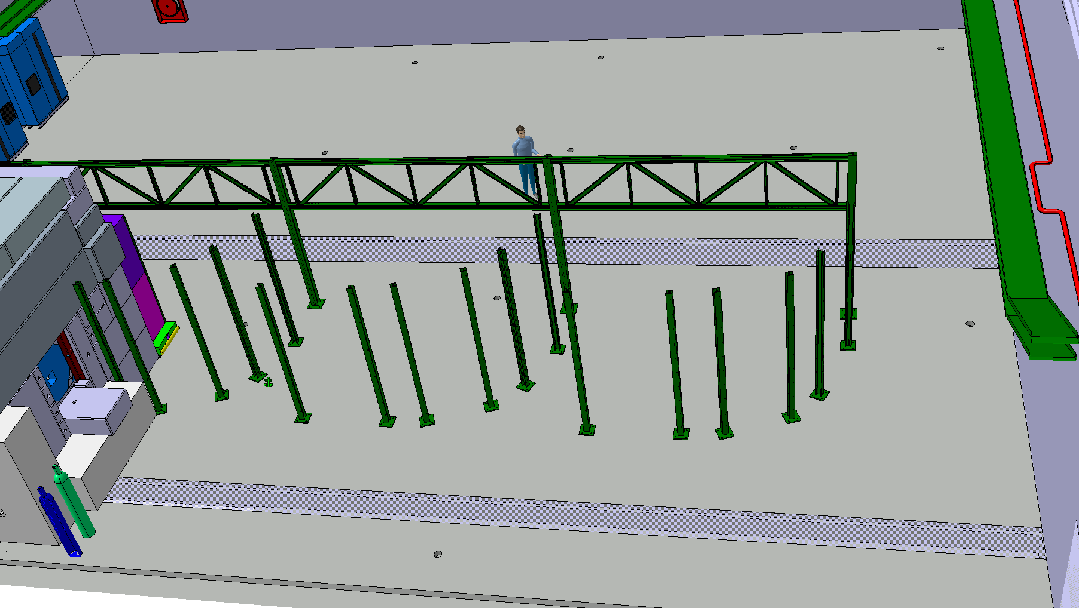
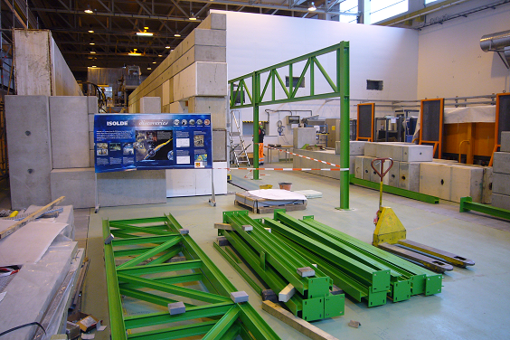
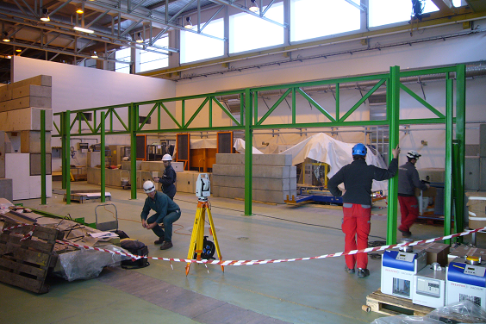
Metal structures Hall 170
S. Maridor
ISOLDE hall 170: Metal structures
HEBT carrying structure for cable trays and infrastructure being installed

Slide 14
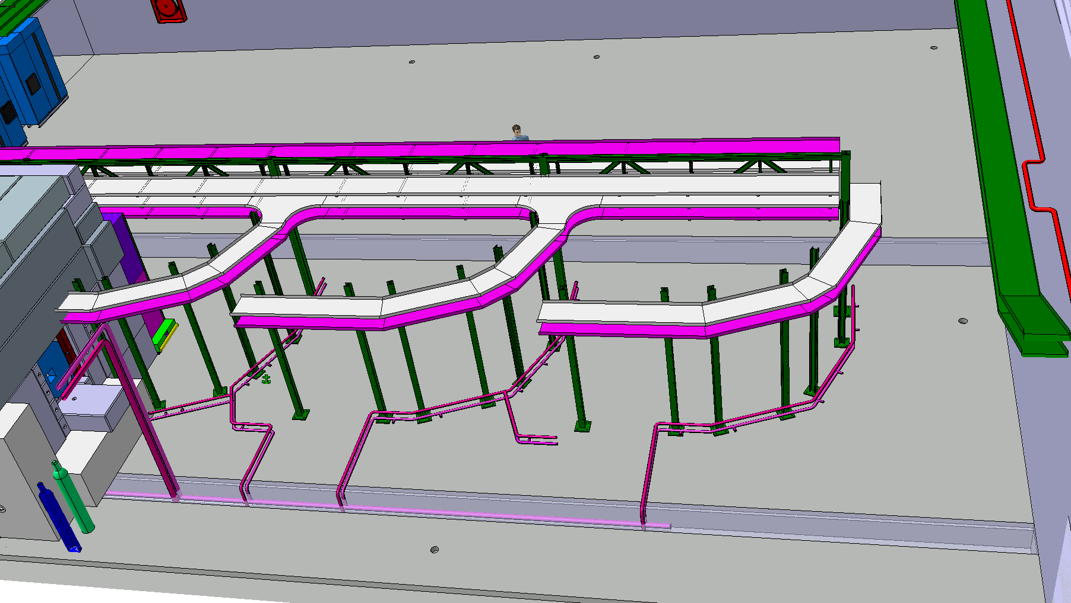
HEBT infrastructure structures Hall 170
S. Maridor
HEBT cable trays and cabling installation as of April
water cooling and vacuum infrastructure as of May

Slide 15
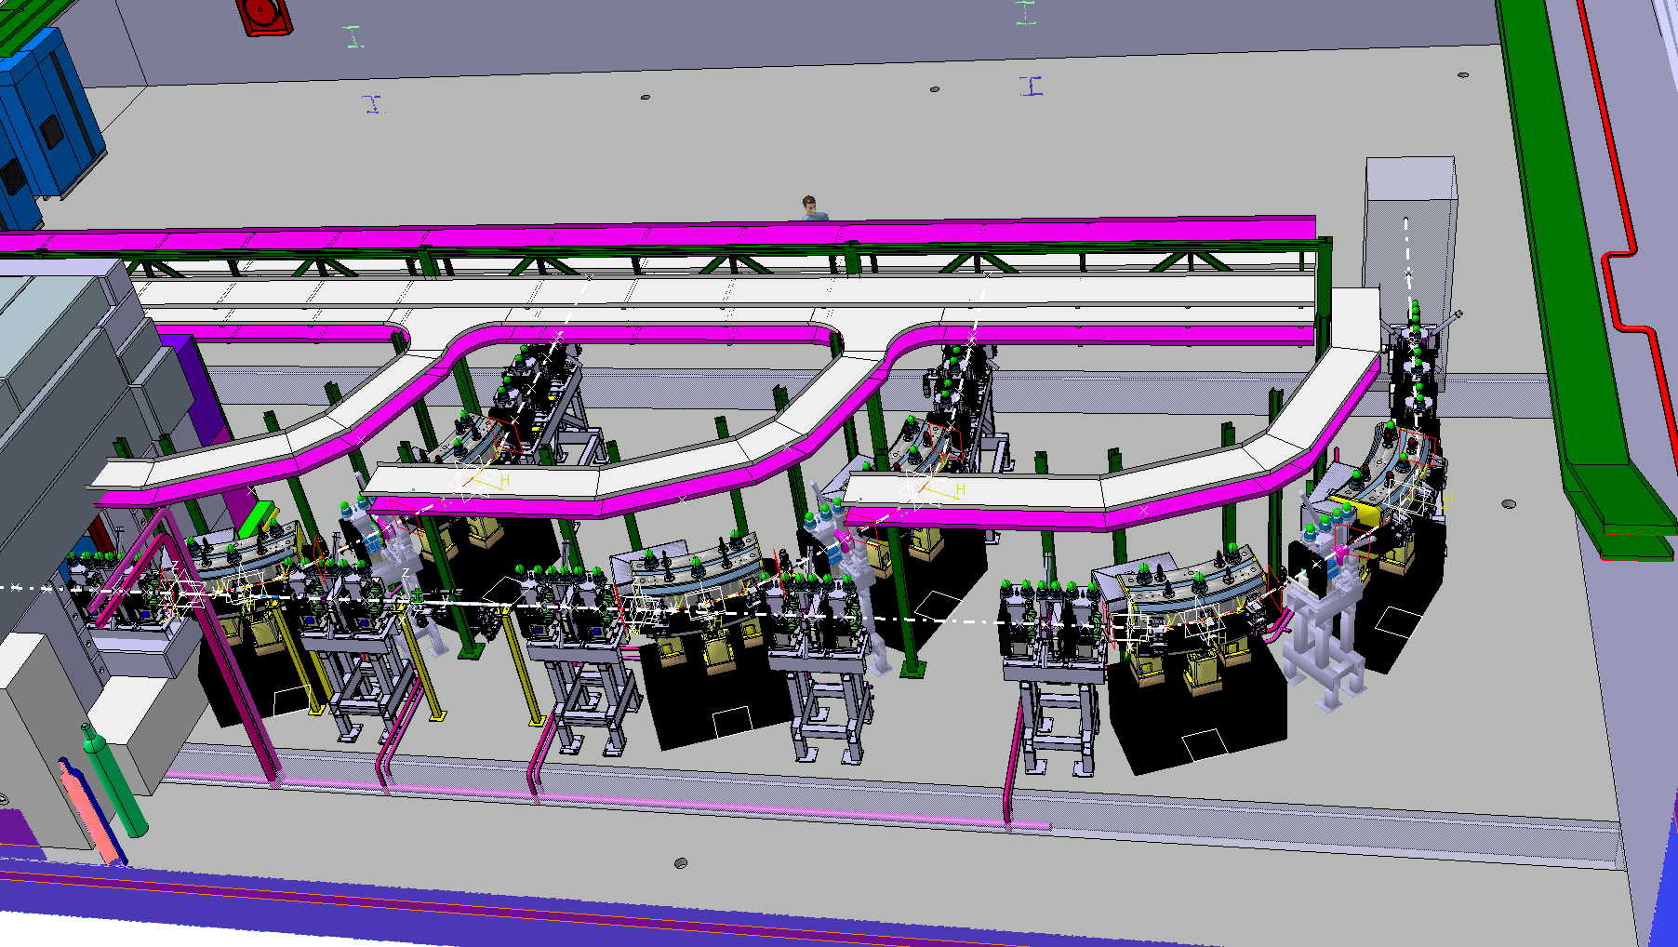
HEBT infrastructure
XT01
XT02
XT03
XT03:
No elements but full infrastructure will be in place
S. Maridor
HEBT supports installed as of April
HEBT elements will arrive as of September: Prioritized installation:
XT00/01 to be ready by mid-Feb 2015, XT02 by mid- April 2015

Slide 16
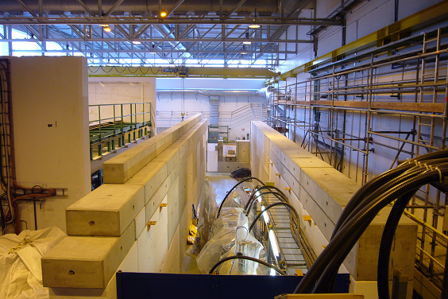
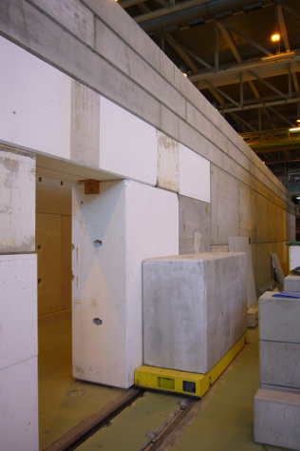
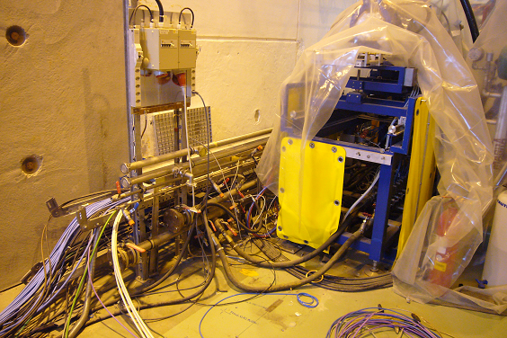
Shielding tunnel Hall 170
Civil engineering:
Shielding tunnel walls and door in place. Preparing for infrastructure inside the tunnel.

Slide 17
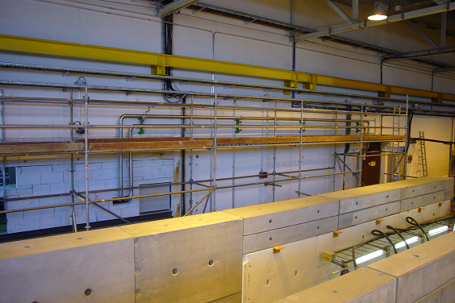
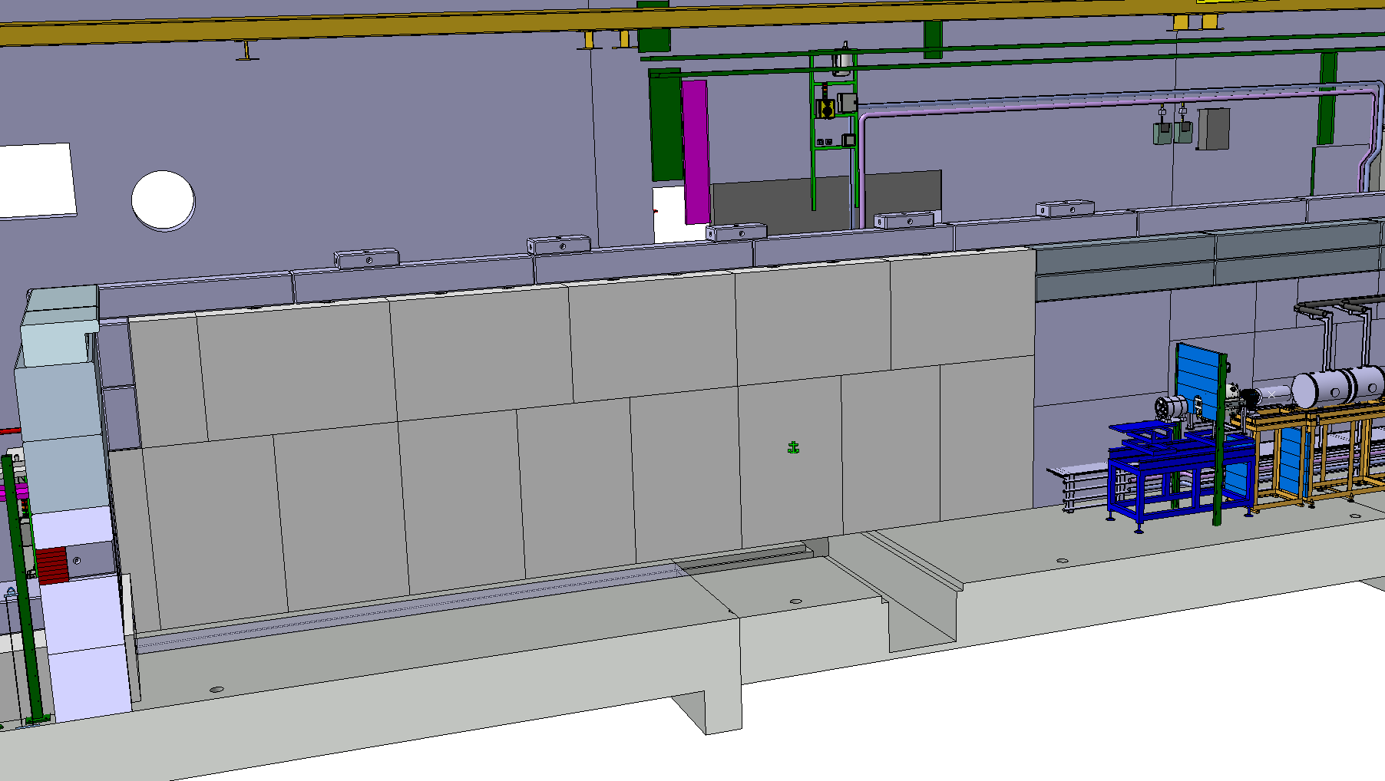
Metal structures HIE tunnel
S. Maridor
Preparations tunnel infrastructure ongoing

Slide 18
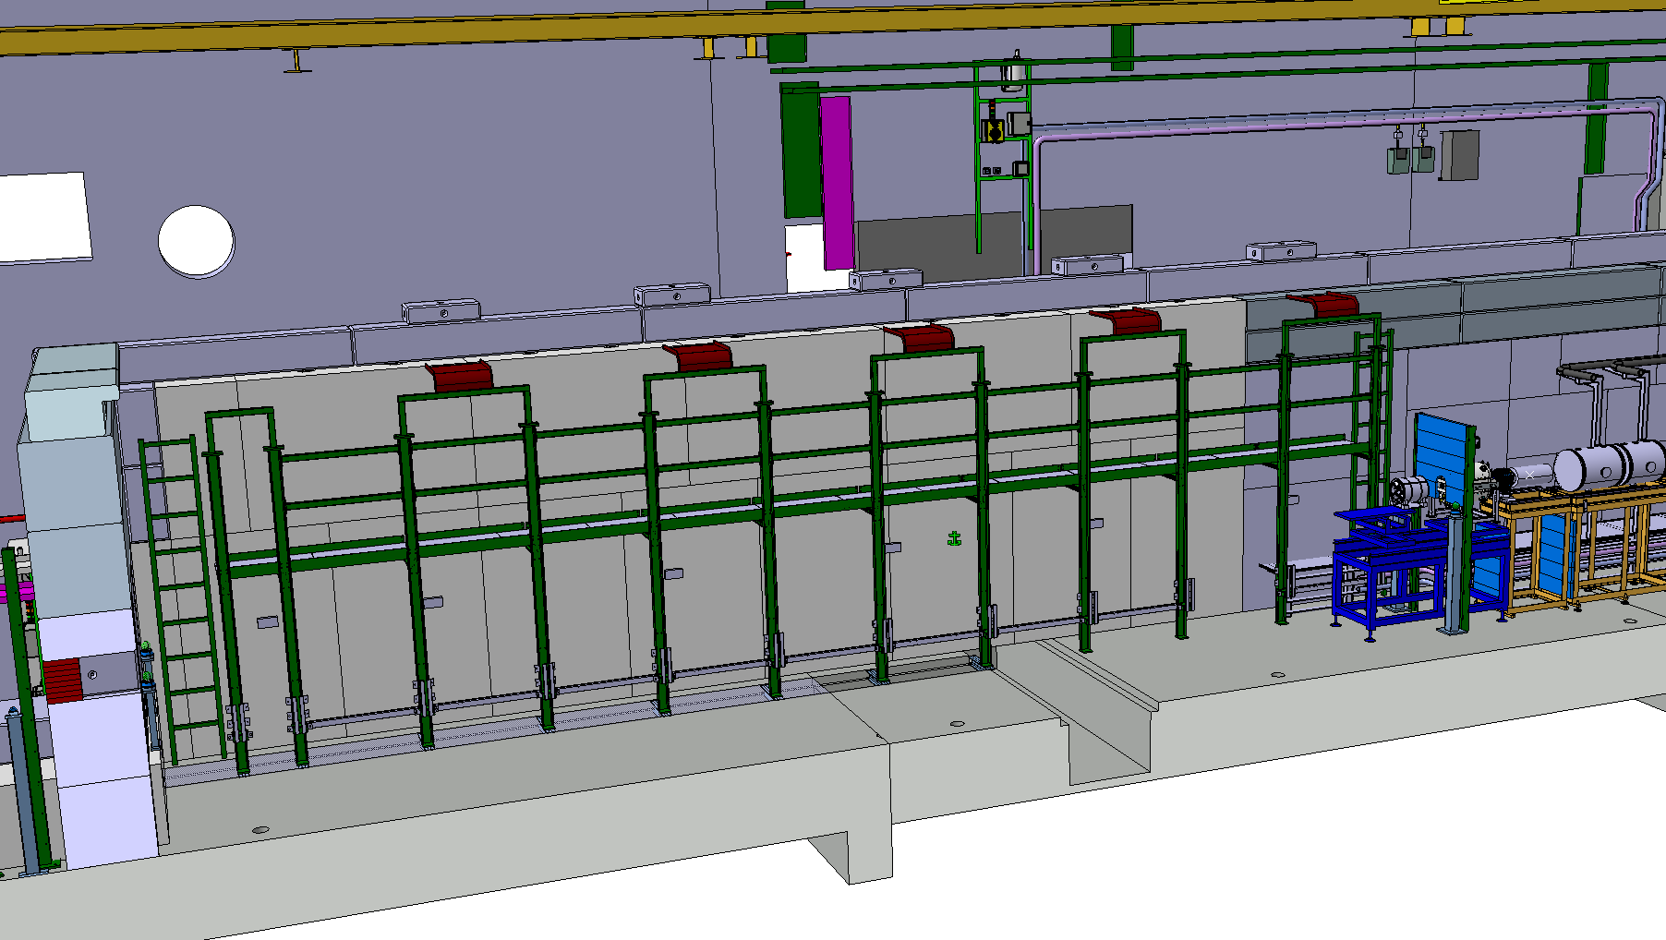
Metal structures HIE tunnel
S. Maridor
Inside metal structure – starts as of end April

Slide 19
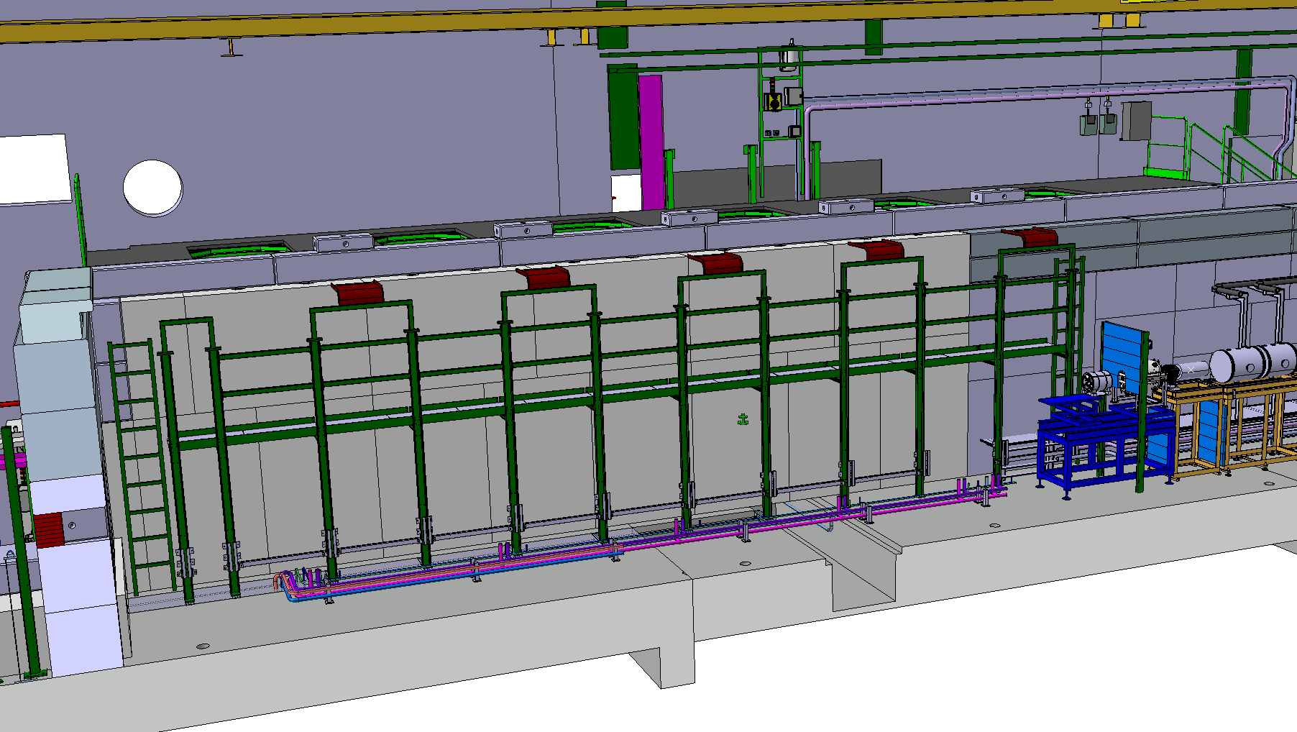
Infrastructure HIE tunnel
S. Maridor
Jumper boxes platform installation as of beginning May (3 wks)
Vacuum and water infrastructure – May/June

Slide 20
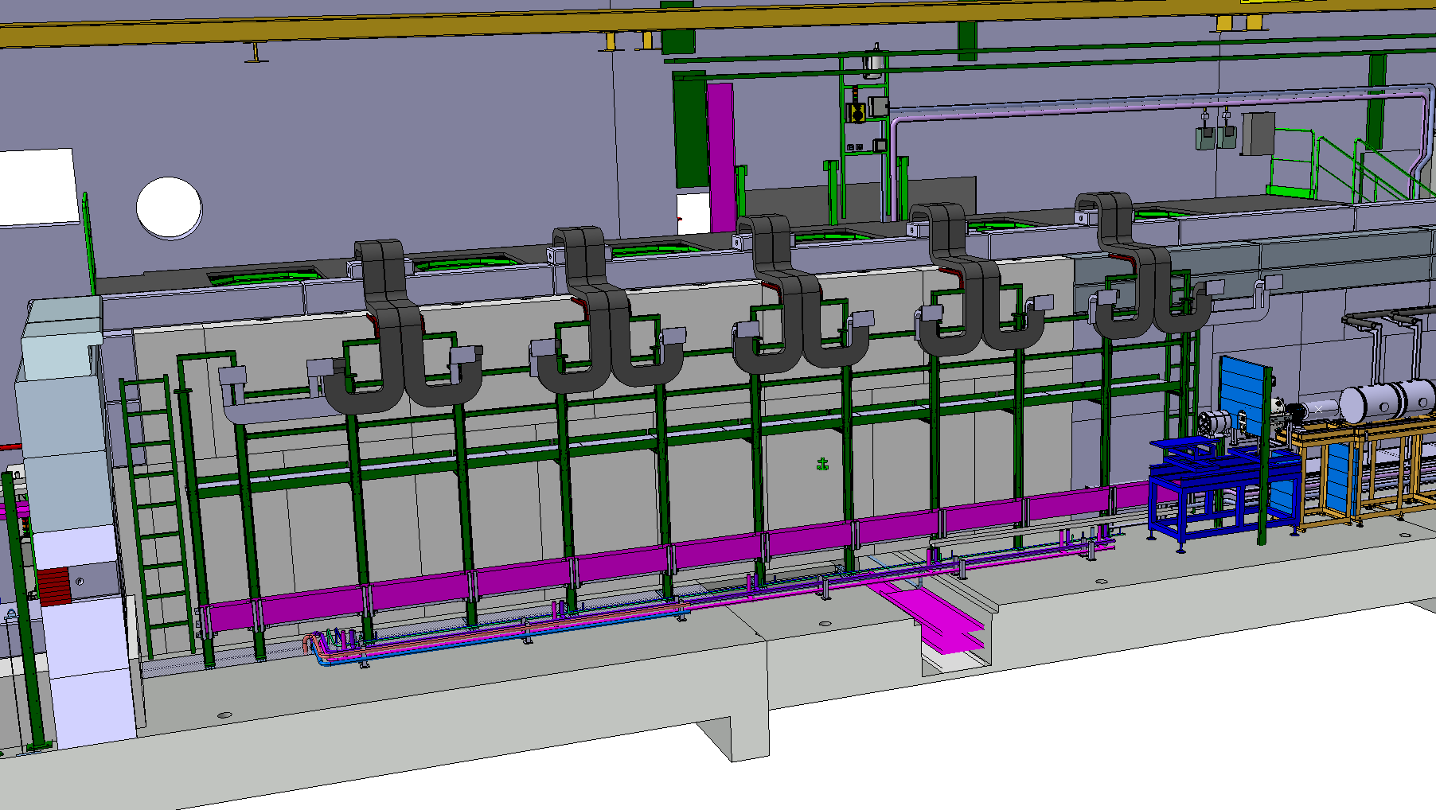
Infrastructure HIE tunnel
S. Maridor
Cable trays and cabling – May/July

Slide 21
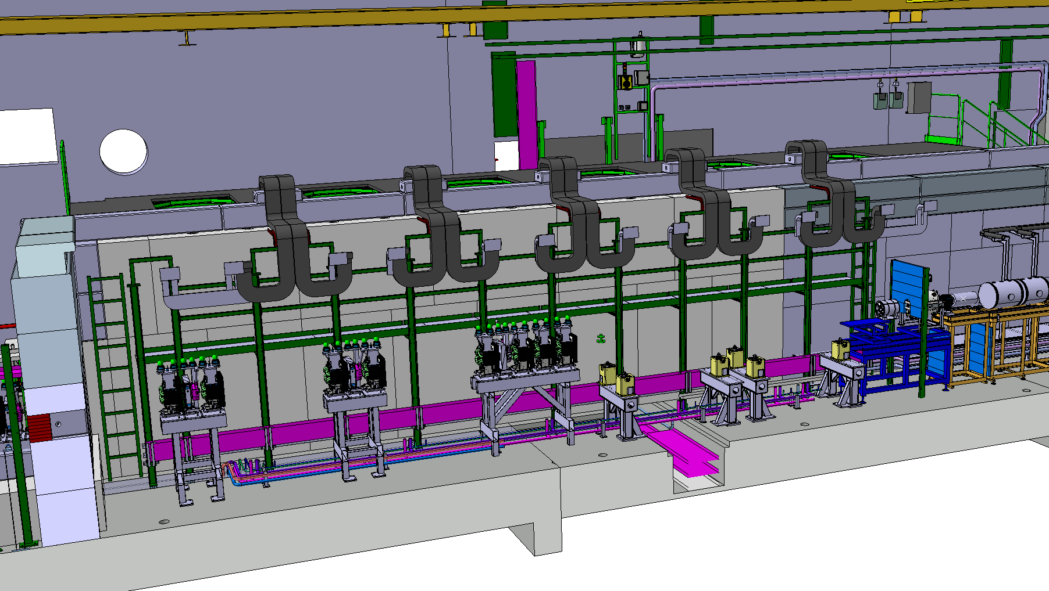
Infrastructure HIE tunnel
S. Maridor
Linac/HEBT supports in tunnel in place – by August
Linac/HEBT Elements arriving as of September

Slide 22
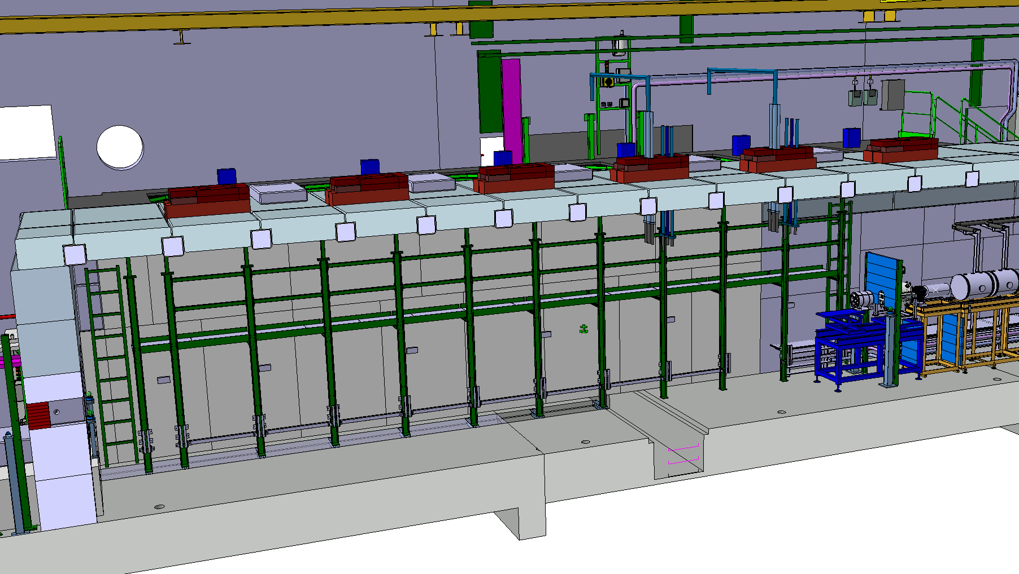
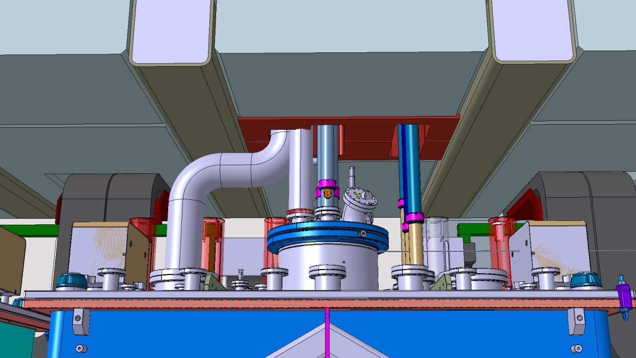
Roof HIE tunnel
S. Maridor
Tunnel concrete roof parts have been on hold awaiting a solution for the cryo modules He release from the top:
Roof now validated & ordered, arrival May (fitting tests)

Slide 23
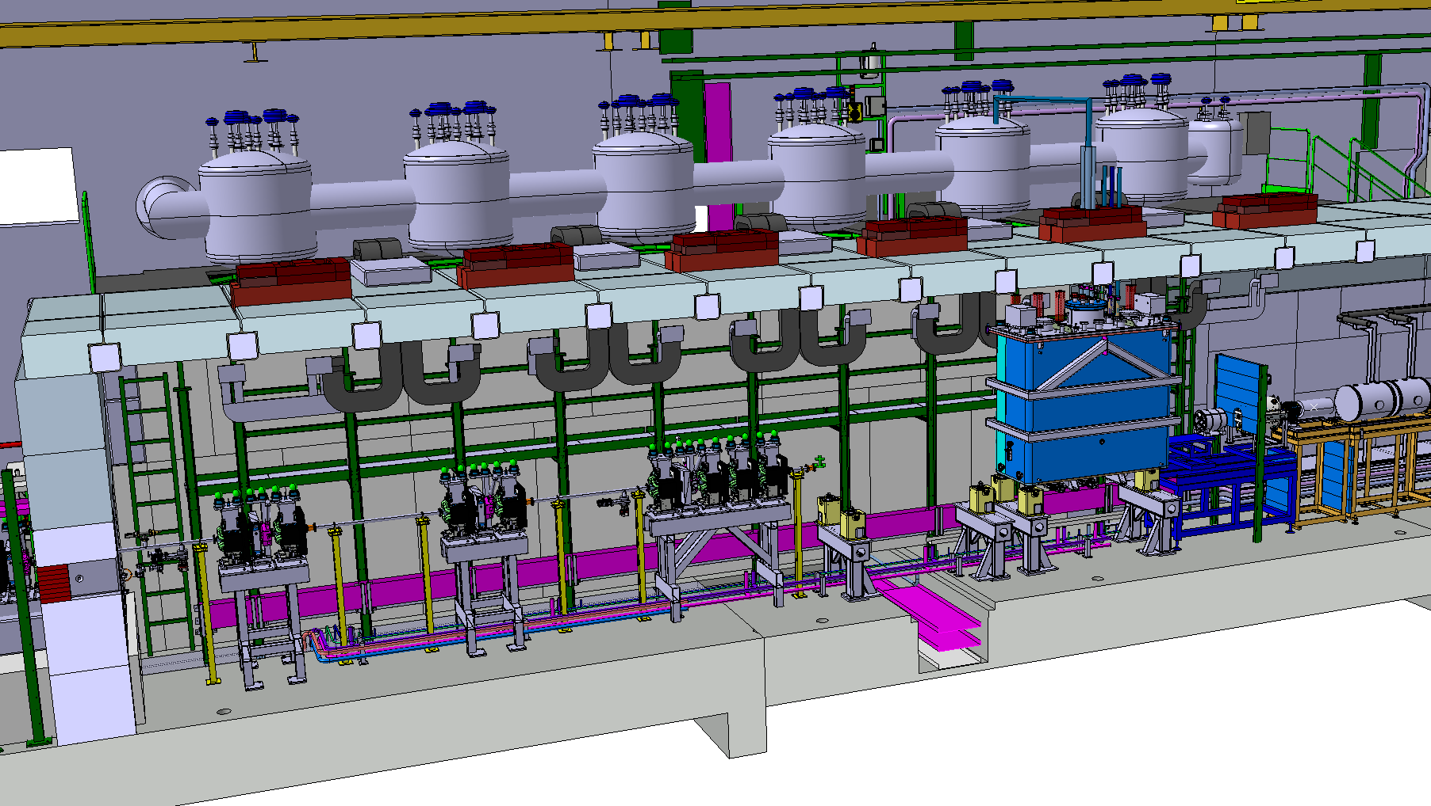
HIE LINAC elements
40mm beampipe
S. Maridor
Cryo Cold Line & Jumper Boxes installation: Sept 2014 – Jan 2015
Cryo Module 1 installation: April – June 2015
Scenario: Physics at ~4MeV/u with 1 CM as of October 2015

Slide 24
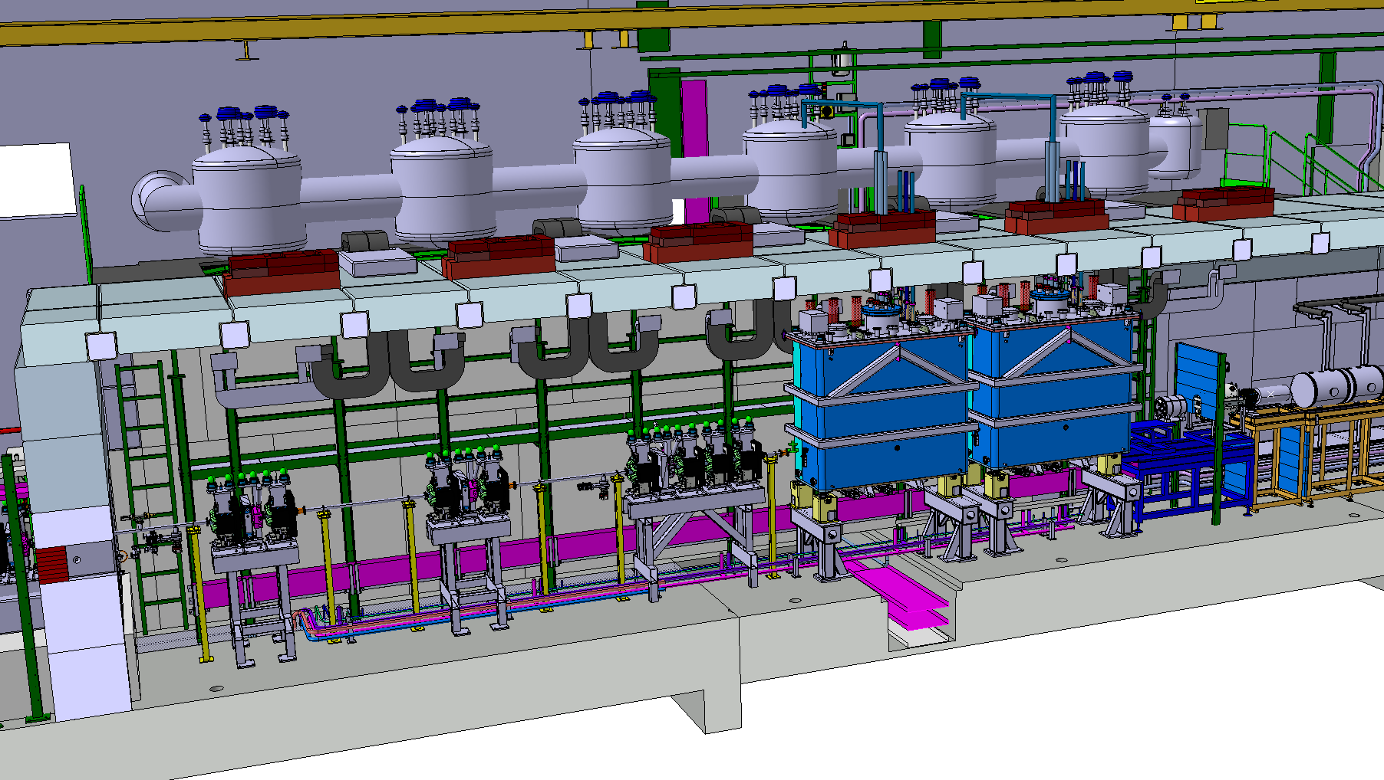
HIE LINAC elements
S. Maridor
Cryo Module 2 installation: Shutdown 2015/16: Jan – March 2015 Scenario: 2nd commissioning at 5.5Mev/u with 2 CM‘s as of May 2015

Slide 25
HIE Simplified Installation Planning
Start Isolde shutdown
17 dec 2012
End LS1:Start Low E physics
July 2014
HIE physics at 5.5MeV/u
October 2015
We are here
March 2014
2011
2012
2013
2014
2015
2016
Q1
Q2
Q3
Q4
Q1
Q2
Q3
Q4
Q1
Q2
Q3
Q4
Q1
Q2
Q3
Q4
Q1
Q2
Q3
Q4
Q1
Q2
Q3
Q4
Civil
HEBT
Cryo
Civil hall & tunnel
Main services
~4MeV/u
Cabling
5.5MeV/u
Ventilation
RF
Demi water
Electrical syst.s
CM 1&2
Timeline:
CM 1
CM 2
sd
sd
Long Shutdown
sd
sd
17 Dec 2012 - Q3 2014
Beam commissioning
7 weeks
shutdown
Isolde Ops
HIE installations and tests (Isolde normal operations)
Machine Check-Out
(Isolde normal operations)
Beam Commissioning
(Isolde normal operations)

Slide 26
Identified delays
Activities | Identified delay |  | building | Finishing date | Comment
Cooling & ventilation: Installation units and piping | 4 months | Introduced by the contractor | 198, 199, 170 | May 2014 | Water station ISOLDE 14 March ready for Isolde Low Energy startup
Electrical systems: service buildings | 2 months | Due to CV contractor delay | 198,199 | June 2014 | No impact
Integration tunnel infrastructure | - | Open actions on metal structure, vacuum and water piping routing, He shielding, CM supports | 170 | Aug 2014 | No impact
Tunnel roof | 1 month | On hold for CM top He release integration | 170 | May 2014 | No impact
Metal Structures: rack platform | 2 months | Due to LS1 load | 170 | March 2014 | No impact
Metal Structures: jumper boxes platform | 4 months | Design needs finishing: Data missing from Cryo due to late Cryo Line procurement | 170 | May 2014 | No impact
Civil Engineering: trench & tunnel | 2 months | Unforeseen difficulties with trench cutting | 170 | Aug 2013 | No impact
Cabling: trays and cables | 4 months | Due to late modif rack platform + delay service buildings CV installations + late cable info diff groups | 199, 170 | Nov 2014 | No impact
Cryogenics: Performance tests | 1 month | Limited resources due to LHC LS1: Compressor & Cold Box installation taking 3 months longer | 198, 199, 170 | April 2015 | margin 1.5 months
10 April
Solved
Solved

Slide 27
Conclusions
  Status Report HIE Installation March 2014:
  Progress since the last ISCC meeting in October
  Installation has continued according to plan and there is a steady progress in the construction of HIE ISOLDE
  What to expect for this year
  High activity in the hall and service buildings will continue
  Challenge: Having ISOLDE low energy physics in parallel
  Have there been or are there any delays
  Yes. Indicated and installation planning has been adapted
  Are we on track with regard to the planning
  Yes, on track and the start of the ISOLDE low energy physics foreseen for 2014 will not be hampered by the HIE ISOLDE installation works

Slide 28
HIE ISOLDE Integration
GS/SE : DANIEL PARCHET, ELISEO PERES-DUENAZ
EN/MEF : STEPHANE MARIDOR, ELEFTHERIOS ZOGRAFOS
BE/ABP : FREDERIK WENANDER
BE/OP : DIDIER VOULOT
PH/SME : MARIA BORGE, MAGDA KOWALSKA
EN/HDO : YACINE KADI
BE/RF : DANIEL VALUCH, WALTER VENTURINI,
LUCA ARNAUDON
EN/CV : PAUL PEPINSTER, FREDRIC BORRALHO
EN/EL : RENE NECCA, JEAN-CLAUDE GUILLAUME, GEORGI GEORGIEV, JEAN-PIERRE BILLON-GRAND EN/EL
TE/CRG : NICOLAS DELRUELLE, JOS METSELAAR
EN/STI : RICHARD CATHERALL, ANA-PAULA BERNARDES
GS/DI : CYRILLE BEDEL, YANNICK BERAUD (EN/MEF)
TE/MSC : YANN LECLERCQ, LLOYD WILLIAMS
DSG/RP : JOACHIM VOLLAIRE, SANDRA GIRON, ALEXANDRE DORSIVAL
TE/ABT : BRENNAN GODDARD, MATTHEW FRASER
TE/HDO : FABIO FORMENTI, VOLKER MERTENS

