Slide 1
TISD activities during LS1
Update from last report
22 Oct 2013
T. Stora

Slide 2
Reminder
8B
9C
37K
LIEBE (LBE loop)
ActILab ENSAR (nanoUCx)
Ba beams
Neutron converter
(RILIS in VADIS) molecular beams

Slide 3
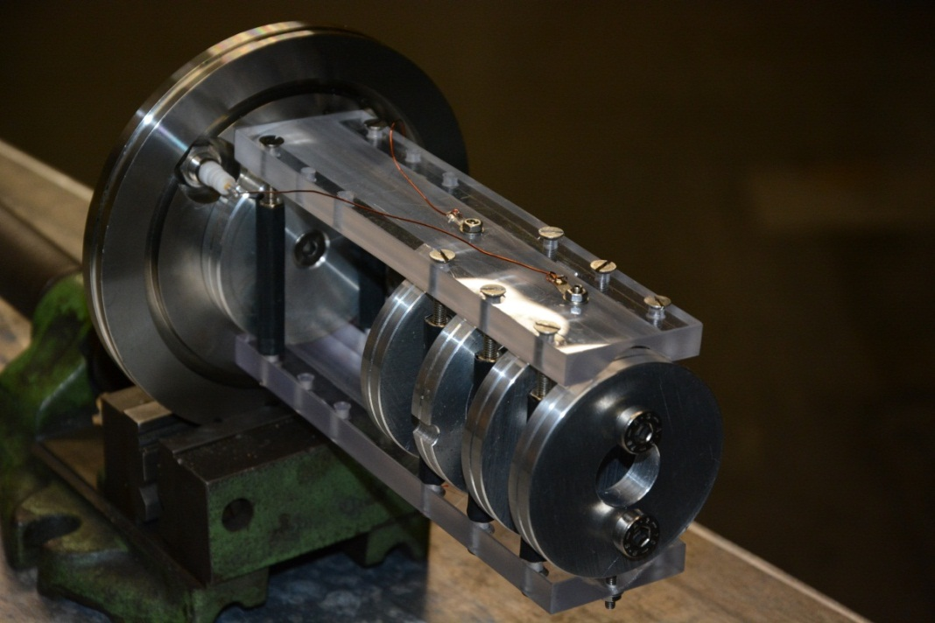

ISOLDE
  Diffusion studies of boron in possible target materials
  Implantation of ¹⁰B as ¹⁰BF₂ into pressed pills of Al₂O₃, CNT, MgF_{2[1]};
  HV=70kV-80kV
SARAF
  Characterisation of neutron beam
  Implantation of ¹⁰B as ¹⁰BF₂ into Al (200ug/cm2) foil, r_{coll}=1.5mm,
  HV=32kV
  n_{BF2}⁺=4*10^16
+
B
+
F
F
B
F
F
[1] J. Vacik et al, On Boron diffusion in MgF2, CP1099, Application of Accelerators in Research and Industry: 20th international Conferene

Slide 4
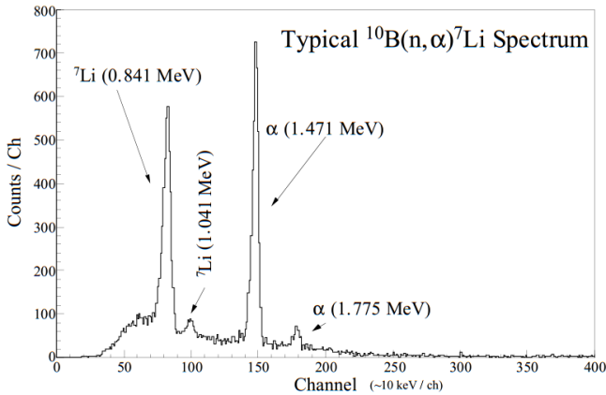
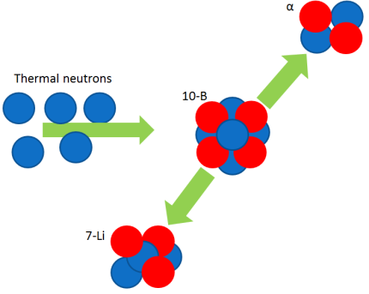
Principle
  Irradiation of sample with thermal neutrons:
  For diffusion measurements: Pu-Be Source 1.1*10⁸ n/s @4π, (before moderation )
  Neutron capture cross section of ¹⁰B: σ_{th}=3840 barn
  Detection of produced ⁷Li and α from ¹⁰B(n,α)⁷Li
  ¹⁰B+n
6%: 7Li (1.015MeV + α (1.777MeV)
94%: 7Li (0.840MeV + α (1.470MeV) +γ(0.478MeV)
α detector
4

Slide 5
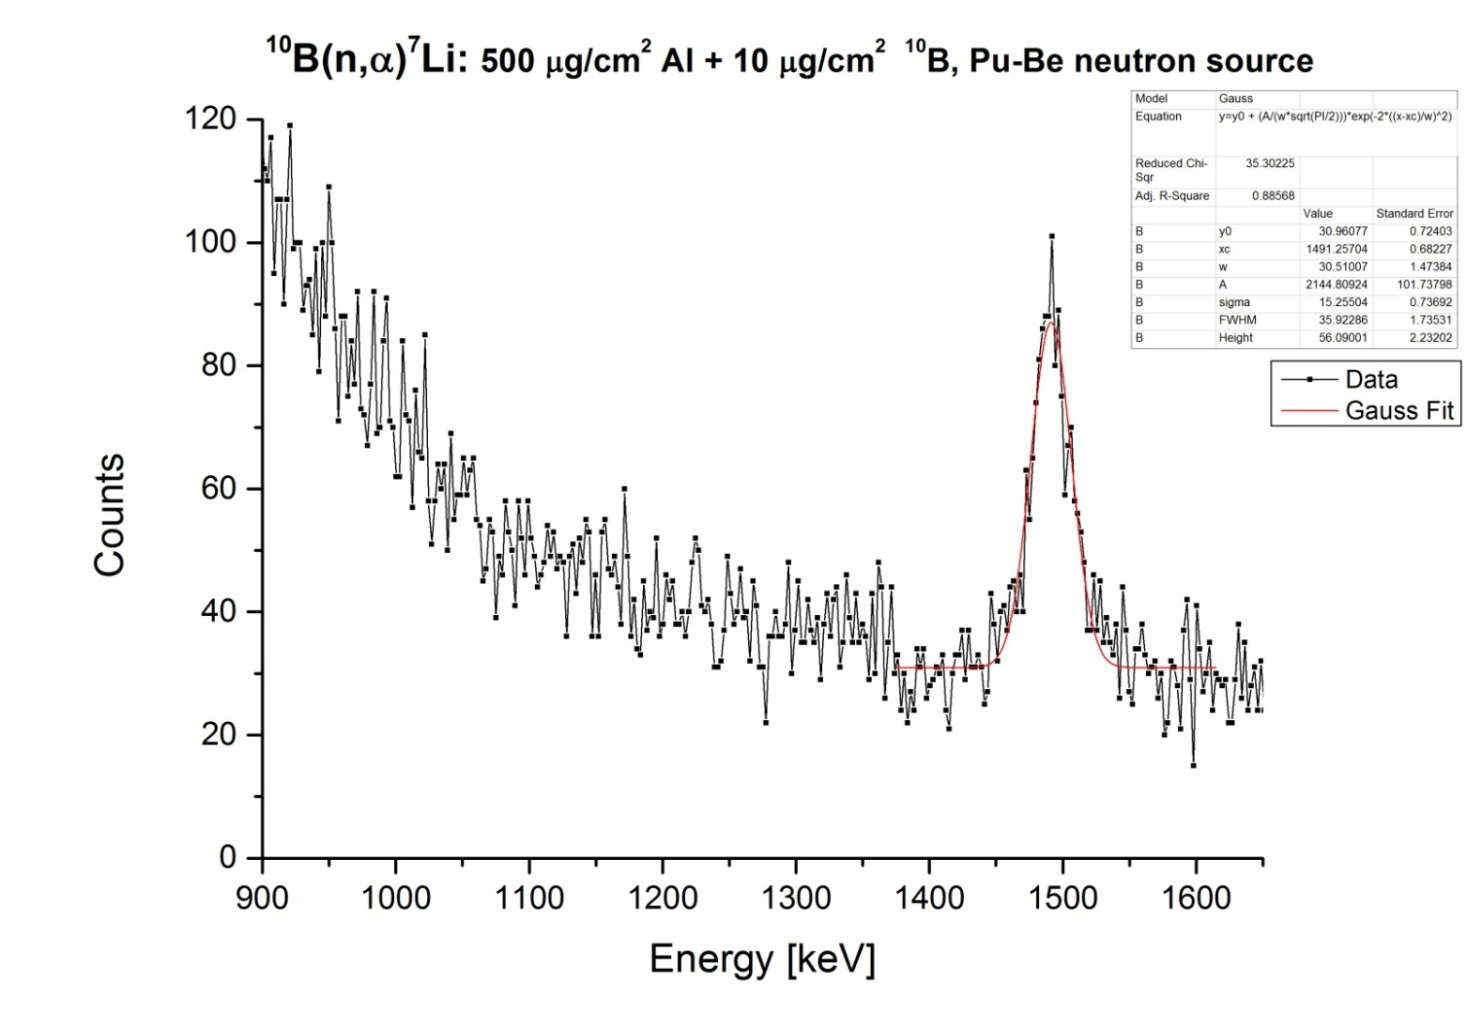
Measurement with calibration sample, done with Pu-Be source

Slide 6
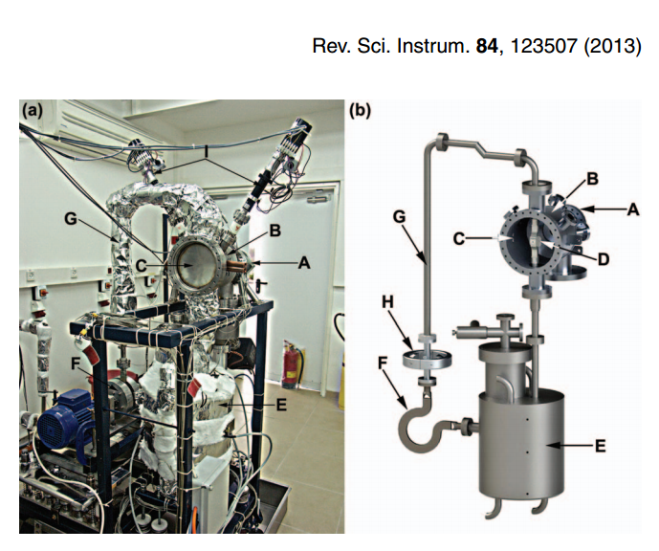
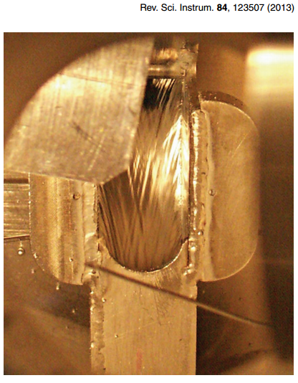
http://www.soreq.gov.il/default_EN.asp
SARAF@Soreq
  Located near Yavne, Israel
  Proton beam (E=1.91MeV) from Soreq Applied Research Accelerator Facility (SARAF) hits liquid lithium target (LiLiT) ,T∼200◦C
  Production of 10-100keV neutrons: ⁷Li(p,n)⁷Be
  Irradiation of ¹⁰B sample with fast neutrons
  Coincidence detection of produced ⁷Li and α from ¹⁰B(n,α)⁷Li

Slide 7
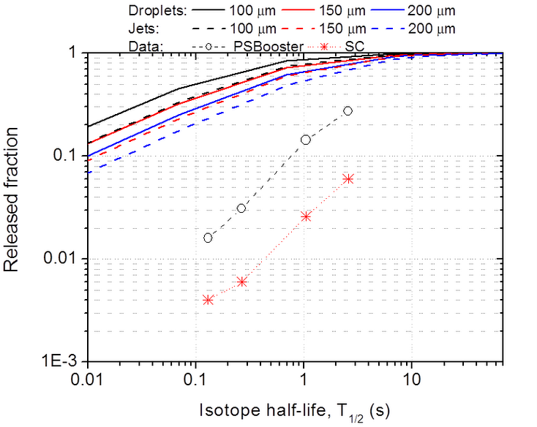
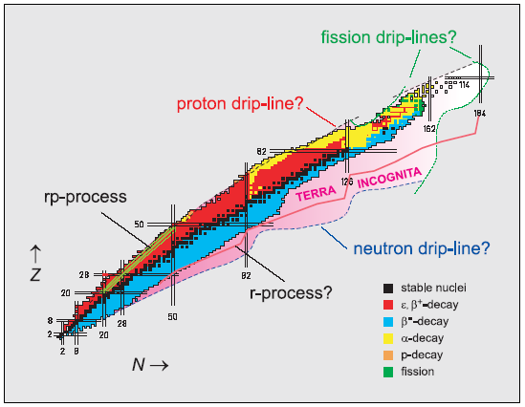
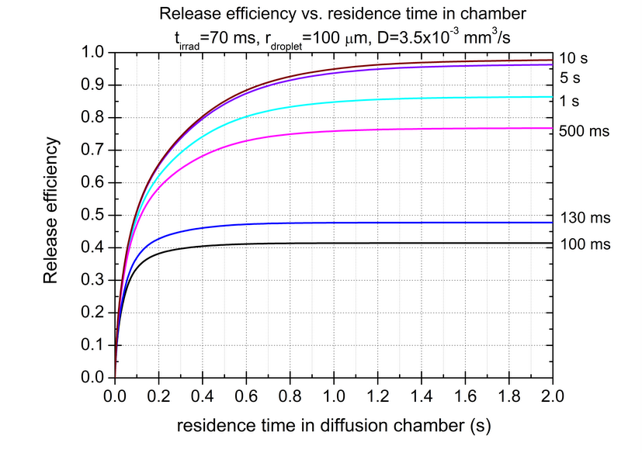
LIEBE: Liquid Lead Bismuth Eutectic Loop target for Eurisol
Validation of the conceptual design of EURISOL direct target by prototyping at Cern-ISOLDE
Motivation: Improvement of yields of short-lived Hg isotopes
Diffusion: model from Fujioka et al. (NIM 186 (1981) 409)
Data: Lettry et al. (NIM B 126 (1997) 170)
Total time till the post acceleration: < 300 ms.
Diffusion of isotope when the LBE is on droplets shape which require the use of a grid, a diffusion chamber and a pump to recirculate the liquid.

Slide 8
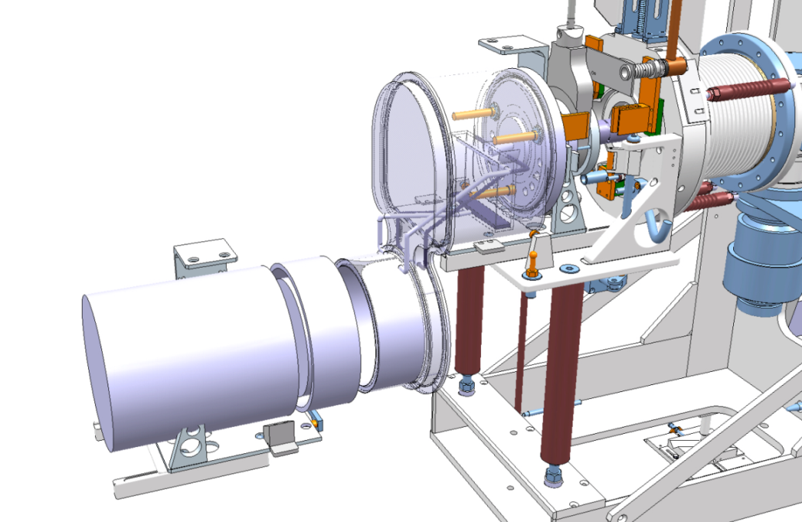
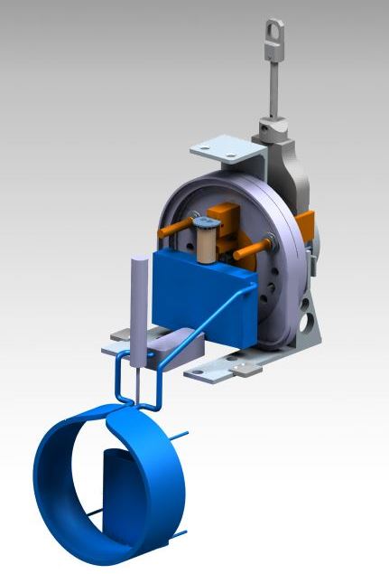
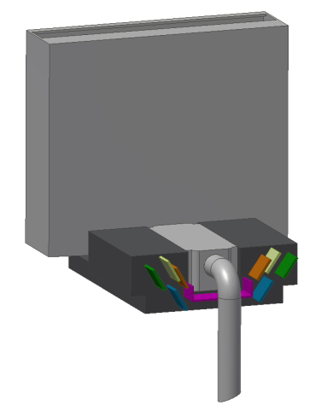
Proposed layout:
Development: integration of a liquid loop target, working at high temperature (from 200 deg C up to 600 deg C) in the Cern-Isolde environment.
Part 1: main part of the target in his confinement
Isolde Front end
Part 2: pump and engine to recirculate the liquid
Main part without confinement
Main challenges:
  High power deposited on target to be evacuated (HEX to dimension at various T)
  Recirculation of liquid through a compatible LBE pump
  High temperature of use (up to 600 deg C)
  Integration in already existing (relatively small) environment
  Monitoring and control
Ion Source
Beam
Heat Exchanger
Main LBE loop
Proposed design
Feeder tank

Slide 9
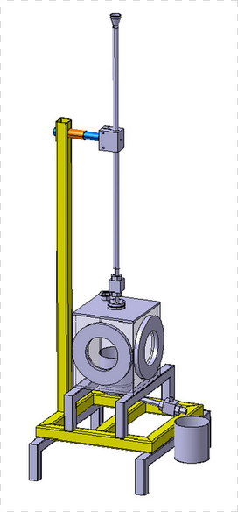
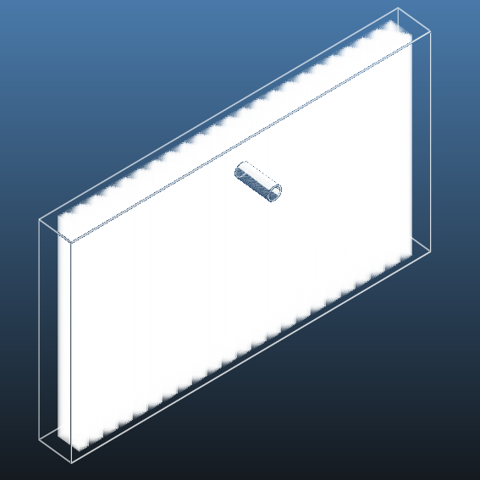
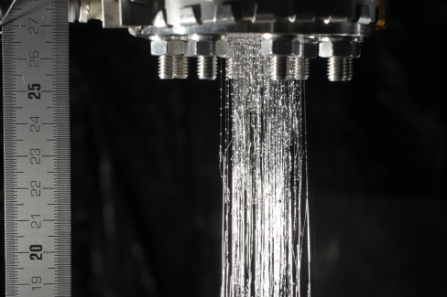
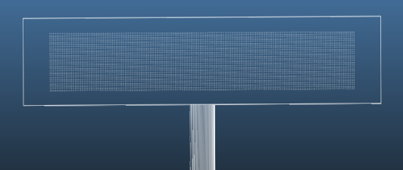
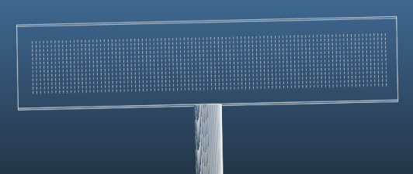
Offline tests: Shower formation, pore size and spacing
Model: Shower inside diffusion chamber
Test stand to investigate shower formation in vacuum
Tests ongoing
LBE shower in air
@ISOLDE-Jan 2014
Grid: 200μm pore diameter, 300 μm spacing
Grid: 200μm pore diameter, 1 mm spacing

Slide 10
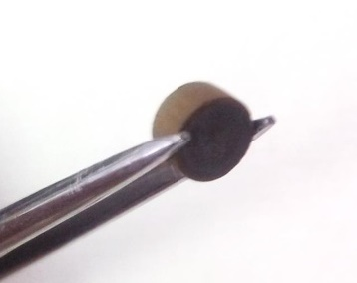
nanoTiC - motivation
Release studies
High Melting point – 3160 ºC
Sintering studies done, shows that TiC can maintain a submicron structure at least until 1500ºC
Operation temperature has to be at least 1500ºC (Ca, K, Sc beams)
nanoTiC after 5 min
Avoid oxidation of TiC
Improve nanostructure stability => Essencial for good release
TRIUMF shows release of Ca and K from TiC
Fractional activity rise at 1450ºC is attributed to a an oxide layer in the samples at higher sintering temperatures.
JPR| 1/3
Notes:
No release from TiO2 material | Little release was seen at 10 and 20 min probably due to the defect healing with heat the five min heat treatment | TiC sample after 5 minutes show release (graph made using these values and maximum error | Ca release | Oxidation at 1450C

Slide 11
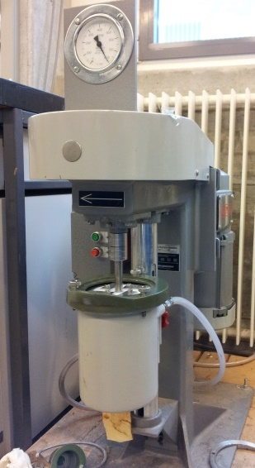
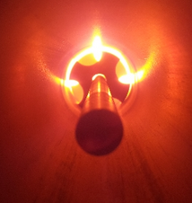
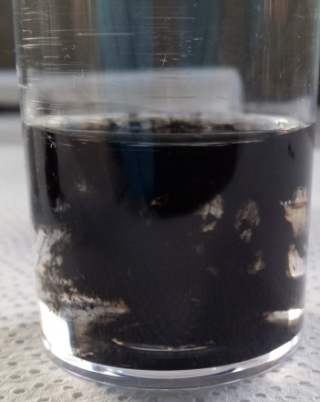
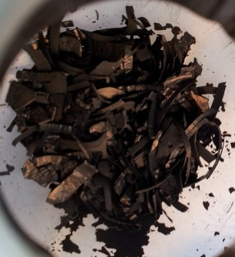
nanoTiC – ongoing studies
TiC
Graphite
Carbon Nanotubes
Carbon Black
How to hinder sintering of TiC?
Doping
Add (a higher melting point) second phase
Lower temperature and time
Study the effect of the different carbon polymorphs
Study the volume ratio of carbon
Powder Suspension
Isopropanol
Polymeric dispersant
Wet mixing
Attrition mill
Zirconia milling elements
Pellet Preparation
Sintering
Drying
Morphology
Density
Porosity
Specific sufrace area
Deagglomerate
Pressing
1500ºC for 2 and 10h
Vacuum
Characterization
JPR| 2/3

Slide 12
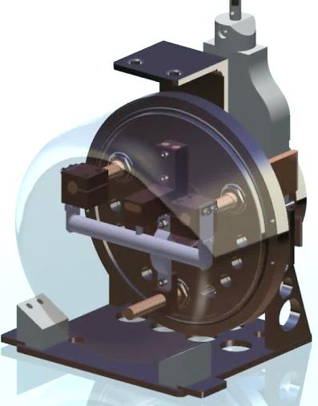
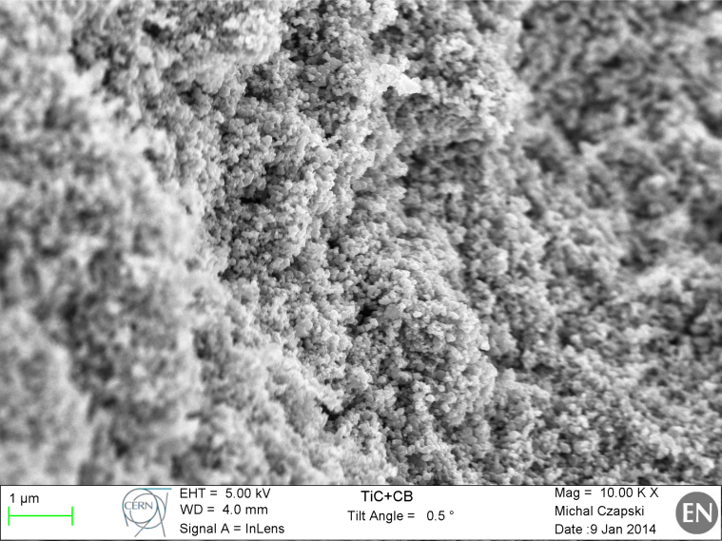
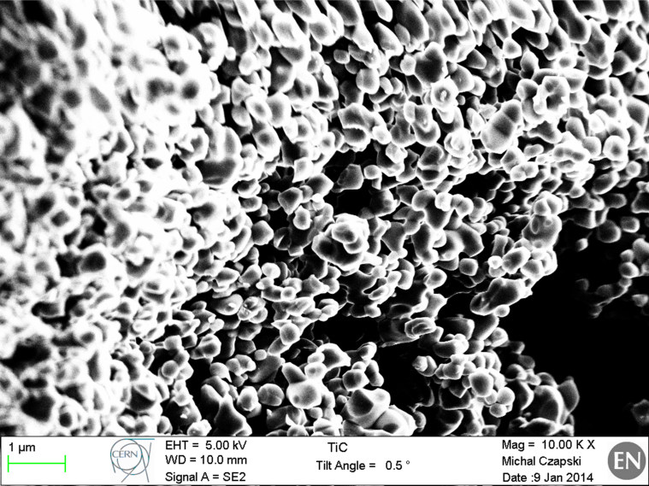
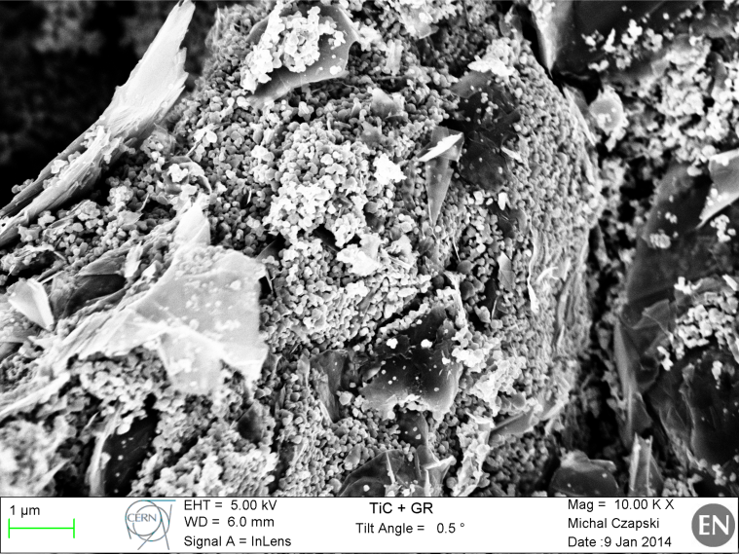
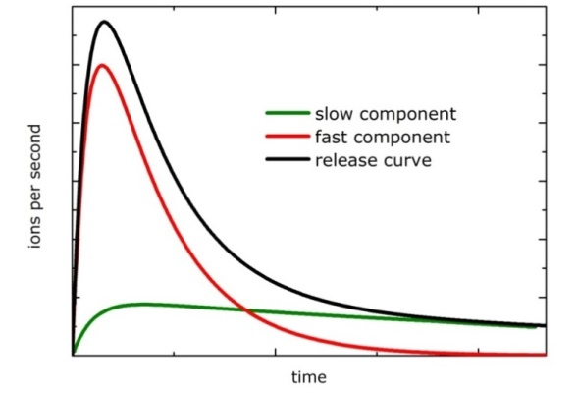
nanoTiC – results and future studies
TiC + Carbon Black
TiC
TiC + Graphite
Future work:
Release studies
Target prototype
Modeling
TiC + Carbon Nanotubes
JPR| 3/3

Slide 13





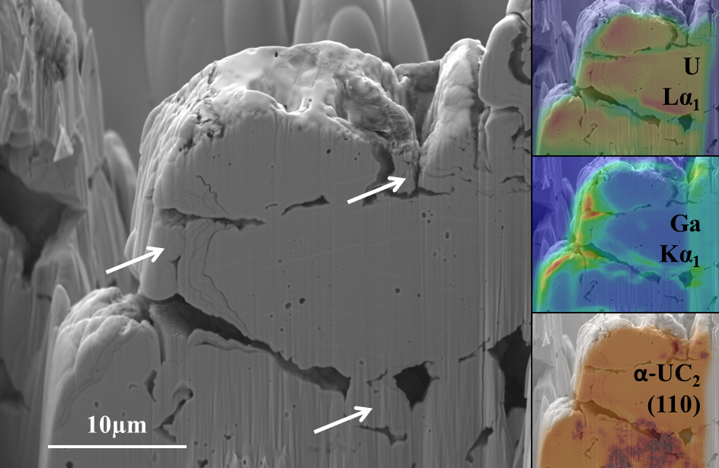
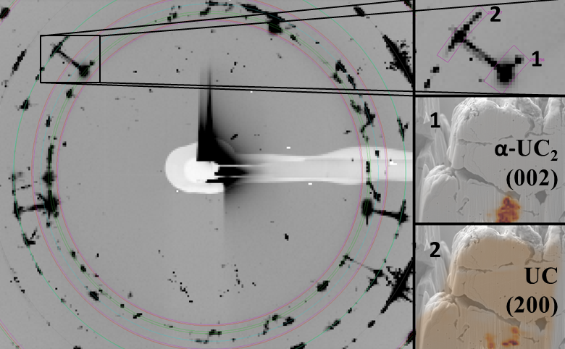
UC_{X} prototype target tests for ActILab-ENSAR
Characterization of conventional UC_{X} using synchrotron-based micro-beam analysis:
  Microscopic morphology – buried porosity & chemistry
  Kinetic stabilization by sub-microscopic UC – UC₂ phase competition
  Grain size of material is smaller than previously estimated; global phase transition observed at 2100◦C
  Phase competition between UC and α-UC₂ as yet missing explanation of performance and durability of this material
A. Gottberg, et al., submitted

Slide 14
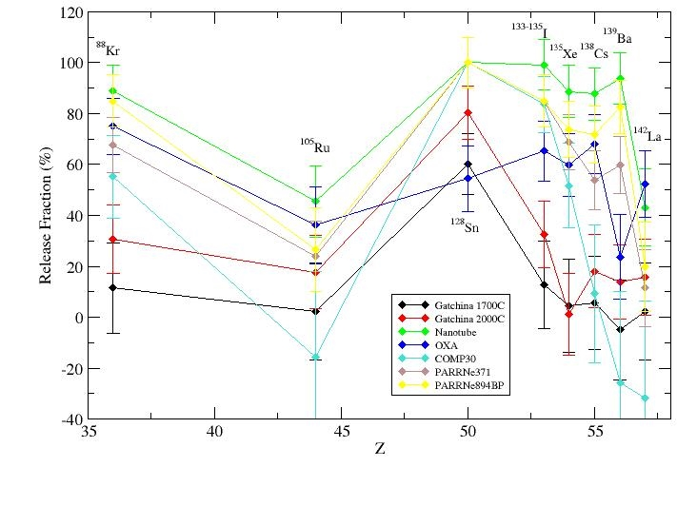
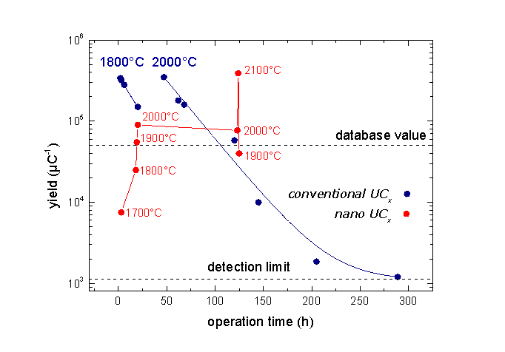
UC_{X} prototype target tests for ActILab-ENSAR
Online tests and synthesis of de-novo designed uranium carbide matrixes:
Different microstructures, densities, grain sizes, crystal structures
tested → tailor-made matrix:
Suspension grinding of UO₂ powder to 160 nm average particle size
Ultrasound-assisted mixing with multi-walled carbon nanotubes
Pressing to 1.6 g/cm³ pellets
Optimized reactive sintering to mixed uranium carbide inside
carbon nanotube matrix
Release fractions from RaBIT irradiations, ALTO 2013
³⁰Na beam intensity evolution
Ch. Lau, et al. , in preparation
ISOLDE online tests:
Despites major technical difficulties (RFQ, tape station, separator):
record yield of ¹¹Be: 6.0x10⁷ /µC, database: 7x10⁶ /µC (confirmed)
Structure appears to be widely conserved over time and temperature
Repeat tests at ISOLDE and at ALTO within ActILab in 2014
A. Gottberg et al. submitted

Slide 15
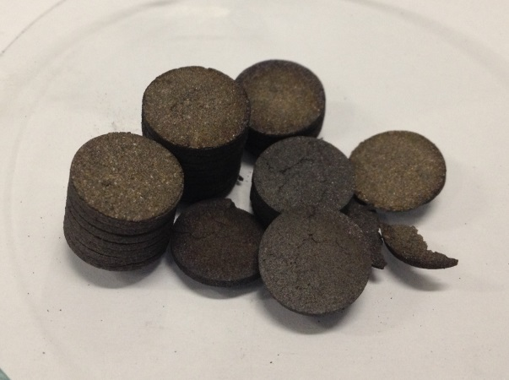

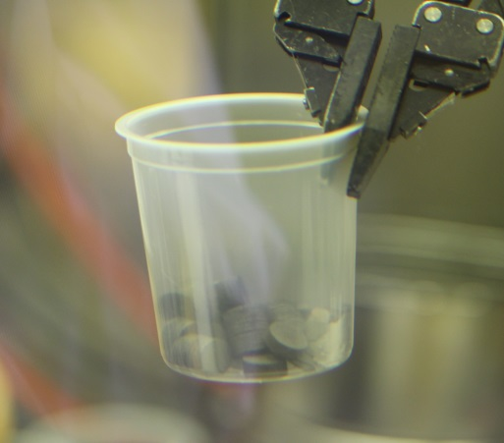
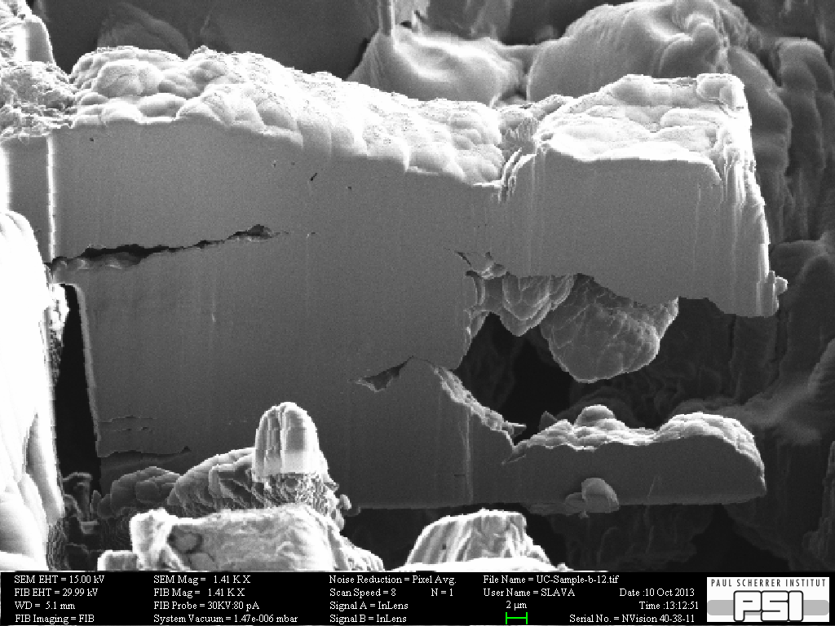
UC_{X} Post-Irradiation Studies for ActILab-ENSAR
Post-irradiation analysis:
First analysis of an irradiated UC_{X} target in the history of ISOLDE
(important to understand ageing processes and for upcoming waste campaign)
Opening target unit #466 (8.8∙10¹⁸ protons in 2011) in inert-gas hot-cell at PSI, 19 mSv/h on contact with Ta beam window
before irradiation
after irradiation
Pellets appear macroscopically unchanged
Microscopic evolution of pore distribution and grain size under irradiation observable
500 µSv/h on contact with single pellet
Results of synchrotron investigations under analysis
Ceramography and electron micro-probe analysis scheduled for April
Perform full suite of investigations on nano UC
2µm

Slide 16
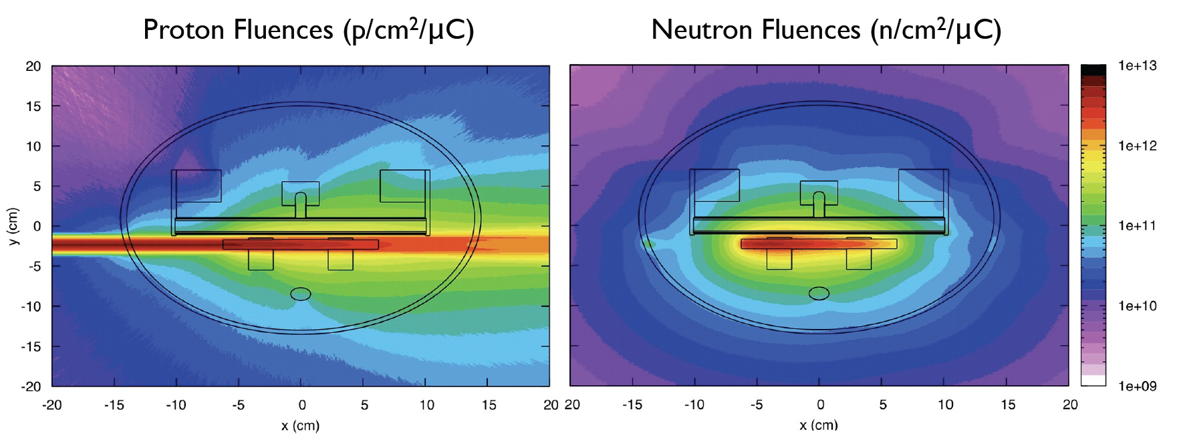
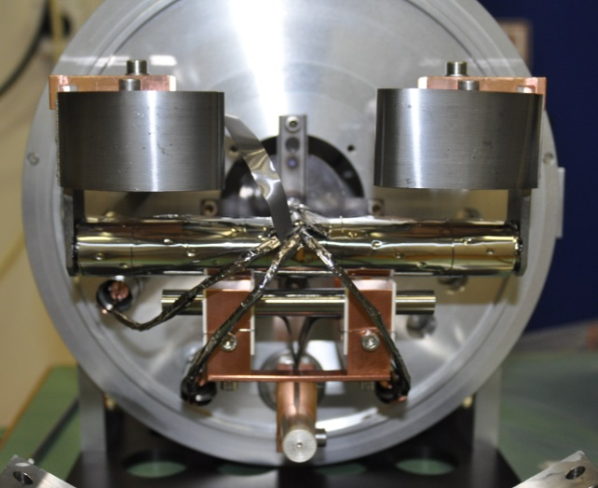
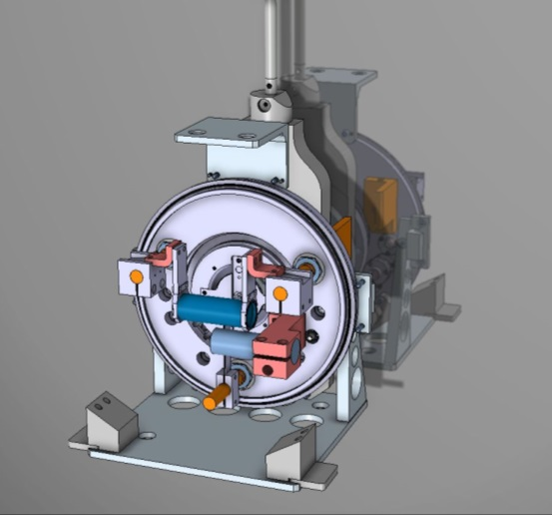
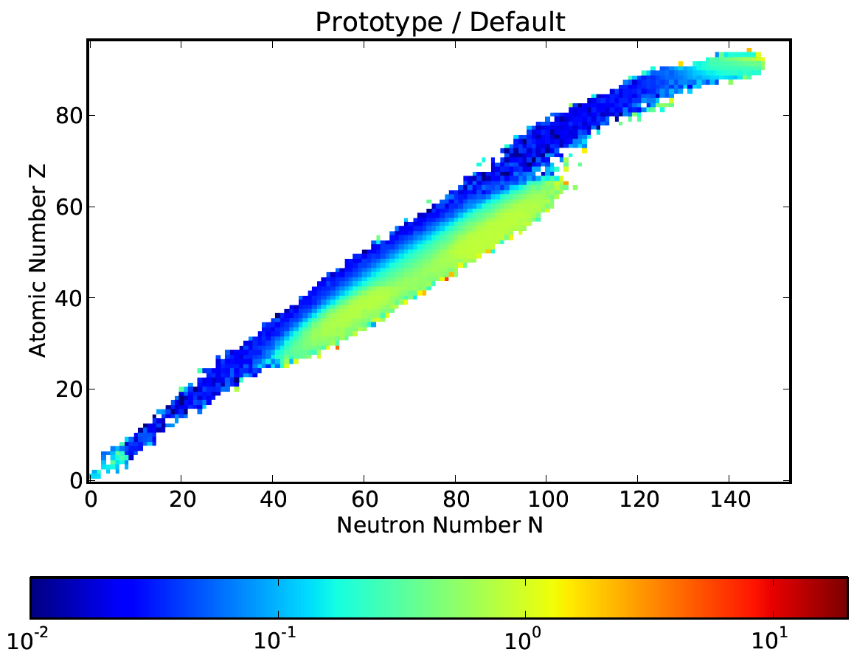
Proton-to-Neutron Converter Prototype
current design
proton fluence (p/cm²/µC)
neutron fluence (n/cm²/µC)
ISOLDE compatible
geometry optimization
max high-energy neutrons
min proton
in UC_{x}
Operated in
October 2012
R. Luis et al., European Physics Journal A, 48 (2012) 90
A. Gottberg et al. submitted to Nucl. Instr. Meth. B (2014)

Slide 17
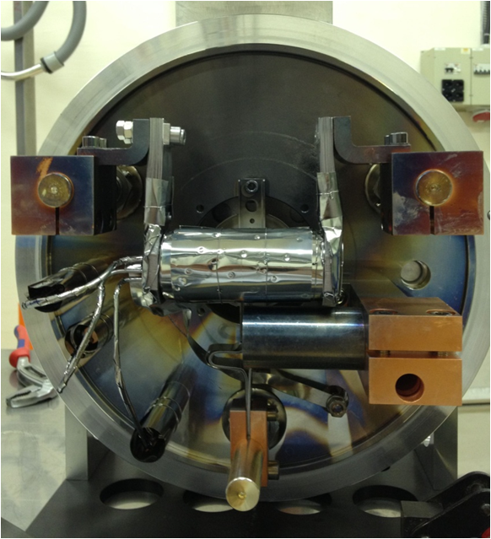
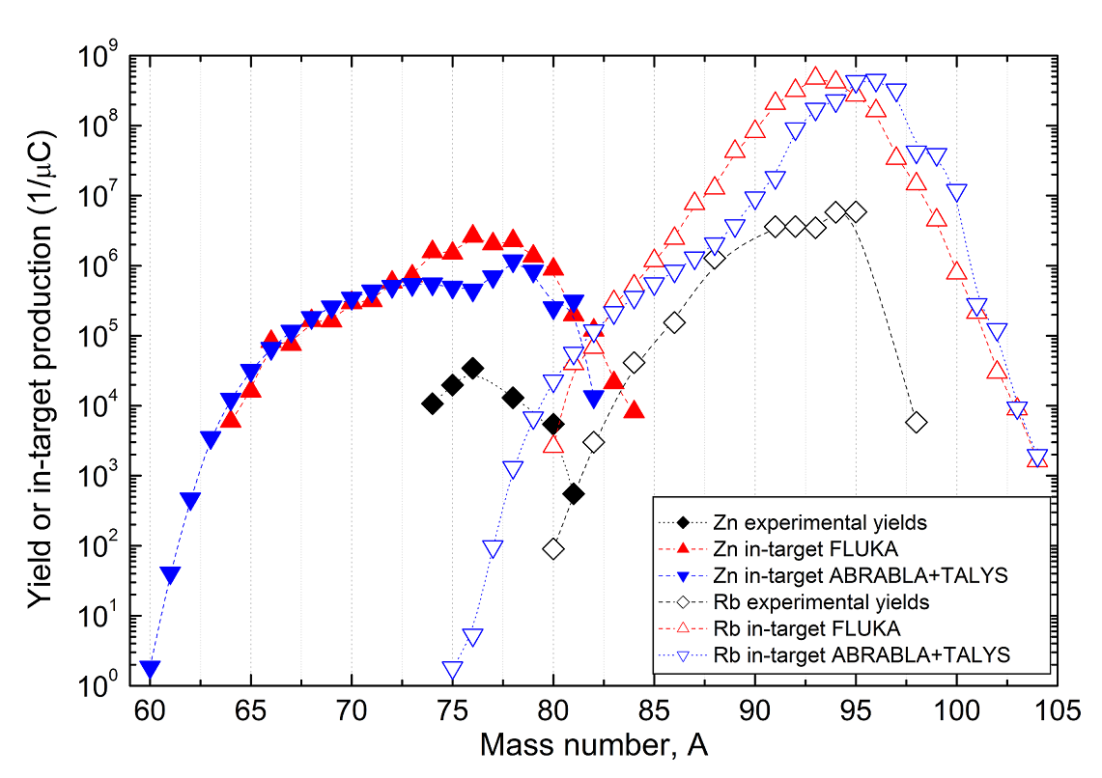
Proton-to-Neutron Converter Prototype Online Tests
Strong suppression of contaminations compared to conventional converter confirmed (10⁴ for ⁸⁰Rb)
Experimental ratio of n-rich species to contamination improved (200 for ⁸⁰Zn/⁸⁰Rb)
Poor extraction efficiencies due to low operational temperatures (caused by structural failure)
A. Gottberg et al. submitted to Nucl. Instr. Meth. B (2014)

Slide 18
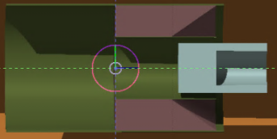
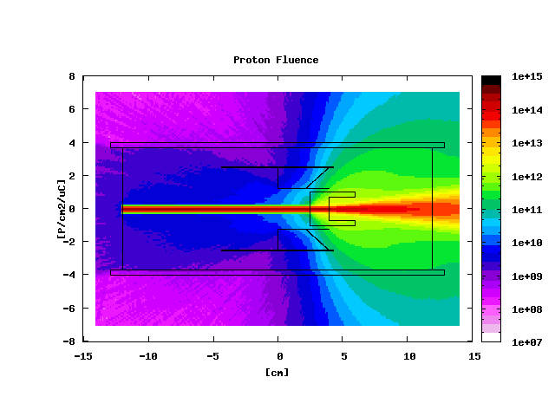
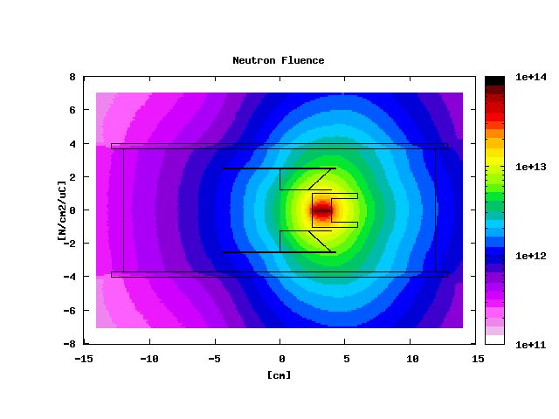
Design Study
Beam Energy: 500 MeV;
Beam Intensity: 100μA;
FWHM: 3mm;
Particles per second: 6.242 E14;
UCx density: 3.63g/cm3

Slide 19
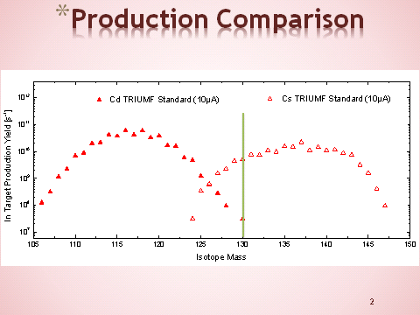

Slide 20
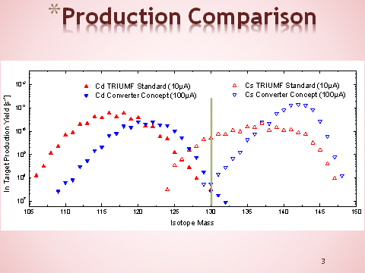

Slide 21
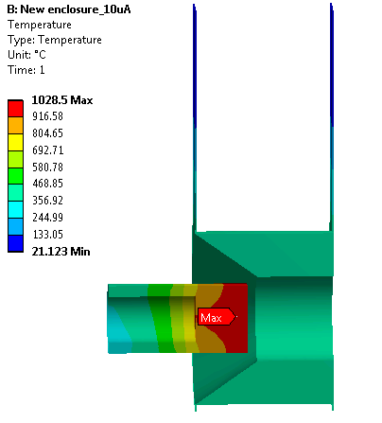
Preliminary Thermal Analysis

Slide 22
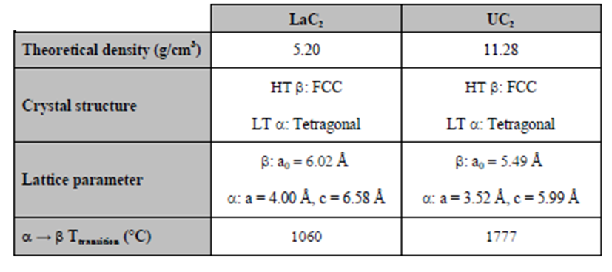
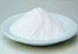
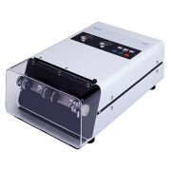
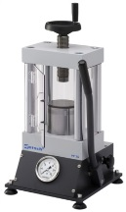





Synthesis of lanthanum carbide pellets
Work in IPNO: Use LaCx as chemical homologue to UCx
La₂O₃ is very hygroscopic and quicly turns into in La(OH)₃
Choice to start with graphite and La(OH)₃ :
lanthanum hydroxide stable in the air
strong degassing during sintering = porosity↑
Precursor
powder
Grinding
Pressing
Sintering
Characterisations
He pycnometry
SEM
XRD
Hg porosimetry
Smaller beads produce:
Finer powder
Larger pores

Slide 23



Grinding with planetary mill :
ISOLDE experience with nanoUCx shall be translated to LaCx.
Milled powders would allow to produce smaller grains by two orders of magnitude.
Smaller grains together with carbon nanotubes can be engineered for better preservation of microstrure at high temperature .
Having small grains of the target increases the efficiency of diffusion of the isotope out of the target material.
This program can be used to manufacture LaC₂ targets.
AIMS:
Reducing grain size
Improving homogeneity in shape and grain size
La(OH)₃ → La₂O₃ + 3H₂O↑
(I)
Reactions during sintering:
La₂O₃ + 11C → 2 LaC₂ + 4 C + 3 CO↑
(II)
Choice of new outgassing program
reduces the dwell time at high temperature
limit sintering responsible for the decrease of the porosity
limit the change in the microstructure (grain growth ...)
(I)
(II)

Slide 24

Choice of LaC2 for the production of i.e. neutron-deficient Barium beams
FLUKA simulations of the production of Ba isotopes from LaC₂ targets at ISOLDE
neutron-deficient isotopes of Ba (Cs, Xe, etc.) isotopes LaC₂ shows higher production cross-sections thanUCx
For Ba with A<120 the production decreases rapidly and good extraction efficiencies are necessary for decent isotope beams
LaC₂ is a better candidate than UC₂
Purchase of material:
Start with La(OH)3 :
lanthanum hydroxide stable in the air
grinding in isopropanol
strong degassing during sintering = porosity↑
Start with carbon nanotubes :
Size
Thermostability
Diffusion
Grinding equipment (Jar+Beads) in Tungten Cabide:
high density
high hardness and high abrasion resistance
high melting point (2900°C> work temperature ~ 2000°C)

Slide 25

Thank you !! Hungry ?

