Slide 1

ISOLDE Technical Report
69th Meeting of the ISCC
31st March 2014
Richard Catherall, EN-STI

Slide 2
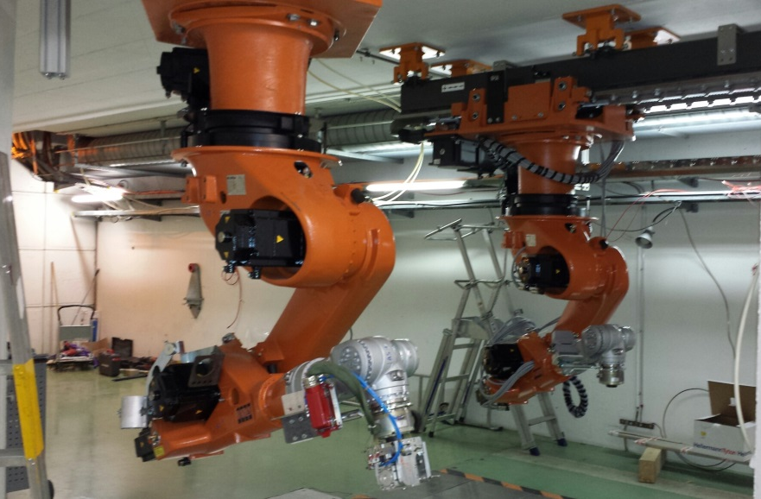
Outline
RILIS
REX
Tape station
RFQ Cooler
Target Area
  Hot cell, Robots, PAD/MAD, FE Modifications,
MEDICIS
Start up schedule

Slide 3
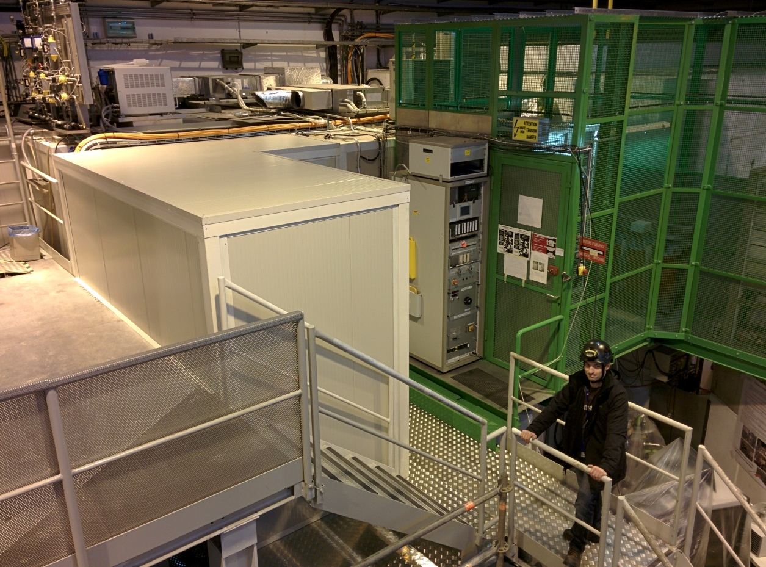
RILIS room extension
RILIS
28 m²
6 m²
Needed for improvement of work safety
New SAS for RILIS laser room finished in February 2014
V. Fedosseev

Slide 4
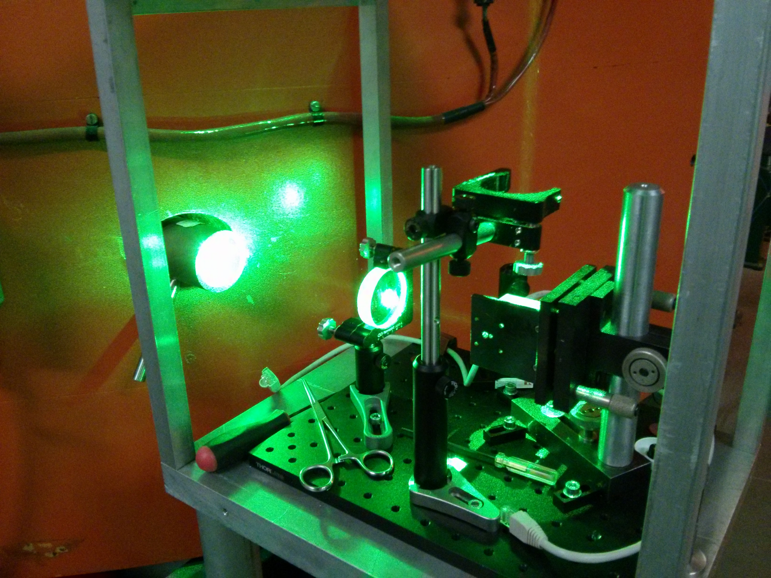
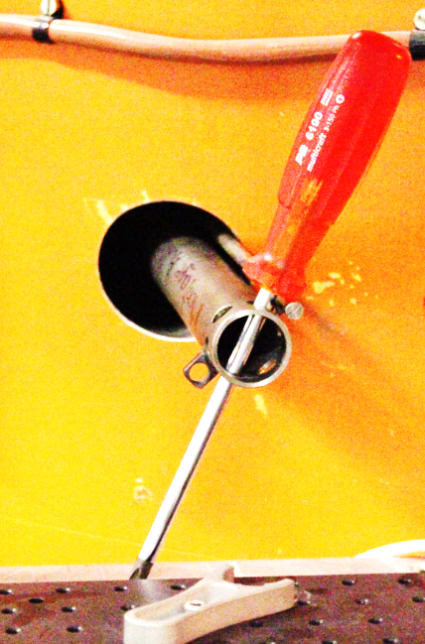
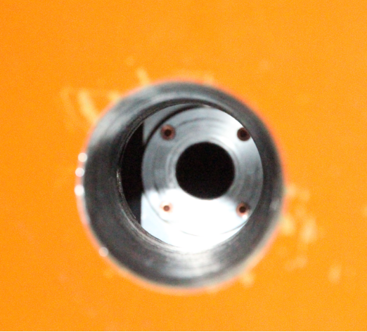
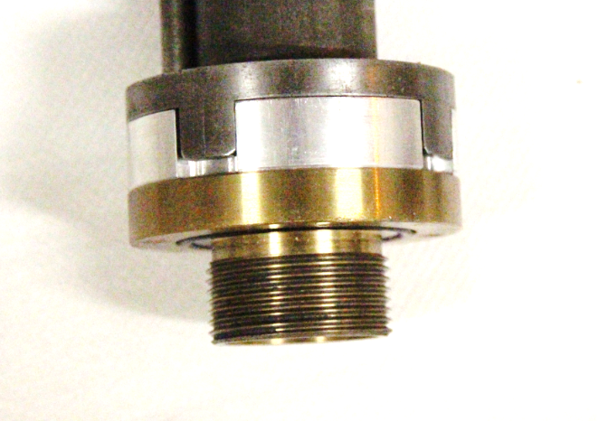
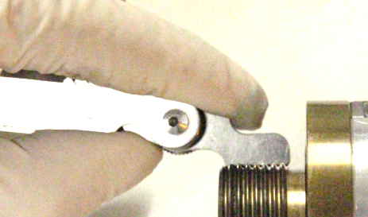
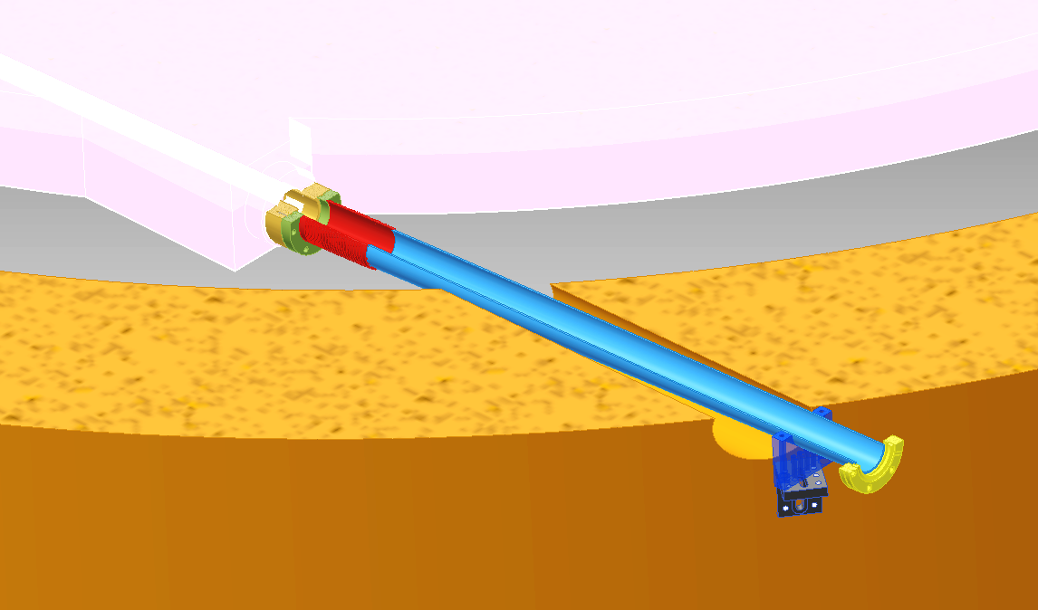
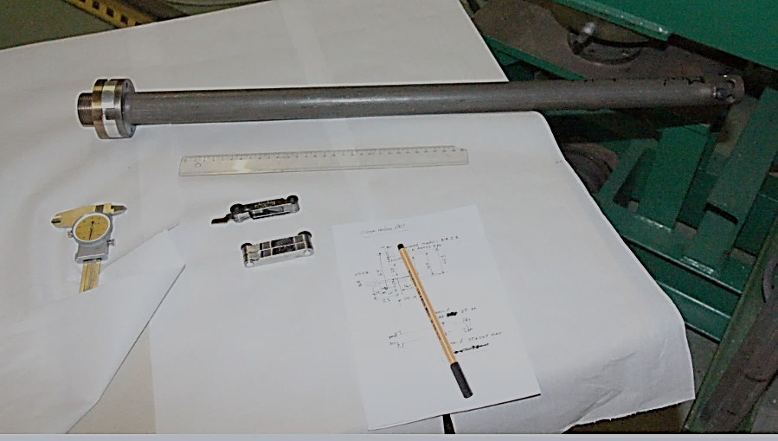
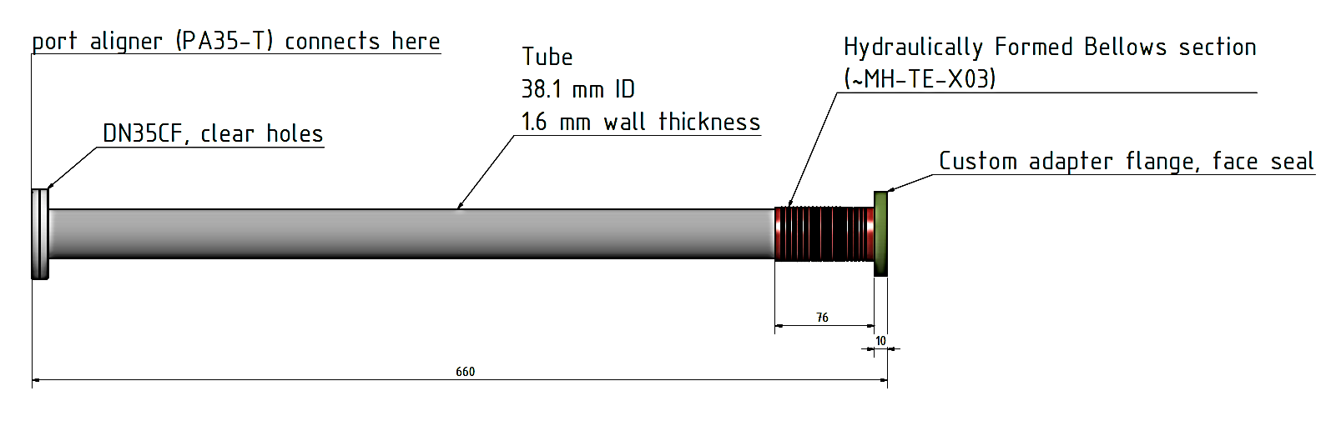
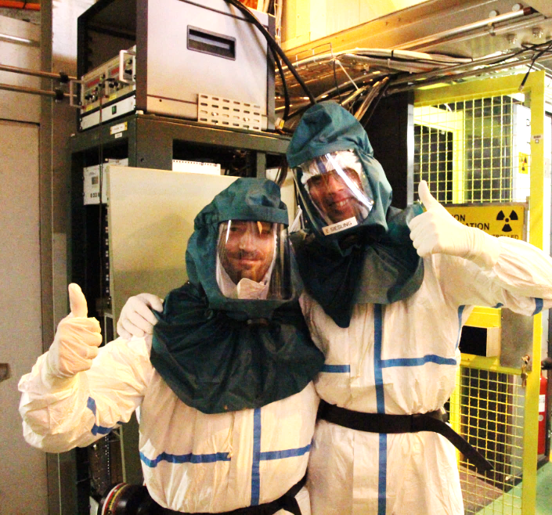
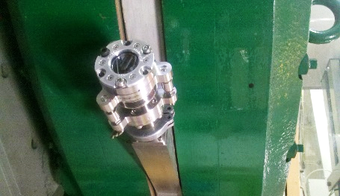
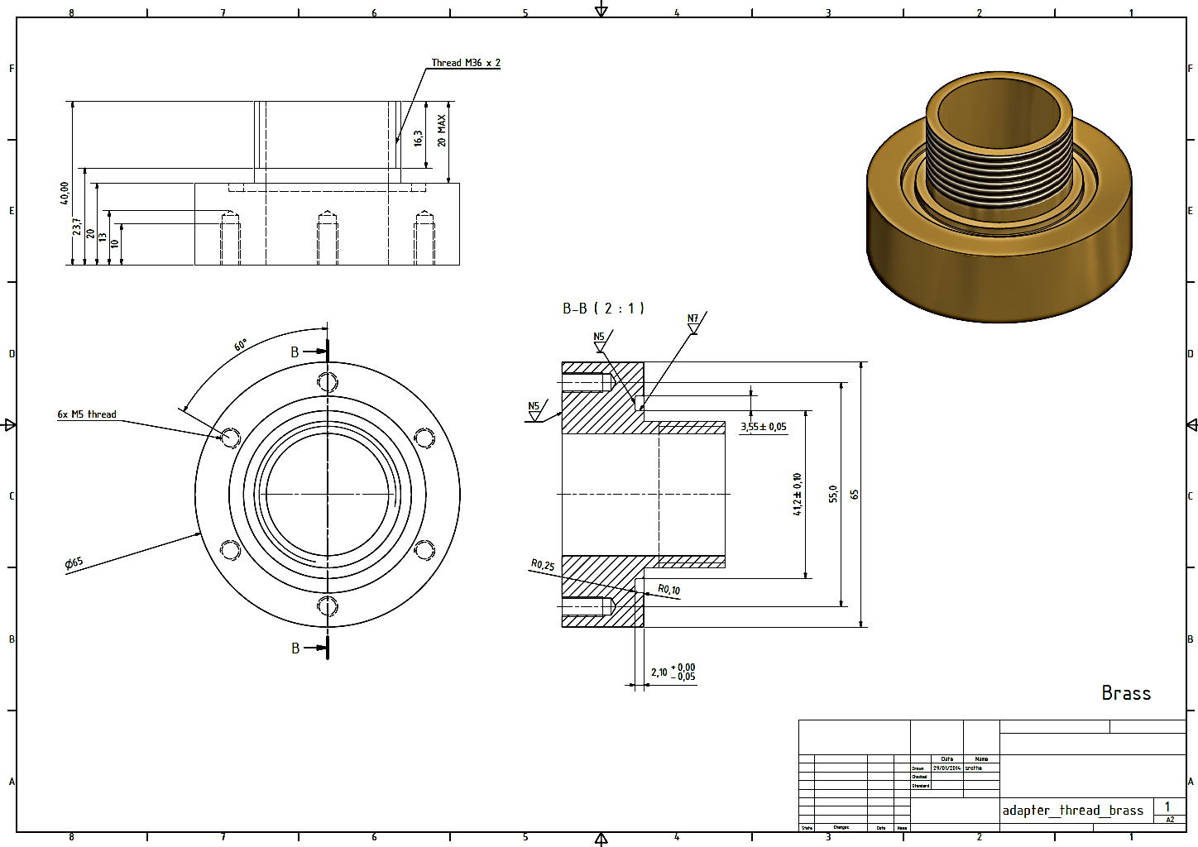
HRS laser window upgrade
New features add safety and usability
ease of access for inspection
use of a standard CF mounted viewport (stocked item)
no special tools required for exchange
preserve thread in HRS Al vacuum tank
adding port aligner makes window useful as additional reference point for RILIS
Process and Status
Pieces have now been manufactured and delivered.
Installation planned for 7th April 2014
port-aligner and viewport are currently tested at ISOLDE-OFFLINE
required torque will be measured prior to installation at HRS
Photo thanks to C.Seiffert
V. Fedosseev
People involved: RILIS, Erwin, Stefano, Alexandre D., Giovanna, Ermanno

Slide 5
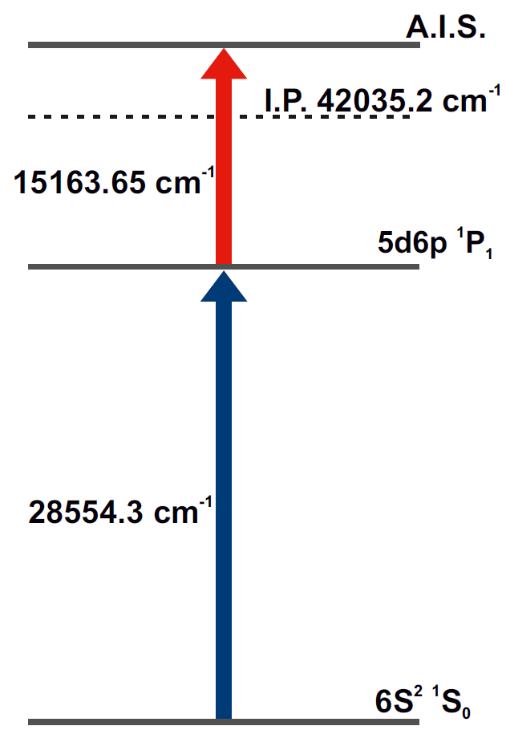

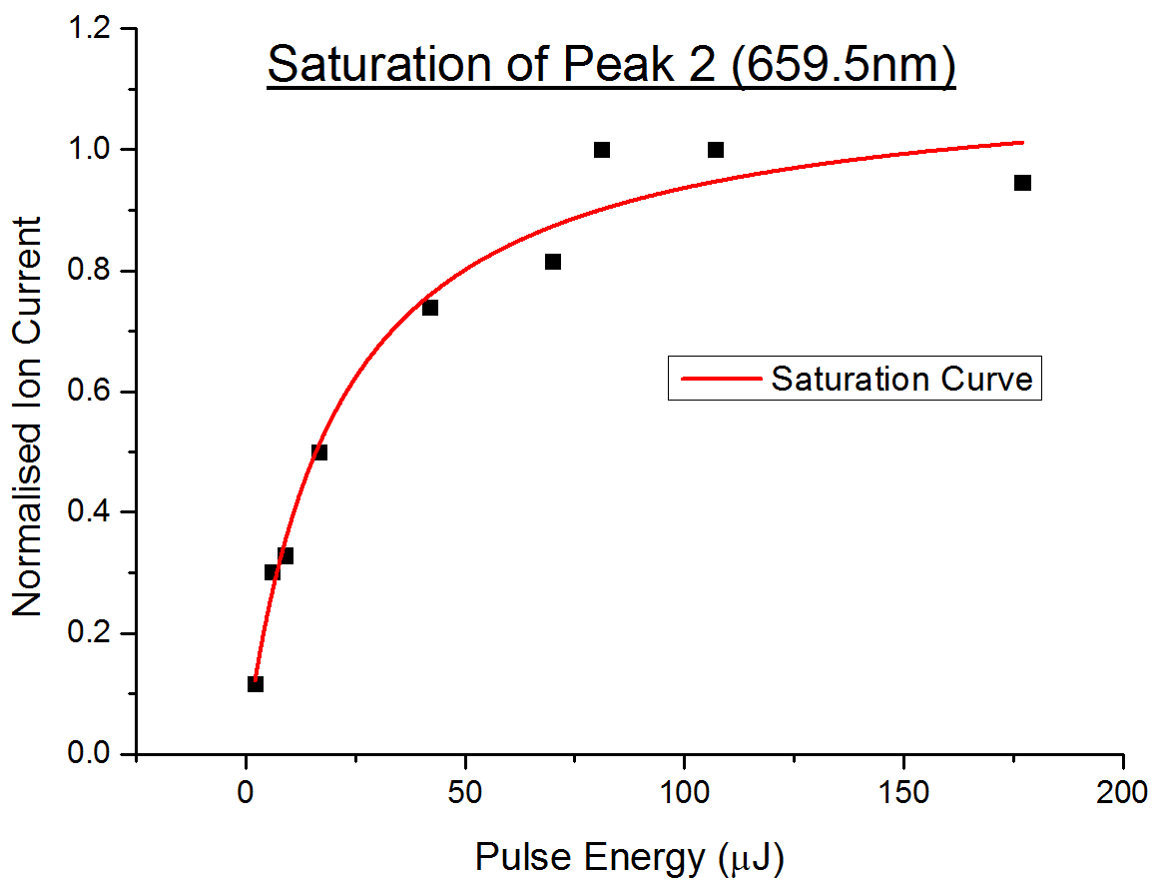
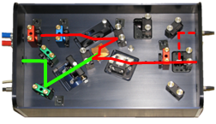
Barium Scheme Development
From a first step of 350.1 nm, scans of the second step were made offline at the LARIS lab
3 potential auto-ionizing schemes were identified
These will be compared @ ISOLDE with efficiency measurements being taken
Second step Dye
659.5 nm
First step
Ti:Sa or Dye
350.1 nm
V. Fedosseev

Slide 6
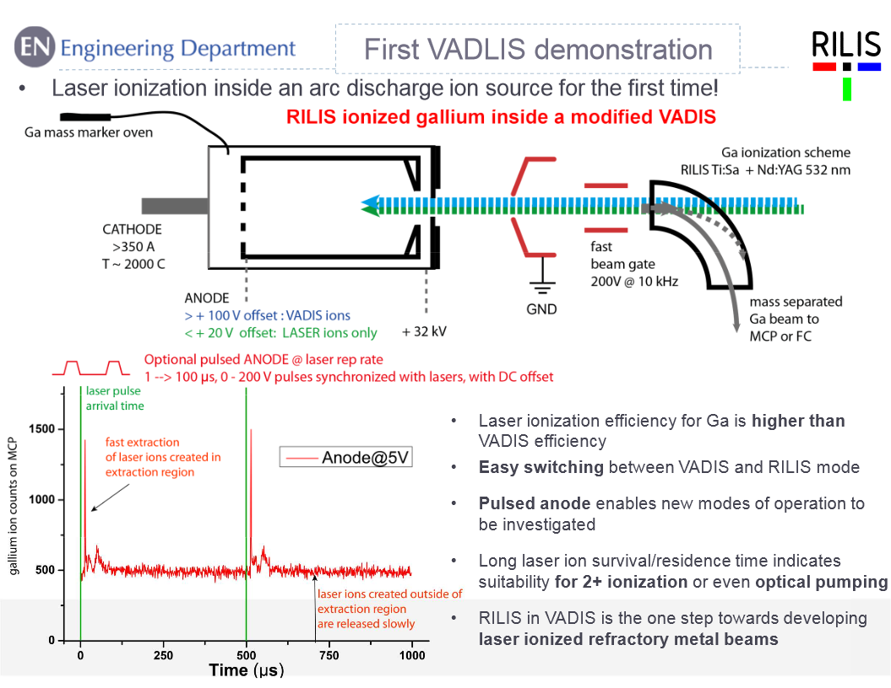
B. Marsh

Slide 7
Outline
RILIS
REX
Tape station
RFQ Cooler
Target Area
  Hot cell, Robots, PAD/MAD, FE Modifications,
MEDICIS
Start up schedule

Slide 8
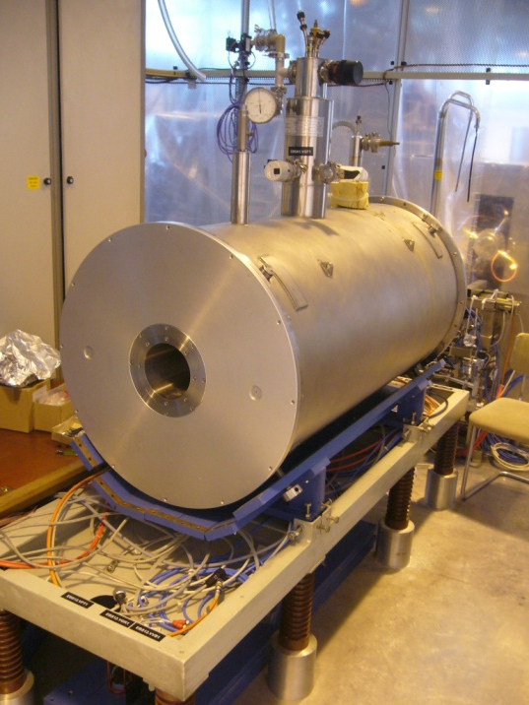
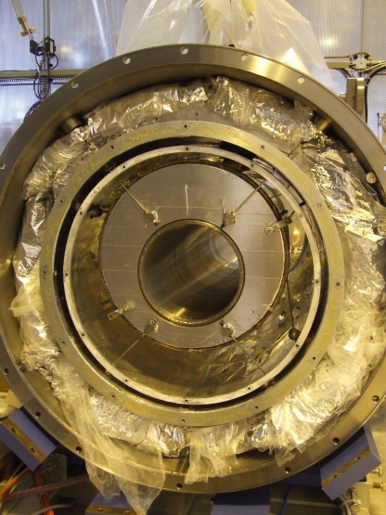
REXEBIS
Repair of REXEBIS magnet cryostat nearly finished
  Last repaired 2005 by external firm Ice Oxford; this time in-house repair.
Major and risky job; complete EBIS needs to be dismantled.
Goal: EBIS re-assembled by March 2014.
Nov and Dec: Moderate modifications and reassembly
Holding time only ~ 7 days
Further discussion with magnet team in ATLAS
Jan - ??: ATLAS magnet team involved
Magnet disassembled again
No clear loss cause identified
Discussing more complex improvements
* Timeline unsure as the magnet team has other higher priorities.
* Worries: still no cathode tests started
lack of results for PhD student
LHe holding time is at least 14 days
F. Wenander

Slide 9
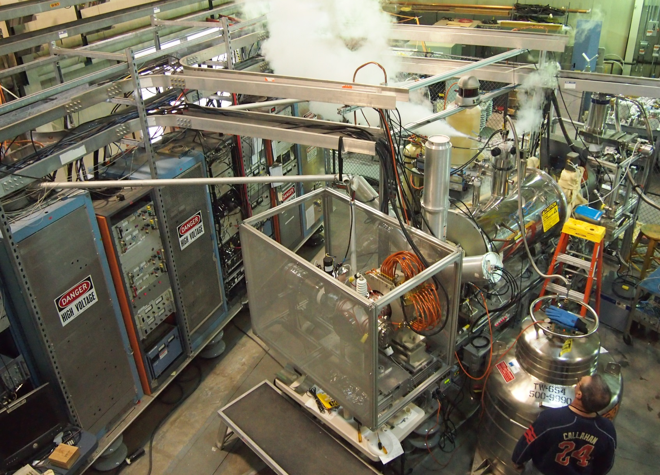


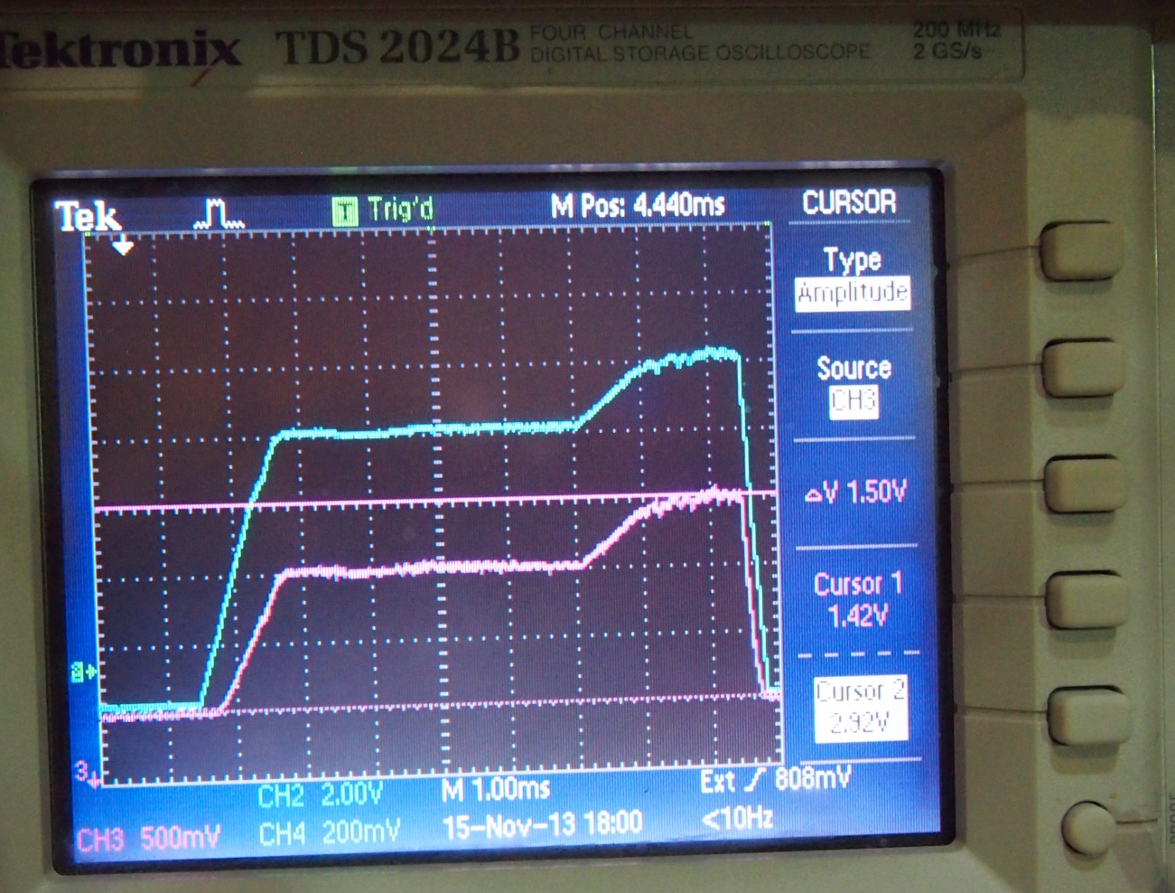
HEC² prototype tests at BNL
First beam time – 08.11.2013-15.11.2013
Anode voltage
Extracted current
(1V=1A)
Prototype gun design by BNL, built by CERN being tested at BNL by joint team at BNL TEBIS
Scenario | E_{e}, keV | I_{e}, A | J_{e}, kA/cm²
HEC² ultimate spec | 150 | 5 | 10-20
Test stand limit as is | 40 | 2.2 | 5
Achieved in 1-st run | 30 | 1.54 | tba
REXEBIS today | 5 | 0.2 | 0.01
These activities supported by HIE-ISOLDE design study will continue in 2014
F. Wenander & A. Shornikov

Slide 10
Outline
RILIS
REX
Tape station
RFQ Cooler
Target Area
  Hot cell, Robots, PAD/MAD, FE Modifications,
MEDICIS
Start up schedule

Slide 11
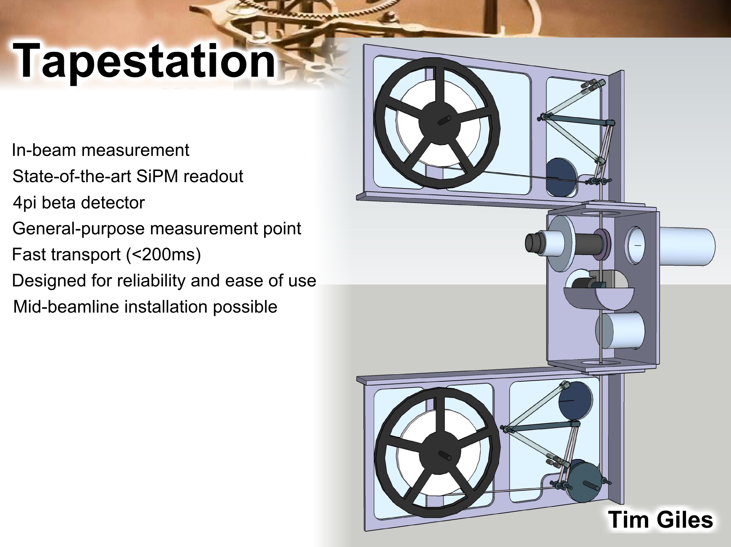
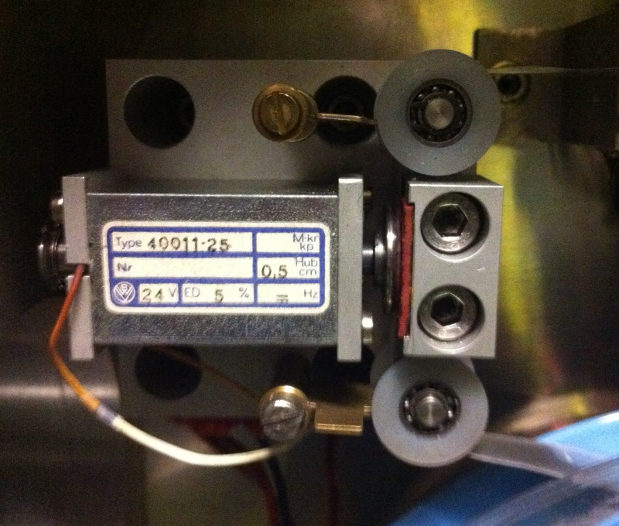
Old tape station will be used for the start up.
Investigations show that the solenoid brake is sticking..done
Electronics also repaired
Test as soon as beam is available
Construction of new tape station throughout 2014
EN-STI/PH-SME collaboration

Slide 12
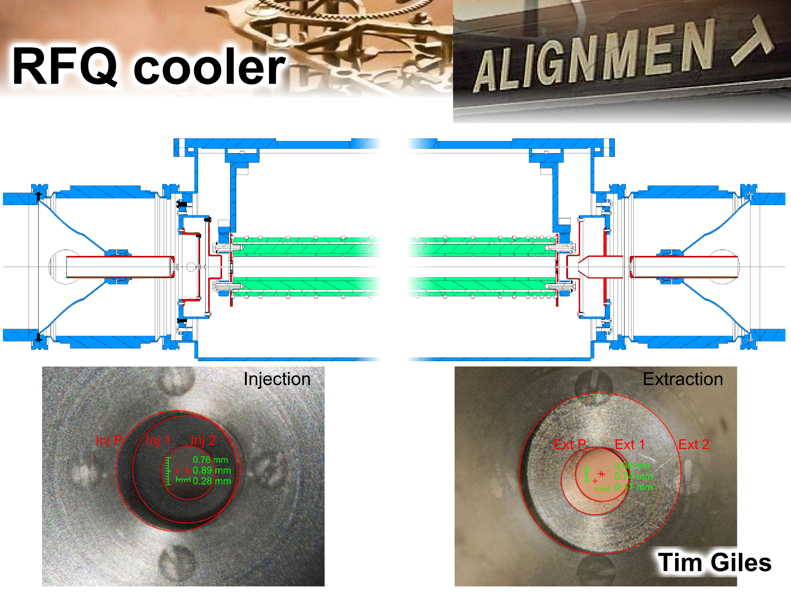

Slide 13
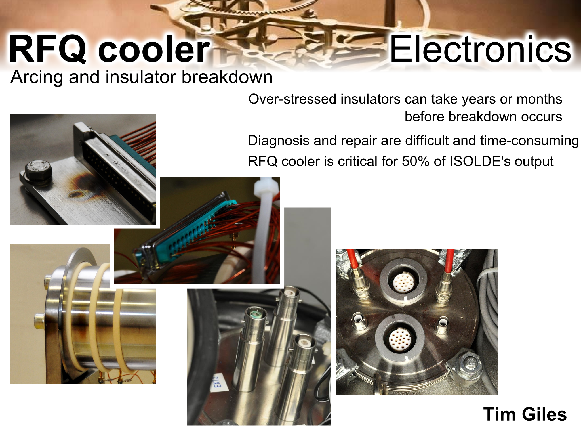
RFQ Cooler is now back in place and aligned

Slide 14
Outline
RILIS
REX
Tape station
RFQ Cooler
Target Area
  Hot cell, Robots, PAD/MAD, FE Modifications,
MEDICIS
Start up schedule

Slide 15
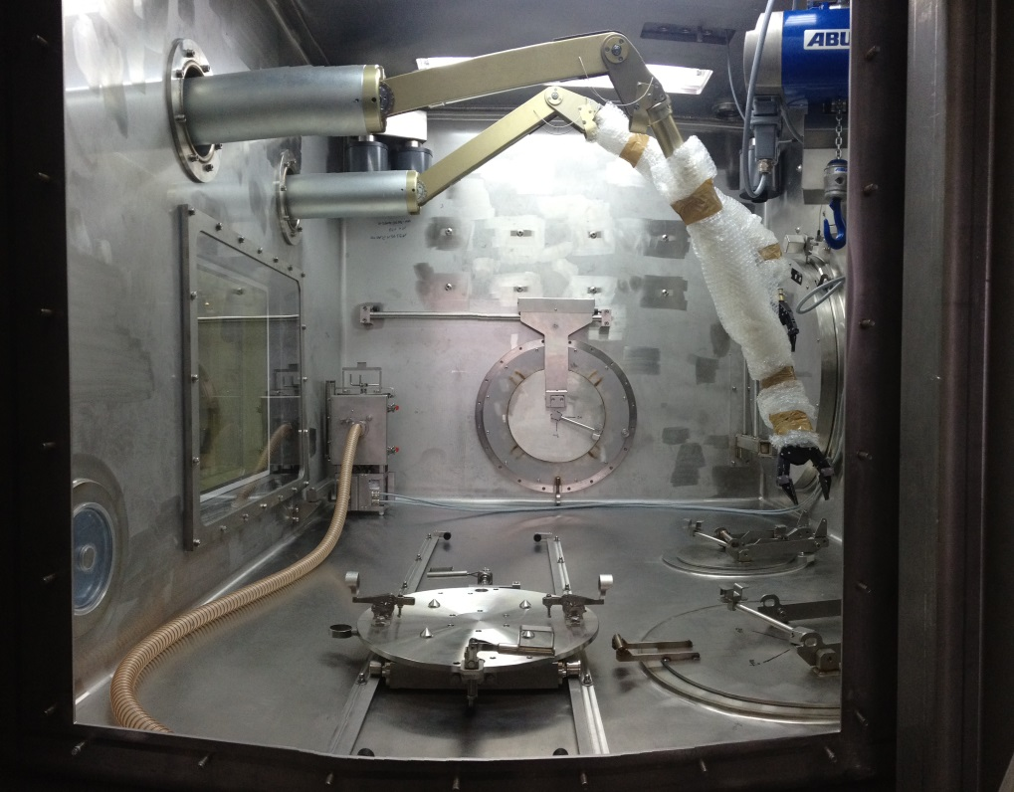
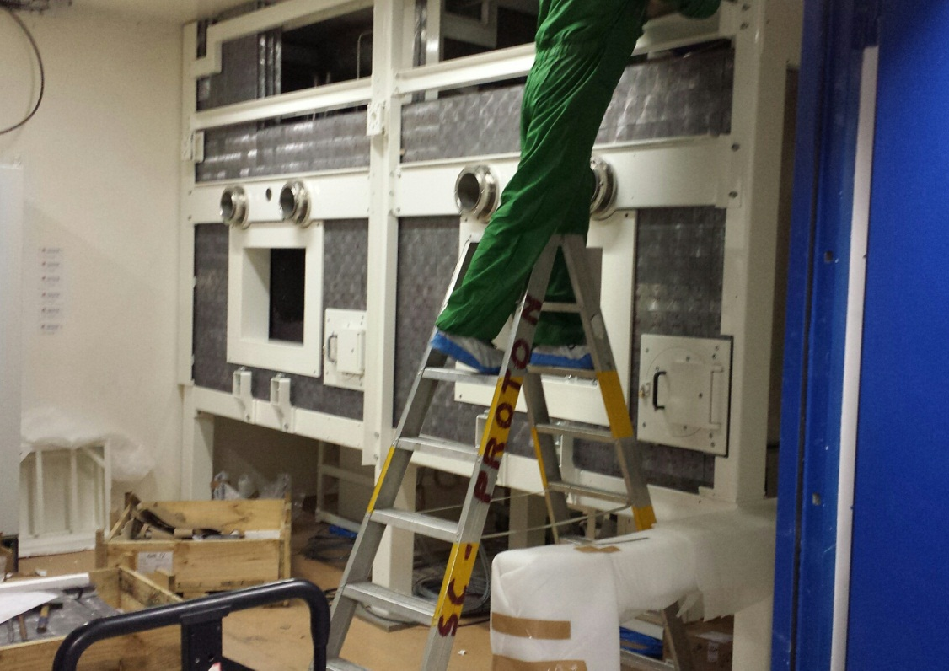
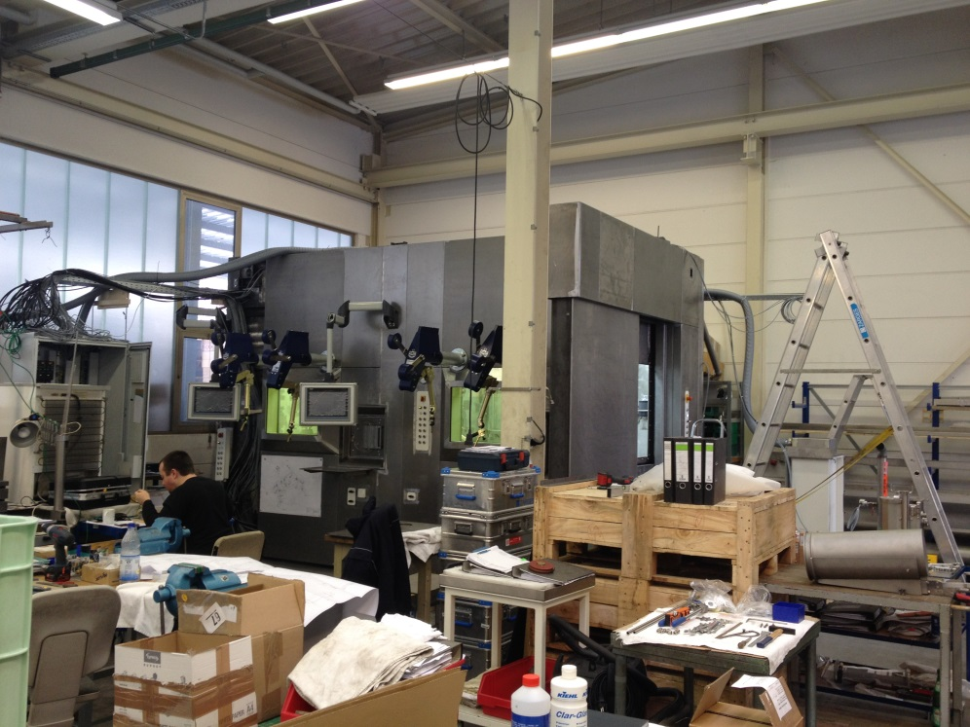
The Target Dismantling Hot Cell
Factory acceptance tests successfully completed.
Delivery and start of assembly 18th March

Slide 16
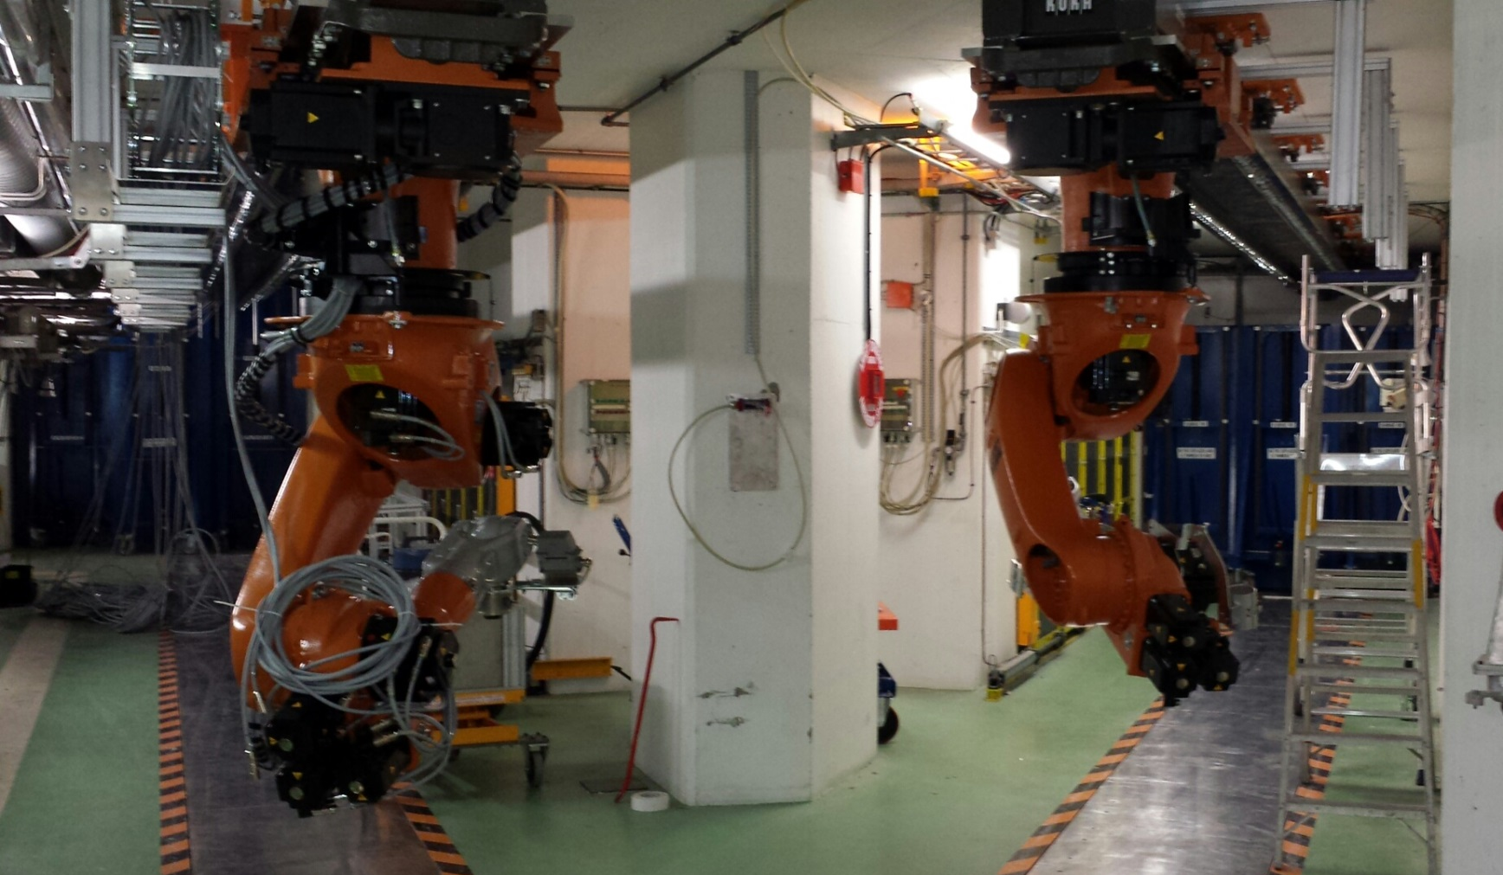
Target Handling Robots
Installation almost finished.
Awaiting re-installation of tunnel services before completion
Shelf and door modifications on-going

Slide 17
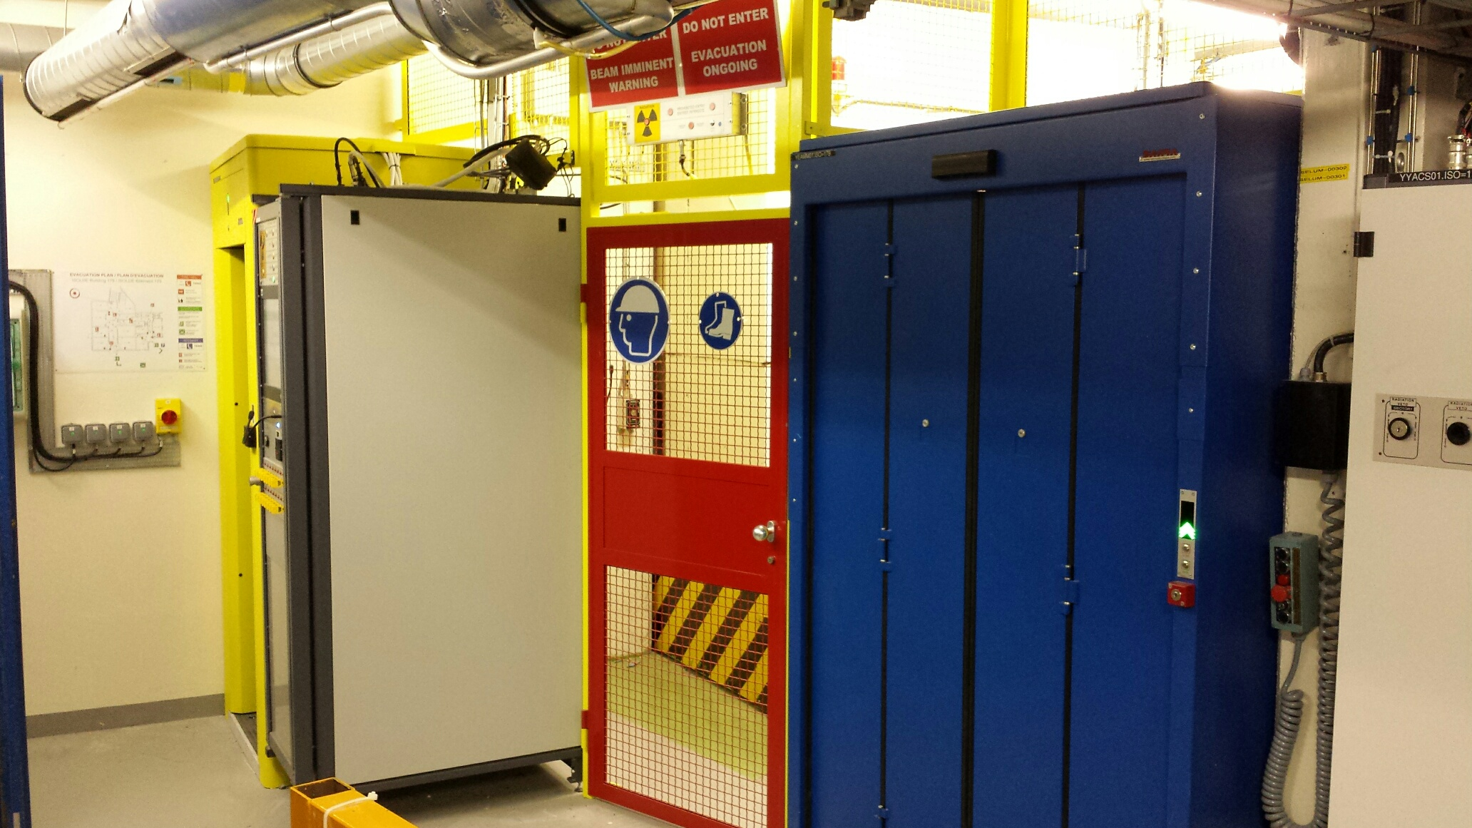
PAD/MAD Access to Target Area
Installed and now operational
SIR, ISOPRIM access, dosimeter and registered on IMPACT

Slide 18
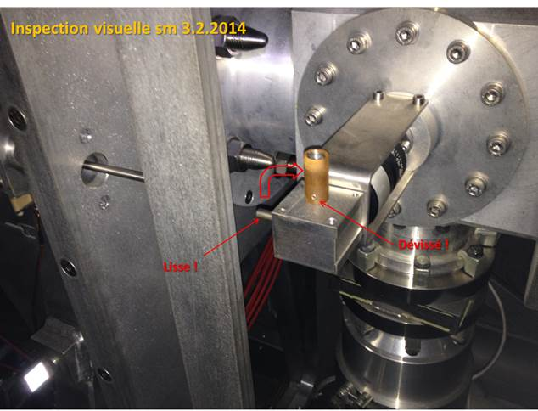
Front End Modifications
Repair of GPS extraction electrode
Repaired externally
Connection required internally
Pneumatic pistons for faraday cage door
New coupling tables compatible with new robots

Slide 19
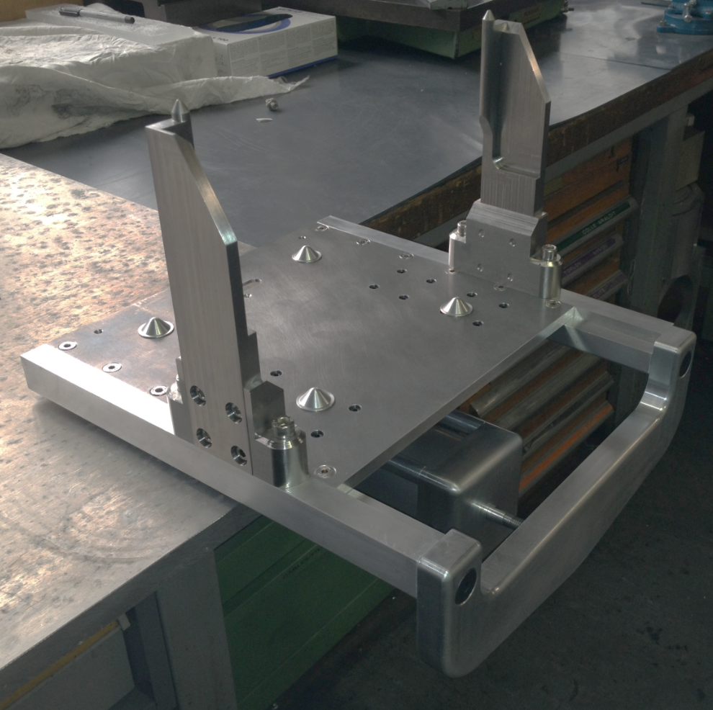
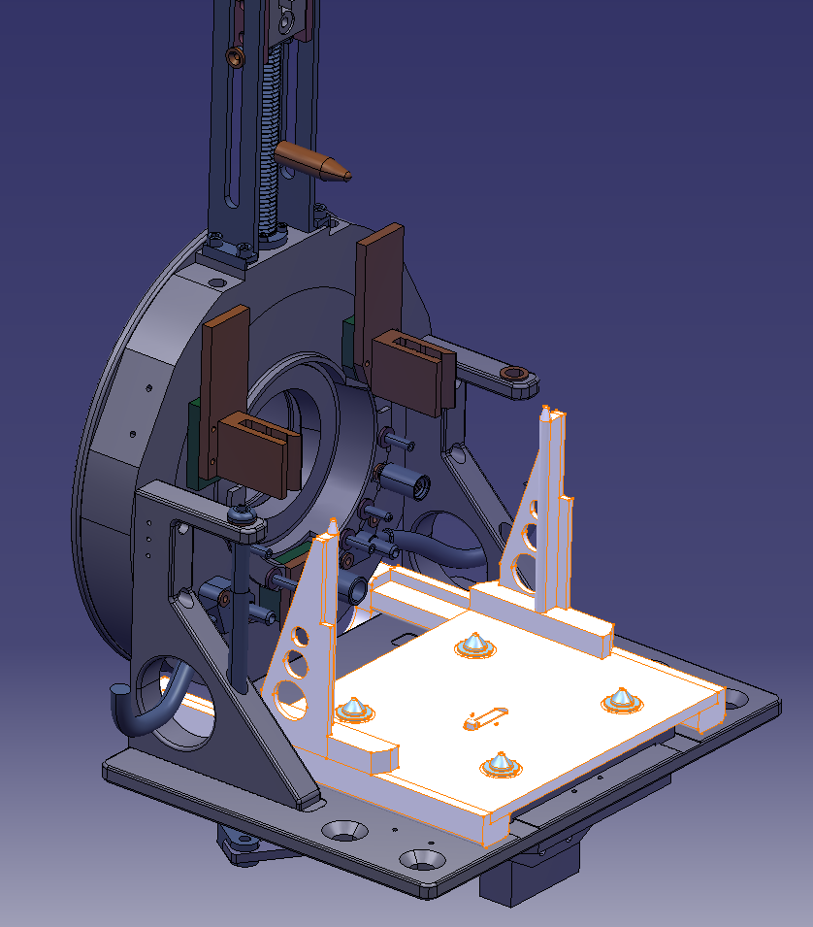
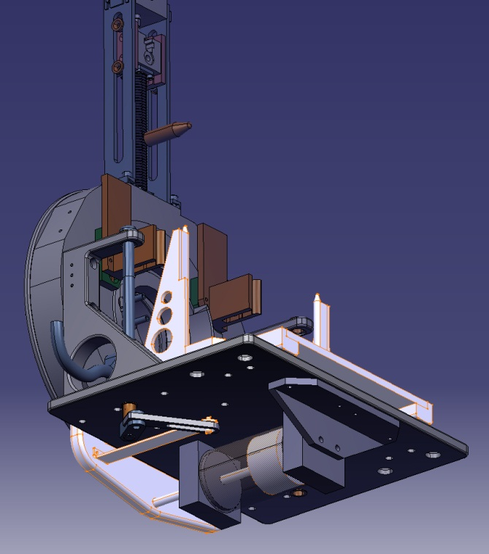
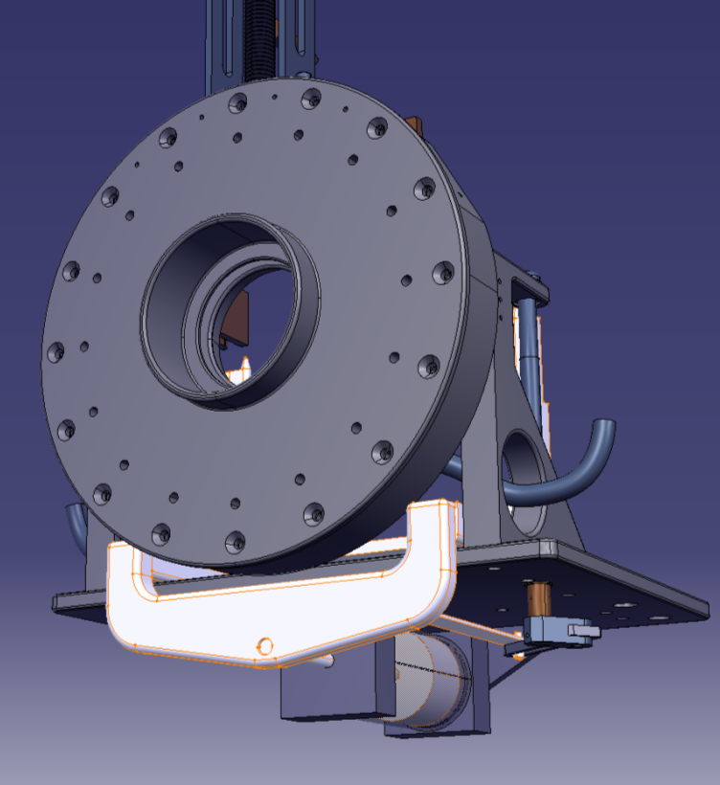
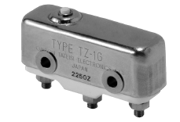
FE Modifications: Proposition
New clamps with linear movement
Install a radhard ceramic switch for target detection
Pneumatic piston diam.80
Use existing cam for table position feedback
S. Marzari

Slide 20
Outline
RILIS
REX
Tape station
RFQ Cooler
Target Area
  Hot cell, Robots, PAD/MAD, FE Modifications,
MEDICIS
Start up schedule

Slide 21

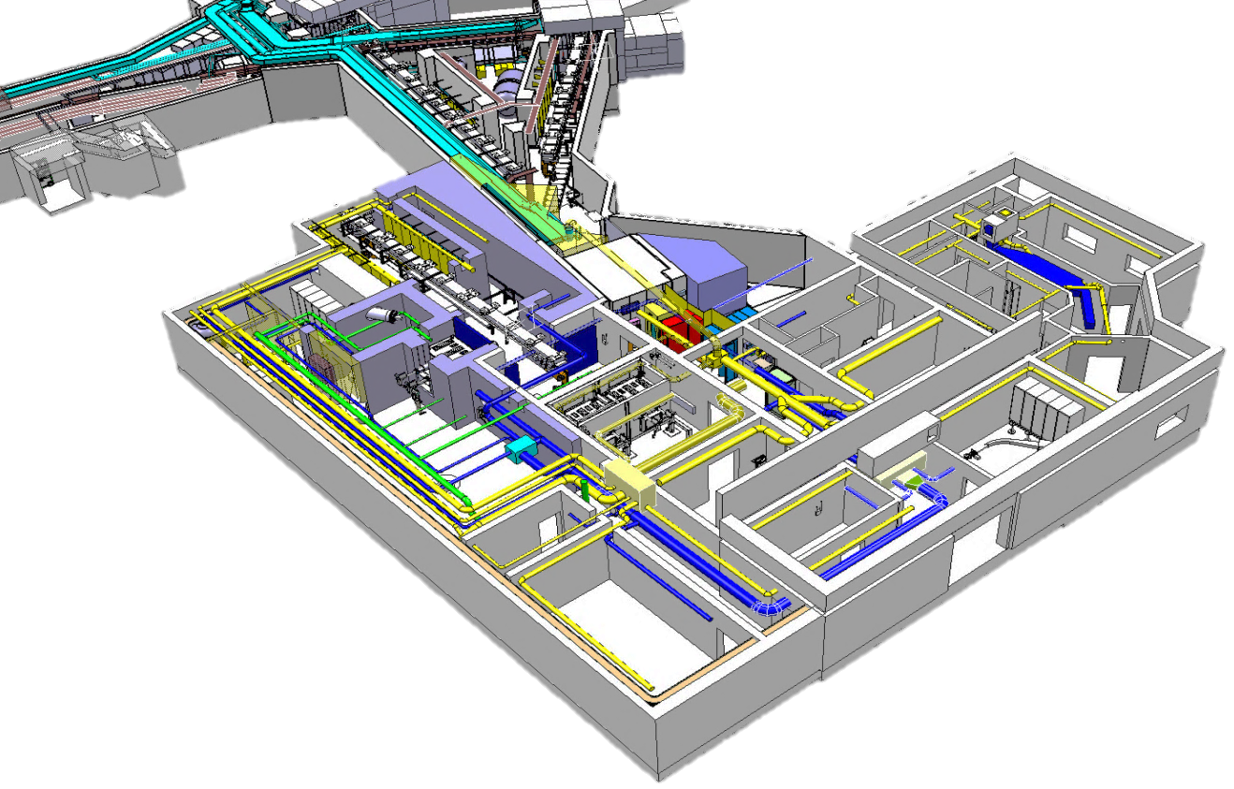

Slide 22
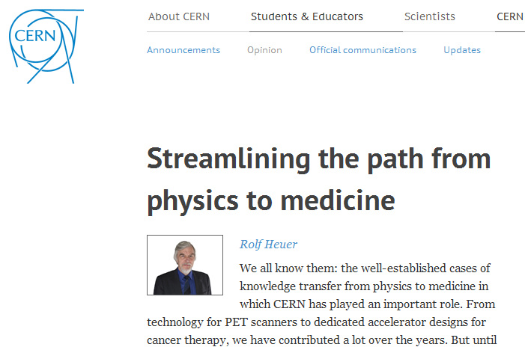
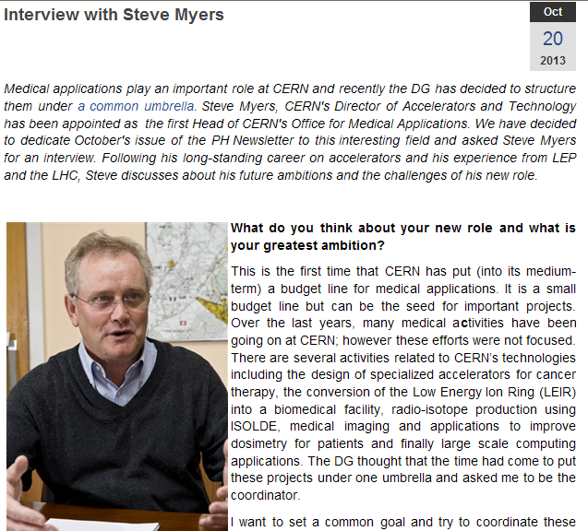
A new office for biomedical applications at CERN
Kick-off meeting 22 Nov 2013 – CERN retreat 14-16Feb 2014

Slide 23

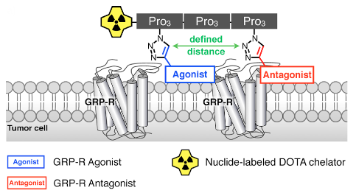

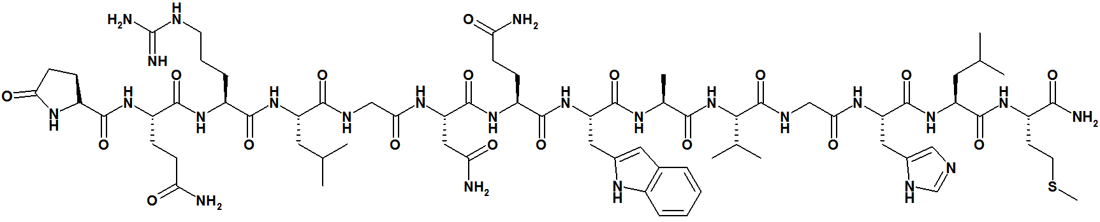
Presentation test experiment in Feb 2014
152Tb from
ISOLDE
Bombesin analog from
Bombina bombina
Prostate
Cancer
cells
Peptide analog that specifically binds to prostate cancer tissues
Batch collected at ISOLDE and exported to CHUV
Tests on mice already showed better biodistribution (less toxicity to healthy tissues) than same peptide + 68Ga
→ Candidate for next therapeutic trials with 149Tb/161Tb
(A. Gottberg, K. Johnston, RP, GS)

Slide 24
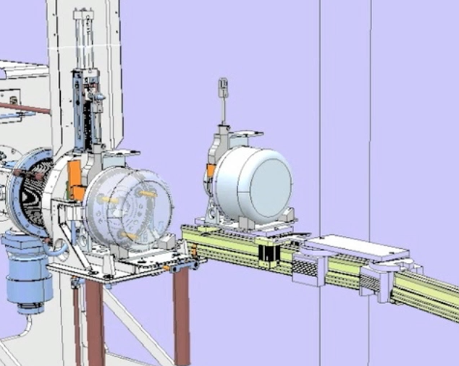
Montrac prototype for MEDICIS
Dump
Protons

Slide 25
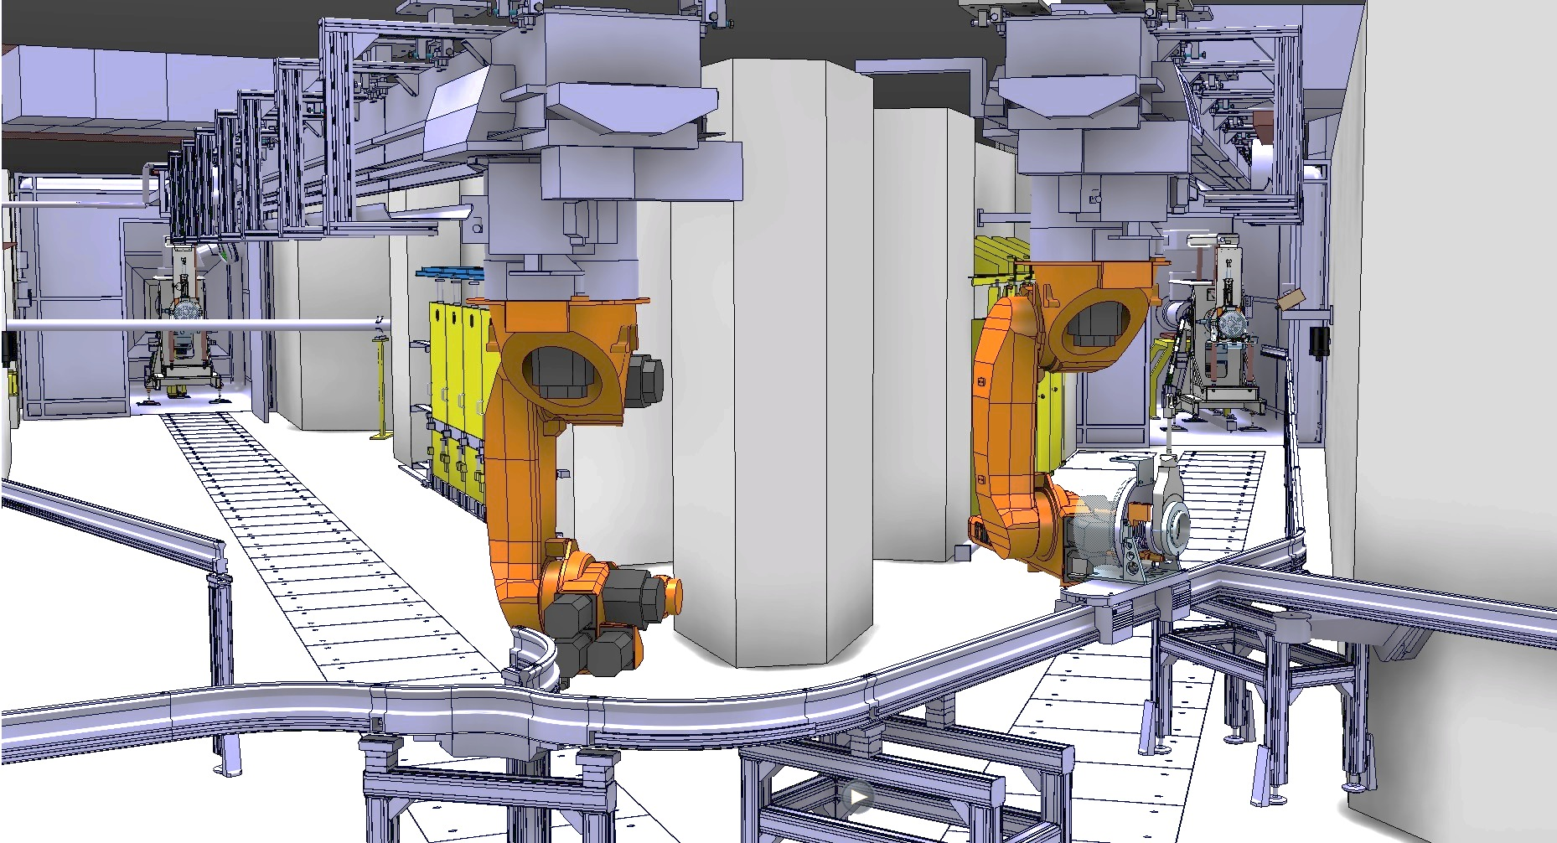
Montrac prototype for MEDICIS
February 2014
MEDICIS ceremoy – 09.2013
Irradiation MEDICIS view position and MONTRAC

Slide 26
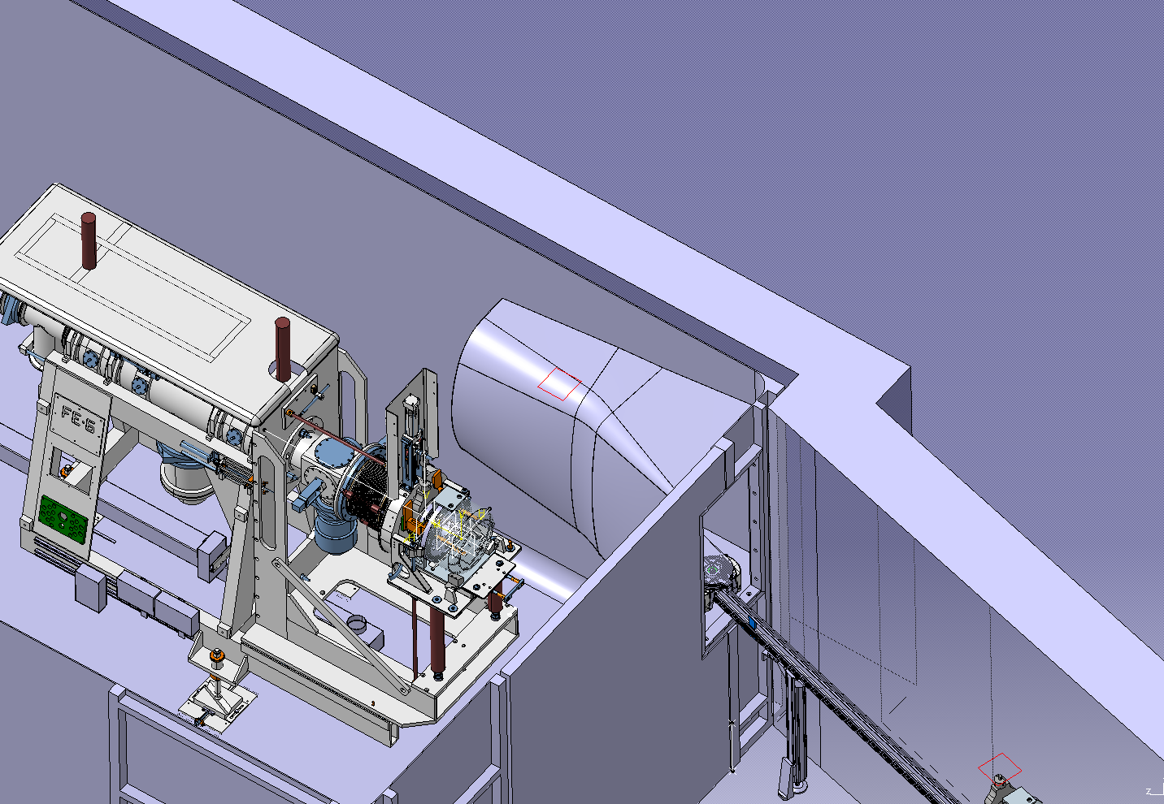
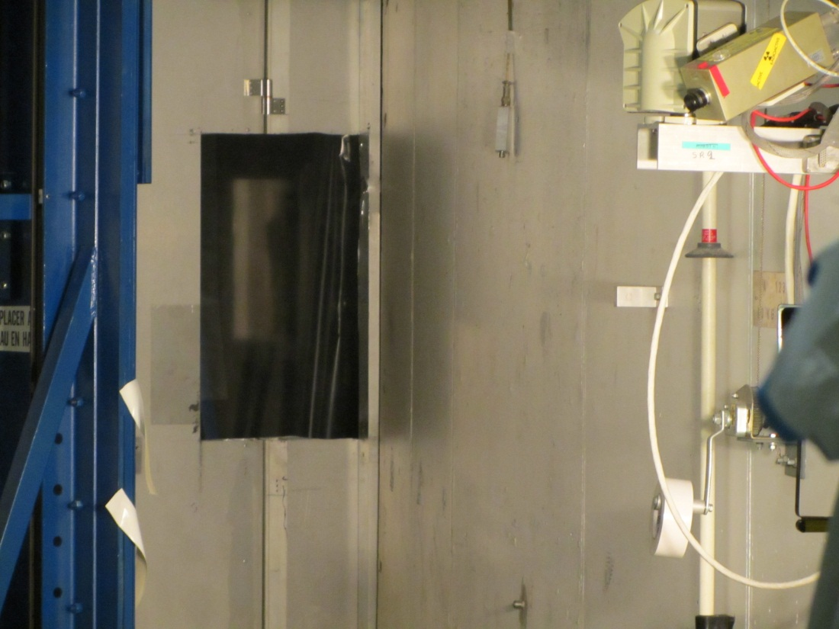
Montrac prototype: Faraday cage modification
06/03/2014

Slide 27
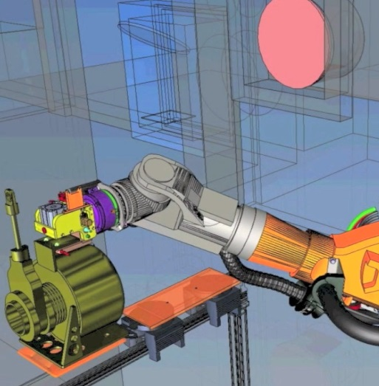
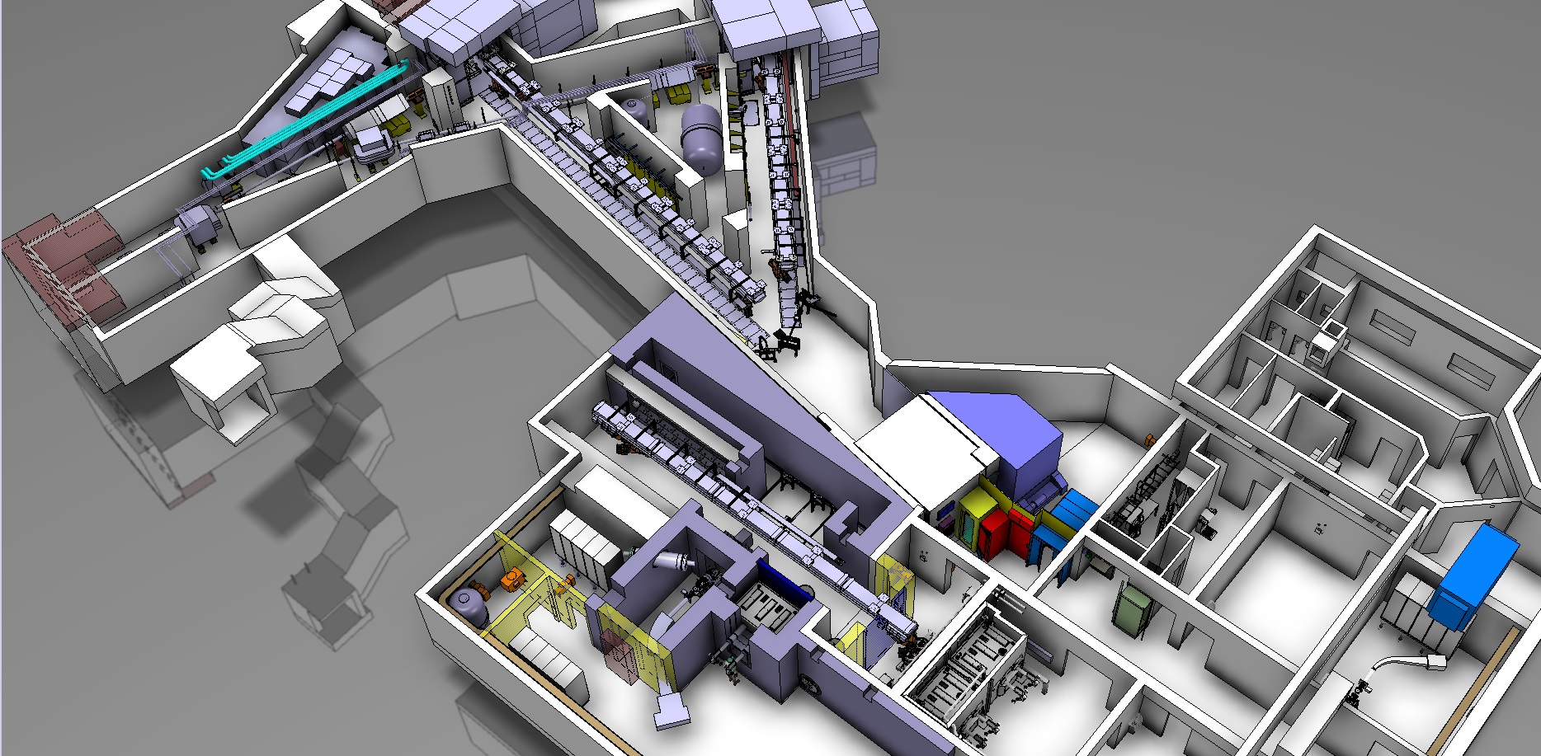

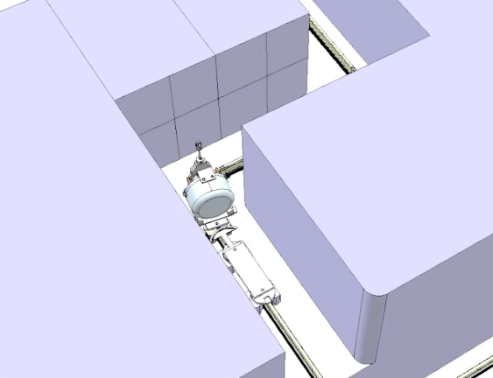
Montrac prototype for MEDICIS
Third Robot will allow to put MEDICIS target on hot cell or mass separator
February 2014
MEDICIS facility
MEDICIS ceremoy – 09.2013
Montrac and chicane allow to bring a irradiated target without stopping ISOLDE

Slide 28
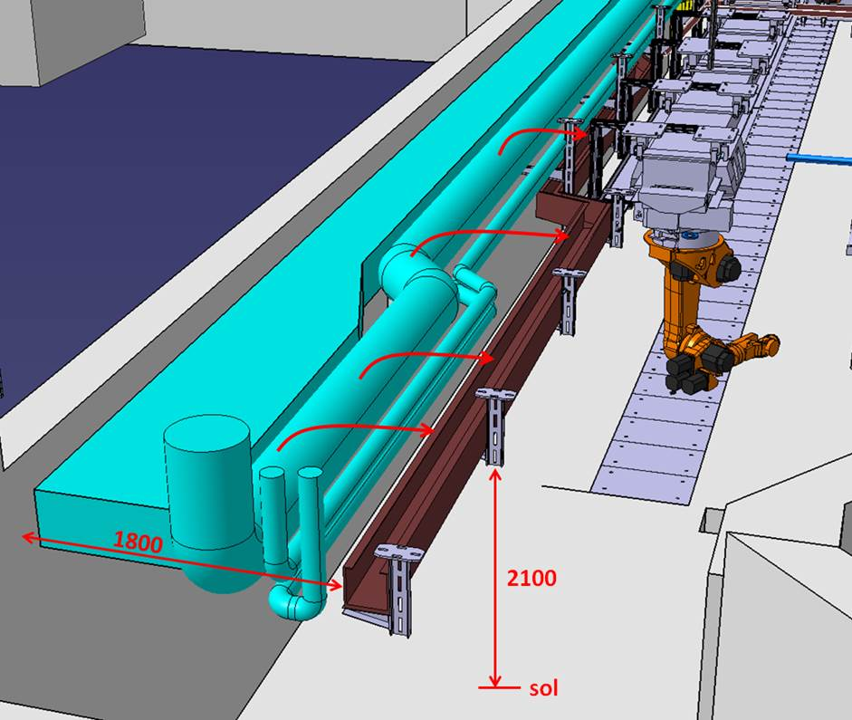
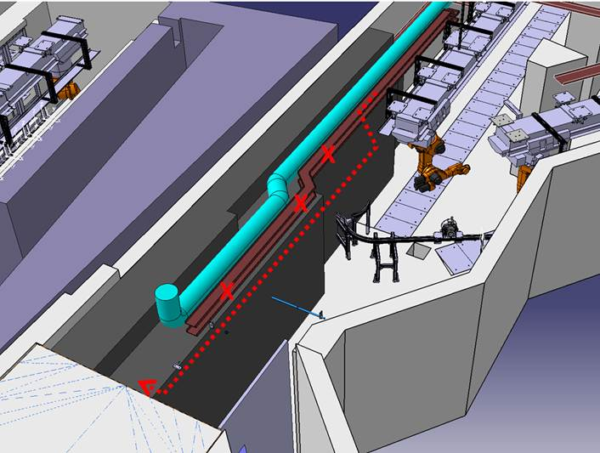
Extra Shielding

Slide 29






Building status
Finished by mid-May 2014

Slide 30
Outline
RILIS
REX
Tape station
RFQ Cooler
Target Area
  Hot cell, Robots, PAD/MAD, FE Modifications,
MEDICIS
Start up schedule

Slide 31

Cooling water
No HT
HT
Protons

Slide 32
Only 15 weeks before protons to ISOLDE!
Thank you for your attention.

Slide 33

HIE-ISOLDE Design Study
69th Meeting of the ISCC
31st March 2014
Richard Catherall, EN-STI

Slide 34

Successful

Slide 35
The Report
A detailed account of the approaches to address:
  the issues associated with an upgrade of primary beam intensity and energy
  the necessary upgrades required for an improvement in secondary beam quality
A description of the most appropriate solution
Approximate cost estimate and eventual timeline for its implementation
CERN Yellow Report

Slide 36

Overall Layout
Title page
Foreword
Participating members
  Associated partners
  Collaborating institutes etc
Steering committee
International Advisory Panel
Management Board
Design Study Members
Preface
Contents
Executive Summary
Introduction and Objectives
Section 1 Infrastructure
Section 2 Beam Quality Upgrade
Section 3 Target Issues
Section 4 Operations
Section 5 Radioprotection and Safety Summary
Section 6 cost and planning summary
Conclusion
List of publications associated with DS
HIE-ISOLDE
Design
Study

Slide 37
Section 1: Infrastructure Upgrade Section
Cooling and Ventilation
  Andrea, Michele
Vacuum
  Mario Hermann, Giovanna Vandoni, Maddalena Maietta, Tim Giles, Irina Graur
Beam dumps
  Valentina, Antonio, Ramon?
Fluka simulations and radiation protection
  Vasilis, Leonel, Joachim
Interfaces
  Robots, Medicis, infrastructure
    Richard

Slide 38
Section 2
Beam Quality Upgrade Section
Neutron converter
  Thierry, Serena, Stefano
Front end modifications towards beam improvement?
  Tim, Jacobo
HRS separator Magnet design
  Tim, Mathieu, Martin,
MRToF as a tool for High resolution – evaluation
  Martin…
HRS separator controls
  Alessandro, Martino
RFQ Cooler Design
  Tim, Carla
HRS Separator integration
  Tim, Carla, Mathieu, Jacobo, Martin
HRS Separator Integration
  Volunteers
REXEBIS Upgrade
  Fredrik, Andrej

Slide 39
Section 3:
Target and Front End Upgrade
Target Materials
  Michal, Thierry
Target Design
  Thierry, Stefano, Serena
Front End Design
  Stefano, Tim, Jacobo
New High Voltage Modulator
  Roger, Jan, Tony

Slide 40
Section 4 Operations
Boundary Conditions for operations
  Radioactive waste and target dismantling
  Target performance
  Access
  Maintenance
  Activation (air and material)
  Robots
  Production requests
    Richard and volunteers

Slide 41
Section 5
Safety and Radiation Protection Summary
Review of safety and radiation protection issues addressed throughout the report
Identification of further issues to be addressed
  ALARA
  Dose rates etc etc
    Ana-Paula, Joachim

Slide 42
Section 6:
Costing and Timeline Summary
Review of costing and timeline proposals extracted from the contents of the report
Mainly tables
  Richard
Conclusions and Executive Summary
  Richard

Slide 43
Planning
31st July 2014
  Sections 1 – 4 submitted for review
31st August 2014
  Sections 5 & 6, and rest submitted for review
22nd-25th September…HIE workshop?
30 September 2014
  Formatting and presentation complete, draft version of complete document submitted for review
31st October 2014
  Submitted to publisher

Slide 44

Off-Line 2
Front End # 8 is operational
  First time in the history of ISOLDE that we have a spare operational FE.
  The Off-line 2 is also operational
    Located in Building 275
    Thanks to T. Giles, M. Augustin and J. Montano
    The new RFQ Cooler Buncher is under construction
      C. Babcock

Slide 45

New Graphite Heater Prototype
Serena Cimmino

Slide 46

New Graphite Heater Prototype
Ohmic Heat / Containement
Thermocouple
Serena Cimmino

Slide 47



Design1
Serena Cimmino

Slide 48


Design 2
Serena Cimmino

