Slide 1
CO₂ Detector cooling
L. Zwalinski, P. Tropea
PH-DT-DI

Slide 2
CO₂ Detector cooling training
Why and how?
Start!
Some history on detector cooling
From present to future LHC experiments
What people do?
Current trends and future developments
Evaporative cooling: thermo siphon or CO₂ pumped cycle
I am curious!
I need some cooling for my detector, guidelines?
What counts and what is negligible
Let’s work!
Design a system for its whole lifetime
Redundancy, maintainability
And be happy for the rest of life!
How will the system be operated?
Cooling/detector interface, operation, long term monitoring

Slide 3
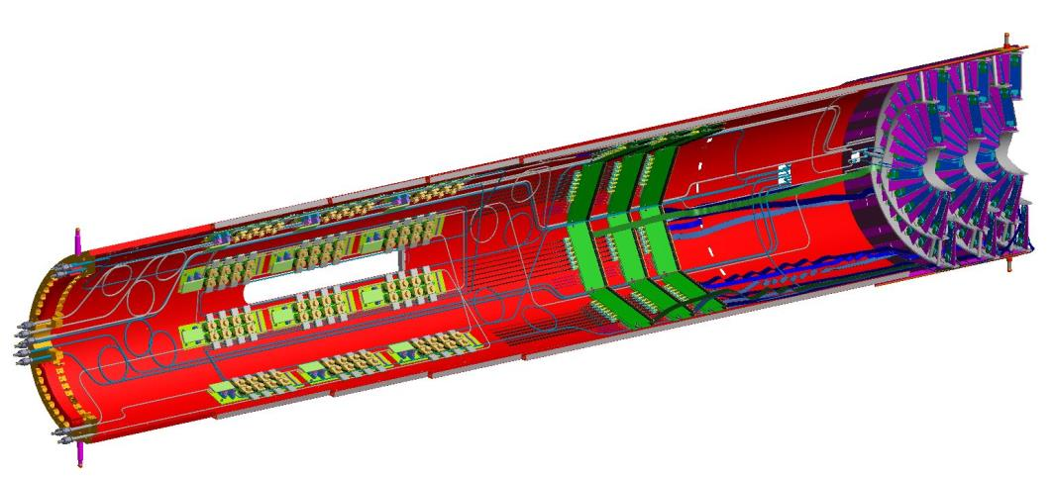
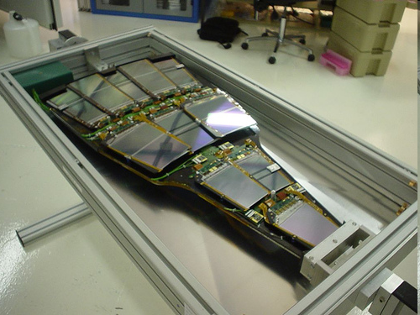
Detector cooling: why?
…many different reasons!
Port Cards and POH
Cooling tubes
and Cables
Dissipate the heat produced by:
  detector
  electronics
  cables
CO2 cooling tubes
and flex cables
3 Half Disks
DC-DC converters
Warm side
Heater
Passive insulation
K. Arndt, CMS Phase I Pixel detector EDR (https://indico.cern.ch/event/278220/)
ΔT
Maintain a neutral environment between different detectors: active thermal screens
Cold plate
Cold side
P. Petagna, Thermal enclosures & environmental management, 2008
Guarantee detector lifetime
  Silicon detectors
  Avoid thermal runaway
  Avoid reversed annealing
  Tsilicon < -5ºC

Slide 4
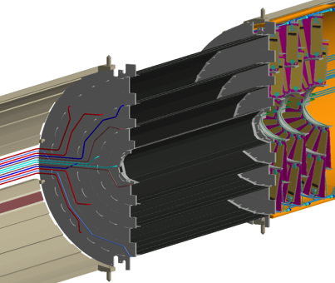
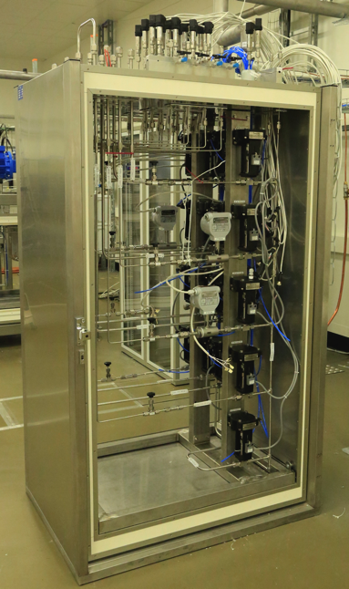
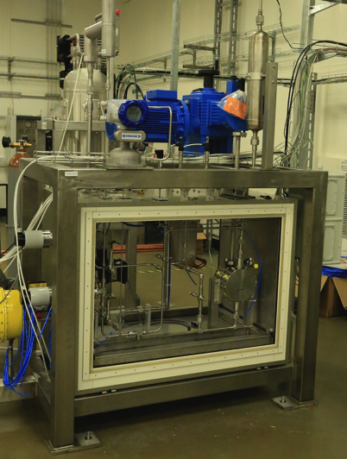
Detector cooling: what?
Some naming and geography for a complex system
Main pipework
Detector transfer lines
Detector distribution
manifold
Detector
& on board
cooling loops
THIS IS NOT A TRIVIAL FRIDGE!
Cooling plant
Manifold

Slide 5
Cooling of LHC experiments – “room” T
Water, C₄F_{10,} C₆F₁₄
ATLAS
Muons, LAr & Tile Calorimeters, Diffusion Pumps, Rod Racks
Demineralized or “treated” water
15-20 °C
TRT, CABLES
Liquid C₆F₁₄
15-20 °C
Alice
SPD
2 phase C₄F₁₀
15 °C
HMPID, SSD & SDD, TPC, TRD, TOF & Calorimeters
Water
16-18 °C
Pretty well known technologies, still very challenging for the application!
Magnetic field, radiation, etc.
24/7 operation, reduced accessibility
No space/no time/no mass requirements
CMS
Muons, ECAL & HCAL calorimeters, Diffusion pumps & magnet Busbar
Demineralized water
16-18 °C
Racks, PC farm
Tap water
16-18 °C
LHCb
RICH1&2
Liquid C₆F₁₄
10 °C
Calorimeters, OT, Muons, Racks
Water
16-18 °C

Slide 6
Cooling of LHC experiments – Low T
C₆F₁₄, CO₂, C₃F₈
ATLAS
Silicon detectors
Evaporative C₃F₈
-25°C
Alice
PHOS crystals
Liquid C₆F₁₄
-25 °C
Introducing further difficulties:
Environmental management
Insulation
Let’s see few examples!
CMS
Tracker, Pixel, Preshower, Tracker/ECAL active thermal screen
Liquid C₆F₁₄
-25 °C
LHCb
VELO
Evaporative CO₂
-25 °C

Slide 7
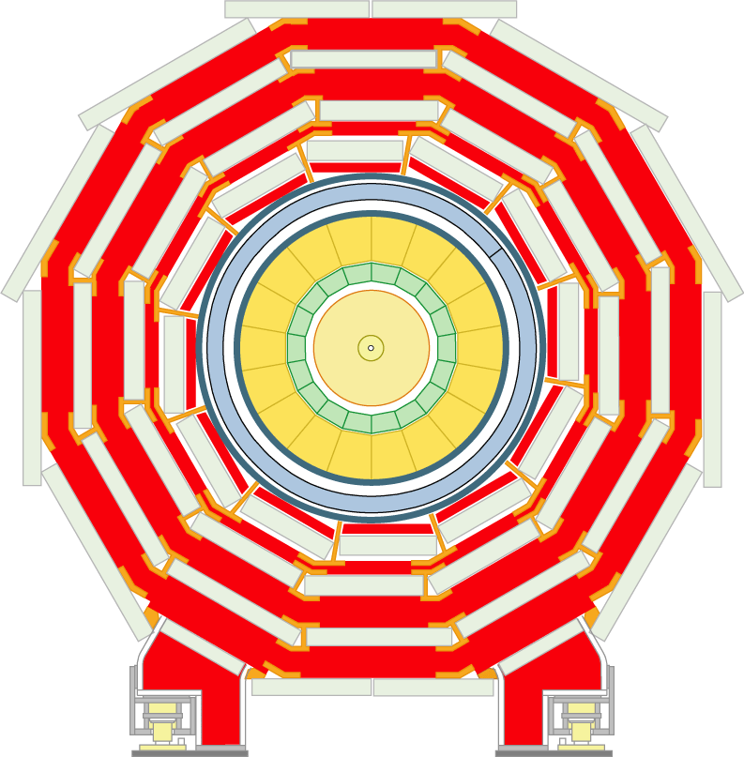
Detector cooling, low T - liquid
Typical system layout
CMS Tracker, Pixel , PreshoweR, 7 plants, 220 loops, 150 kW, -25C
P. Tropea, The CMS Tracker Fluorocarbon Cooling System ,
CERN Engineering Forum: Experiences from LHC cooling systems, 30 October 2008

Slide 8
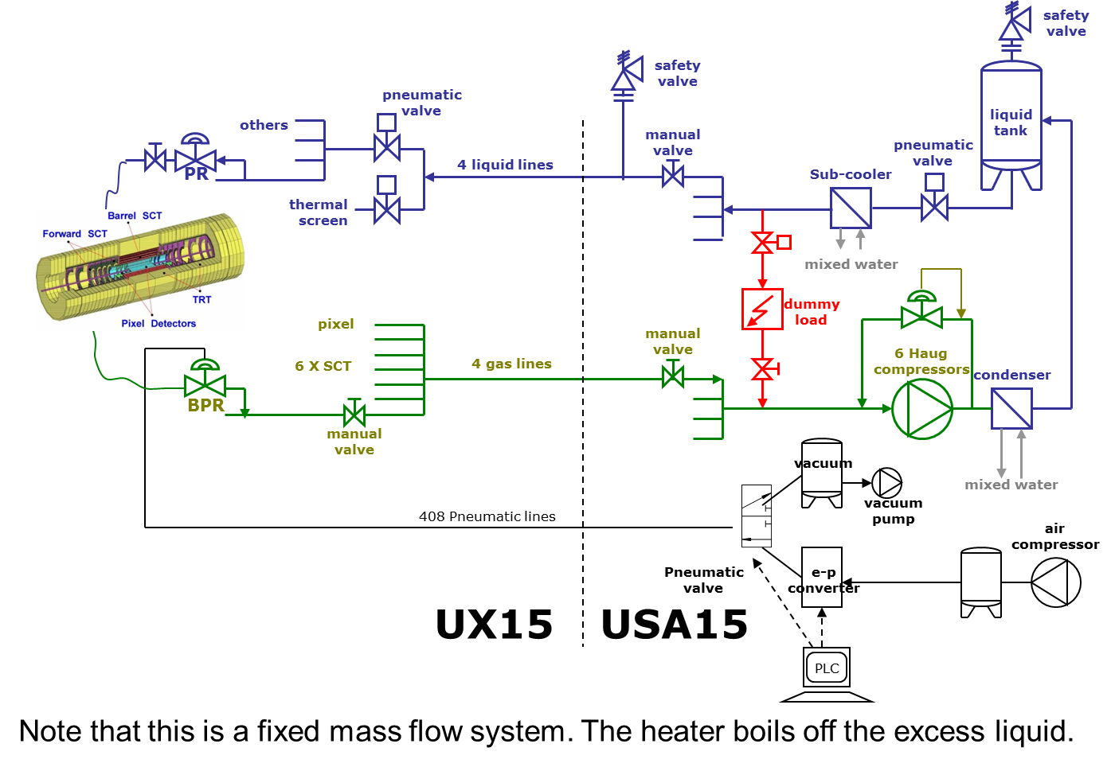
Detector cooling: low T - evaporative
Typical system layout
ATLAS Pixel & SCT: 204 loops, 60 kW, -25C
M. Battistin (EN/CV-DC), ATLAS ID Evaporative Cooling System
ATLAS ID review, 20 September 2007
Sketch from:
M. Battistin (EN/CV-DC), ATLAS ID Evaporative Cooling System
ATLAS ID review
20 September 2007
Sketch from:
M. Battistin (EN/CV-DC), ATLAS ID Evaporative Cooling System
ATLAS ID review
20 September 2007

Slide 9
What is next for low T?
Evaporative cooling vs liquid cooling
Evaporative cooling: WOW!
Low flow for higher Heat Transfer Coefficient (latent heat of evaporation adds to convection): smaller pipes
Limited temperature excursion on the detector (isothermal evaporation)
Temperature control through pressure control
But…
More complex system: evaporators on-detector and process design tightly linked!
Flow distribution
Dry out
EXPERTS NEEDED!

Slide 10
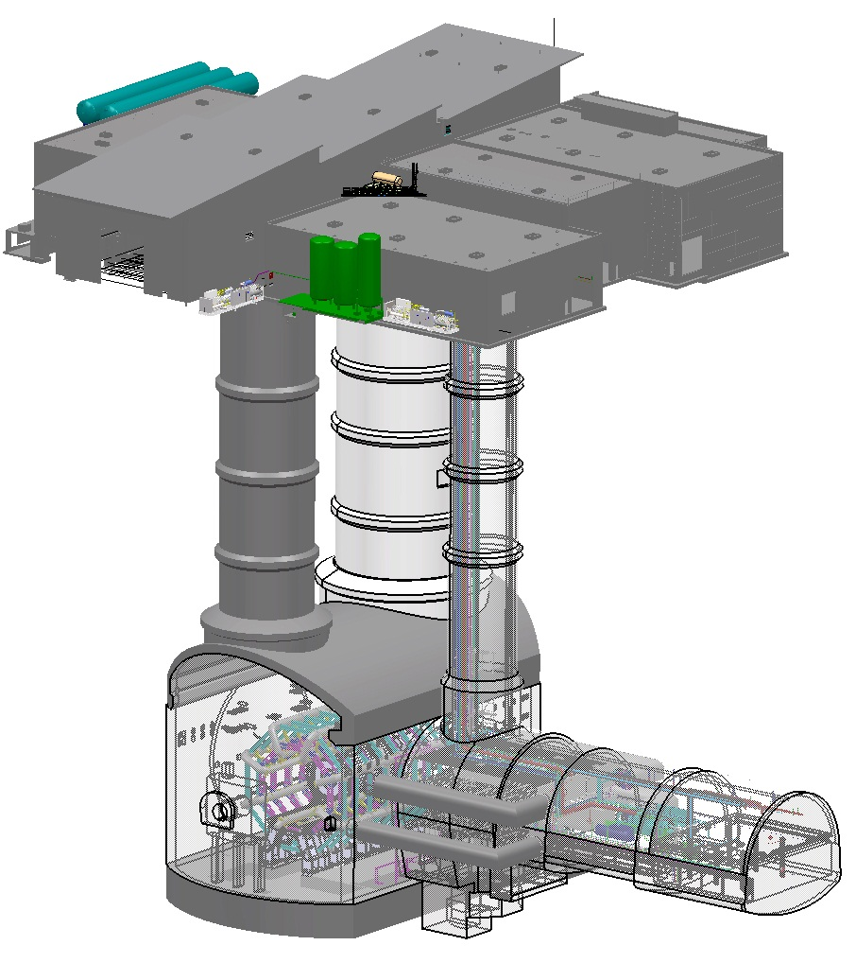
Thermosiphon system
Pictures from: M. Battistin & all TS team ATLAS ID Week CERN October 2013
ATLAS Pix & SCT
Surface:
Condenser
Water circuit
Low T chiller
Brine circuit
Surface-underground
C₃F₈ piping
Underground
USA15 by-pass unit
Connection to existing ID evaporative cooling system
ATLAS Surface
PX15
USA15
UX15
EN/CV & PH-DT

Slide 11
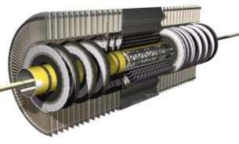
Thermosiphon system
Chiller
Why thermosiphon solution:
No active components
Leaks reduction (caused by compressors vibrations)
Possibility to decrease evaporation temperature from -20 °C to -25°C and to -30°C using blends C₃F₈-C₂F₆
liquid
tank
surface
pneumatic
valve
underground
USA15
Heater
THERMOSIPHON
Heater
dummy
load
UX15
others
pneumatic
valve
manual
valve
EVAPORATIVE
PR
liquid
tank
thermal
screen
Sub-cooler
4 liquid lines
pixel
manual
valve
dummy
load
condenser
6 X SCT
7 Haug
compressors
BPR
manual
valve
4 gas lines

Slide 12
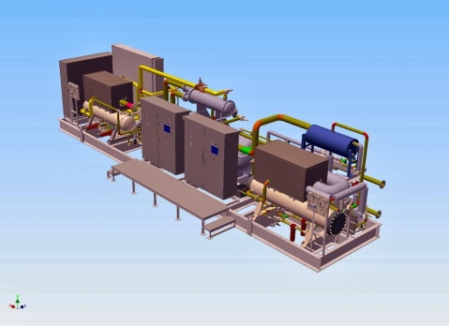
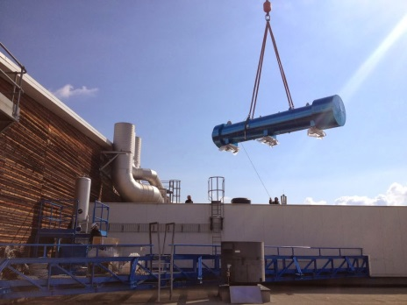
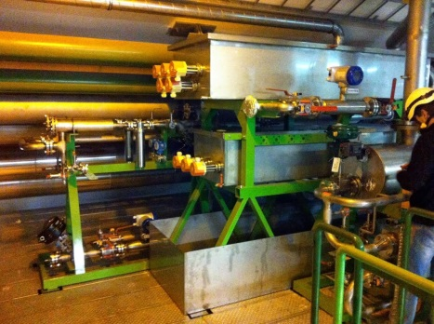
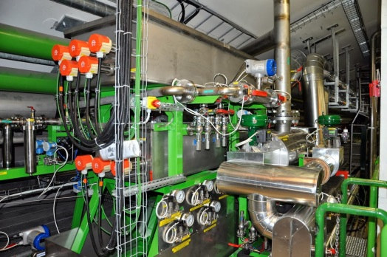
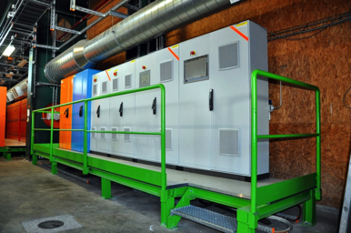
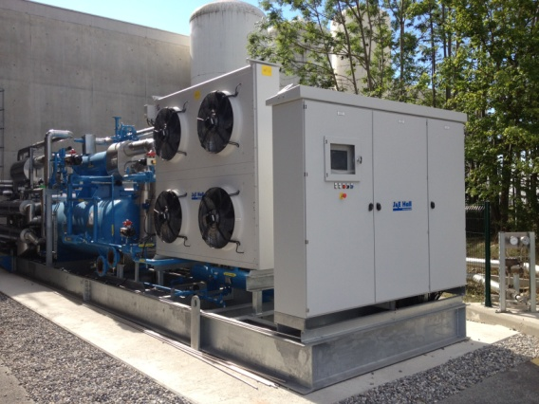
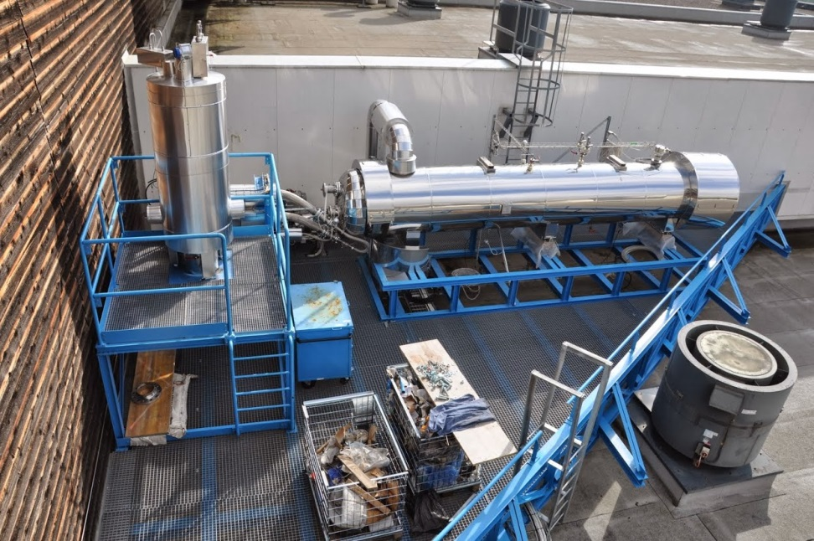
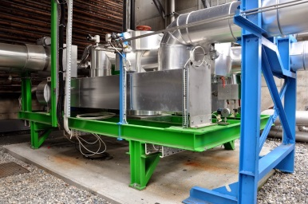
Thermosiphon system

Slide 13
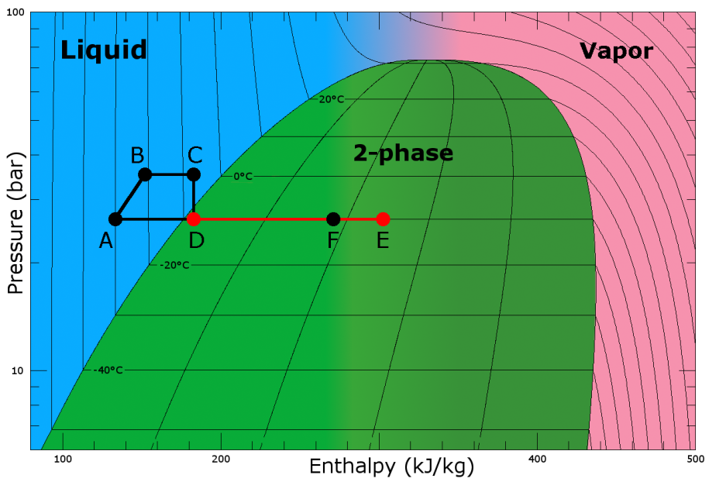
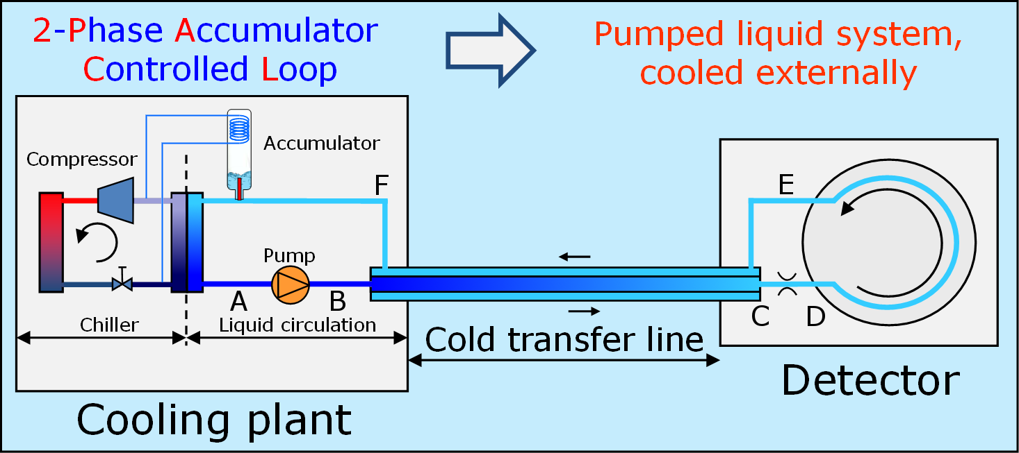
Evaporative CO₂ in pumping cycle
What is different?
Significant saving of cooling hardware (material budget) into the detector due to the physical properties:
large latent heat of evaporation
low liquid viscosity
high heat transfer coefficient
high thermal stability due to the high pressure
Very practical fluid to work (environmental friendly, not activated)
Practical range of the detector application -45⁰C to +25⁰C
Pictures from: L.Zwalinski et al. THE CONTROL SYSTEM FOR THE CO2 COOLING PLANTS FOR PHYSICS EXPERIMENTS, ICALEPCS 2013, San Francisco CA

Slide 14
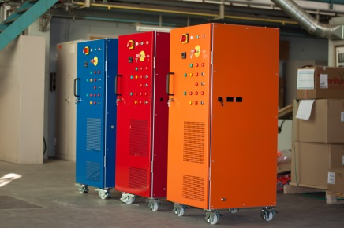
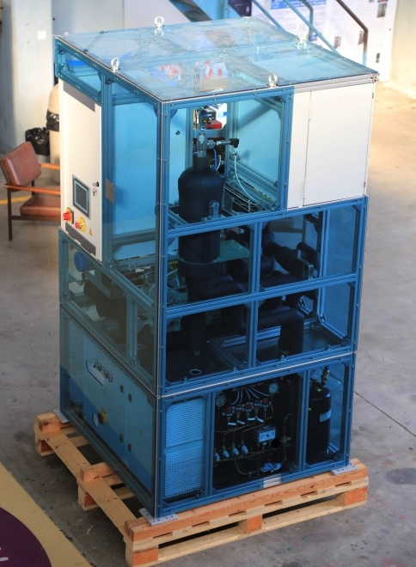
CO₂ 2PACL systems by PH-DT
system family
Experiment | Project name | PLC/DAQ Brand | Project status | Cooling power
ATLAS | SR1 | Siemens | Completed | 2kW
 | IBL | Schneider | Under development | 2x3.3kW
CMS | TIF | Schneider | Completed | 15kW
 | Pixel phase 1 | Schneider | Under development | 2x15kW
General purpose ATLAS & CMS | CORA | Siemens | Completed | 2kW
ATLAS & Belle | MARCO | Siemens | Completed | 1kW
ATLAS & CMS & LHCb ILC-PPC founded by AIDA project | TRACI | Siemens NI LabVIEW DAQ | Completed | 100W
Picture from: B.Verlaat CO₂ cooling is getting hot in high-energy physics CERN COURIER May 2012

Slide 15
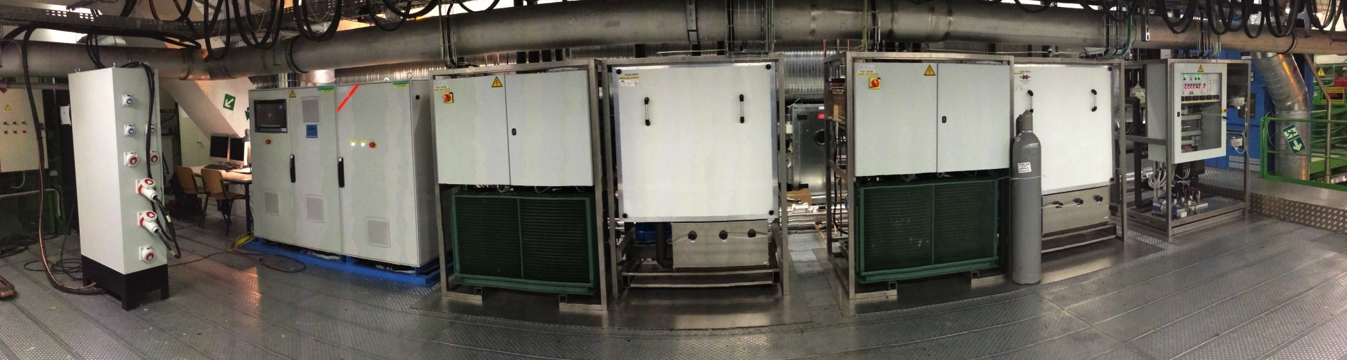
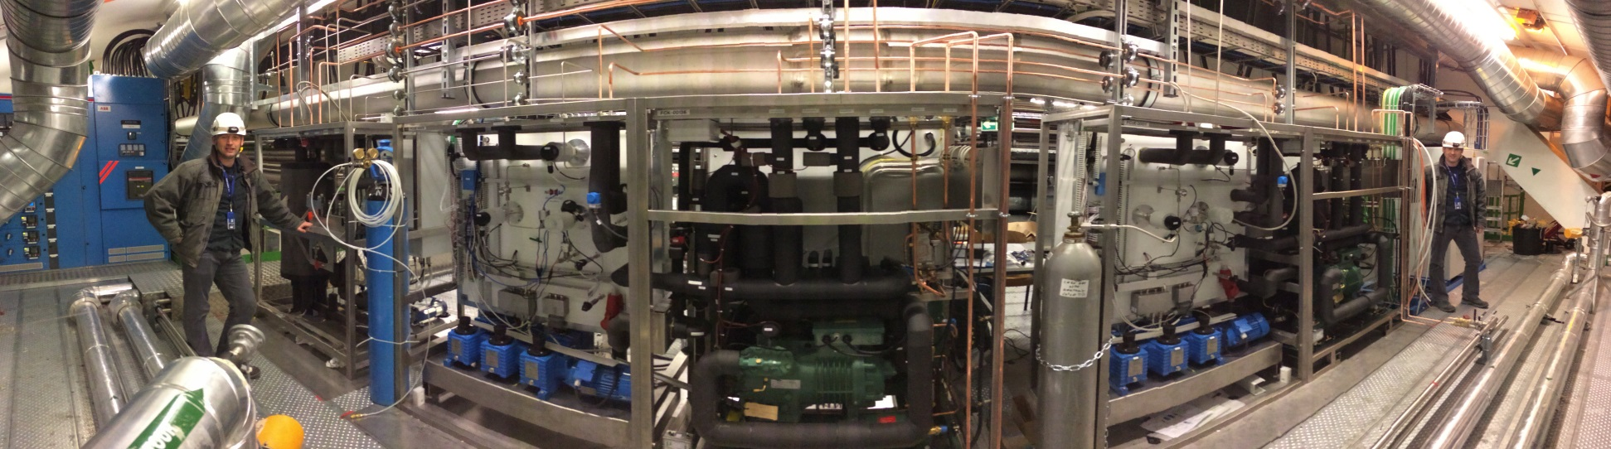
CO₂ 2PACL systems by PH-DT
ATLAS IBL
Plants @ USA15 level 3
Collaboration with Nikhef and EN/CV/DC

Slide 16
CO₂ 2PACL systems by PH-DT
ATLAS IBL
2x3.3kW cooling power
2x plant cores, 2x chillers, 1x accumulator and controls placed in USA15
Transfer line connecting USA15 with UX15 ~100m long
Manifold and Junction box inside the toroid area
CO2 distribution via flexible vacuum insulated lines up to the dry volume
Vacuum system in UX15
Pictures from: B.Verlaat EDMS1233482

Slide 17
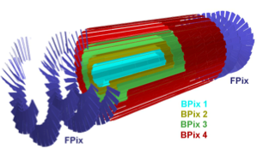
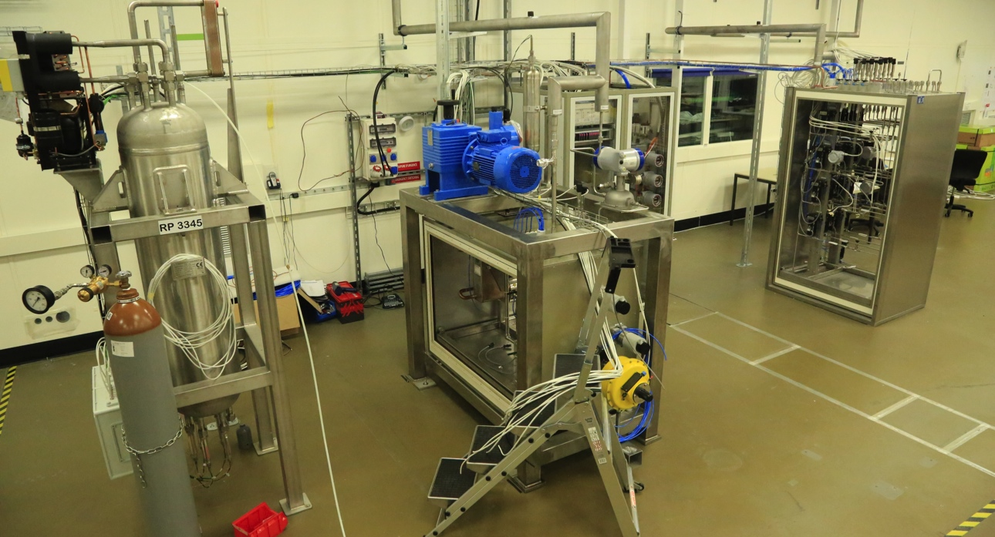
CO₂ 2PACL systems by PH-DT
CMS TIF (test facility for Pix upgrade)
New Pixel detector for CMS to arrive in 2016
15 kW total cooling power @ -20°C
One full scale mock up of the system ready in 2013 @ TIF
Full cooling system at P5 end of 2014
125 M silicon pixels (x2 compared to present detector)
  4 Barrel layers
  3 Forward discs on each side

Slide 18
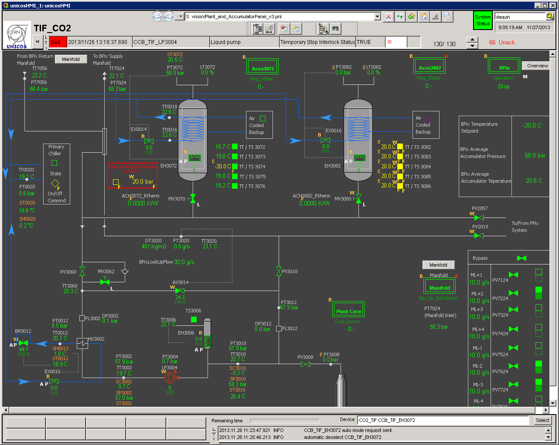
CO₂ 2PACL systems by PH-DT
CMS Pixel Phase I upgrade
Biggest system ever built on 2 PACL principle
Fully built in PH-DT workshop (THANKS!)
Controls in PVSS, merging of PH-DT gas and cooling expertise (GREAT!)
Picture from: S. Pavis, PVSS controls for CMS Pixel Phase I Upgrade

Slide 19
Where did we start from?
The road we followed and we’d like to follow in the future
For CO₂ evaporative cooling system design
(and not only):
MULTIDISCIPLINARY APPROACH
Just to begin with….
Thermal contact & thermal needs
Power dissipation
Simulations

Slide 20
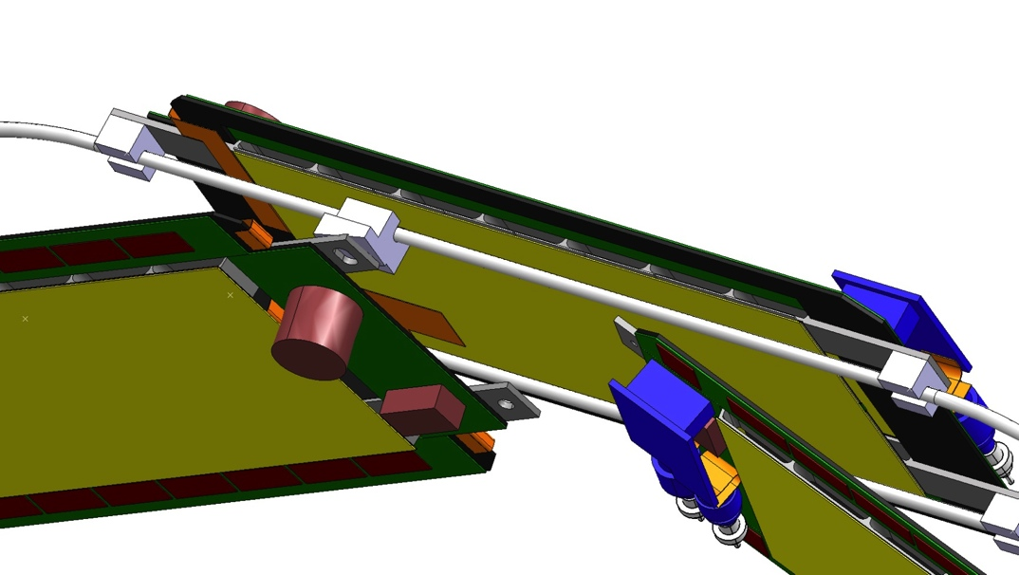
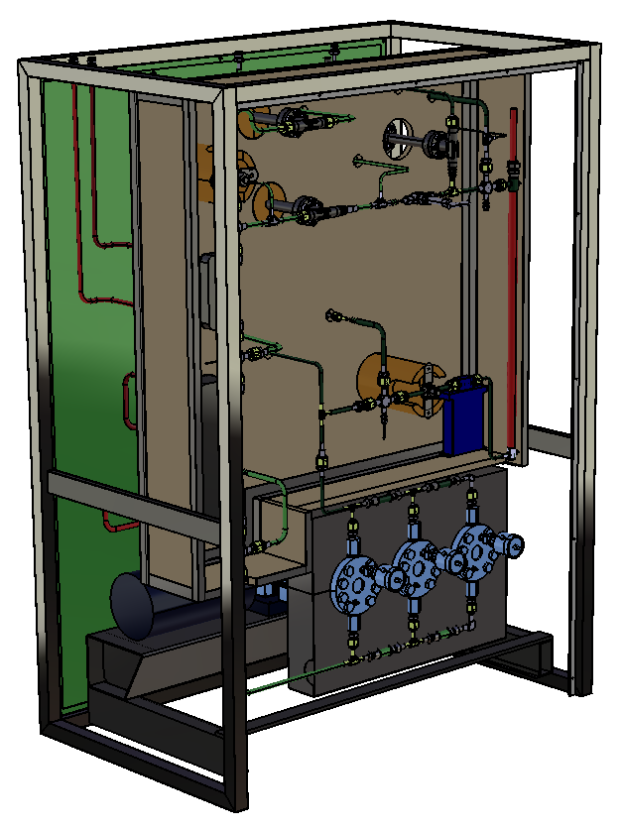
Thermal load
Detector experts & cooling engineers!
I need some cooling for…
Heat transfer
Detector
Detector heat
Transfer line
Conductance
Pressure drop
Heat transfer
Cooling plant
CMS-Upg. -Inner Barrel Aleksis Chávez Niemelä,
Thermal / Mechanical structure (Conductance)
Cooling lines
Evaporative Heat Transfer (Conductance)
Cooling tube distribution (Pressure drop*)
Cooling transfer line (Pressure drop*)
* Pressure drop in a 2-phase system changes the boiling pressure and is manifested as a temperature drop. Needs therefore to be accounted for in the design of the overall thermal chain together with the conductance in the structure.
Is your load:
Stable / changing over the day
Fix/increasing along the years
Uniform

Slide 21
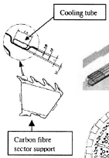
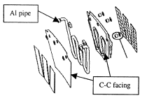
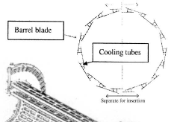
my thermal contact could look like…
Thus the coolant temperature…
Thermodynamic & detector experts!
Sensor
R/O chips
(Kapton, flex…)
Metallic pipe
Thermal conductive ledge
Critical thermal contact!
(ΔCTE, surface of contact…)
(CFRP) Mechanical support
Pictures from:
M. Olcese, Mechanics and cooling of pixel detectors, NIM A 465 (2001)
With this thermal contact/detector layout:
What is the ΔT between coolant and your critical parts of the detector?
How do your pipes look like? (length, diameter)

Slide 22
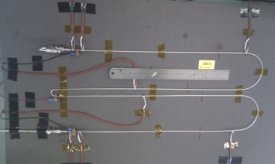
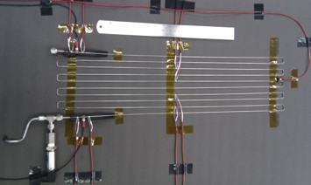
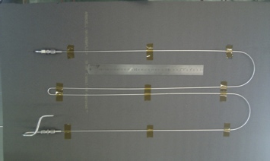
Let’s start seeing if it could work
Simulation & mock-ups for evaporative cooling design
Detector Outlet
Detector Inlet
Electronics
Detector
Pictures from: J. Noite, CMS Bpix cooling loop simulation
CoBra calculator (J. Noite, B. Verlaat) developed to predict flow regime and fluid properties changes (DT and DP) along the pipes (Prof. Thome model for 2-phase).
Have you tested your model?
Thermodynamic experts!

Slide 23
By the way: the detector should also…
…operate in a very different temperature range
Checkout & commissioning conditions:
no insulation/drying available
Room T operation?
With evaporative system, a consistently different Heat Transfer Coefficient is to be expected !
Thermodynamic & detector experts!
J. Noite: HTC comparison at -20°C and +15°C

Slide 24
Ok…and now?
Cooling system design process
The basics detector needs
Thermal contact & thermal needs
Power dissipation
Simulations
Now we should start looking at:
Which environment?
How do I connect the parts of the system?
How reliable do I need my system to be?

Slide 25
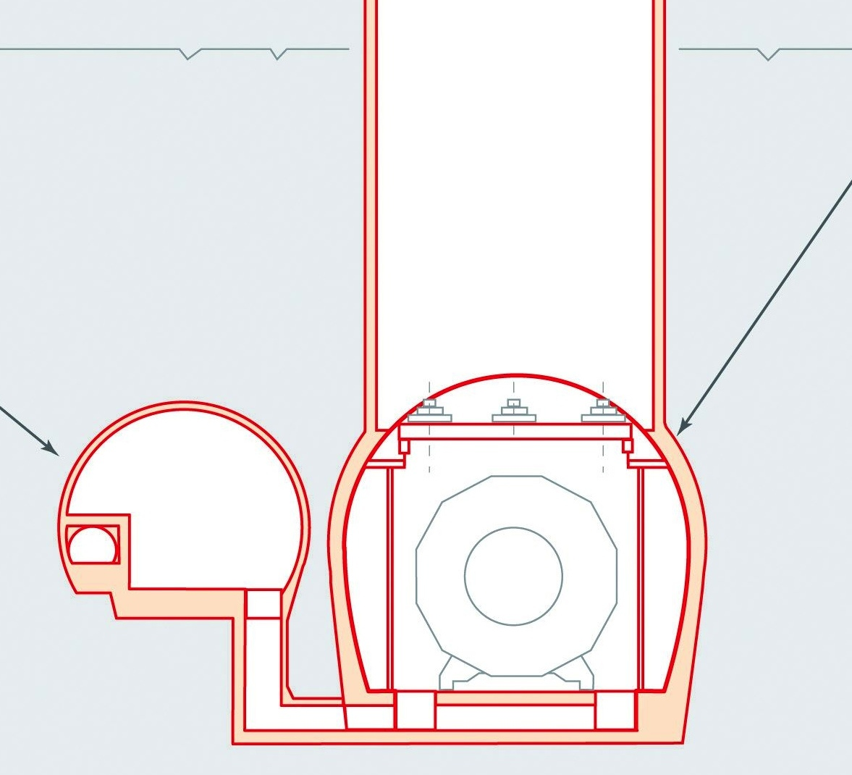
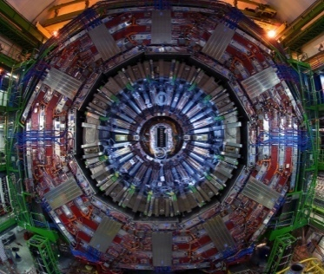
Which environment?
Designers & safety experts!
And how to decide the geography….
Ideally:
Access active components 24/7
No issues of magnetic field and/or radiation for the selection of parts
i.e.: place as much as possible of your system in Service caverns…..but
Radiation protection simulations are needed, to prove everyone is safe when working around the system!
DO NOT FORGET ANCILLARY SERVICES! (dry air, power, water, etc.)
Experimental caverns
100 m underground
Ionizing radiation
Magnetic field
Service caverns
80 m underground
Accessible during LHC operation
No radiation nor magnetic field

Slide 26

How do we bring coolant to the detector?
….speaking about transfer lines and granularity
2PACL CO₂ systems:
inlet to the detector shall be liquid, subcooled
Low operating T: suffering from ambient heat, insulation!
Concentric transfer lines allow perfect heat exchange between inlet and outlet
Granularity (size of detector manifolds) determines Δp at the detector inlet, guides the sizing of the transfer lines & the selection of your pump!!
Cooling, integration, detector experts!
Outlet manifold:
Pressure = fixed
Ambient heat
Vapor return
_{T2phase}
Detector
Inlet liquid
Plant
Transfer line
_{Tliquid}
Pipe length
Inlet manifold: Temperature = fixed
Pictures from: B. Verlaat, Forum on Tracking Detector Mechanics, 2013

Slide 27
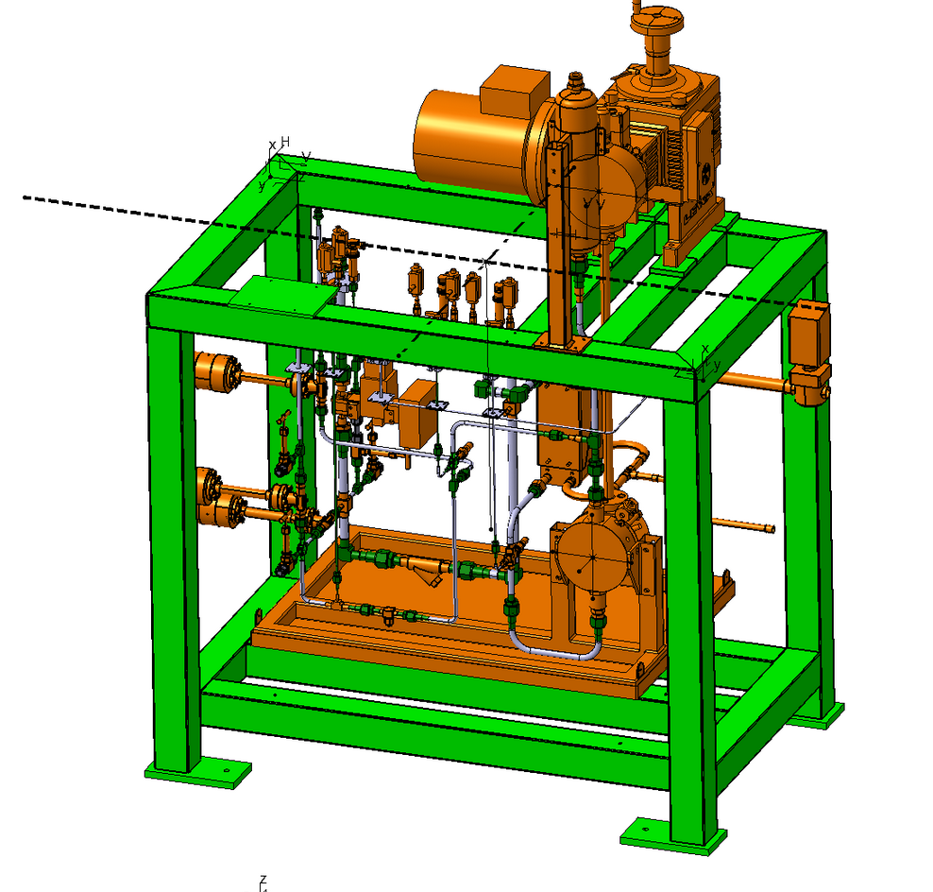
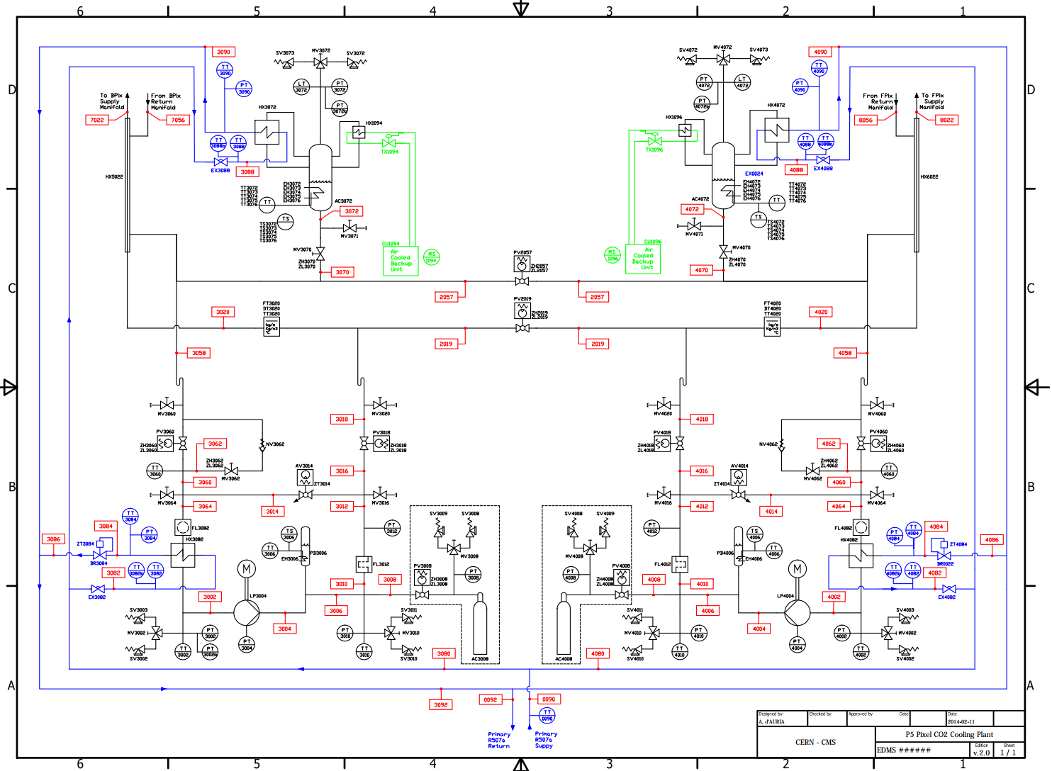
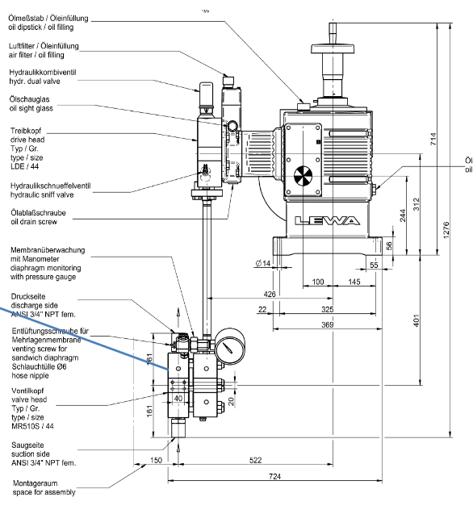
Ok, we have a baseline
Design, control, mechanics, process experts!
How will my system look like?
Membrane pump
150 g/s liquid CO₂
-40 to +15°C operating T
157 bar testing p
Remote head
Frequency driver
Remote stroke adjustment
P&I (process and instrumentation)
Component selection
3D modeling for construction and integration with detector integration office!
Picture from:
A. D’Auria, Process and Instrumentation diagram for CMS Pixel CO2 cooling system

Slide 28
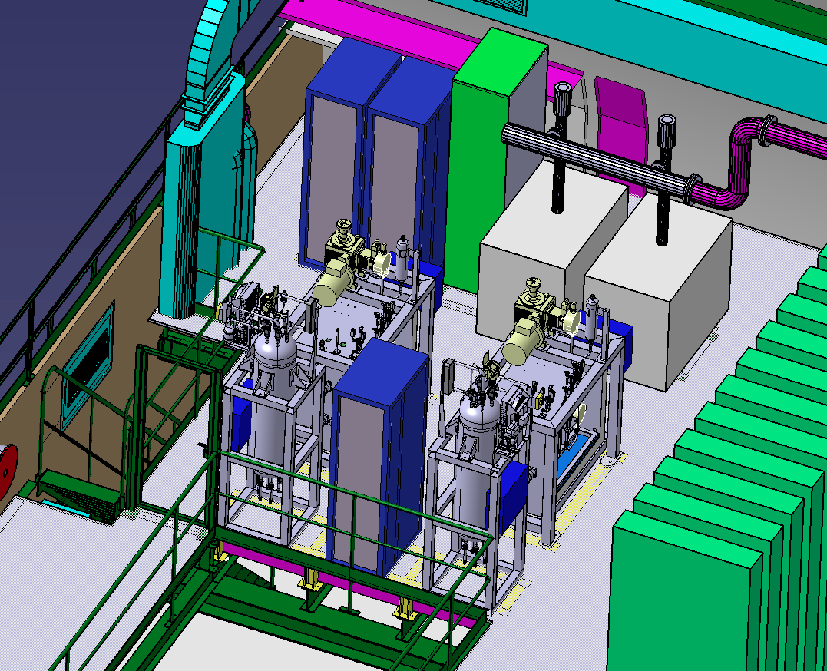
The layout is there: how do I build it?
QA matters
Welding, mechanics, safety and integration experts!
During construction
CO₂ systems design pressure above 100 bar
QA for the construction shall be tight: and be the same over all the system (plant to detector!)
samples for welds, in order to establish accurate welding procedure
Visual inspections by experts, x-rays on sampling welds
P tests following EU standards
Leak tests
Careful choice of connectors!
Integration!

Slide 29
But we also need to know….
Detector, cooling and control experts!
Operation scenarios
  IBL: Operation, Stand-by, Bake-out!
  What is the availability rate needed?
    IBL: Run always!
    What are foreseen maintenance time slots available?
  What happens if cooling gets off?
  Apply alarms philosophy adopted to your needs.
Detector interface
  Who drives the cooling system?
  Who and how decides on the cooling system settings?
  What are the interlocks and the consequences?
  When and how cooling should be stopped?
  Who and how reads the data from the cooling system?
At least very simple
risk analysis is needed!

Slide 30
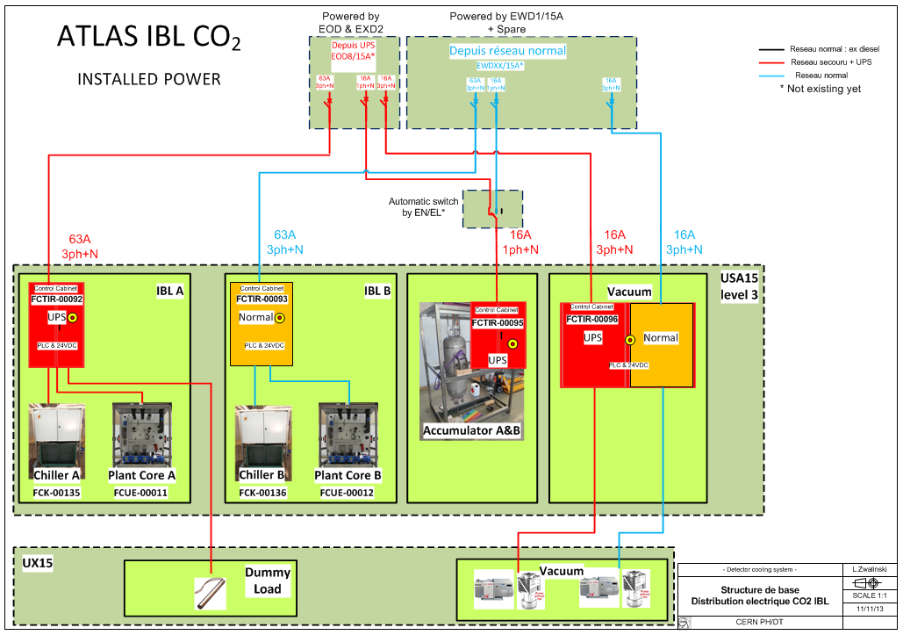
Long live the king!
Adapt your choice to the detector needs!
Redundancy
  Mechanics
    Completely independent systems or shared components/modules
    Use redundant sensors for the key operations
  Control
    One PLC vs multi PLCs system
    One central SCADA server or many individual ones
    Distributed IOs or PLC IOs
    Fieldbus or direct connections and what architecture
  Electrical power
    Normal power, UPS or diesels
    Single or at least two different power sources
ATLAS IBL
shared & modular architecture
Picture from: O.Crespo-Lopez ,L.Zwalinski EDMS1331128

Slide 31
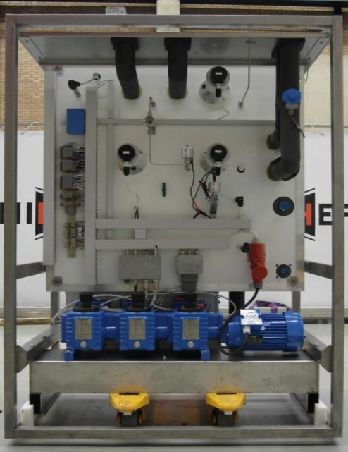
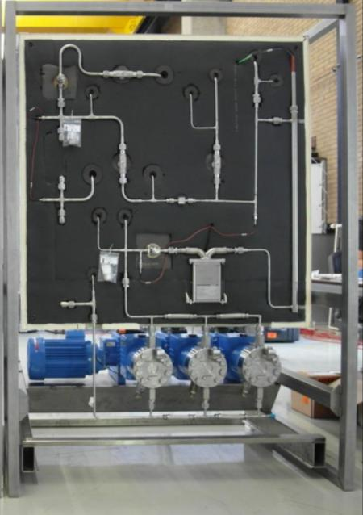
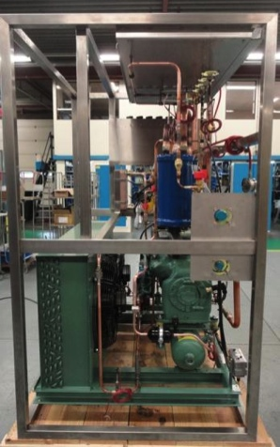
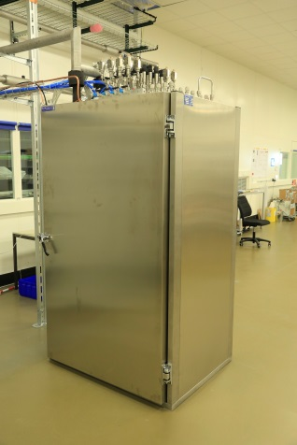
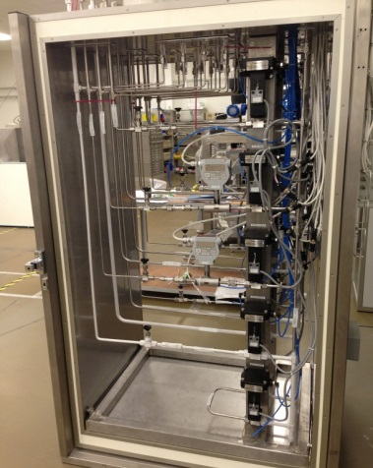
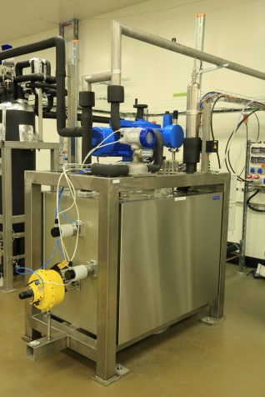
Long live the king!
In case of catastrophic failure we can replace one single module.
It provides more flexibility in operation.
Much easier installation especially in the underground areas.
Maintainability
  Modularity
  Accessibility
  Clear procedures
Quick and easy maintenance.
Decreases the need of using special equipment.
Decrease significantly the number of human errors.
Increase safety of the maintenance team.
Plant Core Back
Plant Core Front
Chiller
Manifold outside
Manifold inside
Plant Core
Access to all warm mechanical components from the outside
Easy to take off foam box front cover providing access to all cold components
Control components and connections kept outside
Quick pump dismounting with lifting tool
Access to all warm mechanical components from the outside
All cold components installed inside fridge box with like cabinet doors opening
Control components and connections kept outside

Slide 32
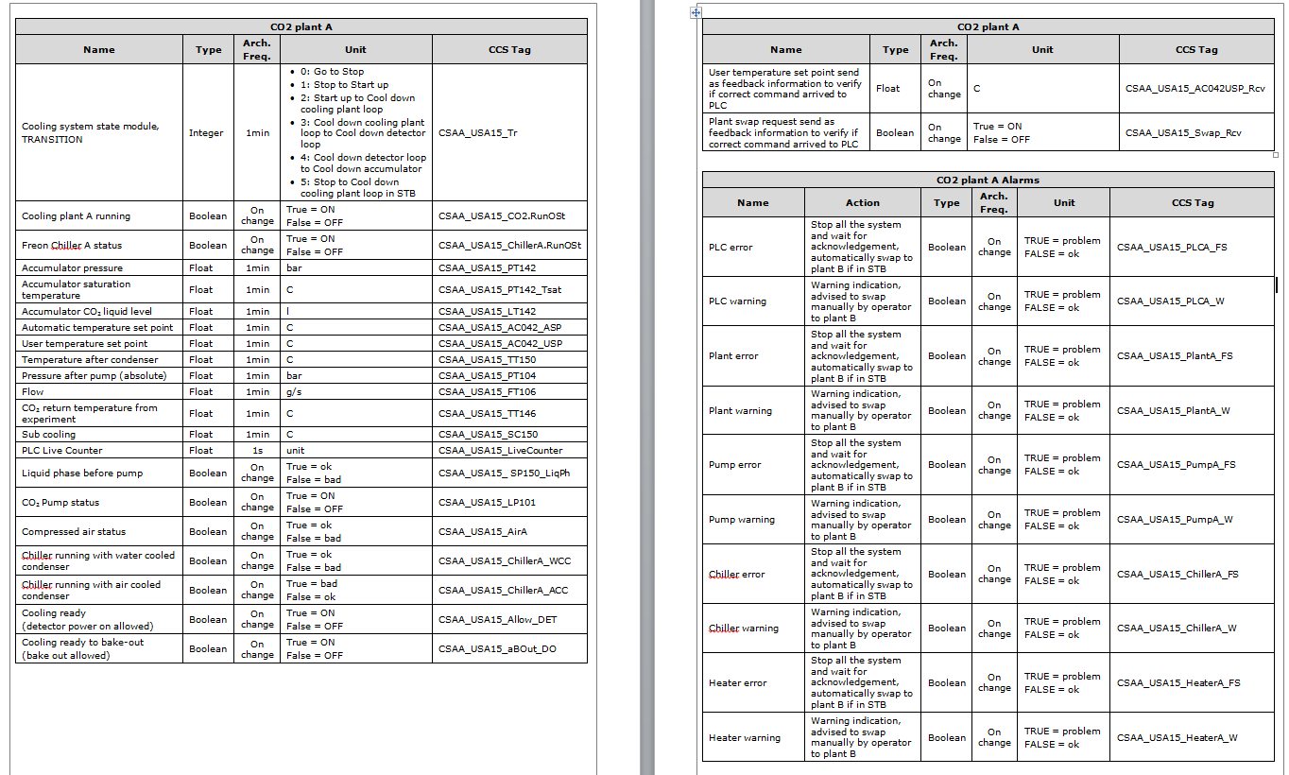
…and they lived happily ever after
Detector interface
  What are the interactions foreseen between detector and cooling system? One way or two way communication?
  Detector Control System: DIP or/and direct communication with PLC.
  Detector Safety System: hard wired signals
  Well defined key information to the detector (*not too much but also don’t limit it to on/off state as people will ask for more)
Pictures from: L.Zwalinski et al. The control system for the CO2 cooling plants for physics experiments, ICALEPCS 2013, San Francisco CA

Slide 33
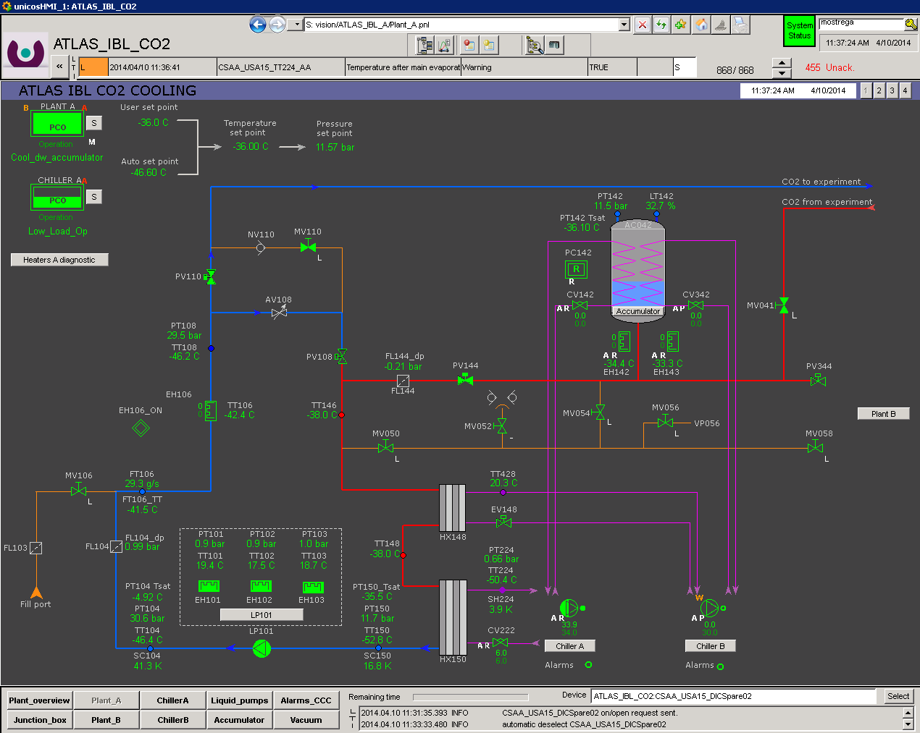
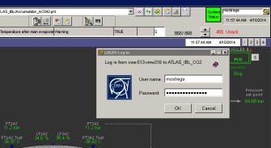


…and they lived happily ever after
Control and detector experts!
Operation
  Understandable interfaces with same philosophy and operation interactions for all new detector cooling systems.
  Clear and intuitive navigation.
  Easy access inside and outside CERN for the experts and support team.
  Access control with different privileges levels driven by e-groups.
  Diagnostic expert interface panels.
Our selected solution is
UNICOS CPC6
& WinCC OA
Pictures from: M.Ostrega, M.Zimny, L.Zwalinski ATLAS IBL CO2 cooling system

Slide 34

…and they lived happily ever after
Remember to make your data safe and available
for any later analysis even after very long time!
Long term monitoring
  Detector data bases
  LHC Logging
  EN-ICE ORACLE
  Local DB
Our current choice for most
of the applications is
LHC Logging
Control experts!

Slide 35
Summary & outlook
What have we learnt
The design of a cooling system must involve experts in many different fields:
  Detector design
  Mechanics and thermal contact
  Cooling process
  Safety (pressure & radiation protection)
  Controls
  Thermodynamics
  Welding
  Integration
  Detector operation
CO₂ cooling system design is not trivial: keep it as simple as possible and make sure all parties are involved!

Slide 36

Detector cooling in PH-DT
STAG
form CUT
THANKS!!!

Slide 37
Some references…
And a big thank you to all people having given precious inputs!
J. Godlewski, S. McMahon, A. Tauro, B. Verlaat, V. Vacek, P. Petagna, M. Battistin, Engineering forum: experiences from cooling systems for LHC detectors 2008
Workshop on quality issues in current and future silicon detectors, 2011
H. Postema, VERTEX 2011
B. Verlaat, ECFA High luminosity LHC Experiments Workshop, 2013
P. Petagna, VERTEX 2013
J. Daguin, CERN detector seminar 2013
Forum on Tracking Detector Mechanics, 2013
L. Zwalinski et al. The control system for the CO2 cooling plants for physics experiments, ICALEPCS 2013

Slide 38
Backup slides

Slide 39




Why CO₂ in particle physics detectors?
Typical Silicon detectors requirements:
Distributed heat load up to 20 kW/m2
Low temperature operation to reduce radiation damage effects (down to -40˚C)
Room temperature for testing
Reliable cooling with minimal temperature gradients
Minimization of material inside the detector active volume
Current BPIX Services
Upgraded BPIX Services
Current 3 layer
Upgraded 4 layer
Current 2 disk
Upgraded 3 disks
Radiation length
Radiation length
η<2.2 : weight = 16.9 Kg (3 layer)
η<2.2 : weight = 6.5 Kg (4 layer)
Today: liquid C6F14
Low thermal capacity (≈1 KJ.Kg⁻¹.K⁻¹)
High density (≈1,7 kg.l⁻¹)
“Big” pipes (3.0 mm ID / 0.3 mm thick)
Tomorrow: evaporative CO2
Enhanced thermal capacity (≈2 KJ.Kg-1.K-1)
Lower density (≈1.0 kg.l-1)
Much smaller pipes (1.6 mm ID / 0.05 mm thick)

Slide 40
How to evaporate liquid CO₂ in your detector?
Liquid
Refrigeration method:
(Atlas)
Vapor compression system
Vapor
Compressor
Pressure
Heater
BP. Regulator
Warm transfer
2-phase
Enthalpy
Cooling plant
Detector
2PACL method:
(LHCb)
Pumped liquid system, cooled externally
Liquid
Vapor
Compressor
Pressure
Pump
2-phase
Chiller
Liquid circulation
Cold transfer
Enthalpy
Cooling plant
Detector

