Slide 1
CLIC (module) instrumentation
Module beam instrumentation
    BPM’s
    Wakefield monitor’s
    Acquisition system
Sector beam instrumentation
    Transverse profile monitors
    Current measurement
    Beam loss monitors
    Bunch form / length
    Beam phase

Slide 2
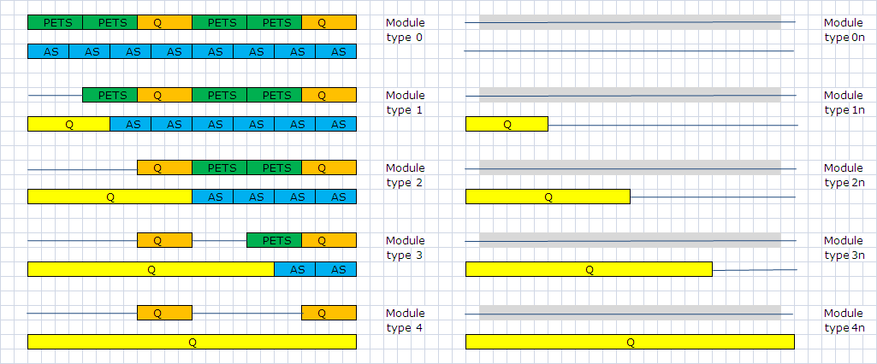
Module types
1 BPM per quadrupole
1WFM per accelerating structure
78
0?
4
5
5
8374
154
634
477
731
In total 10462 modules per Linac

Slide 3
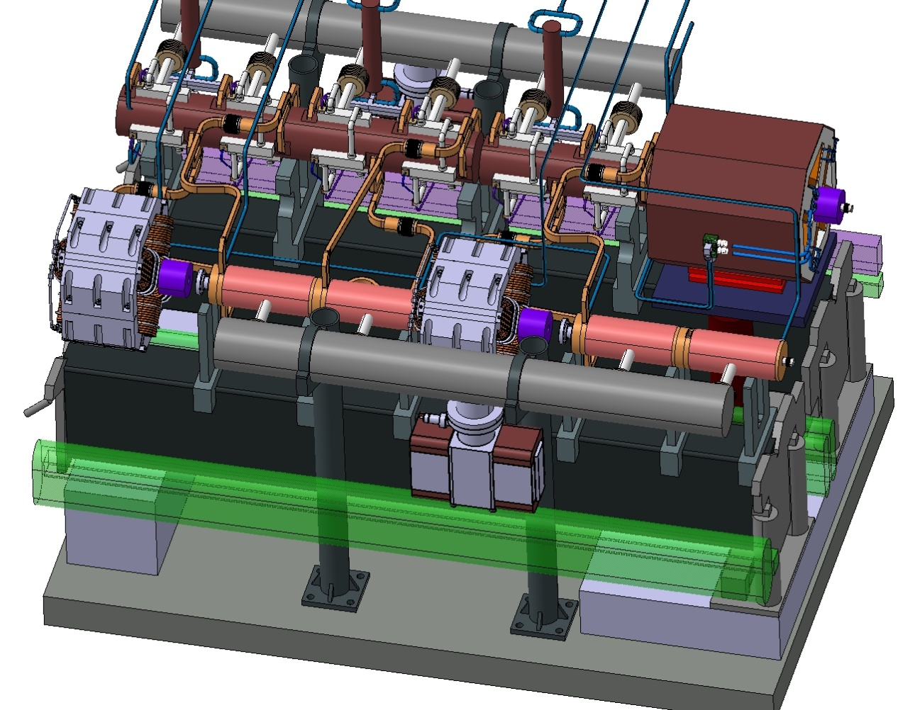
CLIC module, Type 1
Wake Field Monitors
Q-BPM
Main Beam
Beams
Q-BPM
Drive Beam
Hybrid
Other electronics
BLM
Q-BPM

Slide 4
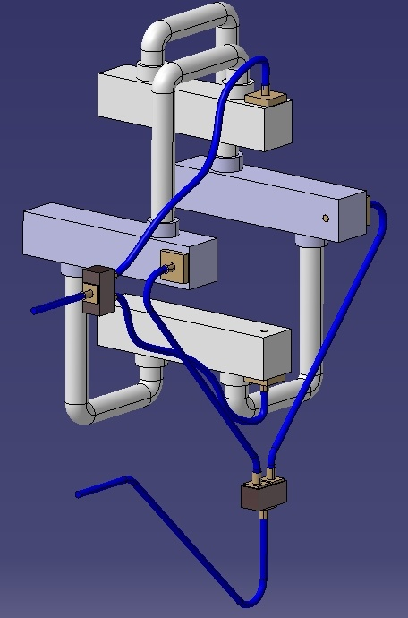
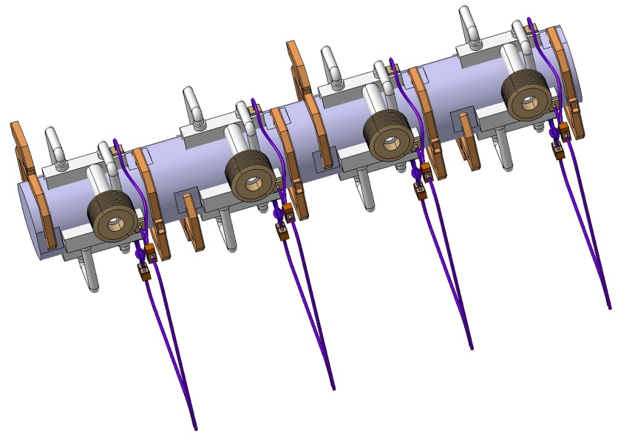
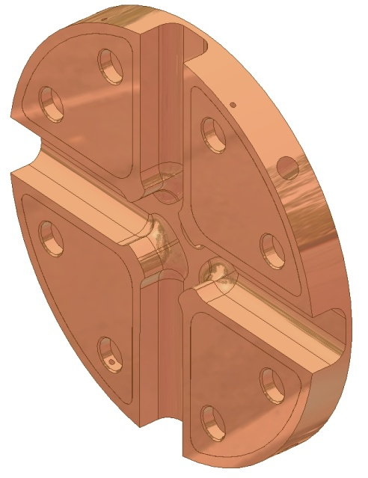
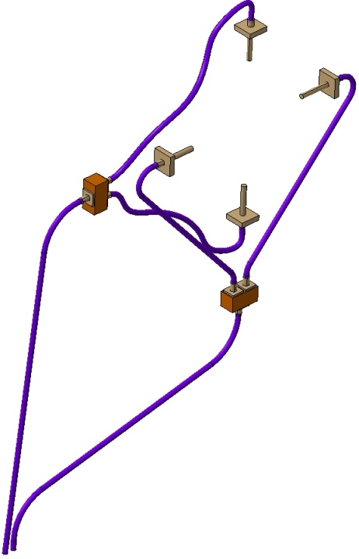
WFM
TM11+
Vacuum

Slide 5
BPM and WFM specifications
Main beam
Nominal beam parameters: Charges/bunch :3.7*10^{9 ,} Nb of Bunches: 312, Bunch length: 45µm-70µm, Train length: 156ns
 | Accuracy | Resolution | Stability | Range | Bandwidth | Beam tube aperture | Available length | Intercepting device? | How many? | Used in RT Feedback? | Machine protection Item? | Comments | Ref
BPM | 5µm | 50nm | 100nm |  | 35MHz | 8.0mm | 95/65mm | No | 4176 | Yes | Yes | Choke BPM? Inductive BPM | CLIC note 764
WFM | 5µm | <5µm |  |  | 35MHz | 8.0mm? | "-" | No | 142812 | Yes | No | TM01~16GHz | CLIC note 764
Intensity!
Drive beam
Nominal beam parameters: Charges/bunch :5.2*10^{10 ,} Nb of Bunches: 2922, Bunch length: 1mm, Train length: 243.7ns
Accuracy | Resolution | Stability | Range | Bandwidth | Beam tube aperture | Available length | Intercepting device? | How many? | Used in RT Feedback? | Machine protection Item? | Comments | Ref
BPM | 20µm | 2µm | ? | <5mm | 35MHz | 23mm | 104/74mm | No | 41480 | Yes | Yes | Inductive ? Strip line ? | CLIC note 764
Intensity!

Slide 6
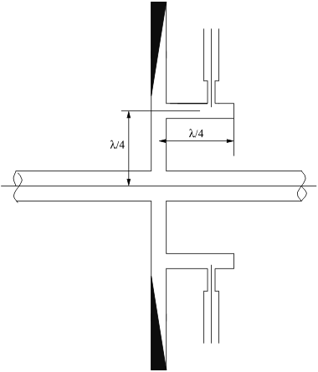
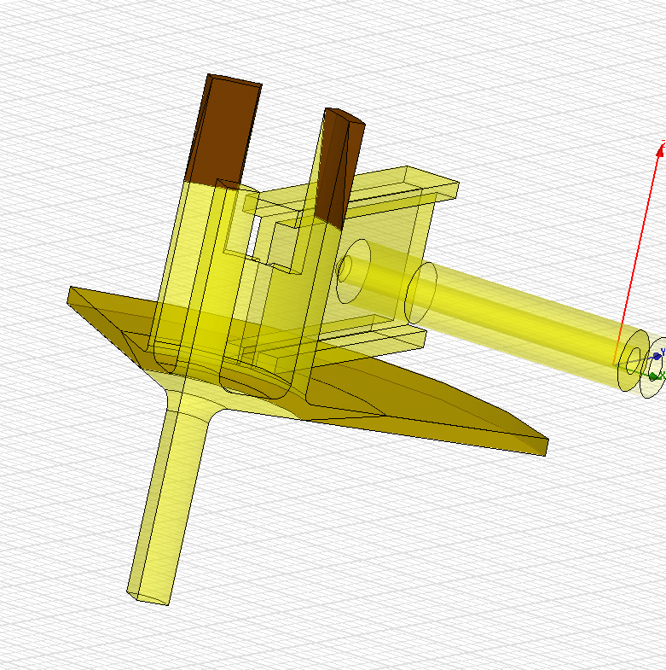
Choke BPM
See Igor Syrachev’s talk, Thursday 14H30
Beam
RF design is made, but mechanical design
Manufacturing still needs to be done!
Choke where the TM11 mode is trapped
Damping material, TM01
Coaxial antenna pickup

Slide 7
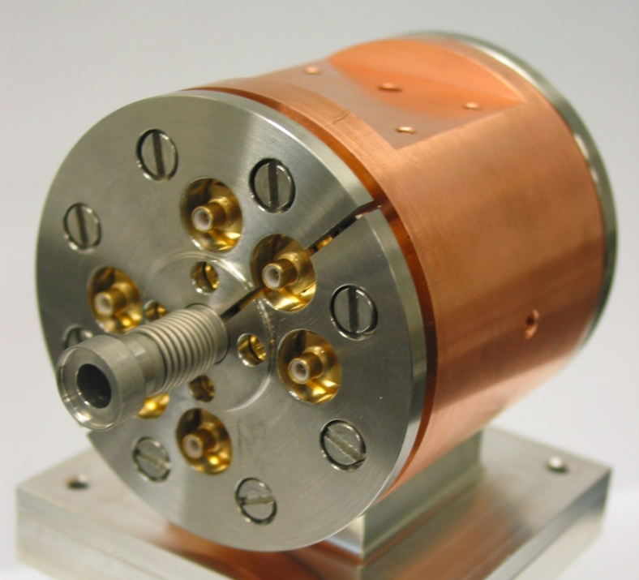
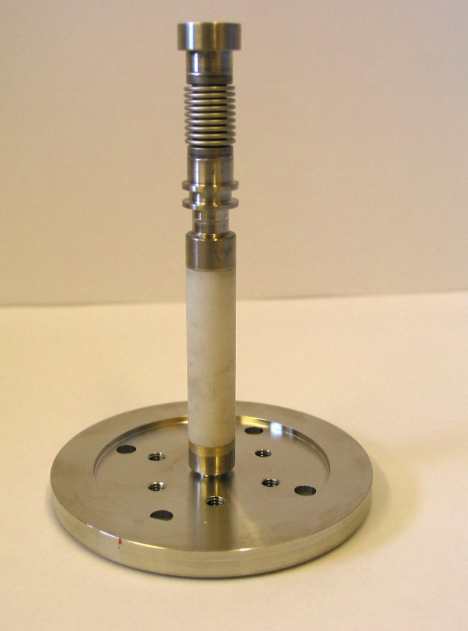
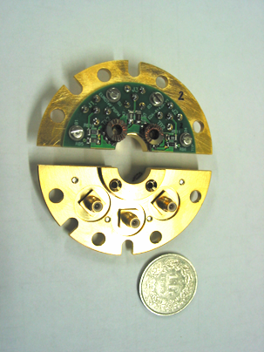
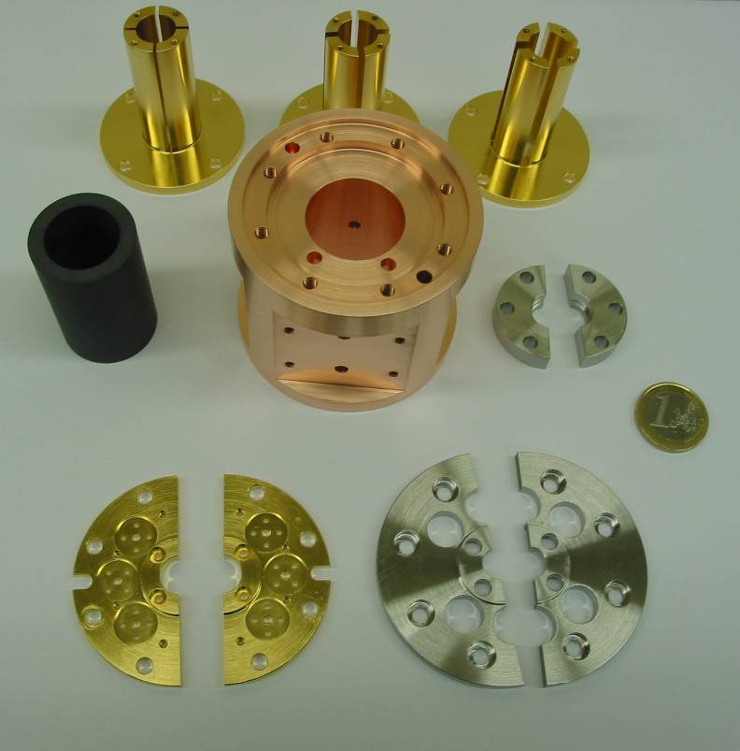
EUROTeV PBPM
Measured resolution ~ 600nm!
Talk by L. Søby, today 15H30

Slide 8
Module acquisition systems
BLM
WFM* 8
BPM
Main Beam
Drive Beam
BPM
BPM
BLM
Very close < 1m
Hybrid
Hybrid
Hybrid
Hybrid’s
Very radiation hard
Tunnel
Below girder, shielded
radiation hard electronics,
Analogue FE
Analogue FE
Analogue FE
Analogue FE
< 35G/Y
Digital FE
Data link
HV
Digital FE
220V or DC
Power
High Voltage
UTR
400m max.
Data treatment
RF reference
Analogue FE
= Down converters, Signal conditioning, Calibration units
OBS: Only 4 cables per module
But could be further reduced!
Digital FE
= Digitizers and control

Slide 9
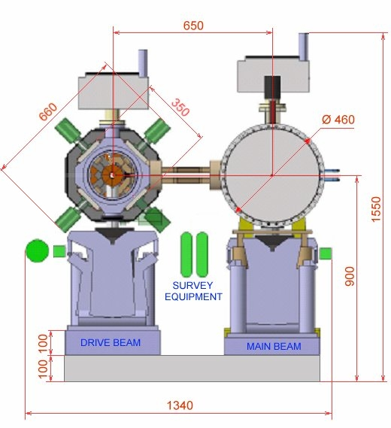
Shielding of electronics
Radiation in PS
Radiation reduced by
a factor 1000!!.

Slide 10
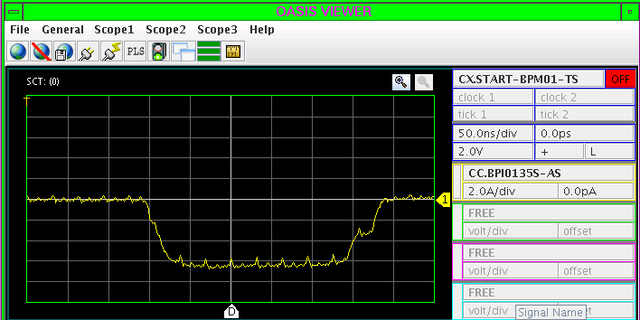
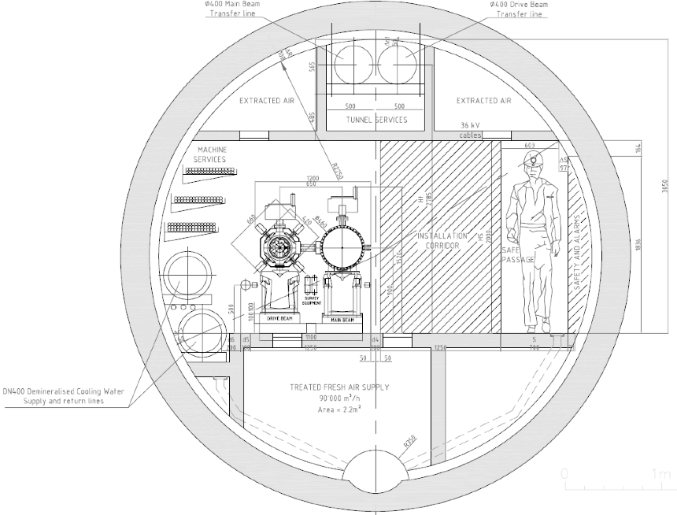
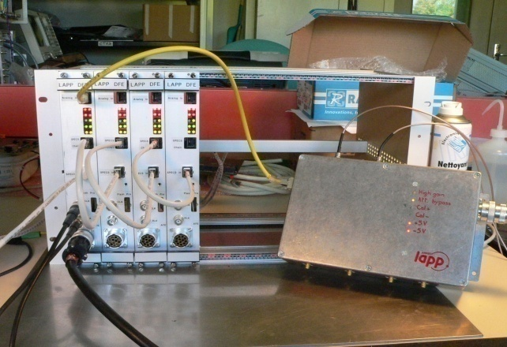
Electronics in the tunnel
LAPP digital FE
Designed to resist up to 350GY
H=27, L=45, D= 30 cm
Analogue FE
< 35GY/Y
Analogue FE
= Down converters, Signal conditioning, Calibration units
Digital FE
= Digitizers and control

Slide 11
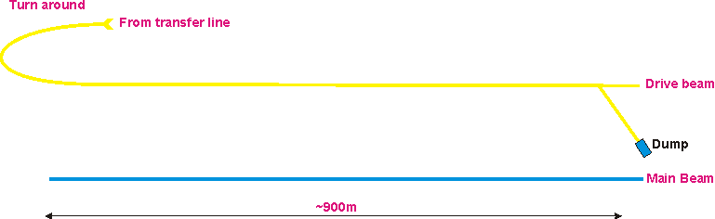
Sector instrumentation
8m
Transverse profile monitors, DB=13pc,L~300mm
Fast (12GHz) BPM, L~100mm, Energy
Form factor, Fast bunch shape measurement,L~500mm
Slow current measurement, DB /50m, L~150mm, 1%
Slow current measurement, DB=1, L~150mm, 0.1%
Beam Phase
Segmented dump, Energy

Slide 12
Module types
298mm
~40 # type-0 per sector
Use “empty” space for “sector” beam instrumentation
~4 type “xn” per sector at extraction
Module length: 2.010 m

Slide 13
Beam loss monitoring
  Beam Loss Monitoring should provide additional monitoring information to the beam current measurements, in the regime where the other devices are insensitive (<< % loss of beam current)
  Important for tune up and failure monitoring
  Detectors should time resolve the losses within the pulse, time resolution?
  Develop monitors capable to disentangle losses from the Main or/and the Drive Beams.
  One technical solution would be to design the BLMs of the Main Beam with an energy threshold slightly higher than the Drive Beam energy.
  BLM must be included in the existing module layouts, but requires no extra longitudinal space.
 |  |  |  |  | Specifications
 | Accuracy | Resolution | Stability | Bandwidth | Beam tube aperture | Available length | Intercepting device? | How many? | Used in RT Feedback? | Machine protection Item? | Comments | Ref
Beam loss | ? | 1%/ Bunch | ? | 20MHz | “-” | “- | No | /50m | No | Yes

Slide 14
Specifications of sector instruments
Main beam
 | Accuracy | Resolution | Bandwidth | Beam tube aperture | Stability | Non-intercepting device? | How many? | Used in RT Feedback? | Machine protection Item ? | Comments | Ref
Intensity | 0.1% |  |  |  |  |  | 48 | No | Yes
Beam Size / Emittance | 10% | 2% |  |  |  | yes | 48 | No | No
Energy | 0.10% |  |  |  |  | yes | 4 | Yes
Energy Spread |  |  |  |  |  |  |  | ?
Bunch Length |  |  |  |  |  |  |  |  |  | single shot
Beam Loss
Beam Phase |  | 0.1° |  |  |  |  | 48 | Yes | No
Drive beam
 | Accuracy | Resolution | Range | Bandwidth | Beam tube aperture | Stability | Non-intercepting device? | How many? | Used in RT Feedback? | Machine protection Item ? | Comments | Ref
Intensity | 0.1% |  |  | 20MHz | 23mm |  | Yes | 48 | No | Yes
Intensity | 1% |  |  | 20MHZ | 23mm |  | Yes | ~864 | No | Yes
Beam Size / Emittance | 50um |  |  |  | 23mm |  | No | 312 | No | No
Energy | 10um |  | 10mm | 12GHz | ? |  |  | 48 | No | No
Energy Spread |  |  |  |  | ?
Bunch Length | 1% |  |  |  | 23mm |  |  | 96 | No | No | single shot
Beam Phase |  |  |  |  | 23mm |  |  | 48

Slide 15
Summery
Module instrumentation is mainly BPM’s and WFM. Requirements are well defined.
A dedicated study and design of CLIC BPM’s and WFM is needed.
Space must be foreseen for electronics on the module and in a radiation shielded location within a few meters, i.e. in the floor.
A digital front-end, reduces significantly the cable costs.
Dive beam SECTOR instruments should be designed for type 1-4 modules.
Main beam SECTOR instruments can only be foreseen close to extraction region on module types 0n-3n.
Specifications are crude but under the way

