Slide 1
Summary of the WG
Technical Issues, Integration & Cost
G. Riddone, R. Ruber
17.10.2008

Slide 2
Technical issues, integration and cost
Module, TL and main components
Technical sub-systems
Integration (module and tunnel)
Cost and schedule
WED AM
THU PM
THU AM
WED PM
28 talks (3 with BD WG)
Very interesting and well prepared talks.
THANKS TO ALL SPEAKERS
About 25 participants
Very fruitful discussions

Slide 3
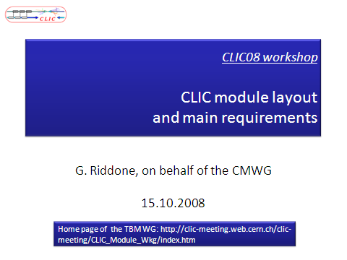
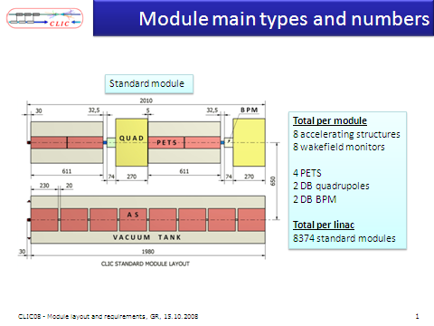
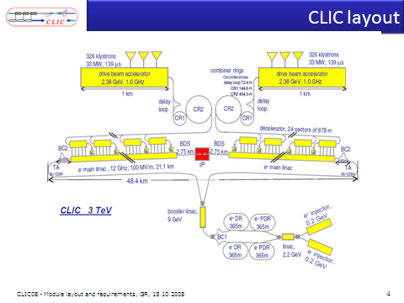
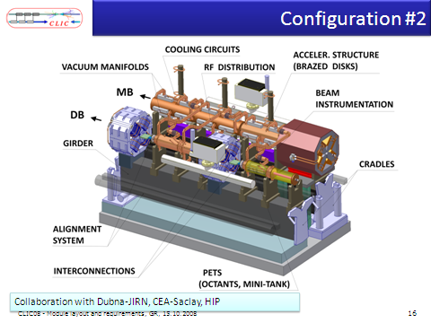
Total per linac
Modules: 10462
Accelerating structures: 71406
PETS: 35703

Slide 4
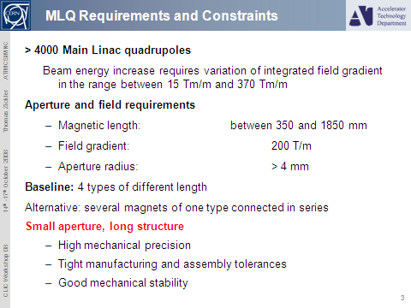
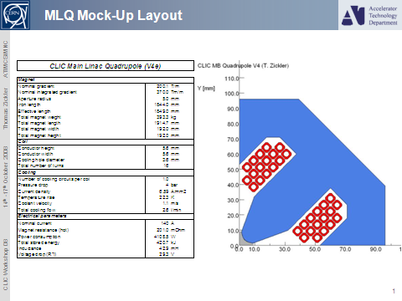
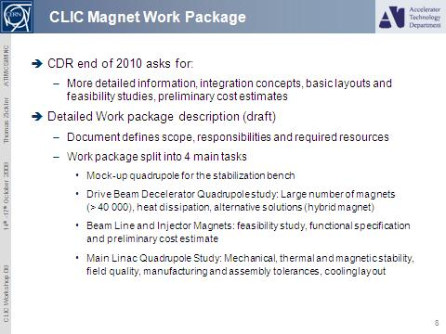
Objective of the presentation: illustrate the design for the stabilization bench
Options have to be studied (need new collaborators)
Specification from beam physics to magnet group
Feed back from magnet group is needed
Preliminary design of a quadrupole for the stabilization bench T. Zickler

Slide 5
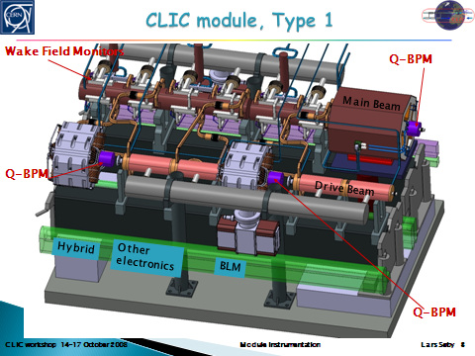
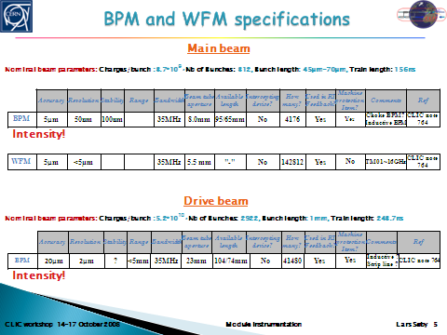
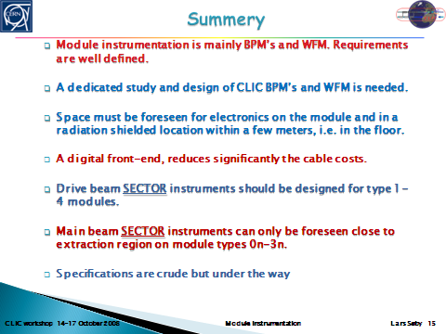
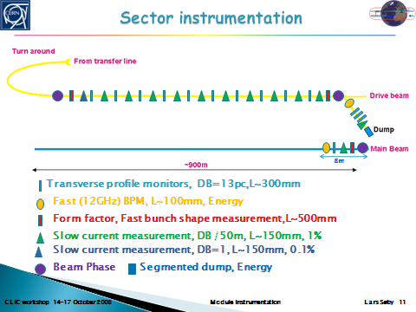
Module instrumentation, L. Soby

Slide 6
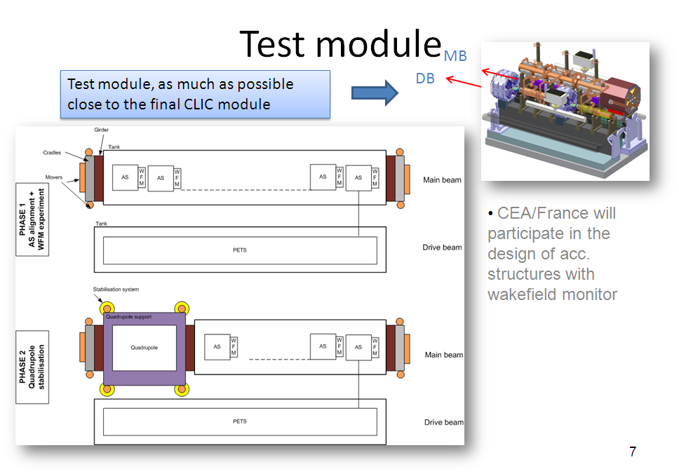
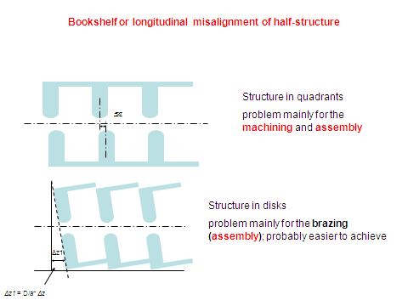
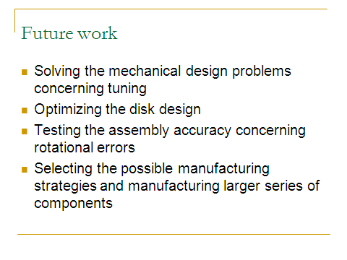
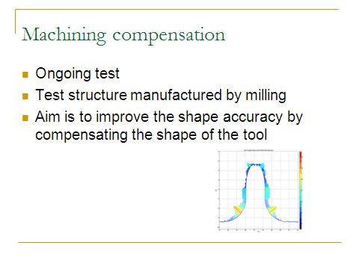
Tolerances: 1 micron or 180 μrad
HIP collaboration
Structure Fabrication and Assembly Tolerances, R. Zennaro
Test module and precise machining/assembly of acc. Structures, J. Huopana

Slide 7
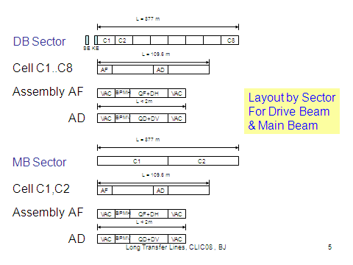
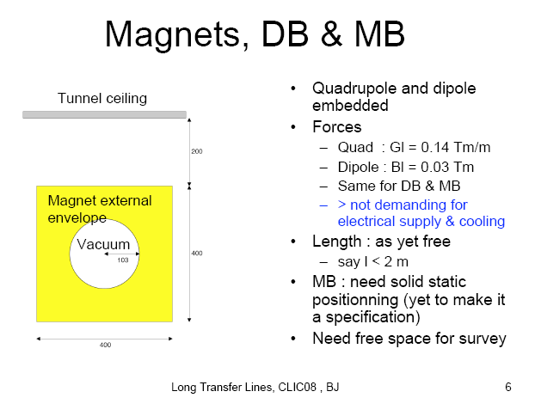
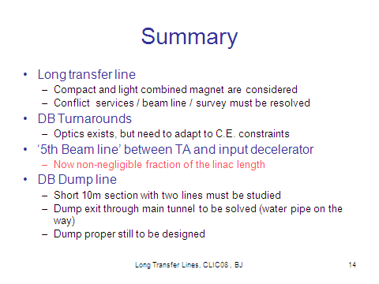
Now requires detailed
engineering studies
Long transfer lines, J. Jeanneret

Slide 8
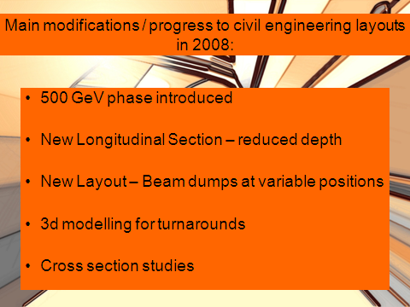
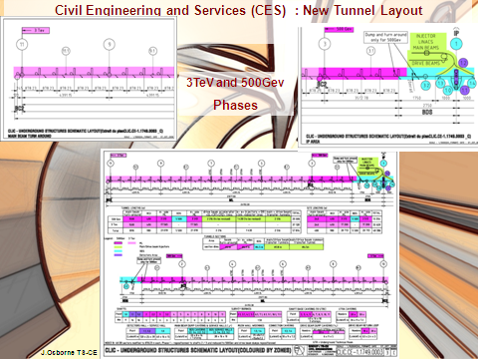
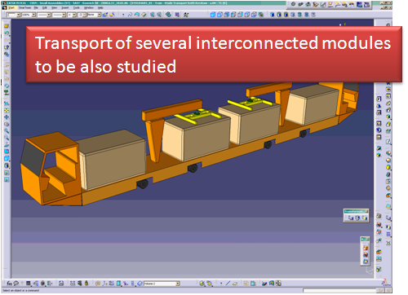
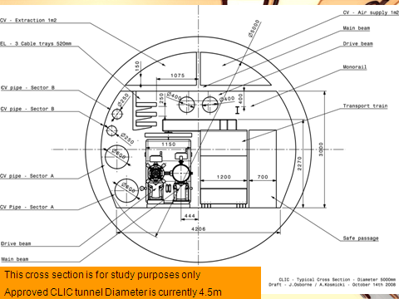
Point symmetry or plane symmetry?
Tunnel layout, J. Osborne
Transport of CLIC elements, K. Kershaw

Slide 9
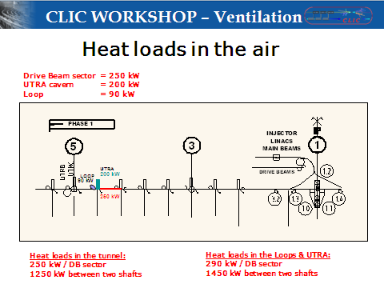
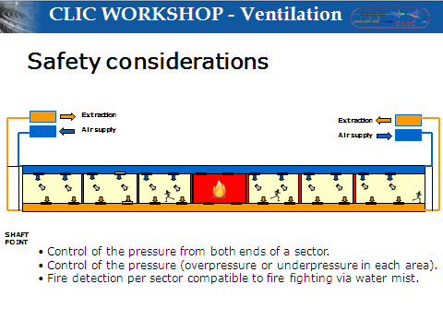
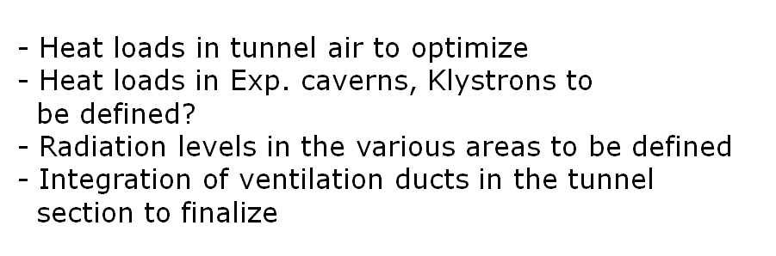
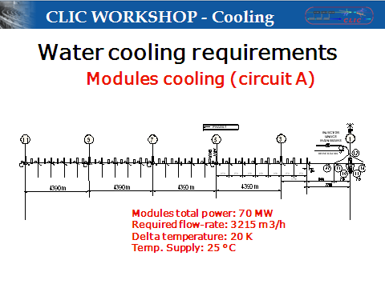
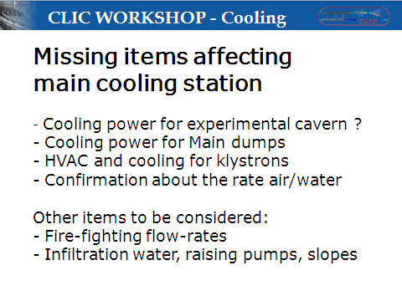
(to be reduced)
Comparison CLIC/ILC
Cooling tower or primary source
2x DN600
2x DN250
Cooling and ventilation in the tunnel,
J. Inigo-Golfin, Ch. Martel

Slide 10
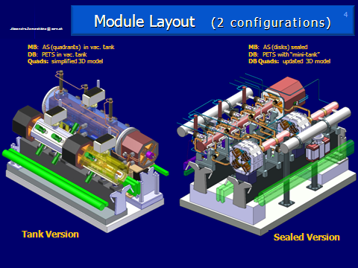
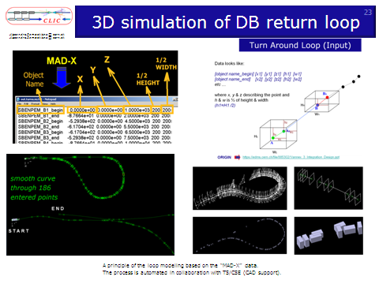
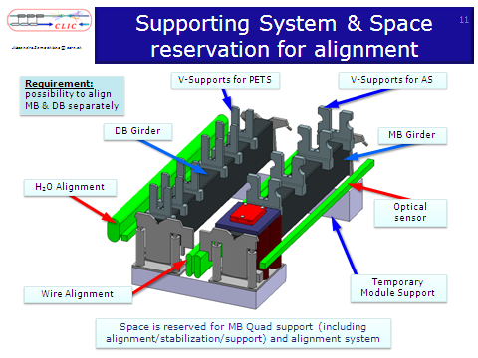
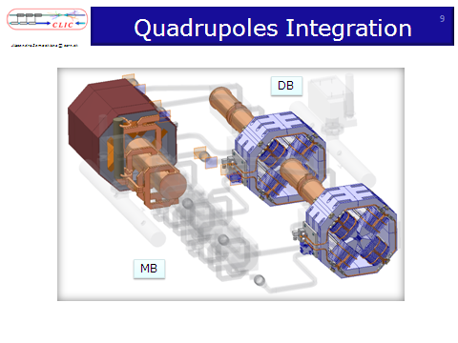
Systematic approach by systems
From to concept to details
Module integration, A. Samoshkin
See also PETS integration for TBL, F. Toral

Slide 11
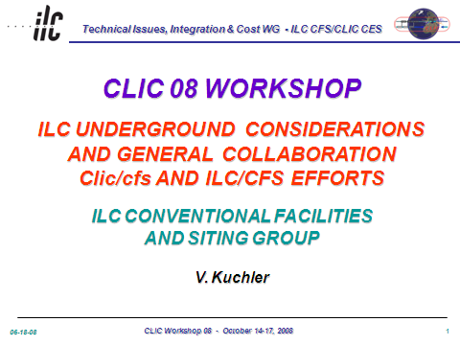
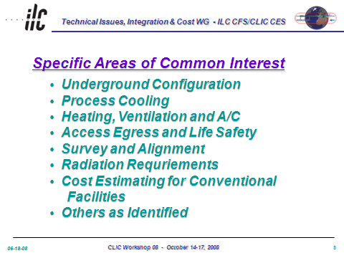
ILC Underground Consideration, V. Kuchler

Slide 12
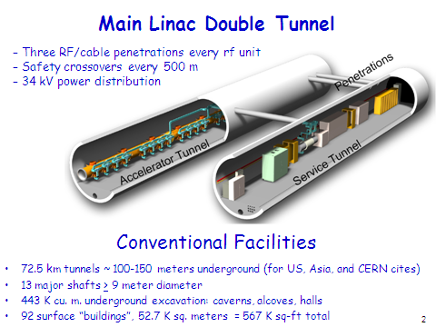
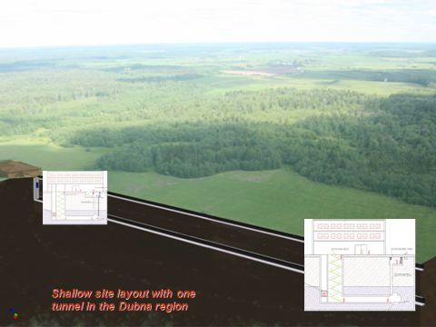
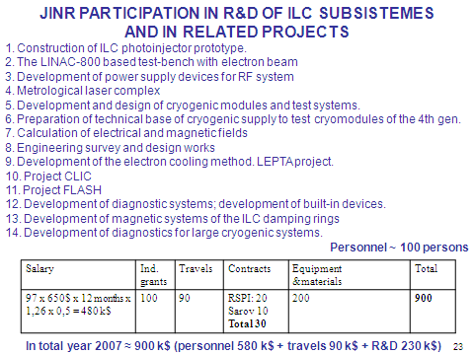
Dubna Siting and ILC Activity at JINR, G. Shirkov

Slide 13
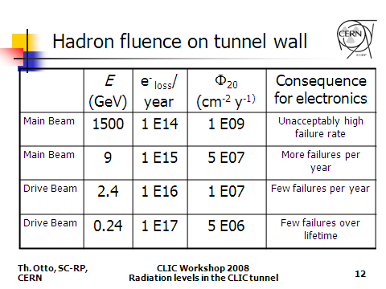
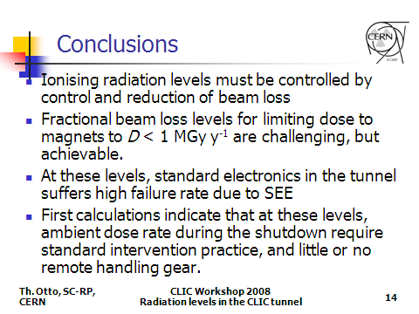
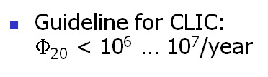
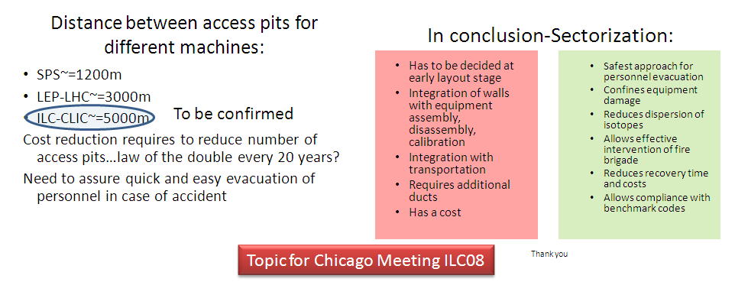
Radiation level in the tunnel, T. Otto
Radiation level in the interaction regions to be studied
Safety issues for underground structures, F. Corsanego

Slide 14
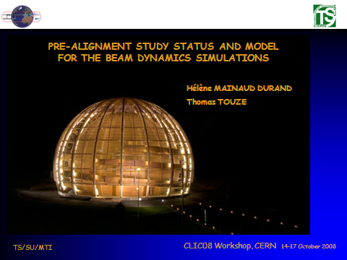
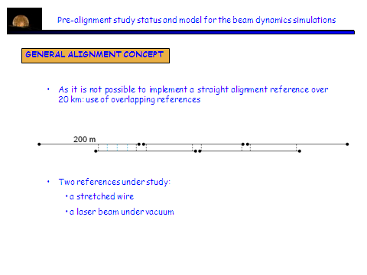
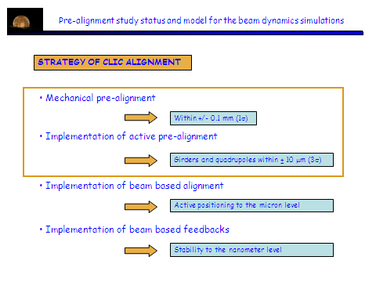
Collaboration Nikhef
Wire: Validation test are underway at CERN
(TT1, T500)
Sensors: capacitive based WPS sensors
Development of an optical -based WPS sensor
MBQ: fiducialisation, align/stab. compatibility
Simulation on propagation network and on CLIC modules
Promising results ➔ input for beam dynamics simulation
Discussions on space reservation and integration of survey equipment
We also would like to open the CLIC survey and alignment studies to the Survey groups from other labs (FNAL, SLAC, Argonne, KEK, DESY), in particular concerning the development and qualification of sensors. The first contacts have already been taken.

Slide 15

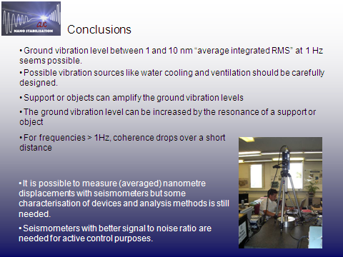
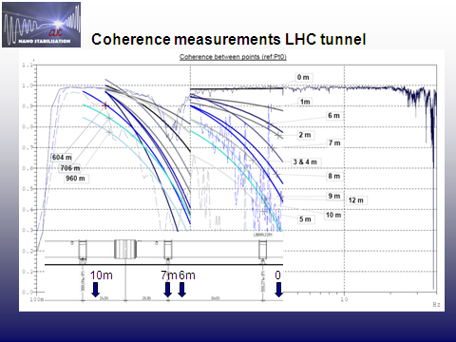
Coherence drop after 1 Hz

Slide 16
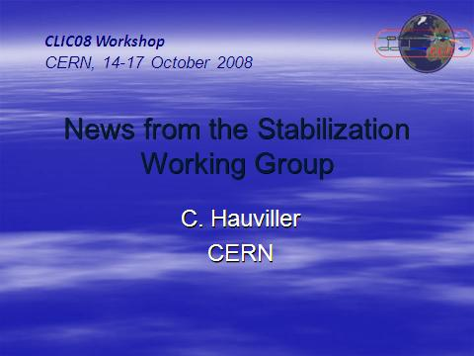
 | Final Focus quadrupoles | Main beam quadrupoles
Vertical | 0.1 nm > 4 Hz | 1 nm > 1 Hz
Horizontal | 5 nm > 4 Hz | 5 nm > 1 Hz
http://clic-study.web.cern.ch/CLIC-Study/CLIC_Stabilisation/Index.htm
Actions:
Sensors: types and measurement methods
Characterize vibrations/noise sources in an accelerator: K. Artoos talk
Actuators: techniques to be developed for heavier (up to 400Kg) and larger structures (up to 2 meter long)
Feedback: Develop methodology to tackle with multi degrees of freedom (large frequency range, multi-elements)
Overall design + analysis: compatibility alignment/stabilisation – mock-up for main linac
Integrate and apply to Linac: discussion started with CESRTA (storage ring) , request ATF2

Slide 17
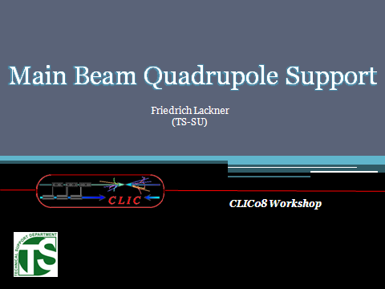
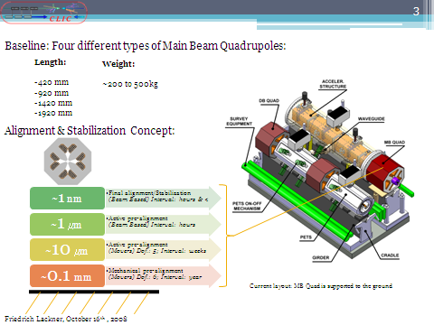
http://clic-alignment.web.cern.ch/clic-alignment/
Start with CTF2 stepper system reactivated (implementing present alignment sensors)
- modal analysis, stiffness of the support ➔ which movers for CLIC
Market research for suppliers for stepper motor developments
Nano-membranes: possible solution of vertical stabilisation
Guiding flexure potential for horizontal stabilisation
Space limitations on current module design: needed extra space
➔ several solutions are under study and implemented within the module working group
Frictionless operation of the pre-alignment system by applying linear elastic deformation?
http://clic-alignment.web.cern.ch/clic-alignment/

Slide 18
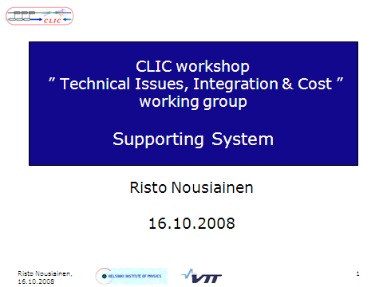
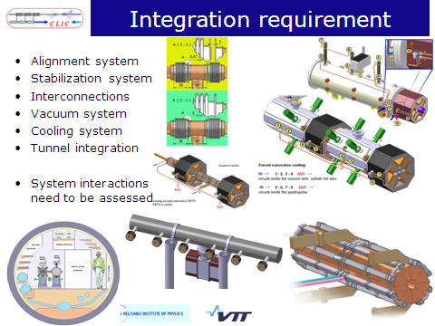



Slide 19




3 TeV and 500 GeV
Pipe reduction from CLIC07, but still 600 mm
Alternative cooling methods are under study

Slide 20



10-8 mbar
10-10 mbar
~80 km→ cost optimized solution is required
→ 3 possibilities have been considered:
  ion pumps,
  NEG coated vacuum chamber + ion pump
  NEG strips + ion pump

Slide 21



Strong recommendation: integrated tool from the first phase of the project
This is the good moment to define better tools for the whole community : what is available, what would be needed in the future?
Common reflection: common tool

Slide 22



Cost for 500 GeV and 3 TeV by 2010
(for each PBS entry and w/o detailed WBS)
ILC/CLIC collaboration
CLIC requirement for cost, H. Braun, G. Riddone
Software tool consideration for ILC cost management, J. Cawardine

Slide 23


Slide 24


Slide 25



Based on CLIC cost requirements and APT experience,
a proposal for a cost tool has been made
Questions: cost estimate tool as part of integrated tool, ICL/CLIC common tool?

Slide 26



Exercise for ML (2 TBM)
First draft for discussion:
7 y for 500 GeV ➔ ready for HW commissioning
+ 3 y for 3 TeV
Actions
Compare CLIC schedule assumptions with ILC assumptions .
Review ILC schedule with same CLIC assumptions

