Slide 1
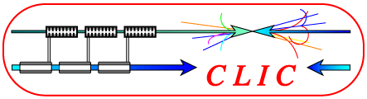
Diagnostics for Breakdown Experiments
RF & DC
Jan Kovermann CLIC workshop 2008 CERN, 16.10.2008

Slide 2
Motivation:
Diagnostics of breakdown events in DC and RF are complementary to the ‘usual’ structure tests and aim at answering the following questions:
What triggers a breakdown?
What happens during a breakdown?
New conditions after a breakdown (conditioning!)?
What limits the performance of a structure?
Goal: Constructive feedback to structure design and production!
Jan Kovermann CLIC workshop 2008 2/13

Slide 3
What kind of diagnostics?
All diagnostics will be applied to RF and DC tests:
Are breakdowns in DC similar to breakdowns in RF?
Reproducible similarities would be extremely helpful in terms of time and costs:
Parameter | DC | RF
Time of one test | days | months
Material cost of one test | A few CHF | Tens of kCHF
Preparation | 1 day | 1 week
If yes, the ‘easy’ benchmarking of materials, surface treatment and production techniques in DC could be applied to RF structures!
Jan Kovermann CLIC workshop 2008 3/13

Slide 4
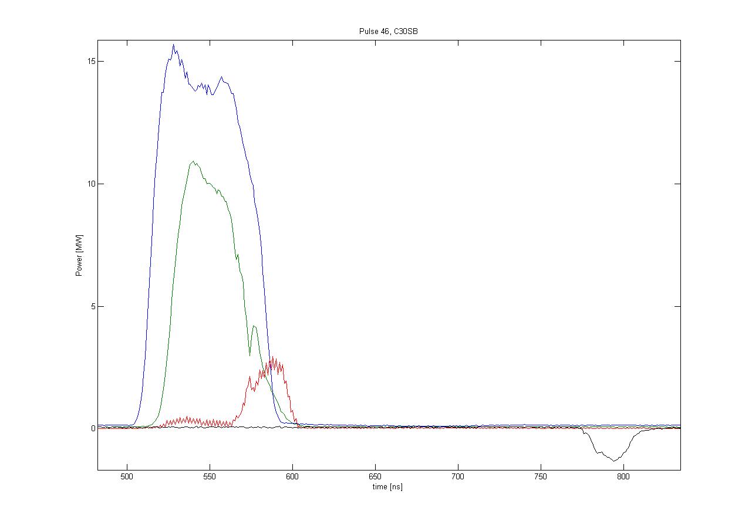
Used and planned diagnostics in RF
‘Standard’ instrumentation:
        RF signals from the structure for normal pulses and breakdown pulses,
        this includes the incident pulse, transmitted and reflected pulse
        all signals calibrated and checked for consistency and stability
Faraday cups at each end of the structure connected to fast ADCs
Incident
Incident power
Reflected power
Transmitted
Transmitted power
e⁻
structure
e⁻
to ADC
ions
ions
to ADC
Reflected
FC
Jan Kovermann CLIC workshop 2008 4/13

Slide 5
Used and planned diagnostics in DC
‘Standard’ instrumentation:
        Current and voltage from the setup for normal pulses and breakdown pulses
        Vacuum level and rest gas composition (mass spectrometer)
POWER SUPPLY
I
VACUUM
(DC SETUP)
U
Which values can be compared with RF?
Total power dissipated per breakdown (~0.5J)
Breakdown-rate vs. gradient for different materials
But: much smaller surface, no RF, completely different timing
Jan Kovermann CLIC workshop 2008 5/13

Slide 6
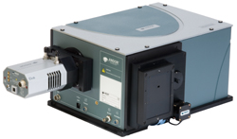
Diagnostics applied to RF and DC
Breakdowns are transient plasma phenomena after they have been triggered:
        Light emission from IR to UV
        Time resolved spectroscopy will be applied to RF and DC
        New system will arrive end of November 2008
Specs:
0.2nm resolution
Gratings for overview and high resolution spectra
Cooled CCD camera for integrated spectrum
High-QE multialkali PMT for time-resolved spectroscopy at single lines
Fully computer controlled
Jan Kovermann CLIC workshop 2008 6/13

Slide 7
Diagnostics applied to RF and DC
Example: DC spectrum measured for Cu electrodes with existing setup
The new system will be able to record a full integrated spectrum and one time-resolved wavelength interval for each breakdown
Jan Kovermann CLIC workshop 2008 7/13

Slide 8
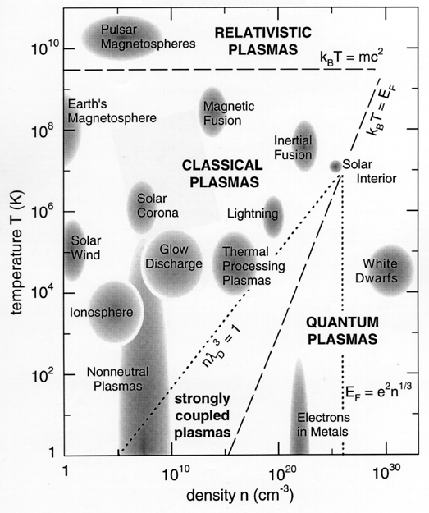
Diagnostics applied to RF and DC
Parameters measured with time resolved spectroscopy will be applied to RF and DC:
‘Classical’ spectroscopy: What lines resp. elements are involved in the process? How do they develop in time? Any correlations to the conditioning-effect?
Is there a blackbody background? Does it change with time? Precursors???
Estimation of plasma parameters:
Plasma temperature and density
Feedback to plasma simulations!
Jan Kovermann CLIC workshop 2008 8/13

Slide 9
Diagnostics applied only to RF
Electron and ion currents on faraday cup (many thanks to Uppsala)
An immense flash of x-rays has been detected during a breakdown
These diagnostics will be upgraded:
The energy distribution of electrons and ions will be measured with a magnetic spectrometer
Energy distribution of x-rays measured with a filter wheel
Investigations are ongoing if the energy distribution of the x-rays can be measured within one shot resp. breakdown
Upgrade of the single-line PMT to a 32-line PMT on the spectrometer
30GHz microwave plasma diagnostics in 12GHz system (to be designed…)
Jan Kovermann CLIC workshop 2008 9/13

Slide 10
Preliminary results from DC
Neutral Cu lines,
T(plasma) ~ 8000K – 16000K (prelim.)
Demonstration of the capability of the new spectroscopy system like ordered:
Neutral copper lines can be clearly identified
Two-line-method to estimate plasma temperature is easily applicable: ~1eV
Jan Kovermann CLIC workshop 2008 10/13

Slide 11
Preliminary results from RF – where does the missing energy go?
Damage by ions from Coulomb explosion:
Measured by M.Johnson & R.Ruber with FC:
~10E10 ions per event on FC, 1/200 of solid angle ➔ 10E13 ions in Coulomb explosion
Ion energies (ToF) ~100eV - 1keV or 2*10⁻¹⁷- 10⁻¹⁶J per ion)
Estimation:
Radial expansion of the coulomb explosion
4mm to next iris
5E11 ions/mm2 on the other side of the iris
~50uJ/mm2 of energy deposited
In 1ns, this is 10kW/mm2
Max. 1mJ in total
Seems that the ions cannot heat up the surface to
melting point (pulsed surface heating is 7kW/mm2
for 68ns, ΔT is only 60K… )
But: One ion impact each 10x10atoms2, sputtering?
Jan Kovermann CLIC workshop 2008 11/13

Slide 12
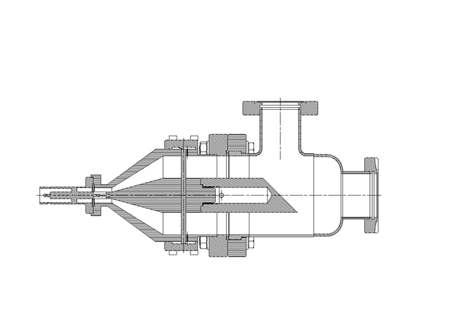
Preliminary results from RF – where does the missing energy go?
Energy carried by electrons:
Measured:
High currents (5V in 50Ohms, 100mA) of electrons hit the FC in each BD event, X-rays are produced by these electrons
X-rays pass vacuum window and Al-foils
at least 10keV to be detectable,
for 10E13 electrons (from single
charged ions), dissipated energy is
around 20mJ
X-rays pass 14mm Cu and 5mm Fe (tank)
➔ at least 100keV to be detectable
In total: 10E13 electrons with 100keV carry
~200mJ
Pb
PMT
PMT
XRAYS
structure
Estimations from surface field calculations: 400keV…
Remember: 500mJ missing RF energy!
Jan Kovermann CLIC workshop 2008 12/13

Slide 13
Conclusion and Outlook
Breakdown diagnostics will be used to discover the processes happening during a breakdown and possibly give information about its trigger mechanism and conditioning
A proven similarity between RF and DC would be extremely helpful in benchmarking materials and processing techniques
Breakdown diagnostics give direct feedback to plasma simulations
Used and planned diagnostics virtually cover all possible ways to get information about breakdowns and stable operation
Jan Kovermann CLIC workshop 2008 13/13

