Slide 1
Structure fabrication for CLIC
CLIC08,
Oct. 14-17, 2008
KEK, T. Higo

Slide 2
Strategy of structure fabrication at KEK
Re-establish GLC/NLC structure fab technique
  60-100MV/m
Extend it to heavily damped structure for CLIC
  Disk damp confirmation
Learn about fabrication by all milling
  Study high gradient performance
  Study mass production feasibility
Discuss about the practical candidate
  For near future application in a few years

Slide 3
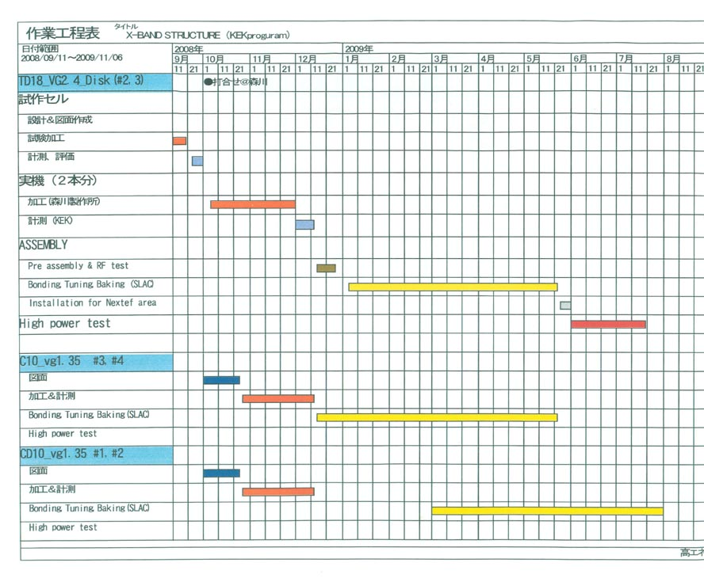
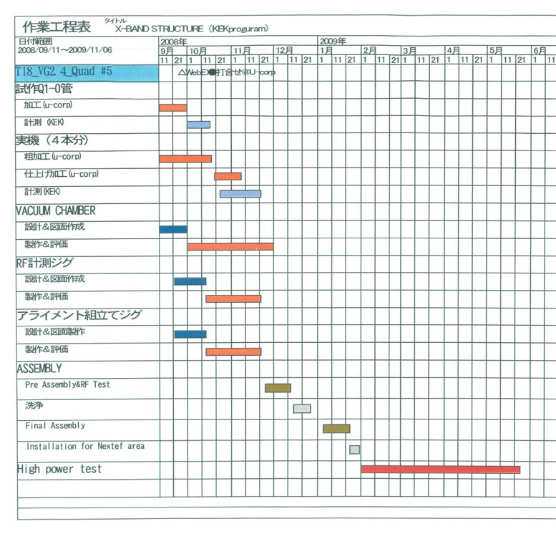
Structure fabrication plan
Disk-damp #2,#3
Quad #5
C10, CD10

Slide 4
Disk-damp fabrication
Started with technology of T18_VG2.4_Disk
  Material
    OFC
  Machining
    Usual turning for disk
    Usual milling for coupler of mode converter type
  Surface treatments
    SLAC does all
    CP, DB and VAC baking
Take the same method but with milling in each cell
  Mechanical design by KEK
  Fabrication study done

Slide 5
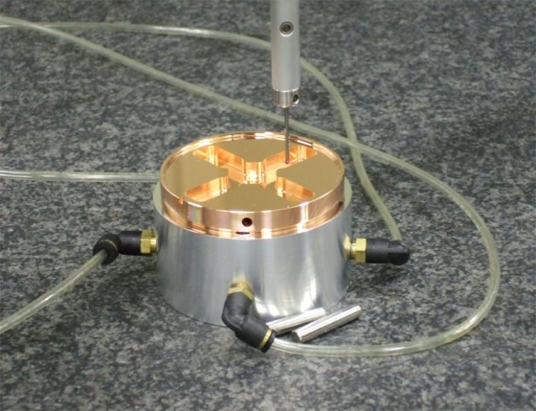
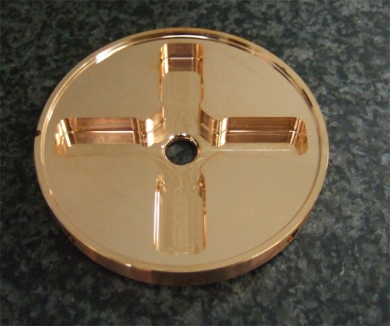
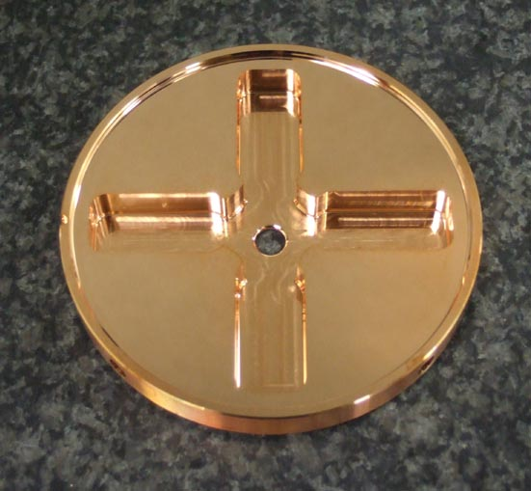
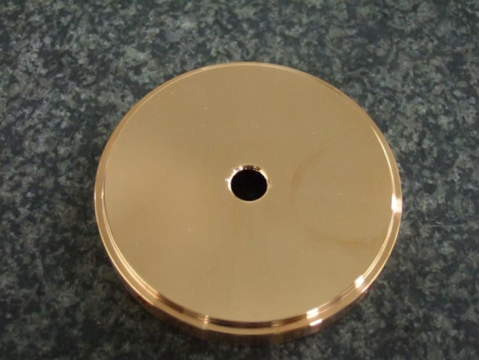
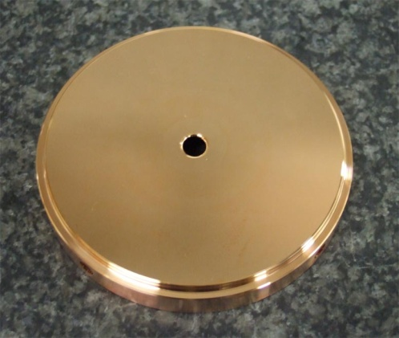
TD18_VG2.4_Disk Fabrication test
Most concerns are
Dimension
Flatness
Cell #1
Cell #19

Slide 6
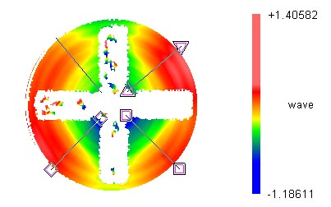
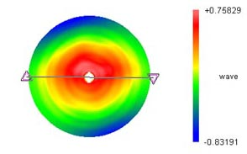
Flatness
Flatness better than 1.5micron in free position
We estimate that the flatness becomes better <1 micron when pushed onto the flat surface.
Flatness if OK.

Slide 7
We found recently the difficulty in dimension control
Different measurement results between vendor and KEK
about ~20microns!
Vendor suffers from big burrs at the top
The creation of burr itself should be suppressed!
→ improve finish turning. Study in progress.
If it is not realized by vendor, KEK should do final cut.
The re-scheduling become needed.
Slanted wall for waveguide channel and cell wall
by several microns / several mm depth. Too much!!
We are under investigation of improvement.
We wait for the confirmation of the reasonable precision
It should be within several microns
C10 and CD10 follow the fabrication of Disk-damp

Slide 8
Quad fabrication and test
Present mission
  Fabrication with all ball point milling
  Assembly for high power realization
  Non heat treated cavity in a vacuum vessel
Discussions to be made
  Feasibility for near future LC
  Pros and cons in general
  Precision alignment issue comes after high power

Slide 9
Status of four quadrants
Brushed up the machining technique
  Longitudinal: a few microns / 200mm
    We think this controllability necessary to assure the precision of the overall 3D surface creation
  Transverse direction: within ± a few microns
Now we decided to make the actual four quadrants
  Four will be delivered to KEK by mid Nov.

Slide 10
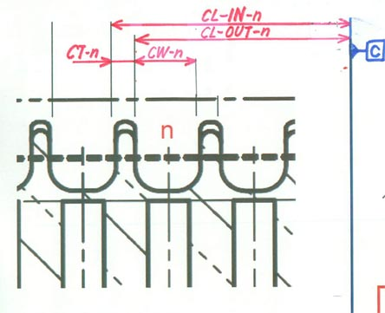
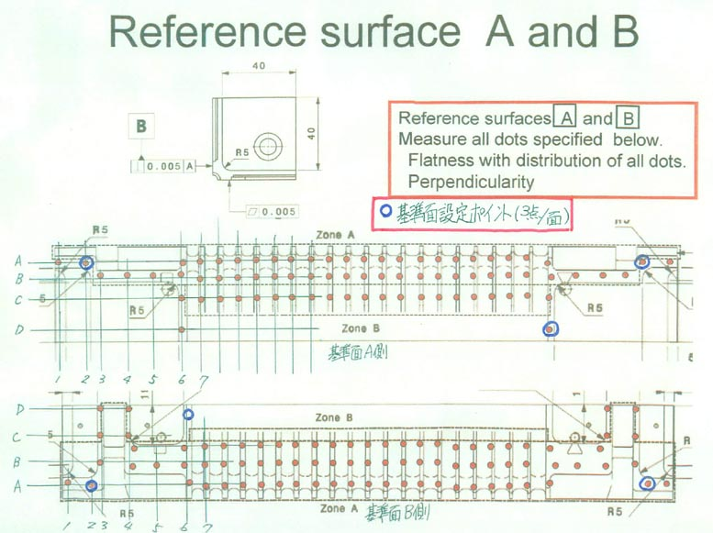
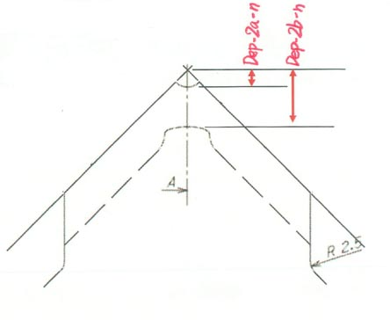
Dimensions to be confirmed
Longitudinal position
Flatness
Depth of cell surface (a, b)

Slide 11
Reference surface flatness
A reference
B reference
A Flatness: 4 μm
B Flatness: 3 μm, Perpendicularity w.r.t. A: 4 μm
C Perpendicularity w.r.t. A+B: 2 μm
Measurement was performed by vendor.
KEK measurement is consistent.

Slide 12
Longitudinal dimension control
+5x10⁻⁵
CAM temp. correction
+5x10⁻⁶
Machine
tune up.
Reproducibility
~ 4μm /200mm
-7x10⁻⁴
+2x10⁻⁵

Slide 13
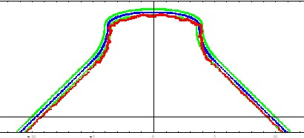
Profile of test cut quadrant Q1-0
Measured w.r.t. A-B-C reference planes. Green lines are ±2.5 microns.
KUM data = NWDSQ7.csv
KUM data = NWDS13.csv
KUM data = NWDS10.csv
KUM data = NWDS17.csv

Slide 14
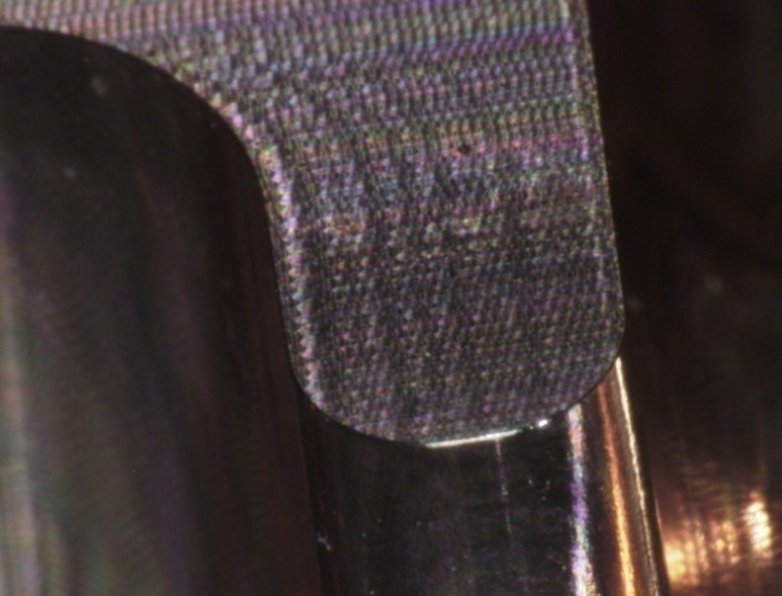
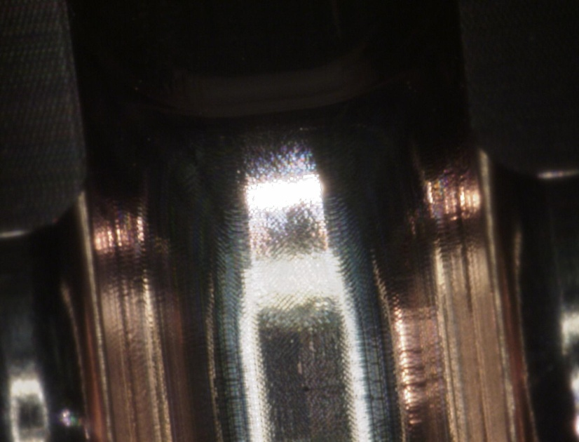
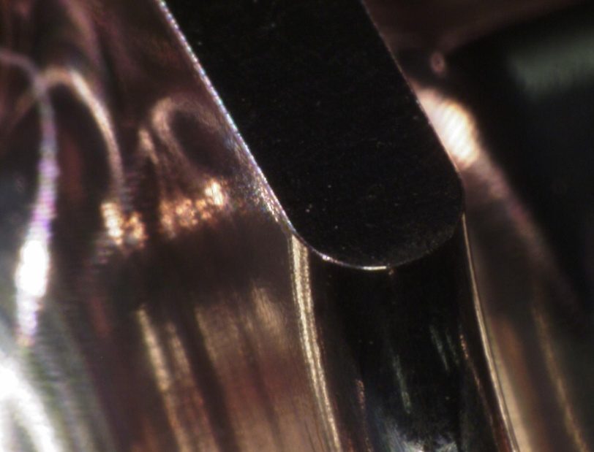
Milled surface view
50 micron rounding
Reference plane formation by milling
Cavity wall formation
…….

Slide 15
Tuning sensitivity and requirement
Cavity sensitivity by Riccardo
  df/db=－1MHz/micron
  df/da=＋0.24MHz/micron
  dｆ/dgap（gap between quads）＝ ＋0.37MHz/micron
Tuning sensitivity
  Riccardo: +10MHz/0.3mm-push, -10MHz/0.4mm-push-back
  Higo: cone, height h, base r=4.2/2:
    df/dh=＋12MHz/mm
Tuning amount
  Riccardo requirement form RF match: ±5MHz
  Vendor potential ~±5μm→±5MHz
  Required tuning amount <±10MHz → 0.5mm/hole
    Fab. At 20C and operation at 30C → - 2MHz
    Temperature tuning capability ±10C → ±2MHz

Slide 16
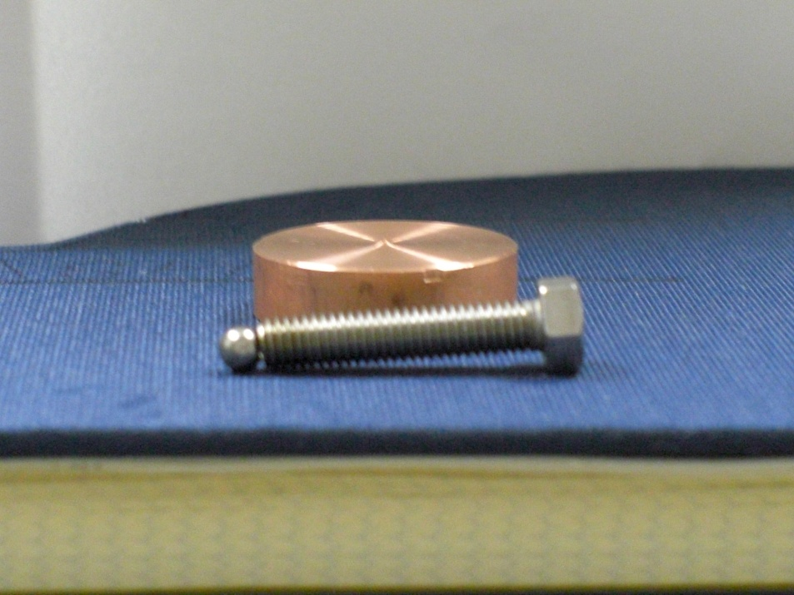
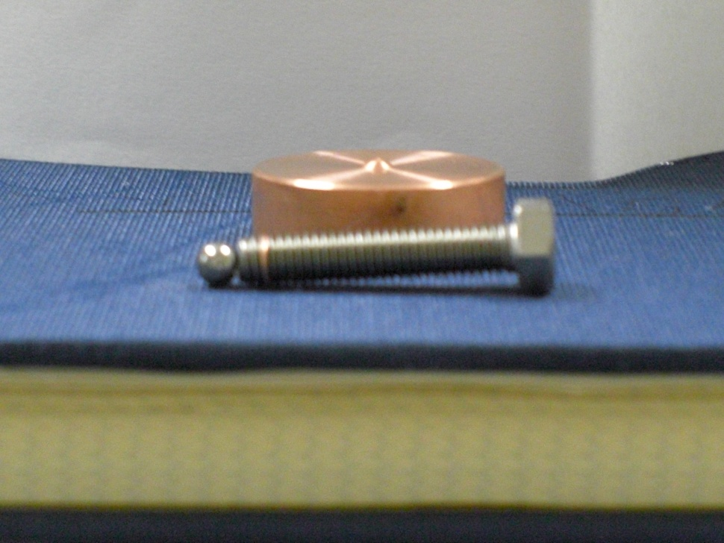
Rough test results of dimpling for rf tuning
081003 Y.Higashi
Dimpled height
0.43mm+/- 50μm 0.63mm+/- 50μm
M5 SUS bolt
φ4mm steel ball
Not big torque was applied -> standard torque for M5 bolt
@ Deterioration of flatness, straightness and twist of structure due to dimple tuning should be considered.

Slide 17
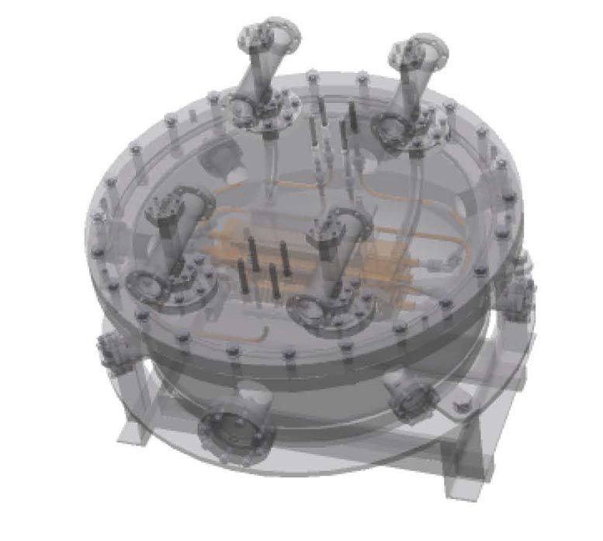
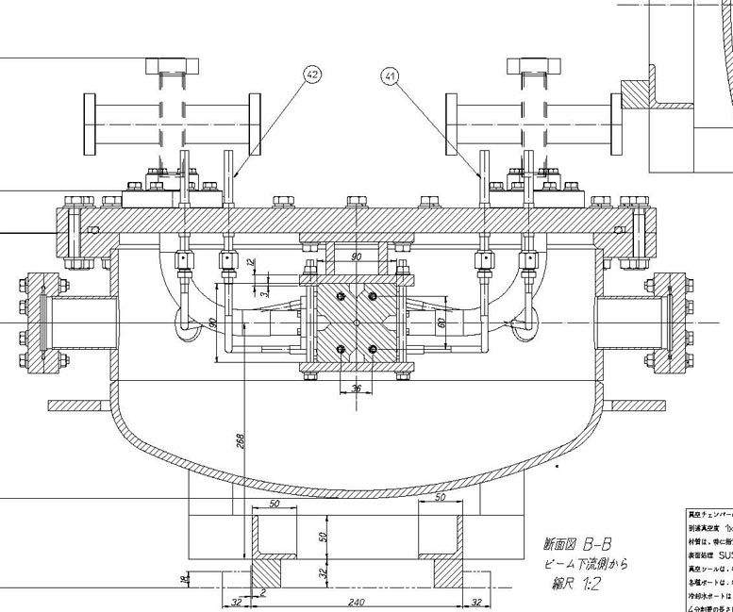
Vacuum chamber preparation
Quads are assembled and fixed to upper big flange.
CF114 flange equipped with waveguide flange feature.
Adjustment of electric phase and position might be difficult.
We may introduce bellows to CF114?
Gaskets with different thicknesses are prepared for adjustment.
VCR connector for copper cooling tube with EBW to quad body.
Vacuum sealing by U-tight seal, similar to helicoflex but cheap.
Chamber is EP finish. Baking or not??

Slide 18
Summary
Disk-undamp fabrication #3, #4 in progress at SLAC.
Disk-damp test cell inspected and some improvement was found necessary before actual fabrication all by vendor.
Quad actual fabrication in in progress, and vacuum chamber fabrication also started.

