Slide 1
Dependence of the breakdown rate on the pulse shape
16.10.2008
Alexej Grudiev

Slide 2
Motivation
Majority of the data are measured with rectangular pulse shape
BUT
In standing wave structures, it is not rectangular
In traveling wave structures, the pulse must have a ramp in order to compensate the energy spread due to the beam loading transient effect

Slide 3
Field emission and rf power flow
Qualitative picture of breakdown initiation
Field emission currents J_{FN} heat a (potential) breakdown site up to a temperature rise ∆T on each pulse.
After a number of pulses the site got modified so that J_{FN} increases so that ∆T increases above a certain threshold.
Breakdown takes place.
P_{FN}
P_{loss}
P_{rf}
P’_{rf}

Slide 4
New rf breakdown constraint S_{c}
S_{c} = 4 ÷ 5 [MW/mm²]
at 200ns, BDR=1e-6
S_{c}¹⁵t_{p}⁵/BDR = const

Slide 5
Summary on gradient scaling
For a fixed pulse length
For a fixed BDR
In a Cu structure, ultimate gradient E_{a} can be scaled to certain BDR and rectangular pulse length using above power law.
What is t_{p} for non-rectangular pulse ?

Slide 6
Conventional pulsed surface heating
For rect pulse:

Slide 7
Pulsed heating by Field Emission
BDR=const means ∆T=const
Using power loss expressed as

Slide 8
Simulation of T53vg3MC experiment
P₀ ~ E²
P_{FN} ~ EJ_{FN}

Slide 9
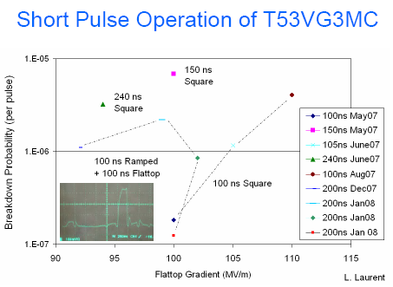
Recent experiment in T53vg3MC
USHG-2008:
C. Adolphsen
L. Laurent

Slide 10
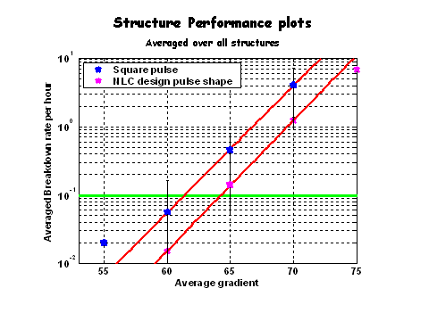
NLC structure
Rect-pulse => NLC-pulse
65 MV/m => 67.5 MV/m
Assuming: E_{a}*t_{p}^{1/6} = const
400ns => 320ns

Slide 11
Staircase pulse shape
97 MV/m
81 MV/m
0 MV/m
0 %
68 % in gradient
82 % in gradient
No influence on BDR for gradients below 80%
Strong influence on the BDR for gradients above 90%
Very good agreement with SLAC data
119 MV/m
111 MV/m
93 % in gradient
100 %

Slide 12
Staircase pulse shape experiment
Sub pulse width and average unloaded gradient | Main pulse width and average unloaded gradient | Time: hr | BKD Events | BKD Rate (1/pulse)
No sub pulse | 100ns@119MV/m (*150MV/m) | 19 | 16 | 3.9e-6
100ns@81MV/m | 100ns@119MV/m (*150MV/m) | 16 | 6 | 1.74e-6
100ns@97MV/m | 100ns@119MV/m (*150MV/m) | 21 | 8 | 1.76e-6
100ns@111MV/m | 100ns@119MV/m (*150MV/m) | 20 | 81 | 1.88e-5
100ns@119MV/m | 100ns@119MV/m (*150MV/m) | 21 | 68 | 1.5e-5
*:Max gradient in the structure
main pulse
sub pulse
after pulse
Chris, Faya
SLED output pulse

Slide 13
CLIC pulse shape
P_{th}= 89%

Slide 14
Conclusions
A theoretical model based on the pulsed heating of field emission sites has been proposed to determine the threshold power level.
It is found that
  P_{th} varies from 83 to 89 % depending on the local electric field βE₀ , from 10 to 5 GV/m, respectively.
  P_{th} is weakly dependent on the pulse shape (in the range of reasonable pulse shapes which can be used for acceleration)
  It is also found that the time when power decreases from flat-top value down to threshold value does not contribute to the effective pulse length
Modified model for effective pulse length definition is proposed. To take the flat-top time t_{b} plus the time when the power exceeds 85% of the flat-top level only during ramping up.
The model predictions agree well with available experimental results on pulse shape dependence of the breakdown rate.

