Slide 1
Safety issues for underground structures
Two issues:
Safety norms, who are the stakeholders?
A specific layout aspect: evacuation and fire control
Fabio Corsanego
CLIC08 Workshop
CERN, 14-17 October 2008
CERN -Safety Commission
Fabio.corsanego@cern.ch

Slide 2
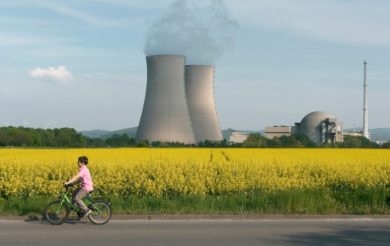
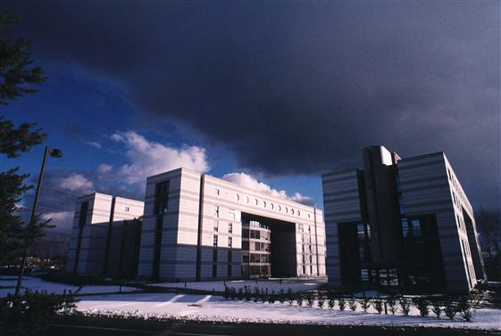

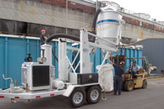
Stakeholders
[those who have an interest in how things are done]
Forgot any?
Your feedback welcomed
a) Owner of the territory (typically a government).
Focus on:
-environment
-Population
-consensus
Constraints
b) “Owner” of the facility (typically a research center):
Focus on:
- Safety of member of personnel
-assets of the organization
Safety Functions
d) Financing institutions
Focus on:
-scientific findings
-respect of planning
-operation continuity
c) Service Providers (typically enterprise or collaborations assigning people and physical resources):
focus on:
-safety of their workers
-contractual responsibilities

Slide 3
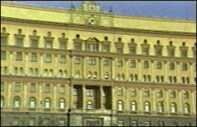
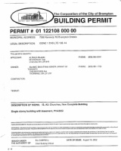




a) Owner of territory:
Diplomatic negotiation or standard authorization procedures?
The government owning of the territory will either:
- issue formal approvals by use of existing procedure ( construction permits, etc.),
-or take a position in the diplomatic negotiation, basing on feedback from its safety agencies
The hosting government mediates between:
  interest in fostering scientific development
  need to protect citizens, assets, and consensus
…can imply our need to consider national legislations as either:
-directly applicable (if standard procedures)
-reference benchmark (if negotiated procedures)
Host state, or supranational regulation is rarely made for a particle accelerators:
- Case by case, integrated by direct discussion with experts of domestic agencies

Slide 4


A large project can be in the need to communicate in a technical language understandable by the territorial authority
Dossiers showing compliance with the basic principles contained in the regulations and guidelines, where :
  We can make use of a reasonable freedom of interpretation;
  We have to fulfill the gaps existing in the reference regulation, and produce sounding justifications, typically by risk analyses.

Slide 5

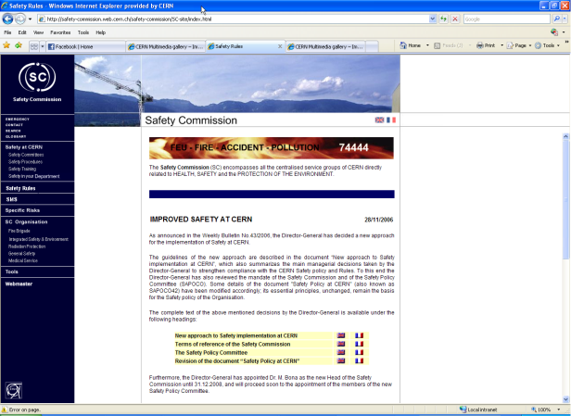
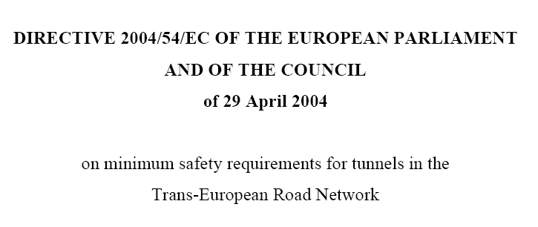
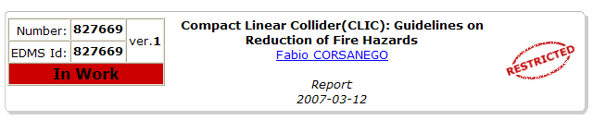
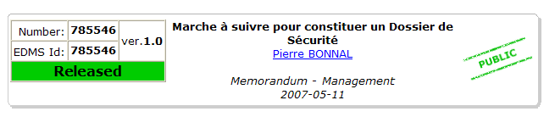
b) Owner of the facility
Should the “owner” be CERN, we would have:
Need to prove compliance with regulation applicable at CERN.
  List of codes and instructions available online
Need to assess the risk and prove efficacy of measures for subjects not covered in details
  (again, benchmark laws and directives, and risk analyses)
Need to obtain approval of the Safety Commission,
  one or more Safety file(s) for the project to be submitted for approvals and technical reviews
  Guidelines available

Slide 6
“Service Providers”
Two distinct cases:
  Private enterprises and their workers,
    at CERN, are subjected to national legislation enforced in the host states
  Collaborating Institutions
    may be required to grant that their employees assigned abroad are exposed to hazards not larger than those acceptable in their home country (I.E: detached US Government Agency Employees)
  This may impact indirectly also on layout of the facility

Slide 7
Financing Institutions
Protection of the scientific program against risks of different nature (incl financial ones) .
Focus is on:
  Scientific return on investment
  Continuity of operation
  Recovery capacity
  containment of damage in case of sinister
  Safety requirements aimed to achieve this goal may be quantitatively stricter than the “prescriptions by law”

Slide 8
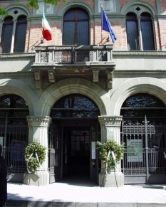
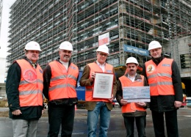

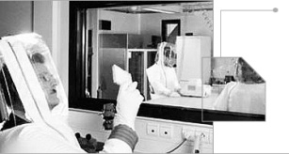
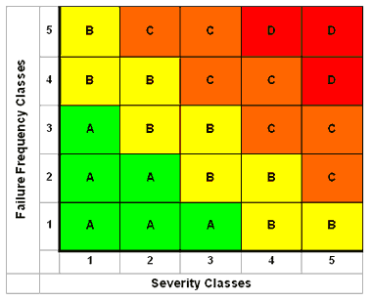


Salient aspects of integration
a) Identify the agencies supporting political decisions in the host states. Typically:
    municipalities and makers of construction rules,
    fire brigades,
    health and safety agencies,
    nuclear safety agencies
Identify their reference codes and standards
b) Identify safety requirements internal to the owning organization
Define areas that shall undergo to risk analysis with the most appropriate techniques:
    “what if”
    “accident scenarios”
    Quantitative methods (Fmeca, Hazop, etc)
c) Identify requirements arising from Labor Codes for hosted workers
d) Identify needs to assure protection of mission continuity
and recovery capacity

Slide 9
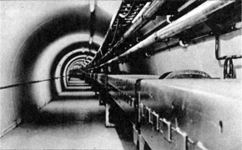

Which Underground distance between exits?
Evacuation scenario in case of fire

Slide 10
Distance between access pits for different machines:
SPS~=1200m
LEP-LHC~=3000m
ILC-CLIC~=5000m
Cost reduction requires to reduce number of access pits…law of the double every 20 years?
Need to assure quick and easy evacuation of personnel in case of accident

Slide 11



Layout and fire escape
Run fast for an 1hr hoping to beat the smoke motion!?
5 km!
FIRE in the tunnel

Slide 12
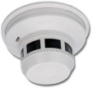
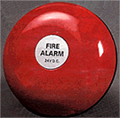


tunnel integration, including transport, cooling and ventilation, and safety issues
smoke
smoke
Tunnel standard section
Motorized Fire doors
~500m

Slide 13

The ventilation system has a role to play in controlling smoke within one sector:
Extraction duct
200C
200C
1000C
100C
Delta P ~10^1 to 10^4 Pascal
Fresh air duct
The natural overpressure of fire can be contrasted by over-pressurizing the side compartments

Slide 14




Fire compartment enhance greatly fire brigade capacity
CASE a: fire doors every 500m
Safety-relay team at <500m-not consuming their air bottles
Engaged team autonomy ~20’ can be fully spent for active work on the fire
20’
CASE b: access every 5000m
Safety-relay team at ~5000m!?
Air!!
20’
They go as far as they can within~20’: available time for intervening is shrunk by distance

Slide 15
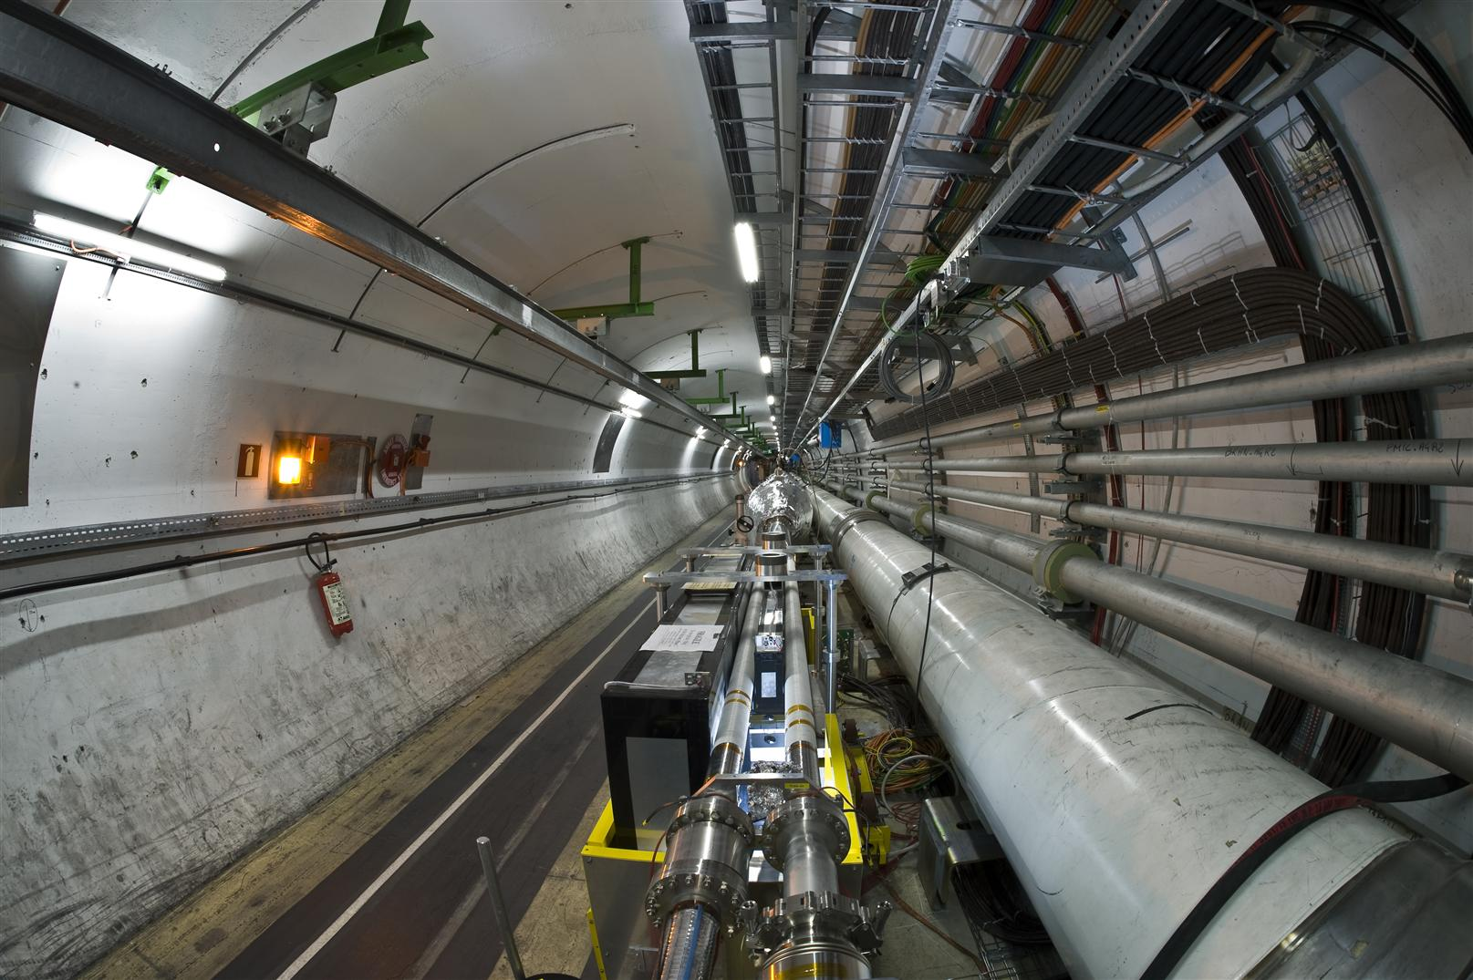


Monorail
FIREWALL
Cable Trays
Fire
Door

Slide 16
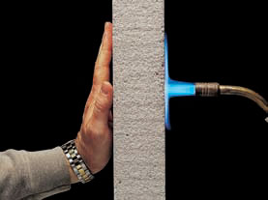
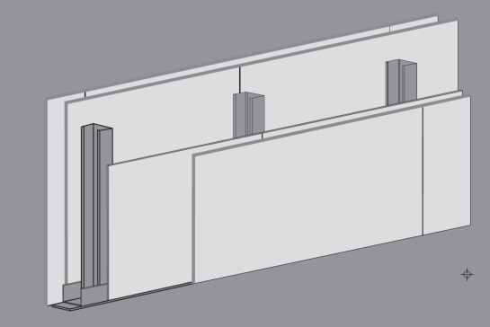
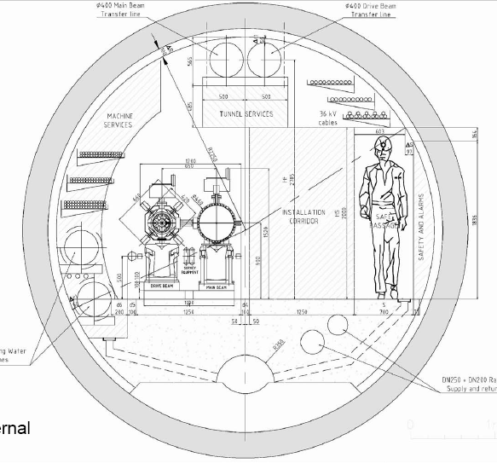
Modular construction, easy install& remove
YTONG-SIPOREX
(Precast Autoclaved Cellular Concrete) F 120
2
3
Fermacell, mineral fiber Panels F30-F120
5
1
4

Slide 17

Monorail
FIREWALL
Fire
Door
Monorail:
fireproof foam plug

Slide 18
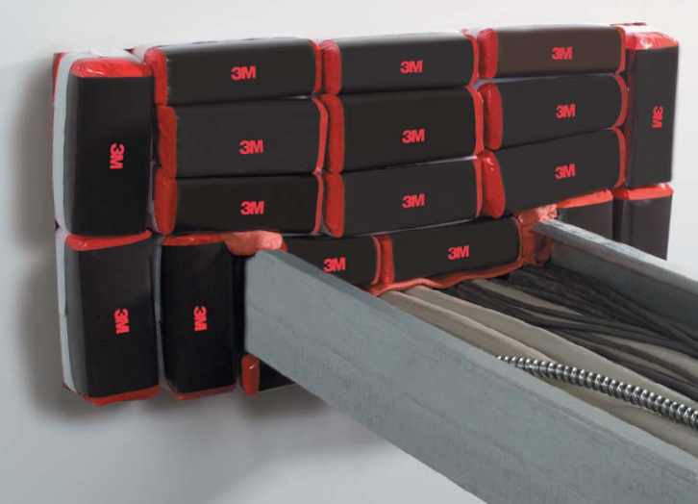
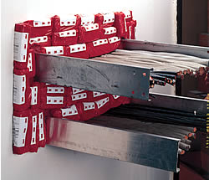
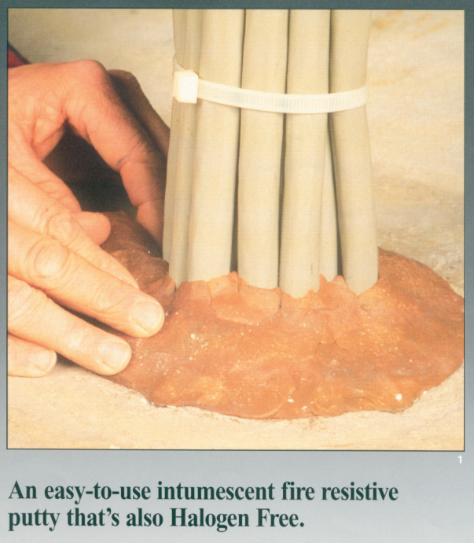
FIREWALL
Cable Trays
Fire
Door

Slide 19
In conclusion-Sectorization:
Has to be decided at early layout stage
Integration of walls with equipment assembly, disassembly, calibration
Integration with transportation
Requires additional ducts
Has a cost
Safest approach for personnel evacuation
Confines equipment damage
Reduces dispersion of isotopes
Allows effective intervention of fire brigade
Reduces recovery time and costs
Allows compliance with benchmark codes
Thank you

