Slide 1
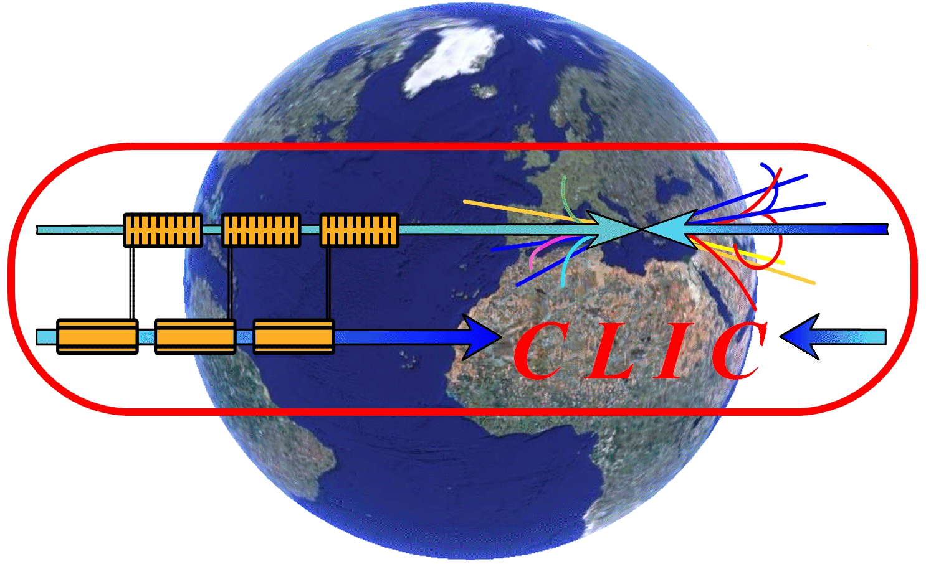
”TWO BEAM HARDWARE AND INTEGRATION”
Working Group
CLIC WORKSHOP October 2008
CLIC MODULE
INTEGRATION
A. Samoshkin, G. Riddone
15-Oct-2008

Slide 2
Main Integration Activities
1
Alexandre.Samochkine @ cern.ch
3D Layout
CLIC
MODULE
INTEGRATION
AND
DESIGN
Cooling
Vacuum
Ventilation
AS Design
Tolerances
Quadrupoles
Coordinate System
Radiation Protection
Tunnel Integration
Alignment/Stabilization
Beam Instrumentation

Slide 3
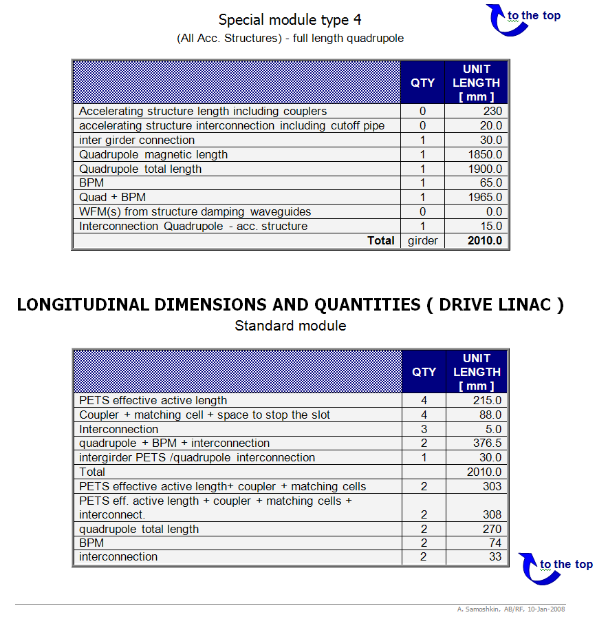
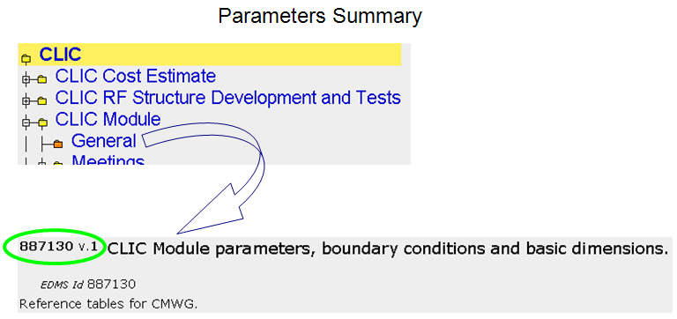
Parameters
2
Alexandre.Samochkine @ cern.ch
Module design is based on latest CLIC parameters
EDMS №887130
https://edms.cern.ch/file/887130/1/CLIC-Parameters_Boundary-Conditions_Module-Dimensions_887130.doc

Slide 4
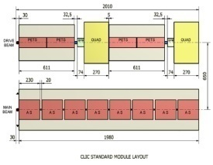
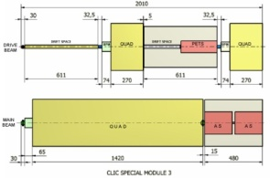
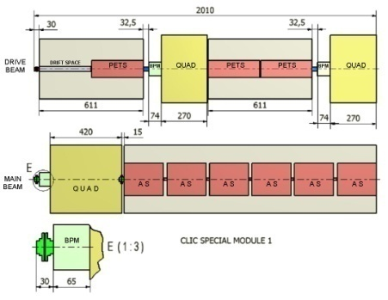
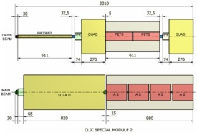
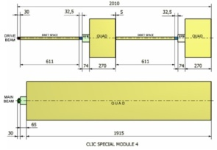
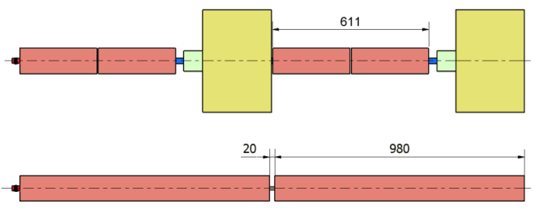
Quadrupole type modules
3
Alexandre.Samochkine @ cern.ch
CLIC Module Type1
154 per Linac
2 configurations
are under study
Standard Module
8374 per Linac
Module Type 3
477 per Linac
Tank Version
Sealed Version
Module Type 2
634 per Linac
Module Type 4
731 per Linac
DB (100 A)
4 PETS, 2 Quads with BPM
Each PETS powers 2 AS
MB (1 A)
8 acc. structures
Main beam filling factor: 91%
AS: based on CLIC ”G” disk damped (sealed version)
(250 mm including 20 mm for interconnection)
+ special modules

Slide 5
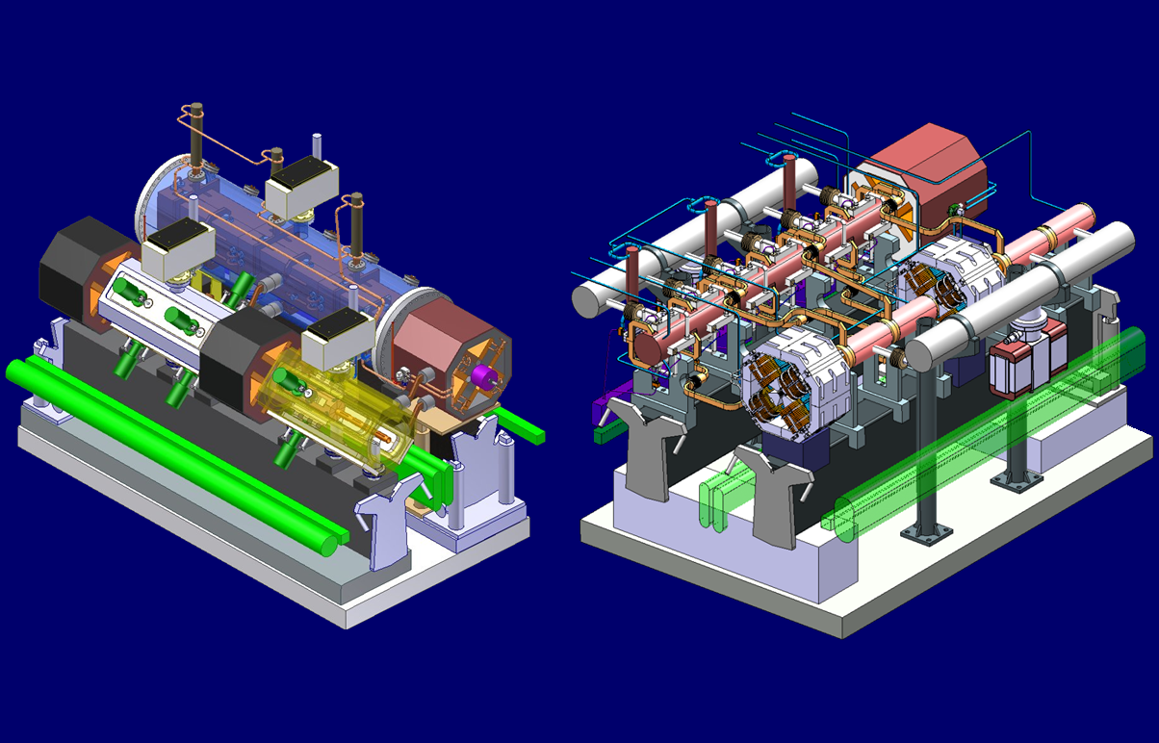
Module Layout (2 configurations)
4
Alexandre.Samochkine @ cern.ch
MB: AS (quadrants) in vac. tank
DB: PETS in vac. tank
Quads: simplified 3D model
MB: AS (disks) sealed
DB: PETS with “mini-tank”
DB Quads: updated 3D model
Tank Version
Sealed Version

Slide 6
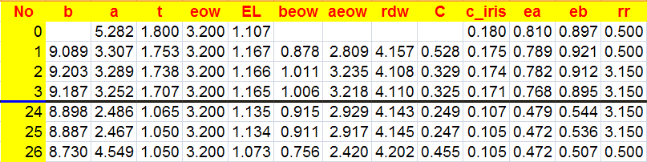
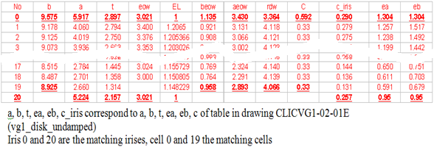
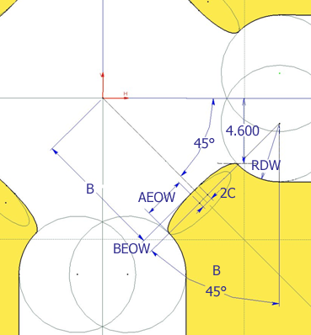
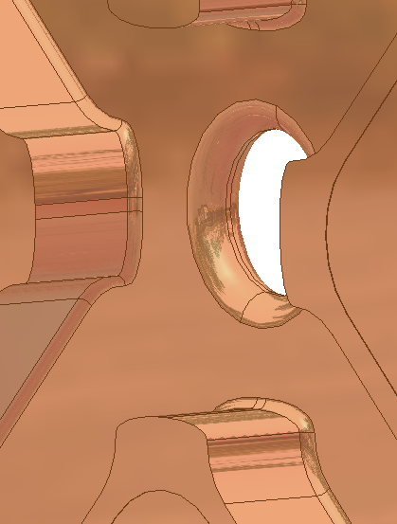
AS Design
5
Alexandre.Samochkine @ cern.ch
RF input for design (AS parameters table)
Main requirement for AS fabrication and assembly:
shape accuracy: 0.005 mm

Slide 7
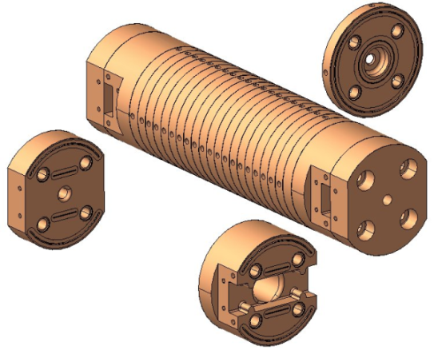
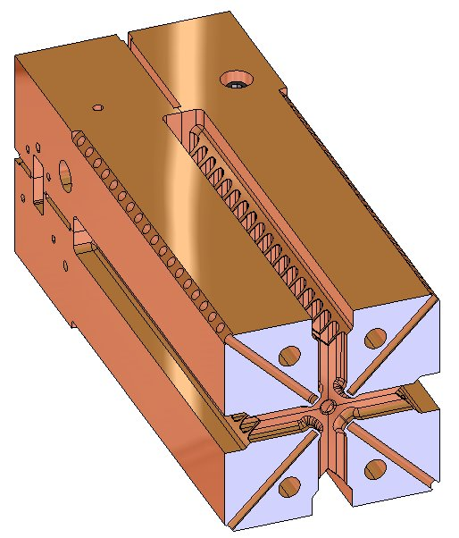
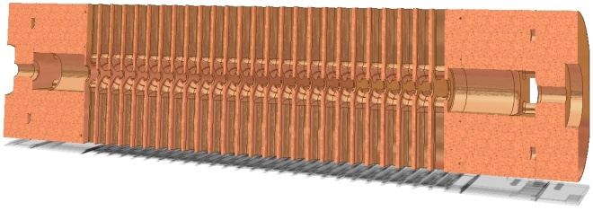
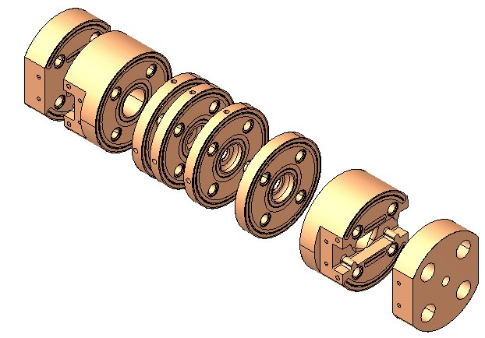
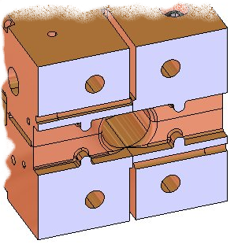
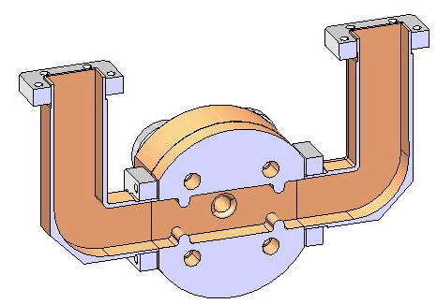
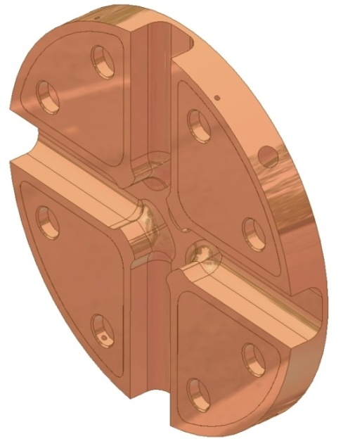
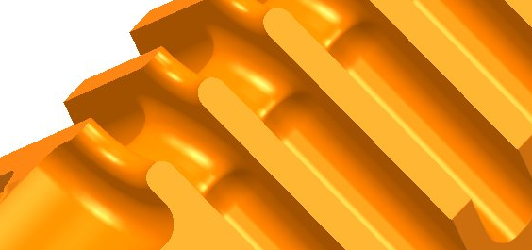
AS Design
6
Alexandre.Samochkine @ cern.ch
DISK
QUADRANT
11WDSDVG1.8T
11WNSDVG1.8T
11 GHz
AS in quadrant
Coupler & WG
(assembly cut)
12GHz AS disk
(damped version)
Irises (on 1 quadrant)

Slide 8
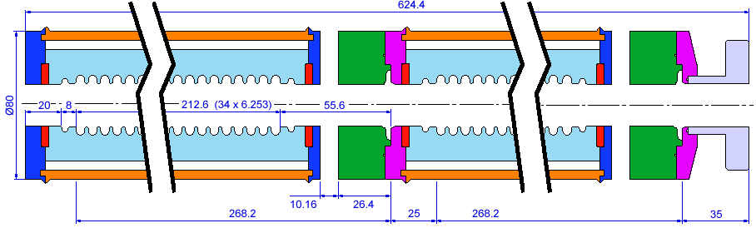
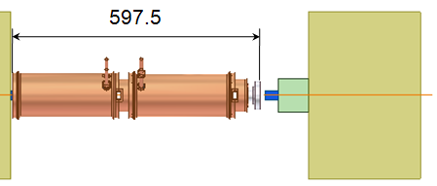
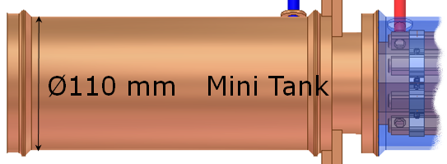
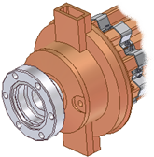
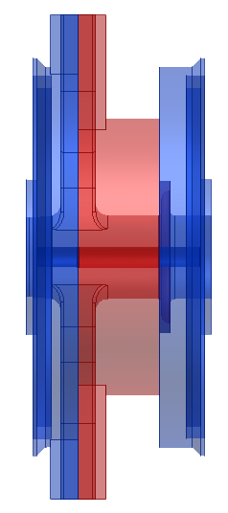
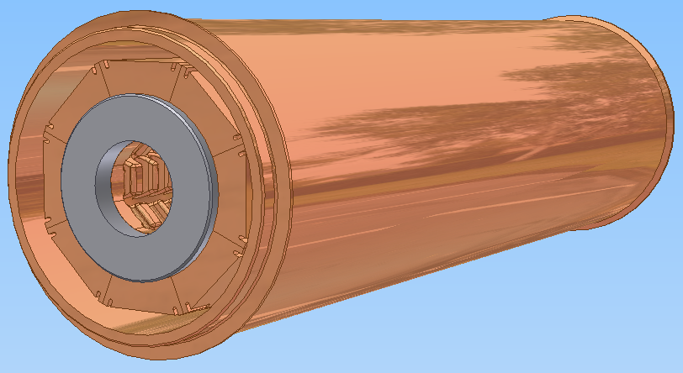
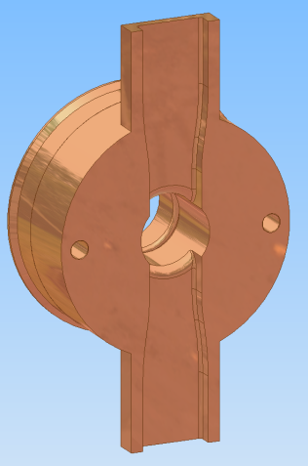
PETS Integration
7
Alexandre.Samochkine @ cern.ch
PETS 3D (fitting on the ST module
schematic background)
PETS inside of “mini-tank”
Coupler

Slide 9
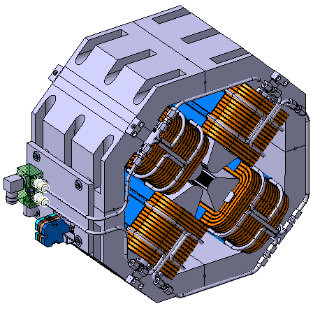
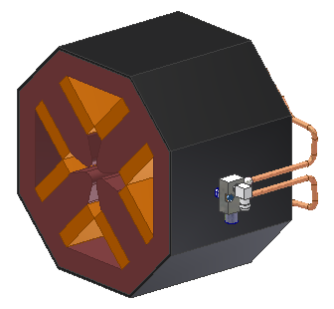
Quadrupoles
8
Aperture and field requirements
(input from D. Schulte)
  Magnetic length: between 350 and 1850 mm
  Field gradient: 200 T/m
  Inner radius of chamber: 2.5 mm (t.b.c)
  Chamber wall thickness : 1.5 mm (t.b.c.)
Indirect water cooling
  Max. current density 2.5 A/mm²
Integrated H/V steering coils (2 mT)
Mechanical precision and stability aspects to be considered in design
Drive Beam Quadrupole
DB
Aperture radius: 13.0 mm
Integrated gradient: 14.3 Tm/m
Nominal gradient: 67.1 T/m
Total length: 270 mm
Magnet width: 390 mm
Magnet weight: 180 kg
Distance between opposite coils: 118 mm
Water cooling
Main Beam Quadrupole
MB
Aperture radius: 4.00 mm
Integrated gradient: 70 (170, 270, 370 ) Tm/m
Nominal gradient: 200 T/m
Iron length: 346 (846, 1346, 1846) mm
Magnetic length: 350 (850, 1350, 1850) mm
Total length: 420 (920, 1420, 1920) mm
Magnet width: < 200 mm
Magnet height: < 200 mm
Magnet weight: ~ 75 (110, 135, 270) kg
Indirect water cooling through yoke

Slide 10
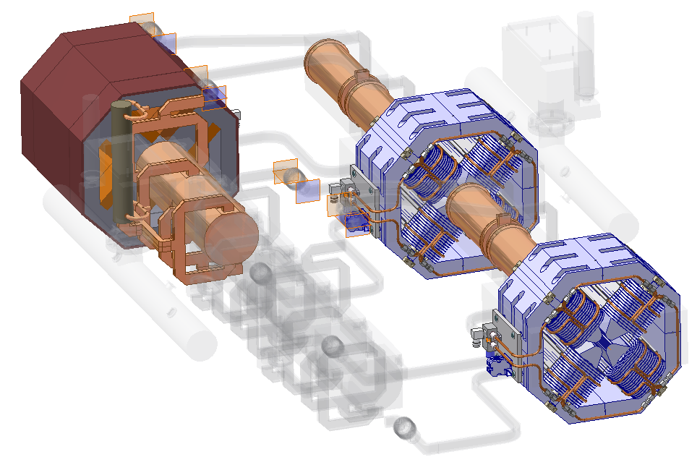
Quadrupoles Integration
9
Alexandre.Samochkine @ cern.ch
DB
MB

Slide 11
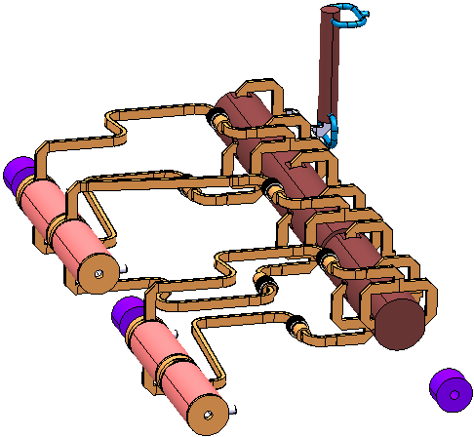
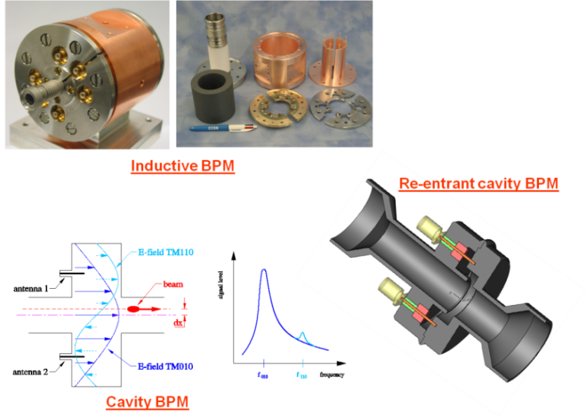
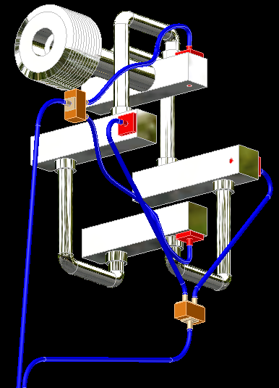
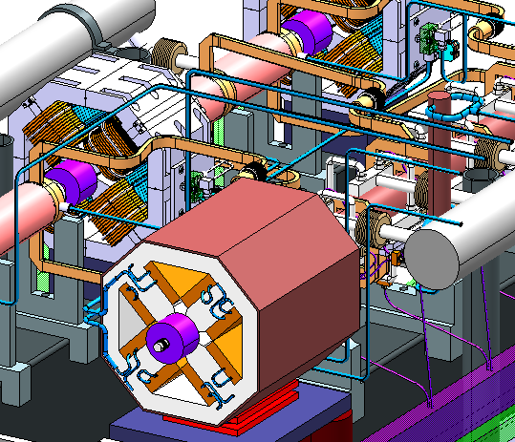
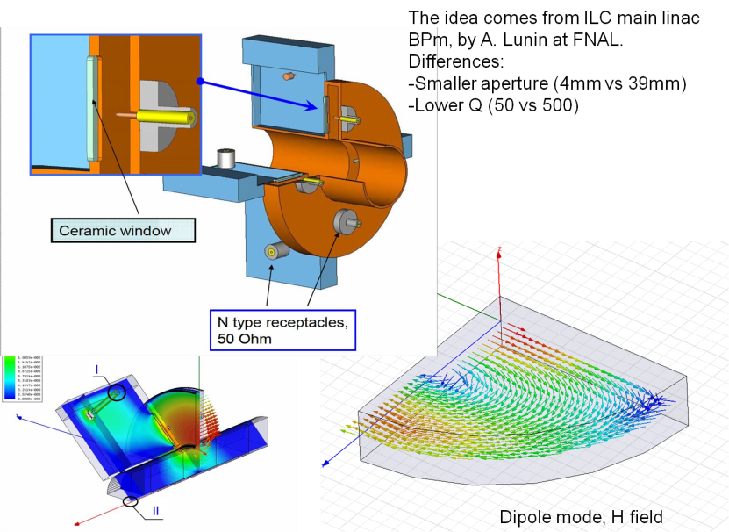
Beam Instrumentation
10
Alexandre.Samochkine @ cern.ch
WFM
BPM
50x100 mm space on the side along the module has been reserved for electronics placement.

Slide 12
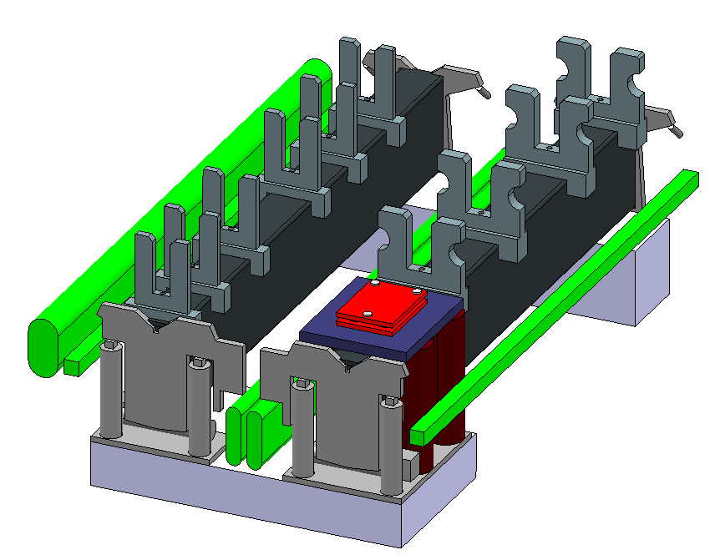
Supporting System & Space reservation for alignment
11
Alexandre.Samochkine @ cern.ch
Requirement:
possibility to align MB & DB separately
V-Supports for PETS
V-Supports for AS
DB Girder
MB Girder
H₂O Alignment
Optical
sensor
Temporary
Module Support
Wire Alignment
Space is reserved for MB Quad support (including alignment/stabilization/support) and alignment system

Slide 13
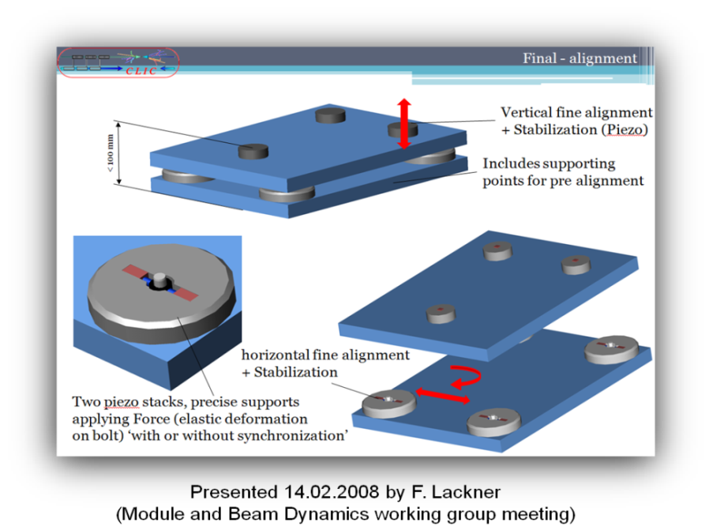
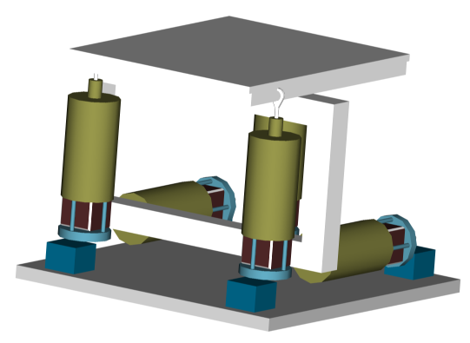
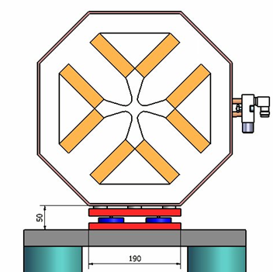
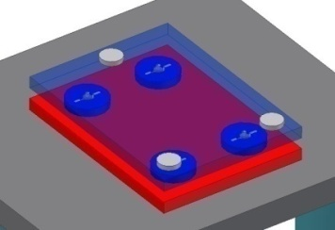
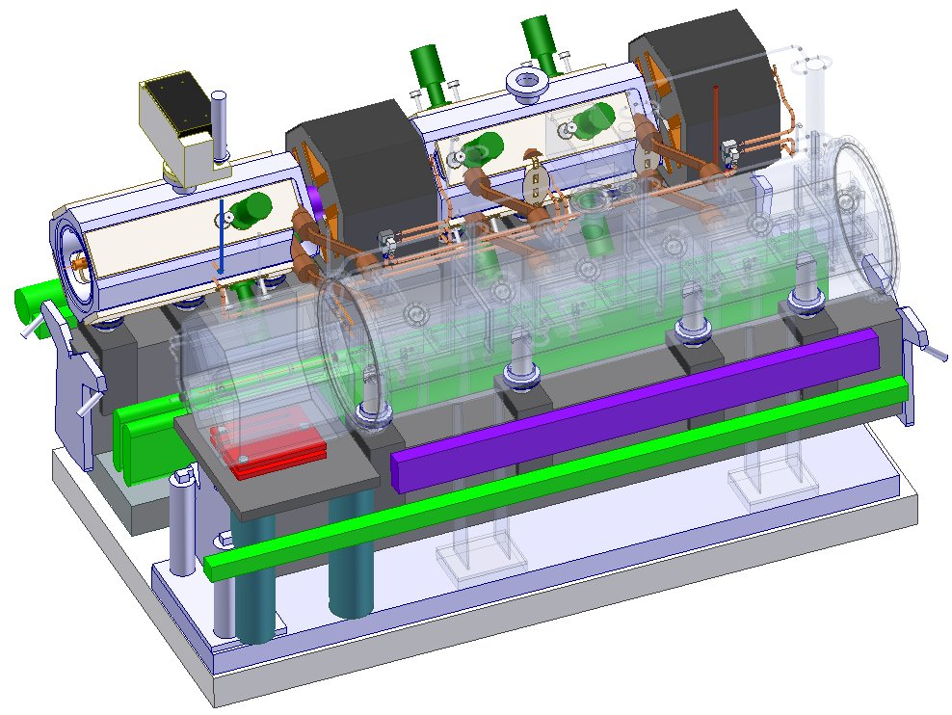
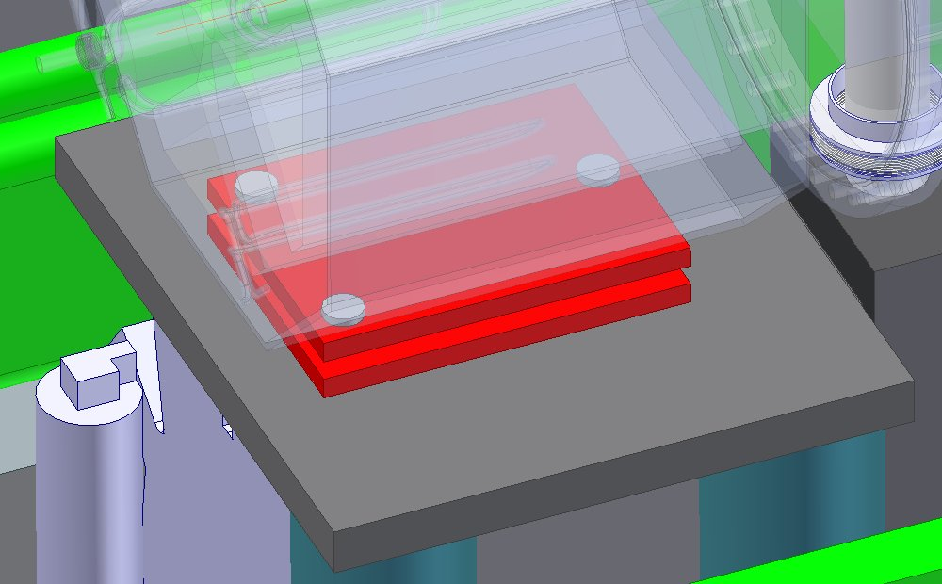
Stabilization
12
Alexandre.Samochkine @ cern.ch
A possible solution for MB quad fine alignment and stabilization.
Integration of
MB Quad support.

Slide 14
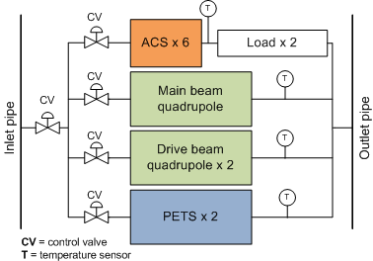
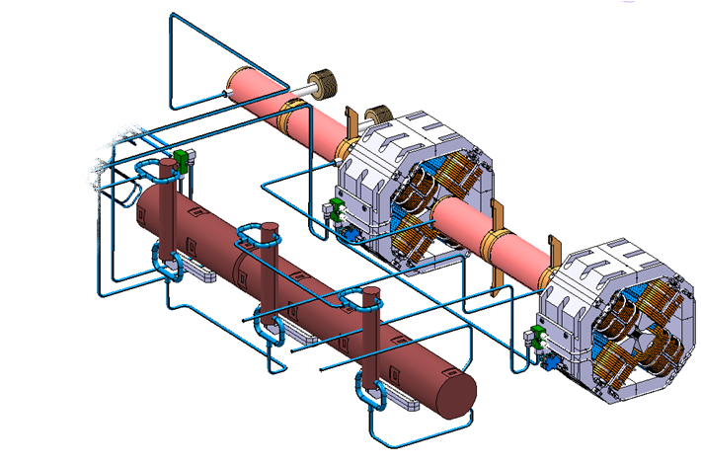
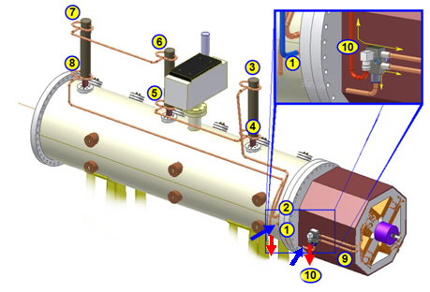
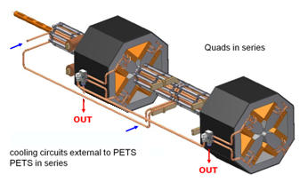
Module Cooling Layout
13
Alexandre.Samochkine @ cern.ch
Config.2
MB - AS in series and loads in series, Quad – in parall
DB - PETS in series, Quads in series
The water circuits have a common inlet and outlet. Loads dimensions were adapted to the module and do not exceed 300mm in length and Ø 50mm.
The system will be updated following more precise calculations later.
Config.1
DB
MB

Slide 15
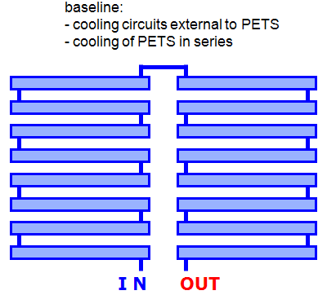
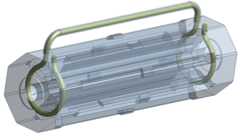




PETS cooling
14
Alexandre.Samochkine @ cern.ch
Baseline:
cooling circuits external to PETS
cooling of PETS in series
Different cooling configurations under study
Forced convection cooling – circuits inside the vacuum tank, outside the octants
Implementation of tubes stimulated a rework of the waveguides. As a result they are 68 mm shorter now. The cooling system will follow series of optimizations. Nevertheless the space is booked up.

Slide 16



RF Network
15
Alexandre.Samochkine @ cern.ch
PETS and AS are connected via waveguides and choke mode flanges (CMF). CMF allows the power transmission without electrical contact between waveguides. This device should be flexible in order to permit independent alignment of two waveguides. Waveguide length optimization is based on losses, phase advance and RF to beam timing considerations.

Slide 17




Choke Mode Flange
16
Alexandre.Samochkine @ cern.ch
Definition:
Waveguide interconnections between PETS and AS via CMF:
X – shift: ± 0.25 mm
Y – shift: ± 0.5 mm
Z – shift: ± 0.5 mm
Twist: < 5°
Welding

Slide 18
Requirements for Vacuum
17
dictated by beam dynamics ➔ fast ion instability
  10⁻¹⁰ mbar for transfer lines: bake-out and NEG are possible solutions
  10⁻¹⁰ to 10⁻⁸ mbar
    Bakeout excluded: tight mechanical tolerances and magnet t°
    Pumping speed in the AS is limited
    MB & DB are under the same vacuum via waveguides
Pumping
  during nominal operation
  during breakdown
  P recovery between breakdowns (main beam 8 m² surface to be pumped)
Sectorisation ➔ length of sector (200 m) determined by several factor, such as:
  Operation: in case of failure or modification all the length vented
  ==> reconditioning. Failure rate?
  Additional space required (~ 200 mm)
  Additional cost

Slide 19

Vacuum Layout
18
Alexandre.Samochkine @ cern.ch
Consideration on the quantity and overall dimensions of devices needed for creation and maintaining vacuum for the experiment is shown schematically.

Slide 20


Vacuum
19
Alexandre.Samochkine @ cern.ch
The vacuum simulation based on calculation method with possible 10% error was done by P. Costa-Pinto to estimate the pressure recovery time inside the AS of a standard module after a spark.
The 11.4 GHz AS (CLIAAS110001) was used for simulation. Model consists of 8 copper AS inside a stainless steel tank of 2 m long and Ø 400 mm. Three different pumping speeds (500 l/s, 1000 l/s and 2000 l/s) have been simulated. The amount of gas released per spark is based on the data measured in the spark test system for Mo, and considered to occur during 75ns. The simulation was performed for the two main gases observed, H₂ and CO.
The results were 6 ms period of time for recovering 10⁻⁸ Torr for H₂ and 20 ms for CO after spark.

Slide 21



Vacuum manifolds
20
Alexandre.Samochkine @ cern.ch
AS Ø140 mm
Support
Vacuum
manifold
(reserved
space
30x30 mm)

Slide 22
Intermodule Interconnections
21
Alexandre.Samochkine @ cern.ch
 | Type 1 |  |  | Type 2 |  | Type 3
 | ST--ST |  |  | 1--1 | ST--2 | 4--ST
 | 2--ST |  |  | 1--2 | ST--3
 | 3--ST |  |  | 2--2 | ST--4
 | I n t e r m o d u l e
Main Beam | AS-AS | Tank-Tank |  | AS-Q |  | Q-AS
Drive Beam |  |  | Q-PETS |  | Q-Drift tube |  | Q-Drift tube
Connection | Copper tube | Bellows |  | Bellows | Bellows | Bellows | Bellows
Requirements
leak tightness | ? | 1 atm
smooth shape/transition for the RF | Yes
compensation after alignment
- transversal | ~0.1mm | ~1mm | ~0.2mm
- longitudinal | ~0.15mm | ~1mm | ~1mm
flexibility | Yes | Yes | Yes
available space | 30mm | 30-->105mm | 30mm
uncoupling
loads
accessibility
dismounting possibility
reliability
stiffness
- axial |  | ~10 N/mm | ~25 N/mm
lateral |  | ~300 N/mm | ~50 N/mm
1 ply thickness |  | ~0.3mm | ~0.1mm
convolution length |  |  | ~14mm
inner Ø |  | ~400mm | ≥ 26 mm
Material | Annealed Cu | 316 L | 316 L

Slide 23





Interconnections
22
Alexandre.Samochkine @ cern.ch
The thin wall tube made of annealed Cu and bolted to the end of AS with two half flanges must ensure a good RF transition and needed flexibility within required range. The shape of AS ends could be adapted to facilitate the assembly.
The length of MB vacuum vessels is reduced to provide a gap of 105 mm to fit the bellows.

Slide 24




3D simulation of DB return loop
23
Alexandre.Samochkine @ cern.ch
Alexandre.Samochkine @ cern.ch
A principle of the loop modeling based on the “MAD-X” data.
The process is automated in collaboration with TS/CSE (CAD support).

Slide 25



Tunnel Layout
24
Alexandre.Samochkine @ cern.ch
Design based on Year 2007 drawings
Tunnel Ø: 4.5 m
Integration of module (considering transport, installation, maintenance and operation issues), transfer lines, cooling pipes, electrical cables and different machine services
Turn around tunnel redesigned in compliance with latest objects layout

Slide 26

CLIC Module Coordinate System
25
Alexandre.Samochkine @ cern.ch
Y
(Discussion with D. Schulte & J. Osborne on 09.09.2008)
YAW
X
e+
ROLL
TILT
Z
BEAM DIRECTION
I P

Slide 27
Conclusions
26
Alexandre.Samochkine @ cern.ch
Integration of different systems in terms of space reservation has been finished.
Detailed design started for the main systems.
The development programs on different systems including, micron precision pre-alignment, nanometer stabilization, cooling, vacuum, beam instrumentation as well as active alignment and beam dynamics are under way.
Integration of these various systems into the CLIC module is of an importance. It helps us to identify the critical areas, demanding additional research works and assists to all people involved in the CLIC feasibility study.
The CMWG meetings are taking place every two weeks, where specialists in different areas discuss the topical questions and deliver their solutions on optimization, reliability, scheduling and cost.
All relevant information is being documented and can be consulted from EDMS.
Collaborators are Welcome.

Slide 28


CAD System used for Integration
Alexandre.Samochkine @ cern.ch

Slide 29
Acknowledgment
CLIC WORKSHOP October 2008
W. Wuensch
I. Syratchev
A. Grudiev
R. Zennaro
T. Zickler
B. Jeanneret
R. Nousiainen
G. Riddone
J. Inigo-Golfin
C. Martel
P. Costa-Pinto
C. Garion
N. Hilleret
H. Mainaud-Durand
T. Touzé
D. Schulte
L. Søby
R. Fandos
J. Osborne
D. Gudkov
A. Kosmicki
CERN CAD Support Team
Alexandre.Samochkine @ cern.ch

Slide 30
Thank you !

