Slide 1

Advanced Control Engineering
CERN – IFAC/CEA
Introduction
EN/ICE Automation Seminars
CERN, 2nd, 3rd June 2014

Slide 2
EN/ICE Automation Seminars
Spread out knowledge in Automation at CERN
Past Seminars
  Industrial Communications (2)
      EtherCAT (M. Rostan, EtherCAT)
      Profinet (W. Schroeder, SIEMENS)
  PID control
      Prof. Cesar de Prada, UVA
https://indico.cern.ch/category/4856/

Slide 3

Workshop goal
IFAC/CEA and the Control Engineering group action: Industry day 3rd edition
  Get closer to the real use of control engineering in industry (e.g. Petroleum refinery, thermoplastics)
Exchange Academia – Industry knowledge
  Existing CERN projects involving advanced control engineering
  Lectures focused on some CEA members research topics
IFAC: International Federation of Automatic Control

Slide 4
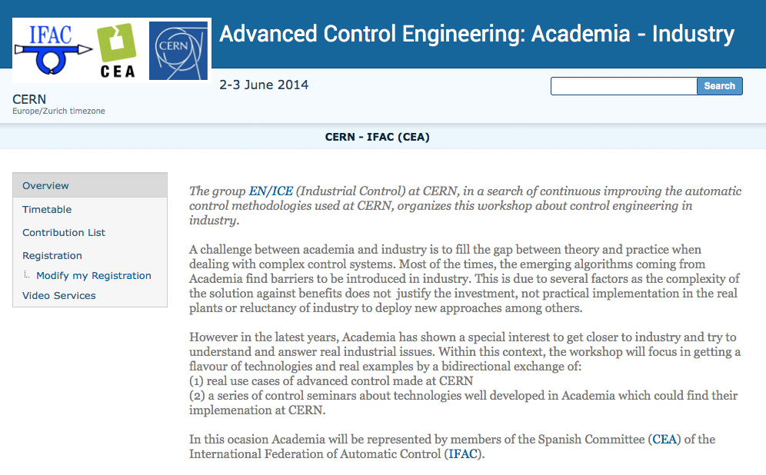
Overview (https://indico.cern.ch/event/303961)
Indico event

Slide 5

IFAC/CEA visitors
Universidad de Oviedo
Universidad Autónoma de Barcelona
Universidad de Leon
Universidad de Valladolid
Universidad de Sevilla
Universidad Politécnica de Valencia
Universidad de Huelva

Slide 6
Programme
Two sessions:
  2nd June: CERN use cases
  3rd June: IFAC/CEA lectures

Slide 7
CERN use cases
CERN industrial control
  Ph.D. Philippe Gayet
Model-Based Predictive Control applied to the LHC magnets temperature control
  Ph.D. Enrique Blanco
High precision current control of the LHC Power Converters
  Hugues Thiesen
Control and simulation of cryogenic plants at CERN
  Ph.D. Benjamin Bradu
Design and performance of the LHC beam-based feedback systems
  Ph.D. Ralph Steinhagen
Formal methods applied to PLC code verification
  Borja Fernandez Adiego

Slide 8
IFAC/CEA lectures
Recent advances in PI/PID tuning
  Ph.D. Ramon Vilanova (UAB)
Overview of Model Predictive Control
  Prof. Cesar de Prada (UVA)
Multi-objective optimization for engineering design
  Ph.D. Xavier Blasco (UPV)
A Visual Analytics approach for process analysis
  Ph.D. Ignacio Diaz Blanco (UOVI)

