Slide 1

2014-05-02 ICE Automation Seminars:
Workshop on Advanced Control Engineering
Design and Performance of the
LHC beam-based Feedback Control Systems
– There and back again –
Ralph J. Steinhagen
Accelerator & Beams Department, CERN

Slide 2
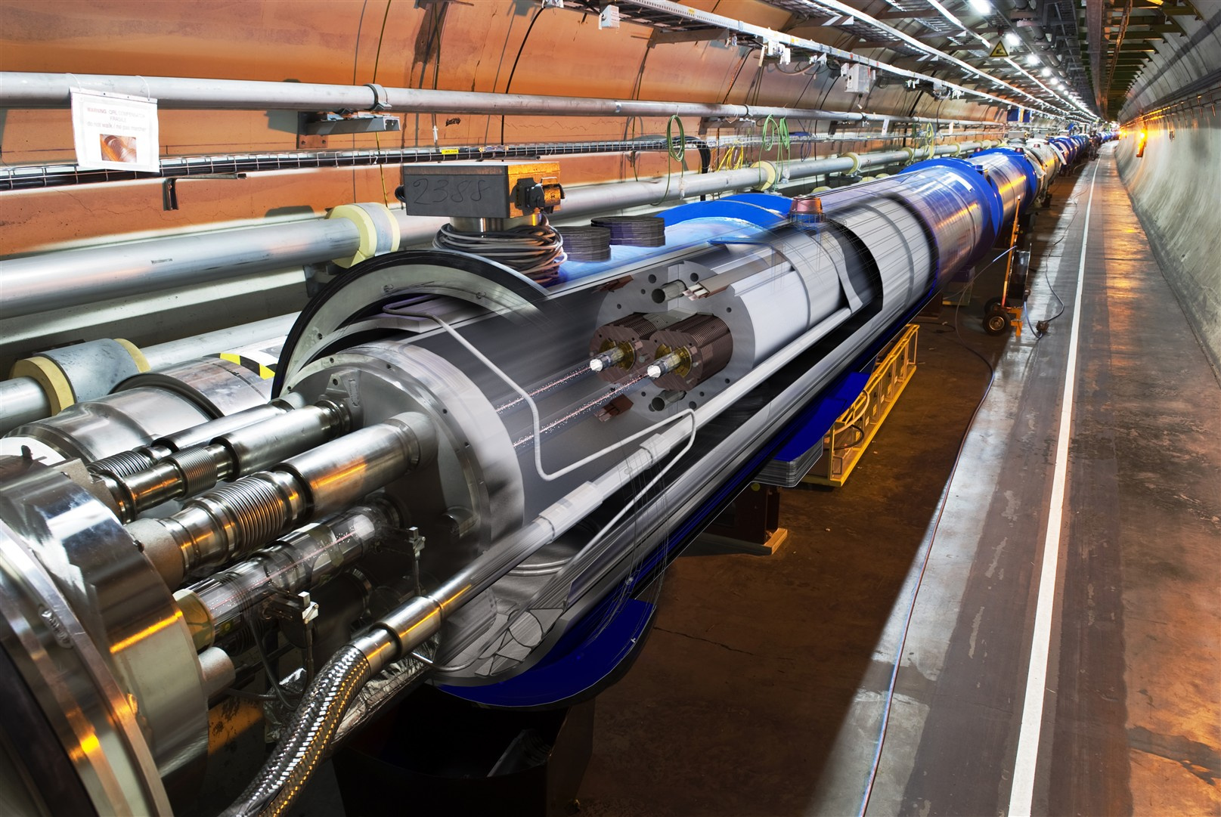
27 km Circumference – 1232 LHC dipole magnet
B field 8.3 T (11.8 kA) @ 1.9 K (super-fluid Helium)
two-in-one magnet design: two beam tubes with an opening of 56 mm (210 mm separation)
Operating challenges:
Very low quench levels (~ mJ/cm³) in an environment that stores MJ → GJ
Control of particle beam stability and losses is paramount!
Notes:
<number>

Slide 3
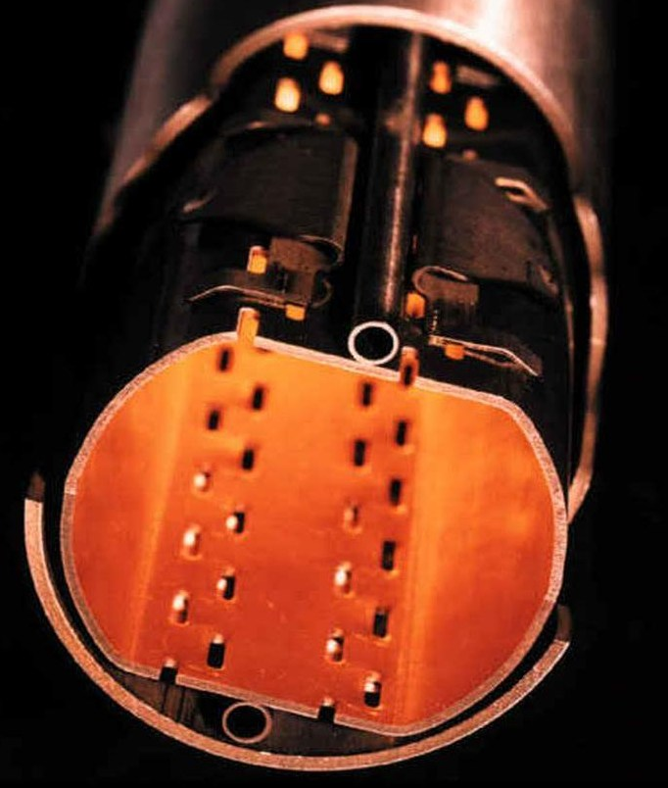
Beam Parameter Stability in Hadron Machines
LHC:
Traditional requirements on beam stability...
... to keep the beam in the pipe!
LHC's increased stored intensity and energy → much tighter requirements on beam stability:
  Capability to control particle losses
    Machine protection (MP) & Collimation
    Quench prevention
  Commissioning and operational efficiency
FBs became a requirement for safe and reliable nominal LHC operation
  implications on controller reliability, availability and system integration
50.0 mm
Beam screen
36 mm
Beam 3 σ envel.
~ 1.8 mm @ 7 TeV

Slide 4

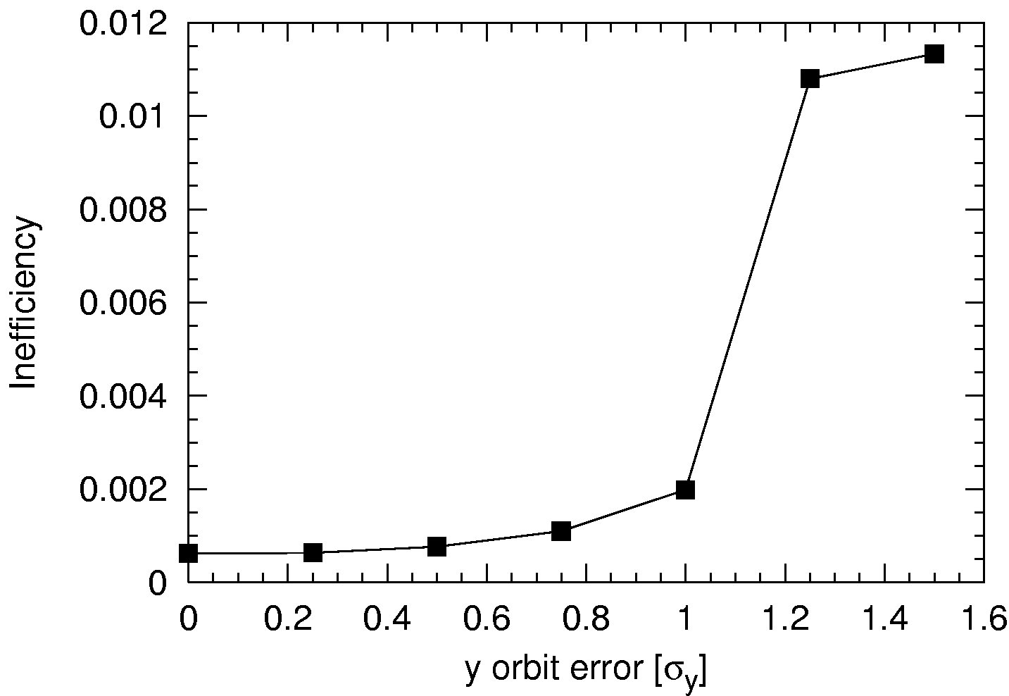
Requirements on Orbit – machine protection
Combined failure¹: Local orbit bump and collimation efficiency (/kicker failure) → bumps may potentially compromise collimation function
IR2
IR3
e.g 'bump in arc'
Potentially:
< 6.7σ
N_{a} [σ]
~7.5σ
secondary halo
6.7σ
closed orbit
5.7σ
MKI
TDI
TCP & TCS
Collimation inefficiency vs. orbit error¹
Coll. system
version ~ 2002
need to operate here!
↔ Δx_{pkpk}< 100 μm
Iberian
peninsula
courtesy R. Assmann
Tight settings (2012):
~2.2 mm gap at primary collimator
peak-to-peak orbit error [σ]

Slide 5
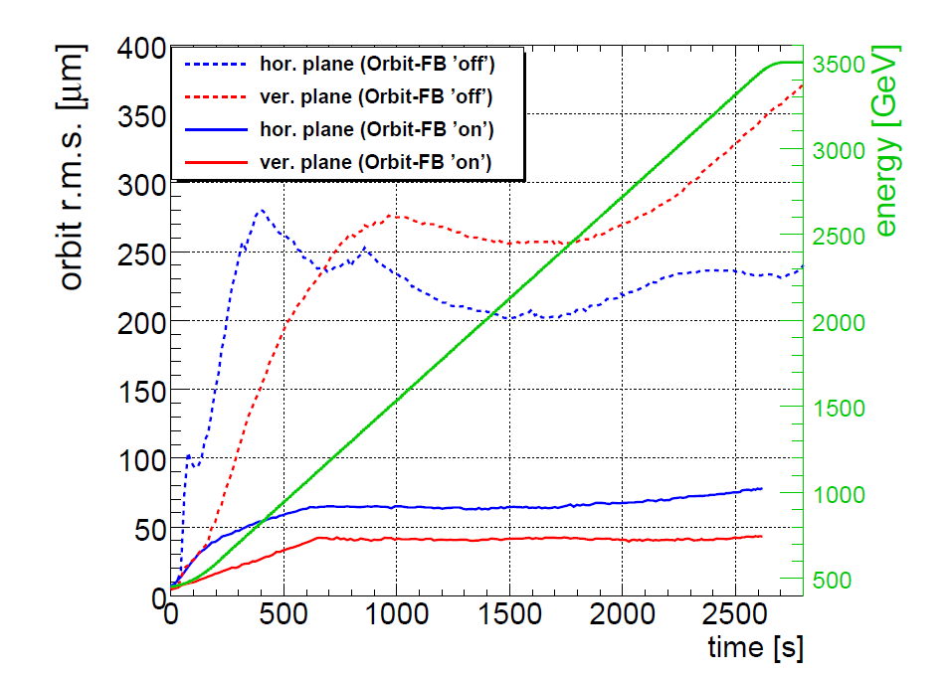
LHC Feedback Operation – Example
Orbit feedback used routinely and mandatory for nominal beam
Typical stability: 80 (20) μm rms. globally (arcs)
Most perturbations due to Orbit-FB reference changes around experiments

Slide 6
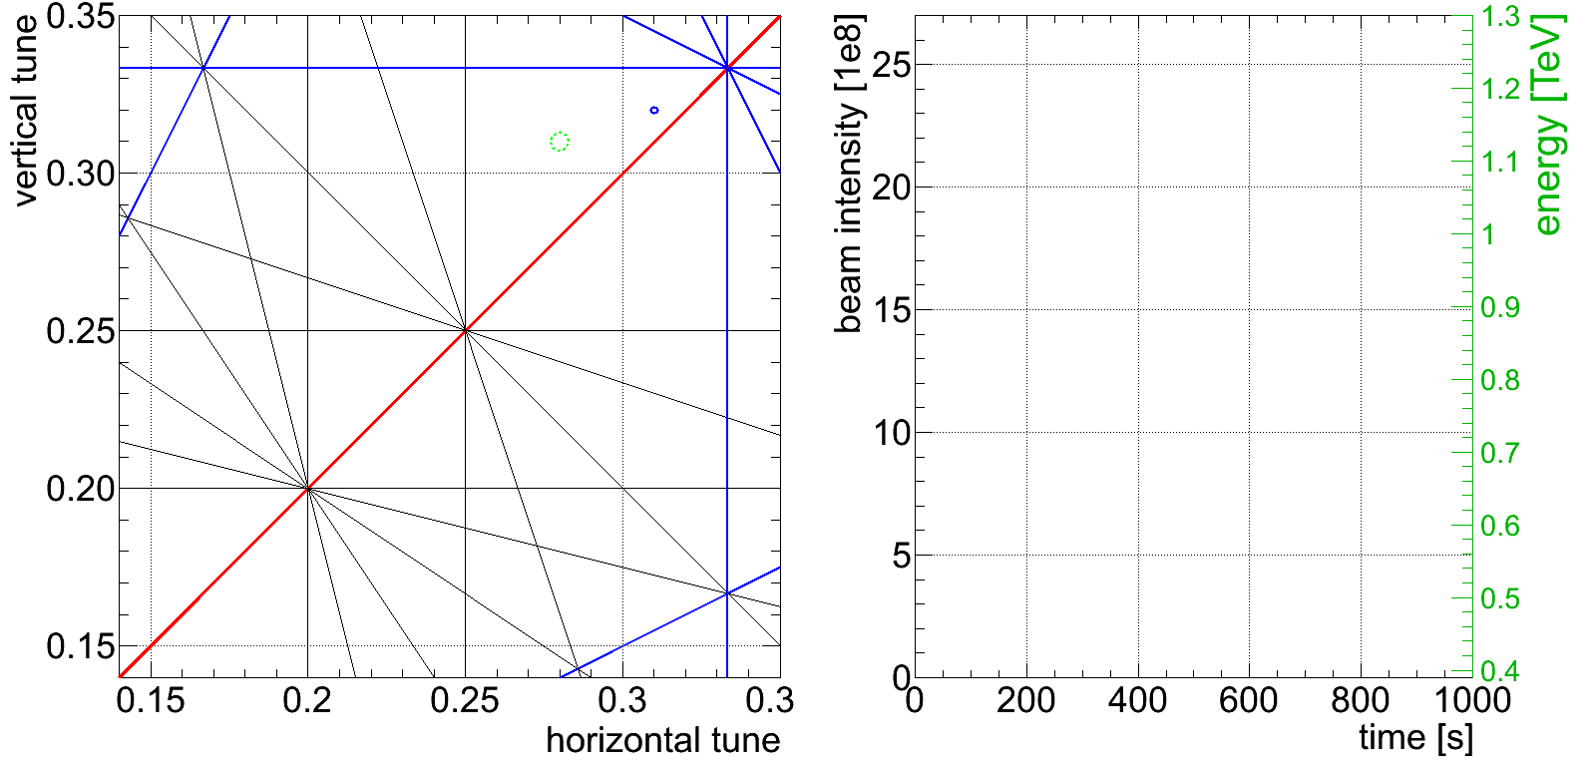
2009 LHC Commissioning
… somewhat a surprise: 3rd ramp without Tune-Feedback

Slide 7
Control Paradigms I/III
Parameter control, either through...
Feed-Forward: (FF)
  Steer parameter using precise process model and disturbance prediction
Feedback: (FB)
  Steering using rough process model and measurement of parameter
  Two types: within-cycle (repetition Δt<<10 hours) or cycle-to-cycle (Δt>10 hours)
predicted disturbance
+
+
Model
Feed-Forward:
M → E
Σ
Reference
actual disturbance
+
Σ
Δx
Feedback:
Δx → E
+
+
Process:
E → P
+
+
Energy, Orbit,
Q, Q', c₋ etc.
Σ
Σ
-
P'
Monitor:
P → P'
P

Slide 8
Orbit-Feedback as Prototype for all
LHC Beam-Based Feedback Systems
Orbit-Feedback is one of the largest and most complex LHC feedback:
  1088 BPMs → 2176+ readings @ 25 Hz from 68 front-end computers
  530 correction dipole magnets/plane, distributed over ~50 front-end computers
  Total >3500 devices involved
Specific requirements fairly distributed → opted for central global feedback system
One central controller (OFC + hot spare):
  higher numerical load
  higher network load (↔ ~120 front-ends)
  dependence of machine operation on single device
  easier synchronisation between front-ends and FBs
  flexible correction scheme changes and gain-scheduling
  most efficient to handle cross-talk and (de-)coupling between FBs
OFC
Ethernet
LHC
Beam FE/
corr. circuits

Slide 9
Common Feedback/Feed-forward Control Layout
Feedback Controller (OFC) performing actual feedback controller logic
  Simple streaming task (10% of total load)
  Beam data quality checks and real-time filtering (80% of total load)
  Server running Real-Time Linux OS with periodic constant load
    multi-core, highly redundant – MTBF > 22 yrs (spec, 120 yrs meas.)
  Technical Network as robust communication backbone
Service Unit: Interface to high-level software control and interlock systems
  Proxies user requests, handles asynchronous non-RT tasks
CMW
Database settings,
operation,other user
Service Unit
m x
Ethernet UDP/IP
Ethernet UDP/IP
n x
Monitor-Frontend
PC-Gateways
Monitor-Frontend
PC-Gateways
Monitor-Frontend
FB/FF Controller
PC-Gateways
Surface
Tunnel
...
...
beam response
beam instrument
corrector magnets

Slide 10
Multiple-Input-Multiple-Output (MIMO) Process Control
'Divide and Conquer' feedback controller design approach:
  Compute steady-state corrector settings based on measured parameter shift Δx=(x₁,..., x_{n}) that will move the beam to its reference position for t→∞.
  Compute a that will enhance the transition
  Feed-forward: anticipate and add deflections to compensate changes of well known and properly described sources
(N.B. here G(s) contains the process and monitor response function)
space
domain
time
domain
external input
(trigger, control parameter, Lumi-Feedback etc.)
Feedback Controller
D(s)
ff estimate¹
+
Σ
+
+
actual beam parameter
reference
Δx → δ_{ss}
δ(t=0) → δ_{ss}
Σ
G(s)
-
“classic” parameter
correction
“classic”
feedback controller
machine
response
feedback-path = measured beam parameter

Slide 11
Space-Domain:
Singular Value Decomposition (SVD) on a slide
Linear algebra theorem*:
n x cor. circuits
R
U
T
T
eigen-vector relation:
λ
V
m x observ-ables
=
x
x
BPM eigenvectors
COD eigenvectors
though decomposition is numerically more complex final correction is a simple vector-matrix multiplication:
numerical robust, minimises parameter deviations Δx and circuit strengths δ
Easy removal of singularities, (nearly) singular eigen-solutions have λ_{i}~0
  to remove those solution: if λ_{i} ≈ 0 → '1/λ_{i} := 0'
    discarded eigenvalues corresponds to solution pattern unaffected by the FB
response matrix
eigenvalues
*G. Golub and C. Reinsch, “Handbook for automatic computation II, Linear Algebra”, Springer, NY, 1971

Slide 12
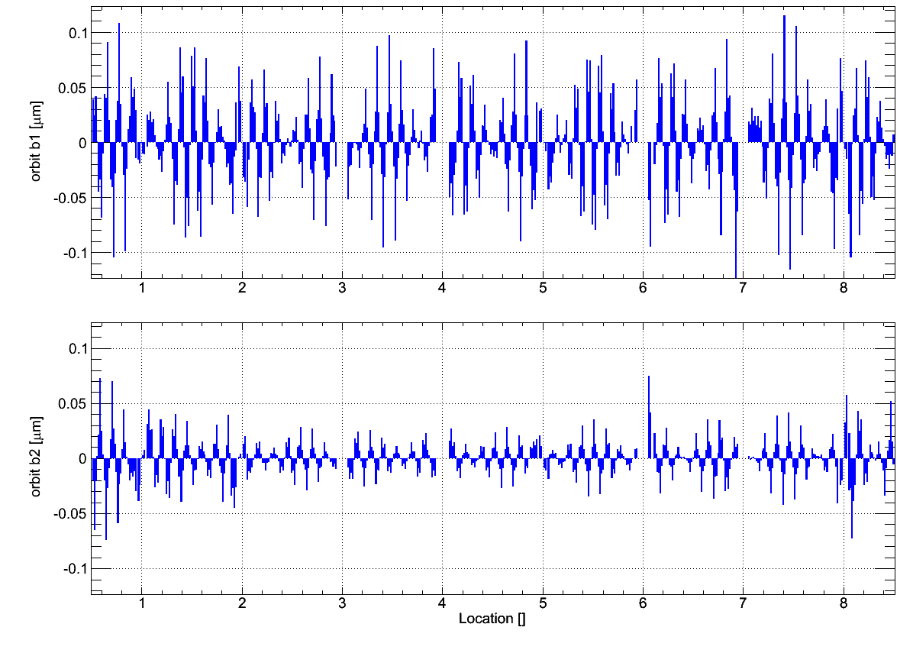
Space Domain:
LHC BPM eigenvector #50 λ₅₀= 6.69•10²

Slide 13
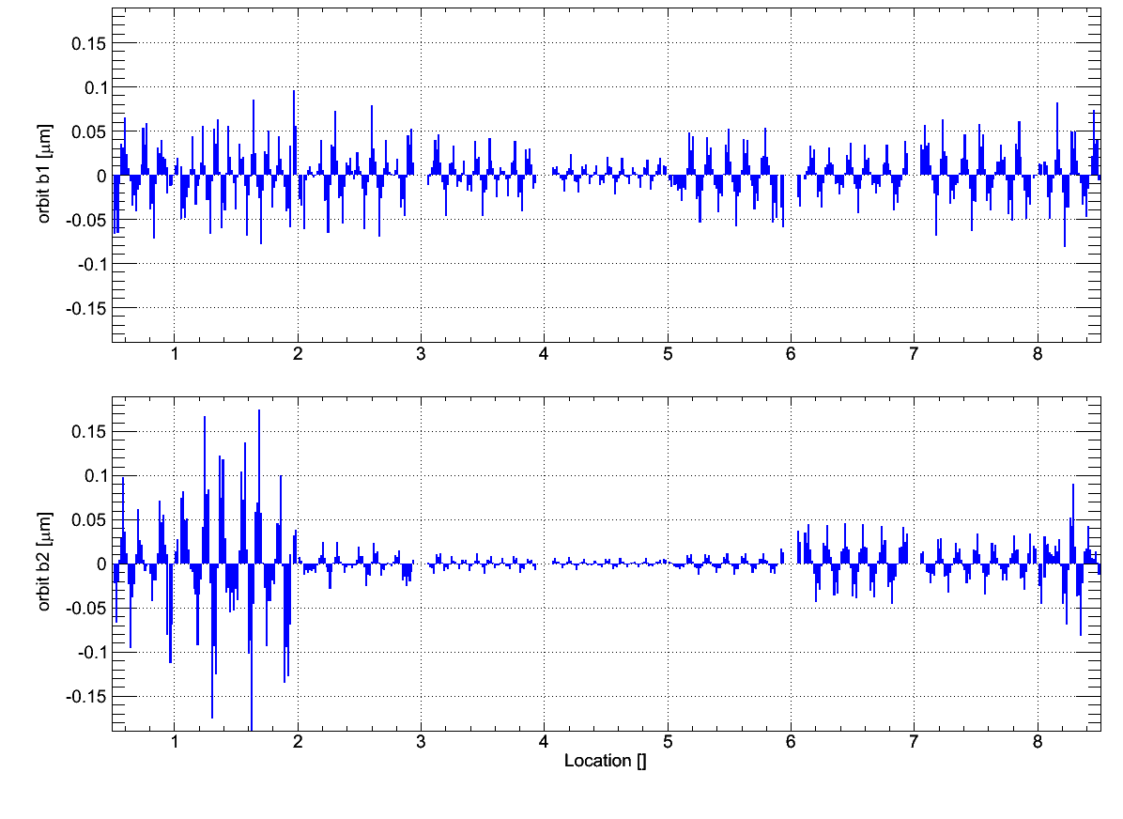
Space Domain:
LHC BPM eigenvector #100 λ₁₀₀= 3.38•10²

Slide 14
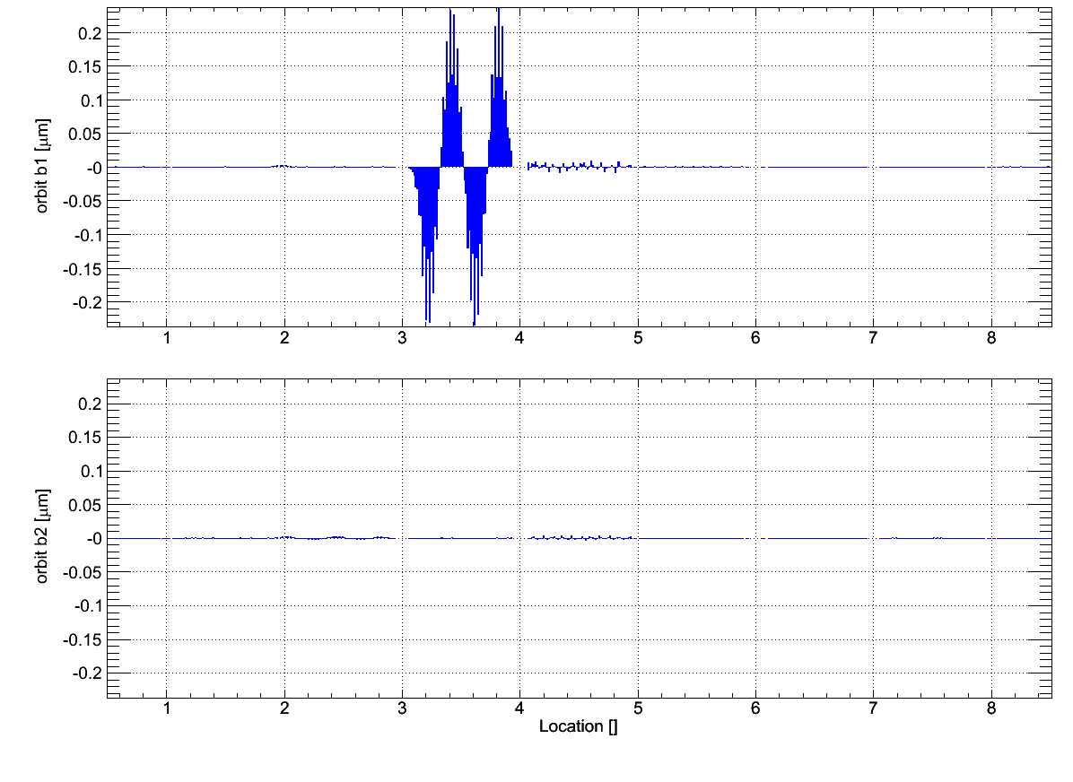
Space Domain:
LHC BPM eigenvector #291 λ₂₉₁= 2.13•10²

Slide 15
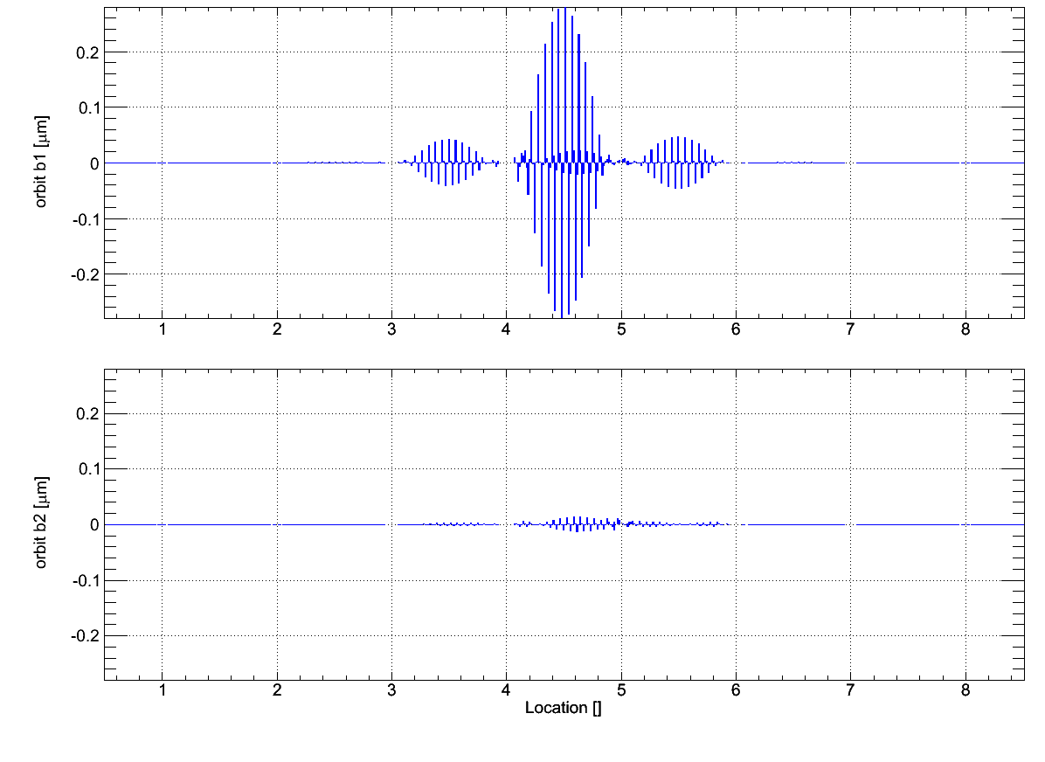
Space Domain:
LHC BPM eigenvector #449 λ₄₄₉= 8.17•10¹

Slide 16
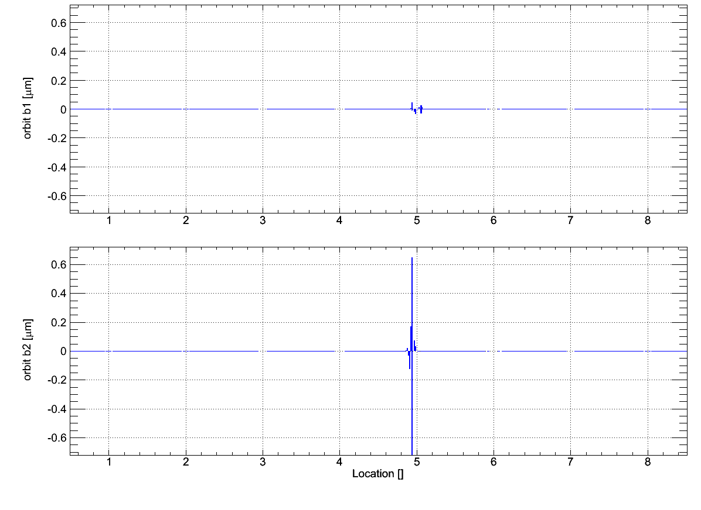
Space Domain:
LHC BPM eigenvector #521 λ₅₂₁= 1.18•10⁰

Slide 17
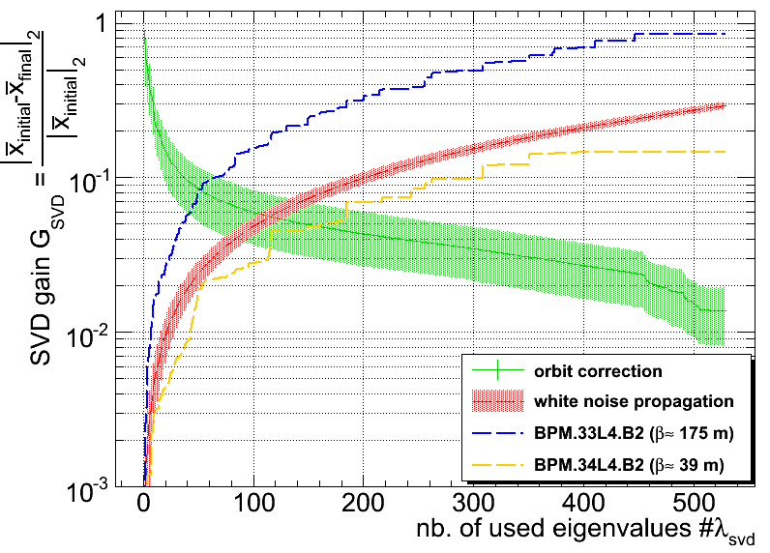
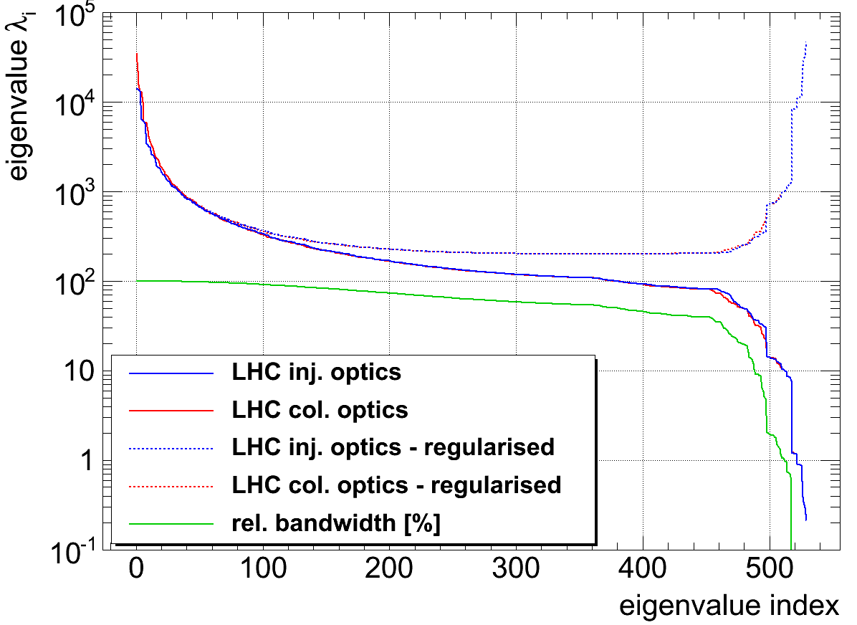
Standard Singular-Value-Decomposition based Orbit Correction
Initially: Truncated-SVD (set λ_{i}⁻¹:= 0, for i>N)
  not without issues: removed λ_{i} allowed local bumps creeping in (e.g. collimation)
Regularised-SVD (Tikhonov/opt. Wiener filter with λ_{i}⁻¹:= λ_{i}/(λ_{i}² + μ), μ>0)
  more robust w.r.t. optics errors and mitigation of BPM noise/errors

Slide 18
Multiple-Input-Multiple-Output (MIMO) Process Control
'Divide and Conquer' feedback controller design approach:
  Compute steady-state corrector settings based on measured parameter shift Δx=(x₁,..., x_{n}) that will move the beam to its reference position for t→∞.
  Compute a that will enhance the transition
  Feed-forward: anticipate and add deflections to compensate changes of well known and properly described sources
(N.B. here G(s) contains the process and monitor response function)
space
domain
time
domain
external input
(trigger, control parameter, Lumi-Feedback etc.)
Feedback Controller
D(s)
ff estimate¹
+
Σ
+
+
actual beam parameter
reference
Δx → δ_{ss}
δ(t=0) → δ_{ss}
Σ
G(s)
-
“classic” parameter
correction
“classic”
feedback controller
machine
response
feedback-path = measured beam parameter

Slide 19
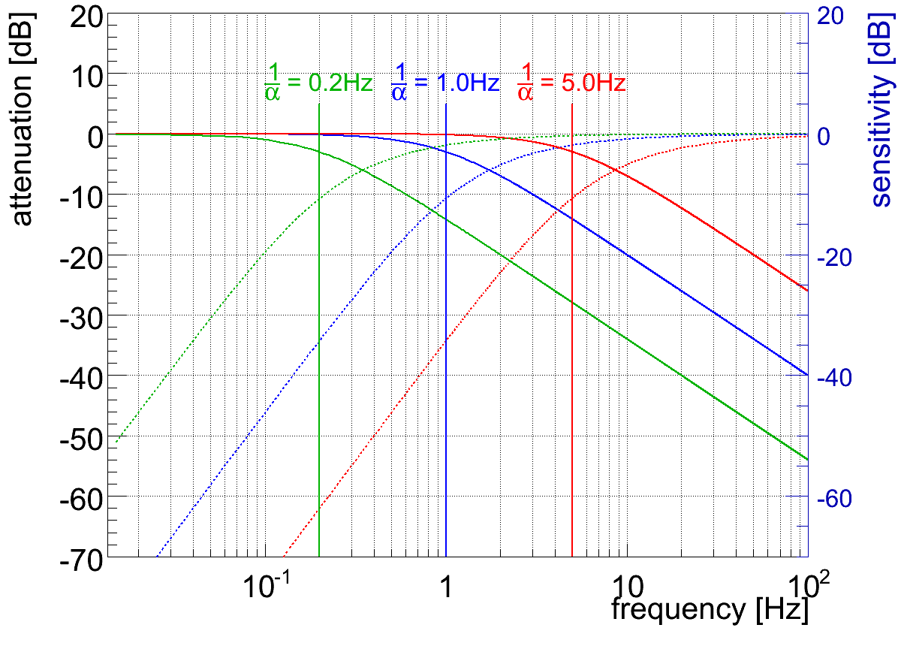
Time-Domain: Optimal Controller Design II/II
Optimal control¹ for the 'small-signal response' yields classic PI-controller
  Single free parameter α > τ...∞
    facilitates trade-off between speed and robustness
    adaptive gain-scheduling based on operational scenario
disturbance rejection S₀(s)
T₀(s)
more robust/precise
faster
¹D. C. Youla et al., “Modern Wiener-Hopf Design of Optimal Controllers”, IEEE Trans. on Automatic Control,1976, vol. 21-1,pp. 3-13 & 319-338

Slide 20
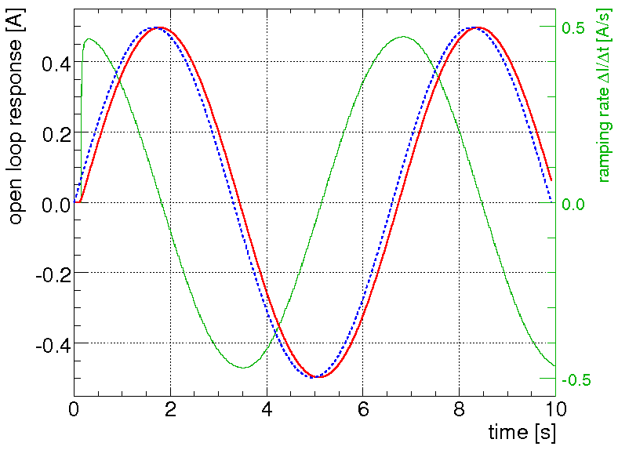
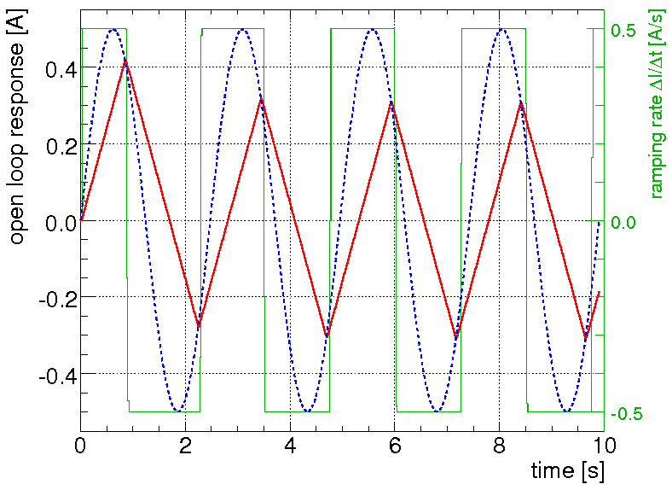
Time-Domain: Non-Linearities I/III
Two non-linear effects that need to be addressed by the controller:
Delays: computation, data transmission, dead-time, etc.
Rate-Limiter: limited slew rate of corrector circuits (due to voltage limitations)
  e.g. LHC: ±60A converter: ΔI/Δt|_{max} < 0.5 A/s
slow perturbation: perfect tracking
fast perturbation: saw-tooth

Slide 21
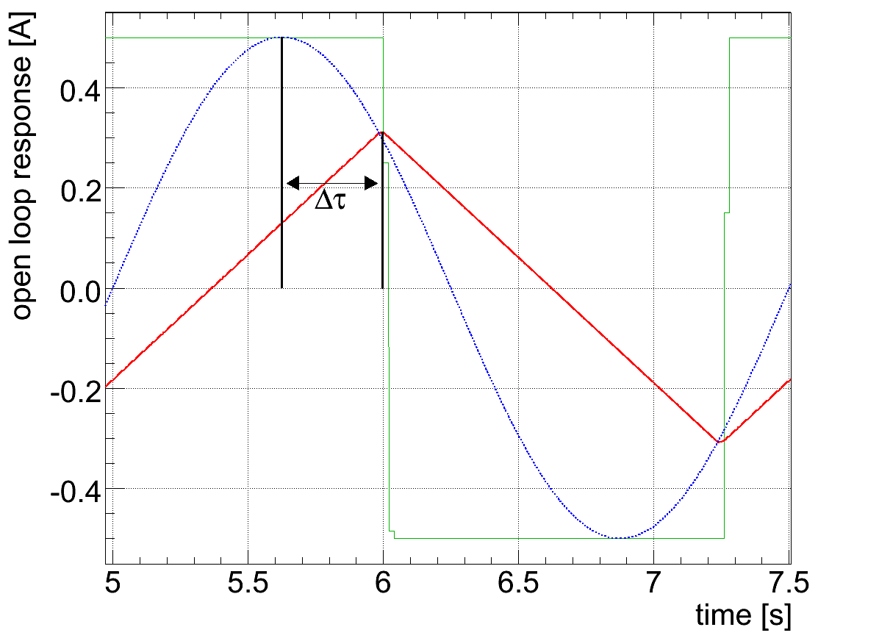
Time-Domain: Non-Linearities II/III
Rate-limiter in a nut-shell:
  additional time-delay Δτ that depends on the signal amplitude
  secondary: introduces harmonic distortions

Slide 22
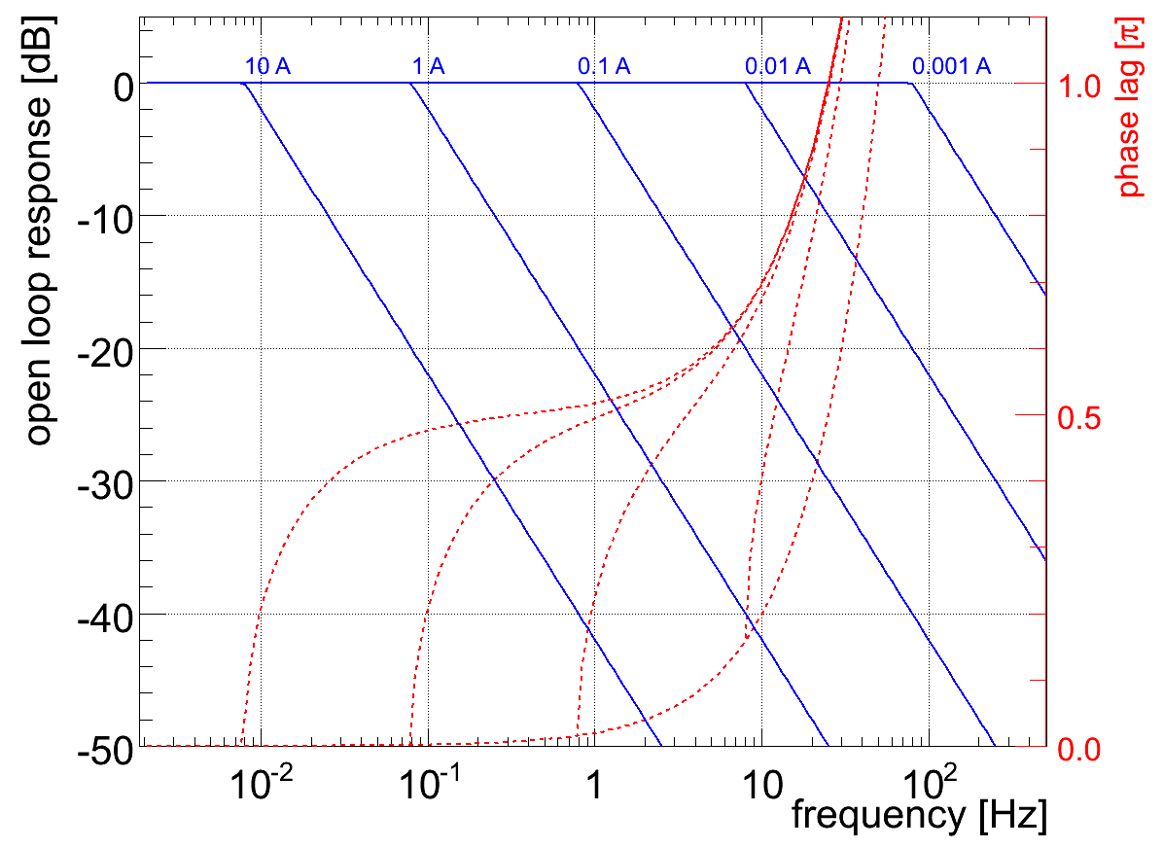
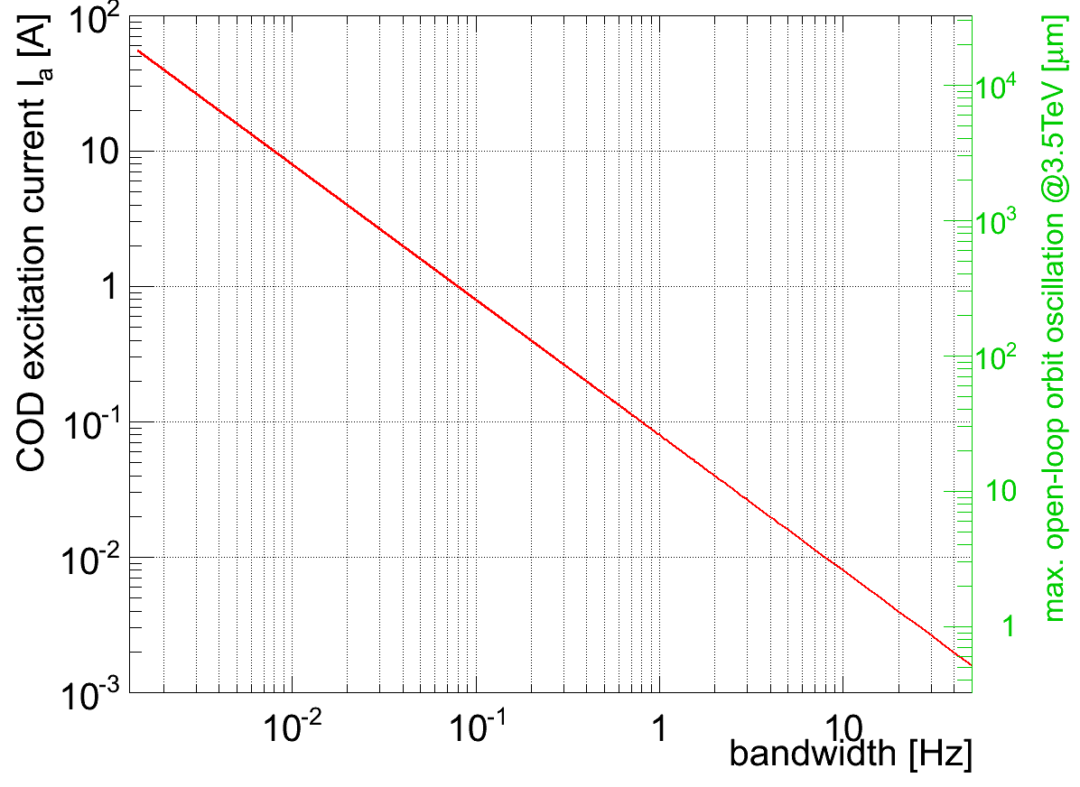
Time-Domain: Non-Linearities III/III
Orbit Feedback Bandwidth vs. Actual Orbit Perturbations
Closed-loop bandwidth and phase margin depend on the excitation amplitude:
  + non-linear phase once rate-limiter is in action...
ΔI=0.1A ↔ Δx≈32 μm@β=180m
~100μm@20mHz
~2 μm@10Hz

Slide 23
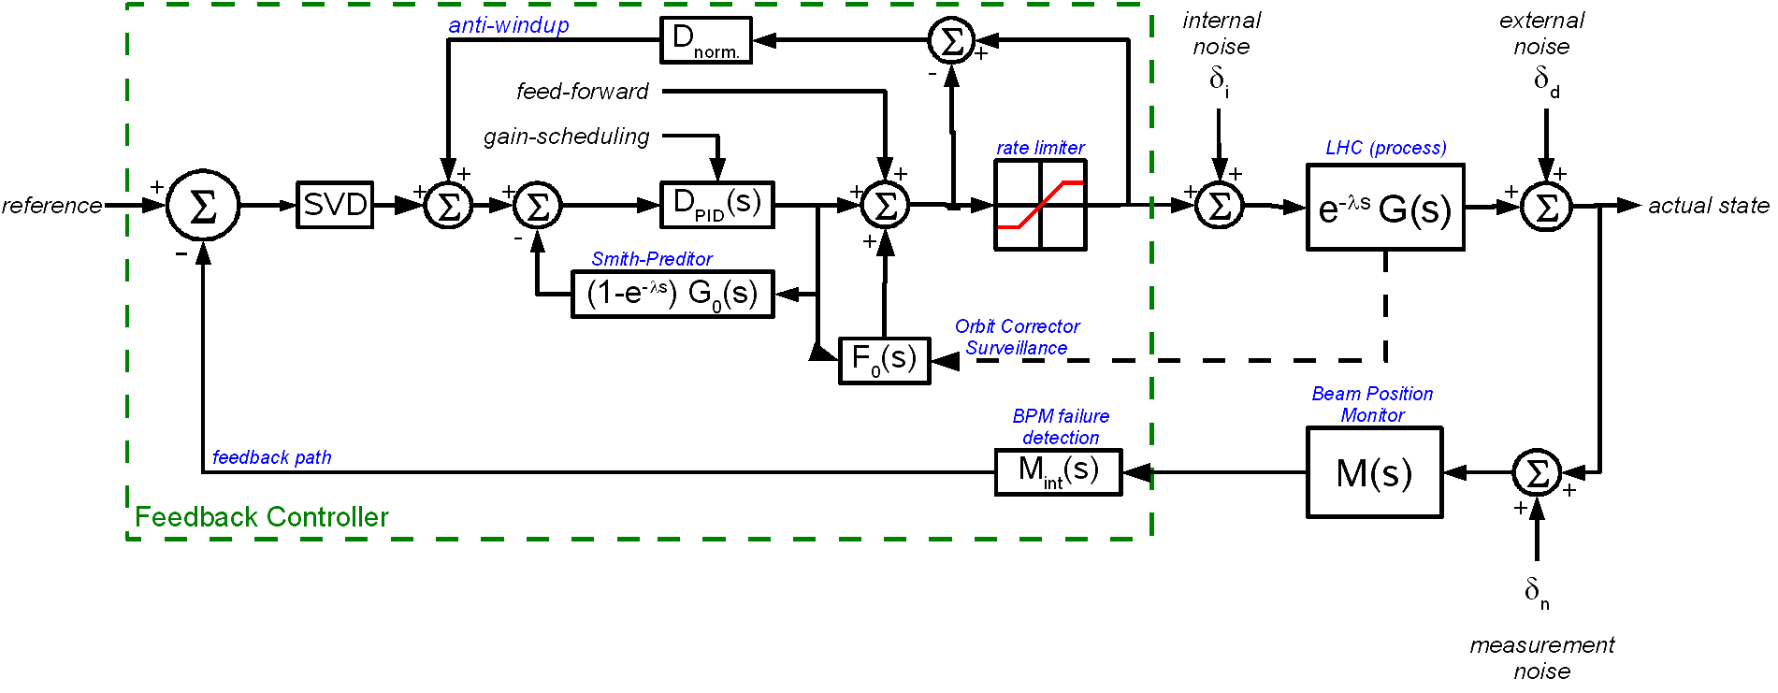
Functional Description of the LHC Feedback Controller
PID Controller & Delays + Rate-Limiter
In essence, the functional OFC description
  τ: the power converter time constant and
→ Smith-Predictor and Anti-Windup paths:
“simple loop design” but large number of control parameters (→ adds complexity to OFC/OFSU design)

Slide 24
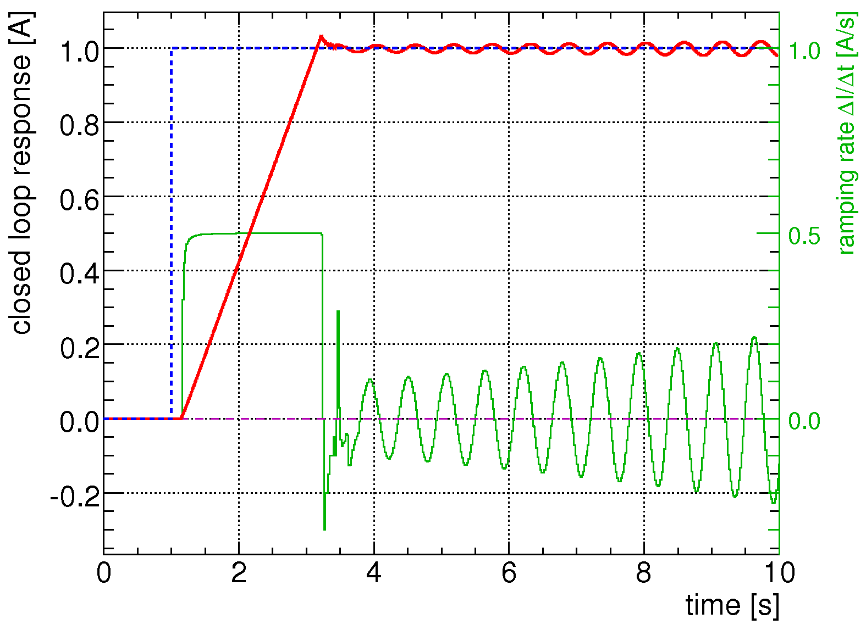
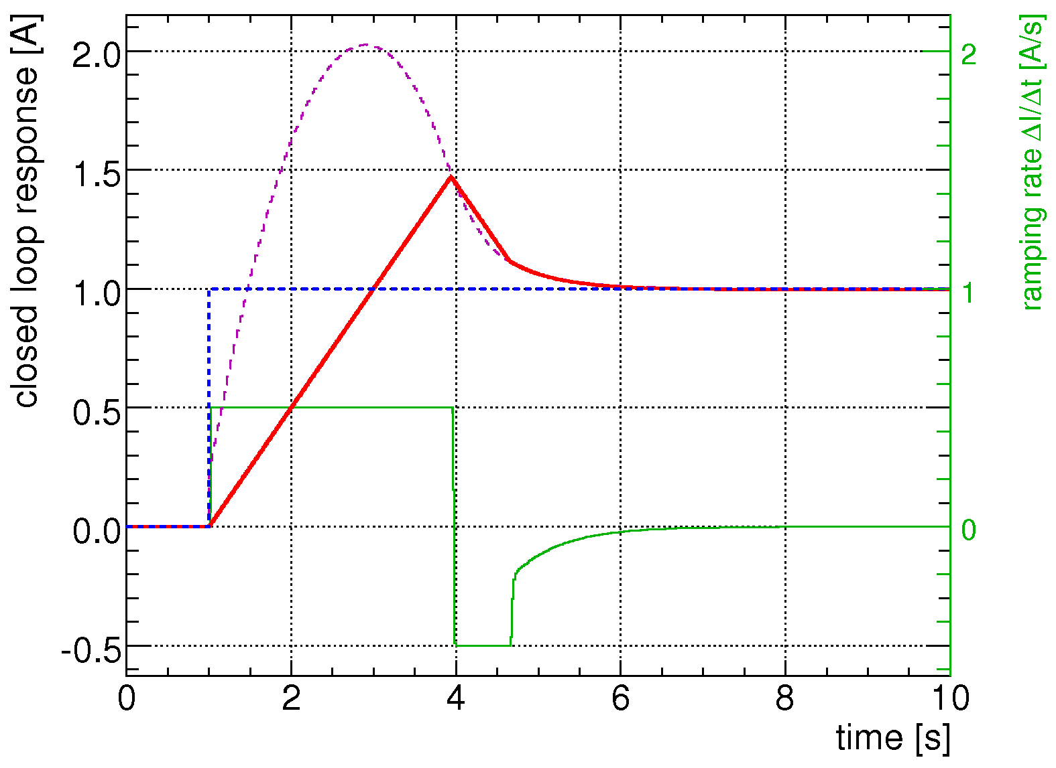
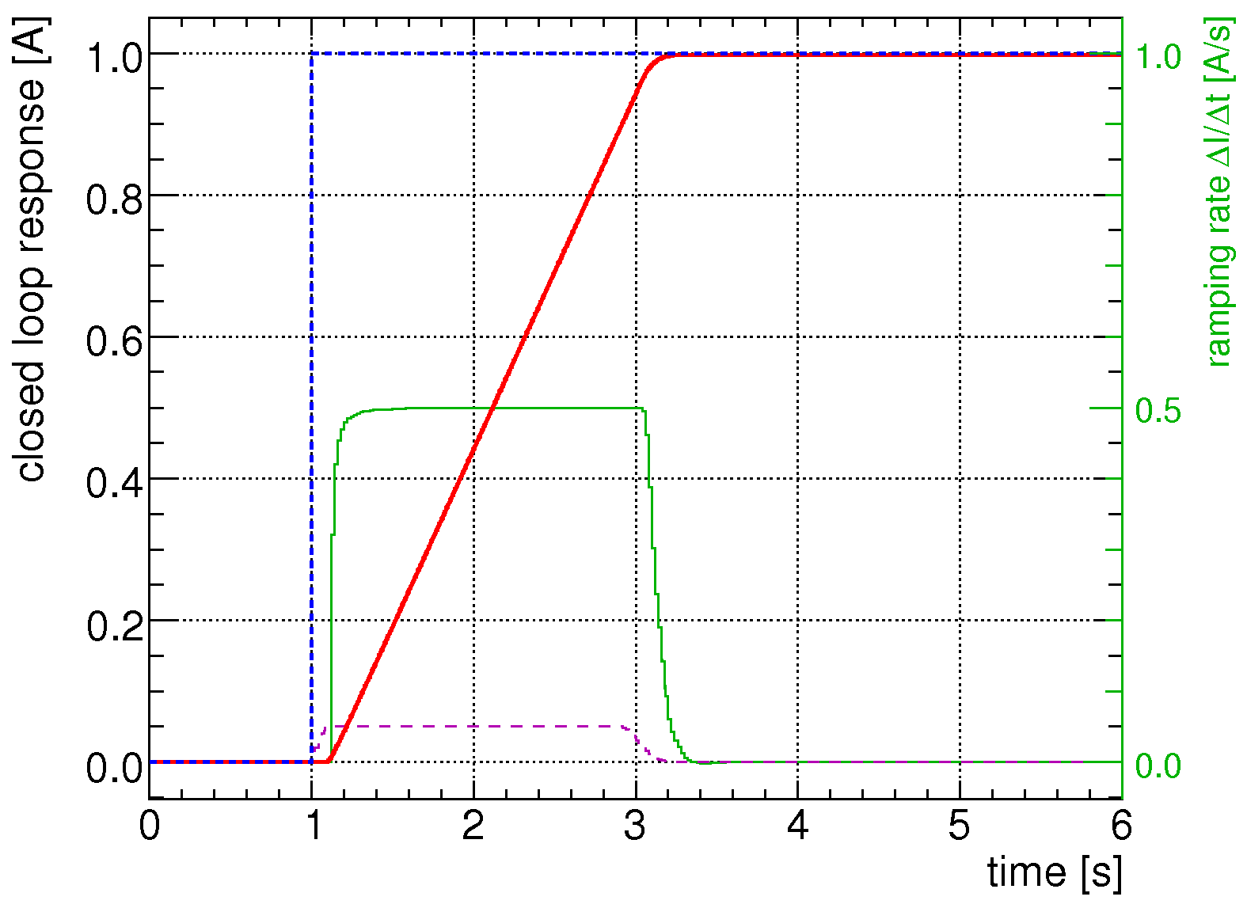
Motivation for Delay and Rate-Limiter Compensation
Example: LHC orbit (Q,Q',C⁻, ...) feedback control
rate-limted process
without anti-windup
reference
current response
ramping rate
integral signal
without delay compensation
with full delay and windup
compensator scheme:

Slide 25

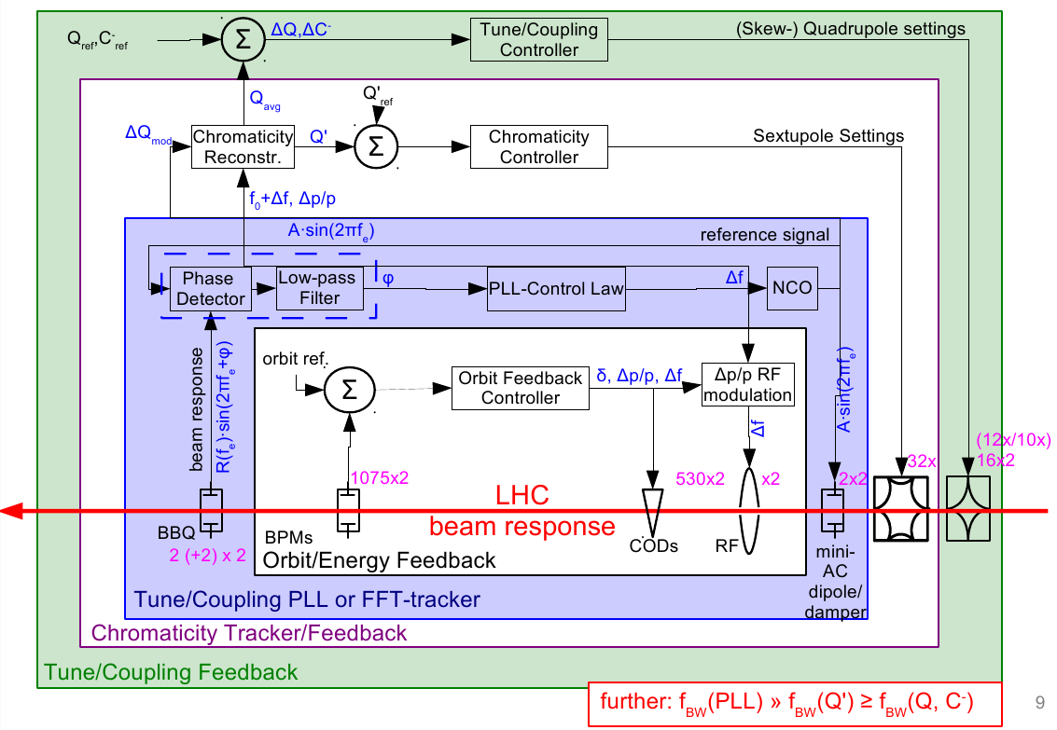
To avoid inherent Cross-Talk between FBs...
… Cascading between individual Feedbacks
Main strategy: derive measurement from FB control variable
  Q'-tracker using 'Q_{raw} = Q_{meas} – Q_{trim}'
  Sub. Δp/p-mod. from Radial-Loop & Orbit-FB reference

Slide 26

Common Feedback/Feed-forward Control Layout
Control implementation split into two sub-systems:
LHC feedback systems most visible faces are:
  Feedback Controller (OFC): actual feedback controller logic
  Service Unit (OFSU): Interface to control system/the world
However 3500+ devices (~130 FE) and many technical services
  Overall strength depends on the reliability of the weakest link
CMW
Database settings,
operation,other user
Service Unit
m x
Ethernet UDP/IP
Ethernet UDP/IP
n x
Monitor-Frontend
PC-Gateways
Monitor-Frontend
PC-Gateways
Monitor-Frontend
FB/FF Controller
PC-Gateways
Surface
Tunnel
...
...
beam response
beam instrument
corrector magnets

Slide 27
Control Paradigms III/III
Digital Control System & 'Real-Time'
LHC feedbacks are 'firm real-time systems'
  some (limited) margin on occasional missing data
  additional latencies are critical for loop stability
“How much phase stability is required (i.e. @1 Hz)?”
utility
dead-line
latency
total system failure (dump)
perturbation, phase error
Correction, res. error
φ
φ
φ
Δφ = 0°
perfect correction
Δφ = 45°
reduced performance
Δφ < ~90°
phase shift
no correction
Δφ = 180°
maximally unstable

Slide 28
Jitter Compensation
Data Concentration Paradigm I/II
Two main strategies:
actual delay measurement and dynamic compensation in SP-branch:
  only feasible for small systems
Jitter compensation using a periodic external signal:
  CERN wide synchronisation of events on sub ms scale
  The total jitter, the sum of all worst case delays, must stay within “budget”.
  feedback loop frequency of 50 Hz feasible for LHC, if required...
Central Timing
generator
... τ=20/40 ms Δτ<1 μs
covers whole ring (27 km)
BI-Frontend
Feedback Controller
PC-Gateways
CTR
CTR
PPC
buffer etc.
CTR
buffer etc.
CTR
DAB
DAB
70x
network
c-alg.
50 x
network
PC-CO
18 BPM/crate
16 COD/gateway
beam response

Slide 29
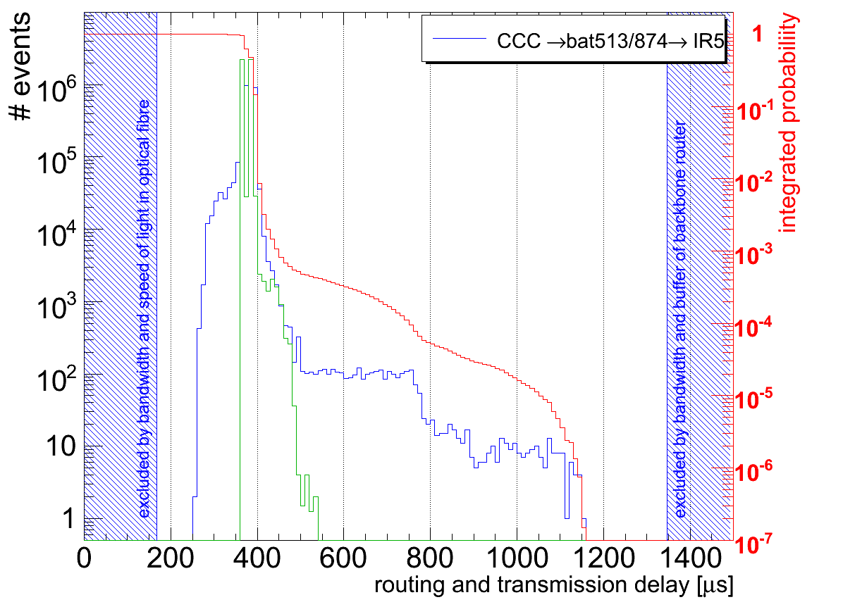
Verification of Real-Time Behaviour
– Measuring how well Real-Time Constraints are being kept
TechNet round-trip tests: difference between standard and RT-Linux Kernel
  Important: measure probability & upper-bound (worst-case) latency
Latencies dominated by speed-of-light in fibers but nevertheless << 1 ms

Slide 30
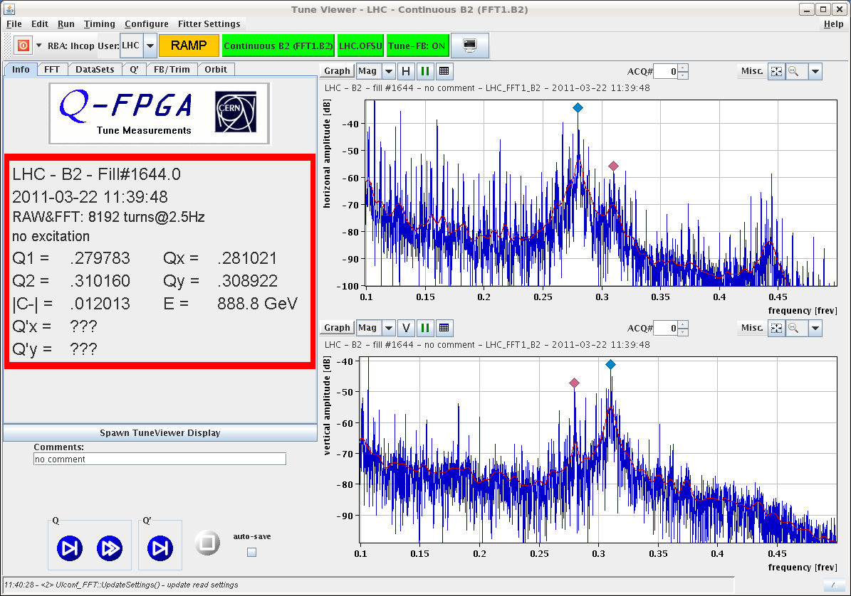
Tune Spectra during High-Intensity Operation
Snapshot of the day with removed mains harmonics
Raw Spectrum
Filtered Spectrum/
Rejected Mains

Slide 31
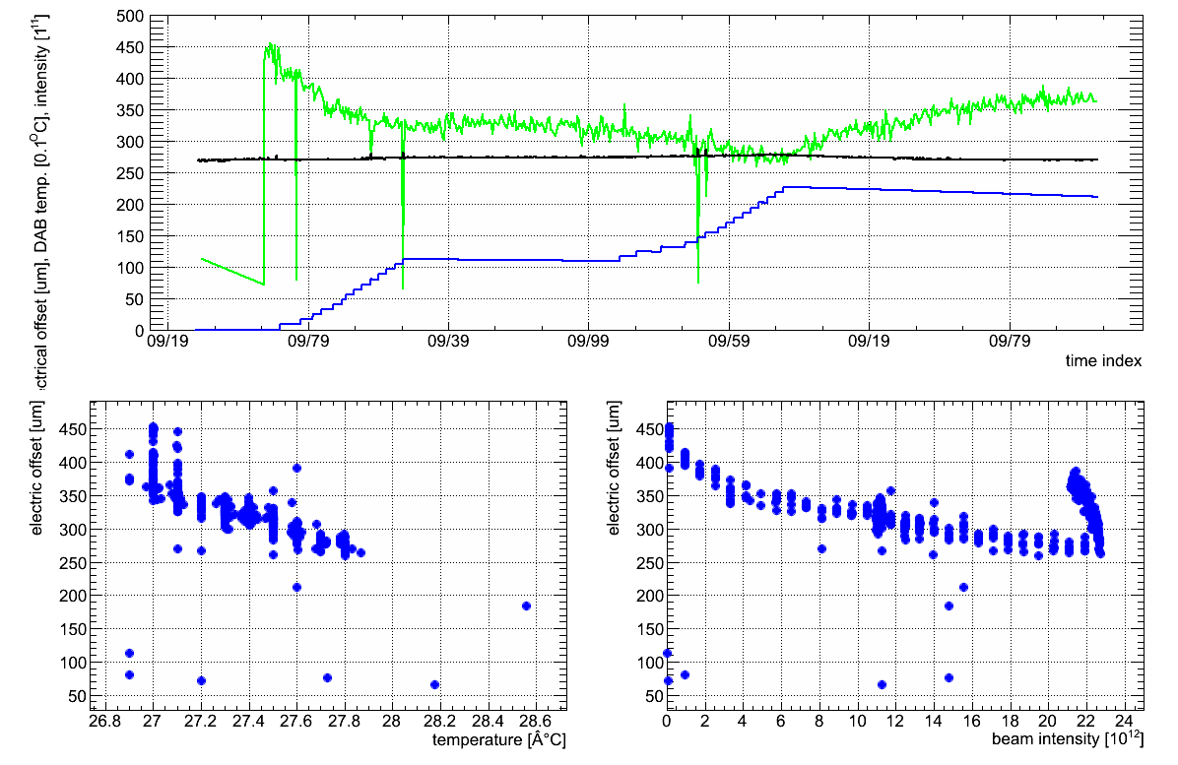
BPM Dependencies other than Position
Measurement drifts ~100 um/h w/o significant temperature changes → Orbit-FB may convert these measurement errors into real orbit shift
now mitigated by temperature controlled racks
no sig. T/n_{b} change
~100 um
el. Offset BPMSW.1L5.B1-H
DAB Temperature
Beam Intensity
correlation with temperature
correlation with beam intensity

Slide 32
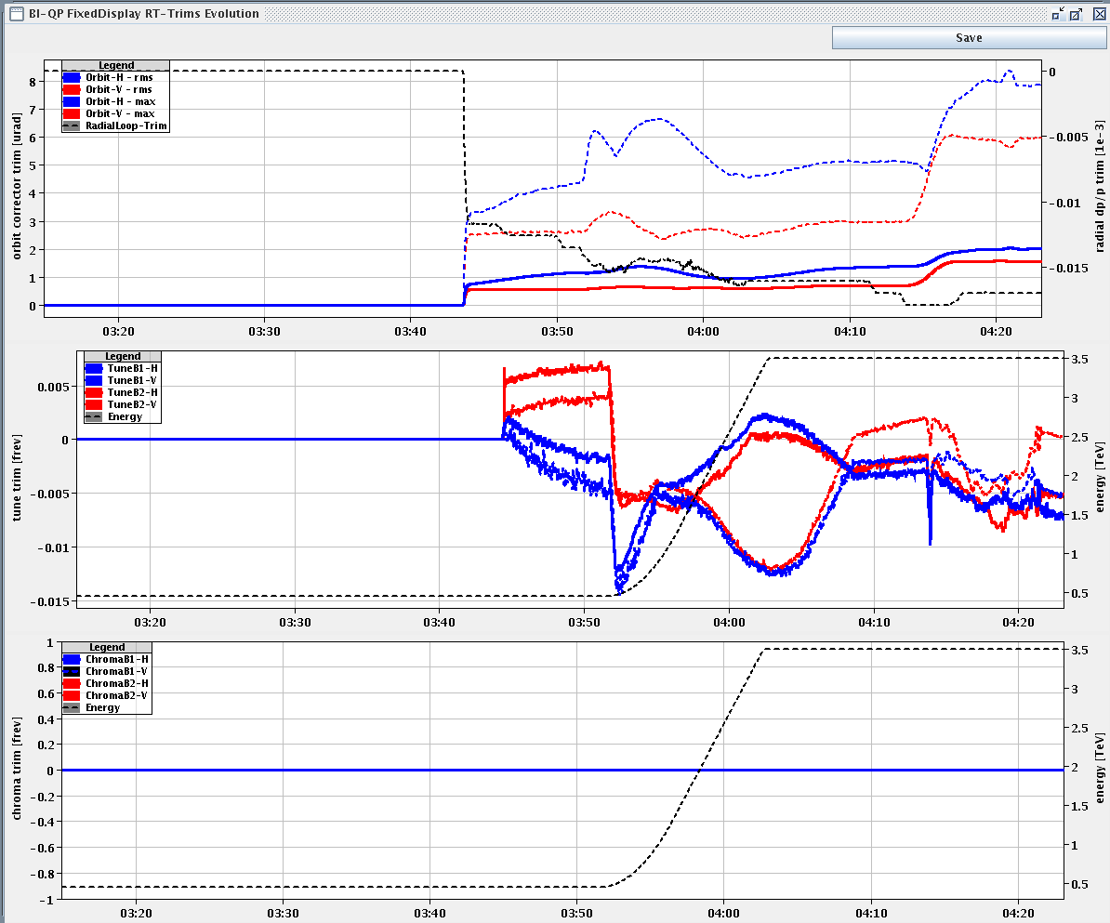
LHC Feedback Operation
Trims became de-facto standard to assess the FB and machine performance
Orbit-FB &
Radial-Loop
Trims (μrad)
Tune-FB trims
injection
ramp
flat-top
Q'(t)-FB trims
Energy (TeV)
Q'(t) not used on a day-to-day basis
β*-squeeze
Notes:
<number>

Slide 33
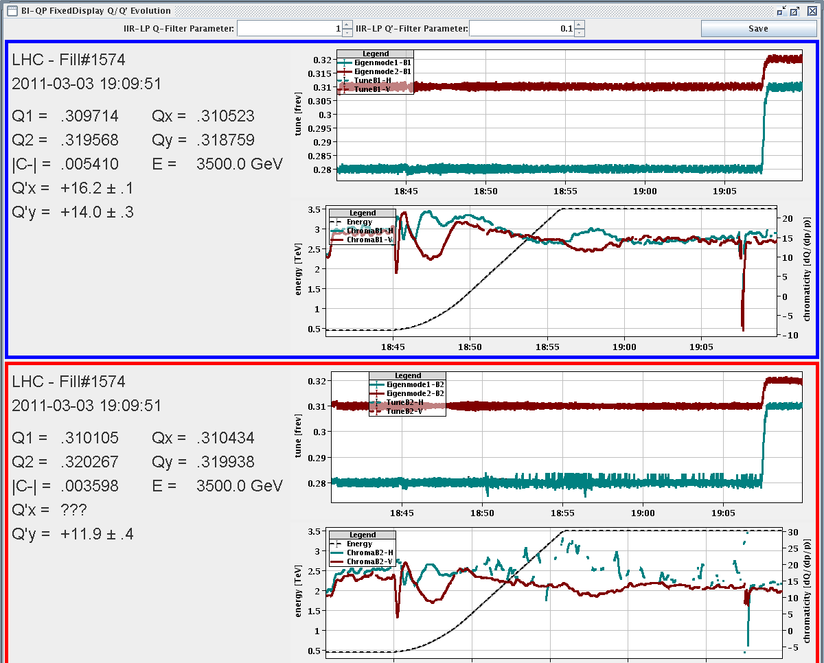
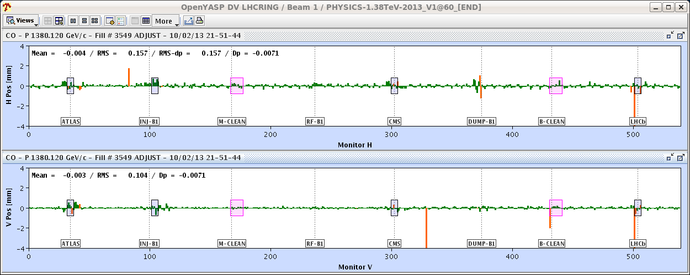
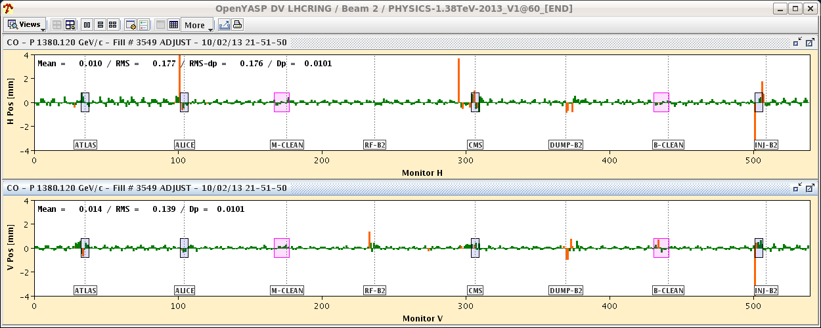
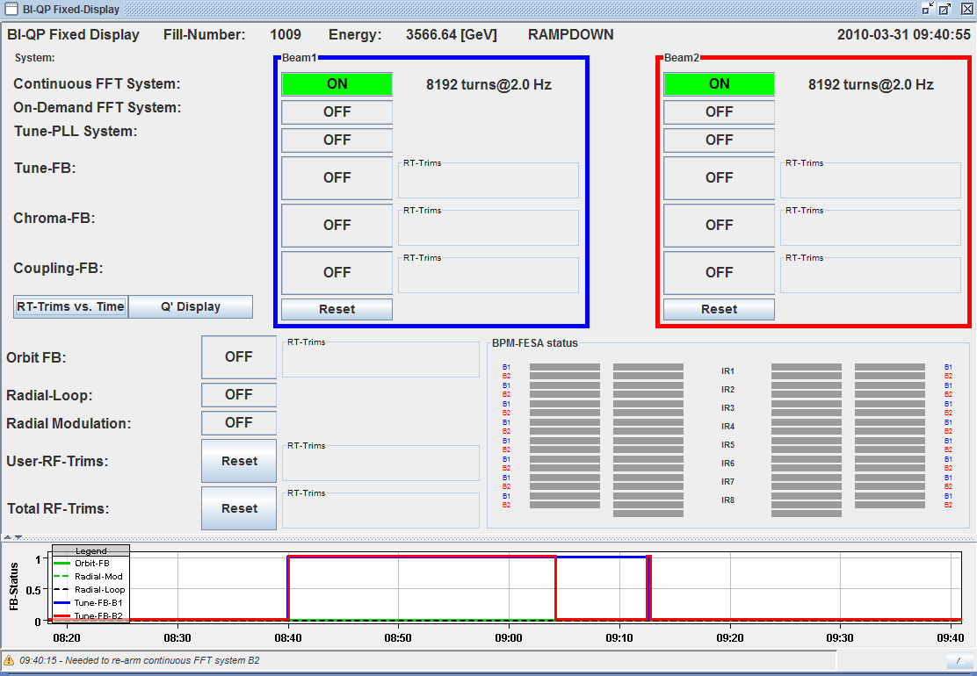
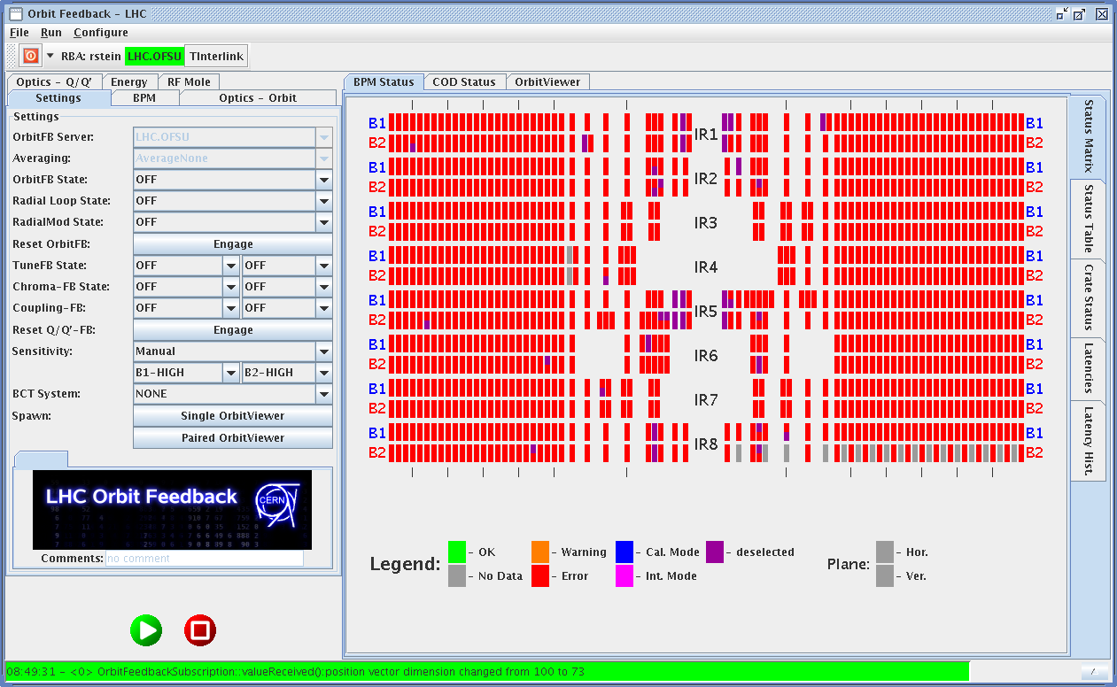
LHC Feedback … one of the more visible systems in the CCC
– Importance of Controls Integration and SW Usability
Q(t)
Beam 1
Q'(t)
energy
Beam 2
Orbit-FB &
Radial-Loop
Trims (μrad)
Tune-FB trims
injection
ramp
flat-top
Q'(t)-FB trims
Energy (TeV)
β*-squeeze

Slide 34
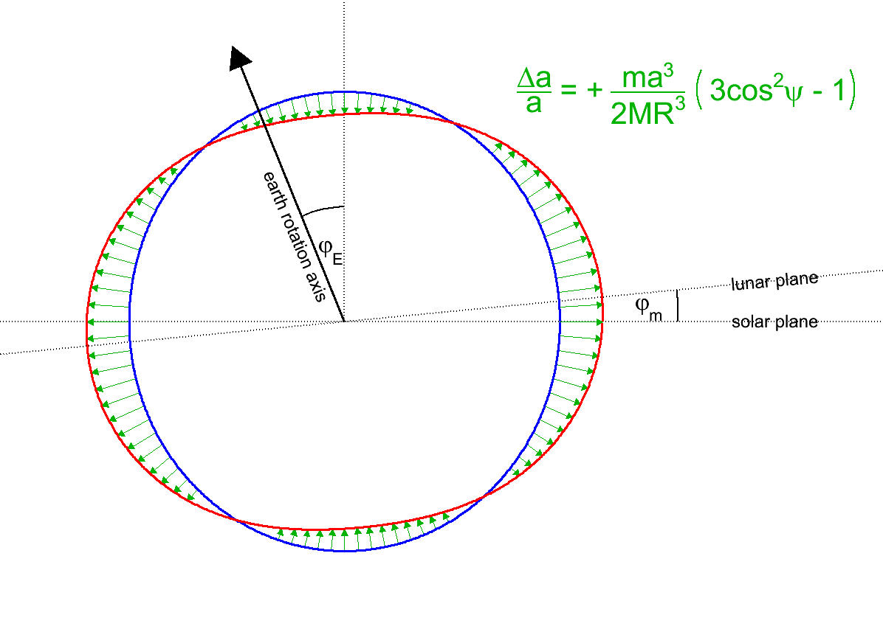
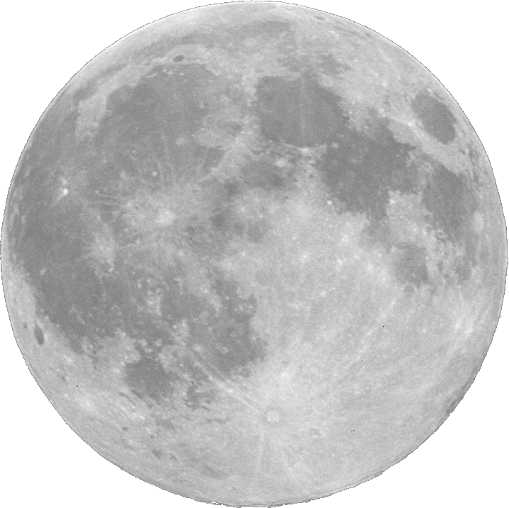

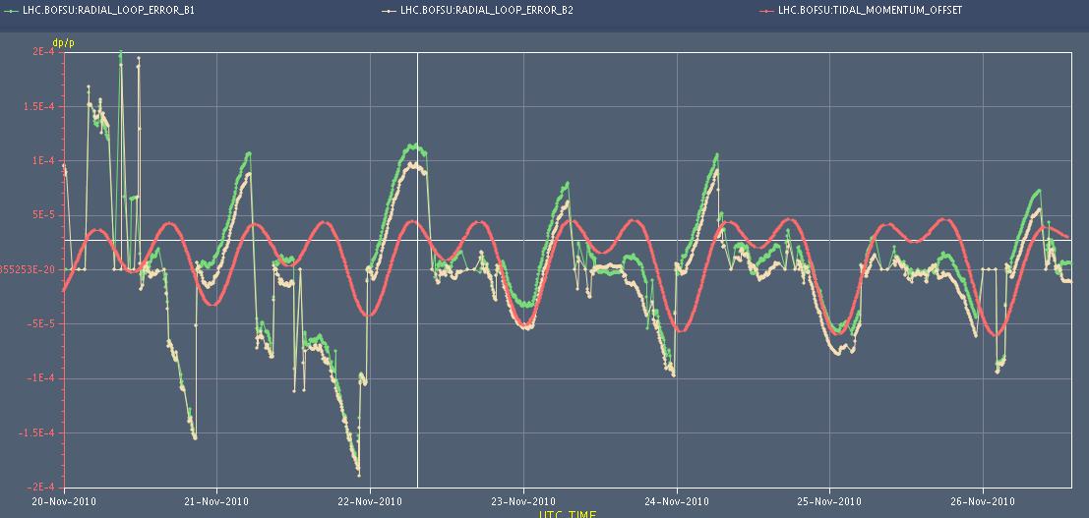
Earth Tides dominating Orbit Stability during Physics:
Known effect from LEP → changes the machine circumference/energy
  Testimony to LHC alignment and beam stability!
Predicted tidal force
Feedback signal Beam 1
Feedback signal Beam 2
Δx≈200 μm
~ one week

Slide 35
Summary
Generally, feedback performed their designed job.
Pushing LHC machine parameter envelope also implied increased performance constraints on Feedback operation (notably orbit stability during squeeze) → will improve FB sub-systems to keep up with LHC progress post-LS1
Main paradigms:
  Split 'space/time' domain design to leverage different user background experiences
  Nested-loop design to minimise inter-loop cross-talk
  Central simple input-processing-output feedback controller
  Managed by service unit (OFSU, settings management, data proxy)
  LHC Technical-Network as communication backbone
  'Firm real-time' constraints using Real-Time capable Linux

Slide 36
Reserve Slides

Slide 37
Expected Dynamic Perturbations vs. Requirements
– or: Design Assumption vs. Operational Reality
From Decay/Snap-back expected dynamic perturbations
Initial assumptions and plans (2006-2009):
  Chromaticity considered as most critical parameter
  FB Priority list: Chromaticity → Coupling/Tune → Orbit → Energy
What turned out to be needed operationally
  2009 → 2011: Tune → Orbit & Energy/Radial-Loop → Q'(t) →…→ C–
    impressive Q'(t), C– and beta-beat stability/reproducibility
  In 2012: Orbit & Tune (snap-back, instabilities)
    Higher energy & smaller-β* → much tighter collimator settings → convert smallest orbit deviations into losses/dumps

Slide 38
Why the notion/split between 'space' and 'time' domain?
Separates specific accelerator physics from specific control theory
  can test the two domains independently
  ample expertise/resources in one but not the other domain → KISS principle: keep it simple and safe
Multiple-Input-Multiple-Output (MIMO) in space-domain
  Can modify correction algorithm without having to worry about whether overall loop remains stable
  Maintains physical meaning of the individual control variables
  Basically relying on inversion of response matrices → SVD
Quasi-Single-Input-Single Output (SISO) in time-domain
  Similar control problem/laws as e.g. for power converters
  Time-domain controller identical for orbit, energy, Q/Q' vs. integrated/more complex 'Kalman' or 'Youla-Kucera-Klein'-based method

Slide 39
Time-Domain: Optimal Controller Design
Youla's affine parameterisation II/II
Using Youla's method: “design closed loop in a open loop style”:
Youla showed¹ that all stable closed loop controllers D(s) can be written as:
Example: first order system
Using for example the following ansatz:
Response/optimality can be directly deduced by construction of F_{Q}(s)
G^{i}(s), pseudo-inverse of the nominal plant G(s)
(1)+(2)+(3) yields the following PI controller:
(1)
with being the circuit time constant
(2)
(3)
¹D. C. Youla et al., “Modern Wiener-Hopf Design of Optimal Controllers”, IEEE Trans. on Automatic Control,1976, vol. 21-1,pp. 3-13 & 319-338

Slide 40
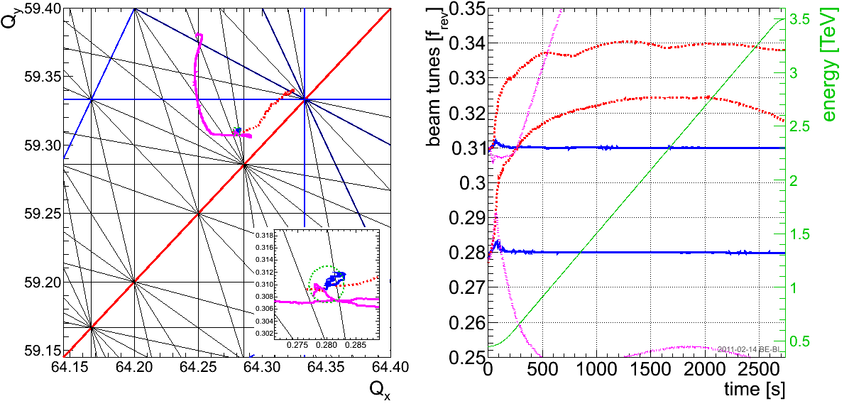
LHC Feedback Operation – Example III/IV
Tune-FB driving and accelerating early commissioning in 2009-2011
  Tunes kept stable to better than 10⁻³ for most part of the ramp and squeeze
reconstructed tunes with FF only
actual tunes
reconstructed bare tunes

Slide 41
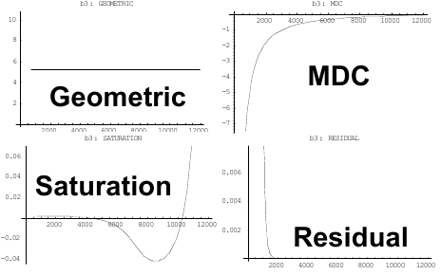
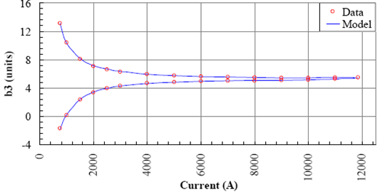
Feed-Forward Back-Bone – Field-Description for LHC (FiDeL)
Example: b₃ – Compensation – Static Part
Based on magnet measurements:
Machine Optics Model
p(t)
Transfer Function
I(t)
Courtesy M. Lamont

Slide 42
Control Paradigms II/III
Machine imperfections cause steady-state offset ε_{ss} and scale error ε_{scale}:
Feed-Forward:
Integral feedback:
Reference = 1
Reference = 1
actual parameter
1-ε
1-ε
norm. parameter
actual parameter
norm. parameter
error signal Δ =
integral feedback signal
time
1^{rst}
2nd
...
n^{th}
time
Uncertainties and scale error of beam response function affects convergence speed (= feedback bandwidth) rather than achievable stability

Slide 43
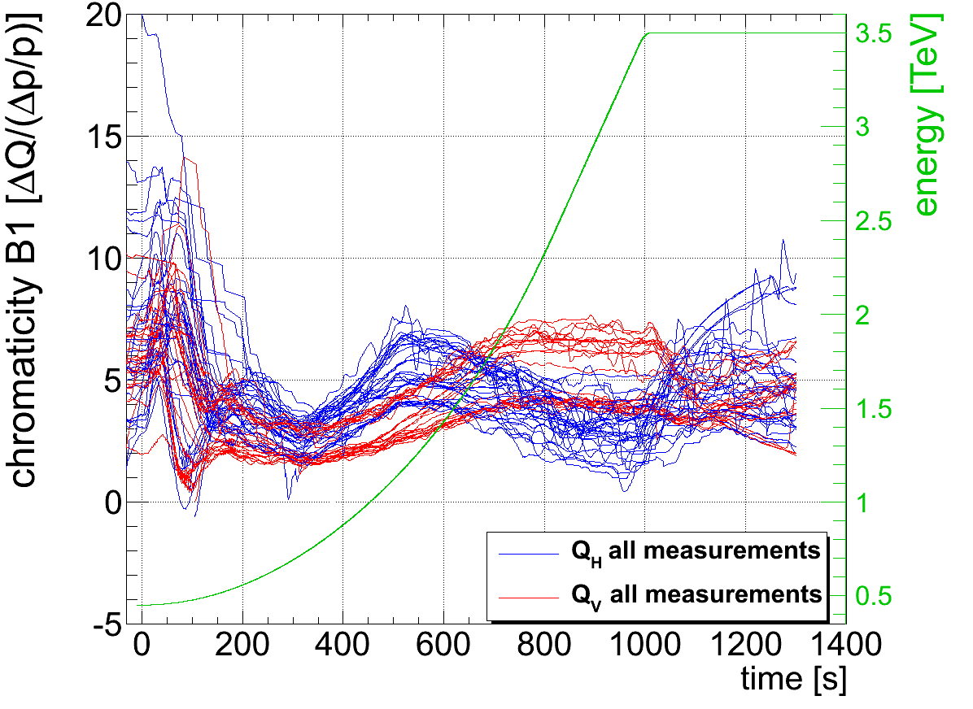
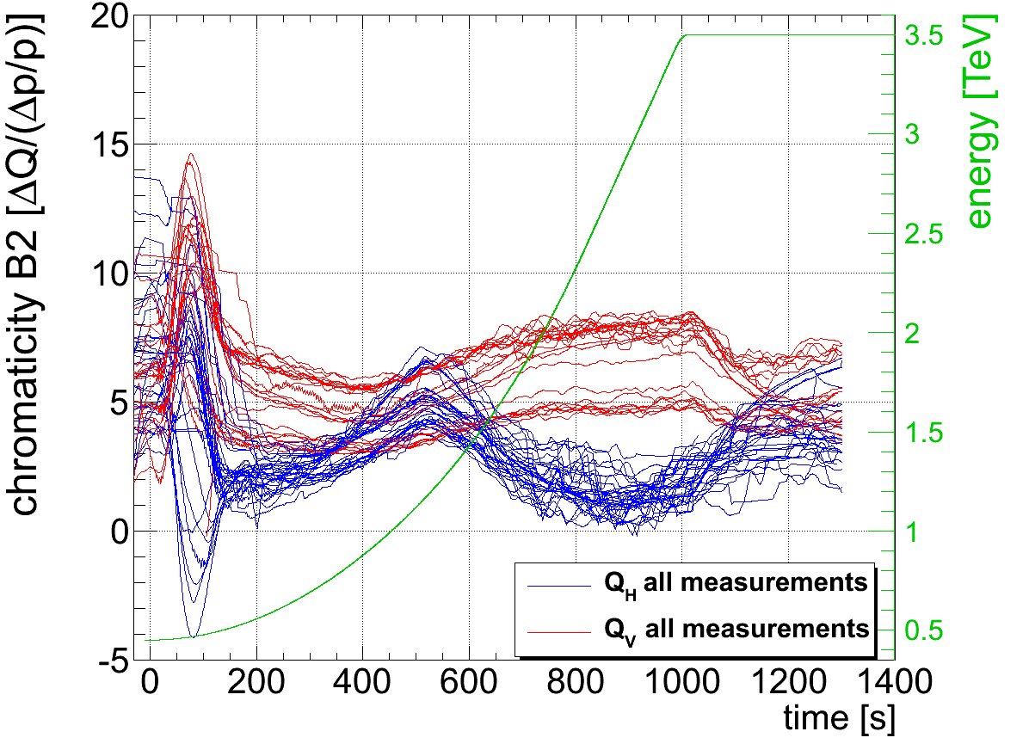
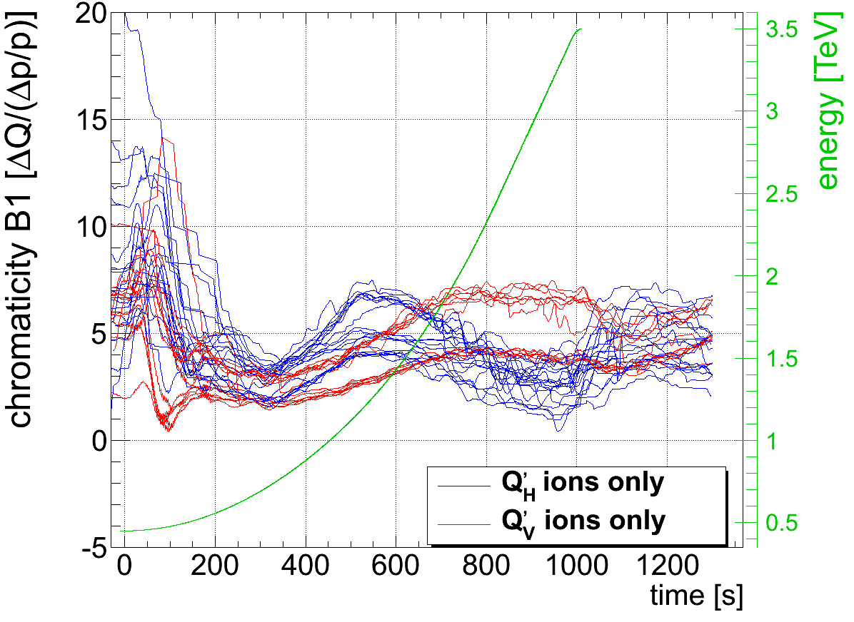
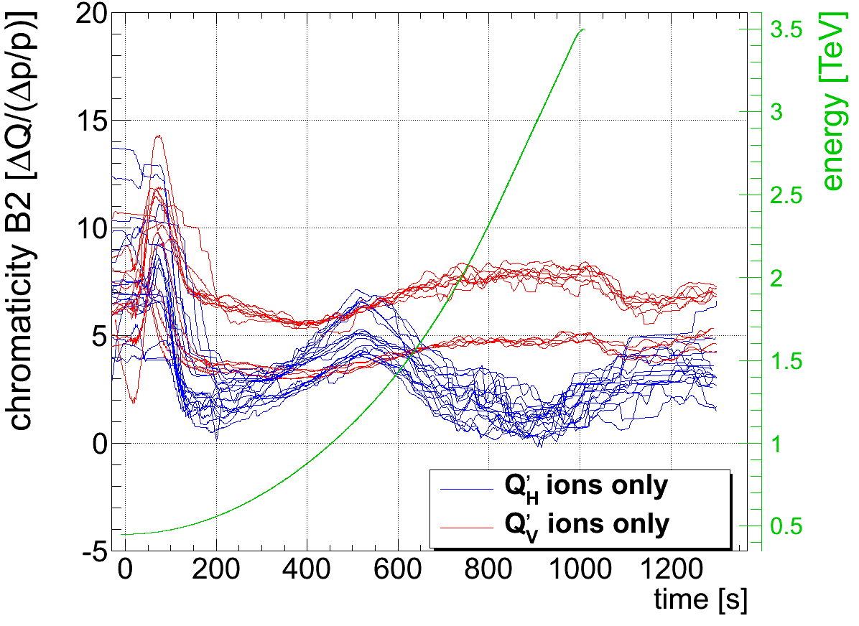
Feed-forward of Q'(t)-Feedback signal for next fill turned out to be sufficient!
  enforced by strict pre-cycling following physics, access or circuits 'off '...
Residual overall Chromaticity Stability

Slide 44
Orbit Feedback Bandwidth vs. Actual Orbit Perturbations
Closed-loop bandwidth and phase margin depend on excitation amplitude:
  + non-linear phase once rate-limiter kicks in...
Consider ~35μm@1Hz as effective bandwidth @4TeV (assuming 3C bump)
Many latencies become a non-issue for f_{bw} < 0.1 Hz
ΔI=0.1A ↔ Δx≈32 μm@β=180m
~100μm@20mHz
~2 μm@10Hz

Slide 45
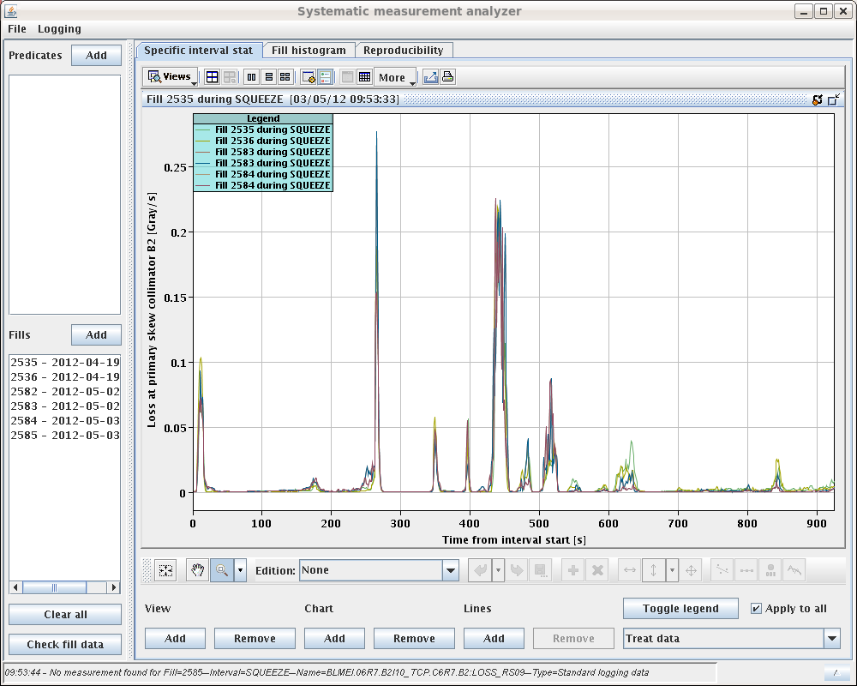
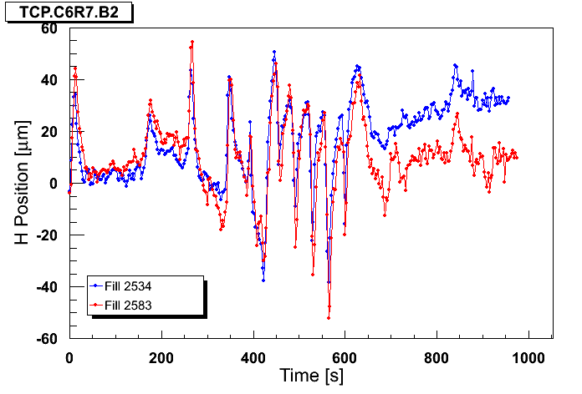
Orbit Stability during β*-Squeeze
Losses and orbit movement at H-TCP.C6R7.B2 well correlated
Maximum drift rates of 40 um/s → (close to) limit of Orbit-FB at 4 TeV
  Underpinned by FB instability observation for 5x bandwidth increase
At this speed, OFC needs to operate with correct optics
J. Wenninger@LBOC, 8th May 2012

Slide 46
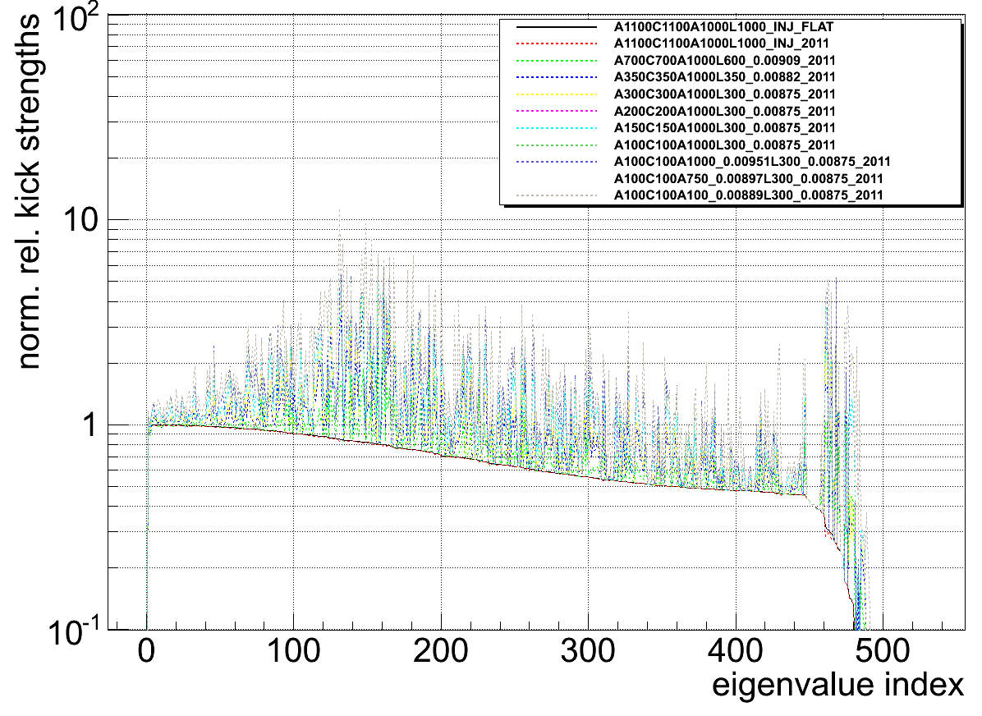
Correction during Squeeze with imperfect Optics
Bandwidth modifier w.r.t. eigenvalue index (<1 more stable, >1 diminishes stability margin)
Typ. opertional bandwidth <10% of maximum possible (sometimes too slow)
faster
relative bandwidth modifier
Ignored by the
Orbit-FB
slower
Ideal design
global
correction
local
correction

Slide 47
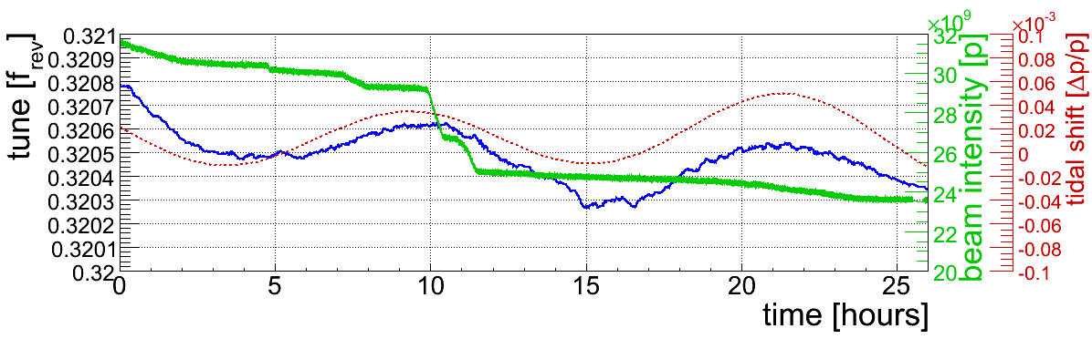
Tune Evolution during Physics
Quirky side effect:
Machine circumference changes are propagated via Q' also to the tune
Probably the slowest high-precision Q' measurement in the World
  Short-Term Tune-Stability of ~10⁻⁶!
However, stability during nominal physics operation is typically driven by impedance and beam-beam related effects.

Slide 48
Typical Q/Q'(t) Control Room View
2010 Statistics: Out of 191 Ramps...
Q(t)
Q'(t)
energy
Beam 1
Beam 2
… 155 ramps with > 99% transmission, 178 ramps with > 97% transmission
… only 12 ramps lost with beam (6 with Tune-FB during initial 3.5 TeV comm.)
… “if without FBs”: 83 crossings of 3rd, 4th or C⁻ resonance, 157 exceeded |ΔQ|>0.01
Impressive performance for the first year of operation and low-ish intensities:

Slide 49
Control Paradigms III/III
Digital Control System & 'Real-Time'
… “A system is said to be real-time if the total correctness of an operation depends not only upon its logical correctness, but also upon the time in which it is performed. [..] are classified by the consequence of missing a deadline:
  Hard – Missing a deadline is a total system failure.
  Firm – Infrequent deadline misses are tolerable, but may degrade the system's quality of service. The usefulness of a result is zero after its deadline.
  Soft – The usefulness of a result degrades after its deadline, thereby degrading the system's quality of service.”
utility
dead-line
utility
dead-line
utility
dead-line
1
1
1
0
time/latency
0
time/latency
0
time/latency
total system failure (dump)
total system failure (dump)
total system failure (dump)
“hard”
“firm”
“soft”

Slide 50
Some common Misconceptions/Fallacies about 'Real-Time' (RT)¹
“There is no science in real-time-system design”
“Advances in supercomputer hardware will take care of RT requirements.”
“[..] is equivalent to fast computing.”
“[..] research is performance engineering.”
“[..] systems function in a static environment.”
“[..] is assembly coding, priority IRQ programming, and device driver writing.”
“[..] all been solved in other areas of computer science or operations research.”
“It is not meaningful to talk about guaranteeing RT performance, because we cannot guarantee that the hardware will not fail and the software is bug free or that the actual operating conditions will not violate the specific design limits.”
Obviously, the above is wrong but seems to be sometimes forgotten when discussing the specific technical implications.
¹John A. Stankovic, “Misconceptions about real-time computing: a serious problem for next-generation systems”, IEEE Computer, Vol. 21 #10, 1988

