Slide 1
Russian “MegaProject”
ATLAS SW&C week
Plenary session : status, problems and plans
Feb 24, 2014
Alexei Klimentov
Brookhaven National Laboratory

Slide 2
Overview
Russian Federation Government grants
“Big Data Technologies for megaScience projects”

Slide 3
Russian Government Grant Program
The program was started in 2010 to attract leading scientists to Russian Universities and Research Institutes
  “…In order to strengthen governmental support for the development of science and innovations in tertiary education and to improve the quality of higher education, on April 9, 2010, the Government of the Russian Federation instituted monetary grants that are made available on a competitive basis to support of scientific research projects implemented by the world’s leading scientists at Russian institutions of higher learning…”
  Resolution No.220 of the Government of the Russian Federation of April 9, 2010

Slide 4
Grant Program Goals
To bring world-renowned scientists, including scientists from among Russian citizens residing abroad, to Russian institutions of higher learning;
To create scientific research laboratories capable of competing with the world’s leading laboratories;
To ensure achievement of world-class research results;
To create conditions required to improve the professional quality of the faculty and research specialists of Russian institutions of higher learning, as well as to create an effective and efficient system of motivation of scientific work;
To encourage young people to pursue professional development in the fields of science, education, and high technologies;
To help create sustainable links between Russian institutions of higher learning and the world’s leading universities and science schools;
To facilitate commercialization of the research results and new technologies developed in the course of the scientific research projects supported under the program.

Slide 5
Russian Government Grant Program
2010-2014 grant winners
  S.Smirnov (Fields medal laureate)
  Sydney Altman (The Nobel prize laureate in chemistry)
  Osamu Shimomura (The Nobel prize laureate in chemistry)
  George F Smoot (The Nobel prize laureate in physics)
The fourth open grant competition statistics
  720 applications
    576 : Universities
    144 : Research Institutes
  Scientists from 40 countries
    EU, USA, Canada, Brazil,Chile, Australia, Asia
  42 winners in 17 disciplines were
  announced on Dec 30, 2013
  Research will be carried in 2014-2016
    at 23 Russian Universities and Labs
Computing Science : 1
“BigData Technologies For mega-Science Projects”

Slide 6

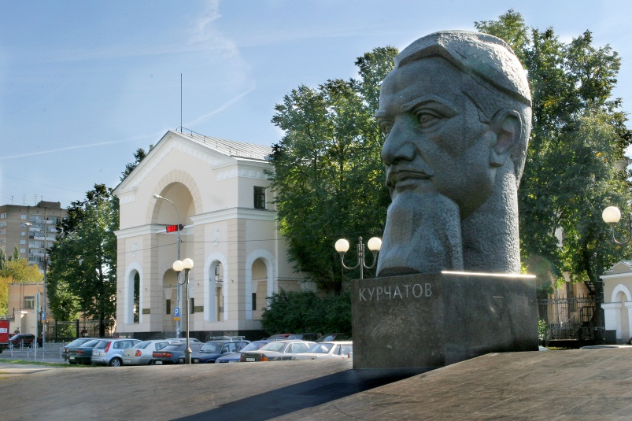
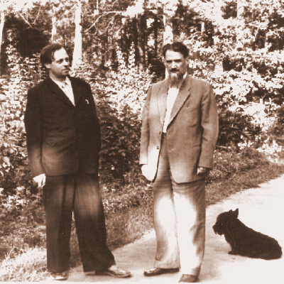
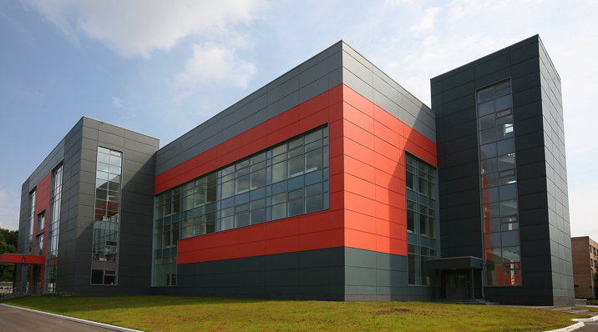
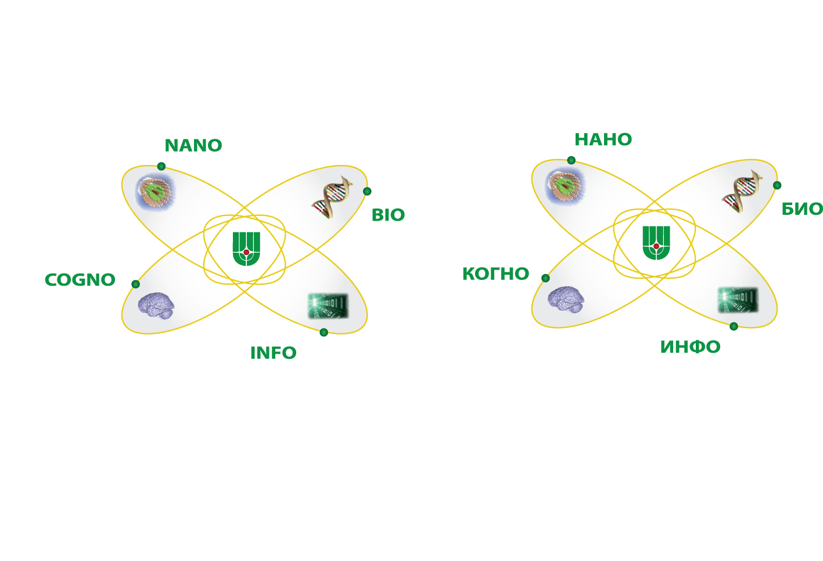
“BigData Technologies For megaScience Projects”
The project will be carried out at the National Research Center Kurchatov Institute in Moscow (NRC KI)
  NRC KI is the lead Russian Organization involved in research at the LHC, FAIR, XFEL, RHIC
  NRC KI will host Tier-1 center for three LHC experiments (ATLAS, ALICE, LHCb)
    Two talks later this week about RF Tier-1 status and plans
  Moscow Engineering Physics Institute (MEPhI), SINP and CNIR of Moscow State University, National University of Information Technologies, Mechanics and Optics (ITMO, St.Petersburg) are participating in the project
3 year project (2014-2016) with possible extension for 2 years, funding is expected in April
“BigData Тechnologies” Laboratory will be set up within Center of nano, bio and information technologies at NRC KI
Academician Kurchatov square
(Moscow)
Igor Kurchatov & Andrei Sakharov (1958)
NBICS center (NRC KI)

Slide 7
Key Considerations
ATLAS is a Big Data and megaScience Project
megaScience projects are international
Software technologies development (and software development in general) for such projects is difficult without international collaboration and cooperation
  Very positive discussions within ATLAS, NRC KI, with LHC and NP experiments, and WLCG
The new Laboratory scientific program should be tightly coupled with LHC experiments priorities and address challenges we will meet in 2-3 years
  And many “our” challenges are not ATLAS (HEP, LHC) specific
ATLAS has a proven use case when software developed for the experiment is expanded beyond HEP and expanded to other areas and disciplines
  PanDA project
    ASCR DoE funded BigPanDA project : “Next Generation Workload Management and Analysis System For Big Data” – BigPanDA (cf K.De talk at Oct 2013 SW&C week)

Slide 8
First Steps
Very strong support from NRC KI directorate
  To build laboratory NOW
    Two senior researches hiring process is started
Very strong support from IHEP Protvino, MEPhI and StPINP ATLAS groups to involve young researchers and computing specialists in the project
Very strong support from Moscow State University
  26 applicants will be interviewed in the next 2 weeks
    From Physics, Mathematics and Applied Mathematics & Cybernatics faculties
      Students, PhD students, researchers
Scientists from JINR, Duke, UTA, ANL, BNL, IJS, Genova have expressed interest to collaborate
Ongoing discussion with other experiments and WLCG to have a plan by June
  Two days workshop at NRC KI (end of June, tentative days Jun 27-28 )

Slide 9
The Growing PanDA Ecosystem
ATLAS PanDA
  US ATLAS, CERN, UK, DE, ND, CA, Dubna, Protvino, OSG …
ASCR BigPanDA
  DoE funded project at BNL, UTA – 3 years (2012-2015)
ANSE PanDA
  NSF funded network project - CalTech, Michigan, Vanderbilt, UTA
HPC and Cloud PanDA
Taiwan PanDA – not only astro-particle physics (AMS), but also biology, chemistry,…
  Dedicated meeting in March between ASGC, Rucio and PanDA teams
CMS PanDA – Common Analysis Framework
AliEn PanDA
MegaPanDA
  MegaPanDA – RF funded project
Original slide from K.De
ATLAS Oct 2013 SW&C week

Slide 10
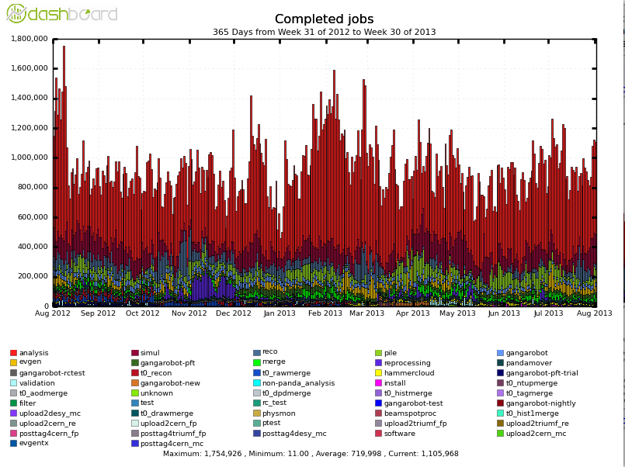
ATLAS PanDA Completed Jobs
Number of completed PanDA jobs (daily average. Max 1.7M jobs/day).
Aug 2012 - Aug 2013
Jobs
Analysis
1M ->
Jobs types

Slide 11

Big Data Has Arrived at an Almost Unimaginable Scale
Library of congress
Business e-mails sent per year
3000 PBytes
Content Uploaded
to Facebook each year.
182 PBytes
ATLAS Managed
Data Volume
130 PBytes
Climate
ATLAS Annual
Data Volume
30 PBytes
LHC Annual
15 PBytes
Nasdaq
Google search index
98 PBytes
Youtube
15 PBytes
US census
Health Records
30 PBytes
http://www.wired.com/magazine/2013/04/bigdata

Slide 12
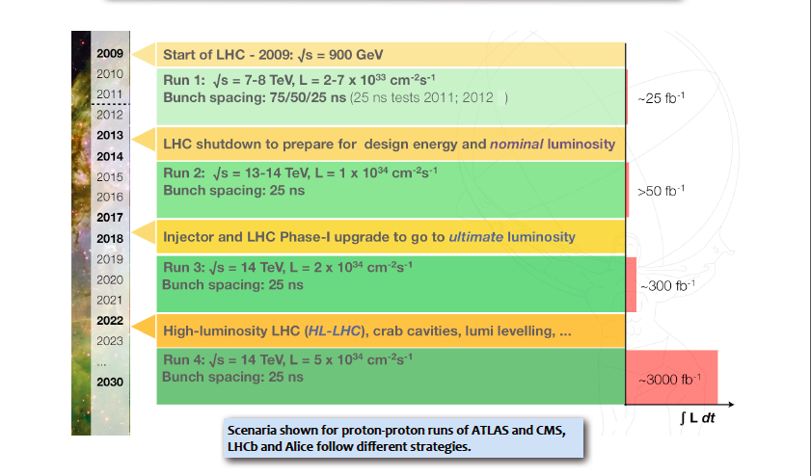
BigData Technologies For Mega-Science
Workload and Data Management System
LHC Upgrade Timeline. 100 times more data in 2018

