Slide 1
Review of the aperture margins for the new HL-LHC magnets
R. De Maria with input from G. Arduini, O. Brüning, R. Bruce,
F. Cerutti, L. Esposito, S. Fartoukh, P. Fessia, M. Fitterer,
M. Giovannozzi, R. Kersevan, S. Redaelli, E. Todesco.

Slide 2
Status HL-LHC layout
HLLHCV1.0 is the present baseline model for layout and optics.
The layout has been frozen since April 2013.
Several updates have been requested (4 cavities with in case a displacement, new D1 length, masks in front of D2, Q5, Q6, review of the D2 length and associated orbit correctors, new Q5 types).
A new layout and optics is foreseen for Spring and will sum up the requests and integrate the changes.
Today I will:
  review the aperture margins for the frozen HL-LHCV1.0 and
  illustrate the impact of few requested variations.

Slide 3
Aperture margin estimations
Aperture margins are determined by:
A model of the inner cross section of the beam screen:
  triplet area: best guess from vacuum but without manufacturing tolerances;
  aperture scaling for D2 and Q4.
A model of alignment accuracy and ground motion;
The optics scenarios (round and flat β*) that provides the ideal position of the beam and the transverse beam size
An operation scenario for estimating orbit and optics imperfections.
The aperture that the collimation system can protect. It is conveniently expressed in sigma@3.5µm/γ regardless of the emittance of the beam and depends whether or not a TCT protects the aperture by asynchronous dumps.

Slide 4
Collision low-β optics parameters
Name | IP1-5 |  |  | IP2 |  |  | IP8
 | β* [cm] | Angle [murad] | sep [mm] | β* [m] | Angle [murad] | sep [mm] | β* [m] | Angle [murad] | sep [mm]
Round | 15 | 590 | 0.75 | 10 | 340 | 2 | 3 | 340 | 2
flat | 7.5, 30 | 550 | 0.75 | 10 | 340 | 2 | 3 | 340 | 2
flathv | 30, 7.5 | 550 | 0.75 | 10 | 340 | 2 | 3 | 340 | 2
sround | 10 | 720 | 0.75 | 10 | 340 | 2 | 3 | 340 | 2
sflat | 5, 20 | 670 | 0.75 | 10 | 340 | 2 | 3 | 340 | 2
sflathv | 20, 5 | 670 | 0.75 | 10 | 340 | 2 | 3 | 340 | 2
Optics available under /afs/cern.ch/eng/lhc/optics/HLLHCV1.0
In the following baseline round and flat optics at 15 cm and 7.5/30 cm are considered.
Ultimate squeeze for improved performance provided tight collimation settings.
Based on the ATS scheme (S. Fartoukh, SLHC report 49, 2010.)
R. De Maria et al, IPAC’13 and reference therein for the last public version.

Slide 5
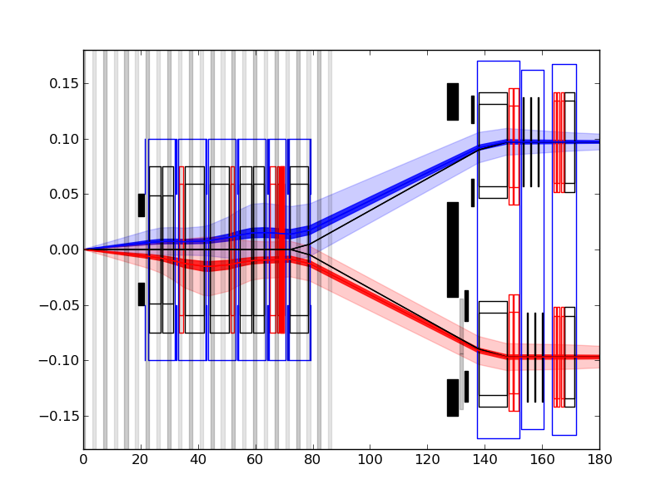
Layout overview HL-LHC V1.0
Triplet and D1
TAN D2 CRAB Q4
Beam 1
IP
Beam 2

Slide 6
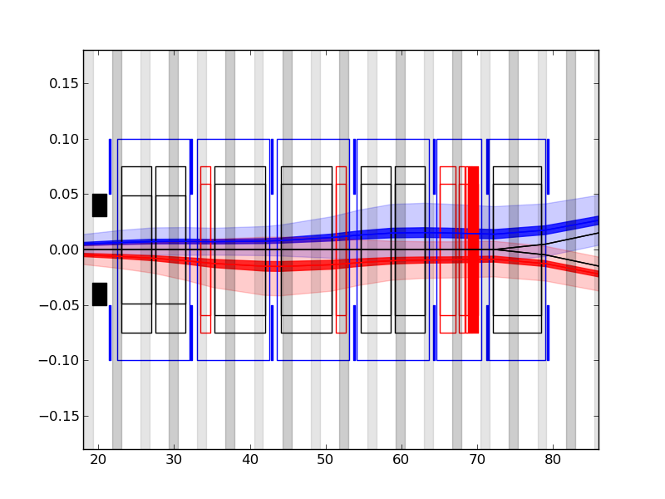
Layout Triplet HL-LHC V1.0
TAS Q1
Q2A
Q2b
Q3
CP
D1

Slide 7
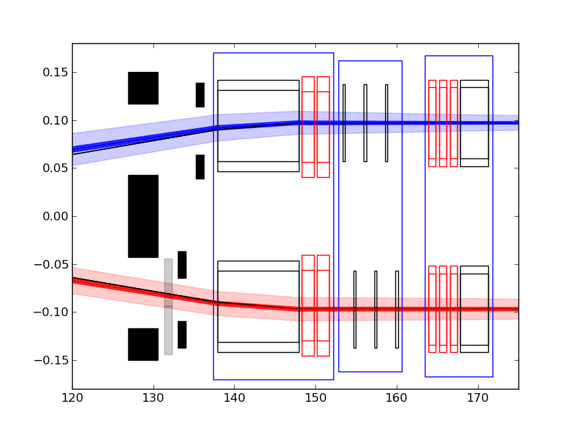
Layout TAN – Q4 HL-LHC V1.0
TAN
TCL
D2
CRAB
Q4
TCT

Slide 8
Aperture model in LHC
Element | Coil ap. [mm] | Sep. [mm] | Shape | Specs [mm]
TAS |  |  | Circle | 30
Q1 | 70 |  | Rectellipse (HV – pol) | 23.85, 18.95
Q2-Q3 | 70 |  | Rectellipse (HV – pol) | 28.9, 24.
D1 warm | 70 |  | Rectellipse (HV – pol) | 64.0, 26.5
D1 cold | 70 |  | Rectellipse (HH ) | 33.7, 28.8
TAN | n/a | 160 | Circle | 26
D2 | 80 | 188 | Rectellipse (HV- opt) | 31.3,26.4
Q4 | 70 | 194 | Rectellipse (HV - opt) | 28.9, 24
Q5 | 56 | 194 | Rectellipse (HV - pol) | 22.55,17.65
Q6 | 56 | 194 | Rectellipse (HV - pol) | 22.55,17.65
pol./opt.: orientation follow polarity / collision optics

Slide 9
Aperture model in HLLHCV1.0 (4/2013)
Element | Origin
TAS¹ | Rescaled to be in the shadow of triplet aperture without shielding
Q1² | He (1.5 mm), CB (5 mm) , CB to BS (1.5 mm), BS (2 mm), W(16mm)
Q2-Q3 to D1² | He (1.5 mm), CB (5 mm) , CB to BS (1.5 mm), BS (2 mm), W(6mm)
TAN³ | Optimized for parallel aperture and smaller or equal aperture
D2³ | scaled like D2: 105·31.3/80 -> (41,41-5)
Crab Cavities⁴ | As big as to be largely in the shadow of D2 and Q4
Q4¹ | scaled like Q4: 90·28.9/70 -> (37,37-5)
Q5¹ | As MQY
Q6¹ | Nominal MQM
1) S. Fartoukh, SLHC-PR-49, 2010. 2) E. Todesco, R. Kersevan, 1st and 2nd PLC, 2012
3) R. De Maria, S. Fartoukh, SLHC-PR55, 2011 4) R. Calaga, CC Workshop, 2010.

Slide 10
Aperture model in HL-LHC V1.0 (2013)
Element | Coil ap. [mm] | Sep. [mm] | Shape | Specs [mm] (radius, half-gap)
TAS¹ |  |  | Circle | 30
Q1² | 150 |  | Octagon | 49 (hv), 49 (45)
Q2-Q3 to D1² | 150 |  | Octagon | 59 (hv), 59 (45)
TAN³ | n/a | 144 | Ellipse | 42(h), 36(v)
D2³ | 105 | 186 | Rectellipse HH | 41(h),36(v)
Crab Cavities⁴ | 84 | 194 | Circle | 42
Q4¹ | 90 | 194 | Rectellipse (HV - opt) | 37(h),32(v)
Q5¹ | 70 | 194 | Rectellipse (HV - opt) | 28.9, 24
Q6¹ | 56 | 194 | Rectellipse (HV - pol) | 22.55,17.65
1) S. Fartoukh, SLHC-PR-49, 2010. 2) E. Todesco, R. Kersevan, 1st and 2nd PLC, 2012
3) R. De Maria, S. Fartoukh, SLHC-PR55, 2011 4) R. Calaga, CC Workshop, 2010.

Slide 11
Aperture model in HL-LHC (Study)
Element | Coil ap. [mm] | Sep. [mm] | Shape | Specs [mm] (radius, half-gap)
TAS |  |  | Circle | reduction
Q1 | 150 |  | Octagon | wait for tol.
Q2-Q3 to D1 | 150 |  | Octagon | wait for tol.
TAN | n/a | 148-158.6¹ | Circle non parallel¹ | 38¹
D2 and mask¹ | 105 or 100¹ | 186 or 188 | Rectellipse HH or oct. ² | wait for 1st design
Crab Cavities | 84 | 194 | Circle | 42
Q4 | 90 | 194 | Rectellipse (HV - opt) | wait for 1st design
Q5 and mask¹ | 70 or 90² | 194 | Rectellipse (HV - opt)
Q6 and mask¹ | 56 | 194 | Rectellipse (HV - pol) | 22.55,17.65
¹ see energy deposition model (see L. Esposito, F. Cerutti, WP2 meetings)
² for crab cavities optimized optics (under study)

Slide 12
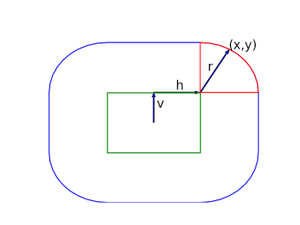
Ground motion and fiducialization
Ground motion span a racetrack area¹:
  Triplet (r=0.6 mm, h= 0, v=0)
  Matching sections (r=0.84 mm, h= 0.36, v= 0)
Fiducialization for MQ (h=0.9 mm, v= 0.6 mm)
Summary²:
Element | r_{m}+r_{f} [mm] | h_{m}+h_{f} [mm] | v_{m}+v_{f} [mm]
TAS | 2+0 | 0+0.5 | 0+0.5
IT | 0.6+0 | 0+1 | 0+1
D1/D2 | 0.84+0 | 0.36+1 | 0+1
TAN | 0.6+0 | 0+1 | 0+1
Q4/Q5 | 0.84+0 | 0.36+0.9 | 0.6
¹JB. Jeanneret, LHC Report 1007, 2007. ²S. Fartoukh, SLHC aperture models.

Slide 13
Aperture protection in the IR1 – IR5
Target:
  If an aperture is protected by a dedicated TCT: -> 12σ.
  If an aperture is not protected: -> 14σ to 20σ to be evaluated with detailed simulations.
  Avoid adding too many TCTs if not strictly necessary due to the operational overhead.
Values expressed as the beam sigma at 3.5µm@7TeV (regardless of the emittance of the beam for ϵ<4µm/γ) after the ground motion and orbit effects are accounted for the worst the case scenario.
First estimates, under validation by collimation team.
No gain from the button BPM include or additional retraction due to impedance issues.
R. Bruce, S. Redaelli, WP2 meeting 13/9 and private communication.

Slide 14
Beam Tolerances
New beam tolerances are being reviewed based on the positive experience of the last LHC run and including the remaining uncertainties of new operation regimes (low β*, levelling, short crossing scheme bumps)
Quantity | LHC Design | HL-LHC
Closed orbit | 3 mm | 2 mm
Beta-beating | 20% (10% in sigma) | 20% (10% in sigma)
Dispersion errors | 54 cm in the arcs | 20 cm in the arcs
Energy Error | 8 · 10⁻⁴ | 2 · 10⁻⁴
Energy | 7000 GeV | 7000 GeV
Emittance | 3.75 µm | 3.5 µm
ATS Note in preparation R. Bruce, R. De Maria, S. Fartoukh, M. Giovannozzi, S. Redaelli, R. Tomas, J. Wenninger.

Slide 15
Aperture summary for HL-LHCV1.0
Element | Target¹ [σ] | Ideal beam [σ] | + imp. [σ] | Sensitivity ² [σ/mm]
TAS | ≥12 | 15.11 | 12.41 | 0.55
Q1 | ≥12 | 15.42 | 13.19 | 0.30
Q2-Q3 | ≥12 | 12.54 | 10.83 | 0.20
D1 | ≥12 | 12.86 | 11.07 | 0.22
TAN (new) | ≥12 | 12.60 (13.46) | 10.59 (11.39) | 0.34 (0.33)
D2 (mask) | ≥14-20 | 15.06 (13.12) | 12.75 (11.01) | 0.38 (0.37)
Crab cavities | ≥18-20 | 23.30 | 19.94 | 0.53
Q4 | ≥16-20 | 20.10 | 16.86 | 0.61
Q5 (mask) | 20 | 30.26 (28.67) | 24.79 (23.48) | 1.26 (1.29)
Q6 (mask) | 20 | 33.88 (32.23) | 19.52 (18.52) | 1.04 (1.01)
Q7 | 20 | 31.09 | 25.36 | 1.37
¹ Tentative target to be validated by collimation simulations.
² Gain/Loss in sigma if aperture increased/reduced by 1 mm in radius

Slide 16
Conclusion
Critical points for the hardware:
  Additional tolerances and cooling tube size have a cost in the β* reach.
  Beam screen designs should be as optimized as new magnet design ( one can easily loose 1cm in triplet tolerances, e.g. PhaseI).
  D2 coil aperture cannot be specified without a design of the beam screen.
  An increase of the mask aperture for the MS magnets should be evaluated.
  Need of additional TCTs to be validated by collimation simulations, but it should be avoided by maximizing MS apertures.
  Aperture of the MS magnets may reduce the possibility to further enhance the crab cavity efficiency.

Slide 17
Backup

Slide 18
Aperture summary HL-LHCV1.0 (round)
Element | Ideal beam [σ] | + imp. [σ] | Sensitivity ¹ [σ/mm]
TAS | 17.53 | 14.22 | 0.75
Q1 | 17.35 | 14.72 | 0.43
Q2-Q3 | 12.88 | 10.95 | 0.29
D1 | 14.30 | 12.21 | 0.31
TAN (new) | 16.22 (16.78) | 13.63 (14.14) | 0.45 (0.46)
D2 (mask) | 19.27 (18.13) | 16.23 (15.30) | 0.55 (0.50)
Crab cavities | 27.86 | 23.87 | 0.63
Q4 | 25.92 | 22.03 | 0.67
Q5 (mask) | 32.81 (31.67) | 27.42 (26.47) | 1.11 (1.07)
Q6 (mask) | 33.88 (32.23) | 27.67 (26.26 | 1.47 (1.42)
Q7 | 42.35 | 34.60 | 1.84
Aperture plots…
¹ gain in sigma aperture if increased by 1 mm in radius

Slide 19
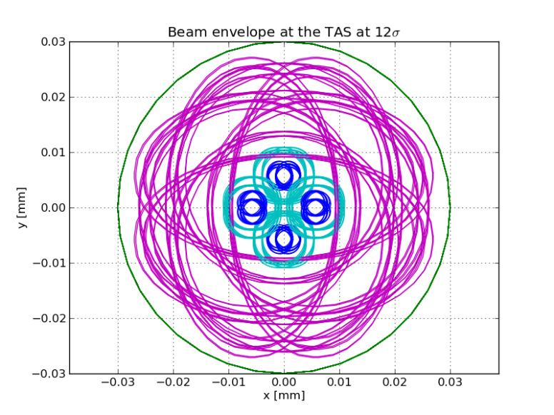
TAS

Slide 20
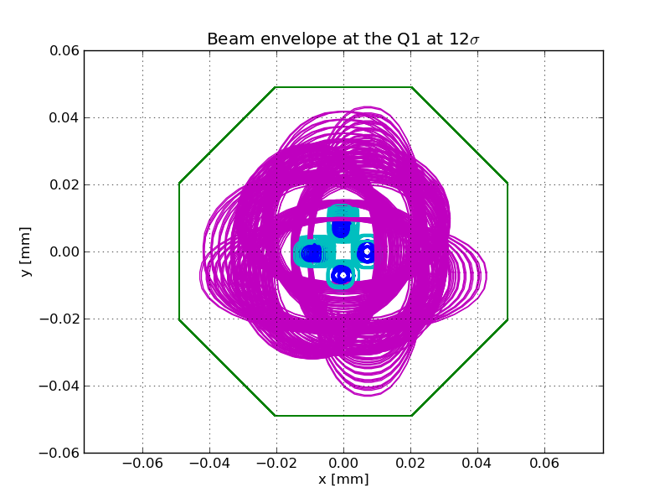
Q1

Slide 21
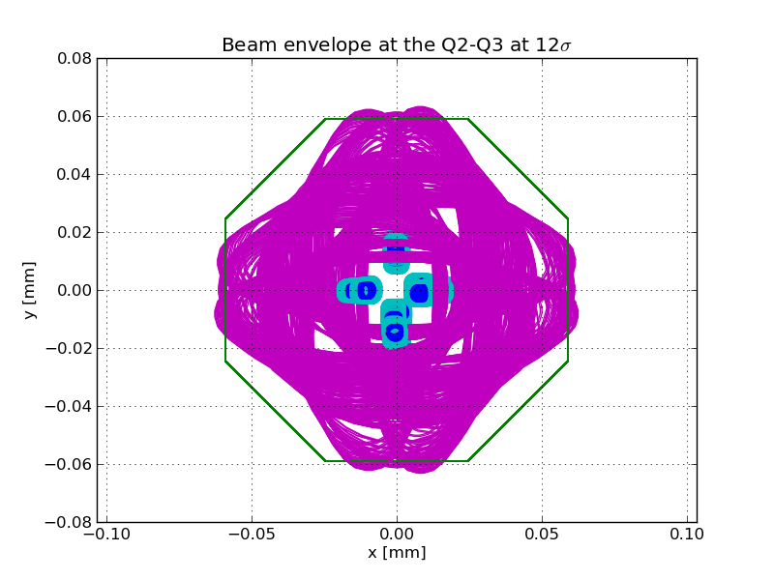
Q2-Q3

Slide 22
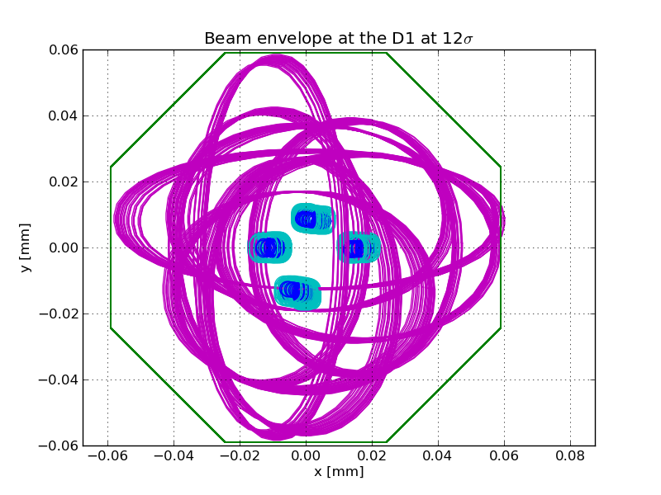
D1

Slide 23
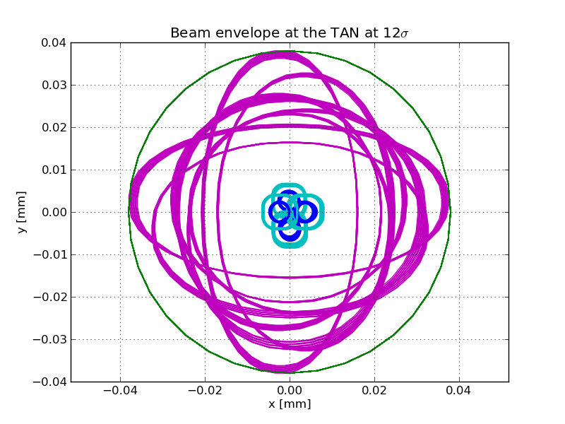
TAN (new)

Slide 24
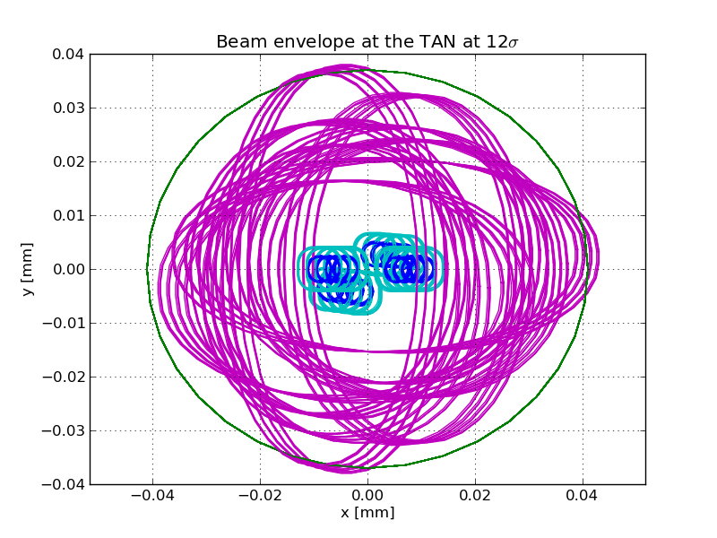
TAN

Slide 25
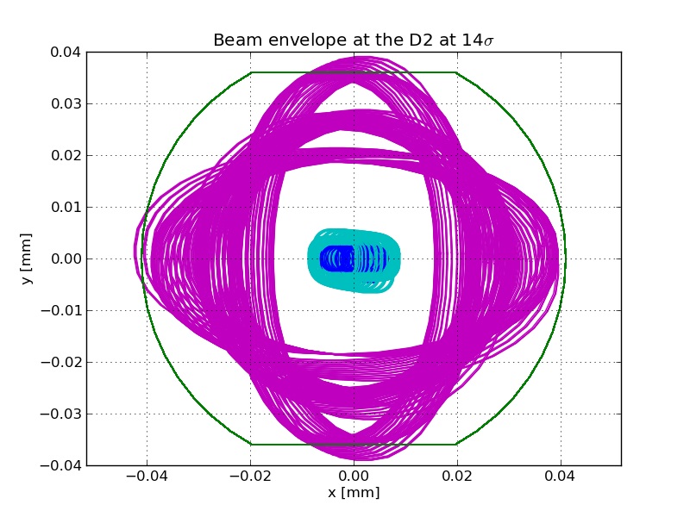
D2

Slide 26
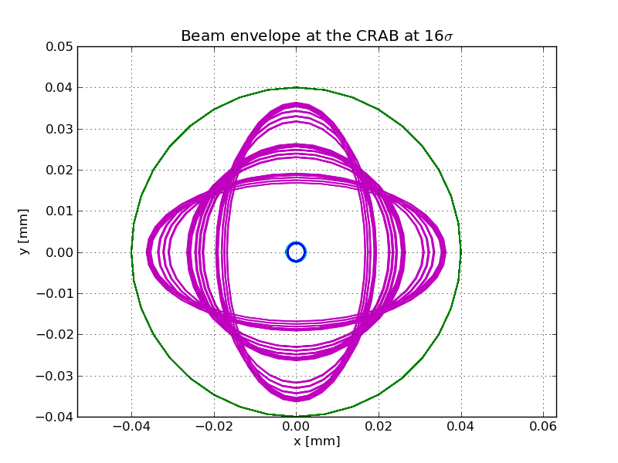
CRAB

Slide 27
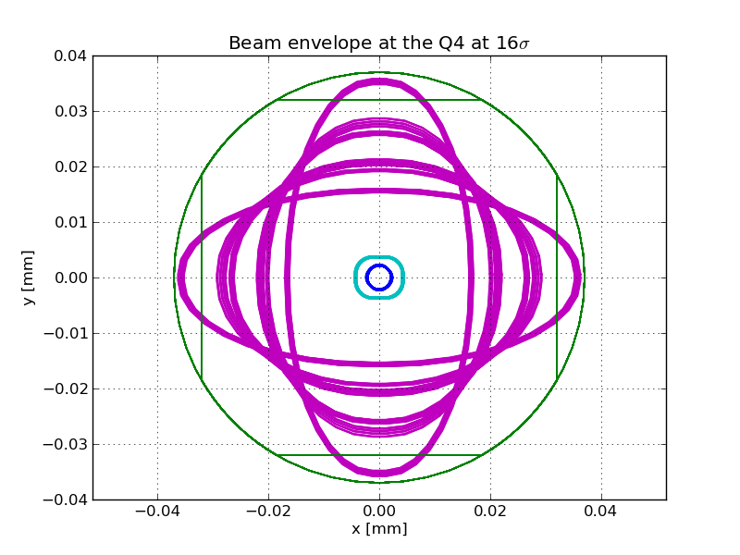
Q4

Slide 28
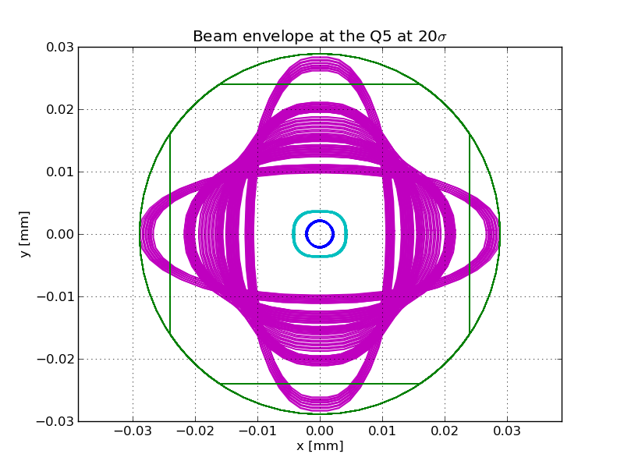
Q5

Slide 29
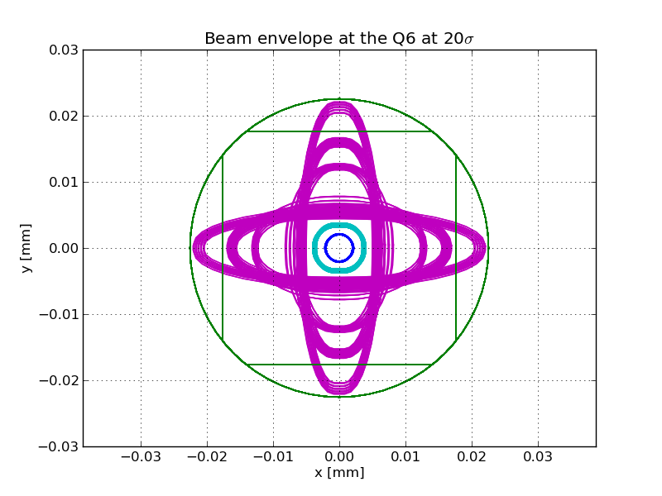
Q6

Slide 30
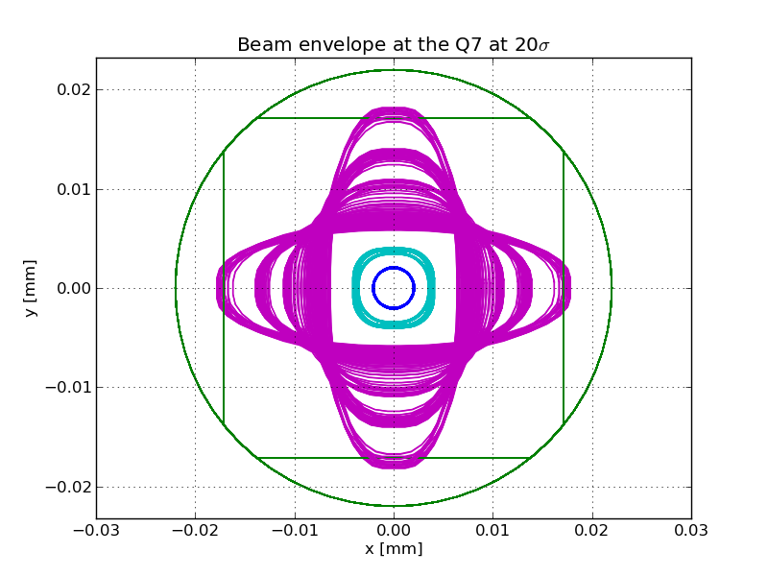
Q7

