Slide 1
Technical Meeting on Vacuum for HI-LUMI LHC, WP12
Vacuum related issues for WP14,
Beam Transfer and Kickers
Jan Uythoven for the WP 14 team members

Slide 2
Outline
Description of Injection System and changes for HL – LHC
    Items which affect vacuum
Description of Beam Dumping system and changes for HL-LHC
    Items which affect vacuum

Slide 3
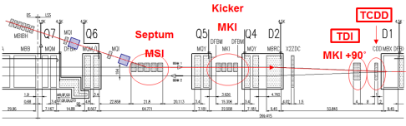
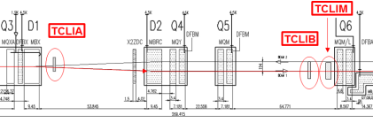
WP 14: Beam Transfer & Kickers: Injection
IP
MKI injection kickers, LS1: full complement 24 shielding wires, reducing beam impedance. Extrapolate run II data. For HL-LHC additional measures such as active cooling and different ferrites might be needed and are being studied.
TDI injection absorber
  LS1 / run2: Interferometry for redundant gap measurement & interlocking
  Vacuum feed-through
  LS2: Replace TDI with multi module beam absorber system, compatible with extremely bright LIU beams
    Tensile stresses, new collimator materials – in the worst case could limit the number of bunches which can be injected at a time
Other absorbers to be verified, some of them might need replacement:
  TCLIA, TCLIAB, TCDD, TCLIM
  TCLIA maximum opening affects maximum crossing angle for ALICE ZDC for ion operation

Slide 4
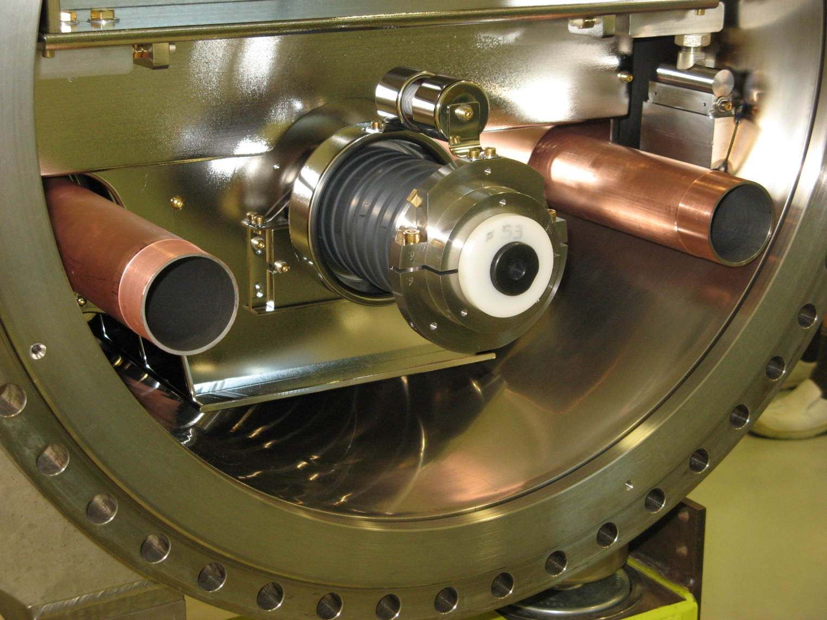
Injection kickers MKI
New NEG coated bypass tubes
M.Barnes
Main upgrade taking place in LS1
  Reduction of beam impedance
  Includes many mitigations concer-
  ning vacuum, especially NEG-coating.
  Removal of solenoids.
  Concerns:
    Beam induced heating > run II
    Vacuum behaviour during scrubbing and operation with 25 ns
HL-LHC: Up to 2017 a prototype magnet including water cooling and new yoke ferrites with higher T-Curie is foreseen
Vacuum involvement for HL-LHC:
  New ferrites & doping or coating of ceramic tube to reduce SEY
Operational experience will show if changes need to be applied

Slide 5
Absorbers for injection
Injection absorber TDI
  LS1: qualification of position measurement by interferometry, feed through. Spare magnet to be exchanged during run II.
  LS2: Likely 2 x 5 tanks instead of one large tank
  Other injection absorbers under study
    TCLIA/B, TCDD, TCLIM
  Vacuum involvement:
    New absorber materials, material choice to be finalised in the coming 12 months
    Additional equipment, pumping and monitoring

Slide 6
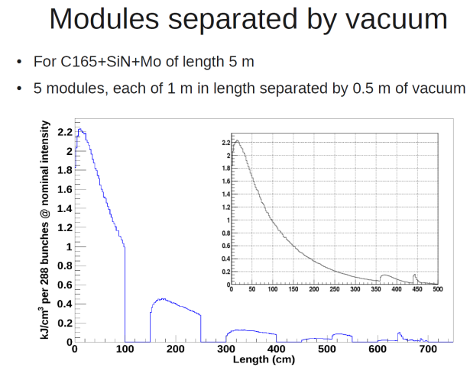
Possible future TDI layout
A.Lechner

Slide 7
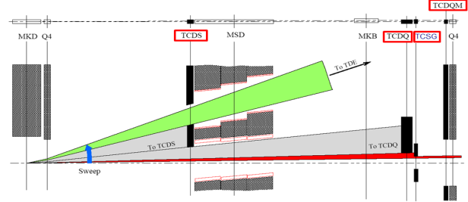
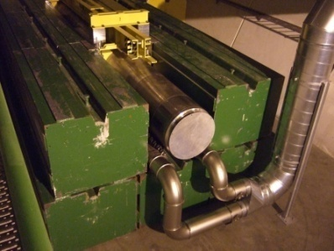
WP 14: Beam Transfer & Kickers: Beam Dump
LS1: TCDQ upgraded, from 2 to 3 modules; CFC instead of graphite absorbers.
Compatible with HL-LHC parameters from 2010 – presently work on bellows VMTAC
LS3: Possible upgrade of other absorbers to be confirmed
  TCDS, TCSG (coll. WP), TCDQM
  Dump block TDE– study gas handling and pressure increase
  TDE window
  Possibly change dilution pattern: dilution magnets MKB
Detailed studies after injection system studies which have priority

Slide 8
Vacuum for Beam Dumping System
N₂ pressure on TDE
  Pressure on dump → see graph run I
  Pressure in bottle → see graph run I
TDE window
Additional MKBs ?
TCDS upgrade

Slide 9
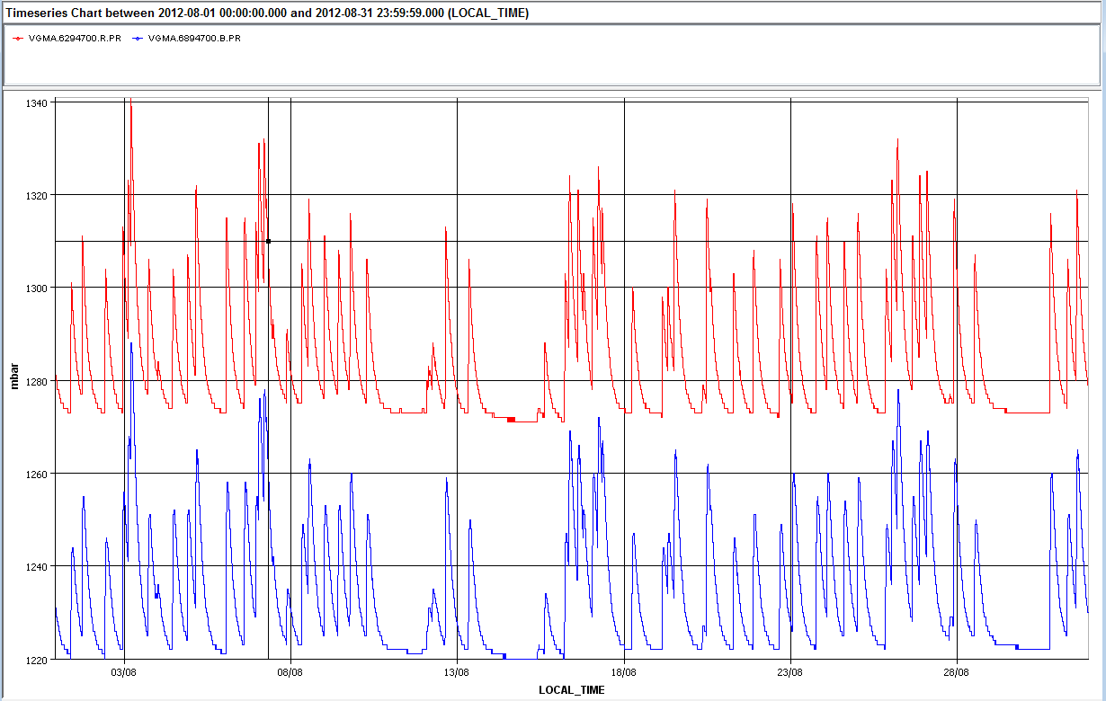
TDE – N₂ pressure
Δ p ≈ 0.06 bar
B2
B1
August 2012

Slide 10
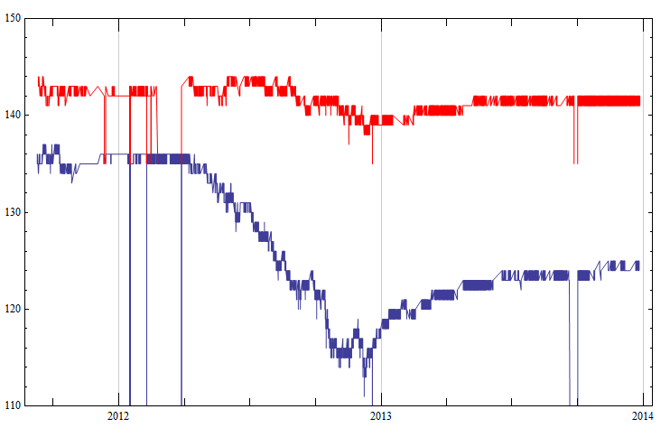
TDE in the bottle
Behaviour not understood

Slide 11
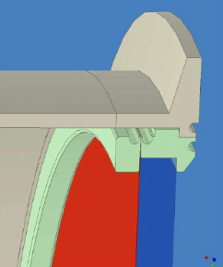
Vacuum work related to dump
No change of TDE itself, but if simulation show limitations changes might be required on:
  N₂ handling
  Dilution kickers MKB
    Possibly extra MKB kickers to be installed,
    new vacuum sector..
  TDE window to be checked
  for HL-LHC beams
    Assuming the different dilution
    failure scenarios
Detail of entrance window, showing 15 mm CC plate,
200 μm metallic foil and vacuum flange.

Slide 12
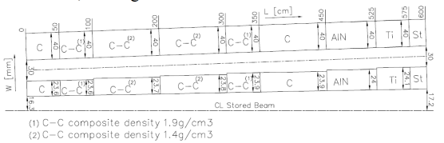
Absorbers
TCDS – likely to be replaced in LS3
  Different absorber material
Possibly also replace:
    TCSG (coll. WP)
    TCDQM
Vacuum involvement:
  Check on absorber materials, installation, …
Present TCDS
B.Goddard, W.Weterings

Slide 13
Conclusions on HL-WP14
LS2 concentrate on injection system
  TDI: New absorber materials and separation of absorbers in several tanks. Coming soon.
  Possibly replace other injection absorbers
  MKI, replaced LS1. Ongoing R&D for new ferrites and coated ceramic tube for low SEY. Possibly install prototype.
  Presently budget foreseen within WP14 for vacuum TDI, TCLIA/B
For LS3 accent will be on the beam dumping system
  Simulations are about to start. TCDS likely to be exchanged.
  Could involve little related vacuum work
  Could involve significant vacuum work:
    TDE window, additional MKBs, N₂ handling system
  Presently budget foreseen within WP14 for vacuum TCDS

