Slide 1
HL-LHC Vacuum
Technical Meeting WP12
Lucio Rossi
6 March 2014 @ CERN

Slide 2
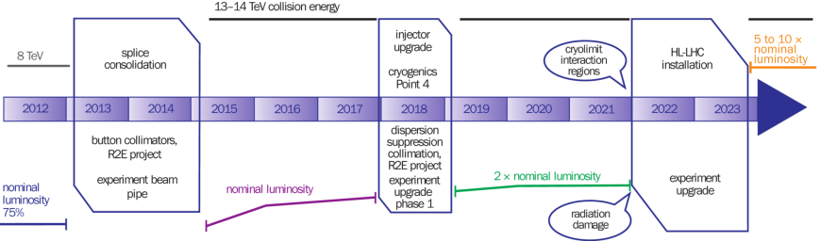
The CERN 10-year plan
(approved early 2011)
Plan modification approved Dec 2013
EYETS
LS2
LS3
0.75 10³⁴ cm⁻²s⁻¹
50 ns bunch
high pile up ∼40
1.5 10³⁴ cm⁻²s⁻¹
25 ns bunch
pile up ∼40
1.7-2.2 10³⁴ cm⁻²s⁻¹
25 ns bunch
pile up ∼60
Technical limits (experiments, too) like :

Slide 3

2013: HL-LHC: from Design Study to Construction Project (funded)
Update of 2013
Approved at special CERN Council
Held in Brussels 30 May 2013
c) Europe’s top priority should be the exploitation of the full potential of the LHC, including the high-luminosity upgrade of the machine and detectors with a view to collecting ten times more data than in the initial design, by around 2030. This upgrade programme will also provide further exciting opportunities for the study of flavour physics and the quark-gluon plasma.

Slide 4
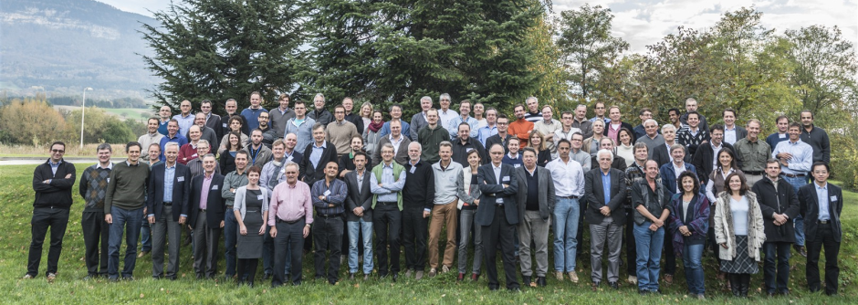
Review of LHC & Injector Upgrade Program (CERN-MAC)
Recommendation (R1): The committee supports the full LHC high luminosity program (HL-LHC), including the full LHC Injector Upgrade (LIU) project and the Upgrade Scenarios 1 and 2, and recommends scheduling LS3 for the installation of all necessary equipment for the HL-LHC as early as possible to maximize the integrated luminosity of the LHC.
Flull plan (incl. CC and LRBBW): OK

Slide 5
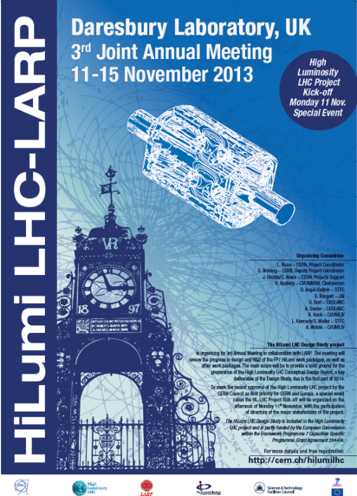
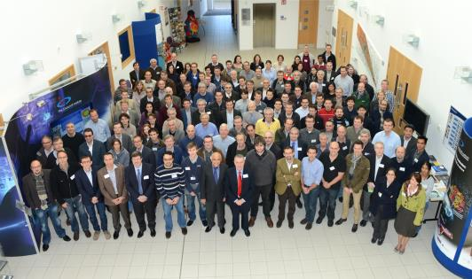
Project Kick off meeting on 11 Nov 2013

Slide 6



Collaboration: the long way
DOE Nb3Sn R&D
2000
LARP
generic
FP6
CARE
Nb3Sn
The HL-LHC project formally started in 2010; however it is the focal point of 20 years of converging International Collaboration
2005
CERN-KEK R&D
LARP
HiField quads
FP7
sLHC PP
(INJ)
FP7
EuCARD
HiField Dip
2010
CERN-KEK D1 design
LARP
Demo
sLHC INJ implem.
today
FP7 DS
Hi-Lumi LHC
M
2015
Construction
Injector
upgrade
HL-LHC commissioning
2023

Slide 7
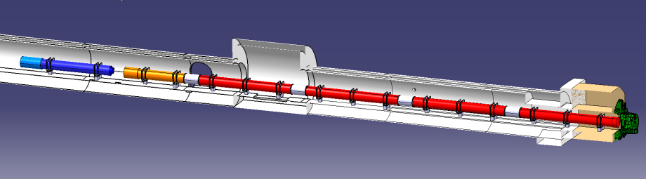




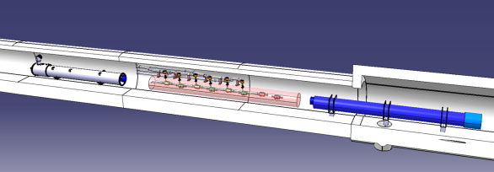


In-kind contribution and Collaboration for design and prototypes: Vacuum best practice enforced!
ATLAS
CMS
Q1-Q3 : R&D, Design, Prototypes and in-kind USA
D1 : R&D, Design, Prototypes and in-kind JP
MCBX : Design and Prototype ES
HO Correctors: Design and Prototypes IT
Q4 : Design and Prototype FR
CC : R&D, Design and in-kind USA
CC : R&D and Design UK

Slide 8
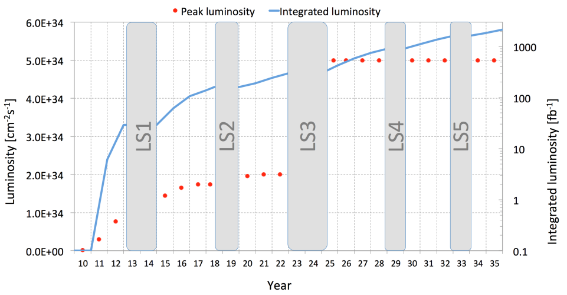
This goal woudl be reached by 2035-36
What to do, to make this jump ?
M. Lamont, CERN

Slide 9
Vacuum: touch all WPs
WP2 : e-cloud
WP3 : cryostat vac, beam pipe, beam screen (and e-cloud); Test facilities
WP4 : cryomodule and beam pipe; Test facilities and assembly facilities
WP5 : collimators vacuum issue; e-lens?; Crystal?
WP6 : cryostat of SC links
WP8 : machine-experiment interface (vacuum lay-out)
WP9 : Cryogenic equip. vacuum
WP7 & W10: UFOs…
WP11: 11 T cryostat and by-pass + collimators
WP12: self-coupling ?
WP13: beam diagnostic related?
WP14: Kickers
WP15 : integration - Installation

Slide 10
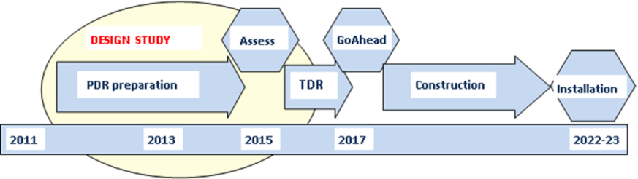
Implementation plan (BEFORE 1 year shift of the LS3 → 2023-24)
All WP active, from diagnostics to Machine Protection;
Integration started with vigour as well as QA (workshop soon)
Cryo, SC links, Collimators, Diagnostics, etc. starts in LS2 (2018-19)
Proof of main hardware by 2016; Prototypes by 2017
Start construction 2017/18 from IT, CC, other main hardware
IT String test (integration) in 2019-20; Main Installation 2022-23 2023-24
Though but – based on LHC experience – feasible
Cost: 810 MCHF (Material, CERN accounting)
Most already in CERN plan: counting on the USA and JP contribution we are basically covered

Slide 11
Have a useful and productive Meeting!
… and do not ask the Moon: even in HiLumi resources are limited and must be optimzed!

