Slide 1
Technical Meeting on Vacuum for HL-LHC
CERN-5 March 2014
Status of the beam screen for the
HL-LHC triplets
Roberto Kersevan
TE-VSC-IVM

Slide 2
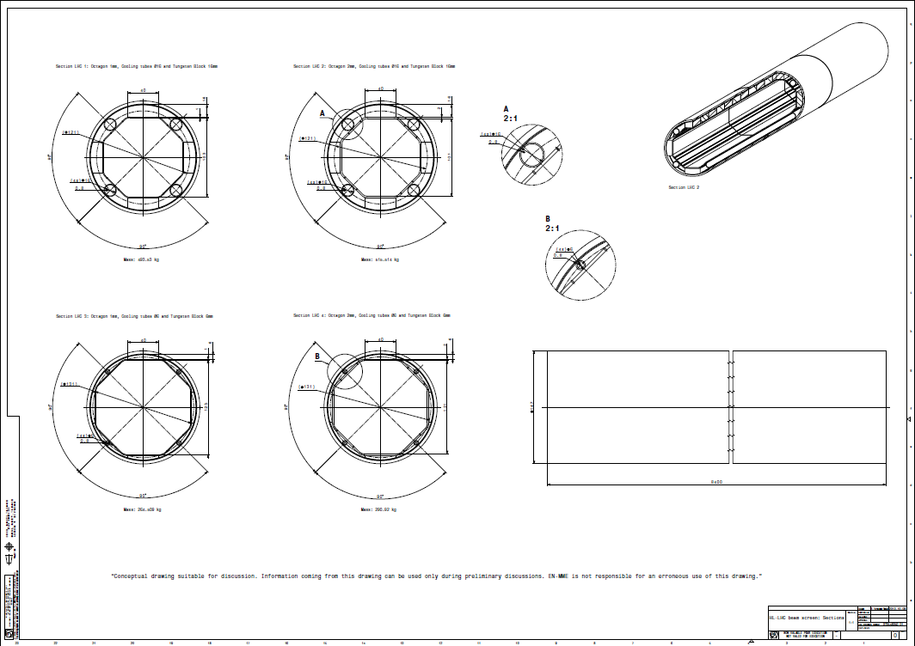
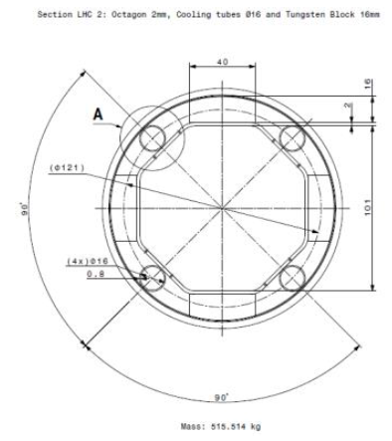
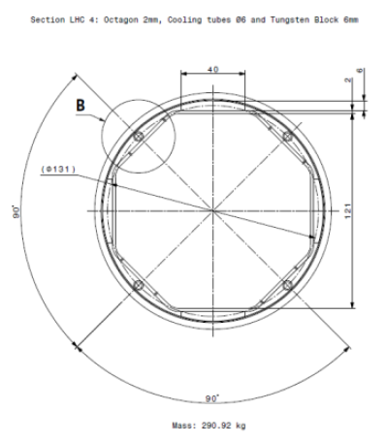
Conceptual design of the beam screen (BS) for the Q1 and Q2-Q3-CP-D1 areas.
1 (left) and2 (right) mm-thick BS
Baseline design is now 1 mm!
P506 stainless steel with 60 microns of co-laminated copper
6 mm W shielding (Q2 and beyond) to be modified to allow for bigger capillaries
(see R. vanWeelderen’s talk, HL-LHC kickoff meeting, Oct 2013)
Drawings courtesy of Luca Dassa, Rafael Fernandez-Gomez, EN-MME-ES

Slide 3
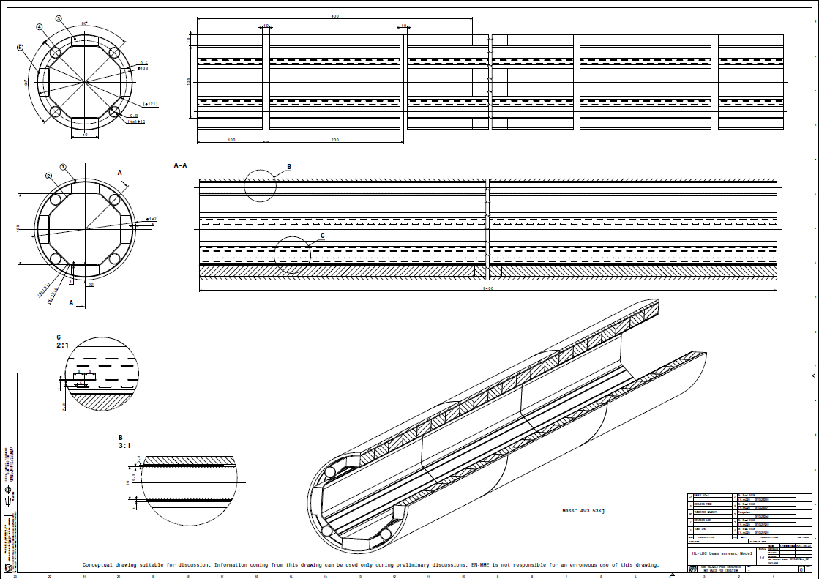
Conceptual design of the beam screen (BS) for the Q1 and Q2-Q3-CP-D1 areas.
Slot pattern will be randomized!
Spacing of sliding rings to be determined
Luca Dassa, Rafael Fernandez-Gomez, EN-MME-ES

Slide 4
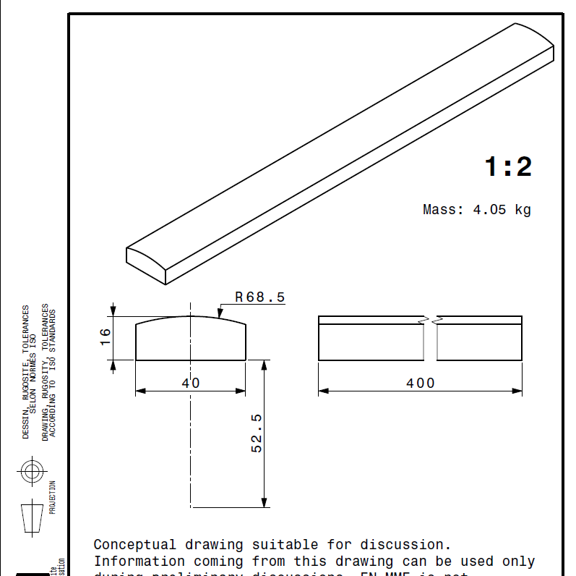
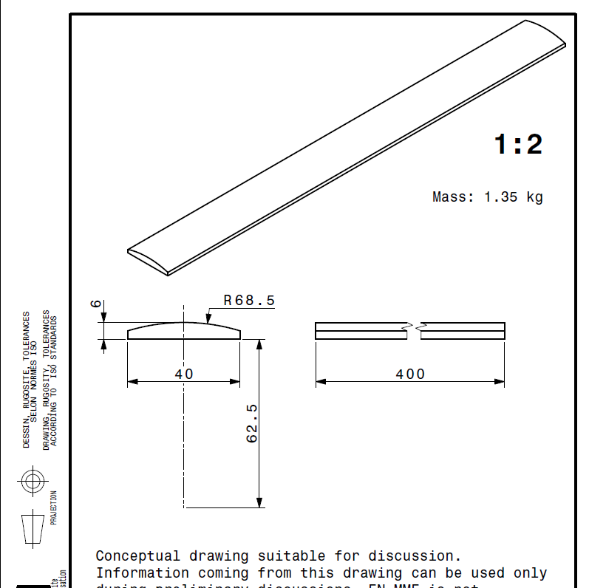
Conceptual design of the beam screen (BS) for the Q1 and Q2-Q3-CP-D1 areas: W shields
16mm @Q1
Approx. weight: 4x4x2.5x8 kg = 320 kg
6mm @Q2, Q3, CP, D1
Luca Dassa, Rafael Fernandez Gomez, EN-MME-ES

Slide 5
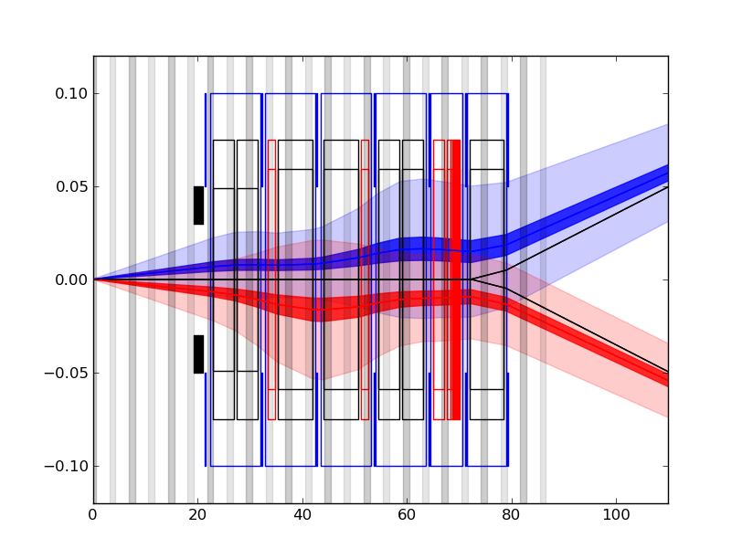
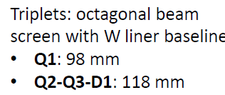
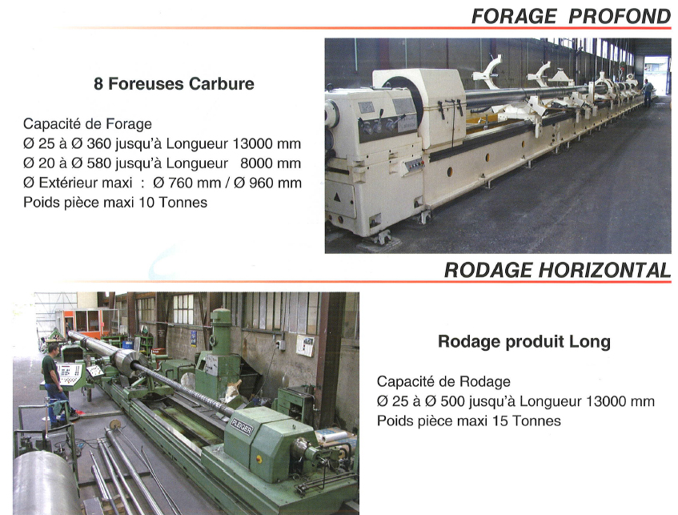
Tolerances:
Tolerances of different parts will have to be carefully minimized in order to allow the biggest area to the beams, especially in Q2-Q3, where the beam trajectories and sizes are the widest (see R. De Maria, this meeting):
W shields: contact with Plansee (25/11/2013) established, first prototypes/samples delivered
Brazing of W shields to BS: study underway
Straightness of BS: TBD during prototyping
Straightness and ID tolerances of cold bore: TBD with supplier (contacts established)

Slide 6
Short and medium term plan:
Engineering
Modify BS design with 6mm W shielding (Q2->D1), to accommodate bigger capillaries UNDERWAY
Repeat magnetic/mechanical stress calculations with new BS profiles UNDERWAY
Visit/discussion with Plansee (25 Nov 2013) DONE
Define brazing parameters of W shielding on BS (same, plus CERN advice) UNDER STUDY
Prototype brazing and validate (LN₂ thermal shock, heat conduction tests,… ) TBD
Launch design and fabrication of 1.2 m-long prototype of low-toleranced ID cold-bore (CB) with 304L SS BS, to study manufacturing issues STARTED
Launch 8m-long prototype with high-precision CB, and real P506 BS Same as previous
Procure P506 BS material of proper thickness (co-laminated Cu and SS, Böhler)
Raise issue of cold-testing 8m-long prototype: feasible or not? At SM18?
Measure magnetic permeability at low-temperature DONE (P. Fessia et al.)
Develop BS insertion tool and installation sequence for BS and CB (H vs V) Concept developed by/with P Ferracin et al.
Develop design of BS for magnets D1 and beyond NOT STARTED YET
Collaborate with BI group on development of shielded BPMs STARTED, T. Lefevre and new fellow, see his presentation this proceedings

Slide 7
Short and medium term plan:
Vacuum R&D
(see also presentation by V. Baglin, this proceedings)
Coldex experiment at SPS (desorption/e-cloud at low temperatures) STARTED, BS with α-C coating installed
Study of equilibrium isotherms for relevant gases (TBD, PhD/Fellow requested)
Development of α-C coating configuration (hollow cathode x4?) (under study)
Material characterization
Integration of electrode for suppression of e-cloud (collaboration with ASTeC Daresbury initiated)
Finalize vacuum layout (including other, non-triplet, areas)
Write/detail Work Package WP12 TBD, by fall 2014
… the logical consequence is that more resources are needed, and are being identified and allocated within the VSC group.

