Slide 1
CRITICAL ISSUES AND DESIDERATA FOR BEAM SCREEN IN THE HL LHC
CERN, 5th March 2014
Tecchnical meeting on vacuum for HL LHC
E. Todesco
CERN, Geneva Switzerland
Acknowledgements:
V. Baglin, P. Ferracin, R. Kersevan, R. Van Weelderen

Slide 2
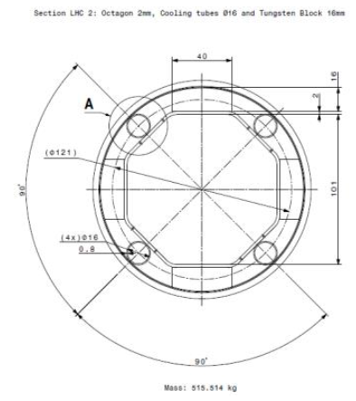
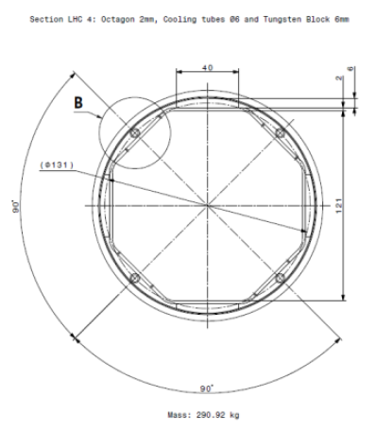
GENERAL REMARKS
Beam screen is one of the key elements of the HL LHC design
  It allows reducing the heat loads and the radiation damage to the same level of the LHC (~4 mW/cm³, ~40 MGy) [L. Esposito, F. Cerutti, E. Todesco, PAC 2013 http://cds.cern.ch/record/1636133/files/CERN-ACC-2013-0283.pdf]
    This is thanks to 16 mm (Q1) / 6 mm (Q2-Q3) tungsten shielding
Q1
Q2, Q3
Luca Dassa, Rafael Fernandez-Gomez, EN-MME-ES

Slide 3
COOLING
First issue: cooling
  The heat load is of the order of 700 W – to remove heat we need thick «capillary» tubes
  Design, dimensions, to be finalized – do we have enough space for the tube in the Q2-Q3? How is the topology ?
  Temperature of the beam screen to be defined, compatible with vacuum
A baseline should be defined asap
in collaboration with cooling colleagues
  Tentative deadline: April
Q2, Q3

Slide 4
BEAM SCREEN ASSEMBLY
Second issue: beam screen assembly
  How to fix the tungsten shielding on the the copper beam screen How to fix the capillaries
  How to center the beam screen in the cold bore
  Check compatibility with inner coating necessary to kill electron cloud
  Check magnetic properties – this object is very close and can strongly perturb the magnetic field of the triplet
A baseline should be defined asap
  Tentative deadline: June

Slide 5
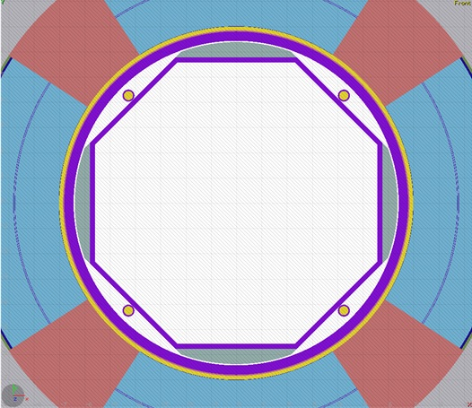
BEAM SCREEN ASSEMBLY in the magnet
Third issue: beam screen assembly in the magnet
  The weigth of the beam screen is considerable (∼40 kg/m in Q1)
  First brainstorming done on 28 January 2014 WP3 meeting [P. Ferracin, M. Juchno, R. Kersevan] (https://espace.cern.ch/HiLumi/WP3/SitePages/Minutes%20and%20Presentations.aspx )
    Magnet assembled without cold bore
    Beam screen inserted in the cold bore
    Cold bore and beam screen inserted in the magnet
      Sliding on supports placed on coil poles
A prototype should be launched soon
  Tentative deadline
    June 2014 end of drawings
    End 2014 manufactured piece, 8-m-long
    Beginning 2015 assembly

Slide 6
BEAM SCREEN ASSEMBLY in the magnet
Fourth issue: tolerance analysis
  Aperture is precious and costs money and performance
  Estimate of fabrication and assembly tolerances
    How to reduce them? Work is ongoing [see talk by C. Garion]
  Tentative deadline:
    First estimates already available
    In parallel with prototyping, reliable final estimates by the end of the year

Slide 7
CONCLUSIONS
There are several critical issues in the design of the beam screen, and its compatibility with triplet assembly, cooling, …
  Conceptual design still to be finalized
    We should have it completed very soon (by mid 2014)
  Prototype should be launched soon after ending conceptual design
  Assembly test and check of tolerances
This is an essential part of HL LHC

Slide 8
Status and Plan from R. Kersevan,
January 2014
Engineering
- Modify BS design with 6mm W shielding (Q2->D1), to accommodate bigger capillaries TBD
- Repeat magnetic/mechanical stress calculations with new BS profiles TBD
- Visit/discussion with Plansee (25 Nov 2013) DONE
- Define brazing parameters of W shielding on BS (same, plus CERN advice) UNDER STUDY
- Prototype brazing and validate (LN₂ thermal shock, heat conduction tests,… ) TBD
- Launch 1m-long prototype of low-toleranced ID cold-bore (CB) with 304L SS BS, to study manufacturing issues STARTED, but resources at MME are SCARCE
Launch 8m-long prototype with high-precision CB, and real P506 BS Same as previous
Procure P506 BS material of proper thickness (co-laminated Cu and SS, Böhler)
Cold-test 8m-long prototype?...
- Measure magnetic permeability at low-temperature
- Develop BS insertion tool and installation sequence for BS and CB (H vs V)
- Develop design of BS for magnets D1 and beyond
Collaborate with BI group on development of shielded BPMs (waiting for input from R. Jones’ trapped-modes simulations)
Develop installation sequence of shielded BS inside cold-bore tube: vertical insertion?

Slide 9
Status and Plan from R. Kersevan,
January 2014
Vacuum R&D
Coldex experiment at SPS (desorption/e-cloud at low temperatures) STARTED
Study of equilibrium isotherms for relevant gases (TBD, PhD/Fellow to be recruited)
Development of amorphous-C coating configuration (hollow cathode x4?) (under study)
Material characterization
Integration of electrode for suppression of e-cloud (collaboration with ASTeC Daresbury initiated)
Finalize vacuum layout (including other, non-triplet, areas)
Write/detail Work Package TBD
… the logical consequence is that more resources are needed, and will be identified and allocated within the VSC group.

