Slide 1

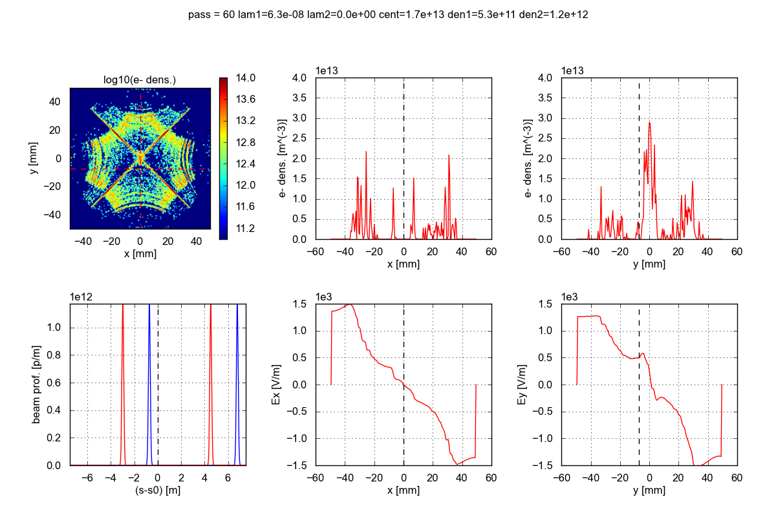
Electron cloud estimates in the HL-LHC triplets/D1
G. Iadarola and G. Rumolo
Technical meeting on Vacuum for HL-LHC
05/03/2014

Slide 2
Outline
  Introduction: the HL-LHC triplets/D1 in IP1 (IP5)
  Electron cloud effects in the HL-LHC inner triplets for IP1 and IP5
    Simulation results
    Comparison with present triplets and mitigation
  IP2 and IP8 triplets: observations and scaling
  Conclusions

Slide 3
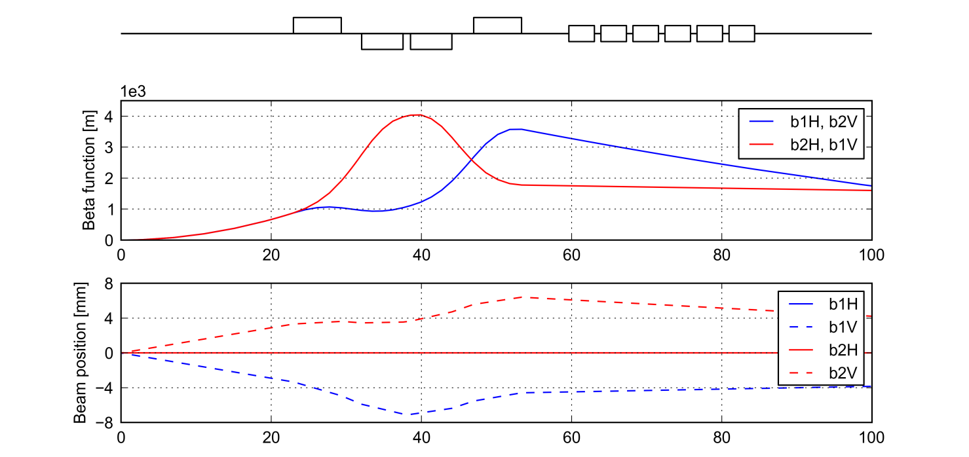
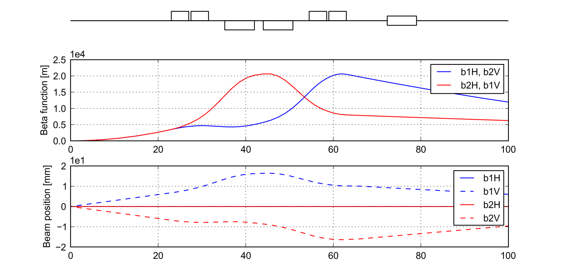
Inner triplets for HL-LHC upgrade
Present
Q1
Q3
D1
Q2 (A/B)
  IP1, 4 TeV, β* = 0.6 m
HL-LHC
Q1 (A/B)
Q3 (A/B)
D1
Q2 (A/B)
  IP1, 7 TeV, β* = 0.15 m

Slide 4
HL-LHC triplets in IP1 (IP5)
  Main differences between present and HL-LHC (with potential impact on integrated effect of e-cloud)
  Total length of triplets (IP1 and IP5): about 25% more quadrupole length
  D1 sharing the same cooling circuits

Slide 5
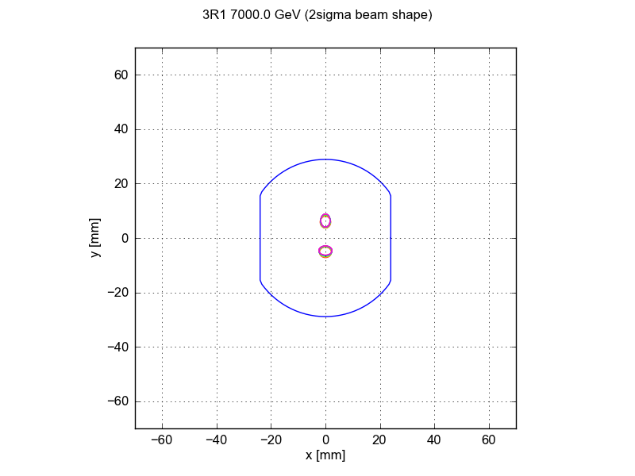
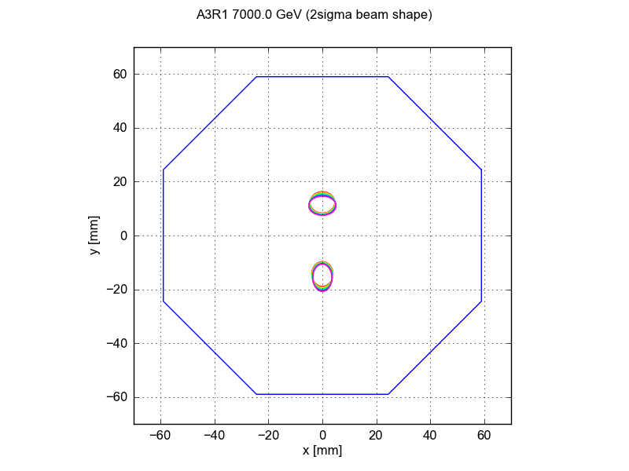
HL-LHC triplets in IP1 (IP5)
  Main differences between present and HL-LHC (with potential impact on integrated effect of e-cloud)
  Total length of triplets (IP1 and IP5): about 25% more quadrupole length
  D1 sharing the same cooling circuits
  → Shape and size of the beam screen

Slide 6
HL-LHC triplets in IP1 (IP5)
  Main differences between present and HL-LHC (with potential impact on integrated effect of e-cloud)
  Total length of triplets (IP1 and IP5): about 25% more quadrupole length
  D1 sharing the same cooling circuits
  Shape and size of the beam screen
  Beta functions (up to a factor 50) and beam positions (up to a factor 2)
  Bunch population (HL-LHC: 2.2 x 10¹¹ ppb, nominal LHC: 1.15 x 10¹¹ ppb)

Slide 7
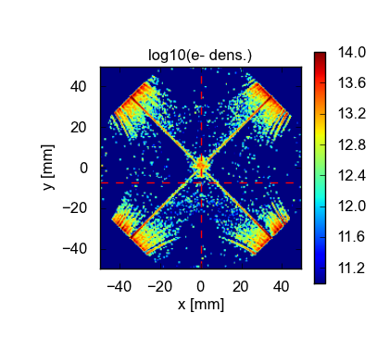
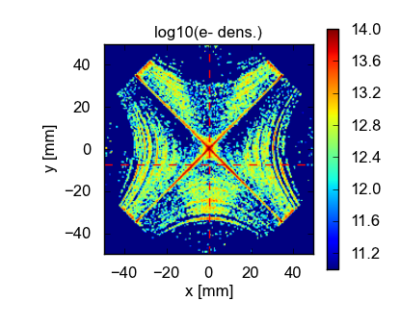
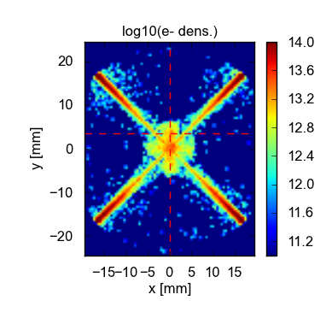


A look to the EC buildup in the quads
  Few snapshots of the electron distribution → HL-LHC triplets develop thicker stripes along field lines farther from the center of the chamber
  HL-LHC (2.20 x 10¹¹ ppb)
Present (1.15 x 10¹¹ ppb)

Slide 8
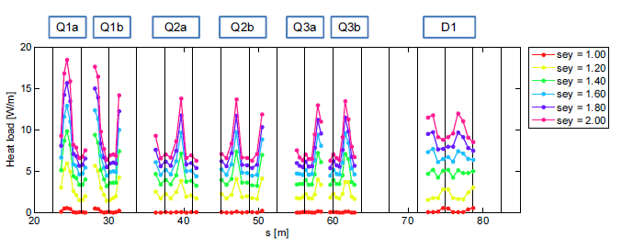
Distribution of heat load – HL-LHC triplets
  Heat load distribution along HL-LHC triplets + D1
  Build up more or less efficient at different locations mainly due to the different hybrid bunch spacings
  The least efficient build up, i.e. lower heat load, at the locations of the long-range encounters (vertical dashed lines)
  → Values in D1 are comparable or higher than values in the quads

Slide 9
Total heat load per element – HL-LHC triplets
  Total heat load per element in HL-LHC triplets + D1
  Similar thresholds for quads and D1
  Values in D1 higher than values in the quads for high SEY values

Slide 10
Total heat load on the triplet beam screen
  Effect of larger bunch population and chamber size. For the same SEY:
  - Similar energy, but significantly larger number, of impacting electrons
  Total heat load about x2-3 larger
  E-cloud suppression can be obtained using low SEY coatings (studies already ongoing → COLDEX) and/or clearing electrodes (low impedance design needed)
Present triplets
  (1.15 x 10¹¹ ppb)
Full suppression
(SEY≈1 or clearing electrodes)
  HL-LHC triplets
  (2.20 x 10¹¹ ppb)
Cu beam scr.
SEY like 2012
Cu beam scr.
SEY like 2012
Aged SPS-like a-C coating

Slide 11
Measured heat load (25ns) – IP2 and IP8

Slide 12
Measured heat load (25ns) – IP2 and IP8

Slide 13
Measured heat load (25ns) – IP2 and IP8

Slide 14

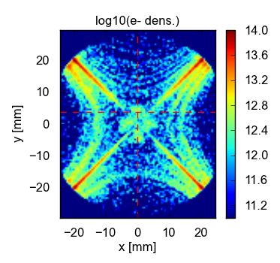
Scaling with bunch population - IP2 and IP8
  Scaling heat load in present inner triplets with bunch population:
  Doubling bunch population leads to about x2-3 larger heat load
  e-cloud suppression strategies needed also in IP2 and IP8
1.1e11 ppb
2.2e11 ppb

Slide 15
Summary
  HL-LHC Inner triplets IP1 and IP5 + D1:
    Expected values of heat load on the beam screens about a factor 3 larger than with present triplets
    Suppression measures (like low SEY coating or clearing electrodes) necessary to keep heat loads within cooling capacity
  Inner triplets IP2 and IP8 + D1
    Data from 2012 show similar behaviour to IP1 and 5
    Pure scaling with bunch population indicates that HL-LHC beams will lead to threefold heat load in the beam screen of IP2 and IP8 triplets

