Slide 1


Welcome
Estonian & Lithuanian
High-School Teachers
to Accelerating Science and Innovation
Notes:
1

Slide 2
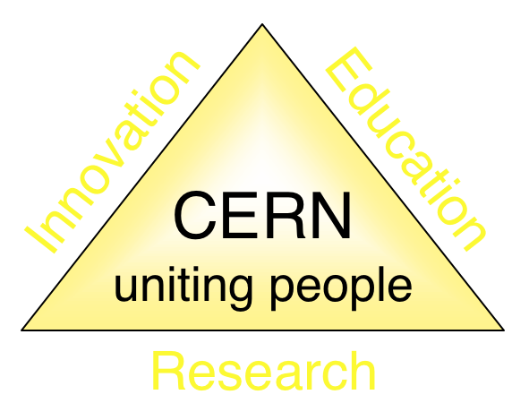
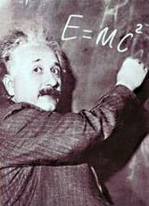
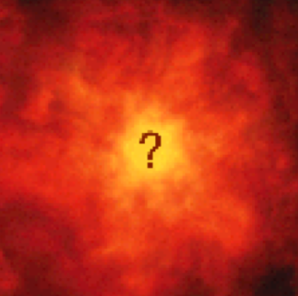


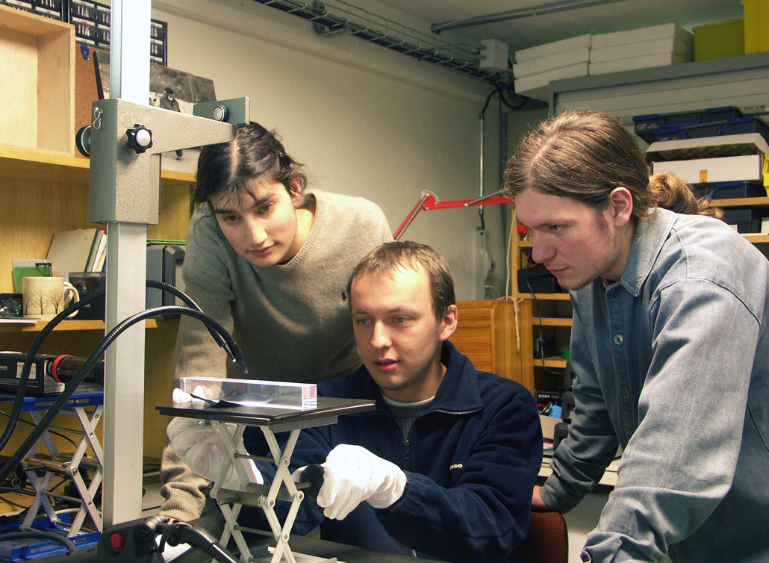
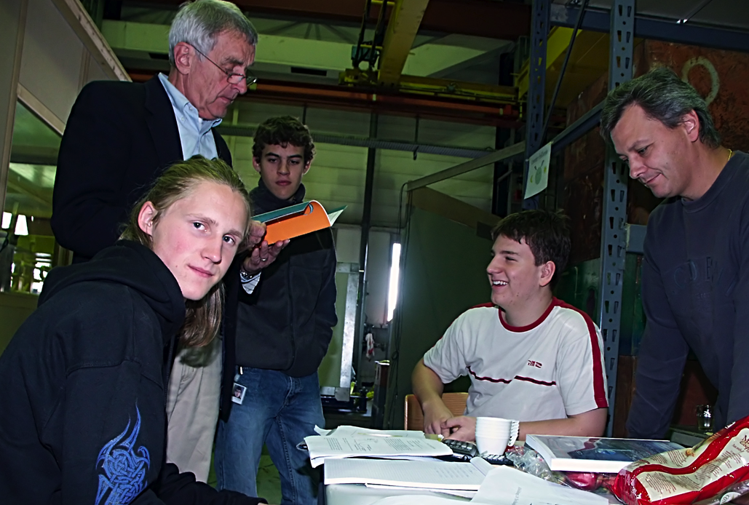
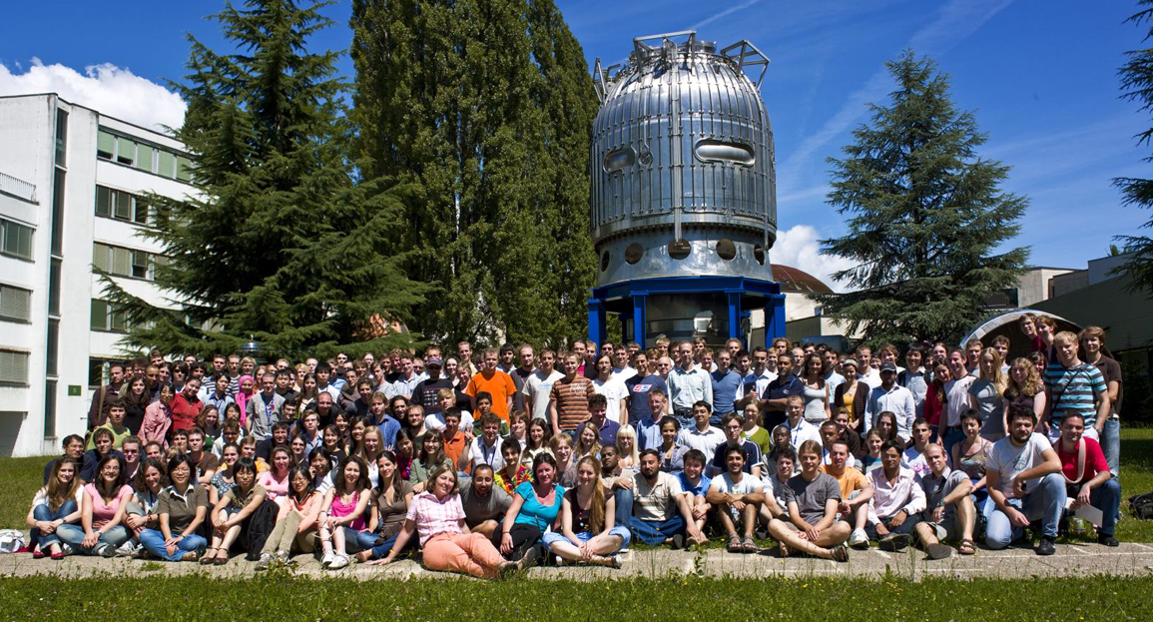
The Mission of CERN
Push forward the frontiers of knowledge
E.g. the secrets of the Big Bang …what was the matter like within the first moments of the Universe’s existence?
Develop new technologies for accelerators and detectors
Information technology - the Web and the GRID
Medicine - diagnosis and therapy
Train scientists and engineers of tomorrow
Unite people from different countries and cultures
Notes:
2

Slide 3
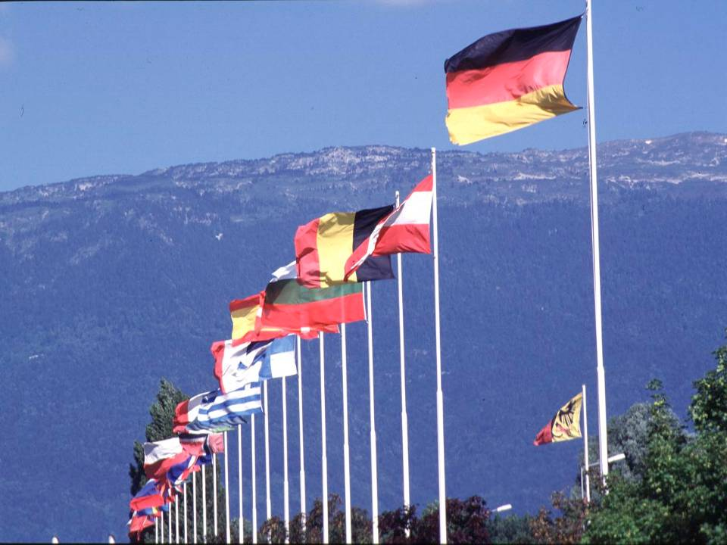

CERN was founded 1954: 12 European States
“Science for Peace”
Today: 21 Member States
~ 2300 staff
~ 1050 other paid personnel
> 11000 users
Budget (2013) ~1000 MCHF
Member States: Austria, Belgium, Bulgaria, the Czech Republic, Denmark, Finland, France, Germany, Greece, Hungary, Israel, Italy, the Netherlands, Norway, Poland, Portugal, Slovakia, Spain, Sweden, Switzerland, UK
Candidate for Accession: Romania
Associate Members in the Pre-Stage to Membership: Serbia
Applicant State: Cyprus
Applicants for Associate Membership: Brazil, Pakistan, Russia, Turkey, Ukraine
Observers to Council: India, Japan, the Russian Federation, the United States of America, Turkey, European Commission, UNESCO
3
Notes:
3

Slide 4
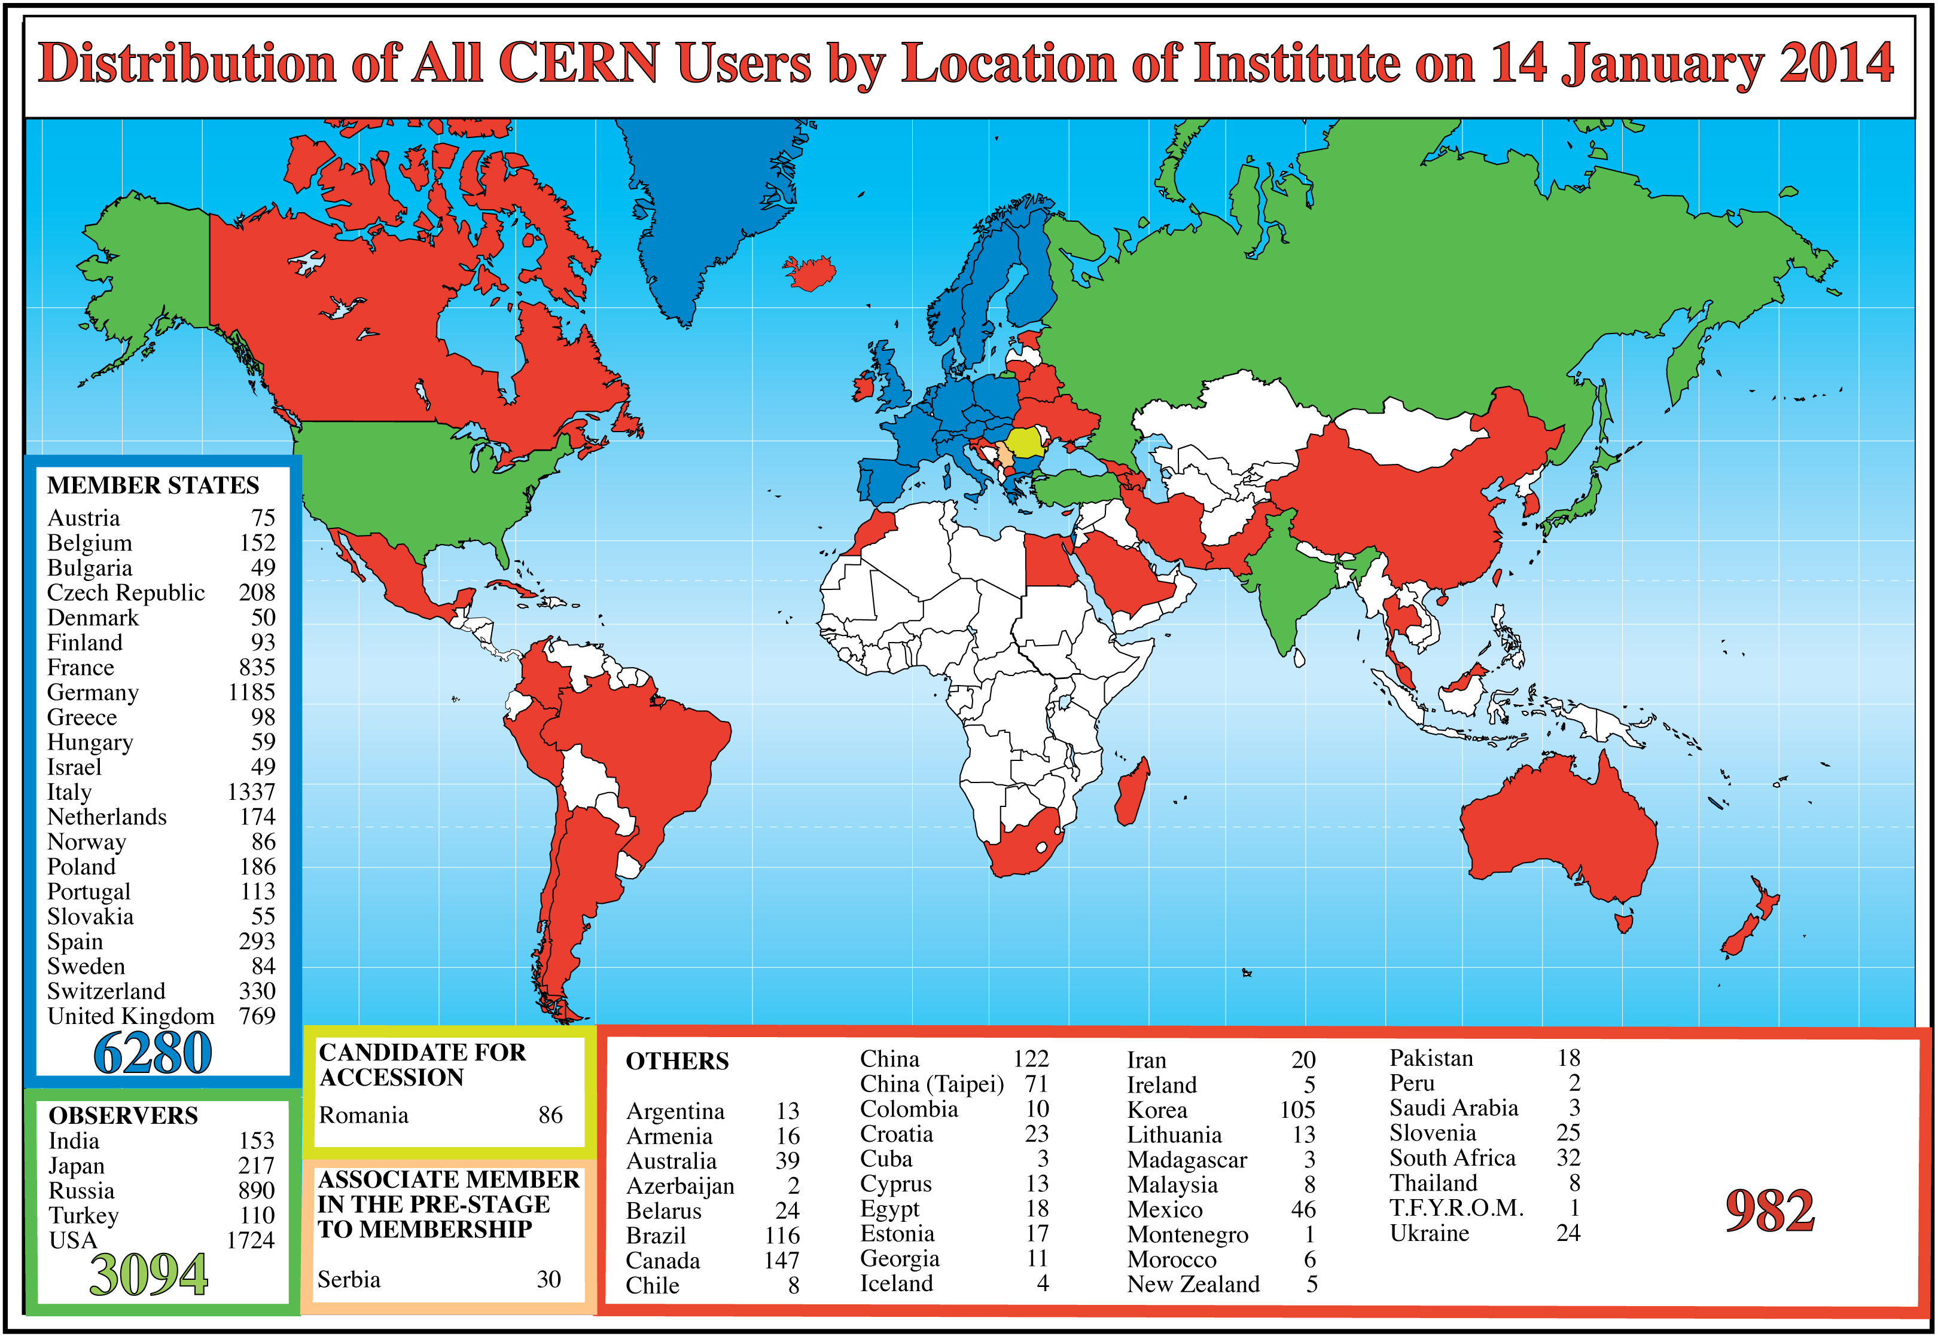
Science is ever more global
Science is getting more and more global
Notes:
4
4

Slide 5
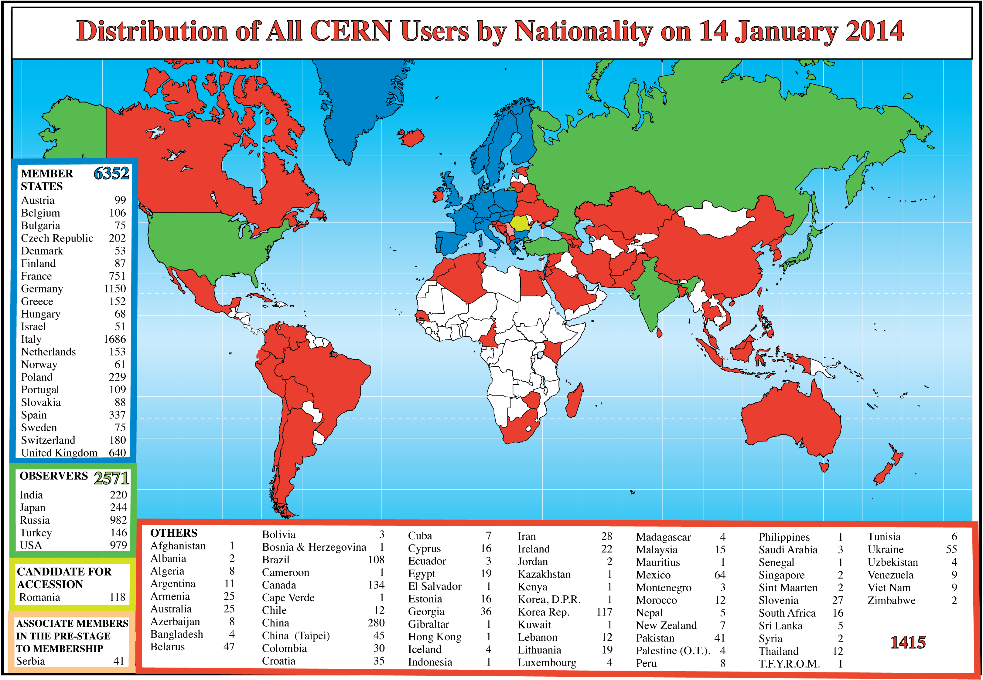
Science is ever more global
Science is getting more and more global
Notes:
5
5

Slide 6
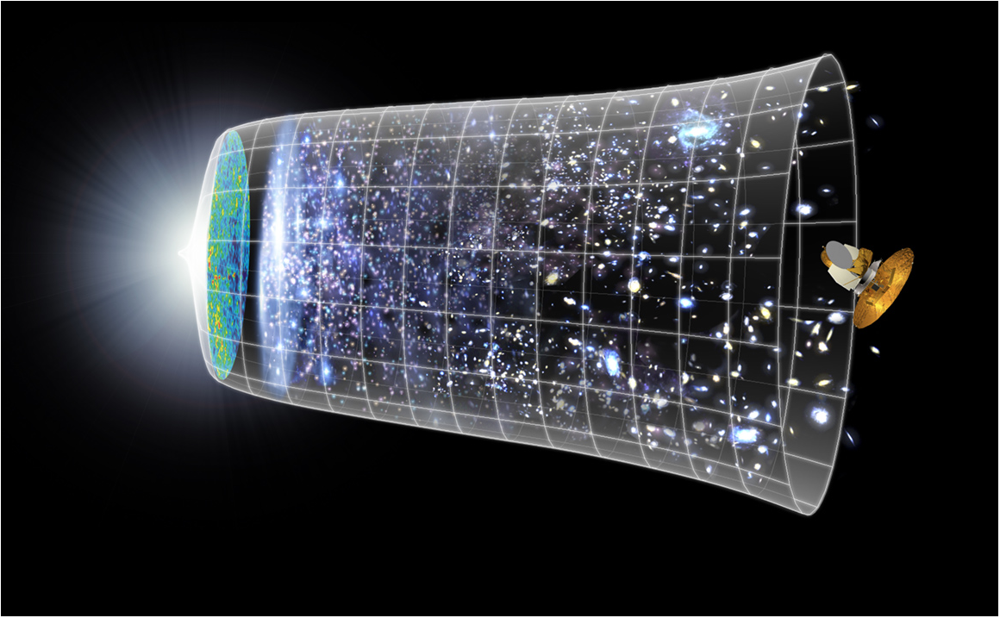
Our Scientific Challenge:
to understand the very first moments of our Universe after the Big Bang
Big Bang
WMAP
Only particle physics can
tell us what
happened here
13.7 Billion Years
Today
10²⁸ cm

Slide 7
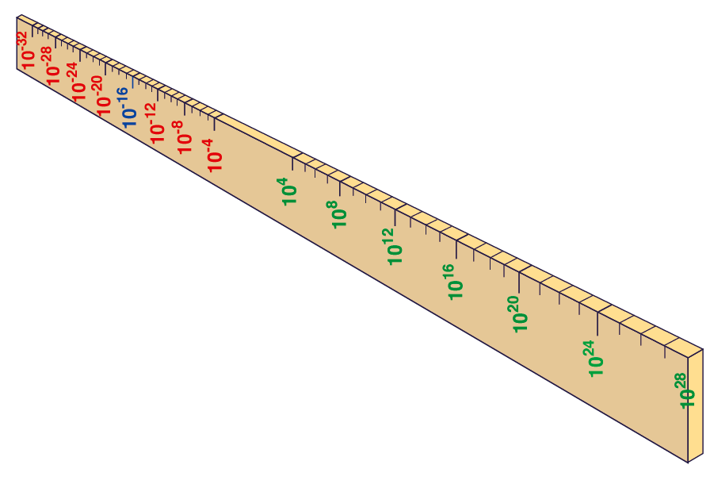
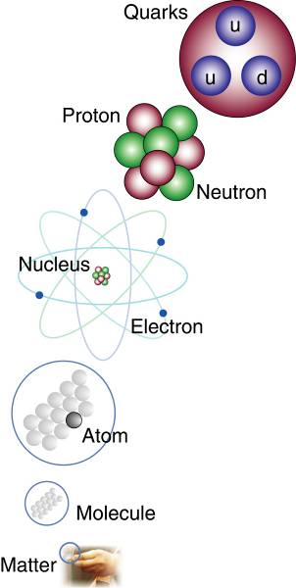
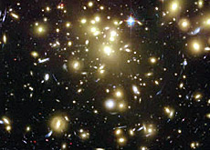
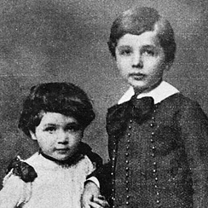


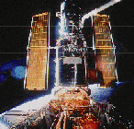
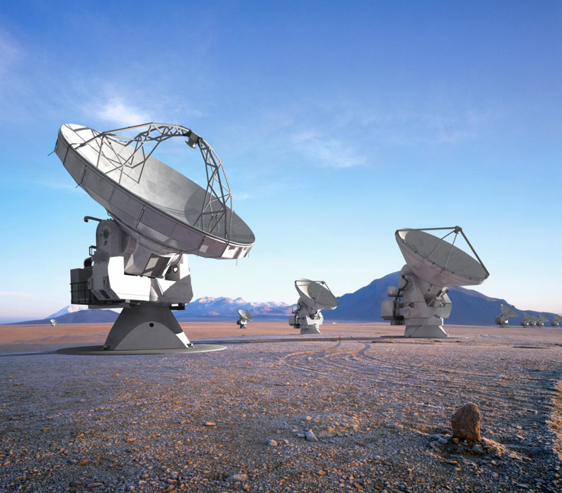
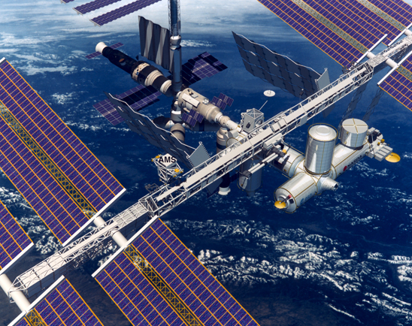
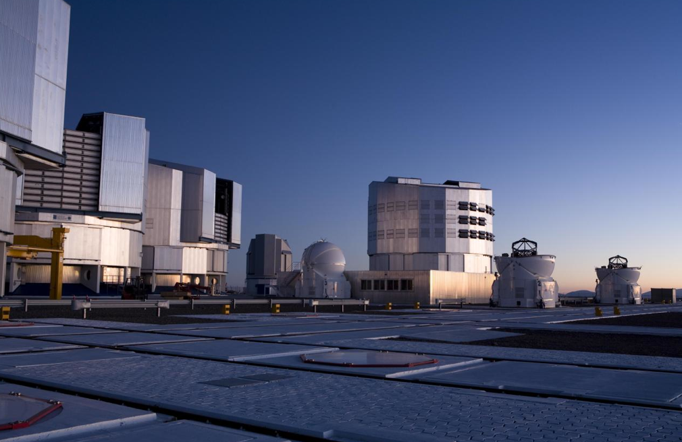
Big Bang
Proton
Atom
Radius of Earth
Earth to Sun
Radius of Galaxies
Universe
LHC
Super-Microscope
Hubble
ALMA
cm
Study physics laws of first moments after Big Bang
increasing Symbiosis between Particle Physics,
Astrophysics and Cosmology
AMS
VLT
Notes:
7
60 Grössenordnungen

Slide 8
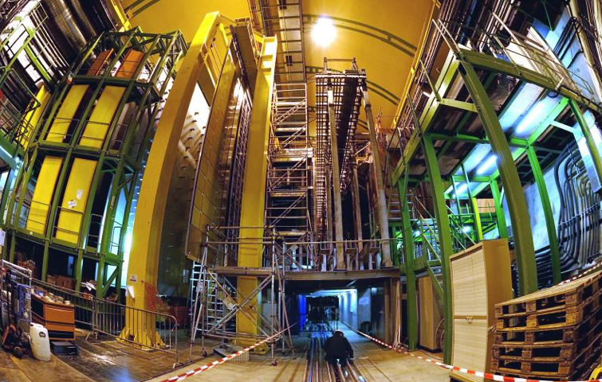


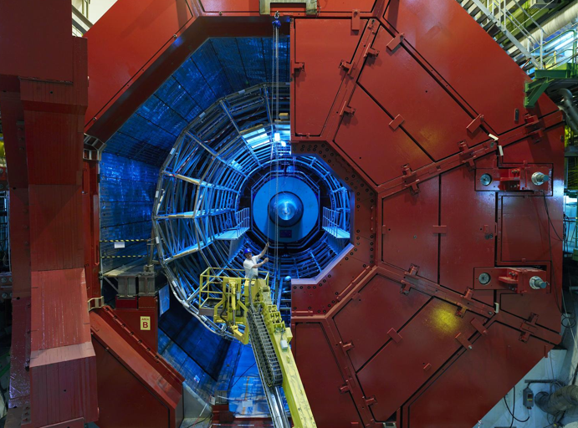

A New Era in Fundamental Science
LHCb
CMS
ATLAS
Since March 2010 exploration of a new energy frontier
in p-p and Pb-Pb collisions
ALICE
LHC ring:
27 km circumference
Notes:
8

Slide 9
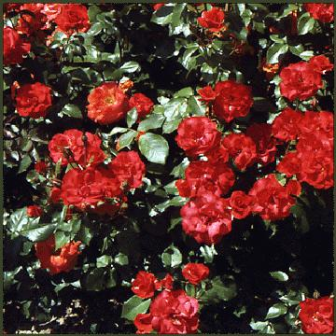
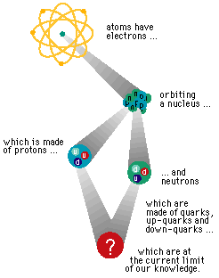
Inside Matter
All matter is made of
the same constituents
What are they?
What forces between them?

Slide 10
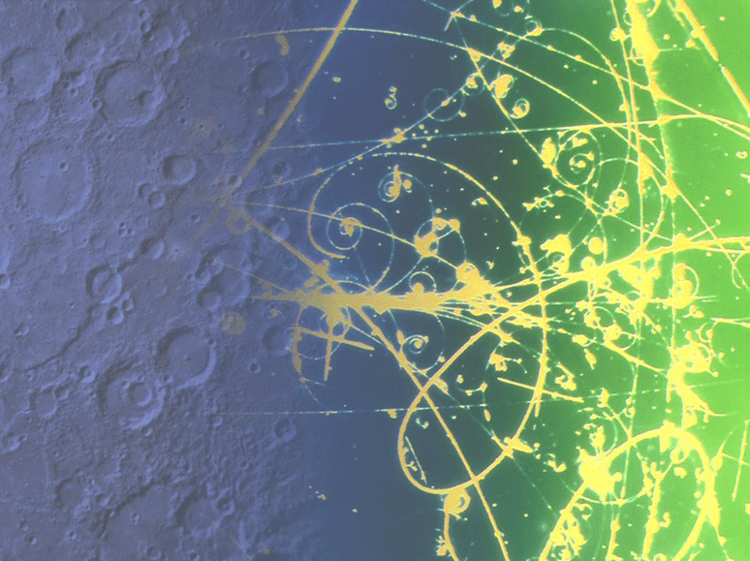
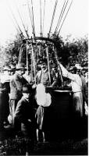
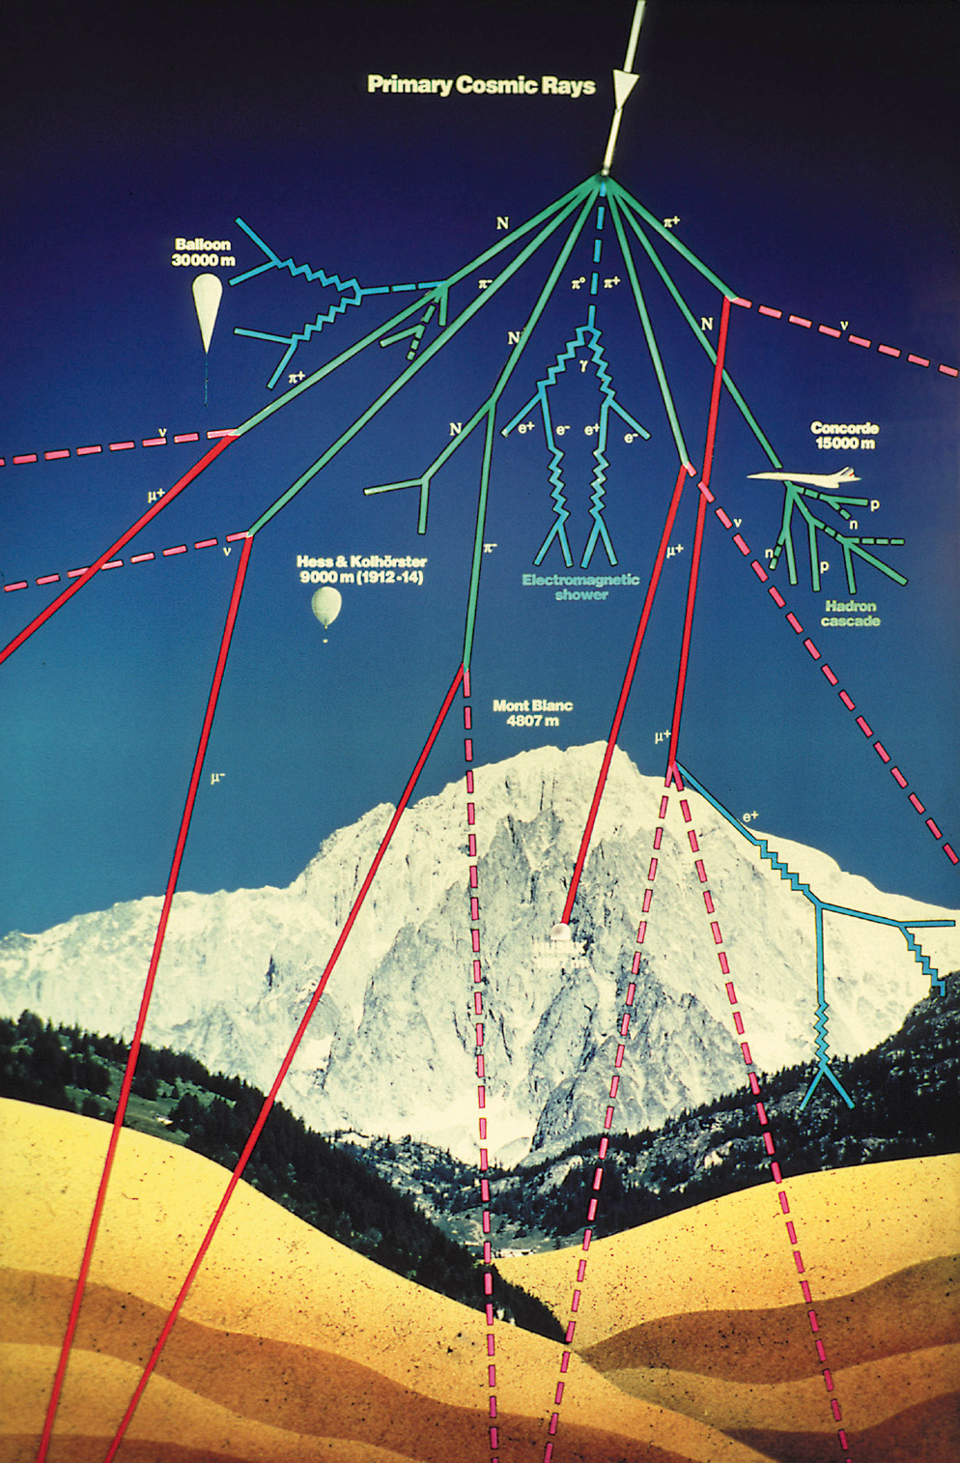
From Cosmic Rays to Accelerators
Discovered a century ago …
… cosmic
-
ray
showers were
found to
contain many
different types
of particles …
Accelerators study these particles in detail

Slide 11
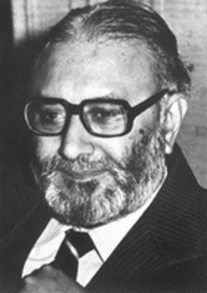
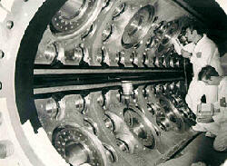
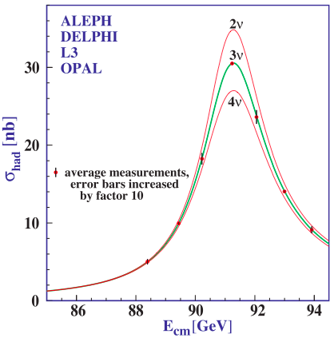
The Standard Model of Particle Physics
Proposed byAbdus Salam,
Glashow and Weinberg
Tested by experiments
at CERN
Perfect agreement between
theory and experiments
in all laboratories

Slide 12
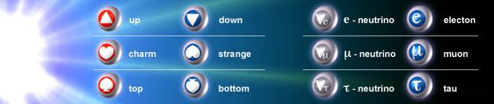
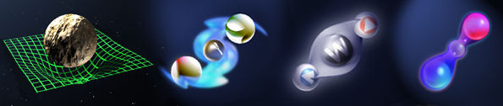
The ‘Standard Model’
= Cosmic DNA
The matter particles
Where does
mass
come from?
The fundamental interactions
Gravitation electromagnetism weak nuclear force strong nuclear force

Slide 13
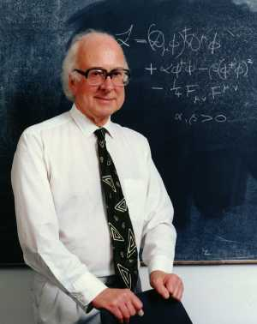

Why do Things Weigh?
Newton:
Weight proportional to Mass
Einstein:
Energy related to Mass
Neither explained origin of Mass
0
Where
do
the
masses
come from
?
Are masses due to Higgs boson?
(the physicists’ Holy Grail)

Slide 14

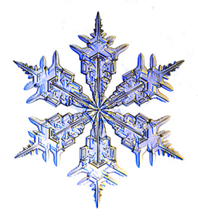


Think of a Snowfield
Skier moves fast:
Like particle without mass
e.g., photon = particle of light
Snowshoer sinks into snow,
moves slower:
Like particle with mass
e.g., electron
The LHC looks for
the snowflake:
The Higgs Boson
Hiker sinks deep,
moves very slowly:
Particle with large mass

Slide 15
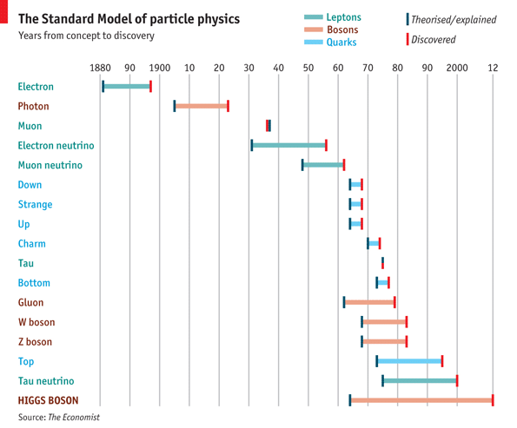
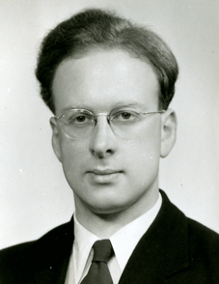
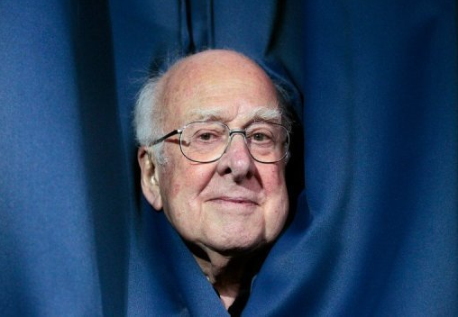
Introduction
Standard Model Particles:
Years from Proposal to Discovery
Notes:
All the particles of the standard model, from conception to discovery, with the higgs the last missing piece. History will remember the higgs discovery of this year as closing the chapter on an amazing century of unraveling the subatomic world and building the SM. End with “given the particle content of the SM and their quantum numbers…”
(Alternatively): The picture of fundamental physics at the start of the last century was a classical one in which all that was left was to measure to increasing precision, with a few anomalies here and there like blackbody radiation or the precession of mercury…

Slide 16
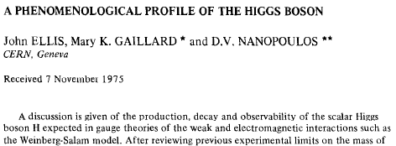
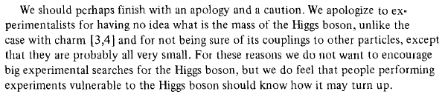
A Phenomenological Profile of the Higgs Boson
First attempt at systematic survey

Slide 17
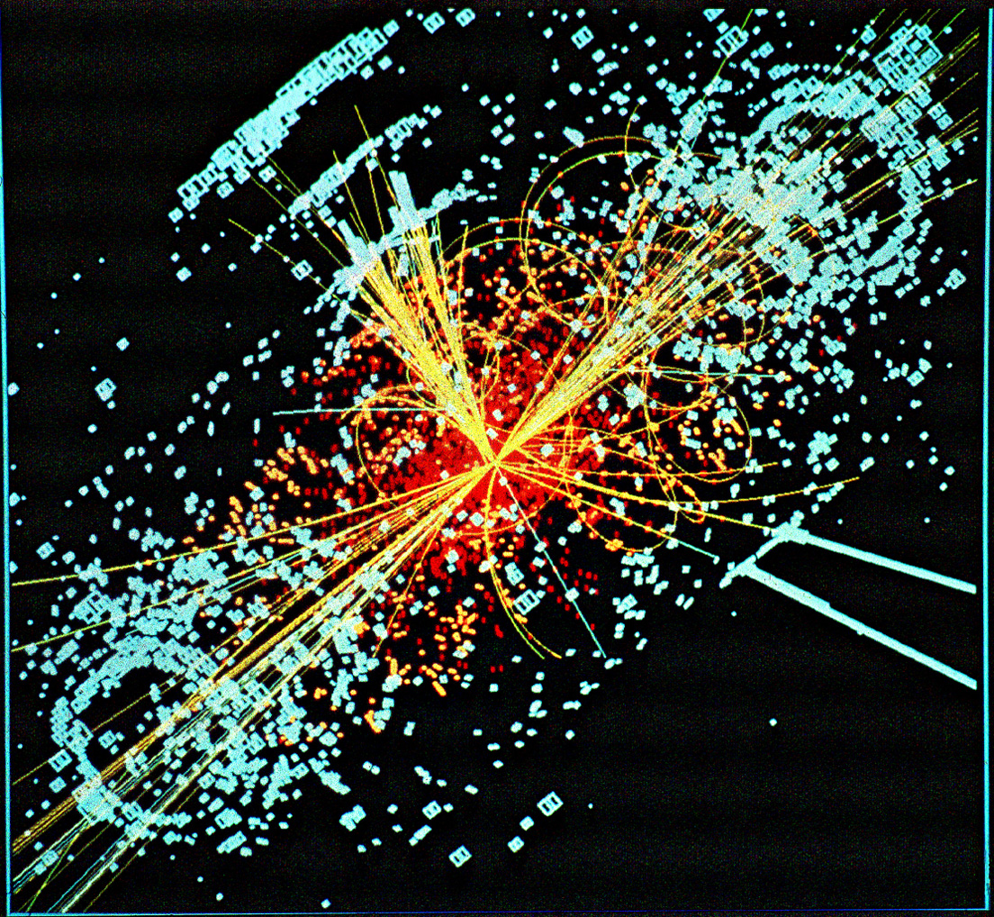
A Simulated Higgs Event @ LHC

Slide 18
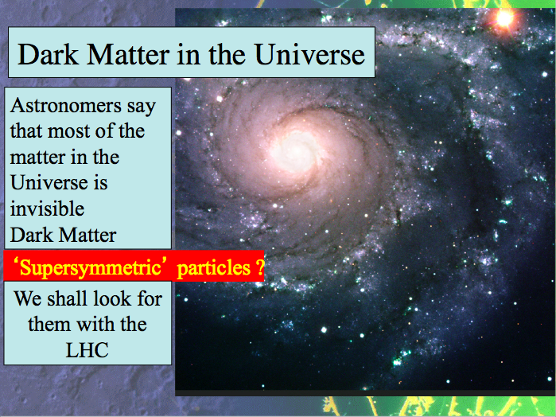

Slide 19
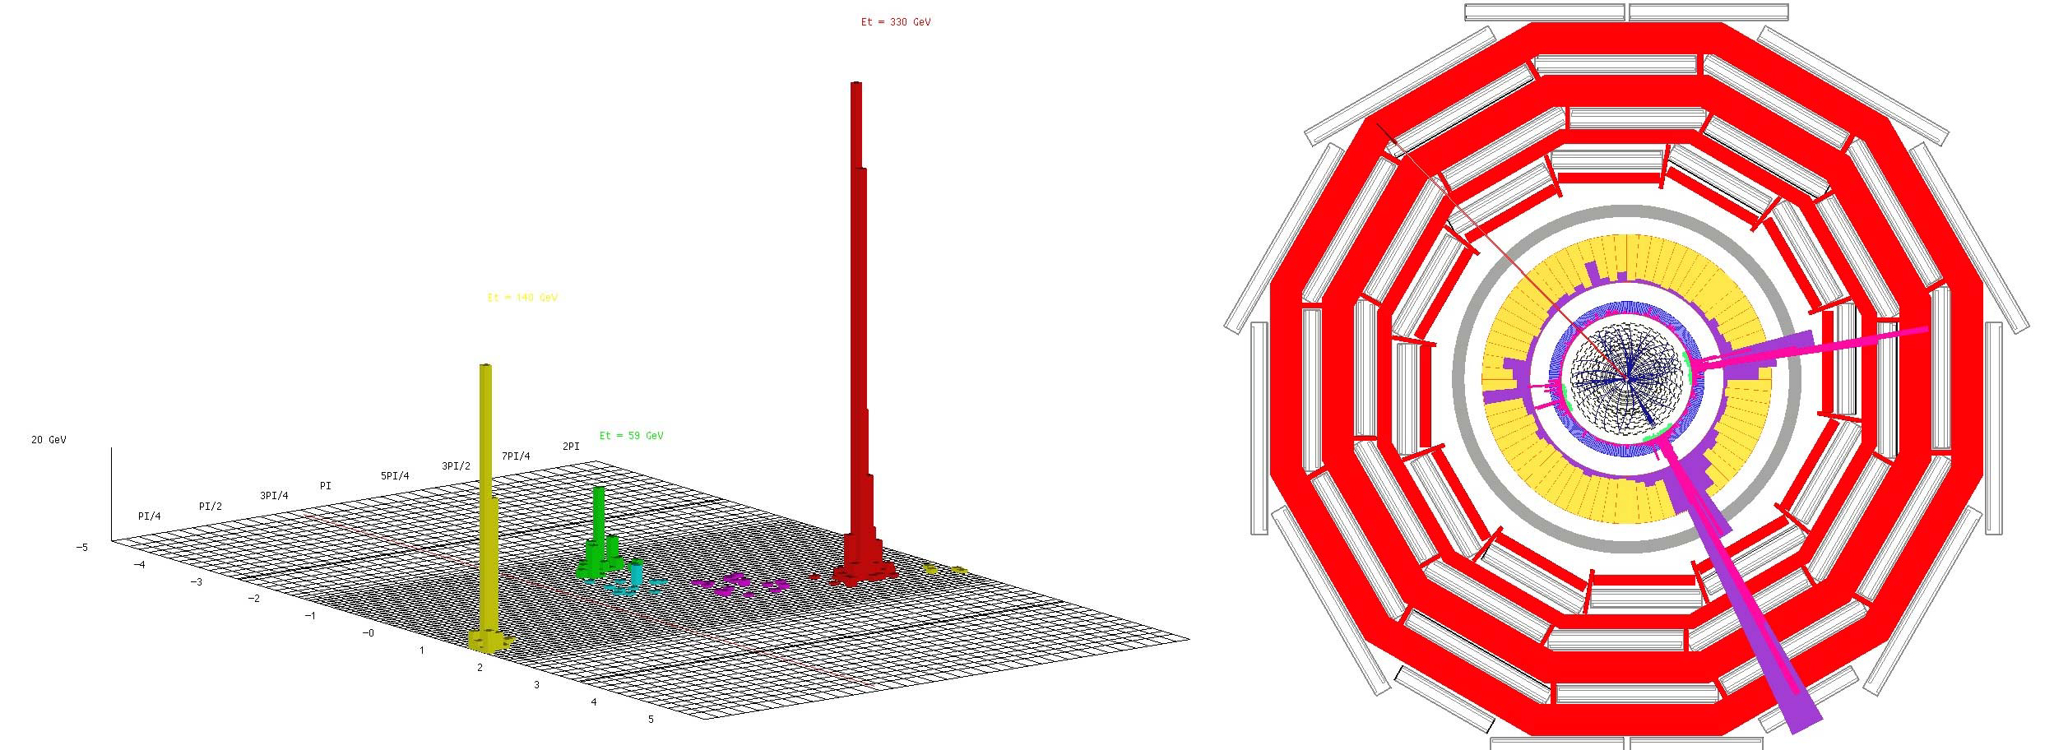
Classic Dark Matter Signature
Missing transverse energy
carried away by dark matter particles

Slide 20
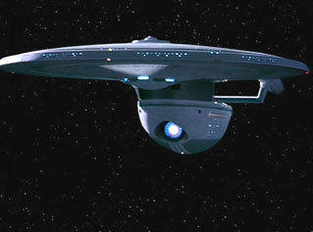

General Interest in Antimatter Physics
Physicists cannot make enough for
Star Trek or Dan Brown!

Slide 21
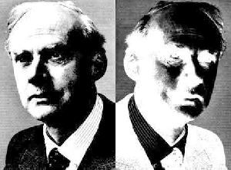
How do Matter & Antimatter Differ?
Dirac predicted the existence of antimatter:
same mass
opposite internal properties:
electric charge, …
Discovered in cosmic rays
Studied using accelerators
Used in PET scanners
Matter and antimatter not quite equal and opposite: WHY?
Why does the Universe mainly contain matter, not antimatter?
Experiments at LHC and elsewhere looking for answers

Slide 22
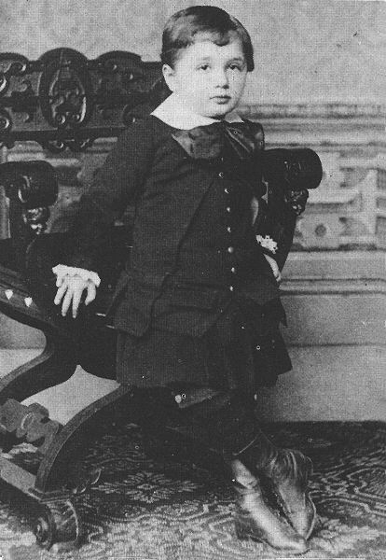
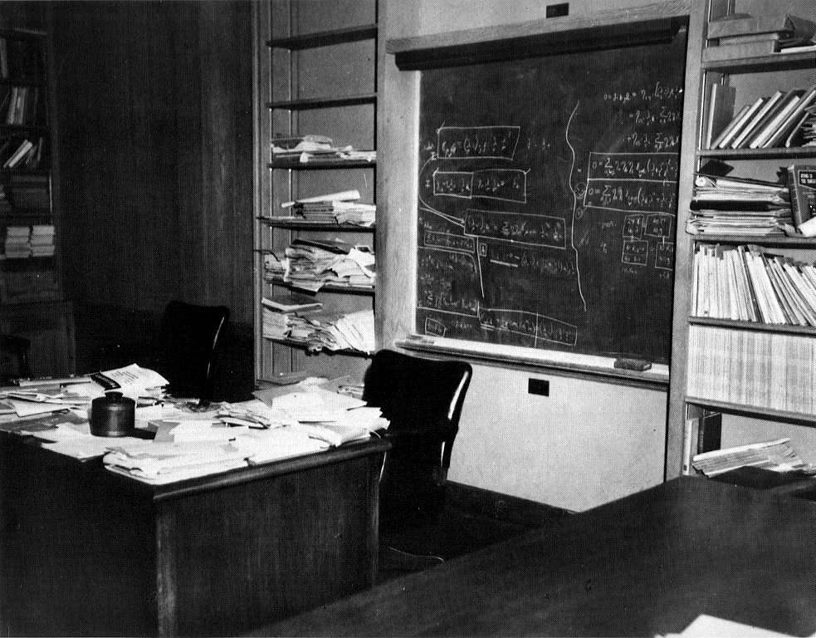
Unify the Fundamental Interactions:
Einstein’s Dream
← … but he never succeeded
Unification via extra dimensions of space?

Slide 23
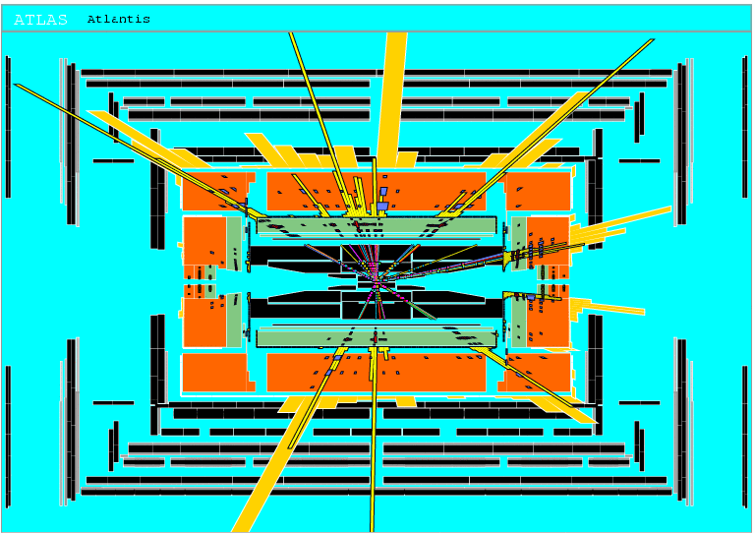
Will LHC experiments create black holes?
Eat up
the entire
Earth?
Would
vanish
instantly

Slide 24
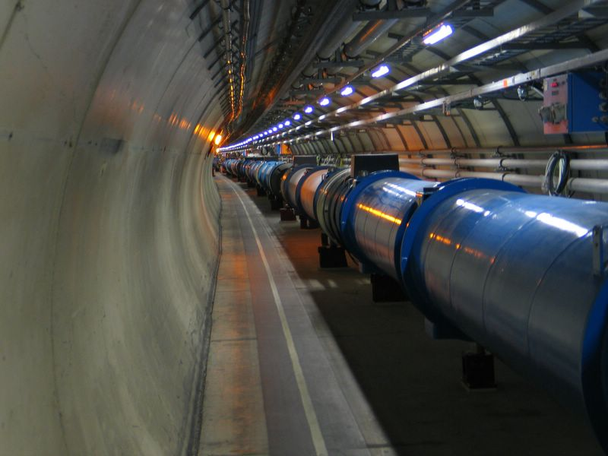
To answer these questions:
The Large Hadron Collider (LHC)
Several thousand billion protons
Each with the energy of a fly
99.9999991% of light speed
Orbit 27km ring 11 000 times/second
A billion collisions a second
Primary targets:
Origin of mass
Nature of Dark Matter
Primordial Plasma
Matter vs Antimatter

Slide 25
The Emptiest Space in the Solar System
Vacuum similar to interplanetary space:
the pressure in the beam-pipes will be ten times lower than on the Moon.

Slide 26
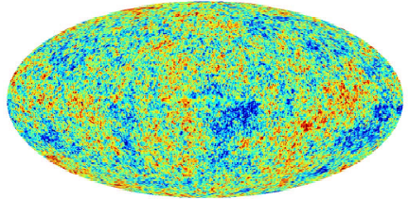
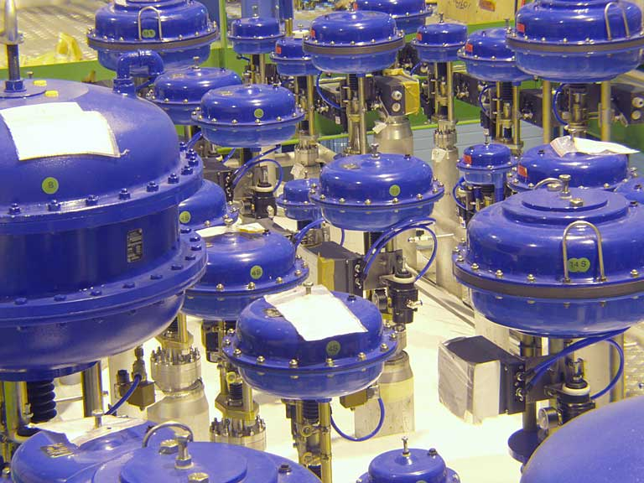
Cooler than Outer Space
LHC 1.9 degrees above absolute zero = - 271 C
Outer space 2.7 degrees above zero = - 270 C

Slide 27
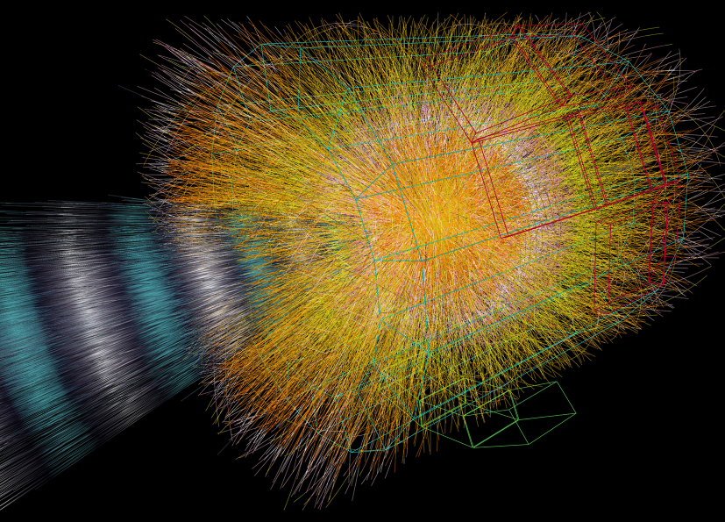
The Hottest Place in the Galaxy
Particle collisions create
(within a tiny volume)
temperatures a billion times higher than in the heart of the Sun

Slide 28
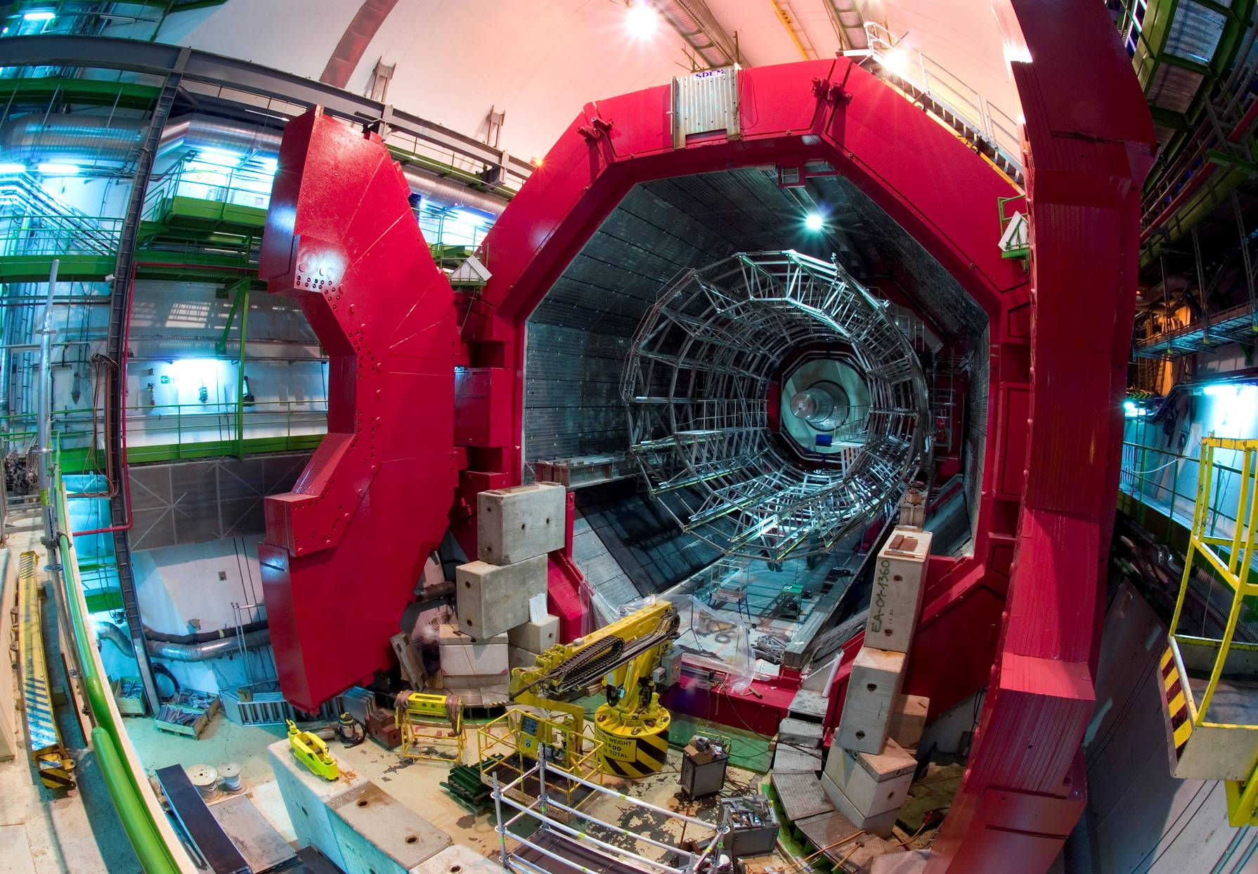





ALICE: Primordial cosmic plasma
ATLAS: Higgs and dark matter
CMS: Higgs and dark matter
LHCb: Matter-antimatter difference

Slide 29
Has the Higgs Boson Finally Been Revealed?
Mass Higgsteria

Slide 30


Interesting Events
Notes:
30

Slide 31

















July 4th 2012
The discovery of a new particle

Slide 32


Higgsdependence Day!

Slide 33


Unofficial Combination of LHC Data
Is this the
Higgs Boson?
No Higgs here!
No
Higgs
here!

Slide 34

Dixit Swedish Academy
Today we believe that “Beyond any reasonable doubt, it is a Higgs boson.” [1]
http://www.nobelprize.org/nobel_prizes/physics/laureates/2013/advanced-physicsprize2013.pdf
[1] = JE & Tevong You, arXiv:1303.3879

Slide 35

Science is ever more global
Notes:
35
35

Slide 36

Science is ever more global
Notes:
36
36

Slide 37

CERN: Where the
World-Wide Web was Invented
Tim Berners-Lee
Invented to enable physicists around the world to collaborate
The first on-line community

Slide 38



CERN: Particle Physics and Innovation
Interfacing between fundamental science and key technological developments
CERN Technologies and Innovation
Accelerating particle beams
Detecting particles
Large-scale computing (Grid)
Notes:
38

Slide 39





Medical Application as an Example of Particle Physics Spin-off
Combining Physics, ICT, Biology and Medicine to fight cancer
Hadron Therapy
Tumour Target
Leadership in Ion Beam Therapy now in Europe and Japan
Protons
light ions
Accelerating particle beams
~30’000 accelerators worldwide
~17’000 used for medicine
X-ray
protons
>70’000 patients treated worldwide (30 facilities)
>21’000 patients treated in Europe (9 facilities)
Imaging
PET Scanner
Clinical trial in Portugal for new breast imaging system (ClearPEM)
Detecting particles
Notes:
39

Slide 40





CERN Education Activities
Latin American School
Natal, Brazil, 2011
Scientists at CERN
Academic Training Programme
NEW:
Asia-Europe-Pacific School of High-Energy Physics
Fukuoka, Oct 2012
Young Researchers
CERN School of High Energy Physics
CERN School of Computing
CERN Accelerator School
CERN School of Physics
France, June 2012
Physics Students
Summer Students
Programme
High-School Teachers
International and National Programmes

Slide 41

CERN Teacher Programme

Slide 42
Summer Students Programme

Slide 43

Summer Students 2013
Notes:
43

Slide 44
Aitäh! Ačiū!
Accelerating Science and Innovation
Notes:
44

