Slide 1


Testable physics by design
CHEP 2015
13-17 April 2015, Okinawa, Japan
Maria Grazia Pia
INFN Genova, Italy
C. Choi, M. C. Han, S. Hauf, G. Hoff, C. H. Kim, H. S. Kim, S. H. Kim,
M. Kuster, P. Saracco, G. Weidenspointner
Hanyang University, Seoul, Korea
EU XFEL GmbH, Hamburg, Germany
CAPES, Brasilia, Brazil
MPE, Garching, Germany
Foreword
Due to limited time allocation, there is room to highlight concepts only
Details will be documented and discussed in a dedicated journal publication

Slide 2
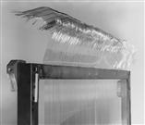

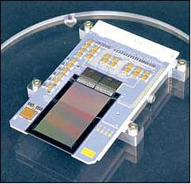
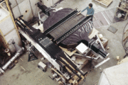
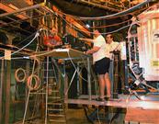
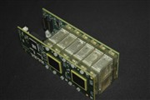

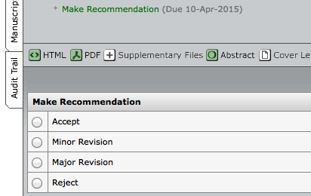
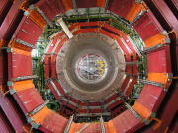
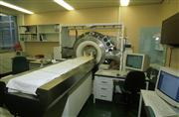
I have a dream…
Copyright CERN
eROSITA
Credit: MPI HLL
Copyright CERN
ClearPEM, CERN
Copyright CERN
Copyright CERN for CMS
Credit: CERN
✖
The simulation is not validated

Slide 3


In the literature…
Limited documentation of simulation validation
  Mostly in the form of specific use cases compared to measurements in the same experimental scenario
    Do they apply to similar/different use cases?
    How to extrapolate the results to different scenarios?
Hardly any validation of the basic physics models implemented in Monte Carlo codes
  Why?
Ongoing projects on uncertainty quantification
  See CHEP 2013, P. Saracco et al.
  Methods to predict the uncertainty of simulation observables based on knowledge of the uncertainties of simulation “ingredients”
(quantitative)
3

Slide 4
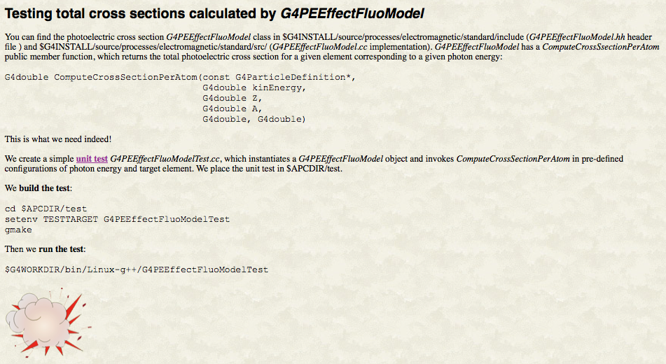
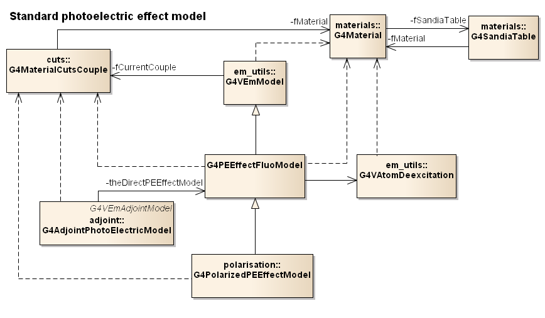
You need an experiment to test a cross section
Geant4 photoelectric cross section

Slide 5
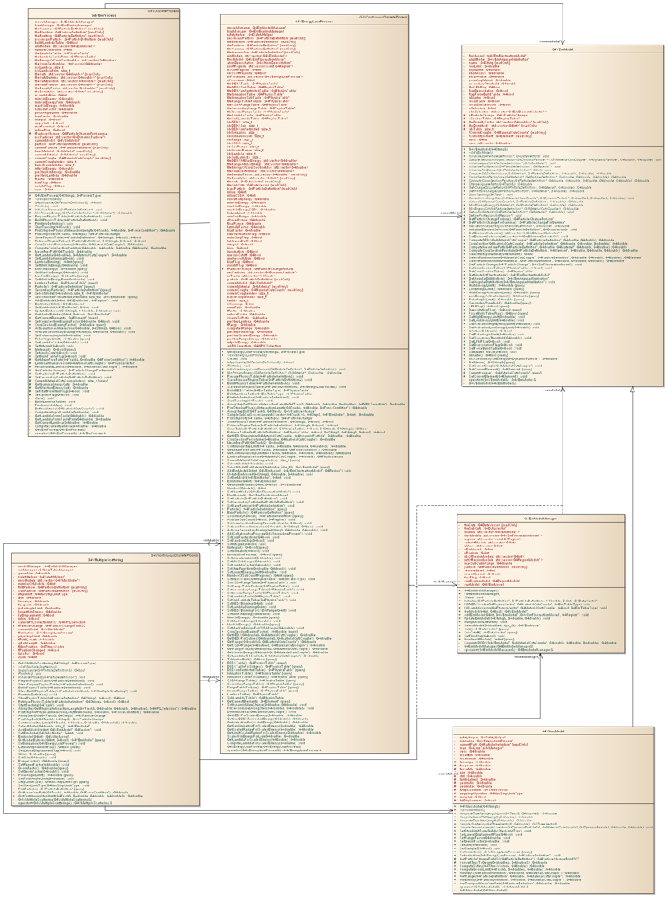

Post-RD44 electromagnetic software design
G4VEmProcess
G4VEnergyLossProcess
abstract class
G4VEmModel
Attributes
Hidden
dependencies
on other parts of the software
One needs a geometry
(and a full scale application)
to test any photon cross section
Operations
G4VMultipleScattering
Difficult to test ➔ no testing
often
Reverse engineered
Do UML diagrams exist? Are they maintained?
Peer reviews?

Slide 6
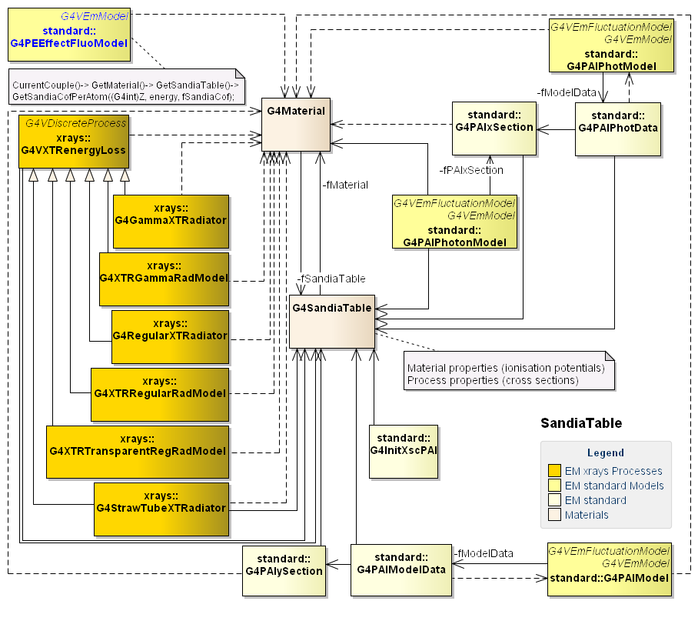
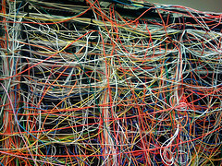

Slide 7
Photoionisation cross section
Cross sections in Geant4 “standard” photoelectric model are based on “improved”
Biggs-Lighthill parameterisation
F. Biggs and R. Lighthill, Analytical Approximation for X-ray Cross Sections III,
Sandia Lab. Report SAND-0070, 1988
“improved”
“improved”

Slide 8
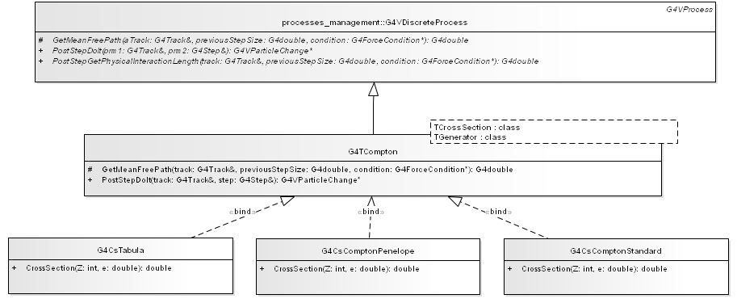
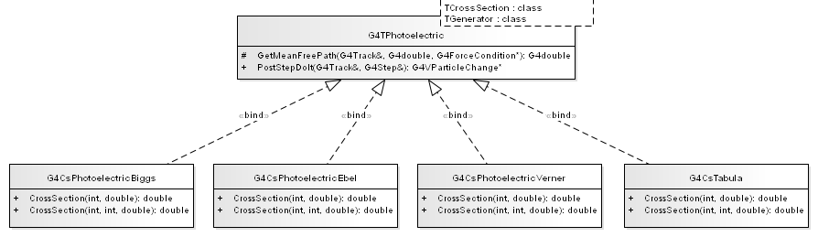
Detangling
Photoionisation
Testable
Open - closed
Cross section models can be compared with statistical categorical tests
Can be validated in a unit test
Handles any tabulated cross section
New models

Slide 9
Lehman laws
M. M. Lehman,
Programs, Life Cycles, and Laws of Software Evolution,
Proc. IEEE, vol. 68, no. 9, Sep. 1980
Continuing Change
  A program that is used and that as an implementation of its specification reflects some other reality, undergoes continual change or becomes progressively less useful. The change or decay process continues until it is judged more cost effective to replace the system with a recreated version.
Increasing Complexity
  As an evolving program is continually changed, its complexity, reflecting deteriorating structure, increases unless work is done to maintain or reduce it.
9

Slide 10
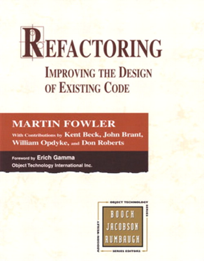
Refactoring
is a disciplined technique for improving the design of an existing code
“Refactoring is the process of changing a software system in such a way that it does not alter the external behavior of the code yet improves its internal structure.”
Refactoring begins by designing a solid set of tests for the portion of code under analysis
Is this all what we need?

Slide 11


Sweeping under the carpet?
Refactoring aims to preserve correctness
Was the original code verified?
Was the original code validated?
IEEE Standard 1012
Software Verification & Validation
ISO 12207
What was the test coverage?
Were the test process and the test results documented?
By improving the design, refactoring can make software testable

Slide 12

Testing à la Feather
Legacy code often lacks tests
Techniques to make existing code testable
Identify change points
Find an inflection point
Cover the inflection point
  Break external dependencies
  Break internal dependencies
  Write tests
Make changes
Refactor the covered code
can’t get this class in a test harness
A narrow interface to a set of classes
If anyone changes any of the classes behind an inflection point, the change is either detectable at the inflection point,
or inconsequential in the application
If the class we want to cover creates its own objects internally
Techniques to deal with irritating parameters, hidden dependencies etc.
Feasible, but painful…

Slide 13
Discipline of software engineering
Most of these problems can be easily solved
if we simply write tests as we develop our code
  …and we maintain the tests
  …and we regularly execute them
  …and we investigate the reasons for failure
If a test is hard to write, that means that we have to find a different design which is testable
It is always possible
Software design reviews: care about testability
13

Slide 14
42
Answer to the Ultimate Question of Life, the Universe, and Everything
Douglas Adams, The Hitchhiker's Guide to the Galaxy
// G4HadronElastic
// 29 June 2009 (redesign old elastic model)
Testable?
Calibrated?
Epistemic uncertainties?
G4double dd = 10.;
G4Pow* g4pow = G4Pow::GetInstance();
if (A <= 62) {
bb = 14.5*g4pow->Z23(A);
aa = g4pow->powZ(A, 1.63)/bb;
cc = 1.4*g4pow->Z13(A)/dd;
} else {
bb = 60.*g4pow->Z13(A);
aa = g4pow->powZ(A, 1.33)/bb;
cc = 0.4*g4pow->powZ(A, 0.4)/dd;
}
G4ChipsAntiBaryonElasticXS
lastPAR[43]=920.+03*a8*a3; lastPAR[44]=93.+.0023*a12;
G4GoudsmitSaundersonMscModel
if(i>=19)ws=cos(sqrtA);
G4EmCorrections
if(15 >= iz) {
if(3 > j) { tet = 0.25*Z2*(1.0 + 5*Z2*alpha2/16.); }
else { tet = 0.25*Z2*(1.0 + Z2*alpha2/16.); }
}
Epistemology!
G4UrbanMscModel
coeffc1 = 2.3785 - Z13*(4.1981e-1 - Z13*6.3100e-2);

Slide 15
Conclusion
“Our lives begin to end the day we become silent about things that matter.”
Martin Luther King, Jr. .
Detector design, experimental strategies, physics results depend critically on software
…which is often untested (partially tested) because it is untestable
  Or became untestable in the course of its evolution
Making software testable
  Improving software design (refactoring)
  Breaking dependencies (techniques à la Feathers)
  Embedding testability in the software design
Testability must be maintained
Epistemological issues: domain knowledge and implementation details
Ongoing effort to make Geant4 physics testable
http://www.ge.infn.it/geant4/papers
and to test it

Slide 16

