Slide 1
Analysis of CERN Computing Infrastructure and Monitoring Data
Christian Nieke, CERN IT / Technische Universität Braunschweig
On behalf of the CERN IT Analytics Working Group

Slide 2
IT Analytics Working Group
Goals:
  Coordinate analysis and trending of application/service usage data
    E.g. batch computing, data storage, network…
  At different stages of maturity
    Getting a quantitative understanding of a service (exploratory)
    Informing strategy or planning decisions (hypothesis check)
    Developing & validating predictive models
Notes:
- Beyond “current” monitoring, typically based on days or months of collected data
-

Slide 3
Data Sources - Before
Experiment Dashboards:
Job Monitoring
Experiment Dashboards:
Data Transfers
No common analysis goal
No common schema
No common format
No common repository
No shared documentation
No easy way of joining
???
Batch Jobs
Experiments:
File Popularity
Batch Nodes
(Hardware and Configuration)
Data Storage Operations
Network
Notes:
Heterogeneous Sources
No uniform schema

Slide 4
Getting the Big Picture
Combined Activity
  Enable integrated studies crossing single data source / service boundaries
  Using a common base repository of prepared input data
  Provide an exchange forum for discussion on analysis methods, tools and result validation

Slide 5

Common Repository
Data Warehouse
  Write once, read many
Hadoop cluster
  Raw files in any format
  Using Hadoop jobs for cleaning and pre-processing
  Export in CSV, Avro, Parquet, … for Analysis
Notes:
Raw files in any format = easy to integrate new data sources
Use Hadoop processing power to convert data
Output / Storage format still under investigation

Slide 6
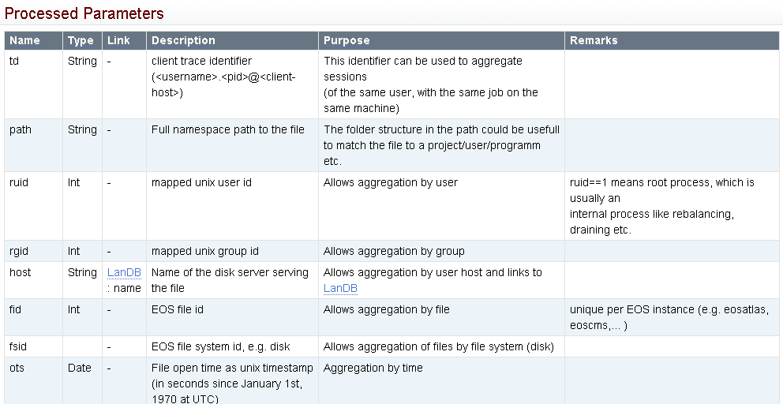
Data Source Documentation
Example: EOS file system operations

Slide 7
Data Sources - Federation
Hadoop
Experiment Dashboards:
Job Monitoring
Scheduler-Id
Experiment Dashboards:
Data Transfers
Scheduler-Id
Batch Jobs
Job-Id
Experiments:
File Popularity
Host name
Batch Nodes
(Hardware and Configuration)
Network
Data Storage Operations
Host
name
Host name
Notes:
Not quite that easy, sometimes timestamps etc. are needed (e.g. hardware for virtual machines)
Message: It is not perfect, but getting better

Slide 8

Example Analysis Workflow
Job Performance: Geneva vs. Budapest
  Different computing centers
  Different hardware
    CPU, Memory, Network, ….
  Do we get the same performance?
    Compare CPU time used per job
Notes:
AMD vs Intel

Slide 9
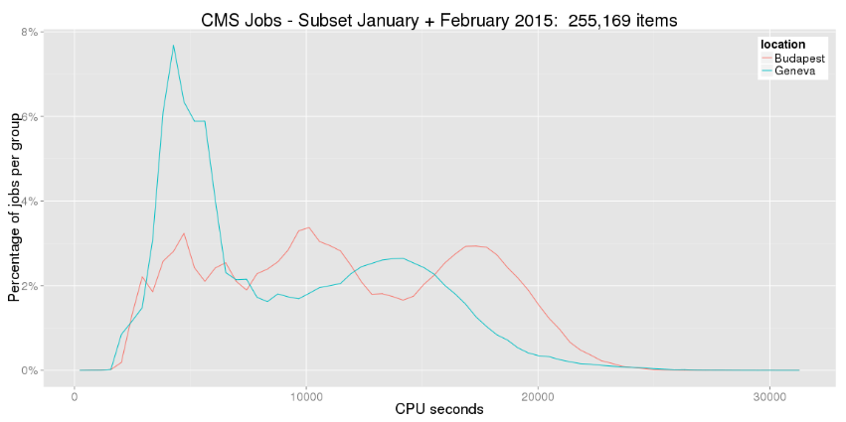
CPU Time and Location
  Based on batch computing logs and network configuration
    We need more information to understand this distribution

Slide 10
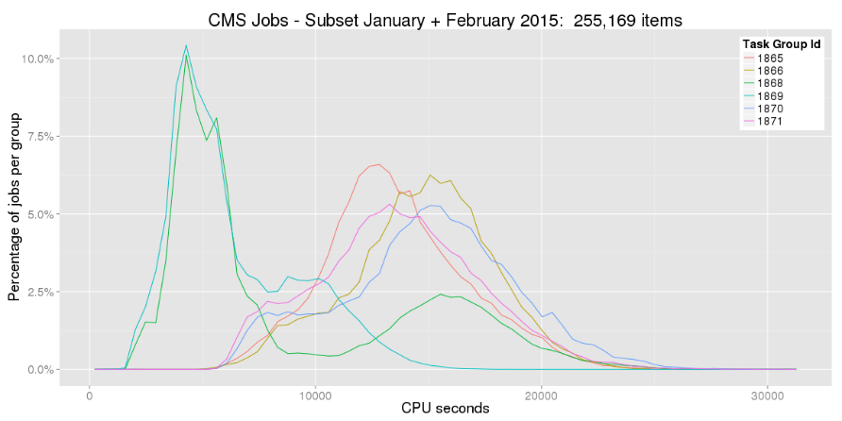
Tasks
  Based on experiment job dashboard
    Different distributions for different tasks
Notes:
Only tasks with good statistics, i.e. > 5000 entries

Slide 11
Tasks
  Selecting a single task
    Let’s randomly select
    this one
Notes:
Only tasks with good statistics, i.e. > 5000 entries

Slide 12
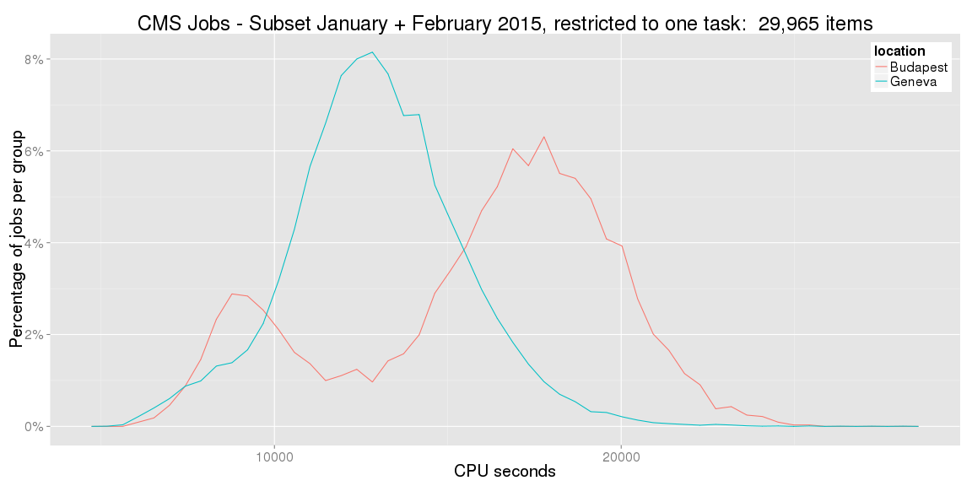
Tasks
  It seems like there are still more underlying effects
    This is not just
    a simple shift
Notes:
Hard to say if better or worse
e.g. ANOVA not possible, since distribution is not normal

Slide 13
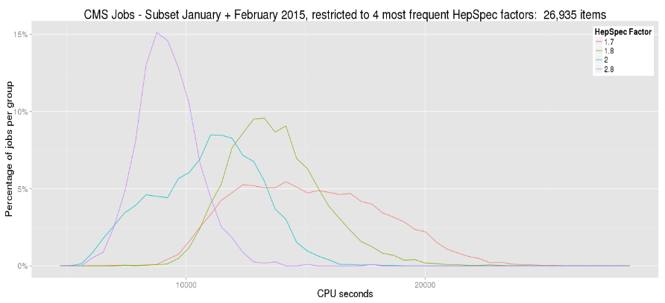
HepSpec Benchmark
  HepSpec Factor based on batch benchmarks
    High benchmark result
    is correlated with low CPU time
Notes:
The result is actually per configuration, not per CPU

Slide 14
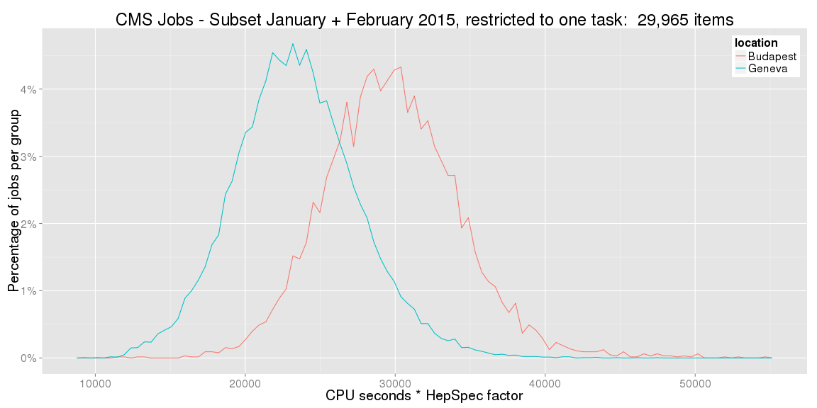
Scaling by CPU Factor
  Removes “expected” deviation
    Now this looks like an answer.
    But what do we actually see?
    Job specific?
    AMD vs. Intel?
    Network delay?
    Data placement?
Notes:
This is still no definite answer, but now we can start making sense of it

Slide 15

Conclusion
Combined Effort
  CERN IT and Experiments
  Federated data repository for uniform access
  Understanding the system as a whole
Examples for Actions Taken
  Rebalancing batch slots per machine to avoid swapping
  User notification in case of inefficient jobs
  Activated TTreeCache for ROOT in ATLAS

Slide 16
Resources
Twiki
  https://twiki.cern.ch/twiki/bin/view/ITAnalyticsWorkingGroup/WebHome
Contact:
  Dirk Duellmann, CERN IT (Working Group Chair)
  or myself

