Slide 2
Experience in running relational databases on clustered storage
Ruben.Gaspar.Aparicio_@_cern.ch
CERN, IT Department
CHEP 2015, Okinawa, Japan
13/04/2015

Slide 3
Agenda
Brief introduction
Our setup
Caching technologies
Snapshots
Data motion, compression & dedup
Conclusions

Slide 4
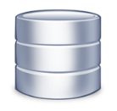



CERN’s Databases
~100 Oracle databases, most of them RAC
  Mostly NAS storage plus some SAN with ASM
  ~600 TB of data files for production DBs in total
  Using a variety of Oracle technologies: Active Data Guard, Golden Gate, Clusterware, etc.
Examples of critical production DBs:
  LHC logging database ~250 TB, expected growth up to ~90 TB / year
  13 production experiments’ databases ~15-25 TB in each
  Read-only copies (Active Data Guard)
Database on Demand (DBoD) single instances
  172 MySQL Open community databases (5.6.17)
  19 PostgreSQL databases (9.2.9)
  9 Oracle11g databases (11.2.0.4)

Slide 5




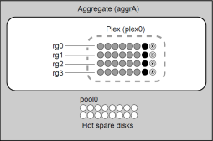



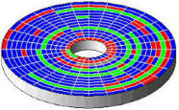

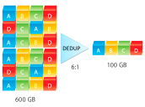

A few 7-mode concepts
autosupport
client access
Thin provisioning
Private network
File access | Block access
NFS, CIFS | FC,FCoE, iSCSI
Independent HA pairs
raid.scrub.schedule
raid_dp or raid4
Remote Lan Manager
once weekly
Service Processor
raid.media_scrub.rate
constantly
FlexVolume
Rapid RAID Recovery
reallocate
Maintenance center (at least 2 spares)
Notes:
If needed, you can further decrease the CPU resources consumed by a continuous media scrub under
a heavy client workload by increasing the maximum time allowed for a media scrub cycle to
complete. You can do this by using the raid.media_scrub.rate option.

Slide 6
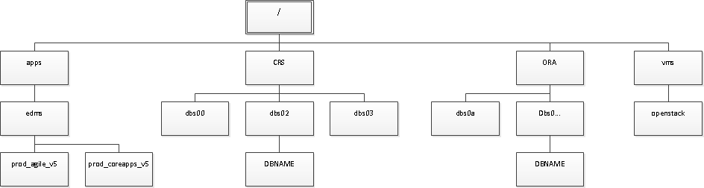
A few C-mode concepts
client access
Private network
cluster
Cluster interconnect
node shell
Cluster mgmt network
Logical Interface (lif)
systemshell
C-mode
cluster ring show
RDB: vifmgr + bcomd + vldb + mgmt
C-mode
Vserver (protected via Snapmirror)
Global namespace
Logging files from the controller no longer accessible by simple NFS export
Cluster should never stop serving data
Notes:
admin Most commands and parameters are available at this level. They are used for common
or routine tasks.
advanced Commands and parameters at this level are used infrequently, require advanced
knowledge, and can cause problems if used inappropriately.
You use advanced commands or parameters only with the advice of support personnel.
22 | System Administration Guide for Cluster Administrators
diagnostic Diagnostic commands and parameters are potentially disruptive. They are used only by
support personnel to diagnose and fix problems.

Slide 7
Agenda
Brief introduction
Our setup
Caching technologies
Snapshots
Data motion, compression & dedup
Conclusions

Slide 8




NAS evolution at CERN (last 8 years)
FAS6200
& FAS8000
FAS3000
scaling up
100% FC disks
Flash pool/cache = 100% SATA disk + SSD
2gbps
6gbps
DS14 mk4 FC
DS4246
scaling out
Data ONTAP®
7-mode
Data ONTAP®
Clustered-Mode

Slide 9


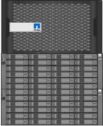



Network architecture
Storage network
Public Network
10GbE
Cluster mgmt network
10GbE
mtu 1500
1GbE
mtu 9000
2x10GbE
10 GbE
10GbE
trunking
Cluster interconnect
10GbE
2x10GbE
Bare metal server
Private Network
Just cabling of first element of each type is shown cabled
Each switch is in fact a set of switches (4 in our latest setup) managed as one by HP Intelligent Resilient Framework (IRF)
ALL our databases run with same network architecture
NFSv3 is used for data access

Slide 10
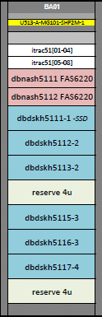
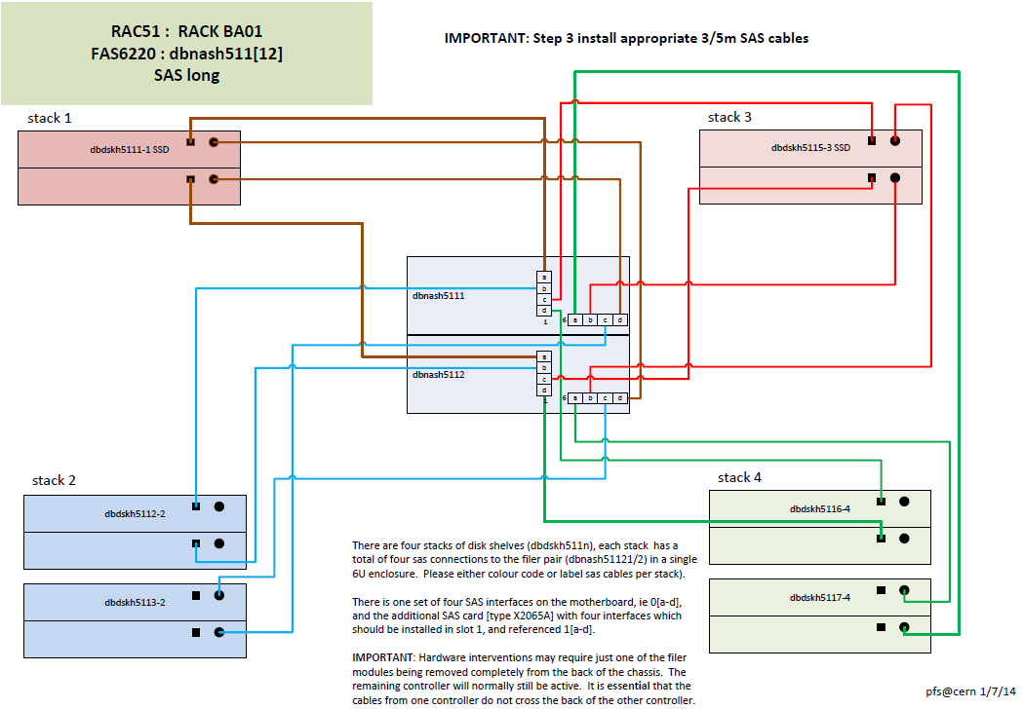
Disk shelf cabling: SAS
Owned by
1st Controller
Owned by 2nd Controller
SSD
SAS loop at 6gpbs 12gbps per stack due to multi-pathing
~3GB/s per controller

Slide 11
Mount options
Oracle and MySQL are well documented
  Mount Options for Oracle files when used with NFS on NAS devices (Doc ID 359515.1)
  Best Practices for Oracle Databases on NetApp Storage, TR-3633
  What are the mount options for databases on NetApp NFS? KB ID: 3010189
PostgreSQL not popular with NFS, though it works well if properly configured
  MTU 9000, reliable NFS stack e.g. NetApp NFS server implementation
Do not underestimate impact

Slide 12
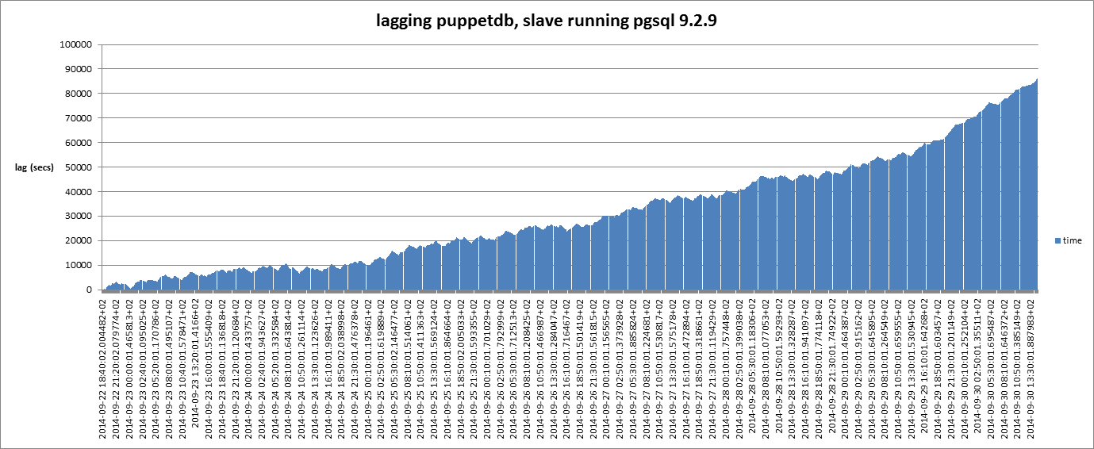
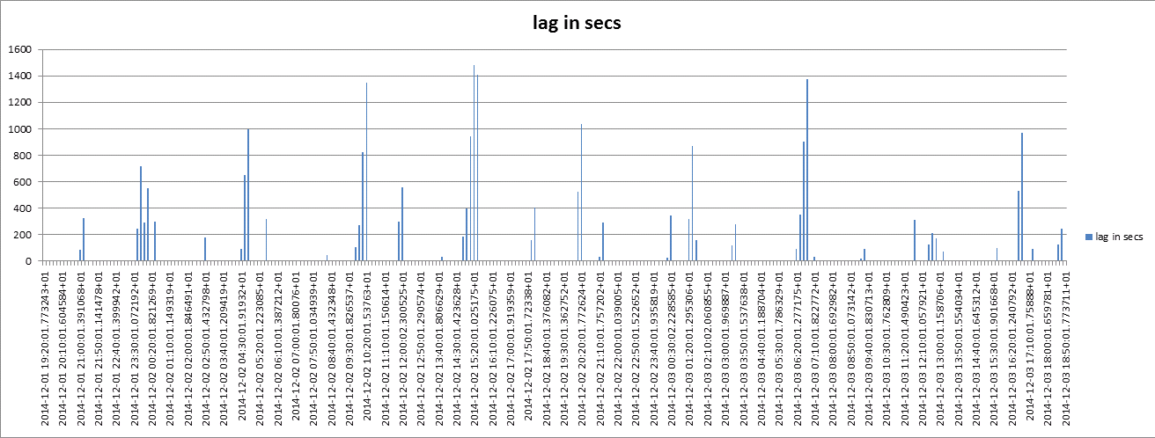
After setting new mount points options (peaks due to autovacuum):

Slide 13
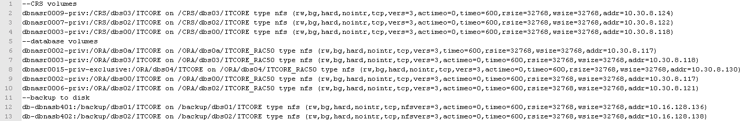
Mount options: database layout
Oracle RAC, cluster database:
global namespace
MySQL and PostgreSQL single instance

Slide 14
Agenda
Brief introduction
Our setup
Caching technologies
Snapshots
Data motion, compression & dedup
Conclusions

Slide 15

Flash Technologies
Flash Cache
Flash Pool
Depending where SSD are located.
  Controllers → Flash Cache
  Disk shelf → Flash Pool
Flash pool (hybrid aggregates) based on a Heat Map in order to decide which block stays and for how long
  Sequential data is not cached ( > 16KB). Data can not be pinned
  Works on random reads and writes workloads
    Writes (μs) warm up cache much faster (ms)
  Data is not sensible to cluster takeover/givebacks → it reduces warm-up period

Slide 16
Agenda
Brief introduction
Our setup
Caching technologies
Snapshots
Data motion, compression & dedup
Conclusions

Slide 17
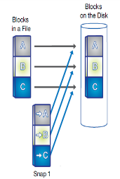
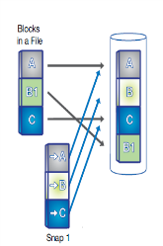
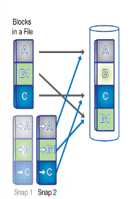
Backup management using snapshots
Backup workflow:
… some time later
new snapshot
snapshot
resume
mysql> FLUSH TABLES
WITH READ LOCK;
mysql> FLUSH LOGS;
or
Oracle>alter database begin backup;
Or
Postgresql> SELECT pg_start_backup('$SNAP');
mysql> UNLOCK TABLES;
Or
Oracle>alter database end backup;
or
Postgresql> SELECT pg_stop_backup(), pg_create_restore_point('$SNAP');

Slide 18
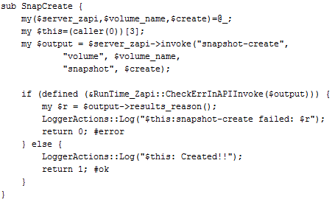
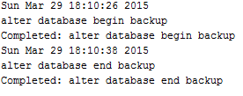
Snapshots for Backup and Recovery
Storage-based technology
  Strategy independent of the RDBMS technology in use
Speed-up of backups/restores: from hours/days to seconds
SnapRestore requires a separate license
API can be used by any application, not just RDBMS
  Consistency should be managed by the application
Backup & Recovery API
Oracle ADCR: 29TB size, ~ 10 TB archivelogs/day
Alert log:
8 secs

Slide 19

Cloning of RDBMS
Based on snapshot technology (FlexClone) on the storage. Requires license.
  FlexClone is a snapshot with a RW layer on top
  Space efficient: at first blocks are shared with parent file system
  We have developed our own API, RDBMS independent
Archive logs are required to make the database consistent
Solution being developed initially for MySQL and PostgreSQL on our DBoD service. Many use cases:
  Check application upgrade, database version upgrade, general testing …
  Check state of your data on a snapshot (backup)
Both clone and parent present similar performance
Notes:
Tested with TR-4266: NetApp Cloning Plug-in for Oracle Multitenant Database 12c

Slide 20
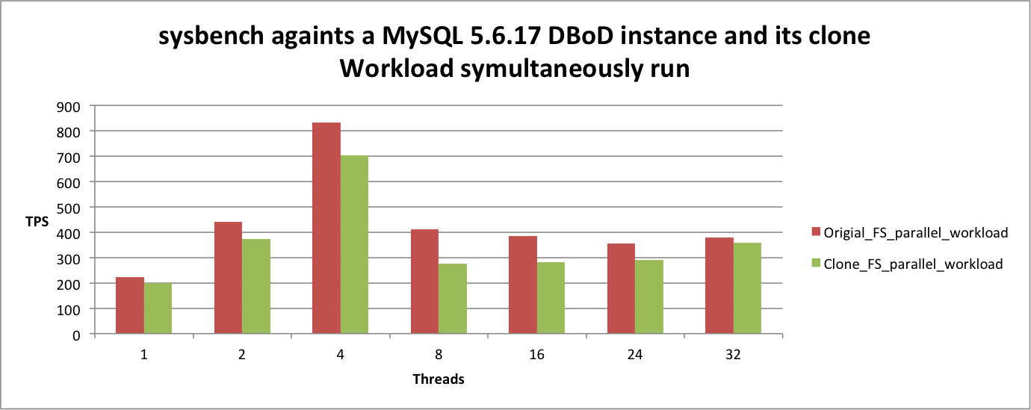
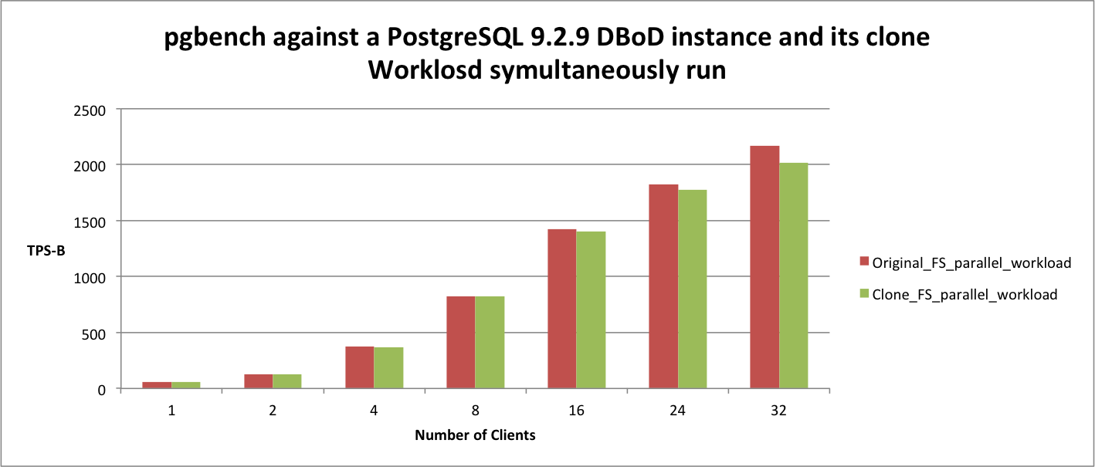
Cloning of RDBMS (II)

Slide 21
Agenda
Brief introduction
Our setup
Caching technologies
Snapshots
Data motion, compression & dedup
Conclusions

Slide 22
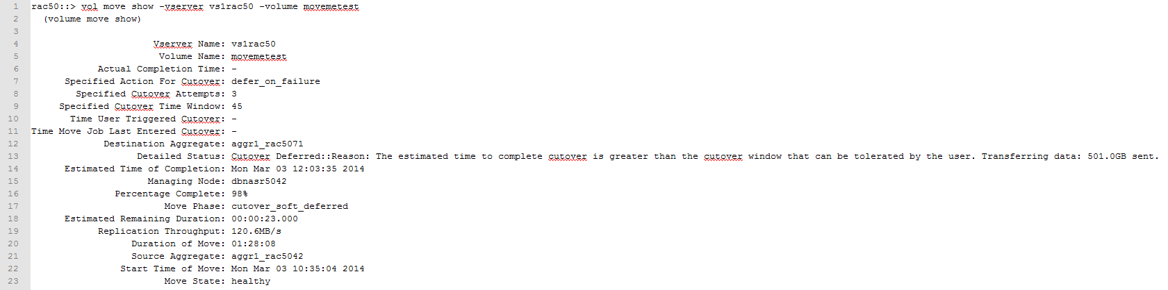
Vol move
Powerful feature: rebalancing, interventions,… whole volume granularity
Transparent but watch-out on high IO (writes) volumes
Based on SnapMirror technology
Example vol move command:
rac50::> vol move start -vserver vs1rac50 -volume movemetest -destination-aggregate aggr1_rac5071 -cutover-window 45 -cutover-attempts 3 -cutover-action defer_on_failure

Slide 23
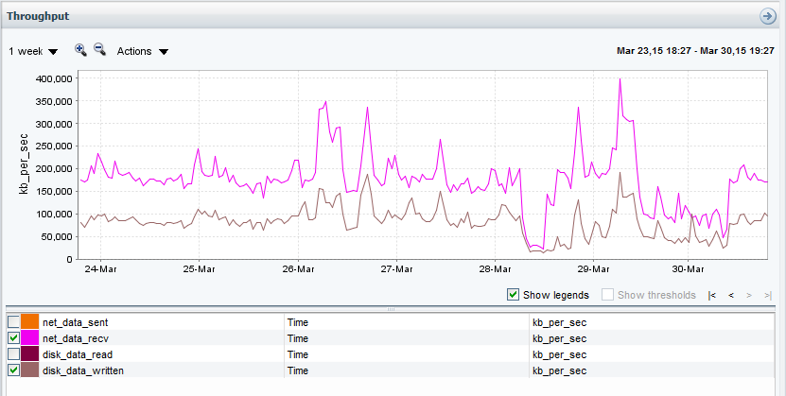
Compression & deduplication
Mainly used for Read Only data and our backup to disk solution (Oracle)
It is transparent to applications
NetApp compression provides similar gains as Oracle12c low compression level.
  It may vary depending on datasets
compression ratio
Total Space used: 641TB
Savings due to compression and dedup: 682TB
~51.5% savings

Slide 24
Conclusions
Positive experience so far running on C-mode
Data safety features (raid_dp, scrubbing, checksum,…) has been proven to be very reliable but bugs may be encountered, relying on e.g. checksums at the application layer when available is advisable.
Mid to high end NetApp NAS provide good performance using the flash pool SSD caching solution
Design of stacks and network access require careful planning
Cluster resilience has being proven in a number of planned interventions and unplanned incidents
  Online interventions are key for critical services
Good contacts with vendor specialists has been proven to be very effective
Flexibility with clustered ONTAP, helps to reduce the investment
  Same infrastructure used to provide iSCSI object storage via CINDER
New service functionality being built based on storage features

Slide 25

Questions

Slide 26
Flash Technologies
Flash Cache
Flash Pool
Depending where SSD are located.
  Controllers → Flash Cache
  Disk shelf → Flash Pool
Flash pool based on a Heat Map
read
read
read
hot
warm
neutral
cold
evict
Eviction scanner
overwrite
Insert into SSD
Every 60 secs &
SSD consumption > 75%
write
neutral
cold
evict
Write to disk
Insert into SSD
Eviction scanner

Slide 27
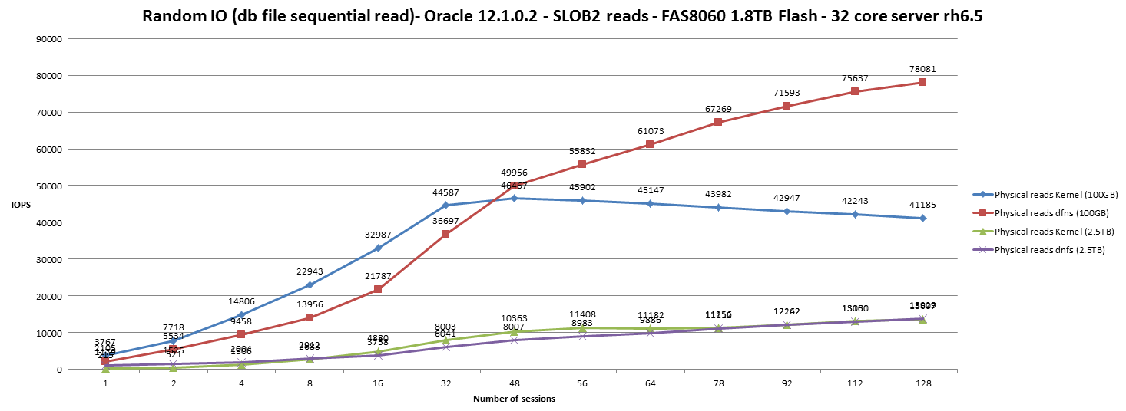
Flash pool + Oracle directNFS
Oracle12c, enable dNFS by:
  $ORACLE_HOME/rdbms/lib/make -f ins_rdbms.mk dnfs_on

