Slide 1
Triggering Events with GPUs at ATLAS
S. Kama, J. Augusto Soares, J. Baines, M. Bauce, T. Bold, P. Conde Muino, D. Emeliyanov, R. Goncalo, A. Messina, M. Negrini, L. Rinaldi, A. Sidoti, A. Tavares Delgado, S. Tupputi, L. Vaz Gil Lopes

Slide 2
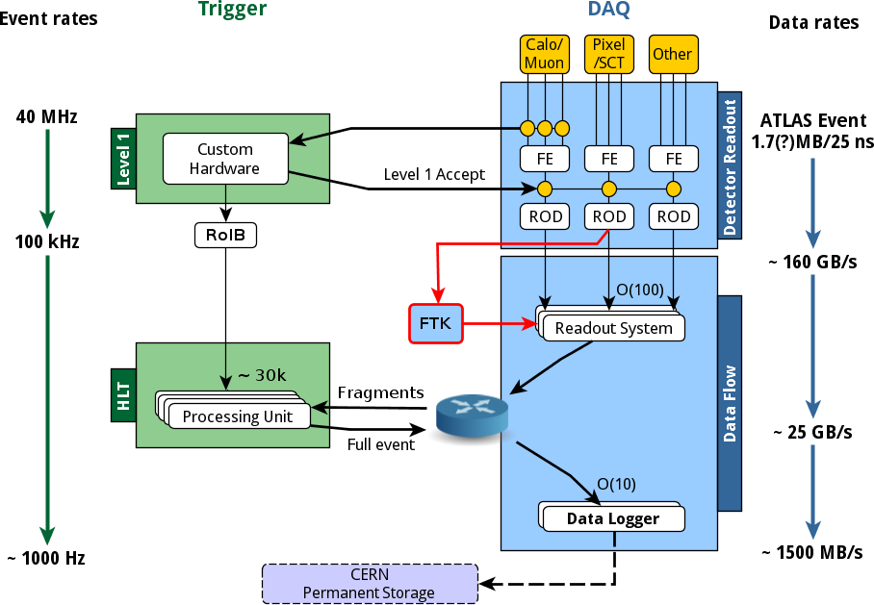
ATLAS Trigger and DAQ
Composed of hardware based Level-1 (L1) and software based High Level Trigger(HLT)
Reduces 40MHz input event rate to about 1kHz ( ~1500MB/s output)
L1 identifies interesting activity in small geometrical regions of detector called Region of Interests (RoI)
RoIs identified by L1 are passed to the HLT for event selection
See R.Hauser’s talk
With about 25k processes
~25k/100kHz = ~250ms/Event decision time

Slide 3
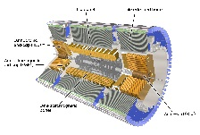
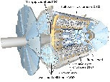

High Level Trigger
HLT uses Stepwise processing of sequences called Trigger Chains(TC)
Each chain is composed of Algorithms and seeded by RoIs from L1
Same RoI may seed multiple chains
Same Algorithm may run on different data
An algorithm runs only once on same data (caching)
If a RoI fails a selection step further algorithms in chain are not executed
Initial algorithms (L2) work on partial event data (2-6%). Later algorithms have access to full event data
L1 ROI
L1 ROI
L1 ROI
L2 Alg
L2 Alg
L2 Alg
L2 Alg
L2 Alg
L2 Alg
L2 Alg
L2 Alg
L2 Alg
L2 Alg
L2 Alg
L2 Alg
L2 Alg
L2 Alg
L2 Alg
L2 Alg
Event Building
EF Alg
EF Alg
EF Alg
EF Alg
EF Alg
EF Alg
EF Alg
EF Alg
EF Alg
EF Alg
EF Alg
EF Alg
EF Alg
EF Alg
EF Alg
EF Alg
EF Alg
EF Alg
EF Alg
EF Alg

Slide 4
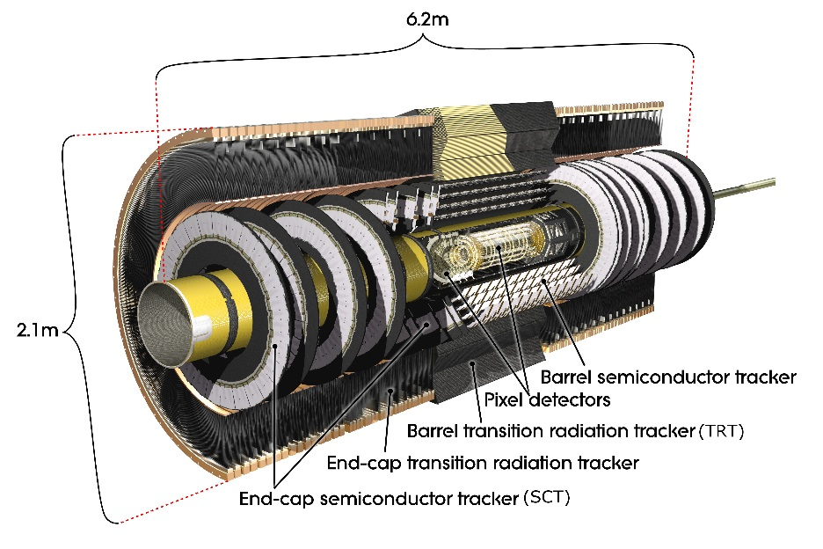
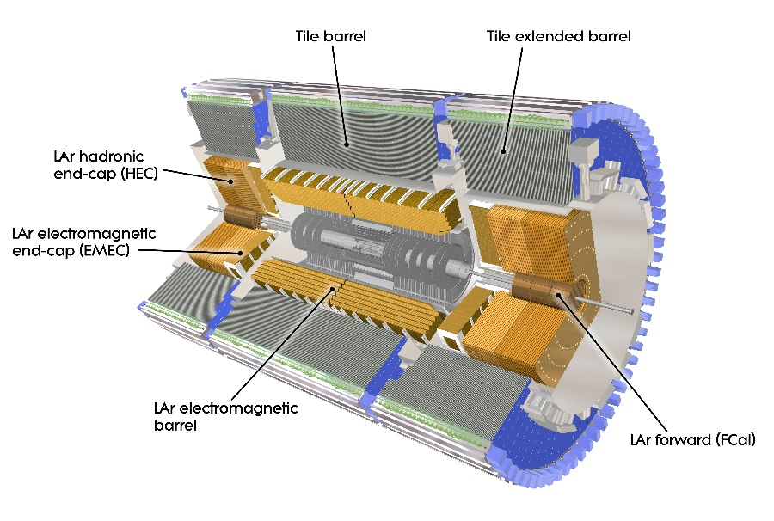
Inner Detector and Calorimeters
Inner detector houses trackers and composed of
  Pixel detector
  Silicon strip detector (SCT)
  Transition Radiation Tracker (TRT)
Calorimeters contain electromagnetic and hadronic components and composed of
  Liquid Argon (LAr)
  Tile Calorimeters

Slide 5
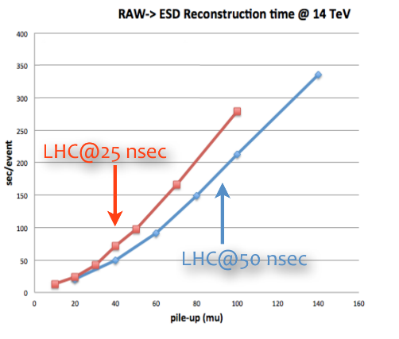
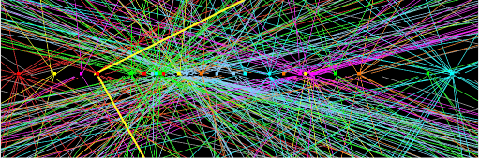
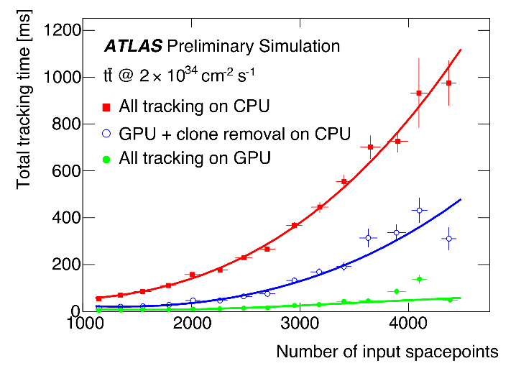
GPU Demonstrator
Increasing LHC instantaneous luminosity is leading to higher pileup
CPU time rises rapidly with pile-up due to combinatorial nature of the tracking
HLT farm size is limited, mainly by power and cooling
ATLAS is developing and expanding demonstrator exploiting GPUs in:
  Inner Detector-Tracking
  Calorimeter-Topo-clustering
  Muons-Tracking
to evaluate the potential benefit of GPUs in terms of throughput per unit cost
Tracks from primary interaction and pileup interaction vertices
GPUs provide good power/compute ratio
During Run-1, ID only demonstrator has shown good speedup (up to 12x)*
*ATL-DAQ-SLIDE-2014-635

Slide 6
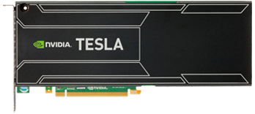
Offloading Mechanism
Trigger Processing Units integrate ATLAS offline software framework, ATHENA, to online environment
Many PU processes run on each Trigger host
A client-server approach is implemented to manage resources between multiple PU processes.
PU prepares data to be processed and sends it to server
Accelerator Process Extension (APE) Server manages offload requests and executes kernels on GPU(s)
It sends results back to process that made the offload request
Trigger PU
(ATHENA)
APE
Server
Trigger PU
(ATHENA)
Trigger PU
(ATHENA)
Trigger PU
(ATHENA)
Data+Metadata
Results+Metadata
Server can support different hardware types (GPUs, Xeon-Phi, CPUs) and different configurations such as GPU/Phi mixtures and in-host off-host accelerators.

Slide 7
Offloading - Client
Implemented for each detector such as TrigInDetAccelSvc
HLT Algorithm asks for offload to TrigDetAccelSvc
TrigDetAccelSvc converts C++ classes for raw and reconstructed quantities from the Athena Event Data Model(EDM) to GPU optimized EDM through Data Export Tools
Then it adds metadata and requests offload through OffloadSvc
OffloadSvc manages multiple requests and communication with APE server
Results are converted back to Athena EDM by TrigDetAccelSvc and handed to requesting algorithm
HLT Algoritm
1
Athena EDM
5
Data+MetaData
TrigDetAccelSvc
OffloadSvc
3
2
GPU EDM
Export Tool
Export Tool
Request
Result
4
Export tools and server communication need to be fast (serial sections)
APE Server

Slide 8
Offloading - Server
APE Server uses plug-in mechanism It is composed of
Manager handles communication with processes and scheduling
  Receives offload requests
  Passes the request to appropriate module
  Executes Work items
  Sends the results back to requesting process
Modules manage GPU resources and create work items
  Manage constants and time-varying data on GPU
  Bunch multiple requests to optimize utilization
  Create appropriate work items
Work items run GPU kernels such as clusterization on given data and prepare results
Each detector implements their own module
Athena
APE Server
Data + Metadata
Work
Module
Todo Queue
Completed Queue
Athena
Results + Metadata

Slide 9
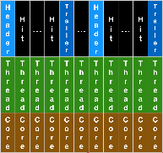
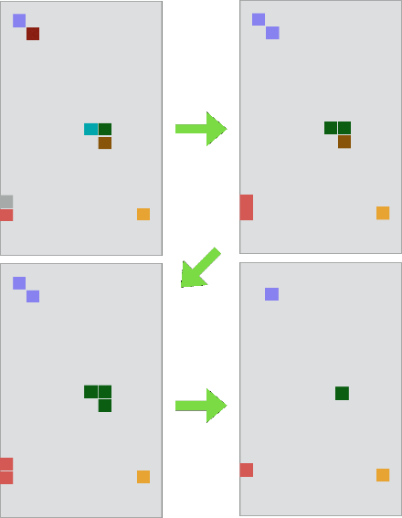
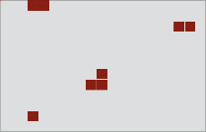
ID Module
Tracking is most time consuming part of trigger
ID module implements several CPU intensive steps on GPU
Bytestream decoding converts detector encoded output to hits on Pixel and SCT modules
Charged particles typically activate one or more neighboring strips or pixels. Hit clustering merges these by a Cellular Automata algorithm
ByteStream Decoding
Hit Clustering
Track Formation
Clone Reomval
Each thread works on a word and decodes it. Data contains hits on different modules on different ID layers
Each hit start as an independent cluster. Adjacent clusters are merged in each step until all adjacent cells belong to same cluster. Each thread works on a different hit

Slide 10
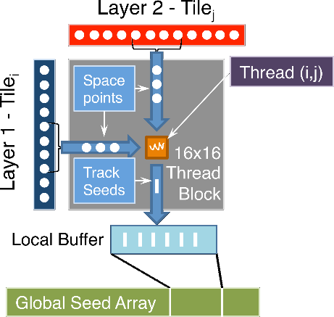
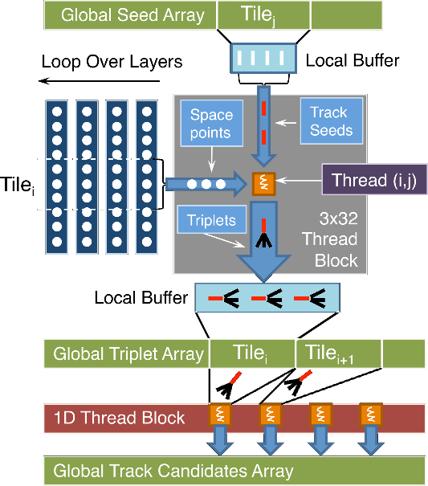
ID Tracking
Tracking starts with pair forming. A 2-D thread array checks for pairing condition and selects suitable pairs
Then these pairs are extrapolated to outer layers by a 2D thread block to form triplets. Finally triplets are combined to form Track Candidates.
In clone removal step, track candidates starting from different pairs but having same outer layer hits are merged to form tracks

Slide 11
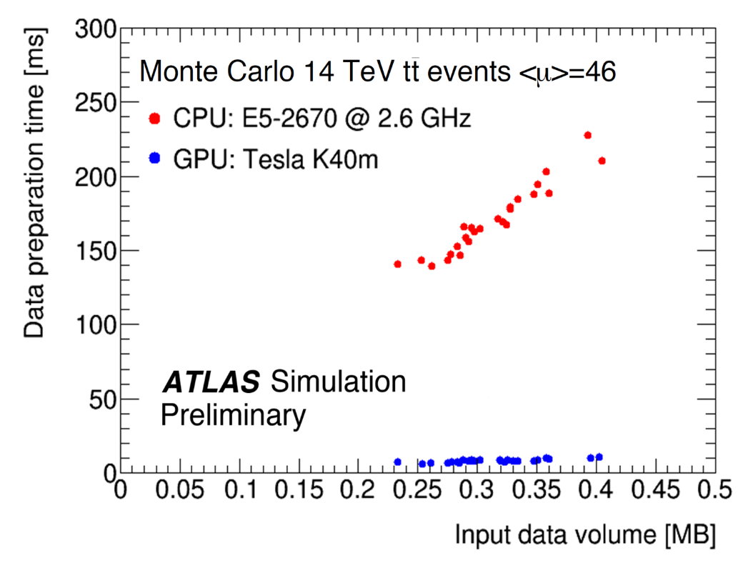
ID Speedup
Raw detector data decoding and clusterization algorithms form the first step of reconstruction(data preparation)
Initial tests with Monte-Carlo samples shown up to 21x speed up compared to serial Athena job.
A new upgraded tracking algorithm is being implemented
Up to 21x

Slide 12
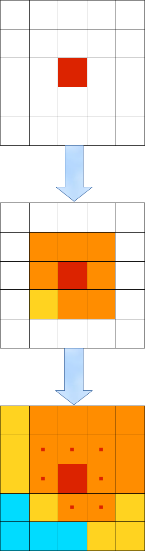


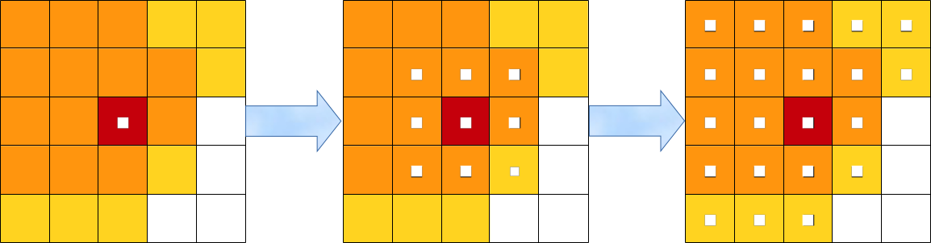
Calorimeter Topoclustering
Topocluster algorithm classifies calorimeter cells by signal/noise
  S/N>4 are Seeds
  4>S/N>2 are Growing cells
  2>S/N>0 are Terminal cells
Growing cells around Seeds are included until they don’t have any more Growing or Terminal cells around them
Parallel implementation uses Cellular Automata algorithm to parallelize the task
Implementation is underway
Standard algorithm
Parallel algorithm
Assign one thread for each cell
Start with adding Seeds to cluster.
At each iteration join to the cluster which contain highest S/N neighboring cell
Terminate when maximum radius is reached or can’t include anymore cells

Slide 13
Next Steps
Finalize porting of ID track finding and clone removal algorithms
Finalize and include Calorimeter Topoclustering module
Implement and include Muon tracking module
Make detailed measurements including throughput per unit cost by the end of the year and use this to estimate potential benefit in future HLT farm

Slide 14
Summary & Outlook
Increasing instantaneous luminosity of LHC necessitates parallel processing
Massive parallelization of trigger algorithms on GPU is being investigated as a way to increase the compute-power of the HLT farm
ATLAS developed APE framework to manage offloading from multiple processes
Inner detector Trigger data preparation algorithms are successfully offloaded to GPU, resulting in ~21x speedup compared to CPU implementations
Further algorithms for ID, Calorimeter and Muon systems are being implemented.

Slide 15
Thank You

Slide 16
BACKUPs

Slide 17
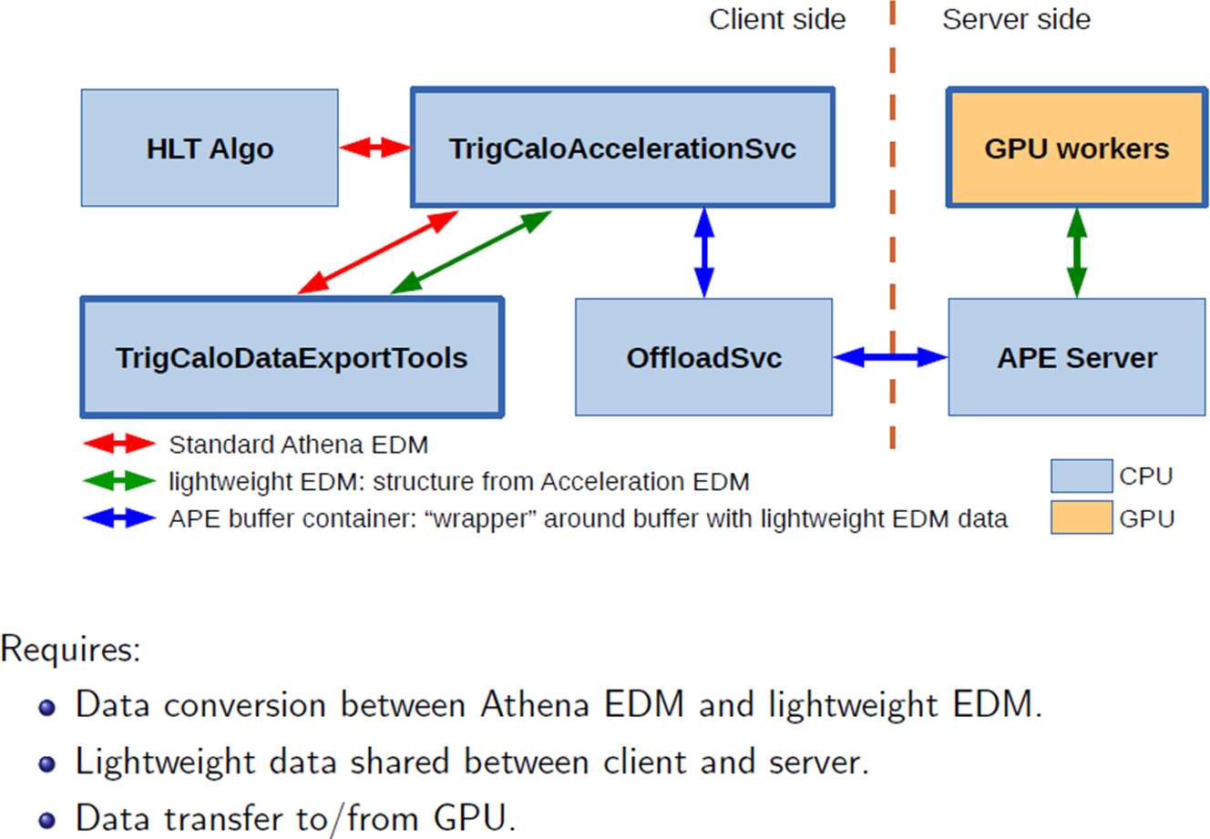
Architectural Design

Slide 18
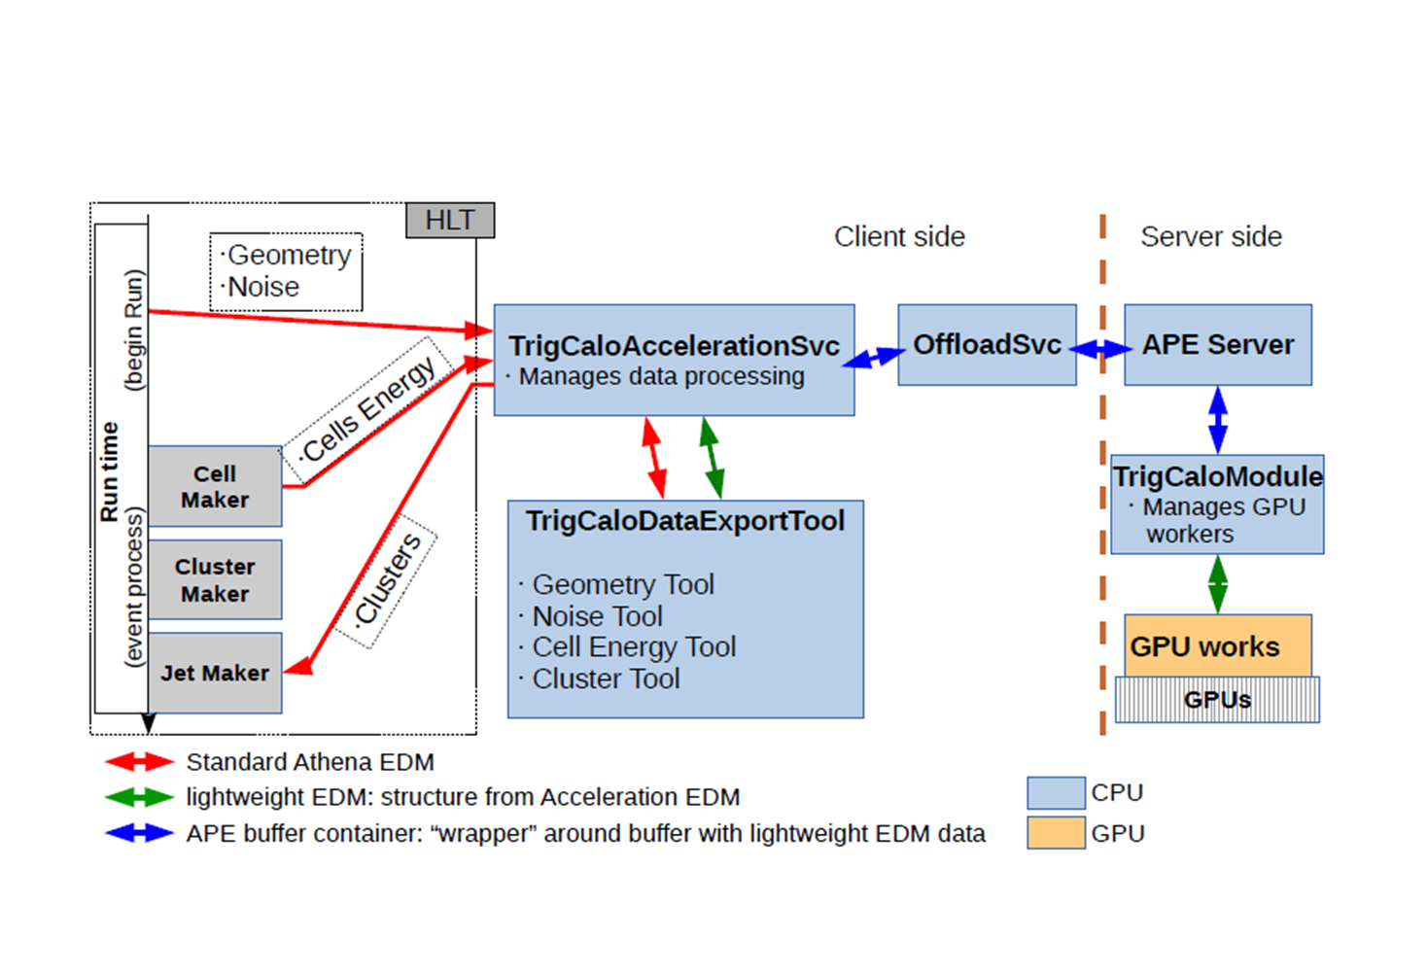
Implementation

