Slide 2
dCache strategy
After 10 years of storage technology support, we feel the responsibility for sites using dCache.
Therefore our main concern is the efficiency and evolution of those sites in terms of new hardware and software technologies.
And not to forget: 3 of those sites are actually the authors of that technology.
We try to achieve this in various ways :
We try to acquire National and European funding and we partner with projects and sites to provide a sustained support infrastructure. (dCache.org)
We focus on activities, allowing sites to use our technology for all their customers, not only a particular community. “Alessandra Forti presentation at the WLCG WS”
One crucial prerequisite is to provide industry standard interfaces and protocols to your storage.
  Collaborating with CERN DM on various topics in that direction.
  Great success with http, even in WLCG (See presentations by Oliver Keeble and Johannes Elmsheuser)
Evaluating new trends in hardware and software, which we might integrate in dCache.
Exploring new communities to broaden the spectrum of our services.

Slide 3
Who are we ?

Slide 4



The dCache.org collaboration
HTW
Berlin
(University)
Cheap labor injector
About 8 developers and support people in total and expecting 3 more within the next 3 months.

Slide 5
Funding and high level objectives

Slide 6


Funding and Objectives
Standardization
Deploying new technologies into
Production and exploring new communities
2010
2013
2015
2018
NFS 4.1 / pNFS
Data Life Cycle
HTTP / WebDAV
Multi Tier Storage
Contributing to the
Dynamic Federation
Quality of Service
Migration Archiving
AAI
AARC
Improve Interoperability
of R&E AAI

Slide 7
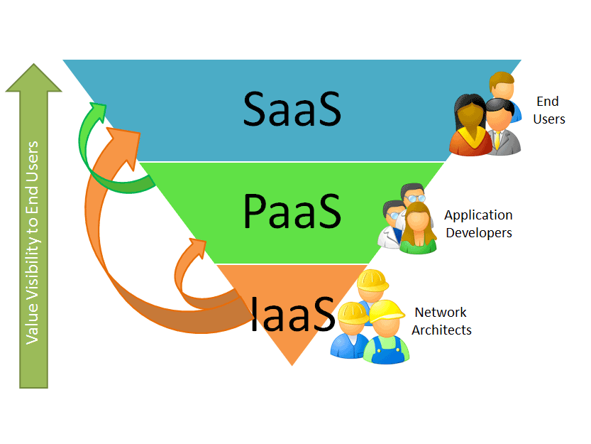
INDIGO Data Cloud Cheat Sheet
11 ++ Million Euros
30 months duration
26 partners
The project aims for an Open Source Data and Computing platform targeted at scientific communities, deployable on multiple hardware, and provisioned over private and public e-infrastructures.
About 800.000 Euro for dCache.
~ 2 more FTEs
Major objectives for dCache is :
“Data LifeCycle Support” and
“Software Defined Storage”

Slide 8
More interesting Challenges

Slide 9
Exploring new communities
Intensity Frontier (IF) at Fermilab.
    Quote “Craig Group” (plenary talk)
Nice
Hm, actually it does …
HOW ?

Slide 10
NFS 4.1 / pNFS
Reminder
  Parallel NFS
  Clients are directly receiving data from distributed storage nodes.
  Industry standard, pNFS client in the Linux Kernel.
Already in use for smaller groups at DESY.
Slowly migrating CMS Grid worker nodes at DESY to NFS4.1/pNFS data access.
  Encouraging results (next slide)
Time consuming, as bugs or misunderstandings are still found in the Linux driver implementation.
  Disadvantage of standards ☺

Slide 11
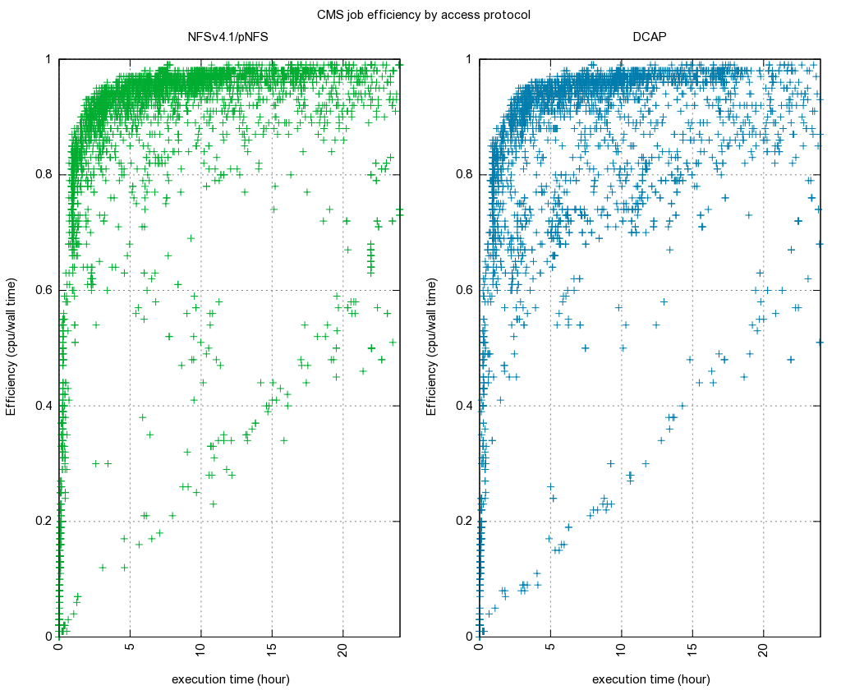
Job Efficiency (NFS – dCap)
Job Efficiency (CPU / Wall Time )
NFS 4.1
pNFS
dCap
Execution Time (hours)

Slide 12
Exploring more …
German support for the Human Brain Project (SMHB)
  Jülich – Aachen Research Alliance
  Distributed dCache between Aachen and Jülich
  dCache’s ability to select pools close to the client or to move data closer to the client made it a perfect match for their requirements.
Two cities, one system.
  Similar to NDGF (4 Countries one system)
  Second copy automatically generated at the other location.
  Or second location just used as a cache.
Jülich
Aachen

Slide 13
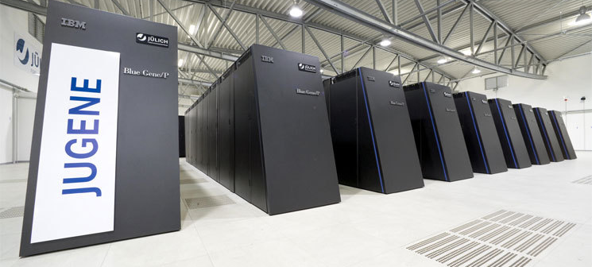

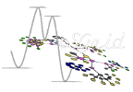

Projects in HPC
HPC jobs on supercomputer
HPC jobs get access to dCache storage.

Slide 14
Requirement : CDMI
ISO/IEC Standard
Important features for the HPC use cases:
  File selection based on meta – data
    (not file name based)
  Supporting remote ‘data lifecycle’
    Bring to / release from fast storage
    Allow tape migration
    …
Required by EGI Fed Cloud
Supported by INDIGO Data Cloud
See presentation on CDMI by Paul Millar

Slide 15
Scientific Data Cloud
First Implementation of the Idea :
DESY CLOUD

Slide 16

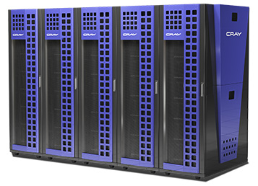


Scientific Data Cloud
High Speed
Data Ingest
Fast Analysis
NFS 4.1/pNFS
Wide Area Transfers
(Globus Online, FTS)
by GridFTP
Sync’ing and Sharing with OwnCloud
See Paul’s presentation

Slide 17
Small file migration to tape
dCache
Tape System
Currently used by
  DESY light sources
  DPHEP
  NEXT : DESY CLOUD
See also Poster and Presentation by Karsten Schwank

Slide 18
Responding to new technologies

Slide 19
Response to CEPH
CEPH complements dCache perfectly.
  Simplifies operating dCache disks.
  dCache accesses data as object-store anyway already.
dCache is evaluating a ‘two step approach’.
  Each pools sees it own object space in CEPH
  All pools have access to the entire space, which is a slight change of dCache pool semantics.
Would merge CEPH and dCache advantages
  Multi Tier (Tape, Disk, SSD)
  Multi protocol support for a common namespace.
    All protocols see the same namespace
  All the dCache AAI features
    Support for X509, Kerberos, username/password

Slide 20
Summary
“On Top” funding secured again for 3 more years.
Storage services based on standards extended our user base towards HPC and ‘long tail of science’ communities and helps sites to reduce software stack costs.
Wider user base broadens our feature set.
Continue to investigate new hardware and software technologies and will make them available to our customers.

Slide 21

Don’t forget
Upcoming 9th dCache Workshop
18 – 20 May 2015
Amsterdam, Science Park
Visit www.dCache.org for details

Slide 22
The END further reading www.dCache.org

