Slide 1
Integrating Network Awareness in ATLAS Distributed Computing Using the ANSE Project
J.Batista, K.De, A.Klimentov, S.McKee, A.Petroysan
for the ATLAS Collaboration and Big PanDA team
University of Michigan
University of Texas at Arlington
Brookhaven National Laboratory
Joint Institute of Nuclear Research (Dubna)
CHEP 2015, Okinawa, Japan, April 13-17, 2015

Slide 2
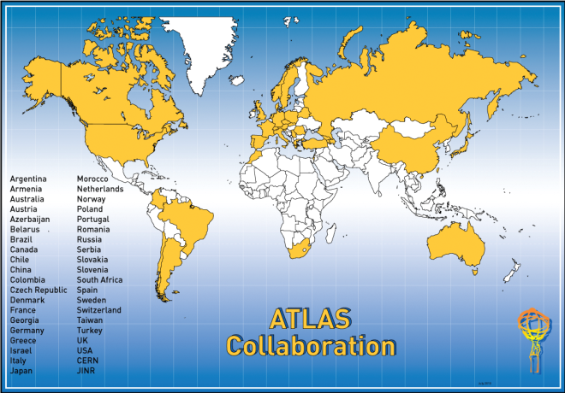
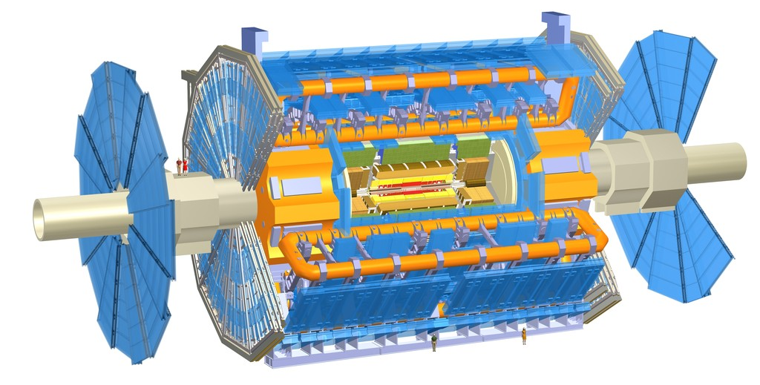


The ATLAS Experiment at the LHC
ATLAS

Slide 3
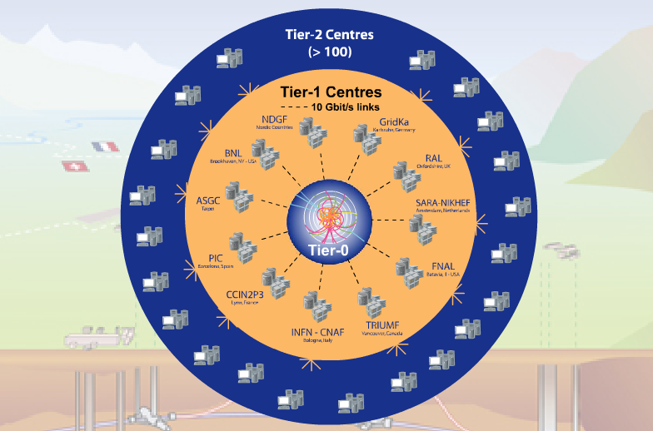

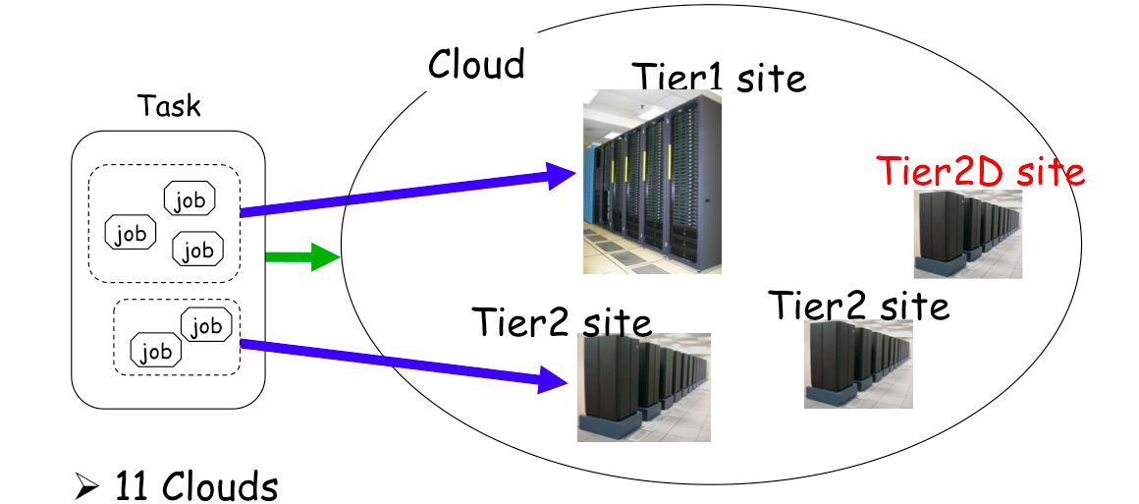
Distributed Computing in ATLAS
ATLAS Computing Model :
  11 Clouds : 10 T1s + 1 T0 (CERN)
Cloud = T1 + T2s + T2Ds
T2D = multi-cloud T2 sites
2-16 T2s in each Cloud
Workload Management System
Task → Cloud :Task brokerage
Jobs → Sites :Job brokerage
Basic unit of work is a job:
  Executed on a CPU resource/slot
  May have inputs
  Produces outputs
JEDI – layer above PanDA to create jobs from ATLAS physics and analysis 'tasks'
Current scale – one million jobs per day

Slide 4
PanDA Overview
The PanDA workload management system was developed for the ATLAS experiment at the Large Hadron Collider
  Hundreds of petabytes of data per year, thousands of users worldwide, many dozens of complex applications…
  Leading to >400 scientific publications – and growing daily
  Discovery of the Higgs boson, search for dark matter…
A new approach to distributed computing
  A huge hierarchy of computing centers working together
  Main challenge – how to provide efficient automated performance
  Auxiliary challenge – make resources easily accessible to all users
Large Scale Networking enables systems like PanDA
Related CHEP Talks and Posters :
  T.Maeno : The Future of PanDA in ATLAS Distributed Computing; CHEP ID 144
  S.Panitkin : Integration of PanDA Workload Management System with Titan supercomputer at OLCF ; CHEP ID 152
  M.Golosova : Studies of Big Data meta-data segmentation between relational and non-relational databases ; CHEP ID 115
  Poster : Scaling up ATLAS production system for the LHC Run 2 and beyond: project ProdSys2
  Poster : Integration of Russian Tier-1 Grid Center with High Performance Computers at NRC-KI for LHC experiments and beyond HENP; CHEP ID 100
Reference : https://twiki.cern.ch/twiki/bin/view/PanDA/PanDA

Slide 5
Core Ideas in PanDA
Make hundreds of distributed sites appear as local
  Provide a central queue for users – similar to local batch systems
Reduce site related errors and reduce latency
  Build a pilot job system – late transfer of user payloads
  Crucial for distributed infrastructure maintained by local experts
Hide middleware while supporting diversity and evolution
  PanDA interacts with middleware – users see high level workflow
Hide variations in infrastructure
  PanDA presents uniform ‘job’ slots to user (with minimal sub-types)
  Easy to integrate grid sites, clouds, HPC sites …
Production and Analysis users see same PanDA system
  Same set of distributed resources available to all users
  Highly flexible – instantaneous control of global priorities by experiment

Slide 6










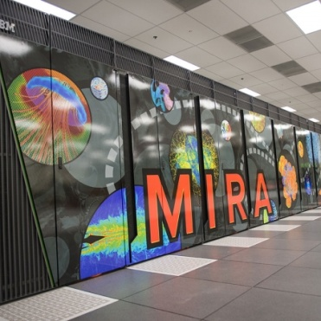


Resources Accessible via PanDA
Many
Others
  About 150,000 job slots used continuously 24x7x365

Slide 7
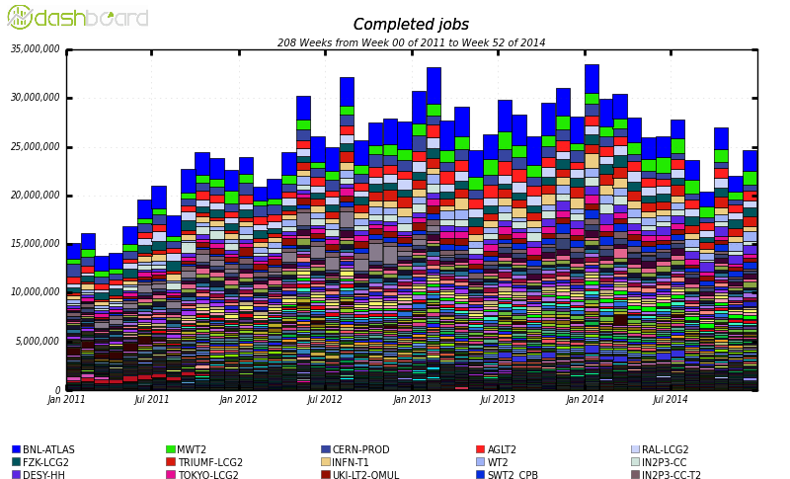
PanDA Scale
  Current scale – 25M jobs completed every month at >hundred sites
  First exascale system in HEP – 1.2 Exabytes processed in 2013

Slide 8
The Growing PanDA EcoSystem
ATLAS PanDA core
  US ATLAS, CERN, UK, DE, ND, CA, Russia, OSG …
ASCR/HEP Big PanDA
  DOE funded project at BNL, UTA – PanDA beyond HEP, at LCF
CC-NIE ANSE PanDA
  NSF funded network project - CalTech, Michigan, Vanderbilt, UTA
HPC and Cloud PanDA – very active
Taiwan PanDA – AMS and other communities
Russian NRC KI PanDA, JINR PanDA – new communities
AliEn PanDA, LSST PanDA, other experiments
MegaPanDA (COMPASS, ALICE, NICA) …
  RF Ministry of Science and Education funded project

Slide 9
PanDA Evolution. ”Big PanDA”
Generalization of PanDA for HEP and other data-intensive sciences
Four main tracks :
  Factorizing the core : Factorizing the core components of PanDA to enable adoption by a wide range of exascale scientific communities
  Extending the scope : Evolving PanDA to support extreme scale computing clouds and Leadership Computing Facilities
  Leveraging intelligent networks : Integrating network services and real-time data access to the PanDA workflow
  Usability and monitoring : Real time monitoring and visualization package for PanDA

Slide 10
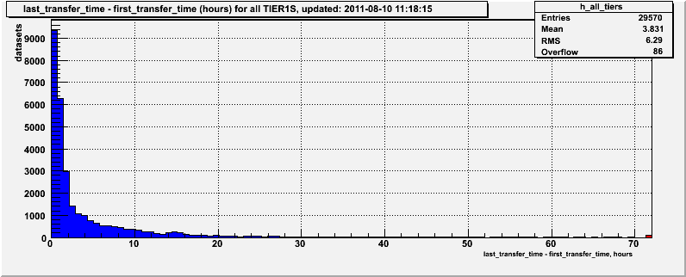
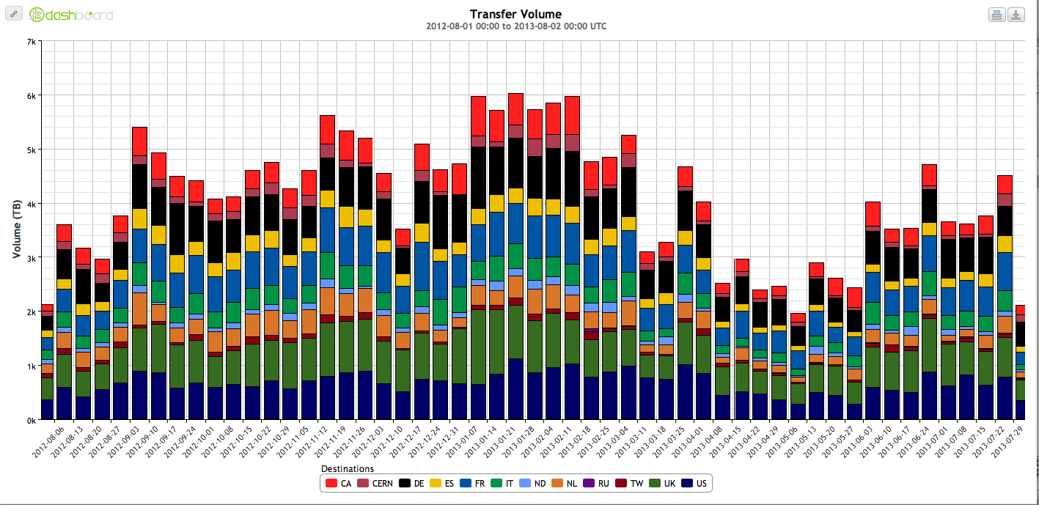
ATLAS Distributed Computing. Data Transfer Volume during Run 1.
TBytes
CERN to BNL data transfer
time . An average 3.7h
to export data from CERN
6 PBytes ->
Data Transfer Volume in TB (weekly average). Aug 2012 - Aug 2013

Slide 11
PanDA and Networking
PanDA as workload manager
  PanDA automatically chooses job execution site
    Multi-level decision tree – task brokerage, job brokerage, dispatcher
    Also predictive workflows – like PD2P (PanDA Dynamic Data Placement)
  Site selection is based on processing and storage requirements
    Why not use network information in this decision?
    Can we go even further – network provisioning?
  Network knowledge useful for all phases of job cycle
Network as resource
  Optimal site selection should take network capability into account
    We do this already – but indirectly using job completion metrics
  Network as a resource should be managed (i.e. provisioning)
    We also do this crudely – mostly through timeouts, self throttling
Goal for PanDA
  Direct integration of networking with PanDA workflow – never attempted before for large scale automated WMS systems

Slide 12
Sources of Network Information
Distributed Data Management Sonar measurements
  Actual transfer rates for files between all sites
  This information is normally used for site white/blacklisting
  Measurements available for small, medium, and large files
perfSonar (PS) measurements
  perfSonar provides dedicated network monitoring data
  All WLCG sites are being instrumented with PS boxes
Federated XRootD (FAX) measurements
  Read-time for remote files are measured for pairs of sites
  Using standard PanDA test jobs (HammerCloud jobs)

Slide 13
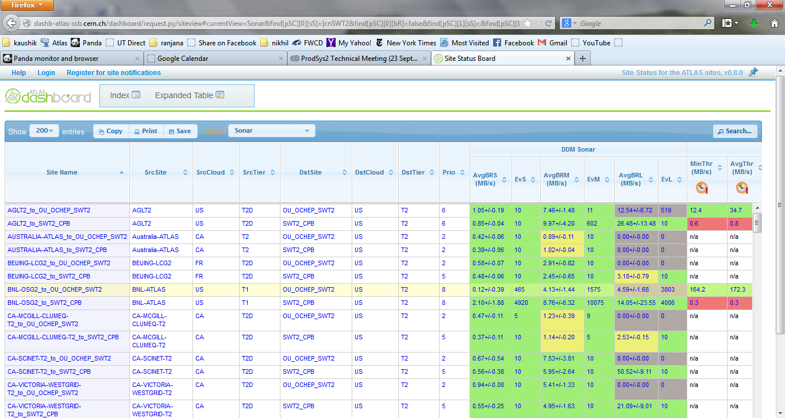
Network Data Monitoring. Sonar.

Slide 14
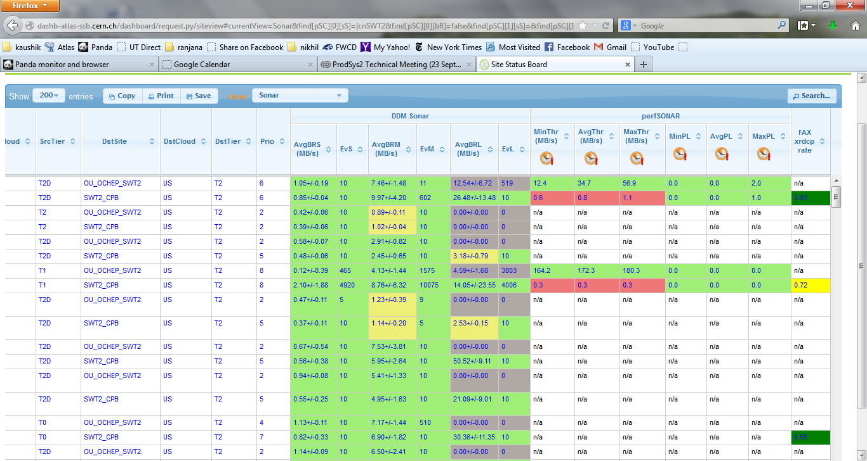
Network Measurements. perfSonar
SSB: http://dashb-atlas-ssb.cern.ch/dashboard/request.py/siteview#currentView=Sonar&highlight=false

Slide 15
Example: Faster User Analysis
First use case for network integration with PanDA
Goal - reduce waiting time for user jobs
  User analysis jobs normally go to sites with local input data
  This can occasionally lead to long wait times (jobs are re-brokered if possible, or PD2P data caching will make more copies eventually to reduce congestion)
  While nearby sites with good network access may be idle
Brokerage uses concept of ‘nearby’ sites
  Use cost metric generated with Hammercloud tests
  Calculate weight based on usual brokerage criteria (availability of CPU resources, data location, release…) plus new network transfer cost
  Jobs will be sent to the site with best overall weight
Throttling is used to manage load on network

Slide 16
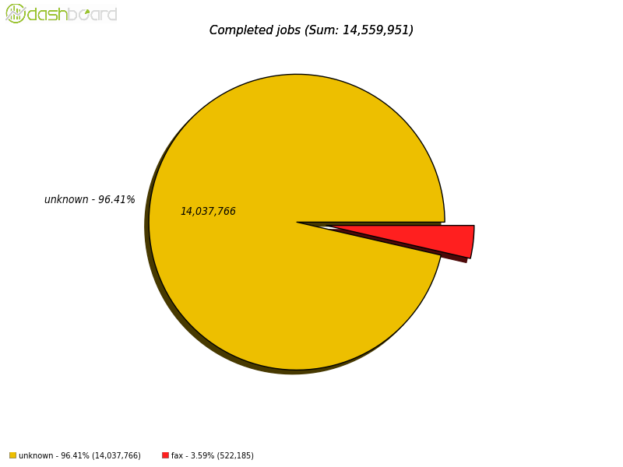
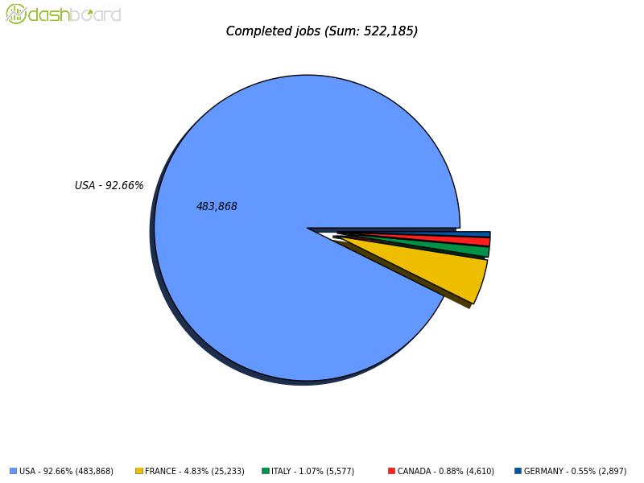
Jobs Using FAX for Remote Access
Completed jobs (Sum : 14,559,951)
About 4% of jobs access data remotely
Through federated XRootD
FAX 3.6% (522,185 jobs)
“FAX” jobs (Sum : 522,185)
Remote site is selected based on network
performance
USA 92.66%
Italy 1.07%
Data for
October 2014
France 4.83%

Slide 17
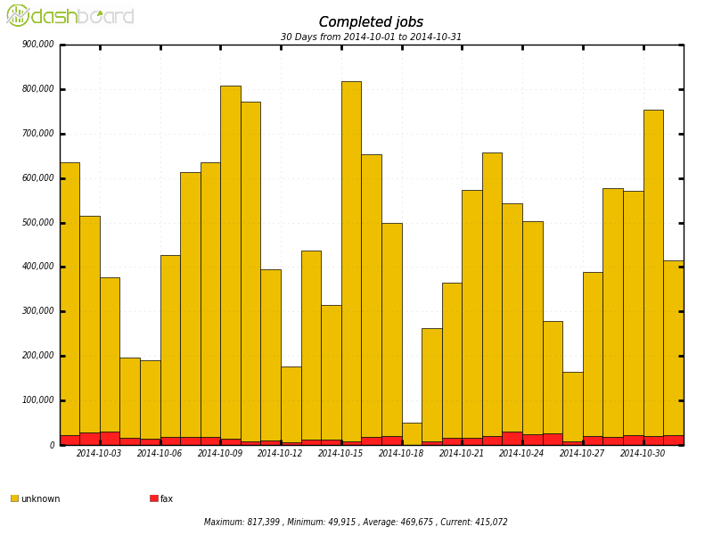
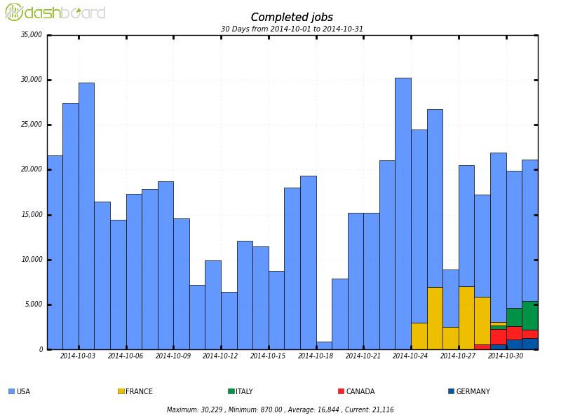
Daily Remote Access Rates
FAX
USA
France
Italy
Canada
Germany
Data for
October 2014

Slide 18
Jobs from Task 4199733

Slide 19
Job Wait Times for Example Task

Slide 20
Cloud Selection
Second use case for network integration with PanDA
Optimize choice of T1-T2 pairings (cloud selection)
  In ATLAS, production tasks are assigned to Tier 1’s
  Tier 2’s are attached to a Tier 1 cloud for data processing
  Any T2 may be attached to multiple T1’s
  Currently, operations team makes this assignment manually
  Automate this using network information

Slide 21
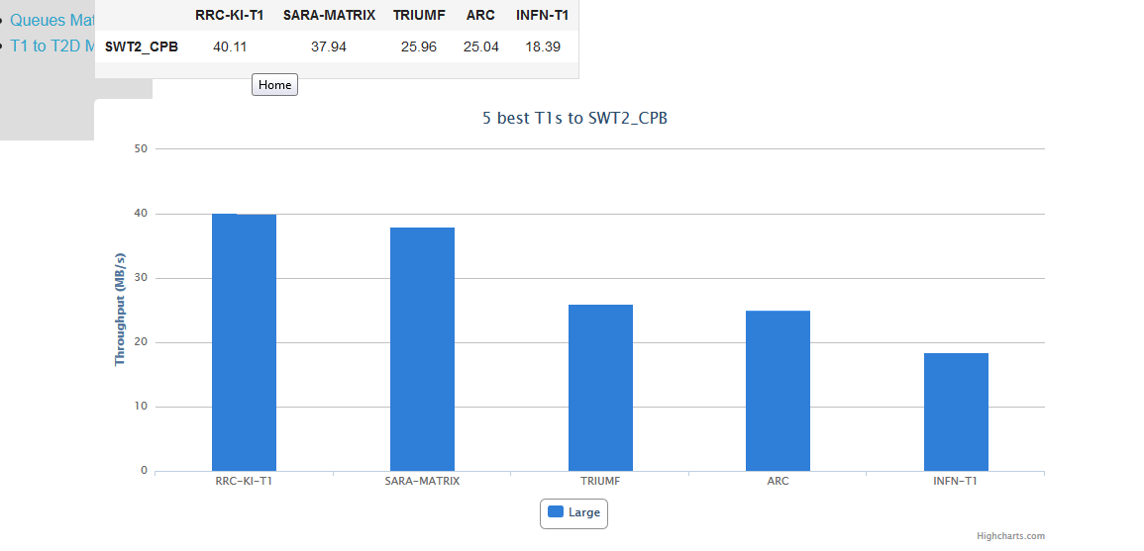
Example of Cloud Selection
5 best T1s for SouthWest T2 in TX, USA

Slide 22
Summary
The knowledge of network conditions, both historical and current, are used to optimize PanDA and other systems for ATLAS and allows to WMS control of end-to-end network paths can augment ATLAS's ability to effectively utilize its distributed resources.
Optimal Workload Management System design should take network capability into account
Network as a resource should be managed (i.e. provisioning)
Many parts of distributed Workload Management Systems like PanDA can benefit from better integration with networking
Initial results look promising
Next comes SDN/provisioning
We are on the path to use Network as a resource, on similar footing as CPU and storage

Slide 23
Back up slides

Slide 24
