Slide 1
David Cameron
Riccardo Bianchi
Claire Adam Bourdarios
Andrej Filipcic
Eric Lançon
Efrat Tal Hod
Wenjing Wu on behalf of the ATLAS Collaboration
CHEP 15, Okinawa
ATLAS@Home: Harnessing Volunteer Computing for HEP

Slide 2







What is volunteer computing?
Ordinary people voluntarily running scientific tasks on their PCs

Slide 3
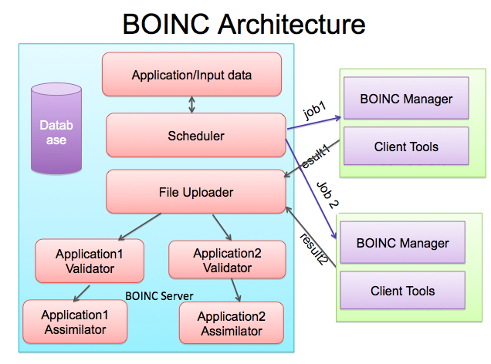
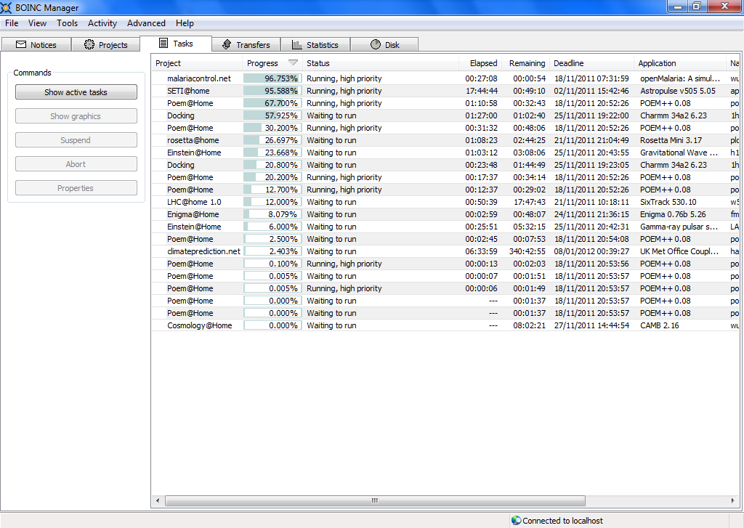

Berkeley Open Infrastructure for Network Computing (BOINC)
BOINC Client

Slide 4

ATLAS@Home
Why use volunteer computing for ATLAS?
  It’s free! (almost)
  Public outreach
Considerations
  Low priority jobs with high CPU-I/O ratio
    Non-urgent Monte Carlo simulation or specific tasks
  Need virtualisation for ATLAS sw environment
    CERNVM image and CVMFS
  No grid credentials or access on volunteer hosts
    ARC middleware for data staging
  The resources should look like a regular ATLAS computing resource
    ARC Control Tower

Slide 5
Basic ATLAS@Home Architecture
ATLAS Job Management System
ARC Control Tower
Grid Catalogs and Storage
ARC CE
proxy cert
BOINC Plugin
Job Working
Directory
Volunteer PC
BOINC Client
Shared Directory
BOINC server
Data Staging Area
VM

Slide 6
ATLAS@Home jobs
Real simulation tasks
  Full athena jobs
  50 events/job
Runs in CERNVM with pre-cached software
But some data still needs to be downloaded at runtime
Image is 1.1GB (500MB compressed) and downloaded only once
Input files (data file + small scripts) is 1-100MB
Output is ~100MB
VM memory is now 2GB (was 1GB initially, but now more complex jobs)
Jobs take from few hours up to a few days on fast (single) core

Slide 7
Validation of results
Several steps of validation
  Per work unit, that correct output is produced (just that file exists)
  The contents of the output is verified in a later merging process
  Physics validation comparing results to regular Grid task
Full physics validation of the BOINC Monte-Carlo simulation was successfully verified in March 2015
In addition to validation, 20 million top quark pairs were simulated to extend the statistics to study the top quark properties in detail.

Slide 8
How does it work for volunteers?
Install BOINC client and VirtualBox
  Linux, Mac and Windows supported
  Currently 80% of hosts have Windows
In BOINC client choose ATLAS@Home and create an account
That’s it!
BOINC client can be configured to run whenever is convenient, e.g.:
  After computer is idle for 5 mins
  Only between 5pm and 8am
More info in backup slides

Slide 9
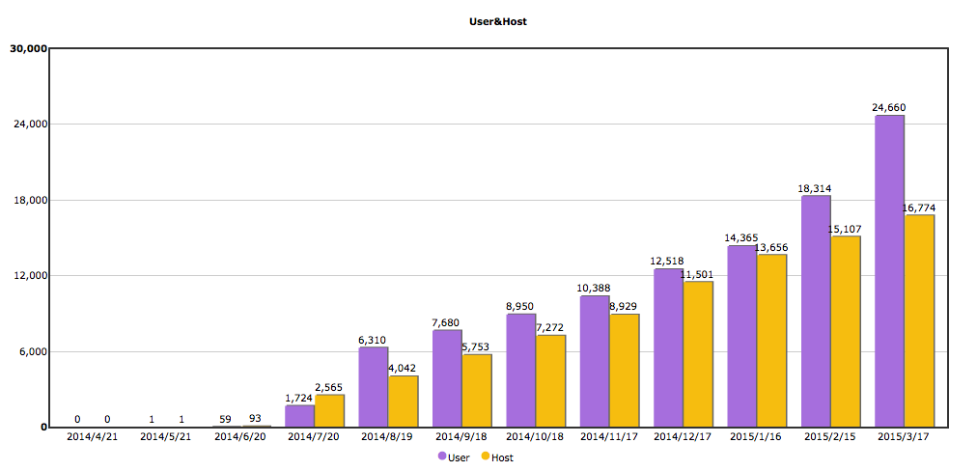
Volunteer growth
Currently 25k volunteers, 1200 active
Einstein@Home: 300k volunteers, 47k active
Seti@Home: 5 million volunteers, 150k active

Slide 10
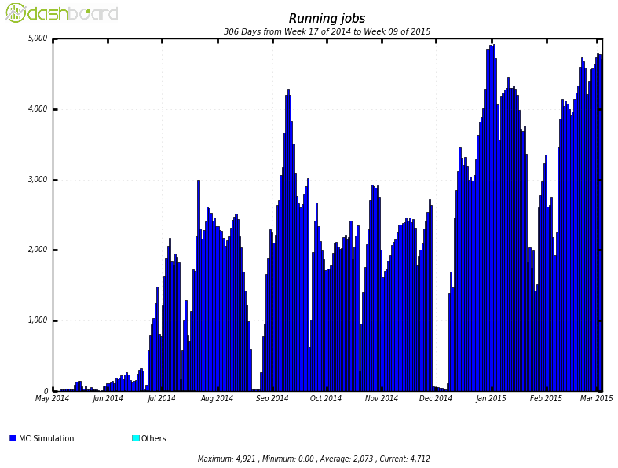
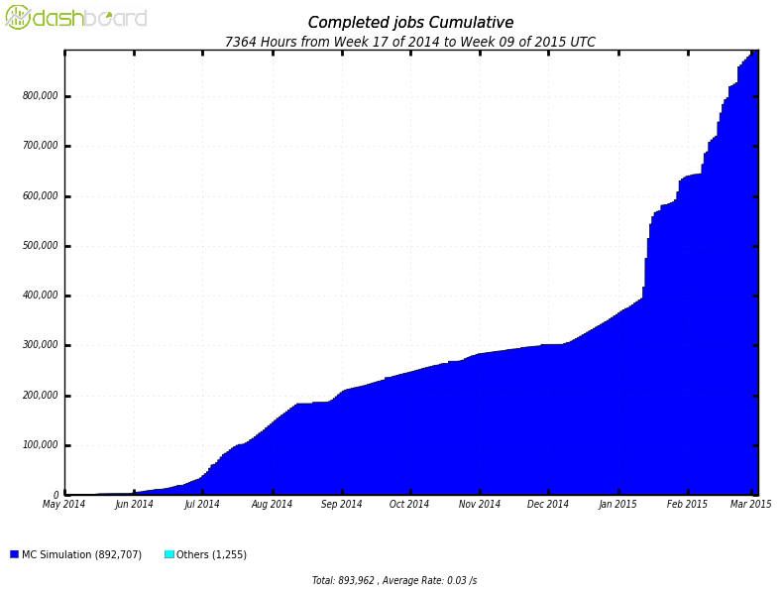
Job statistics since May 2014
5000 running jobs
900k completed jobs
Continuous 4000-5000 running jobs
almost 900k completed jobs
1M CPU hours, 20M events
50% CPU efficiency
Gaps are due to technical issues, not lack of volunteers

Slide 11
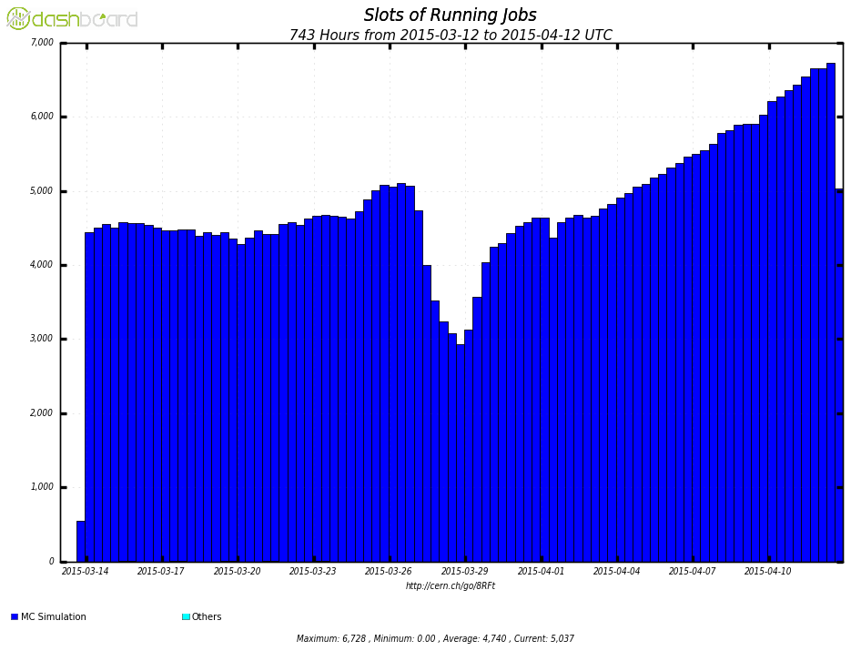
Job statistics since May 2014
5000 running jobs
900k completed jobs
LHC restart 5 April
Continuous 4000-5000 running jobs
almost 900k completed jobs
1M CPU hours, 20M events
50% CPU efficiency
Gaps are due to technical issues, not lack of volunteers

Slide 12
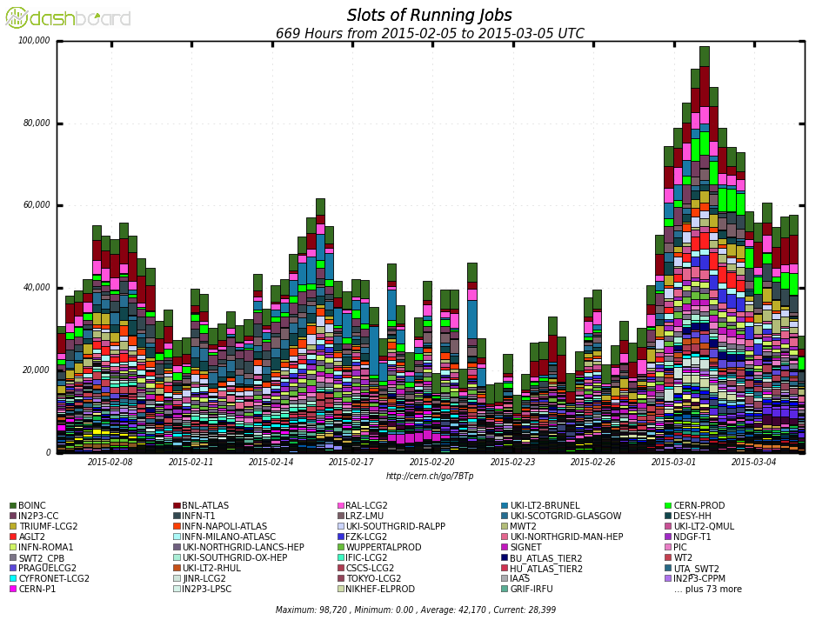
Scale of ATLAS@Home
Largest ATLAS simulation site!

Slide 13
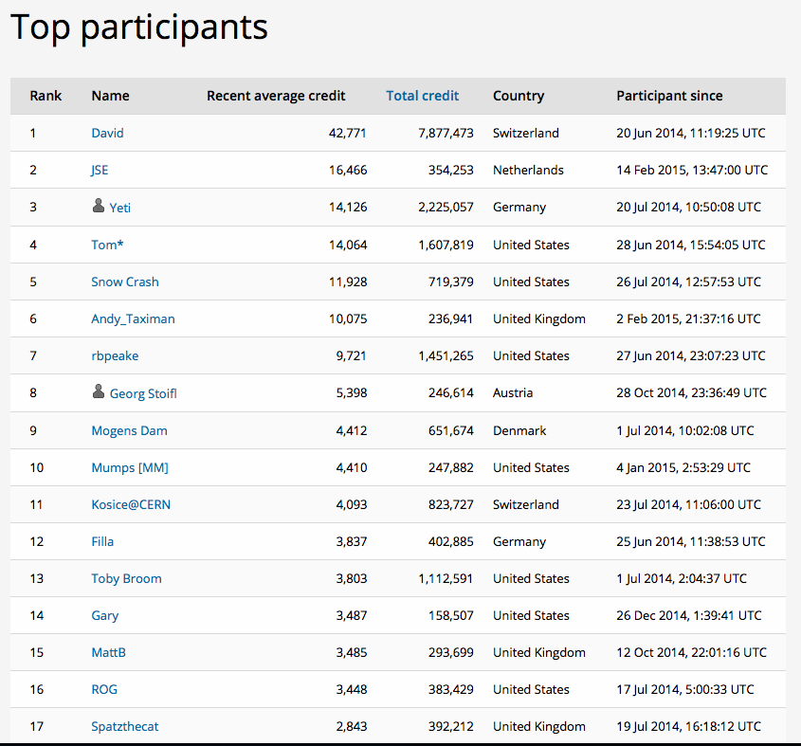
Very roughly 3 credits/event
Wide variety and distribution of volunteers

Slide 14
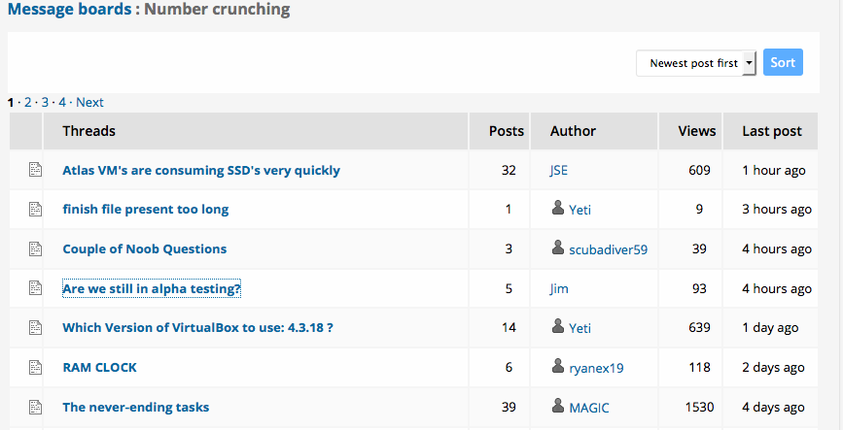
Very active message boards

Slide 15
ATLAS@Home potential
It is not possible to run all ATLAS jobs on ATLAS@home
  See earlier considerations about I/O, unreliability etc
But ~50% of jobs could feasibly run on this platform
  Event generation, MC simulation, other non-data intensive tasks
The high entry barrier may limit general public participation for now
Can it replace small Grid sites?
  For example a CPU-only T3 site or small university cluster
  Instead of setting up all the Grid infrastructure just install BOINC on the worker nodes
  Standard Grid accounting in APEL is provided by ARC CE
Idle administrative desktops
  eg now available as part of NICE, to put on CERN administrative PCs

Slide 16
Lessons Learned and Conclusions
Setting up ATLAS@Home has been an exciting and fruitful experience
Hardware is free and manpower running costs are a fraction of an equivalent-sized computing centre
But the volunteers don’t come completely for free
  Some volunteers are extremely competent and knowledgeable and help others
  But some expect support/feedback/rewards
The number of running jobs is rising slowly
  ATLAS@Home is heavy to run compared to most projects
  Still a beta project
BOINC developers very enthusiastic to help us
  They give us fixes/new features in days
We have a few more things to fix before ATLAS@Home can move out of beta
  Adding “screensaver” visualisation of events and physics info
There is a lot of potential as long as we keep the public interested

Slide 17
Acknowledgements
Our CERN IT colleagues in LHC@Home for providing the BOINC infrastructure and storage space
BOINC developers for rapid response to our questions and problems
.. and please join us!
  http://atlasathome.cern.ch
  http://atlasphysathome.web.cern.ch

Slide 18
Backup

Slide 19
How to join ATLAS@Home in a few clicks
http://boinc.berkeley.edu/download.php
Install the package and start it
Tools -> Add project or account manager…
Add project
Select ATLAS@Home (2nd on the list)
Enter email address and a password
Click Finish
Optionally add information to your profile

Slide 20
Configure BOINC Client
BOINC by default will run one task per core
ATLAS@Home is too heavy for this on most PCs
Preferences -> Computing preferences -> % of the processors
  eg to use 1 core of a 4 core PC:

