Slide 1
Evaluation of NoSQL databases for DIRAC monitoring and beyond
Adrian Casajus Ramo, Federico Stagni, Luca Tomassetti, Zoltan Mathe
On behalf of the LHCb collaboration

Slide 2
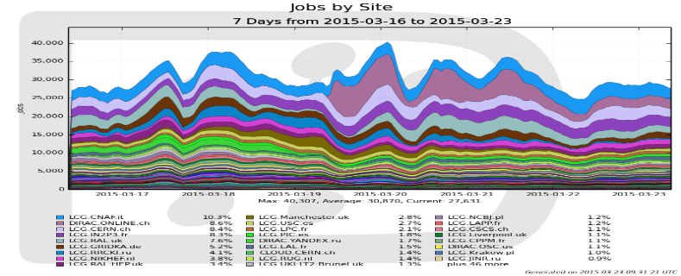
Motivation
Develop a system for real time monitoring and data analysis:
  Focus on monitoring the jobs (not accounting)
Requirements
  Optimized for time series analysis
  Efficient data storage, data analysis and retrieval
  Easy to maintain
  Scale Horizontally
  East to create complex reports (dashboards)
Why?
  Current system is based on MySQL:
    is not designed for real time monitoring (more for accounting)
    does not scale to hundred of million rows (>500 million).
      It requires ~400 second to generate a one-month duration plot
    is not for real time analysis
    is not schema-less:
      Often change the data format

Slide 3

Motivation

Slide 4
Technologies used
Database:
  InfluxDB is a distributed time series database with no dependency
  OpenTSDB is a distributed time series database based on HBase
  ElasticSearch is a distributed search and analytic engine
Data visualization:
  Grafana
    Metric dashboard and graph editor for InfluxDB, Graphite and OpenTSDB

Slide 5
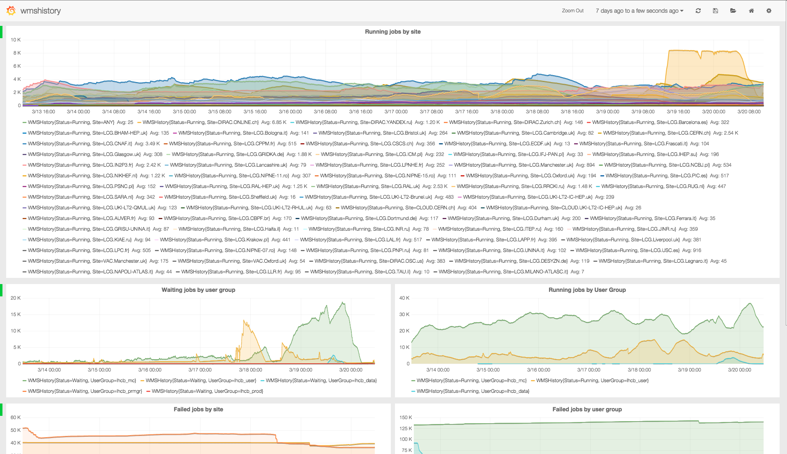
Motivation
Grafana dashboard:

Slide 6
Technologies used
Database:
  InfluxDB is a distributed time series database with no dependency
  OpenTSDB is a distributed time series database based on HBase
  ElasticSearch is a distributed search and analytic engine
Data visualization:
  Grafana
    Metric dashboard and graph editor for InfluxDB, Graphite and OpenTSD
  Kibana
    Flexible analytic and visualization framework
    Developed for creating complex dashboards

Slide 7
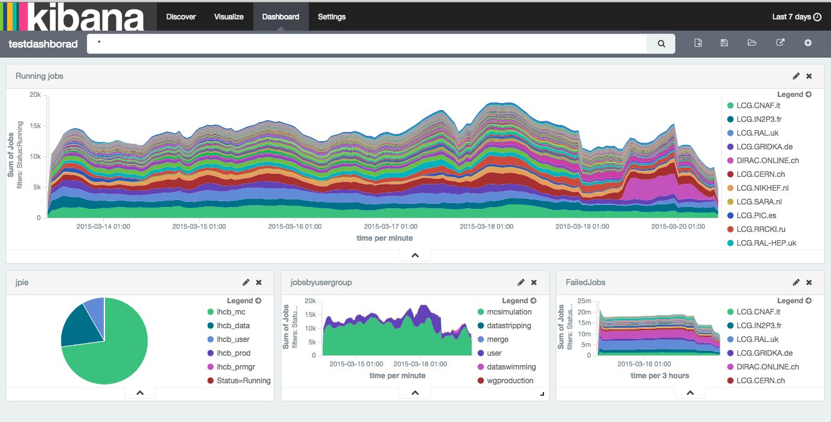
Technologies used
Kibana dashboard:

Slide 8
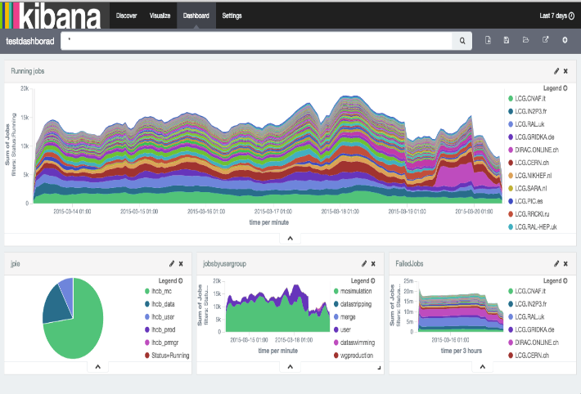

Technologies used
Database:
  InfluxDB is a distributed time series database with no dependencies
  OpenTSDB is a distributed time series database based on HBase
  ElasticSearch is a distributed search and analytic engine
Data visualization:
  Grafana
    Metric dashboard and graph editor for InfluxDB, Graphite and OpenTSD
  Kibana
    Flexible analytic and visualization framework
    Developed for creating complex dashboards
Communication
  RabbitMQ
    Robust messaging system

Slide 9
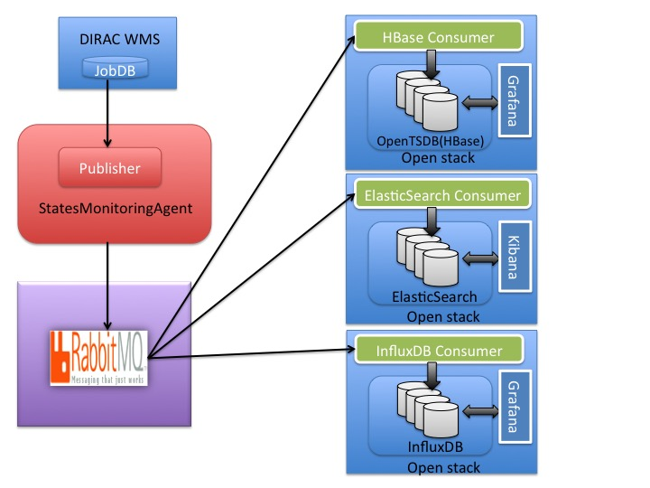
Overview of the System

Slide 10
Hardware and data format
RabbitMQ
  one physical machine
12 VMs provided by CERN OpenStack
  Each VM has 4 core, 8 GB memory and 80GB disk
  We used 3 clusters with 4 nodes
Data format:
  The records are sent to the RabbitMQ in JSON format.
  Each record must contain a minimum of four elements:
    metric, time, key/value pairs, value
    For example: {"Status": "Done", ”time": 1404086442, "JobSplitType": "MCSimulation", "MinorStatus": "unset", "Site": "ARC.Oxford.uk", "value": 10, ”metric": ”WMSHistory", "User": "phicharp", "JobGroup": "00037468", "UserGroup": "lhcb_mc”}

Slide 11
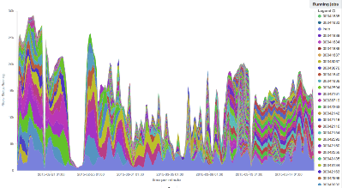
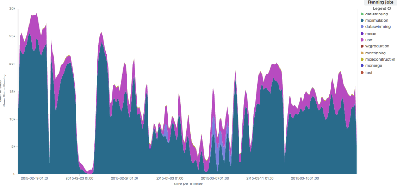
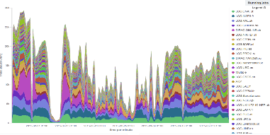
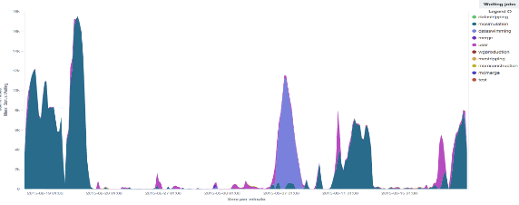
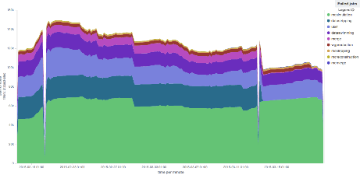
Performance comparison
We have recorded ~600 million records during ~1.5 month
We defined 5 different queries
  Running jobs grouped by Site
  Running jobs grouped by JobGroup
  Running jobs grouped by JobSplitType
  Failed jobs grouped by JobSplitType
  Waiting jobs grouped by JobSplitType
Query intervals: 1, 2, 7 and 30 day
  Random interval:
    Start and end time are generated randomly between 2015-02-05, 15:00:00 and 2015-03-12 15:00:00
The high workload is generated by 10, 50, 100 clients (python threads) to measure the response time and the throughput
  REST APIs are used to retrieve the data from the DB
  All clients are used a random query and a random period
  All clients are continuously running parallel during 7200 second
InfluxDB has not scaled after 2 days

Slide 12
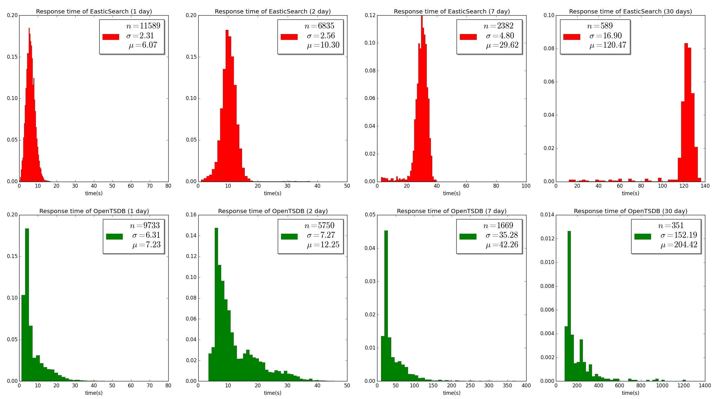
Results: 10 client

Slide 13
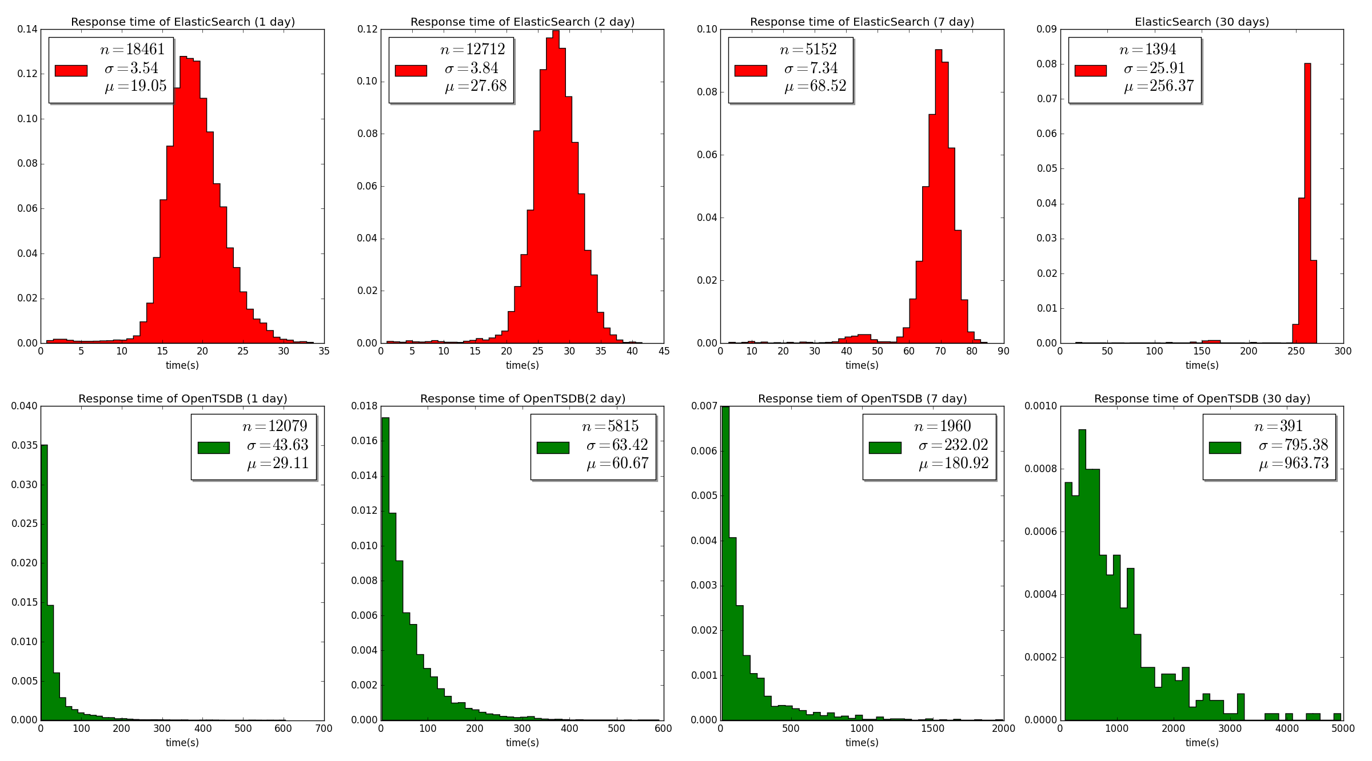
Results: 50 client

Slide 14
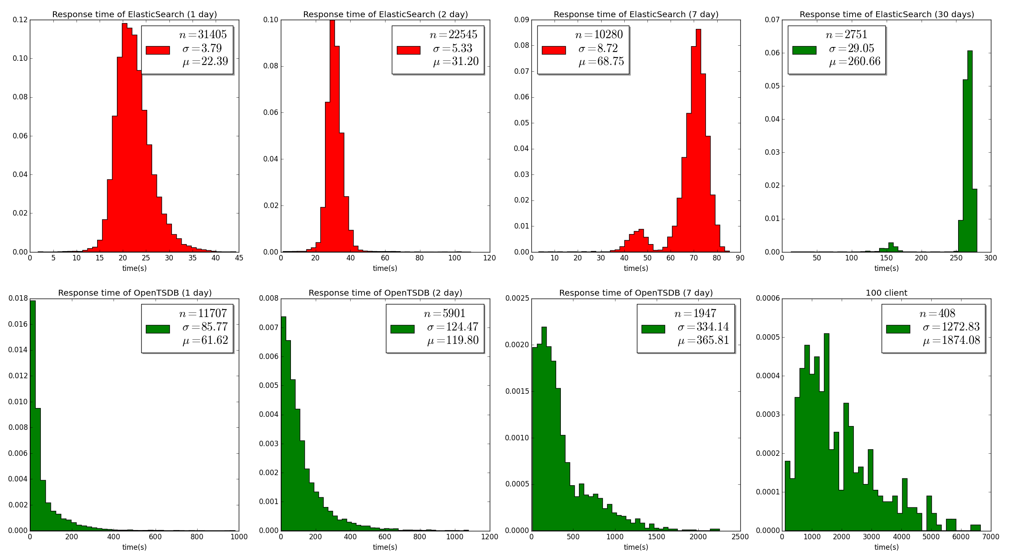
Results: 100 client

Slide 15
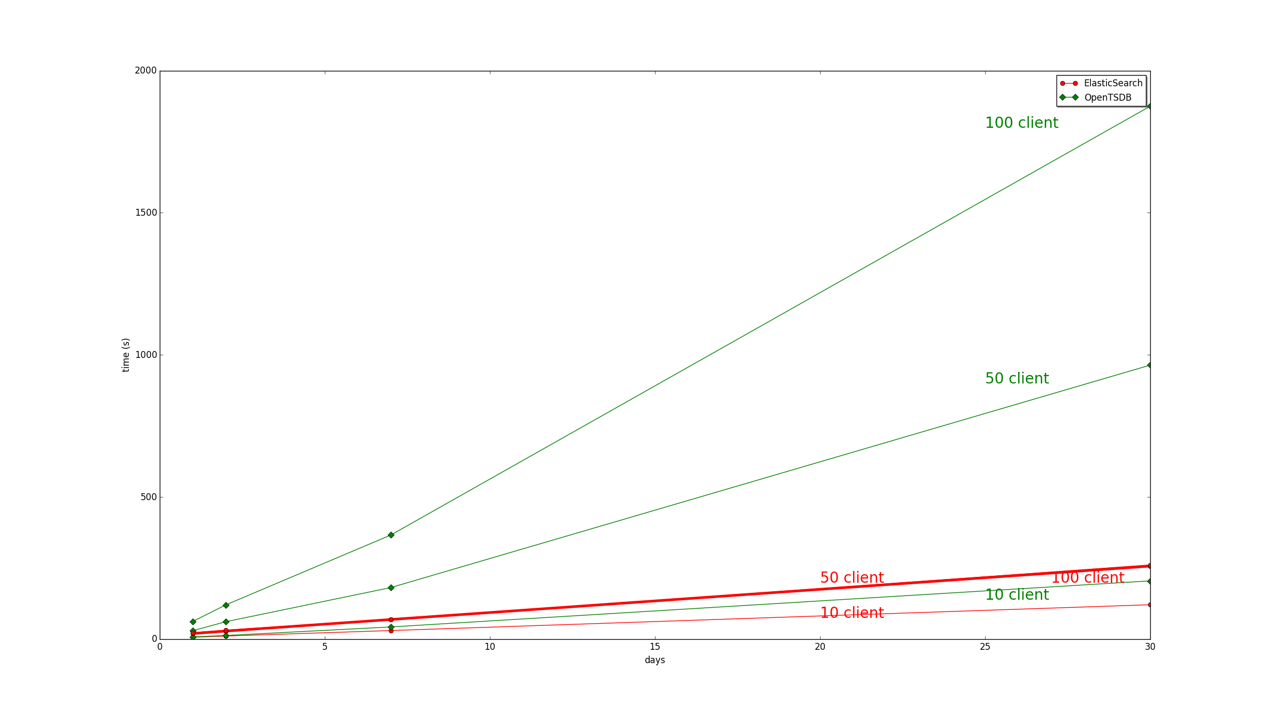
Response time of all experiments

Slide 16
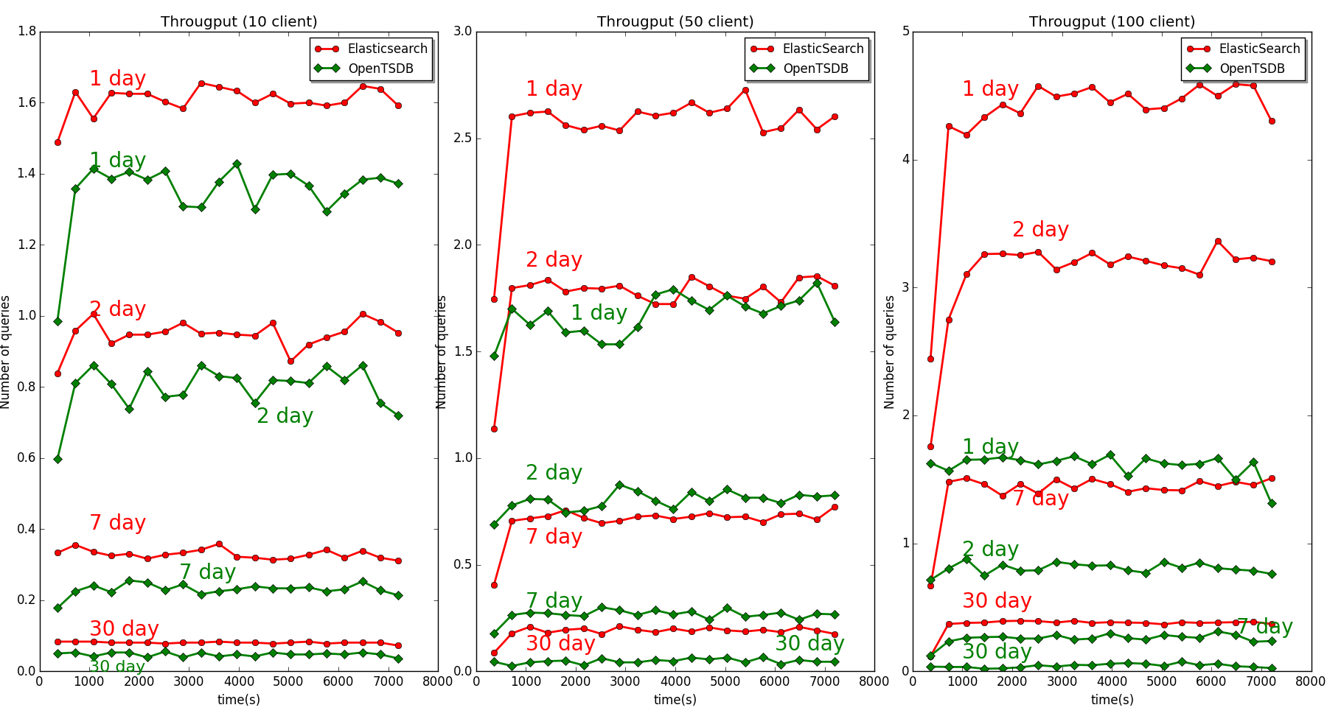
Throughput of all experiments

Slide 17
Conclusions
ElasticSearch was faster than OpenTSDB and InfluxDB
  It is easy to maintain
  Marvel is a very good tool for monitoring the cluster
    license required…
  It can be easily integrated to the DIRAC portal
  OpenTSDB was slower than ElasticSearch but it may scale better by adding more nodes to the cluster
    It is not easy to maintain (lot of parameters which have to be correctly set)
    Very good monitoring of the cluster.
InfluxDB is a new time series database, which is easy to use, but it does not scale
Kibana can fulfil our needs
  But we’ll look at integration in the DIRAC portal
According to our experience we decided to use ElasticSerach for real time monitoring of jobs, and for all real time DIRAC monitoring systems

Slide 18
Thanks!
Question, comments
?

