Slide 2
High-Speed Mobile Communications
in Hostile Environments
CHEP 2015
Okinawa
Stefano Agosta
CERN IT/Communication Systems

Slide 3



Introduction
Increasing demand for indoor wireless networks
Homes
Offices
Hostile environments
CERN underground
Trains
Meeting points

Slide 4
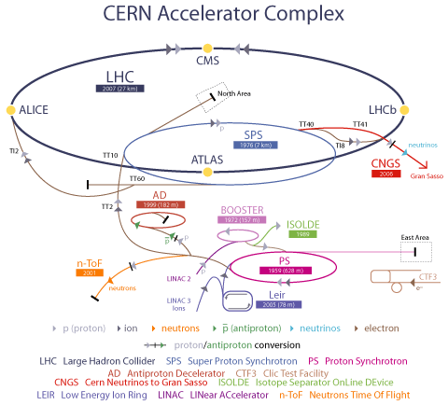
CERN needs
Target
Ionizing radiations
Gas release risk
Strict access constraints

Slide 5
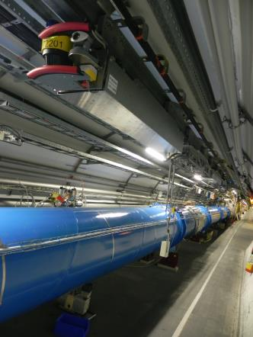
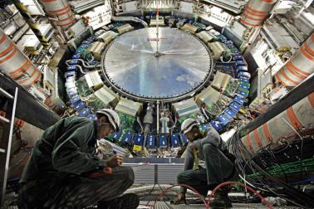
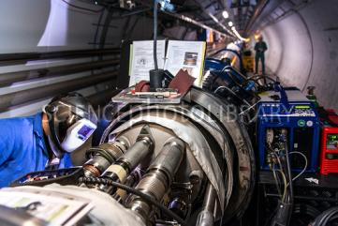
CERN needs
Services
Voice and data for :
  Standard machines operation
  Train Inspection Monorail (Radio Protection surveys)
  Temperature and humidity sensors
  Remote experts consultancy

Slide 6

WiFi technology
Widely deployed in residential and office areas
802.11ac wave 2 offers 3.5 Gbps
Access Points (AP) cover small areas (few meters)

Slide 7
WiFi @CERN
Adopted for offices
Not suitable in the underground
  Ionizing radiations
  Tunnel lengths (27 Km for LHC, 7 Km for SPS)
  Temporary VDSL during LongShutdown1
    10 Mbps, 275 APs in LHC tunnel

Slide 8

LTE technology
100% IP network
High spectral efficiency
MIMO (reliability and/or throughput enhancement)
Round Trip Time <10 ms
1 Gbps download, 500 Mbps upload

Slide 9
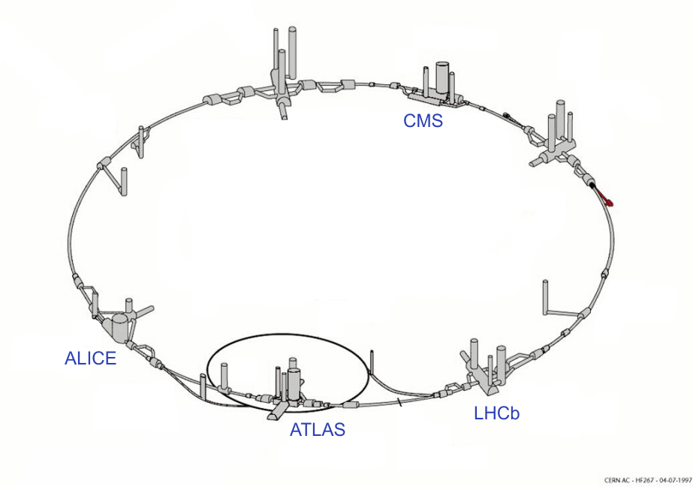
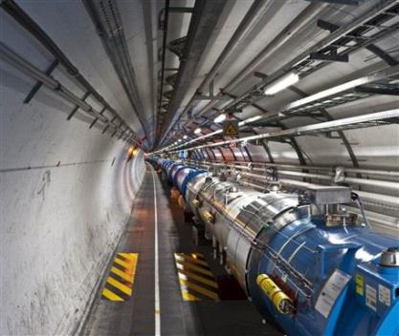
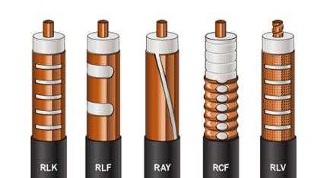

CERN tunnels mobile infrastructure
Target: tunnels + LHC caverns
Services: GSM, UMTS, TETRA, TETRAPOL
Antenna cable
  resistant to radiations

Slide 10
CERN tunnels mobile infrastructure
Inter-technology compatibility
  Passive Radio Frequency network optimized for bands:
    400 MHz
    800 MHz
    900 MHz

Slide 11


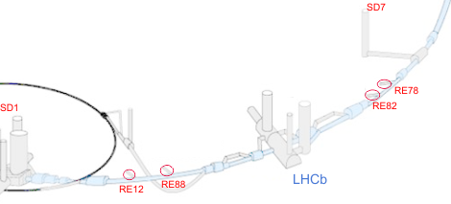


CERN tunnels mobile infrastructure
LHC repeating system
LTE
GSM + UMTS
Mobile operator
eNodeB
Mobile operator
base station
Master Unit
Remote Units
Remote Units

Slide 12
Measurements
LTE @ LHCb cavern
  70 Mbps download, 15 Mbps upload
LTE-Advanced @ LHC8
  >100 Mbps download, >50 Mbps upload
  Limited by measurements tools

Slide 13
Conclusions
Voice + data services needs in CERN underground
WiFi: good performance, problematic feasibility
LTE: high throughputs in tunnels + caverns
RF infrastructure upgrade for inter-technology compatibility

Slide 14
Questions?
Thank you!

