Slide 1
A New Event Builder
for CMS Run II
on behalf of the CMS DAQ group

Slide 2
Overview
  Overview of CMS DAQ for LHC run II
  Event-building protocol
  Performance measurements

Slide 3
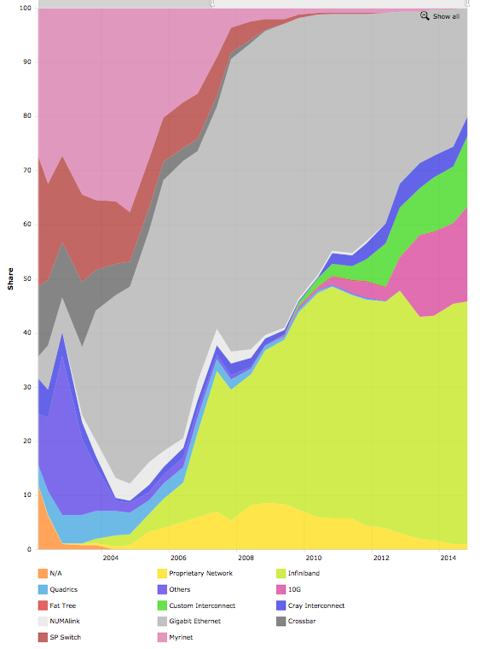
CMS DAQ for LHC Run II
Requirements
  100 kHz level 1 trigger rate (unchanged)
  Event size might double to 2 MB
    Increase in pileup
    New detectors
  Accommodate legacy and new
  uTCA-based detector readouts
    1-2 kB or 8 kB fragments
Aging hardware
  Most components reached
  end-of-life cycle
New technologies
  Myrinet widely used when
  DAQ-1 was designed
  Ethernet and Infiniband dominate
  the top-500 supercomputers today
DAQ1 TDR (2002)
2014
Myrinet
1 Gb/s
Ethernet
10 Gb/s
Ethernet
Infiniband
Top500.org share by Interconnect family

Slide 4
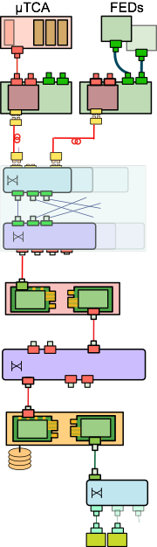

CMS Event Builder
Detector front-end (custom electronics)
Front-End Readout Optical Link (FEROL)
  Optical 10 GbE TCP/IP
Data Concentrator switches
  Data to Surface
  Aggregate into 40 GbE links
72 Readout Units (RUs)
  Combine FEROL fragments into super-fragment
Event Builder switch
  Infiniband FDR 56 Gbps CLOS network
62 Builder Units (BUs)
  Event building
  Write events to transient files on RAM disk
Filter Units (FUs)
  Run HLT selection using files from RAM disk
576 x 10 GbE
200 m
72 x 40 GbE
72 x 64 IB 56 Gbps

Slide 5

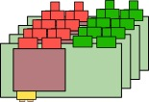

EvB Protocol
FEROLs
Fragment
Fragment
Fragment
Fragment
Fragment
Fragment
Fragment
Fragment
EVM
RU 1
RU 2
Super-fragment
Assign event to BU1
Assign event to BU1
Super-fragment
Super-fragment
Event Request
Event
Request
Event
Request
Event
BU 1
BU 2

Slide 6
Achieving Performance
Avoid high rate of small messages
  Request multiple events at the same time
  Pack data of multiple events into one message
Avoid copying data
  Operate on pointers to data in receiving buffers
  Copy data directly into RDMA buffers of Infiniband NICs
  Stay in kernel space when writing data
Parallelize the work
  Use multiple threads for data transmission and event handling
  Write events concurrently into multiple files
Bind everything to CPU cores and memory (NUMA)
  Each thread bound to a core
  Memory structures allocated on pre-defined CPU
  Interrupts from NICs restricted to certain cores
  Tune Linux TCP stack for maximum performance

Slide 7
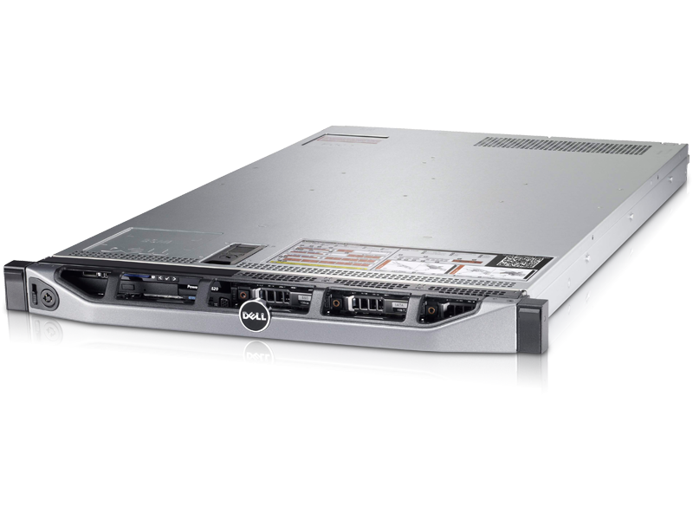
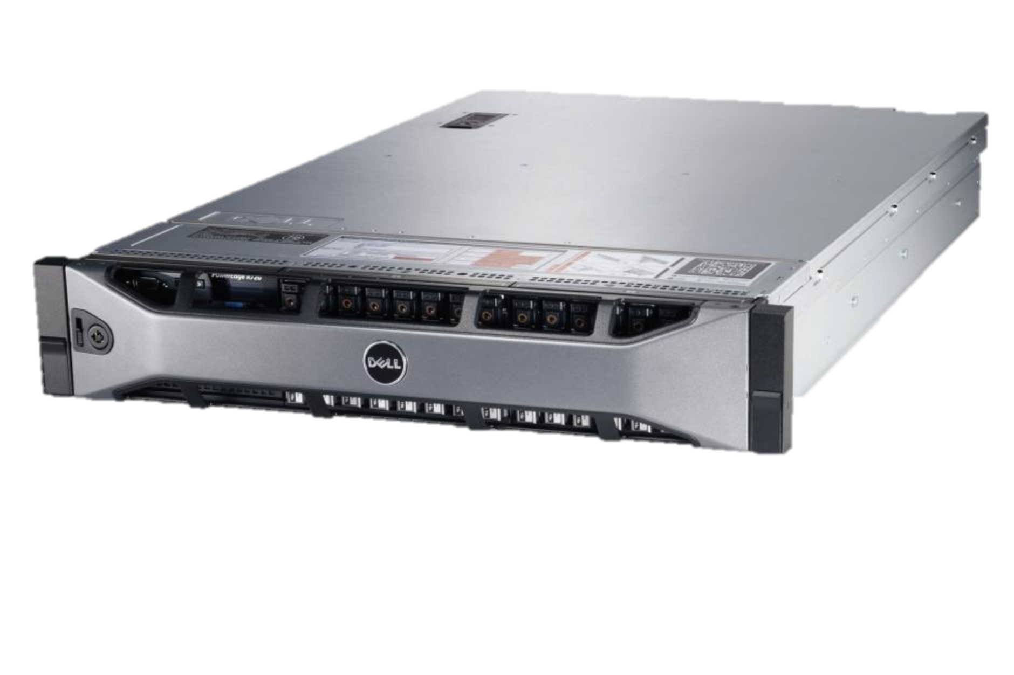
Computers
Readout Unit (RU)
  Dell PowerEdge R620
  Dual 8 core Xeon CPU
  E5-2670 0 @ 2.60GHz
  32 GB of memory
Builder Unit (BU)
  Dell PowerEdge R720
  Dual 8 core Xeon CPU
  E5-2670 0 @ 2.60GHz
  32+256GB of memory
  (240 GB for Ramdisk on CPU 1)

Slide 8
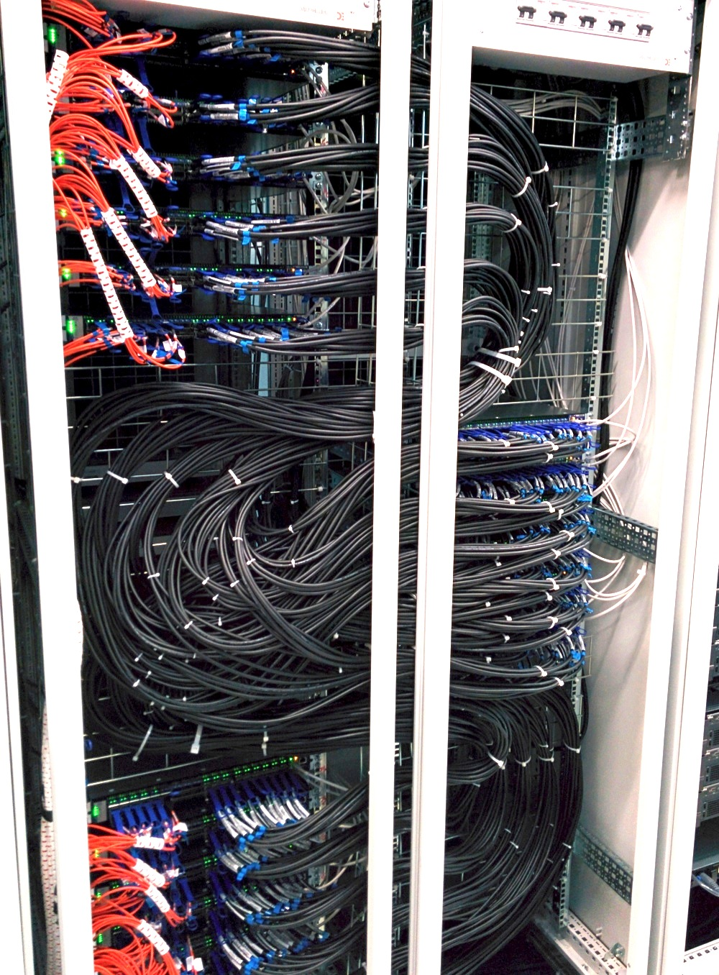
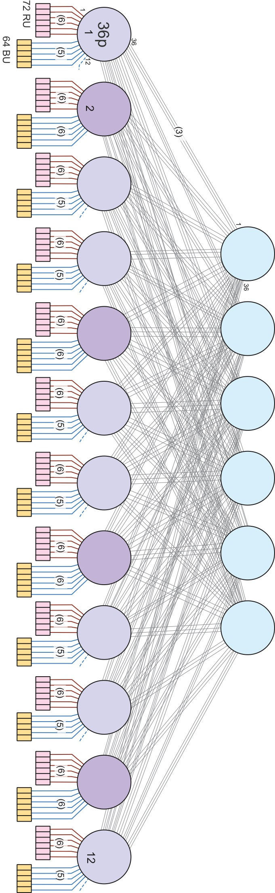
Data Network
40/56Gb NICs (Infiniband or Ethernet)
  Mellanox Technologies
  MT27500 Family [ConnectX-3]
10/40 GbE switches
  Mellanox
  SX1024 & SX1036
Infiniband switches
  Mellanox SX6036
Infiniband CLOS network

Slide 9
Performance Measurements

Slide 10


Data Concentrator
4 – 16 FEROLs
1 kB
256B - 16kB
EVM
RU
1 RU
1 kB
1 – 256 kB
2 BUs
BU 1
BU 2
Notes:
----- Meeting Notes (27/03/15 15:09) -----
Mention fixed size payload from EVM

Slide 11
Data Concentrator
Legacy FEDs
uTCA FEDs

Slide 12
Builder Unit
8 FEROLs per RU
1 kB
256B - 16kB
EVM
44 RUs
1 kB
2 - 128 kB
89 - 5633kB
1 BU

Slide 13
Builder Unit

Slide 14
Scalability
8 FEROLs per RU
1 kB
256B - 16kB
EVM
1 - 44 RUs
1 kB
2 - 128 kB
3 - 5633kB
1 – 44 BUs

Slide 15
Scalability

Slide 16
Summary
CMS has a complete new DAQ system for LHC run II
  State-of-the-art technology
  Order of magnitude smaller than previous DAQ system
Optimal use of high-end hardware
  New event-building protocol
  New software to exploit hardware capabilities
  A lot of fine-tuning to get full performance
EvB scaling behavior not understood
  Study of Infiniband CLOS network under EvB traffic ongoing
DAQ is ready for first physics data
  More work is needed to achieve the ultimate performance

Slide 17
⬅⬆

Slide 18
BU Performance vs Threads

Slide 19
Scalability

