Slide 1
21st International Conference on Computing in High Energy and Nuclear Physics
CHEP2015
April 13th -17th , 2015
Okinawa Institute of Science and Technology Graduate University
Onna, Okinawa, Japan

Slide 2
Closing Address
1. Some numbers
2. People
3. Announce

Slide 3
1. Some numbers
1.1. Contribution
1.2. Participation
1.3. Logistics

Slide 4
1.1 Contributions
3 opening talks
7 review talks
6 talks on specific topics
5 industrial talks
255 parallel talks
248 poster presentations
8 track summary talks + 1 track organization
8 lightning talks
2 closing talks

Slide 6
1.2. Participation
Around 450 participants from 28 countries
Australia | 2
Austria | 1
Belgium | 1
Brazil | 1
Canada | 5
China | 9
Czech Republic | 5
Finland | 3
France | 28
Germany | 54
India | 1
Italy | 27
Japan | 69
Kazakhstan | 1
Malaysia | 1
Netherlands | 7
Norway | 4
Poland | 1
Republic of Korea (S) | 5
Russia | 7
Slovak Republic | 1
Slovenia | 3
Spain | 8
Sweden | 1
Switzerland | 108
Taiwan | 2
U.K. | 25
United States | 66

Slide 7
1.3. Logistics
# of paper cups ~ 8,000
# of water bottles ~ 7,500
# of lunch boxes ~ 2,800
# of bus transport services ~ 140
# of lost and found ~ 30

Slide 8
2. People
2.1. Committees
2.2. OIST Staff
2.3. Secretaries and Volunteer Students
2.4. Local Organizers

Slide 9
2.1. Committees
International Advisory Committee
Program Committee

Slide 10
International Advisory Committee
Mohammad Al-Turany | GSI
Dario Barberis | U. Genoa
Ian Bird | CERN
Daniele Bonacorsi | INFN-BO
Predrag Buncic | CERN
Federico Carminati | CERN
Marco Cattaneo | CERN
Gang Chen | IHEP
Kihyeon Cho | KISTI
Guenter Duckeck | LMU
Michael Ernst | BNL
Maria Girone | CERN
David Groep | NIKHEF
Volker Guelzow | DESY
Frédéric Hemmer | CERN
Matthias Kasemann | DESY
Nobuhiko Katayama | IPMU
Borut Kersevan | IJS
Alexei Klimentov | BNL
Eric Lancon | CEA
Jerome Lauret | BNL
Simon C. Lin | ASGC
Milos Lokajicek | FZU
Adam Lyon | FNAL
David Malon | ANL
Frans Meijers | CERN
Gonzalo Merino | Wisconsin
Johan Messchendorp | KVI-CART/U. Groningen
Mauro Morandin | INFN-PD
Richard Mount | SLAC
Harvey Newman | CALTECH
Rob Roser | FNAL
Hiroshi Sakamoto | U. Tokyo
Alberto Santoro | UERJ
Takashi Sasaki | KEK
Oxana Smirnova | Lund U.
Dongchul Son | KNU
Panagiotis Spentzouris | FNAL
Reda Tafirout | TRIUMF
Jeff Templon | NIKHEF
Pere Mato Vila | CERN
Yasushi Watanabe | RIKEN
Stephen Wolbers | FNAL
Frank Wuerthwein | UCSD
30/44

Slide 11
Program Committee
PC Core Team = Chairs
PC Members

Slide 12
2.2. OIST Staff
Plenary Presentation
  President J. Dorfan and Dean of Faculty Affairs K. Peach
Conference Support
  N. Calder, Y. Morita, Y. Maneva, J. Kosinski, J. Dickison
IT Service Support
  T. Dyce, G. Shamugalingam, U. Palani, R. Yokuda, H. Omokawa
  And Fujisoft Inc. for audio-visual services
Security staff, loading service, cleaning staff, health center
And many, many OIST people
  Kindly allow us to occupy all meeting rooms

Slide 13
2.3. Secretaries and Volunteer Students
Secretaries
  Y. Takemoto, Y. Tezuka, C. Ueda (U. Tokyo)
  Y. Naya, K. Iwai(RIKEN)
  V. Huan, S. Shen (ASGC)
Volunteer Students
  19 Students from U. Tokyo, Tokyo Tech, Kobe U., Hiroshima U.

Slide 14
2.3. Secretaries and Volunteer Students
Scientific Secretaries
Track1 | Junpei Maeda | Kobe U.
Track2 | Shima Shimizu | Kobe U.
Track3 | Yasushi Watanabe | RIKEN
Track4 | Kiyoshi Hayasaka | Nagoya U.
Track5 | Osamu Jinnouchi | Tokyo Tech.
Track6 | Fukuko Yuasa | KEK
Track7 | Chikara Fukunaga | Tokyo M. U.
Track8 | Junichi Kanzaki | KEK

Slide 15
2.4. Local Organizers
Fukuko Yuasa | KEK
Takashi Sasaki | KEK
Takanori Hara | KEK
Hideki Miyake | KEK
Katsuo Tokushuku | KEK
Tomoaki Nakamura | U. Tokyo
Tatsuya Chujo | U. Tsukuba
Chikara Fukunaga | Tokyo M. U.
Hiroshi Sakamoto | U. Tokyo
Yoshinari Hayato | U. Tokyo
Yasushi Watanabe | Riken
Tada'aki Isobe | Riken
Masahiro Kuze | Tokyo Tech
Osamu Jinnouchi | Tokyo Tech
Masaharu Nomachi | Osaka U.
Hisaya Kurashige | Kobe U.
Toru Sugitate | Hiroshima U.
Kenta Shigaki | Hiroshima U.
Yasushi Nagasaka | Hiroshima I. T.
Tsumoru Shintake | OIST

Slide 16
3. Announce
Proceedings
  Deadline at May 17th (No extension!!)
The next CHEP2015-participant mail
  Access to the Conference Photo Album
  Link to Evaluation Page
    Your feedback is very important
HEP Software and Computing Mailing List
  Subscribe from:
  hep-sw-comp+subscribe@googlegroups.com

Slide 17
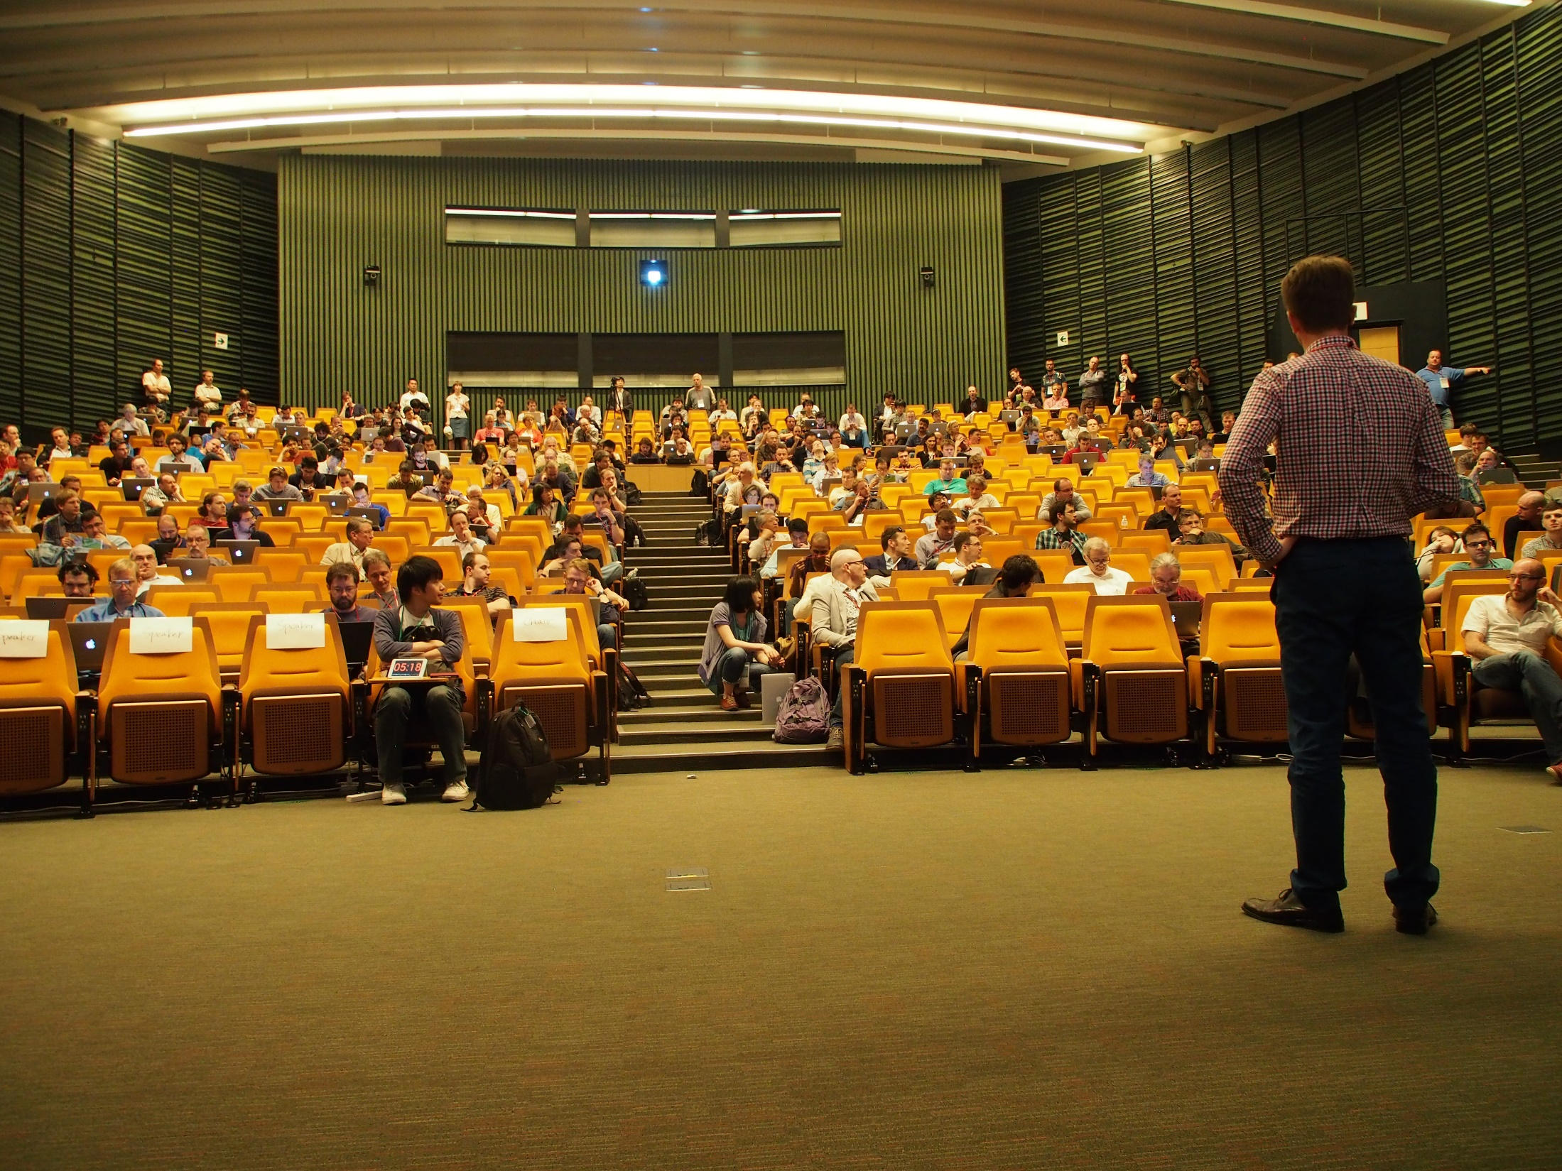

Slide 18
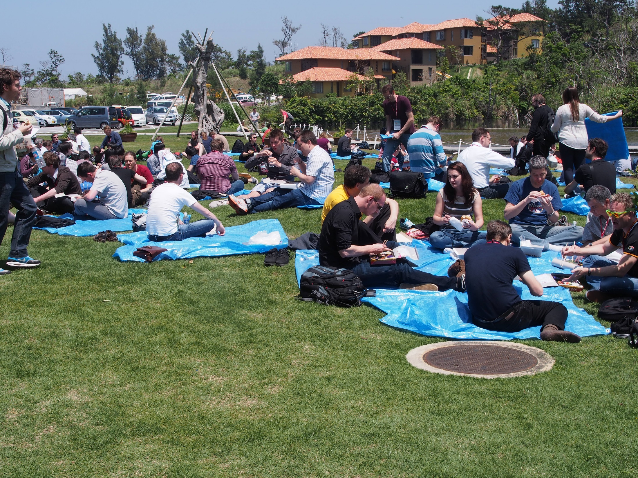

Slide 19
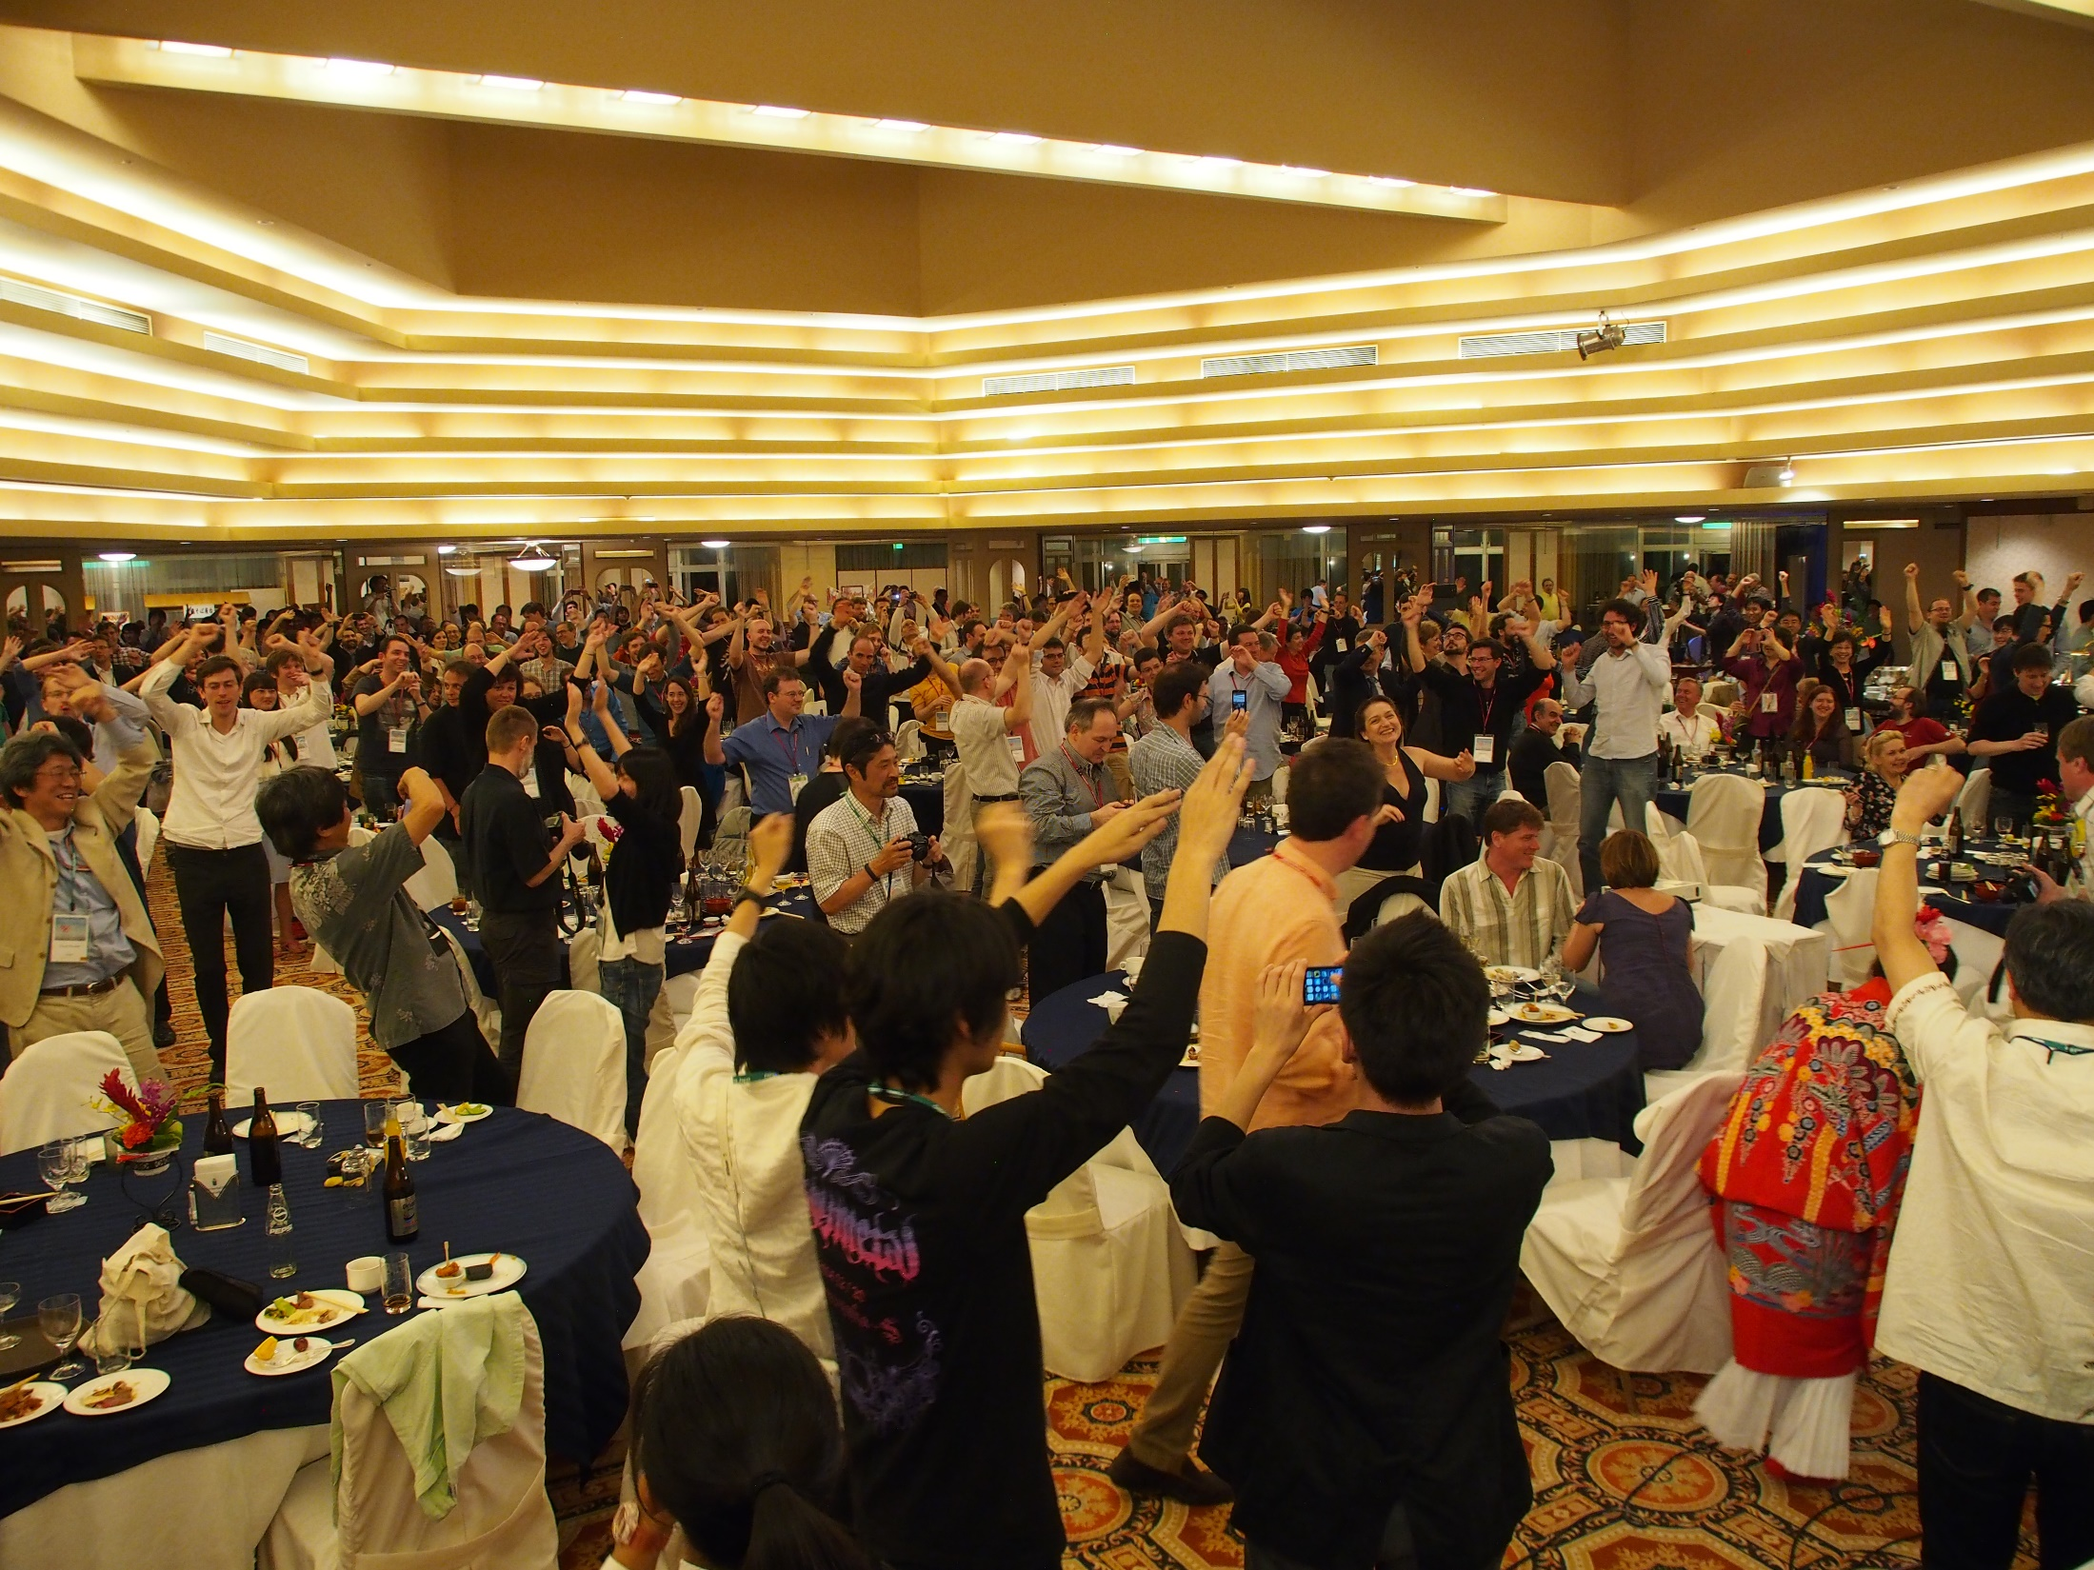

Slide 20

See you again at CHEP2016 in Stanford, Fall 2016

