Slide 2
The DAQ needle in the Big Data Haystack
Technology Convergences in the post-LHC era
Emilio Meschi - CERN/PH

Slide 3
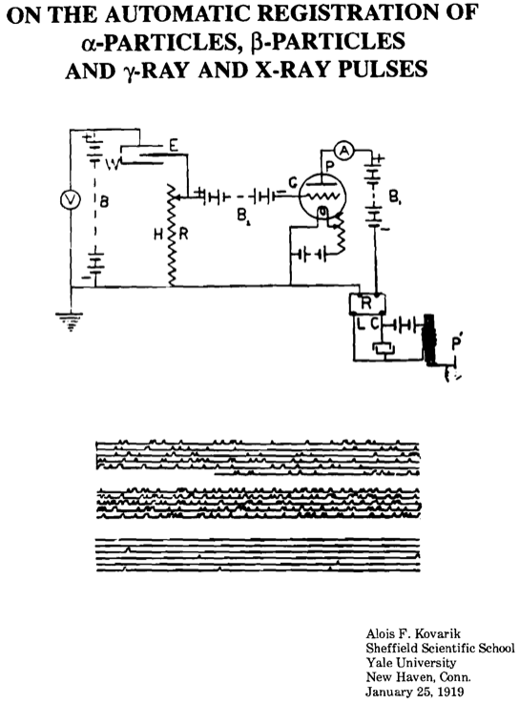
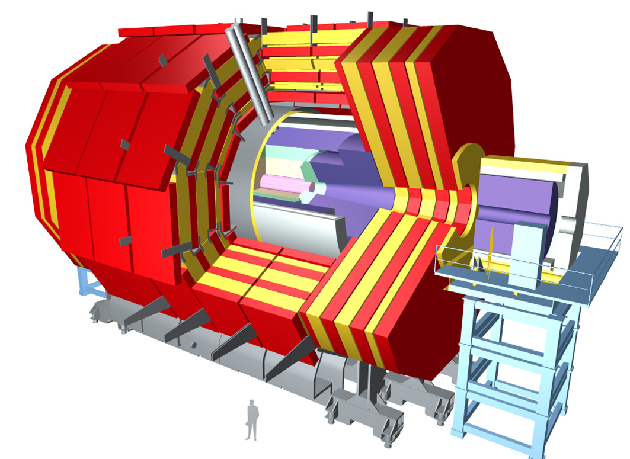
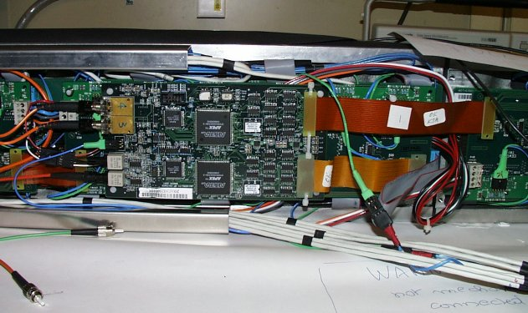
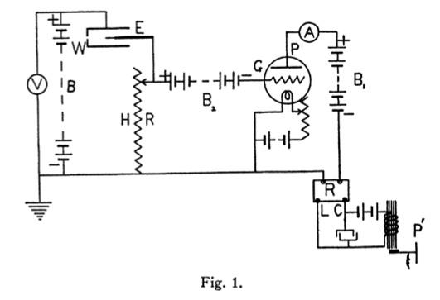
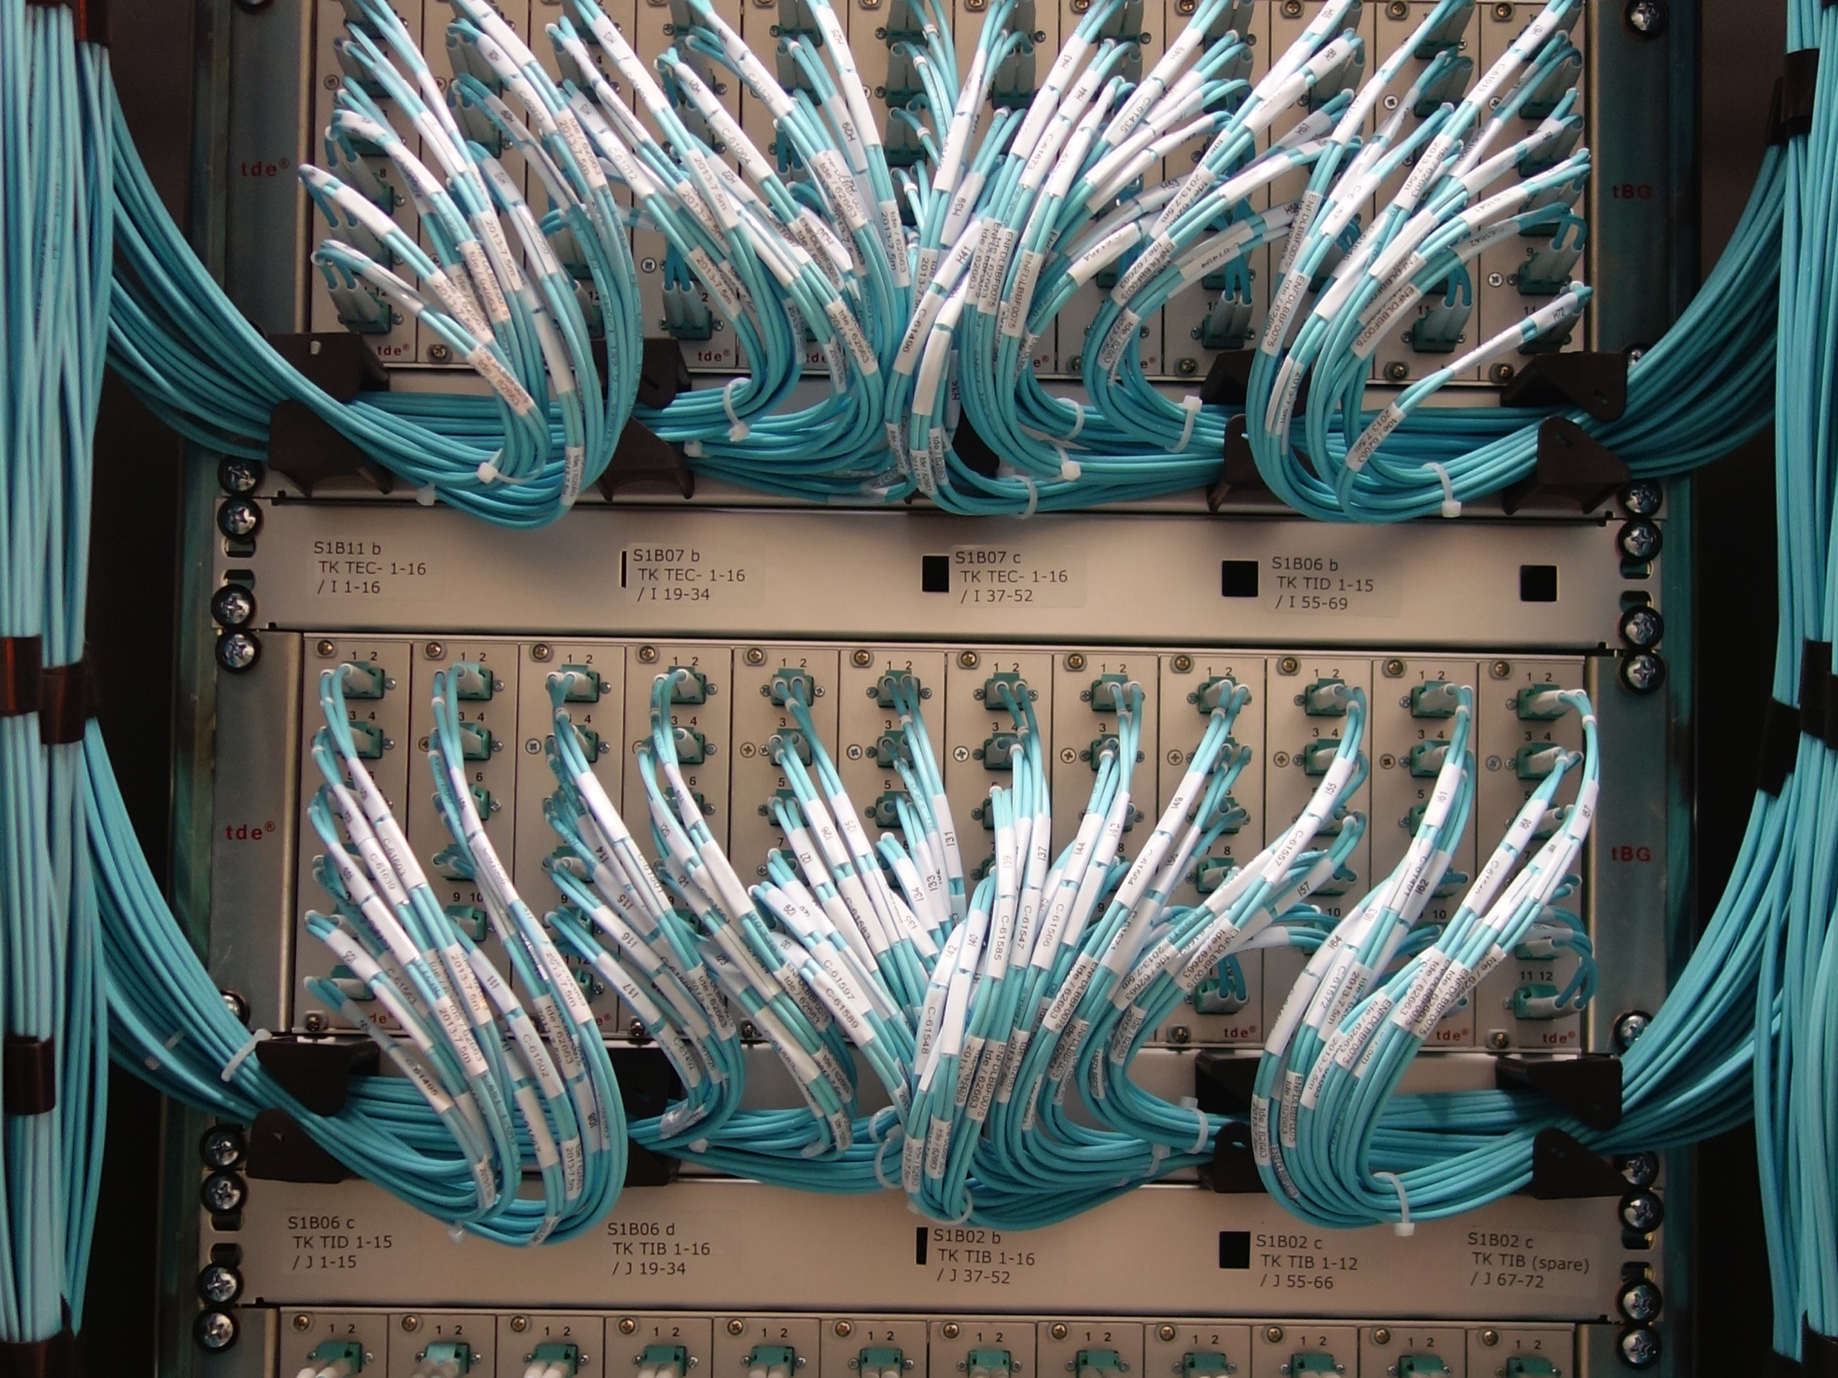
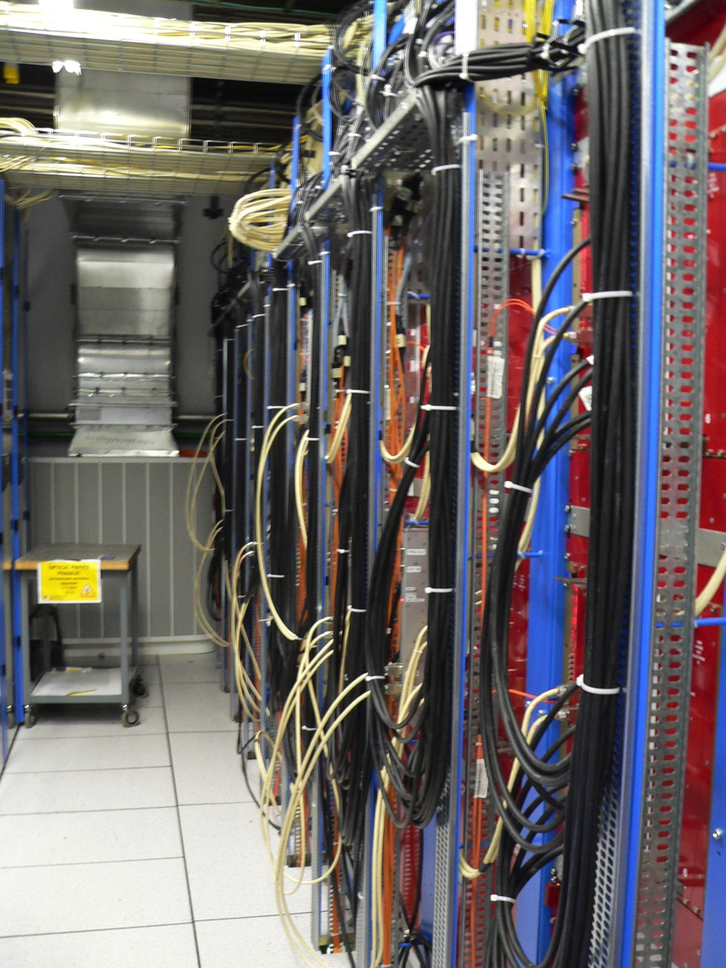
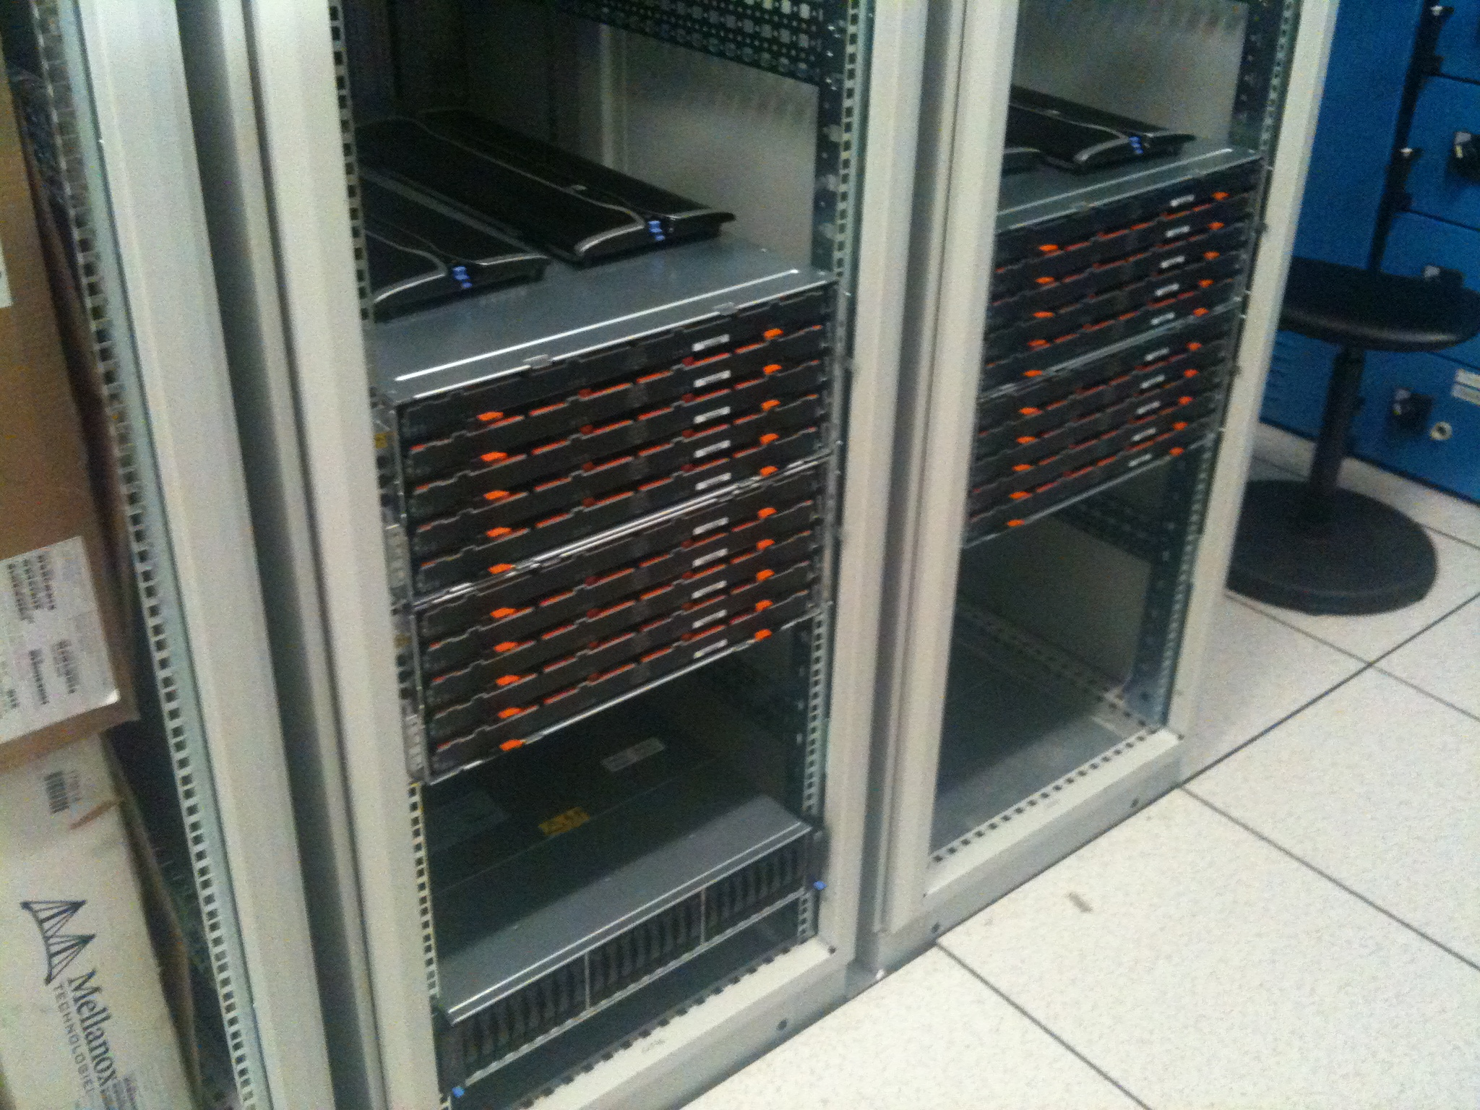
“…visual or audible methods of counting are quite trying on the nerves because close attention is necessary on account of the probability law of emission of the particles; and long periods of counting are essential because the method is a statistical one”
Alois F. Kovarik - Phys. Rev. 13 (1919) 272-280
Human Factor
“Typical detectors are…more than 100 000 electronics channels… Raw data per event can reach several megabytes due to more common use of time-sliced digitising… [forcing] data compaction in situ, to keep the transported data to a level acceptable to storage devices…the purpose becomes…gathering all events of physics interest with minimum background…[and]…minimum deadtime.
One should have in mind that the data acquisition system (not including front-end electronics) amounts to about 5% of the detector cost…”
Ph. Gavillet - NIM A235 (1985), 363-379
Channel count, storage, deadtime…standardization
“The Fastbus- and VME-based tree architectures of the eighties run out of steam when applied to LHC’s DAQ requirements. New concepts and architectures change rack-mounting backplane buses for high- speed point-to-point links, abandon the centralized event building and use switched networks and parallel architectures instead, and replace mainframes and workstations with cheaper PC farms.”
J. Toledo et al. - Microprocessors and Microsystems 27,8 (2003), 353-358
Parallel backplanes vs. point-to-point, switched networks, commercial hw
Source:
http://journals.aps.org/pr/abstract/10.1103/PhysRev.13.272
What are the main points of today ?
Ever increasing channel count
Smaller and smaller bunch spacing
Large mass of persistent data
Experiments with life span of several decades
  Human Factor
Notes:
The third quote is not necessarily the most insightful one could find about the LHC DAQ architectures, but one that I liked for the wording and which touches on the four most crucial innovations which are not innovations. In fact, it boils down to the unconventional use of conventional, already existing technologies

Slide 4
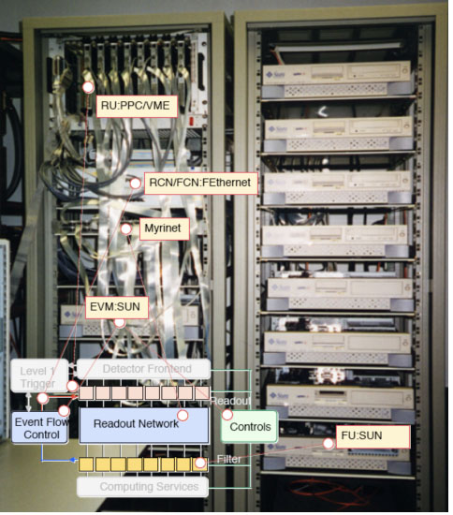
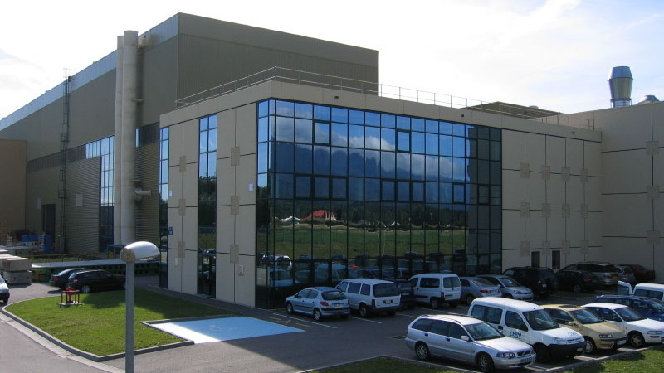
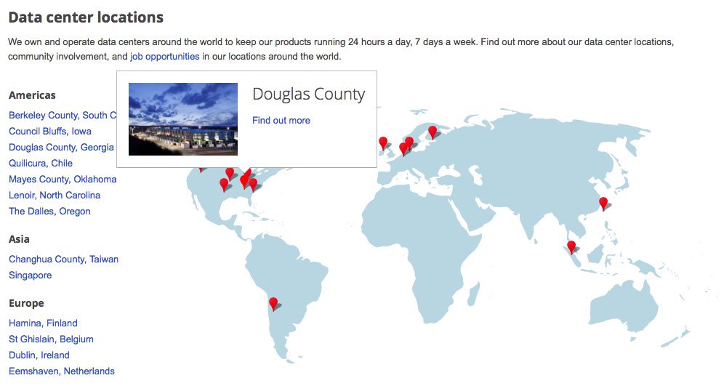
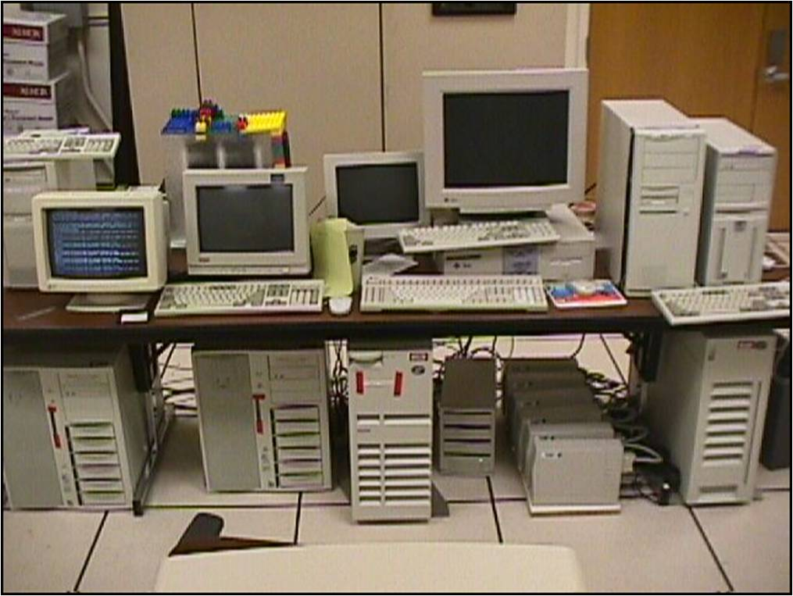
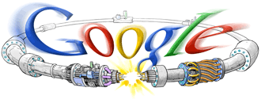
1998
2015
Source:
http://www.google.com/about/datacenters/inside/locations/

Slide 5
Since LHC
HEP no longer alone at the forefront of data manipulation and even data analysis
  telecommunications
  commercial data mining
  machine learning
Yet future challenges are formidable and resources limited
among others:
  “human” cost of creating and maintaining custom electronics and software over life span of experiments may become prohibitive
As in the past: use “conventional” (new and old) technologies in non-conventional ways
Take a holistic look at the problem: from the front-end to offline analysis
Notes:
telecommunications (real time, bandwidth, switched networks)
commercial data mining (“event building”, high performance computing ‘a la’ HEP)
machine learning (sophisticated algorithms applied in ‘quasi real time’)

Slide 6
Two examples
Optical links
Big Data Analytics

Slide 7
The detector readout dilemma
Physics and Machine
Number of detector channels
Readout
Data reduction
Complexity
Depth of pipelines
Power consumption
Power dissipation
Rad-hardness
COST
Material budget
Space
Engineering
Cooling

Slide 8
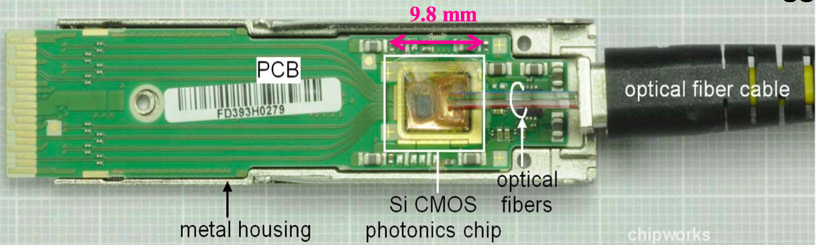
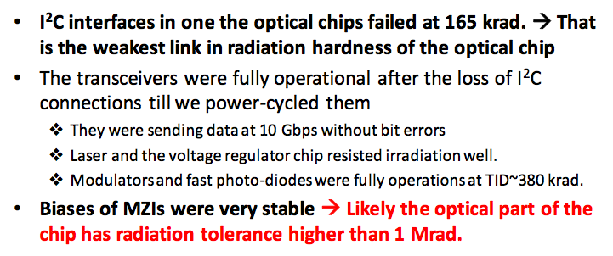
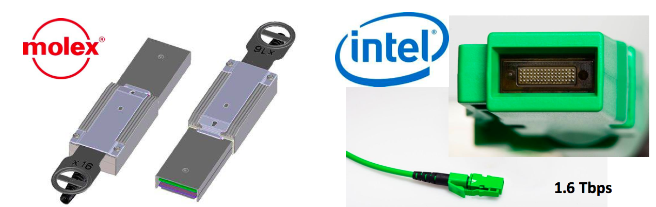
Of course…Silicon Photonics…
Source: A Paramonov et al. WIT2014

Slide 9
…makes one immediately think of brute force readout of entire detector
Unless read out at crossing frequency, large fraction of b/w used for trigger data
High-speed bidirectional links – do we want to use them in only one direction ?
  bring “calibrations” to detector
  bring algorithms to detector
intelligent detectors - built with in mind the way we analyse them – e.g.
  “stub” tracking in silicon strips detector
  layer-to-layer interconnects with local processing
Notes:
Radiation hardness and radiation effects

Slide 10
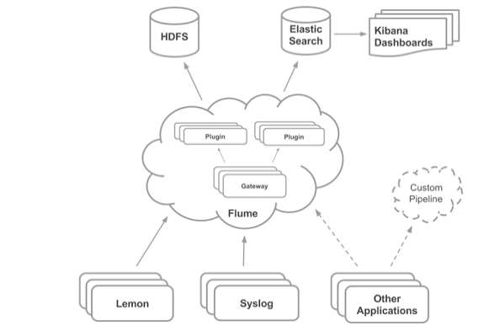
Big Data analytics
Commercial applications analyze vast amounts of unstructured data
  Bandwidth will soon surpass those of a typical DAQ
  Applications require “quasi-real-time”
Distributed search engines / “NoSQL” databases
We start using them today…
Cern-IT cloud infrastructure
CMS F3 monitoring
http://openstack-in-production.blogspot.jp/2013/10/log-handling-and-dashboards-in-cern.html
See S.Morovic talk later in this session

Slide 11
Big Data analytics
But distributed search engines are not limited to monitoring
The principle can be applied to e.g.:
search the data we want in the detector (as opposed to “partial event building” of old)
build online “event directories”
execute complex algorithms comparable to our high-level pattern recognition (e.g. clustering)
What if we could embed a distributed search engine in our detector front-end (…or nearby) ?

Slide 12
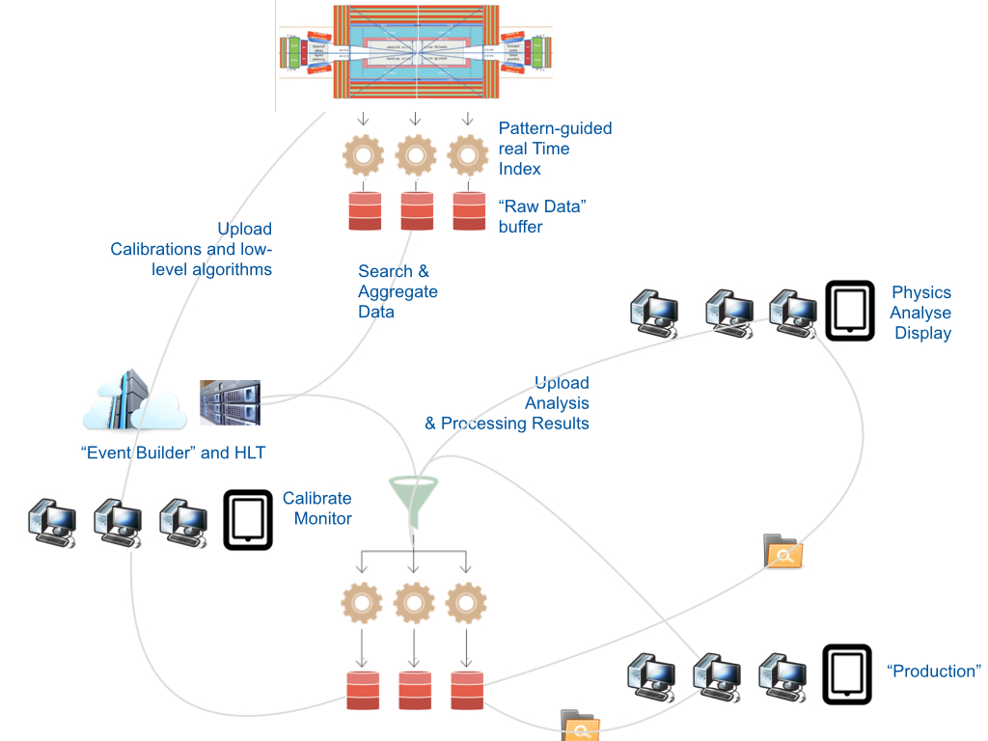
All DATA-DRIVEN tasks based on Internet hardware and software services.
The required performances are anticipated by the data processing and data communication trends
Notes:
High Level Trigger a strictly controlled process - mainly because of the limited availability of processing power…
What if…
not the processing power but the bandwidth became the relevant parameter
HLT could be delocalised over large transnational networks of data centres
A group interested in a particular type of physics could run their own particular data selection by submitting a “search” to the experiment’s data acquisition system
…limited to available bandwidth

Slide 13
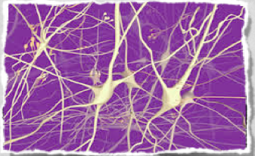
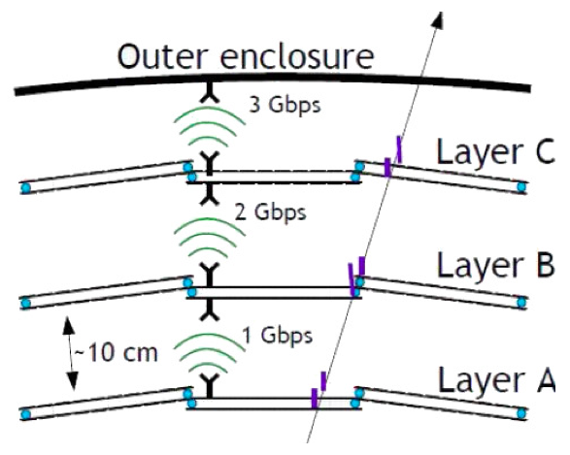
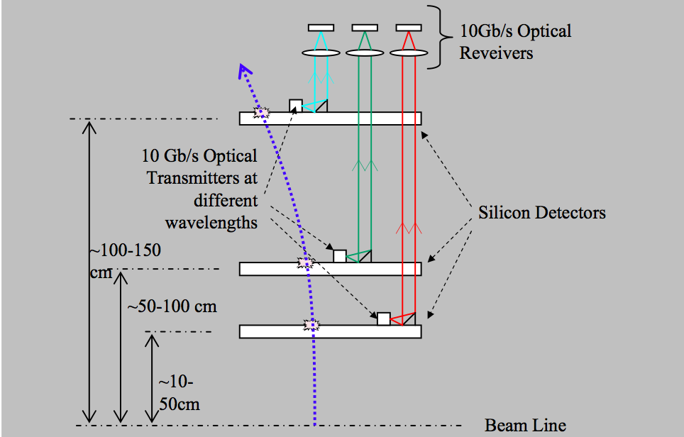
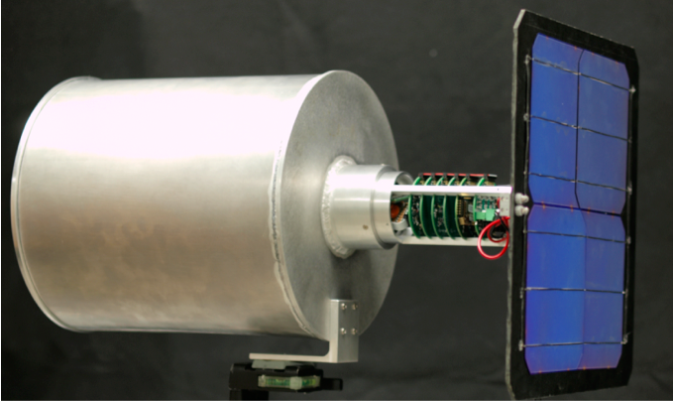
Even More Exotic Stuff
“Artificial retina” for 40 MHz tracking
(https://www.sciencedirect.com/science/article/pii/S0168900200006768)
Wireless readout
(2014 JINST 9 C11002)
Low-power conventional Multi-Gigabit links
(2014 JINST 9 C12011)
Free-space optical links
(http://www.sciencedirect.com/science/article/pii/S1875389212018998)
Wireless powering and readout
(arXiv:1310.1098v1)
…just to name a few

Slide 14
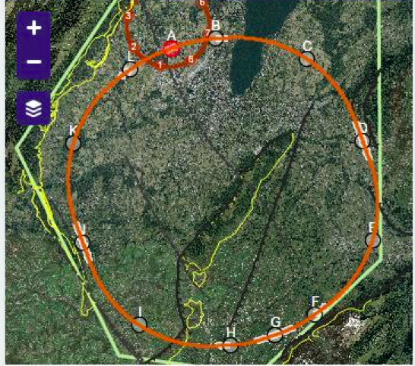
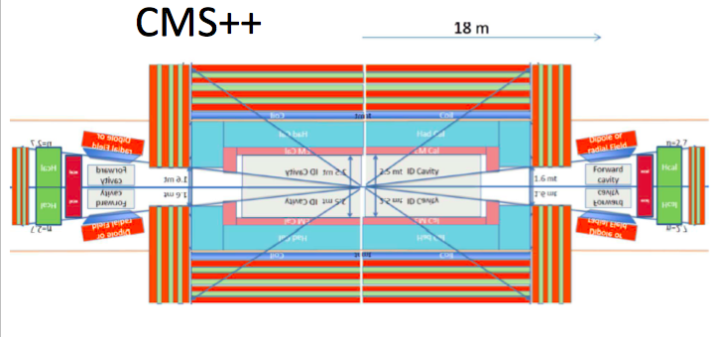

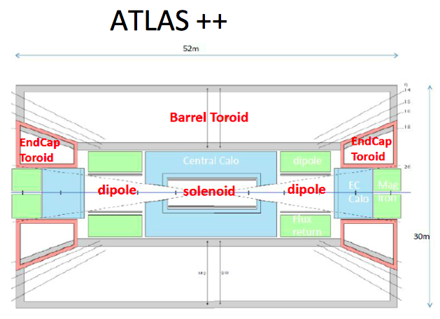
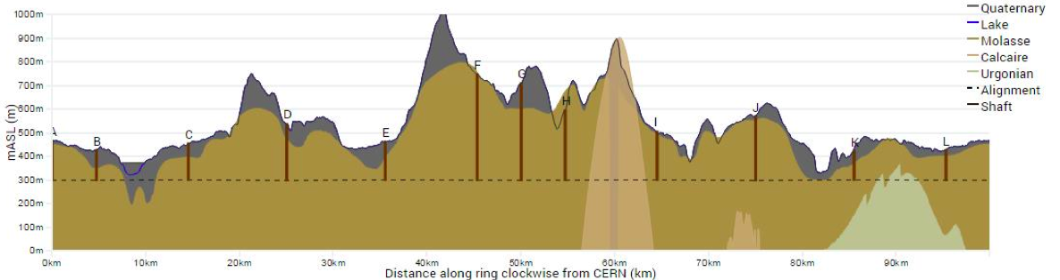
Source: http://fcc.web.cern.ch
B/w out of IP virtually
unlimited
Impractical location for
surface infrastructure
Human factor
Experiments

Slide 15
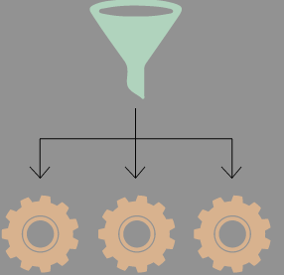
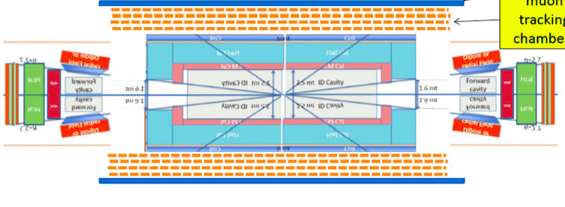
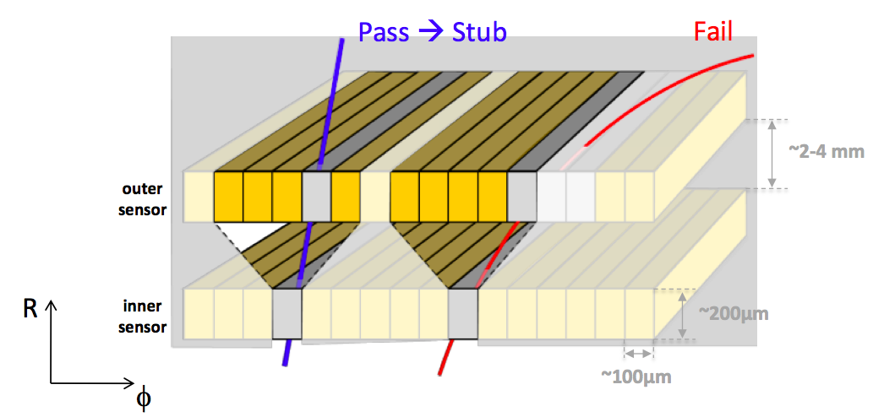
5ns interbunch
with timestamping
On-detector
pattern recognition
(e.g. “retina”)
Quasi-FE data organising
pipelines with indexing
Free-space radial optical (or radio) links
Multi-layer
stub identification

Slide 16
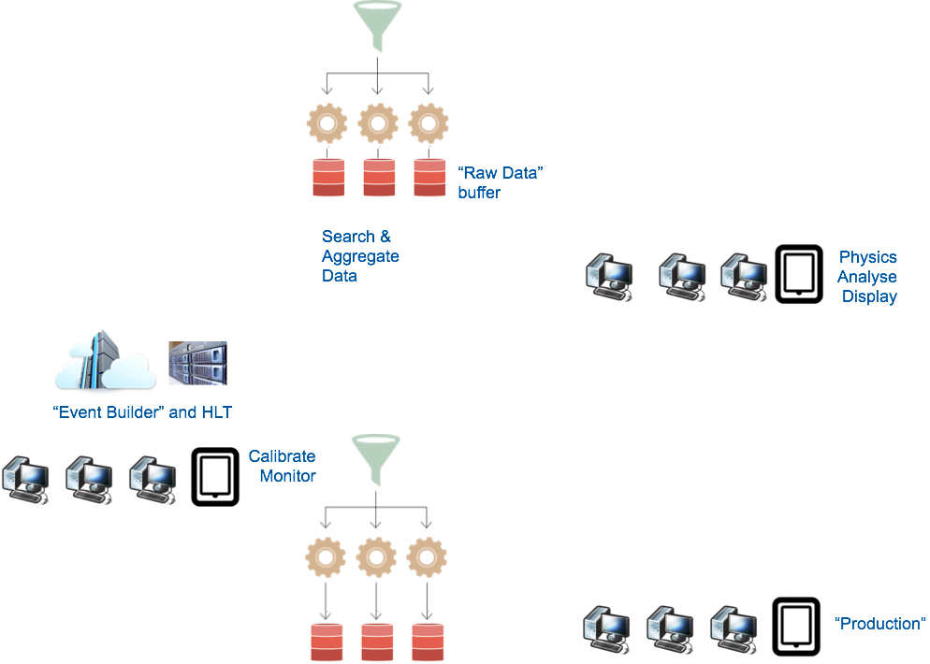
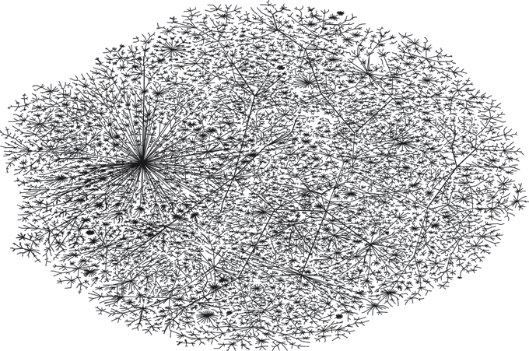
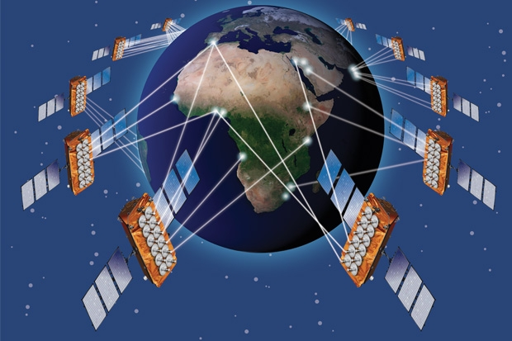
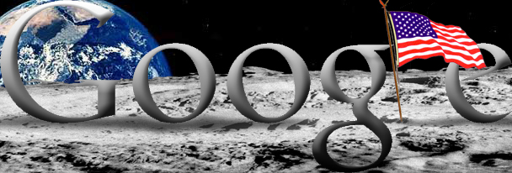
2040?
5ns interbunch
with timestamping
On-detector
pattern recognition
(e.g. “retina”)
Data-organising
pipelines with indexing
Free-space radial optical (or radio) links
Multi-layer
stub identification
http://simoneferrarogd.deviantart.com/art/Doodle-google-space-60-freak-213457167
http://www.wired.co.uk/news/archive/2010-11/29/broadband-satellite-gets-funding

Slide 17
Summary
Any, or all, or some combination of this may or may not come true one day
»Det er svært at spå, især om fremtiden«
Danish Proverb
…or Niels Bohr…
…or ‘Yogi’ Berra…
…or Jaques Chirac…
Perhaps:
»Correct attribution is hard, especially for the past« D. Arnold
The interest of trying to guess how our future DAQ systems will look like lies not in the final attribution, but in the criticism, discussion and ultimately *thinking* a particular guess will elicit
See you all hopefully in twenty(?) years to verify what, eventually, actually came to pass

Slide 18
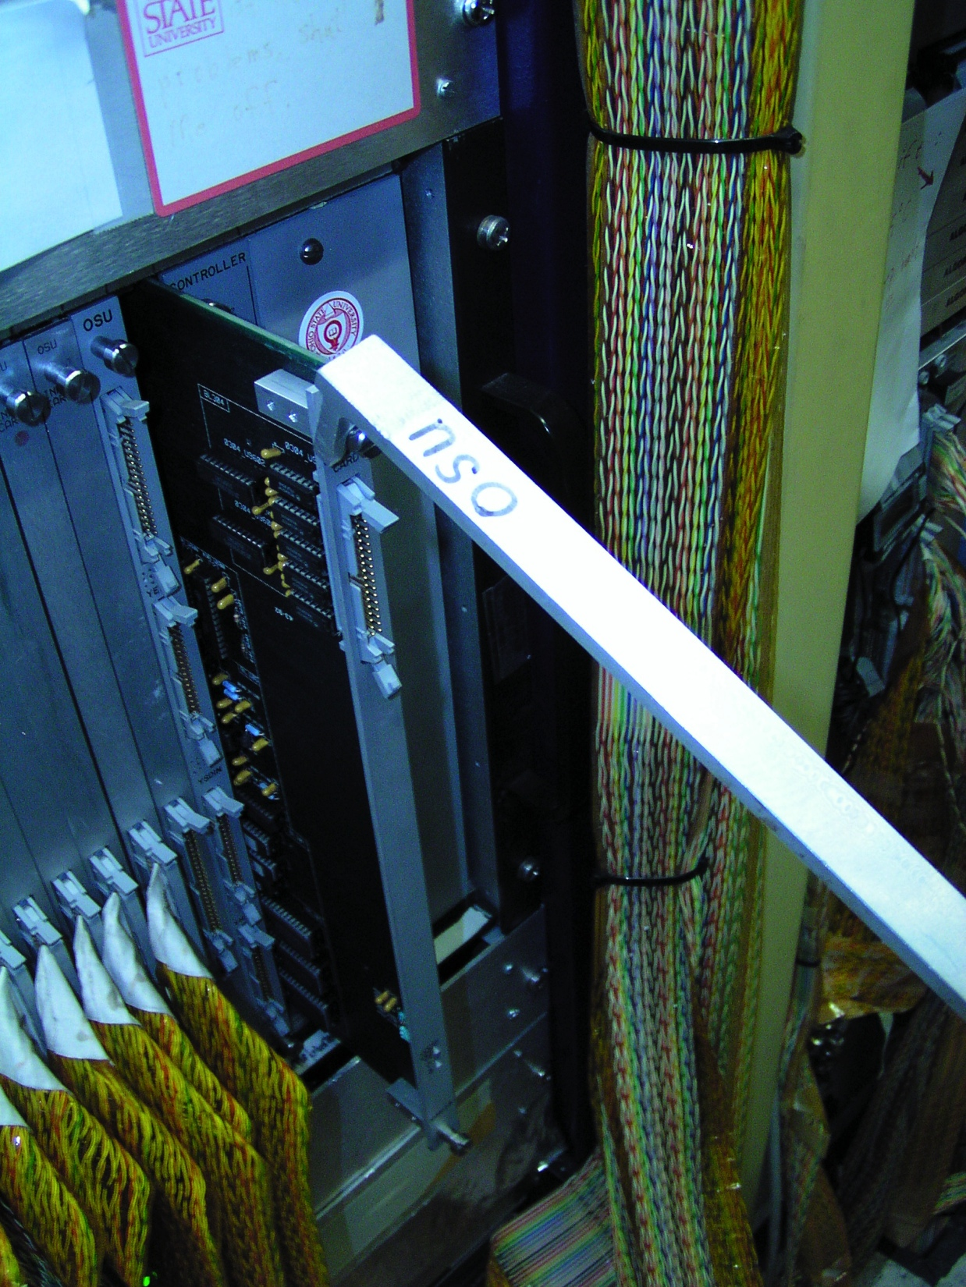
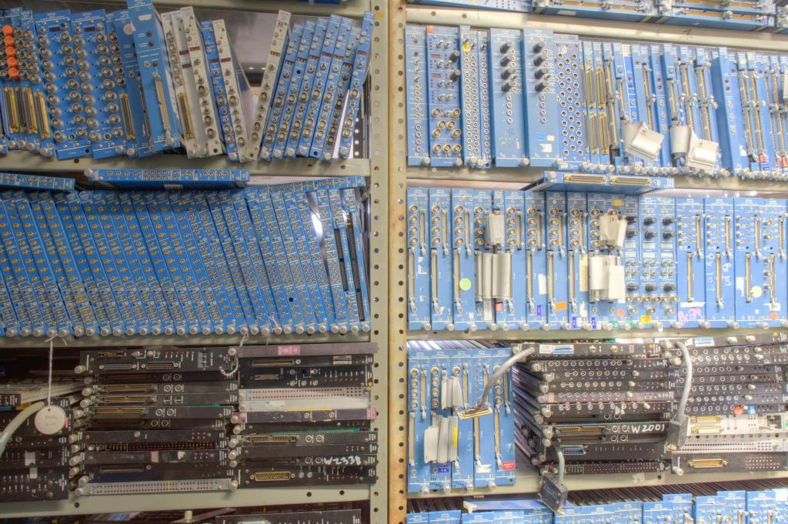
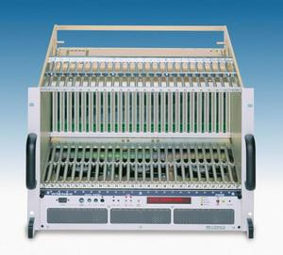
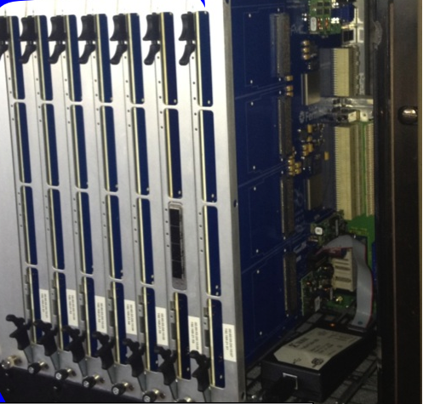
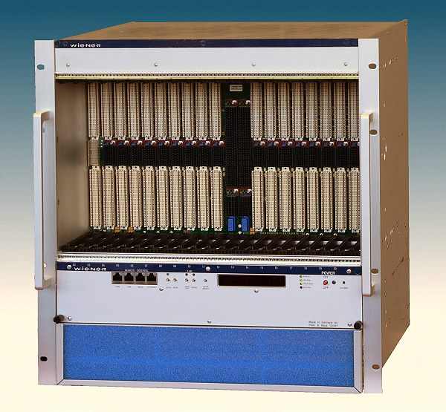
Off topic: modular electronics
“Nuclear” physics experiments
Computer architectures
Telecom
Mechanical and
Electrical Standard
Backplane(s)
Bus, controllers
Lots of on-board
Intelligence
Large throughput
High speed links
Use of modular electronics in central DAQ

Slide 19
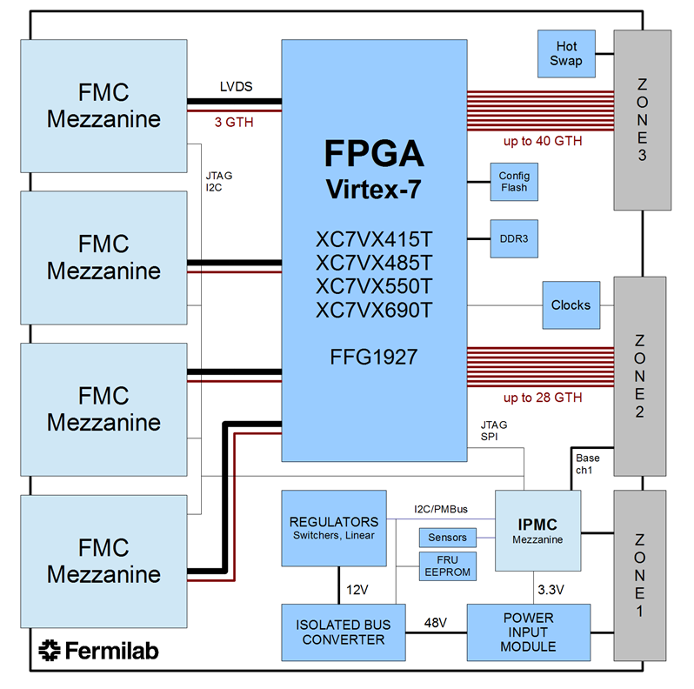
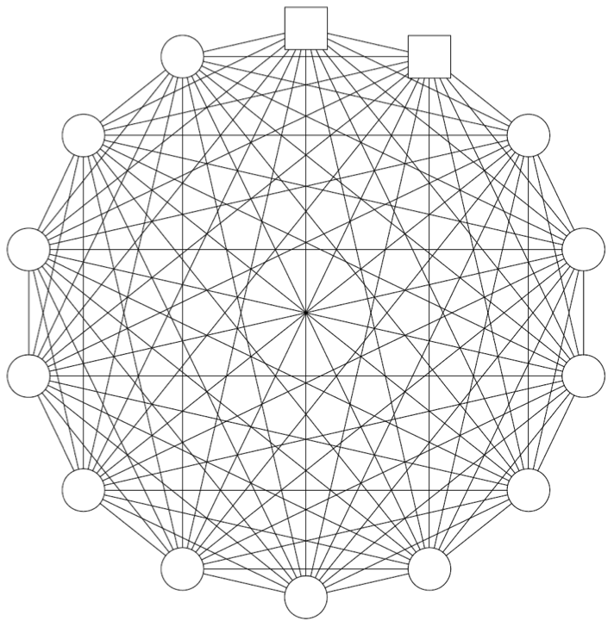
Off topic: modular electronics
The fabric interface connections in 14 slot full mesh ATCA backplane. Each line represents a multi-lane bidirectional channel rated for up to 40~Gb/s.
Source: Okumura, Yasuyuki et al. http://arxiv.org/abs/1403.4331

