Slide 1



Online-Analysis of Hits in the Belle-II Pixeldetector for Separation of Slow Pions from Background
Institute for Information
Processing Technologies
Steffen Bähr

Slide 2
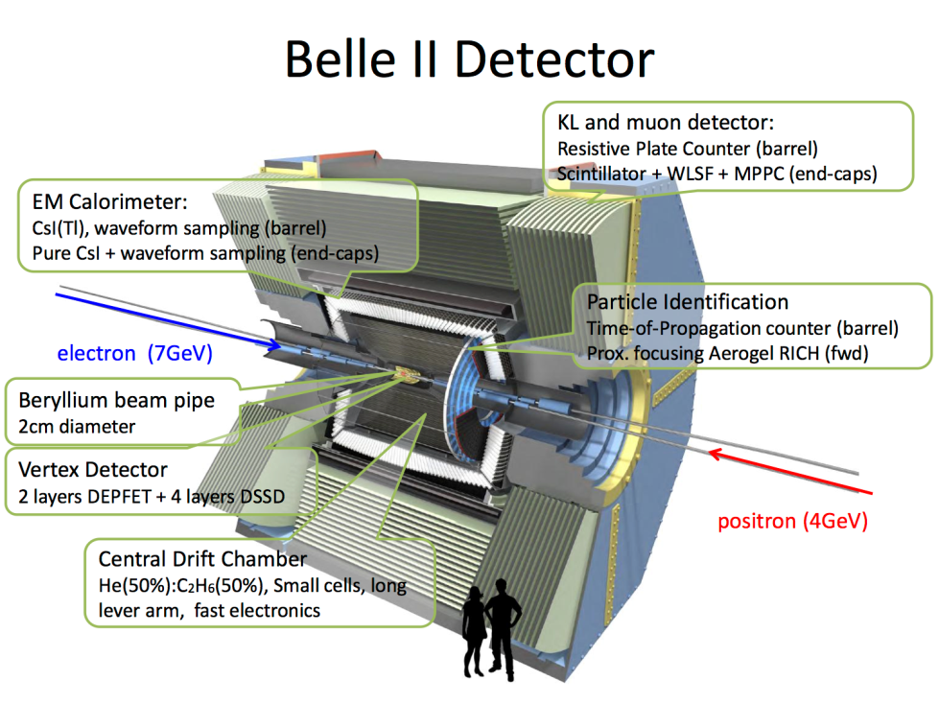
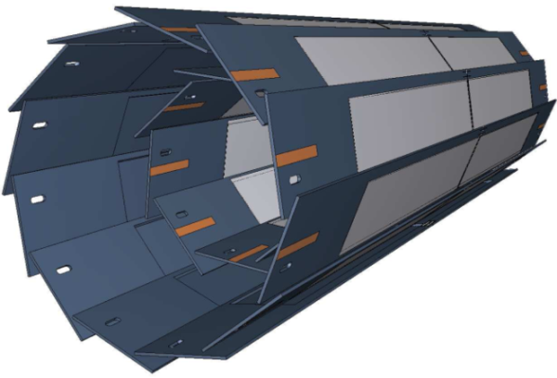
Data at the Belle-II Pixeldetector
Increase of luminosity in Belle-II leads to high data rates
About 1 MByte/event generated by the pixeldetector alone
Demanded output data rate by DAQ at 100 kByte/event
Notes:
Motivation für Online Cluster Analyse
Querschnitt des Belle-II Experiments, mehrere Detektoren PXD am nächsten zum Wechselwirkungspunkt
Magnetfeld -> langsame Pionen werden abgelenkt
Erreichen dadurch nicht die äußeren Schichten und werden durch Extrapolation aussortiert
Rekonstruktion der D*-Mesonen erschwert da, die Pionen aus dessen Zerfall bei 60Mev peaken

Slide 3
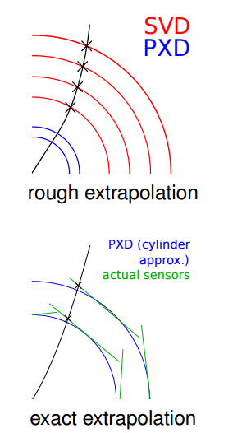
Data Reduction via Region of Interests
Usage of clusters of hits in outer layers of the detector to extrapolate to the PXD
Definition of Region of Interests and storage of all active pixels Inside this area
Main mechanism for data reduction
Notes:
Motivation für Online Cluster Analyse
Querschnitt des Belle-II Experiments, mehrere Detektoren PXD am nächsten zum Wechselwirkungspunkt
Magnetfeld -> langsame Pionen werden abgelenkt
Erreichen dadurch nicht die äußeren Schichten und werden durch Extrapolation aussortiert
Rekonstruktion der D*-Mesonen erschwert da, die Pionen aus dessen Zerfall bei 60Mev peaken

Slide 4
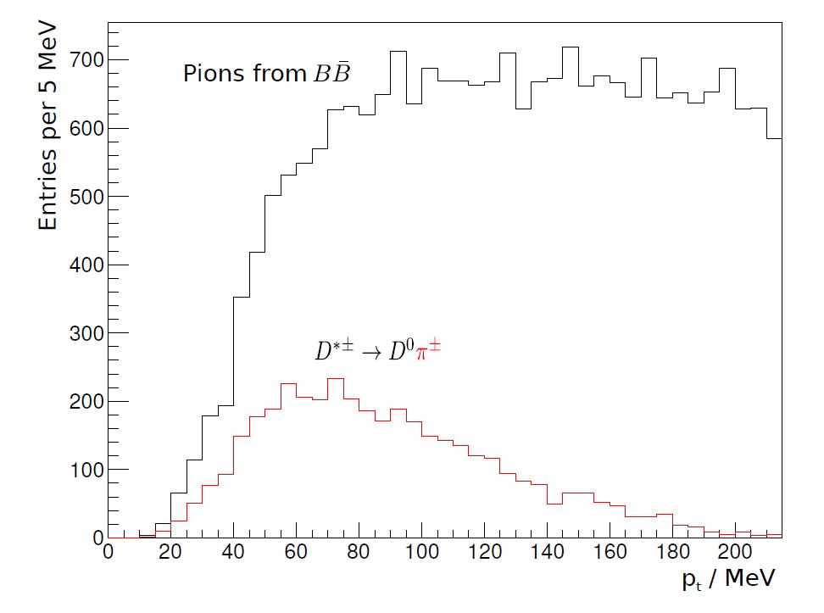
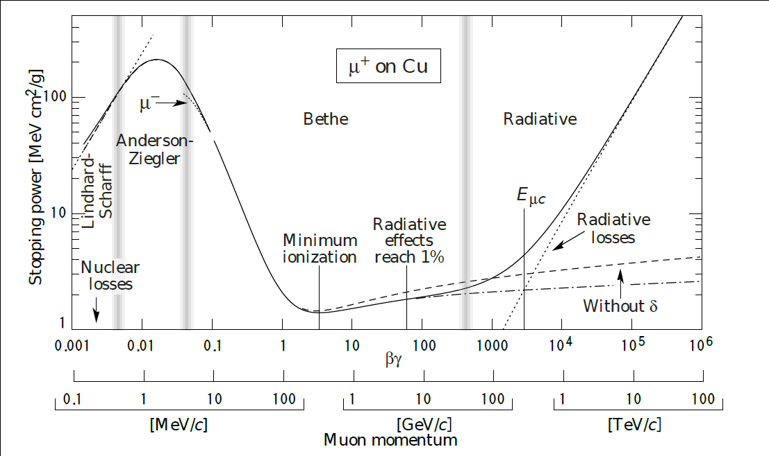
Problematic D* Decay
Particles with low impuls experience high stopping power
D* decays produce pions with low transversal momentum
  Below 60 MeV majority of the pions attributed to to this decay

Slide 5
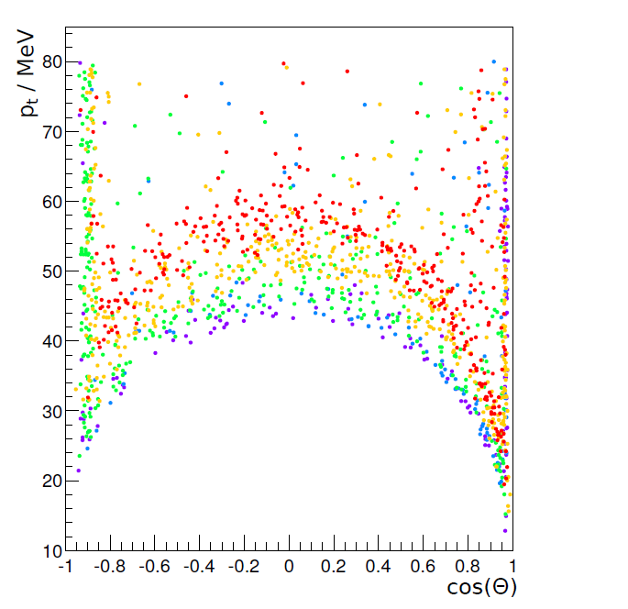
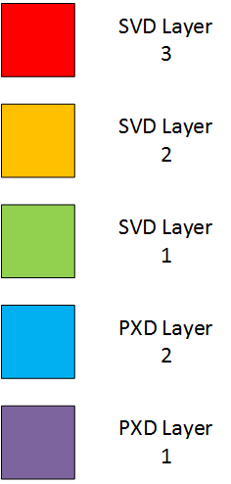
Momentum Distribution of Slow Pions
P_{t} < 60 MeV may already be insufficient to reach outer SVD Layers
Data reduction via track extrapolation is not feasible
Alternative online recovery mechanism is necessary

Slide 6
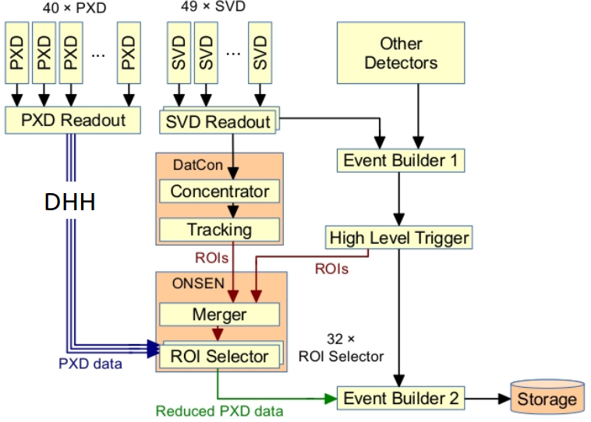
Pixeldetector Data Aquistion and Reduction
Online Cluster Analysis

Slide 7
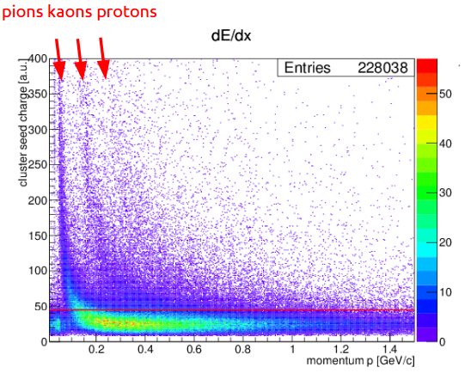
Charge of slow Pions within the Pixeldetector
Usage of charge deposited in pixels for different momenta tracks to separate pions

Slide 8
NeuroBayes Algorithm for Rescue
NeuroBayes Algorithm to predict slow pions using clusters of hits in the pixeldetector
Robust and has good generalization
Algorithm based on neural networks
Several characteristics of hit clusters used for classification
Cluster Feature
Total Charge
Standard Deviation
Maximum Pixel Charge
Minimum Pixel Charge
Length in Z
Length in Phi
Total Length
Number of Pixels
PXD Layer

Slide 9
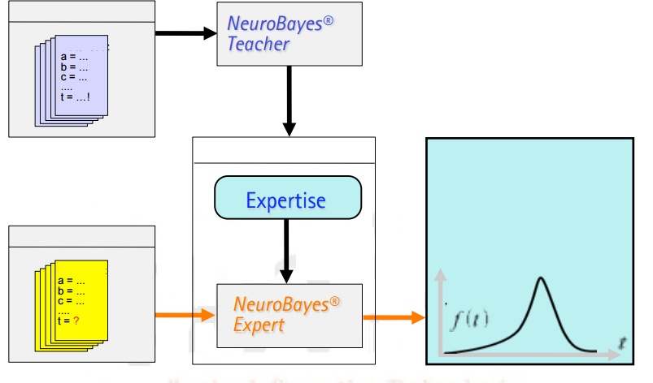
NeuroBayes Structure
Historic Data
Learn
and
Predict
Predictionsystem
Probability Density Function
Current Data

Slide 10
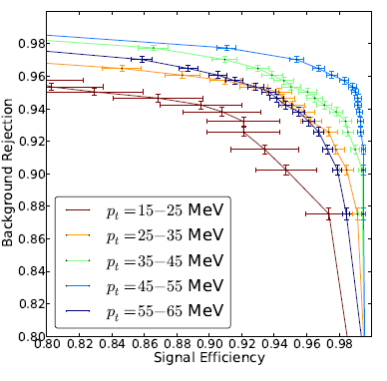
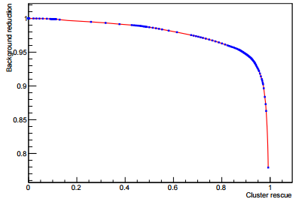
NeuroBayes Classification Performance
NeuroBayes achieves very good signal efficiency and background rejection ratios for pions with P_{t} < 65 MeV

Slide 11
Implementation on FPGAs
Demanded characteristics of implementation
  200 Mio Clusters / Second
  Low usage of ressources, FPGA is shared
  Accuracy of implementation cannot deviate too far from
Achievements of implementation on Virtex-6
  350 Mio Cluster / second
  ~3 % of overall ressources used
  Accuracy : Deviation < 1.5 * 10 ⁻⁵ from ideal, no negative Influence

Slide 12
Summary
Pixeldetector data is too big to be handled
Slow pions not detected by track extrapolation
Recovery of slow pions using NeuroBayes algorithm on FPGAs near PXD
FPGA Implementation‘s performance is sufficient to be deployed

Slide 13
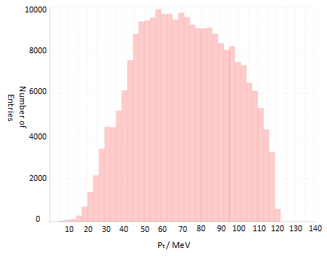
Sample used for NeuroBayes Training
The Pion Sample covers the transversal impuls of pions not reaching the outer Layers
Background includes QED, Touschek and Coulomb

Slide 14
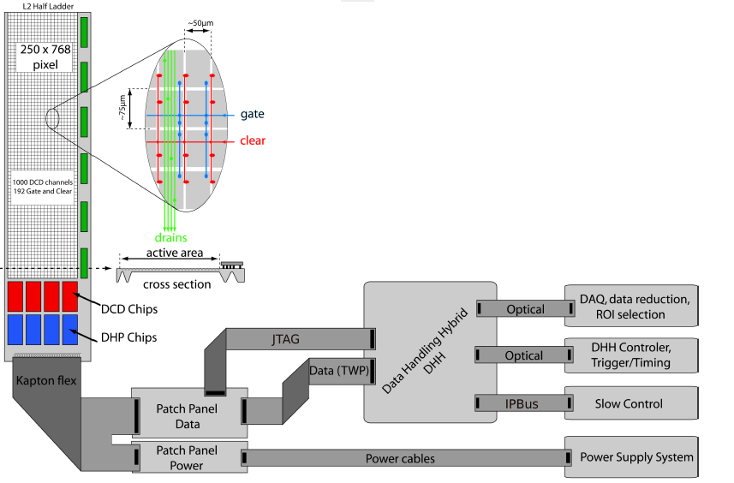
Using the NeuroBayes at the PXD
Algortihm needs to handle the data rates
  Usage of FPGAs with guaranteed Throughput
Needs to be placed close to the readout of PXD
  FPGAs of DHH has free resources

Slide 15
Challenges for the Implementation on FPGA
Performance
  Interface is clocked with 200 MHz
  1 Cluster / Clock Cycle has to be able to be achieved
Resources
  30 % of the CLBs available
  50 % of the DSPs available
Quality
  Output of FPGA Implementation cannot differ to much from Software

Slide 16
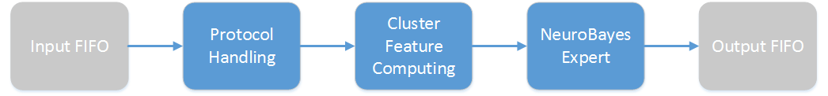
Cluster Processing Pipeline
Incoming Clusters are passing through a processing pipeline
  Protocol Handling for the Interface to the DHH‘s Clustering
  Computation of Cluster Features for the NeuroBayes
  NeuroBayes Expert makes the decision and passes it to the output interface

Slide 17
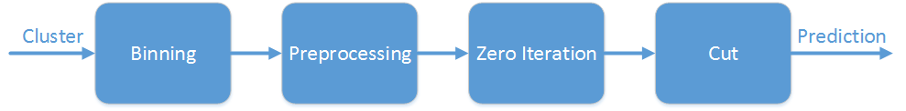
Overview of NeuroBayes on FPGA
The NeuroBayes Expert consists of 4 major components
  Binning of the Cluster Features
  Preprocessing by using CDF
  Zero-Iteration done by vector multiplication
  Cut on the Ouput

Slide 18
Conversion to Fixpoint
Original NeuroBayes Algorithm uses Floating Point
  Usage on FPGA requires more ressources and impacts latencies
  Transformation to fixpoint is more efficient, but impacts the quality
Quality of a Fixpoint implementation‘s Output depends on the used bitwidth
  Higher Bitwidth equals higher consumption of Ressources, while increasing Quality
  DSPs have 25*18 Bit Inputs

Slide 19
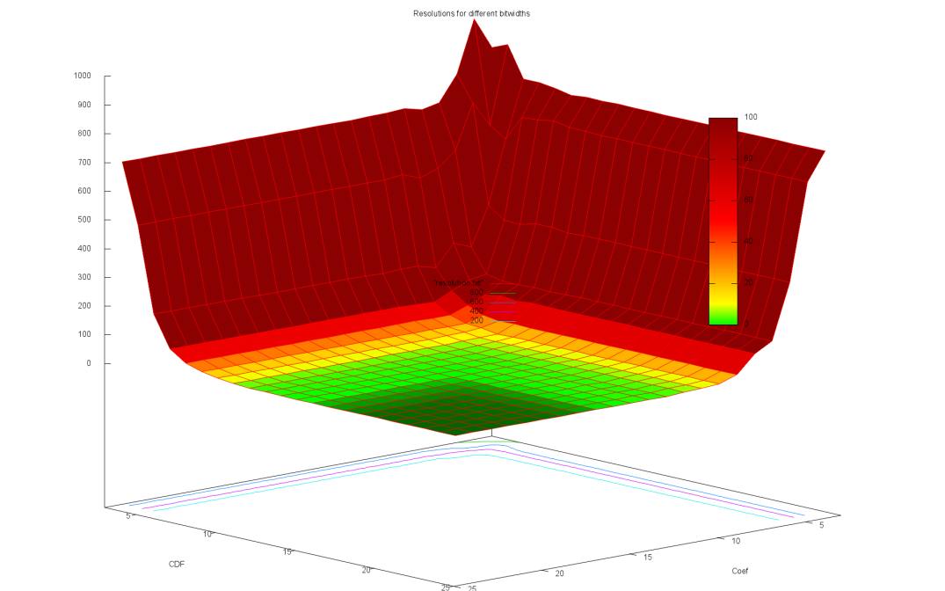
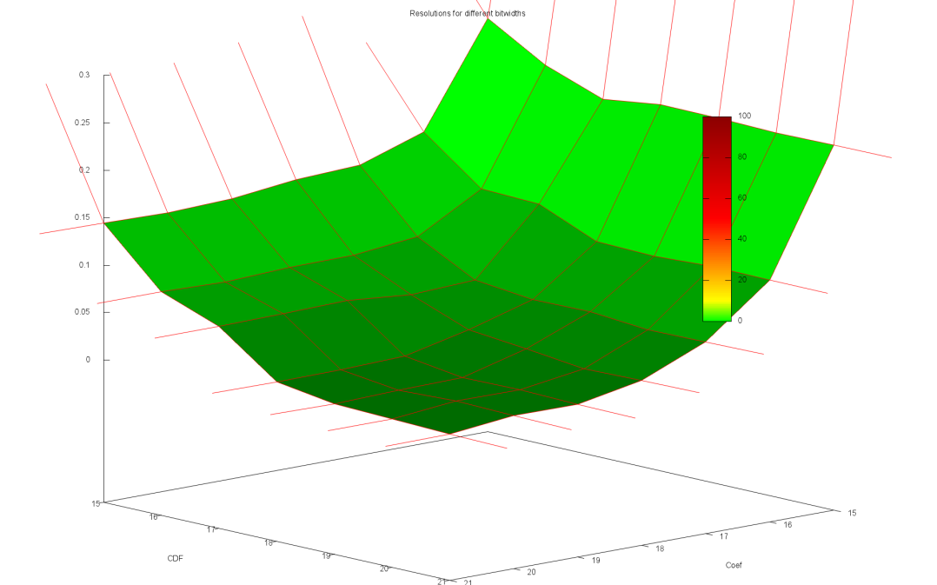
Evaluation of Fixpoint Implementation
Usage of 25*25 Bitwidth results in no difference of output to floating point implemenation
Difference is small for 25*18
  Most resource efficient configuration for multiplication
  Difference is at 1.5 * 10^-5

Slide 20
Evaluation of Performance
Computation of the Algorithm takes several clock cycles
  Performance requirements cannot be met
Usage of Pipelining throughout the implemenation
Fixpoint Vector Multiplication is the critical path
  High Frequency through usage of cascading DSPs
Component | Latency | Frequency
Cluster Feature | 1 cycle | 446 MHz
Preprocessing & Binning | 1 cycle | 446 MHz
Vector multiplication | 9 cycles | 350 MHz
Cut | 1 cycle | 446 MHz
Total | 12 cycles | 350 MHz

Slide 21
Ressource Consumption
Critical Path for CLBs in the implemenation is the Binning and Preprocessing
  Mostly Usage of Look Up Tables
Usage of DSPs for vector multiplication makes life easier
  50 % of DSPs are still available
  Each multiplication needs one DSP
Ressource | Demand | Constraint
DSP | 3,125 % | < 50 %
CLB | ~ 2 % | < 30 %

Slide 22
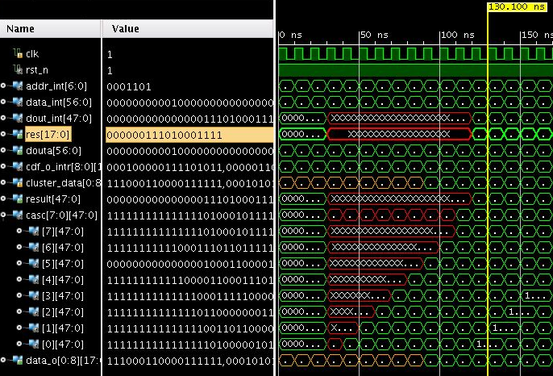
Simulation
Cluster Feature | Value
Total Charge | 425
Standard Deviation | 49
Maximum Pixel Charge | 135
Minimum Pixel Charge | 23
Length in Z | 2
Length in Phi | 2
Total Length | 1
Number of Pixels | 4
PXD Layer | 2
Result of Software is:
0000001110100011110010001 -> slow Pion Cluster
(S)DDD,DDDDDDDDDDDDDD

