Slide 1


ALFA: The new ALICE-FAIR software framework
Mohammad Al-Turany
GSI-ExpSys/CERN-PH

Slide 2

ALFA
A tools set library that contains:
  Transport layer (FairMQ, based on: ZeroMQ, nanomsg)
  Configuration tools
  Management and monitoring tools
A data-flow based model (Message Queues based multi-processing ).
Provide unified access to configuration parameters and databases.

Slide 3
ALFA and FairRoot
AliRoot6 (O²)
CbmRoot
R3BRoot
SofiaRoot
MPDRoot
ShipRoot
PandaRoot
AsyEosRoot
FopiRoot
EICRoot
ALFA
FairRoot
????
DDS
Building configuraion
Testing
Fair MQ
MC Application
Module
Detector
Magnetic Field
Event
Generator
Runtime DB
Libraries and Tools
Protocol Buffers
BOOST
ROOT
ZeroMQ
CMake
Geant4
Genat4_VMC
Geant3
VGM
…

Slide 4
ALFA, FairRoot and co. at CHEP15
Alexey RYBALCHENKO: Efficient time frame building for online data reconstruction in ALICE experiment
https://indico.cern.ch/event/304944/session/1/contribution/353
Matthias RICHTER: A design study for the upgraded ALICE O2 computing facility
https://indico.cern.ch/event/304944/session/1/contribution/439
Ludovico BIANCHI: Online tracking with GPUs at PANDA
https://indico.cern.ch/event/304944/session/1/contribution/363
Dmytro KRESAN : Online/Offline reconstruction of trigger-less readout in the R3B experiment at FAIR
https://indico.cern.ch/event/304944/session/1/contribution/425
AliRoot6 (O²)
PandaRoot
R3BRoot
SofiaRoot
MPDRoot
ShipRoot
CbmRoot
AsyEosRoot
FopiRoot
EICRoot
ALFA
FairRoot
Florian UHLIG: New developments in the FairRoot frameworkhttps://indico.cern.ch/event/304944/session/2/contribution/258
Tobias STOCKMANNS: Continuous Readout Simulation with FairRoot on the Example of the PANDA Experiment
https://indico.cern.ch/event/304944/session/2/contribution/319
Aram SANTOGIDIS: Optimizing the transport layer of the ALFA framework for the Intel Xeon Phi co-processor
https://indico.cern.ch/event/304944/session/9/contribution/27

Slide 5

Strategy
Massive data volume reduction
  Data reduction by (partial) online reconstruction and compression
Much tighter coupling between online and offline reconstruction software

Slide 6
Scalability through multi-processing with message queues?
Each process assumes limited communication and reliance on other processes.
No locking, each process runs with full speed
Easier to scale horizontally to meet computing and throughput demands (starting new instances) than applications that exclusively rely on multiple threads which can only scale vertically.

Slide 7
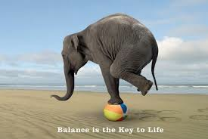
Correct balance between reliability and performance
Multi-process concept with message queues for data exchange
  Each "Task" is a separate process, which:
    Can be multithreaded, SIMDized, …etc.
    Can run on different hardware (CPU, GPU, XeonPhi, …etc.)
    Be written in an any supported language (Bindings for 30+ languages)
  Different topologies of tasks can be adapted to the problem itself, and the hardware capabilities.

Slide 8
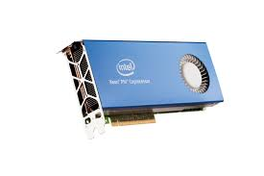

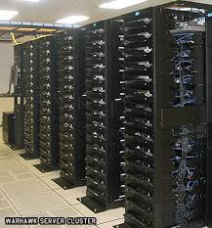
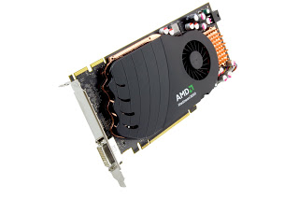
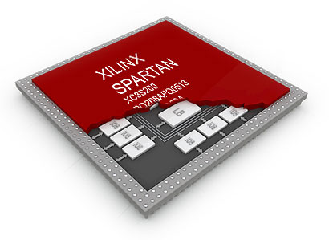

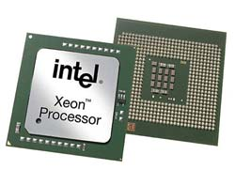
ALFA uses FairMQ to connect different pieces together
FairMQ
FairMQ
nanomsg

Slide 9
Heterogeneous Platforms: Message format
The framework does not impose any format on messages.
It supports different serialization standards
  BOOST C++ serialization
  Google’s protocol buffers
  ROOT
  User defined

Slide 10
How to deploy ALFA on a laptop, few PCs or a cluster?
DDS: Dynamic Deployment System
  Users describe desired tasks and their dependencies using topology files
  The system takes so called “topology file” as the input.
  Users are provided with a WEB GUI to create topology (Can be created manually as well).

Slide 11
DDS: Basic concepts
Implements a single-responsibility-principle command line tool-set and APIs,
Treats users’ tasks as black boxes,
Doesn’t depend on RMS (provides deployment via SSH, when no RMS is present),
Supports workers behind FireWalls,
Doesn’t require pre-installation on WNs (Worker nodes),
Deploys private facilities on demand with isolated sandboxes,
Provides a key-value properties propagation service for tasks,
Provides a rules based execution of tasks.
...
http://dds.gsi.de

Slide 12
Tests of ALFA devices via DDS
Devices (user tasks) | startup time* | propagated key-value properties
2721 (1360 FLP + 1360 EPN + 1 Sampler) | 17 sec | ~ 6x10⁶
5441 (2720 FLP + 2720 EPN + 1 Sampler) | 58 sec | ~ 23x10⁶
10081 (5040 FLP + 5040 EPN + 1 Sampler) | 207 sec | ~ 77x10⁶
FLP(First Level Processer), EPN (Event Processor Event)
N –To-N connections
  Each EPN need to connect to each FLPs (Time frame building)
  Each FLP need to connect to all EPNs (Heartbeat signal)
Throughout tests only one DDS commander server was used. In the future we will support multiple distributed servers.
Our current short term target is to manage 100K devices and keep startup time of the whole deployment within 10-50 sec.
* startup time - the time which took DDS to distribute user tasks, to propagate all needed properties, plus the time took devices to bind/connect and to enter into RUN state.

Slide 13
Backup

Slide 14
DDS status
Last stable release - DDS v0.8 (2015-02-17, http://dds.gsi.de/download.html),
Home site: http://dds.gsi.de
User’s Manual: http://dds.gsi.de/documentation.html
Continues integration: http://demac012.gsi.de:22001/waterfall
Source Code:
https://github.com/FairRootGroup/DDS
https://github.com/FairRootGroup/DDS-user-manual
https://github.com/FairRootGroup/DDS-web-site
https://github.com/FairRootGroup/DDS-topology-editor

Slide 15
Related talks
Florian UHLIG: New developments in the FairRoot framework
https://indico.cern.ch/event/304944/session/2/contribution/258
Alexey RYBALCHENKO: Efficient time frame building for online data reconstruction in ALICE experiment
https://indico.cern.ch/event/304944/session/1/contribution/353
Matthias RICHTER: A design study for the upgraded ALICE O2 computing facility
https://indico.cern.ch/event/304944/session/1/contribution/439
Tobias STOCKMANNS: Continuous Readout Simulation with FairRoot on the Example of the PANDA Experiment
https://indico.cern.ch/event/304944/session/2/contribution/319

Slide 16
Related talks
Ludovico BIANCHI: Online tracking with GPUs at PANDA
https://indico.cern.ch/event/304944/session/1/contribution/363
Dmytro KRESAN : Online/Offline reconstruction of trigger-less readout in the R3B experiment at FAIR
https://indico.cern.ch/event/304944/session/1/contribution/425
Aram SANTOGIDIS: Optimizing the transport layer of the ALFA framework for the Intel Xeon Phi co-processor
https://indico.cern.ch/event/304944/session/9/contribution/27

Slide 17
Elements of the topology
MAIN
GROUP_1
N=10
TASK_1
COLLECTION_1
TASK_1
TASK_2
TASK_5
TASK_6
TASK_5
TASK_3
TASK_4
#### Task
* A task is a single entity of the system.
* A task can be an executable or a script.
* A task is defined by a user with a set of props and rules.
* Each task will have a dedicated DDS watchdog process.
#### Collection
* A set of tasks that have to be executed on the same physical computing node.
#### Group
* A container for tasks and collections.
* Only main group can contain other groups.
* Only group define multiplication factor for all its daughter elements.
COLLECTION_2
TASK_2
TASK_7

