Slide 1

The production deployment of IPv6 on WLCG
David Kelsey (STFC-RAL)
CHEP2015, OIST, Okinawa
16 Apr 2015

Slide 2
HEPiX IPv6 Working Group
Members of the group – Thanks to them!
J. Bernier (IN2P3), S. Campana (CERN), K. Chadwick (FNAL), J. Chudoba (FZU), A. Dewhurst (RAL), M. Elias (FZU), S. Fayer (Imperial), T. Finnern (DESY), C. Grigoras (CERN), T. Hartmann (KIT), B. Hoeft (KIT), T. Idiculla (RAL), D. Kelsey (RAL), F. Lopez Munoz (PIC), E. MacMahon (Oxford), E. Martelli (CERN), R. Nandakumar (RAL), K. Ohrenberg (DESY), F. Prelz (INFN), D. Rand (Imperial), A. Sciaba (CERN), U. Tigerstedt (CSC), R. Voicu (Caltech), C. Walker (QMUL), T. Wildish (Princeton)
And many others in earlier times

Slide 3
WLCG Sites - IPv6 readiness
World running out of IPv4 addresses
  RIRs Asia/Pacific, Europe, Latin America/Caribbean run out of IPv4
We did a WLCG site survey in summer 2014
Tier 1s: ~75% are IPv6 ready. Rest within 1 year
Tier 2s: ~20% are IPv6 ready. ~20% within 1-2 year
  ~ 60% have no plans yet
~10% of sites report lack of IPv4 addresses (in next 1-2 years)
  Including CERN
Growth of Virtual Machines and/or Containers
This is a challenge!

Slide 4
LHC Experiments & IPv6
Most important IPv6-only use case to address
Need dual-stack federated storage services
And dual-stack central services too
  Central experiment job submission infrastructure
  VOMS, catalogues, info etc
Site providing IPv6-only CPU -
Virtual Machines/Worker Nodes

Slide 5
LHC Experiments & IPv6 (2)
ATLAS Request (WLCG GDB Oct 2014)
Tier 1s provide dual stack perfSONAR (April 2015)
T2Ds provide dual stack perfSONAR (August 2015)
CMS Request (WLCG GDB Sep 2014)
  Substantial fraction CMS data accessible via AAA through IPv6 by end 2015
ALICE runs many dual-stack central services (works)
testing all their frameworks
LHCb job submission (DIRAC)
Tests started on lxplus-ipv6 (does not break IPv4)
About to test on DIRAC v6r13

Slide 6
IPv6 testbed – data transfers
Caltech, CERN, DESY, FNAL, FZU, Glasgow, IHEP, KIT, INFN, Imperial, Lyon, NDGF, PIC, Wisconsin
Simple GridFTP mesh of tests over IPv6
Ran for 706 days (ended Feb 2015)
  Total data transferred ~ 6.8 PB (10 TB per day)
Useful for: Verifying network stability, routes etc.

Slide 7
FTS3/dCache data transfers
A new testbed mesh via dual-stack FTS3 (KIT)
CCIN2P3, CSCFI, DESY, KIT, Imperial, NDGF and PIC
All running dCache (V2.10.x or later)
  Some dual-stack, some IPv6-only
Transfers 1 GB files over SRM/gsiftp
Now works – but performance differences and failures
Problems along the way included
  LHCONE/LHCOPN IPv6 peering
  DNS problems
  gfal2 – (V2.8.1 does not accept TURLs with IPv6 number)
  dCache configuration (for hosts with DNS aliases)

Slide 8
FTS3 data transfer mesh
Time to transfer (s)

Slide 9
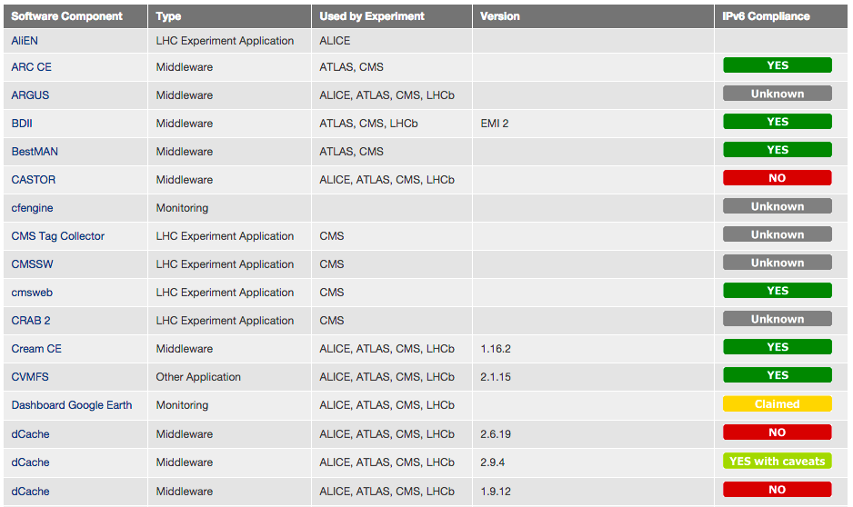
  IPv6 readiness of WLCG software http://hepix-ipv6.web.cern.ch/wlcg-applications
Much progress during 2014-15.
Many storage technologies now support IPv6

Slide 10
IPV6 Network Monitoring
perfSONAR monitoring
As we turn on production dual-stack
  We need to collect IPv6 monitoring data
  Since perfSONAR V3.4 Dual-stack is recommended
  Add AAAA record to DNS
  If both ends are dual-stack
    IPv4 & IPv6 tests will both be run

Slide 11
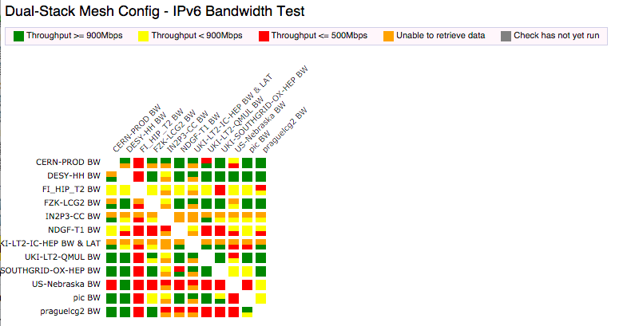
perfSONAR dashboard
http://maddash.aglt2.org/
Dual-Stack Mesh Dashboard
(does not yet show IPv6 correctly!)

Slide 12
LHCOPN/LHCONE & IPv6
To get same network performance
  Need IPv6 data to take the same route as IPv4
LHCOPN sites should be peering with IPv6
  By April 2015
CERN and 5 Tier 1s completed
  More to come
LHCONE – IPv6 peering by August 2015

Slide 13
2015 Deployment plan
LHCOPN/LHCONE IPv6 routing
perfSONAR dual-stack monitoring
Gradually deploy production dual-stack data services
  When LHCOPN/LHCONE peering ready
  When testing proves functionality and performance
Important central services to dual-stack
  Including dual-stack SAM
Currently ~2% of WLCG services are dual-stack
Need more work on guidance, e.g. security

Slide 14
Summary
Deployment of WLCG dual-stack is starting
  LHCOPN/LHCONE routing
  perfSONAR monitoring
Controlled deployment of dual-stack storage
  And central services
New members in WG/Testbed always welcome

Slide 15
Links
HEPiX IPv6 web
http://hepix-ipv6.web.cern.ch
HEPiX IPv6 wiki
https://w3.hepix.org/ipv6-bis/
Working group meetings
http://indico.cern.ch/categoryDisplay.py?categId=3538
WLCG Operations IPv6 Task Force
http://hepix-ipv6.web.cern.ch/content/wlcg-ipv6-task-force-0
Paper published in proceedings of CHEP2013
  For earlier work

Slide 16
Questions?

