Slide 1
Jobs masonry with elastic Grid Jobs
Federico Stagni, Philippe Charpentier
On behalf of the LHCb collaboration

Slide 2

The masonry problem

Slide 3
The jobs masonry problem (*)
Hard deadline
Maximum length job
Exceeding queue length job -- KILLED
t
T_now
Maximum length job
One more fitting job
Maximum length job
Wasted Resources
T_end
VOs overestimates the length of the jobs, so that they are not killed
* copyright: A. McNab

Slide 4
Elastic Simulation jobs
1) We (just) discovered that we can run up to here..
T_now
t
T_end
2) And we already used up to here..
3) we'll try and fit a job there, no matters what

Slide 5
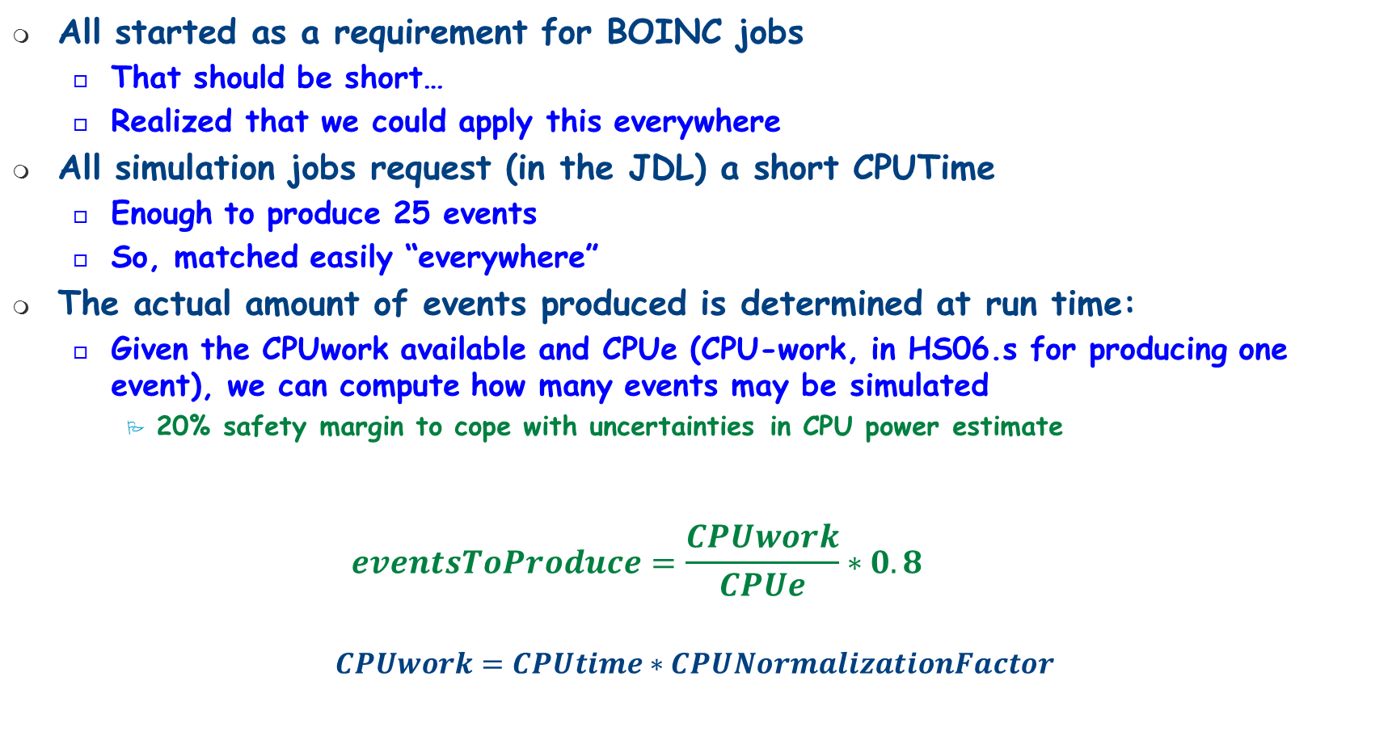
LHCb simulation jobs become elastic
All started as a requirement for BOINC jobs
  That should be short…
  Realized that we could apply this everywhere
All simulation jobs request (in the JDL) a short CPUTime
  Enough to produce 25 events
  So, matched easily “everywhere”
The actual amount of events produced is determined at run time:
  Given the CPUwork available and CPUe (CPU-work, in HS06.s for producing one event), we can compute how many events may be simulated
    20% safety margin to cope with uncertainties in CPU power estimate
    $$eventsToProduce=\frac{CPUwork}{CPUe}∗0.8$$
$$CPUwork=CPUtime∗CPUNormalizationFactor$$

Slide 6
Determining CPUe
Simulation productions go through a testing phase before being submitted
A limited amount of jobs are created and submitted to a site chosen for testing
  each job produces a fixed amount of events
Productions undergoing a testing phase are monitored by a dedicated agent
  when all jobs are finished, an evaluation takes place:
    If all jobs failed, the production request is rejected
    If jobs are successful, we are evaluate CPUe
      Job description is modified: CPUe is added, destination is changed…
Simulation productions have to produce at least a requested amount of events
  In case not enough events have been produced, simulation productions are automatically extended
Mgmt of sim prods in LHCb:
G.Corti, Track 2, Thu, 9:15

Slide 7
Determining CPUNormalizationFactor
CPUNormalizationFactor = power of the machine
Highly discussed subject
  Power of the machine is not deterministic (HT, power saving, BIOS settings…)
LHCb (DIRAC) goes for the simplest solution
  Every pilot jobs runs a quick benchmark script
    “Proven” to be rather reliable
  So, we don’t use BDII info
    (also, they are available only for a fraction of resources)
  We would like to use MachineFeatures
    And soon we will for those sites that provide it already
      And at that point we’ll have the possibility to make a comparison…
A history-based estimation for LHCb job requirements:
N.Rauschmayr, Track 4, Mon, 14:45

Slide 8
Determining (CPU)Time left
Pilot checks time left before matching any job
  Using Job Features where available
    Right now only in VMs, not completely integrated in the pilot
  Interrogating directly the batch system
    if supported by DIRAC

Slide 9
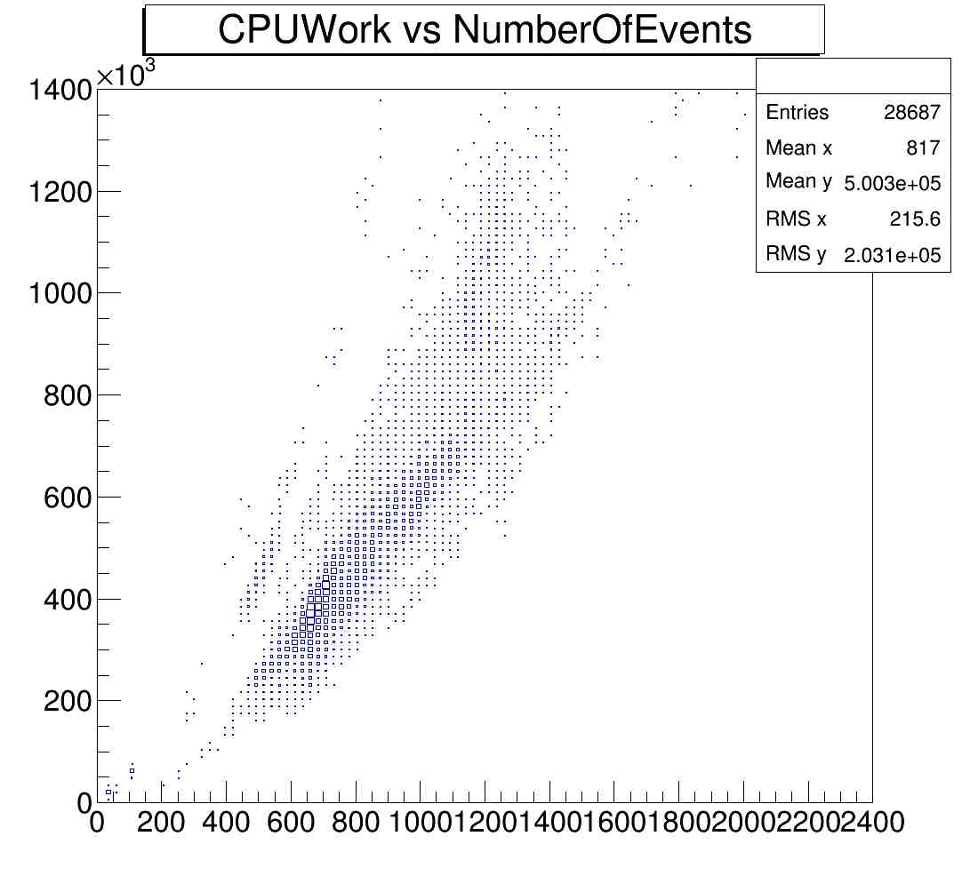
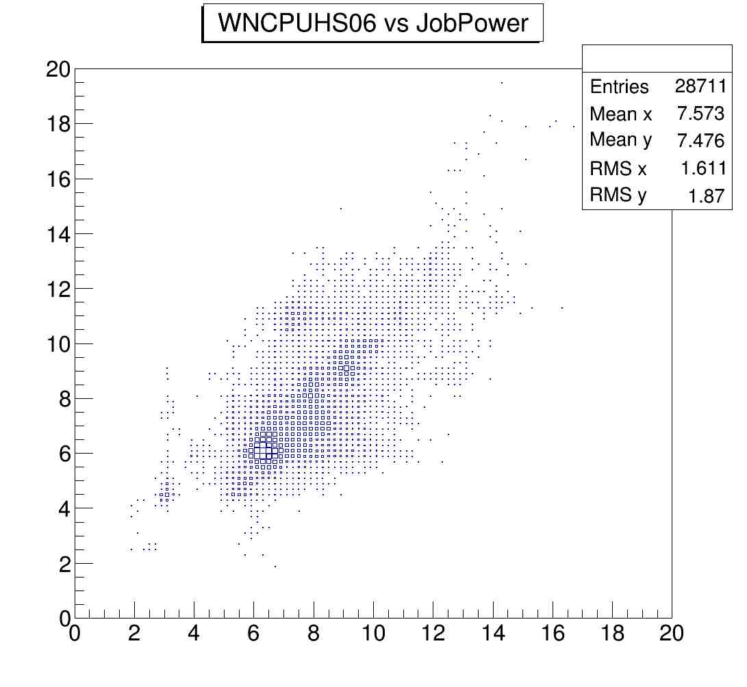
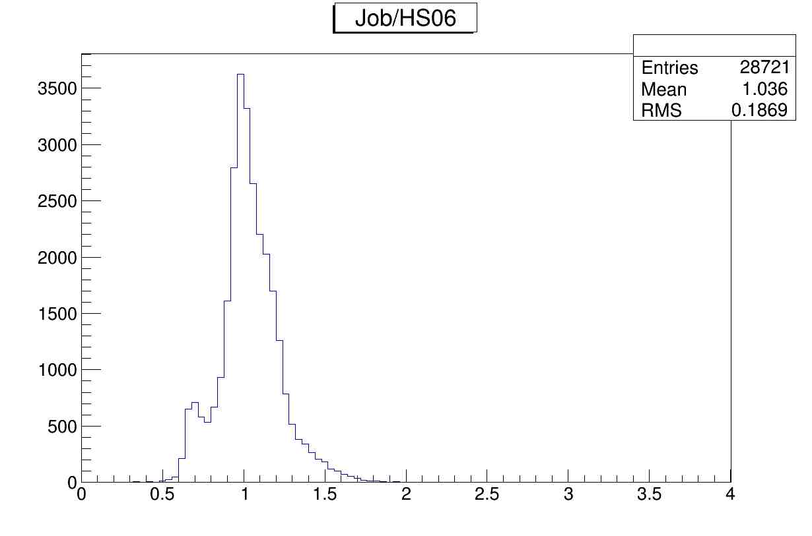
Elastic MC jobs in practice

Slide 10
Summary and prospects
LHCb simulation jobs are elastic
  For about a year now
Simple concept, rather important implications
  Simulations jobs can run “everywhere”
    Low priorities, back-filling jobs
Power calculations non-deterministic
Next steps
  Better control of when to end producing.
    for VM: look for shutdown messages
  We can send signals to the simulation applications to stop
    needs anyway to know CPUe (for precise calculations)
  Run-time adjustment of CPUe

Slide 11
Thanks!
Question, comments
?

