Slide 2
Benefits of Enterprise Social Networking for HEP
#ESN for #HEP
CHEP 2015
Bruno Sousa ● CERN IT Department
check http://cern.ch/chep2015 feed

Slide 3

Why #ESN
“the average interaction worker spends
28% of their time managing email
and 20% looking for internal information
or tracking colleagues that can help with
specific tasks” McKinsey
Typically there is
room for improvement
Mark Smiciklas https://www.flickr.com/photos/intersectionconsulting/7537238368/
check http://cern.ch/chep2015 feed

Slide 4


Why #ESN
email is too flexible
we receive too many
knowledge locked
reply all syndrome
check http://cern.ch/chep2015 feed

Slide 5
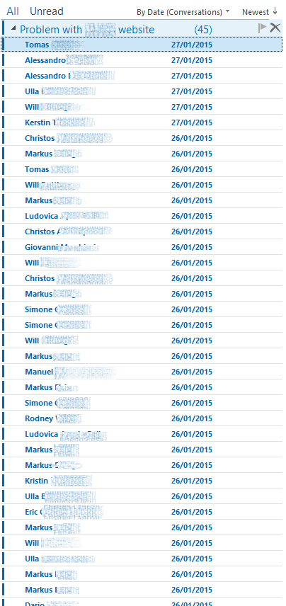
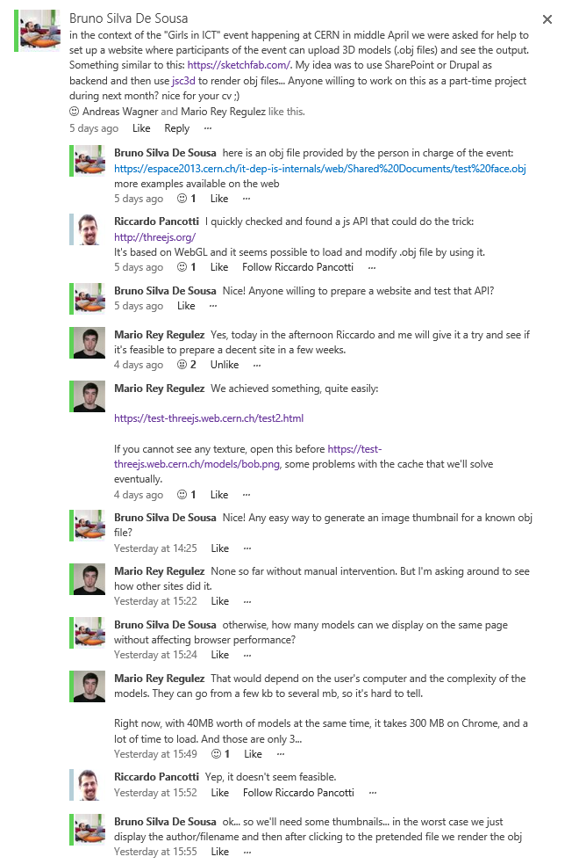
Why #ESN
top-posting?
bottom
posting?
VS
>>quoting
>>characters?
inline replies
RFC1855
Netiquette
Guidelines
check http://cern.ch/chep2015 feed

Slide 6
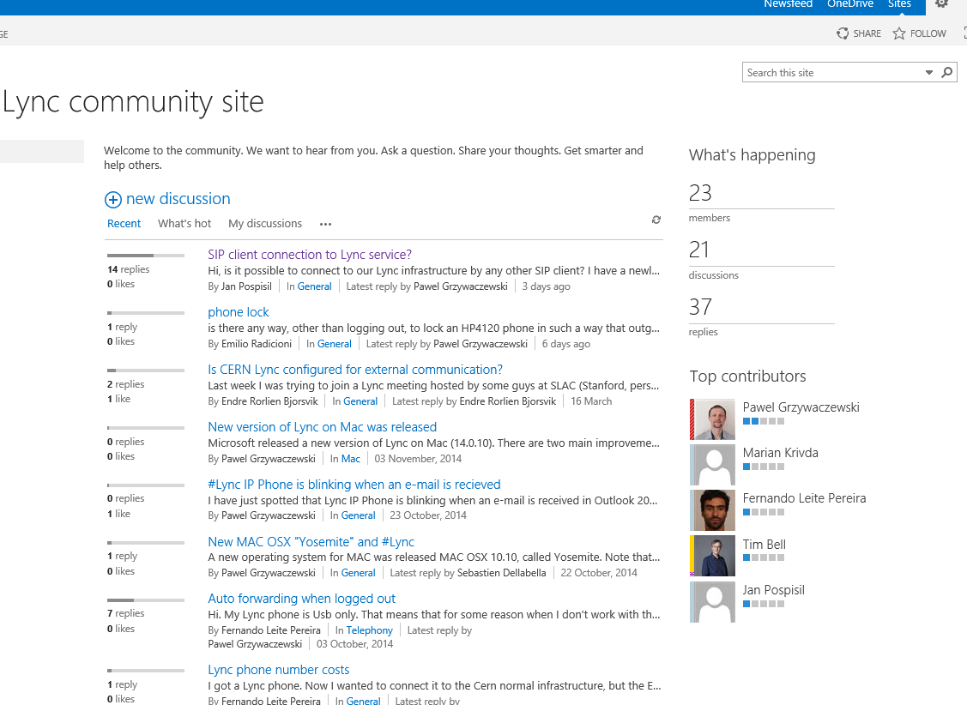
Why #ESN
knowledge base can be built by the community
VS support tickets
“If HP only knew what HP knows, we would be three
times more productive.“ Lew Platt former HP CEO
check http://cern.ch/chep2015 feed

Slide 7

Why #ESN?
Why #ESN
documents
collaboration
and sharing
over email?
check http://cern.ch/chep2015 feed

Slide 8
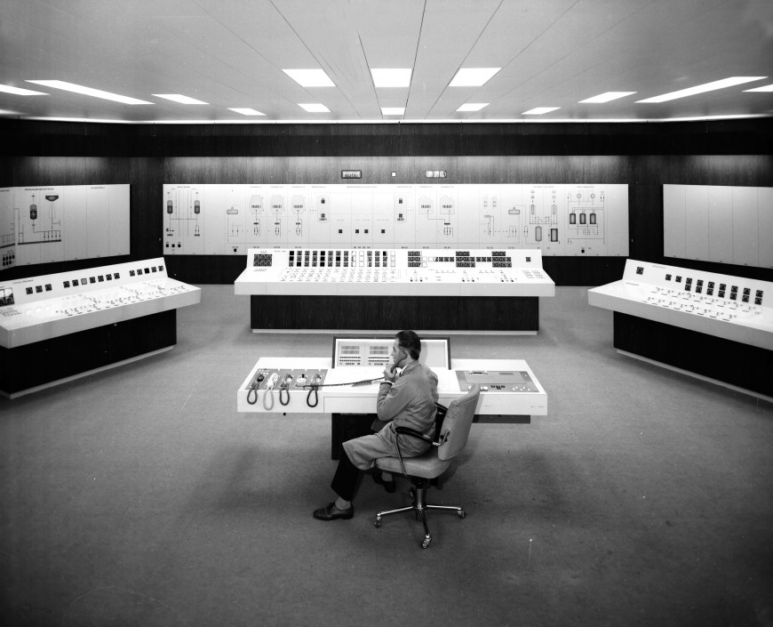
Why #ESN
identify expertise and capture
tacit knowledge
check http://cern.ch/chep2015 feed

Slide 9
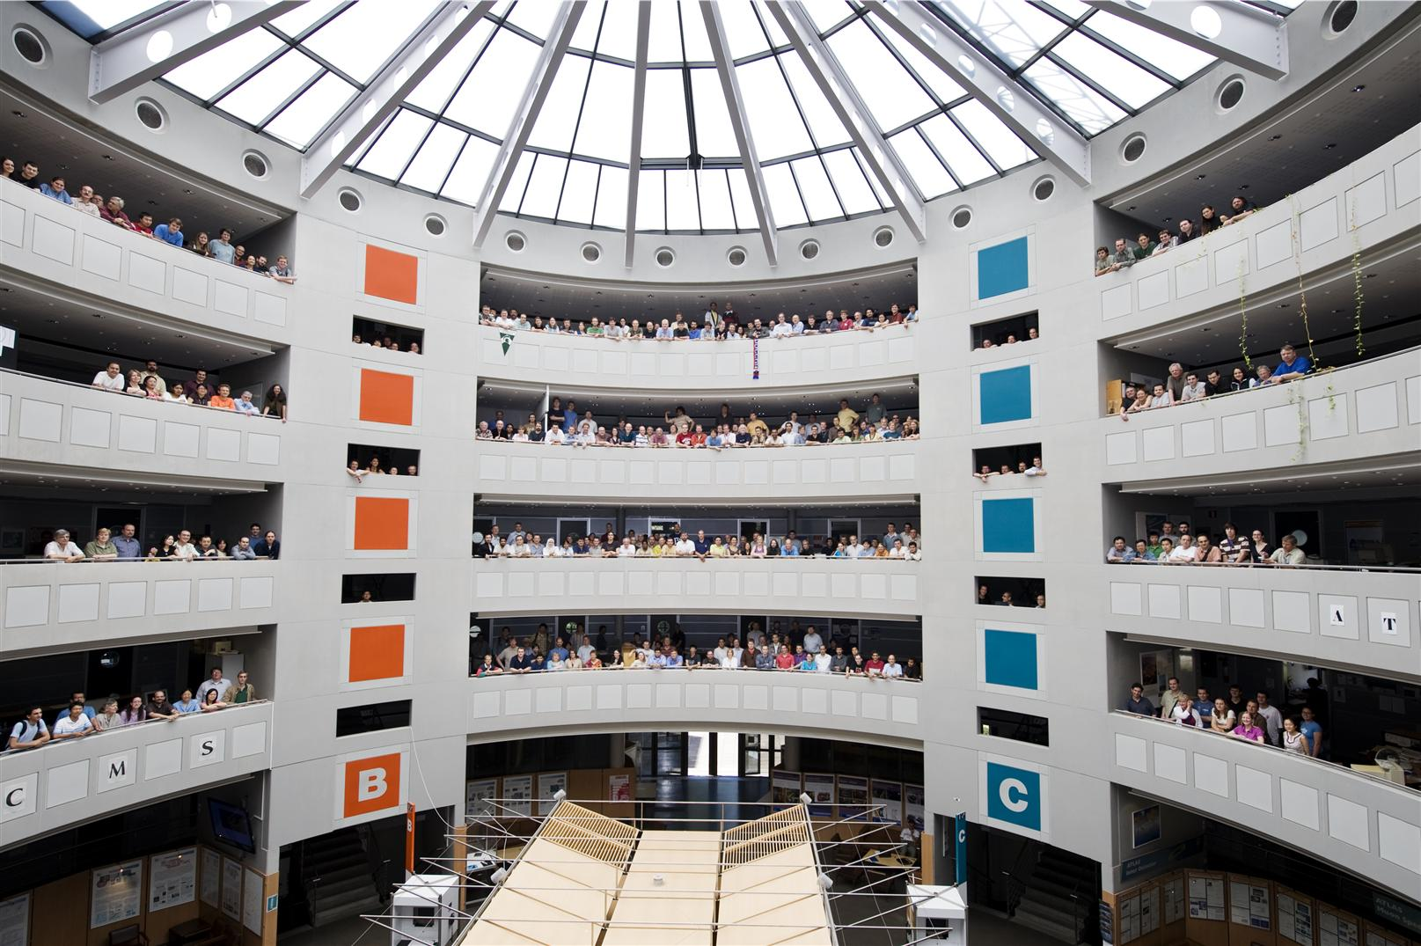
Why #ESN
connect people
give them a voice
flatten communication
check http://cern.ch/chep2015 feed

Slide 10

Why #ESN
it’s mainstream
“Deloitte predicts that over 90% of Fortune
500 companies will have partially or fully
implemented an ESN by the end of 2013”
“By 2016, 50% of large companies will have
ESN and 30% of these will be considered
as essential as email is today” Gartner
DILLEmma Photography https://www.flickr.com/photos/dillemma/8719283397/
check http://cern.ch/chep2015 feed

Slide 11
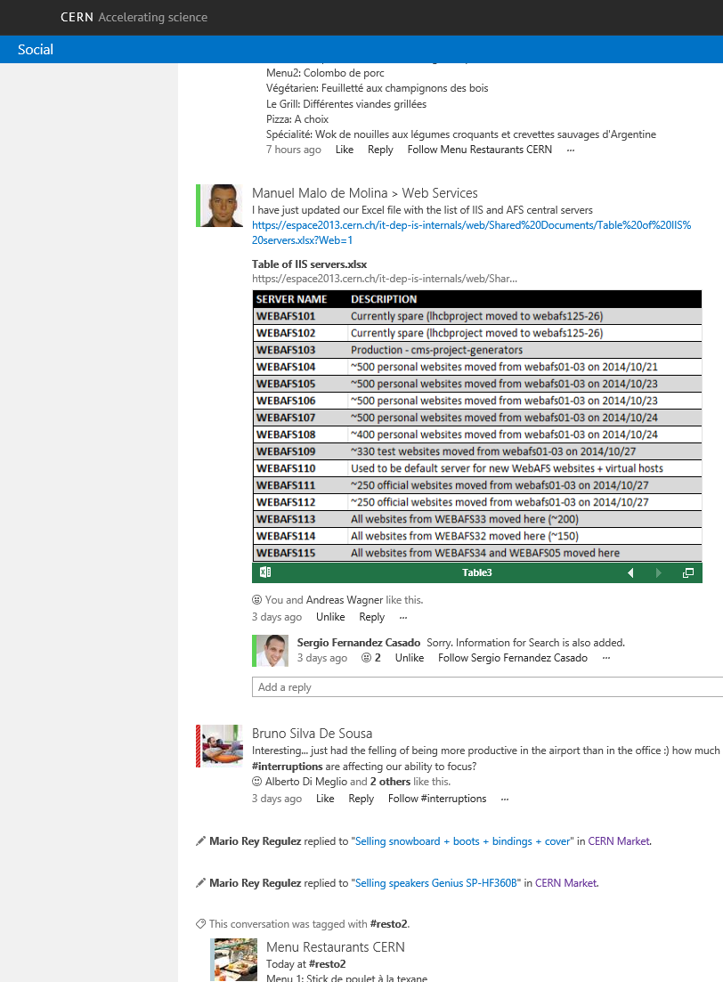
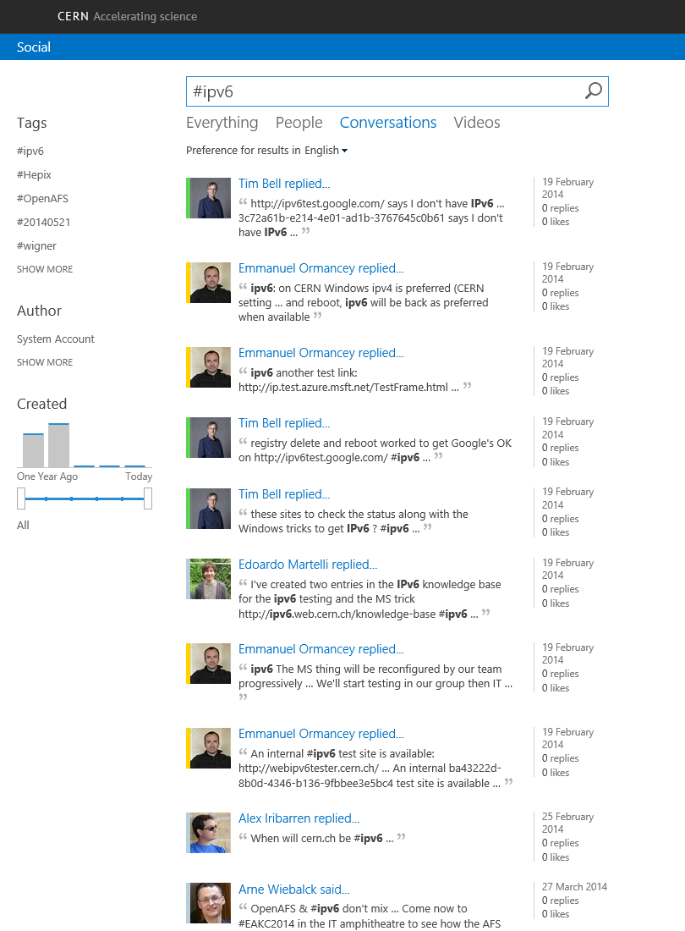
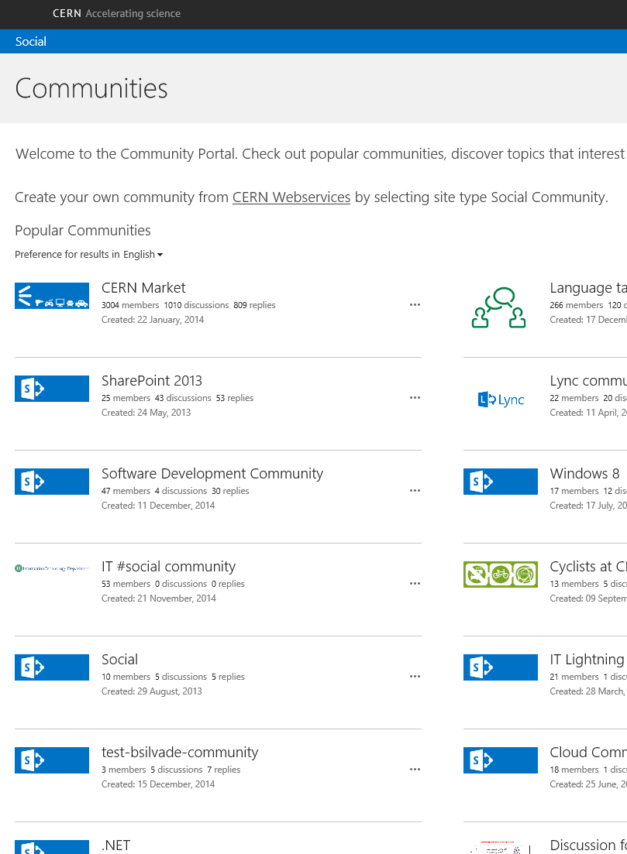
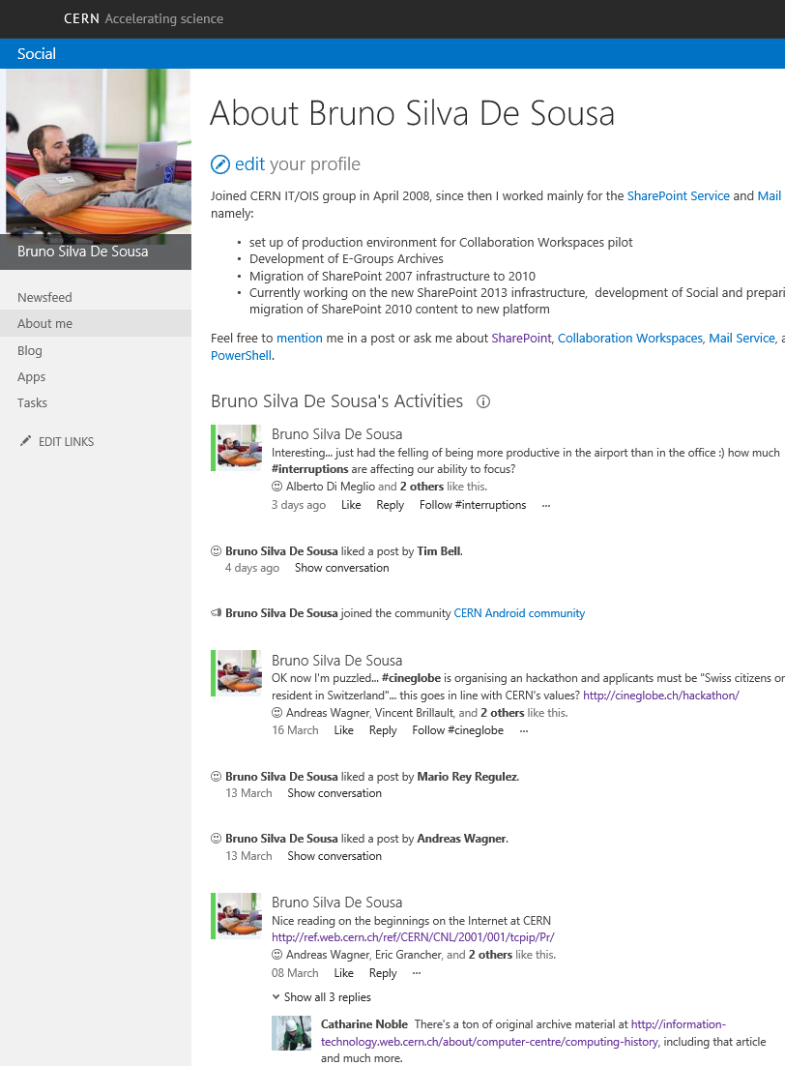
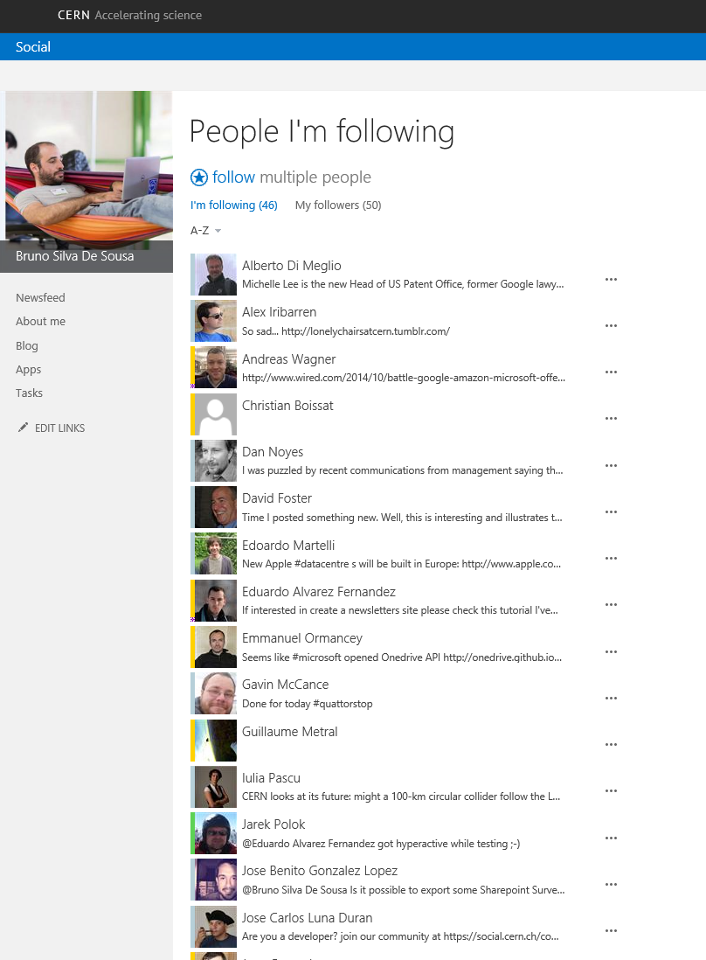
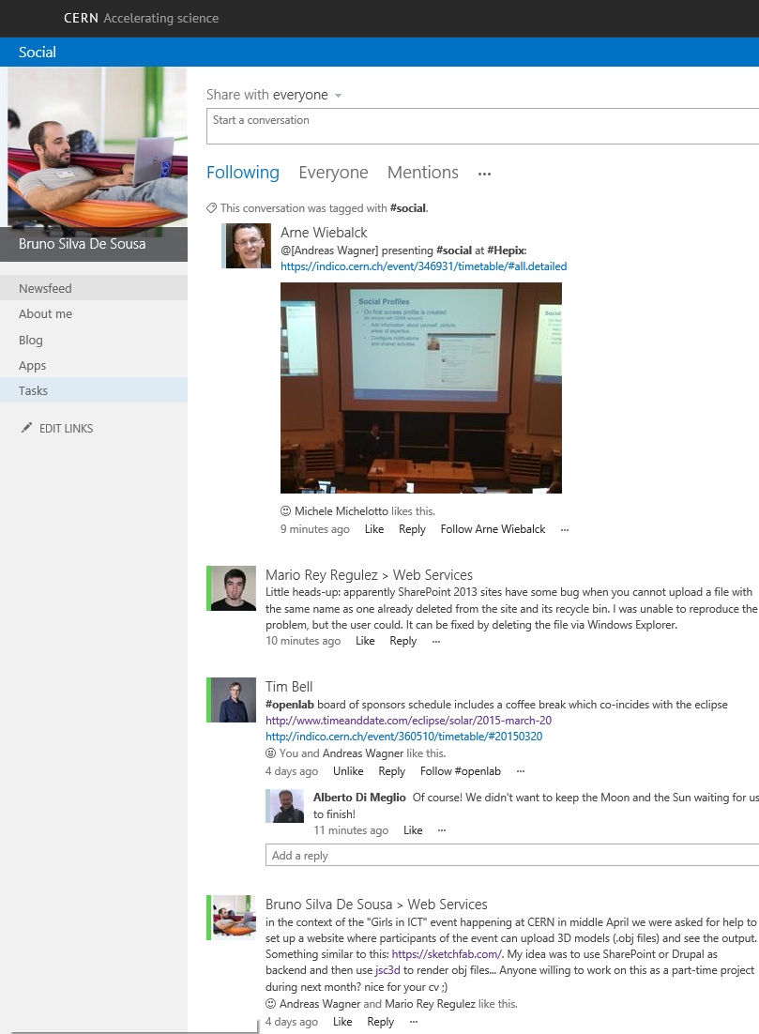
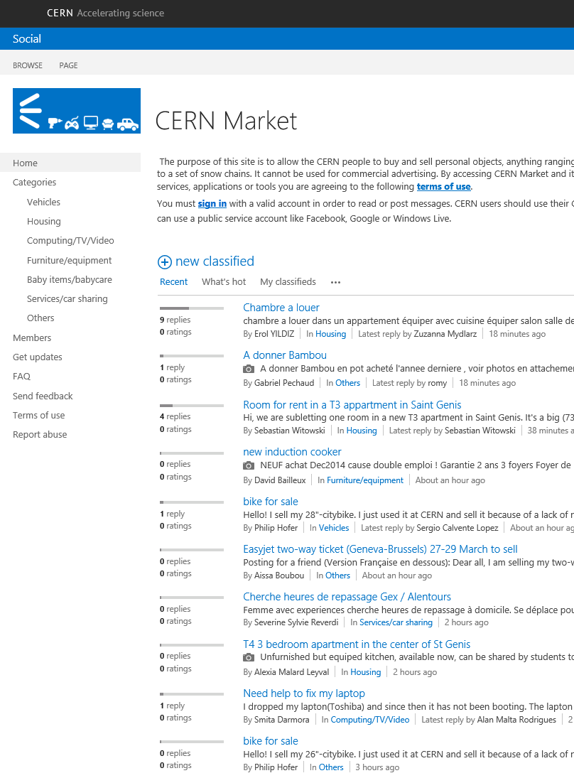
Social@CERN
Profiles
Networking
Microblogging
Communities
Documents
Search
check http://cern.ch/chep2015 feed

Slide 12
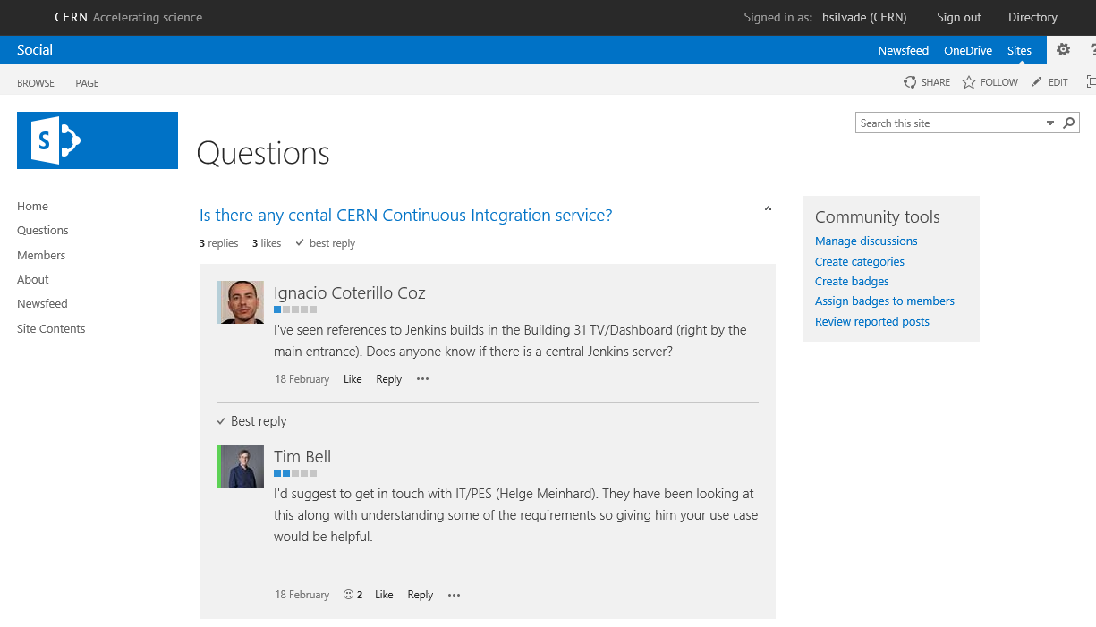
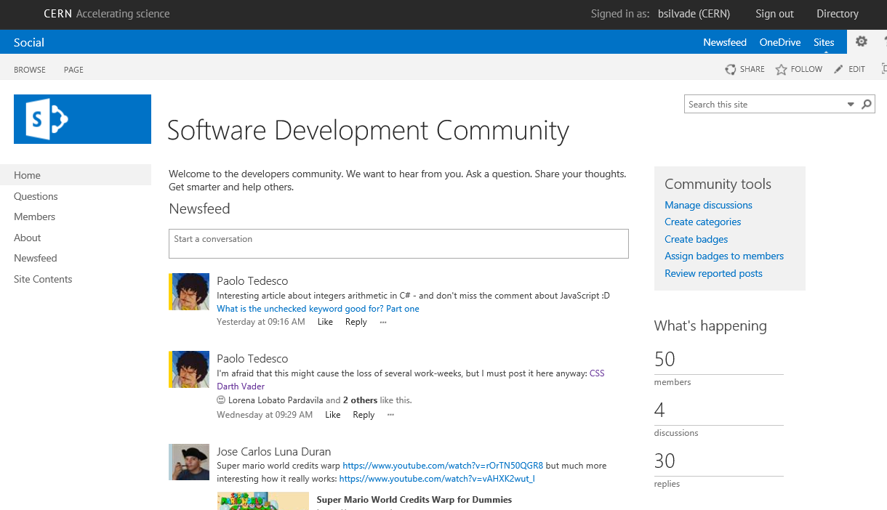
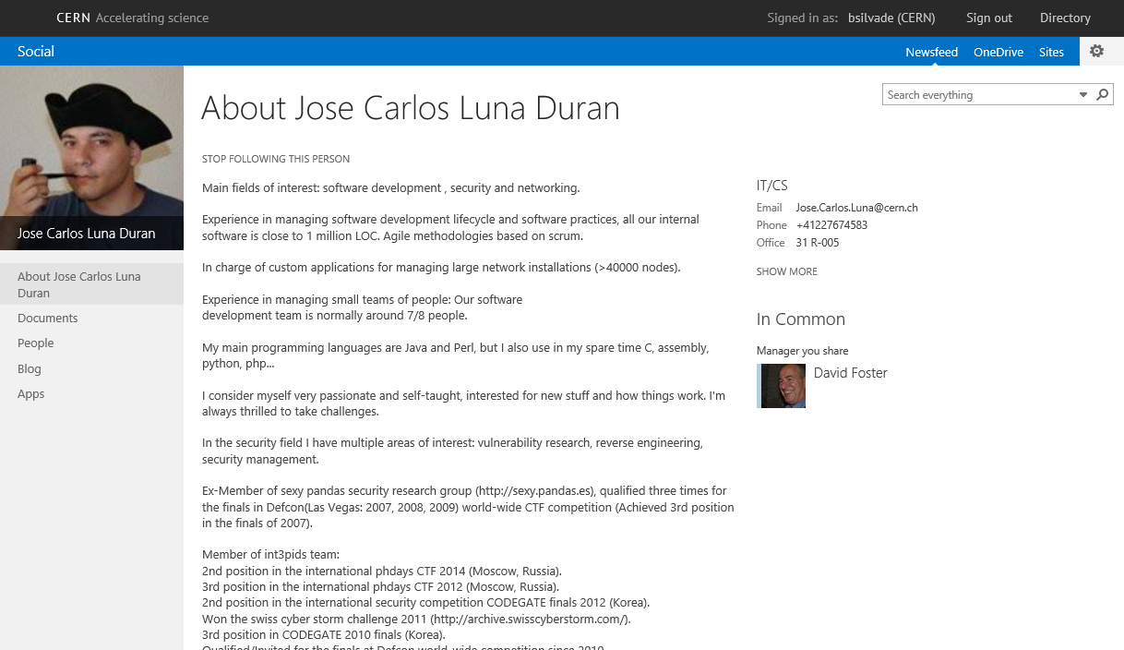
Developers@CERN
Profiles & skills
Share and discuss
Ask & contribute
check http://cern.ch/chep2015 feed

Slide 13

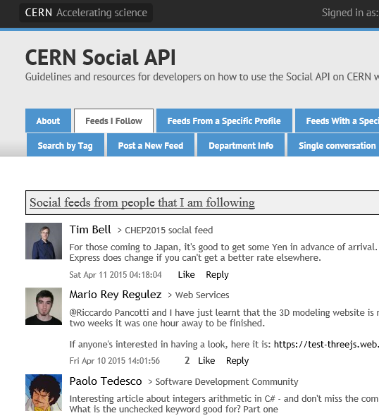
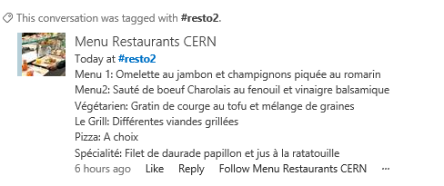
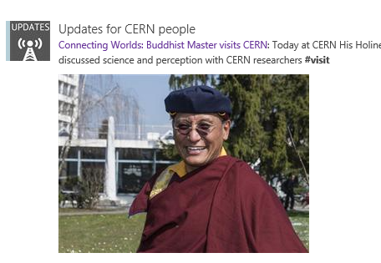
Deploying an #ESN
only 20% is technology
Feed with content
API for integration
and 80% cultural change
SOCIAL COMPUTING STRATEGY
REQUIRED
Moyan Brenn Photography https://www.flickr.com/photos/aigle_dore/5849712695/
check http://cern.ch/chep2015 feed

Slide 14
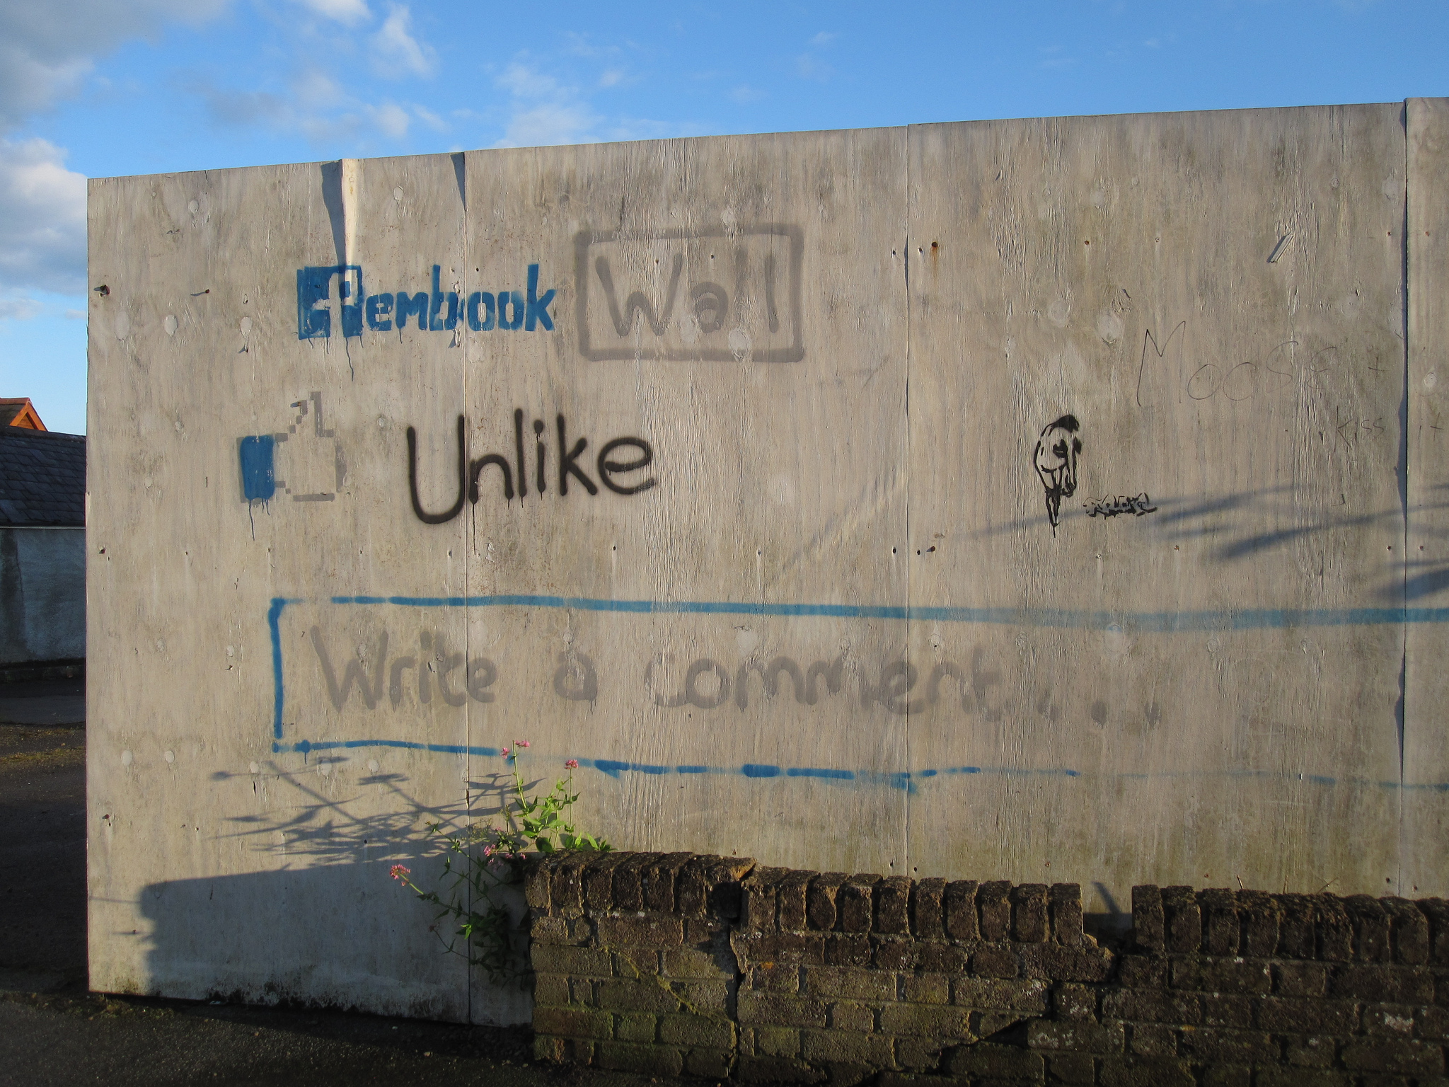
Obstacles
Adoption drop-off
Isolated success
Cultural blockers
PERSEVERANCE IS KEY
N53 https://www.flickr.com/photos/nh53/7530227002/
check http://cern.ch/chep2015 feed

Slide 15

The goal
PROVIDE A STIMULATING
ENVIRONMENT
People can learn from others
Attract, engage and keep talents
Foster innovation
Paul Hocksenar https://www.flickr.com/photos/vermininc/2784297184/
check http://cern.ch/chep2015 feed

Slide 16
Questions?
More in depth details about Social@CERN
http://cern.ch/go/L9CN
check http://cern.ch/chep2015 feed

Slide 17
References
The social economy: Unlocking value and productivity through social technologies
http://www.mckinsey.com/insights/high_tech_telecoms_internet/the_social_economy
Gartner Says 80 Percent of Social Business Efforts Will Not Achieve Intended Benefits Through 2015 http://www.gartner.com/newsroom/id/2319215
Gartner Reveals Five Social Software Predictions for 2010 and Beyond http://www.gartner.com/newsroom/id/1293114
Enterprise Social Networks: another tool, but not yet a panacea https://www2.deloitte.com/content/dam/Deloitte/global/Documents/Technology-Media-Telecommunications/dttl_TMT_Predictions2013_EnterpriseSocialNetworks.pdf
Enterprise Social Networking (ESN) for Improved Collaboration and Productivity http://www.elcomcms.com/resources/elcom-blog/posts/enterprise-social-networking--esn--for-improved-collaboration-and-productivity
Social computing in the enterprise – building a social computing strategy http://download.microsoft.com/download/2/7/8/27848976-01A8-41D5-8890-A2465C2A26F8/Social%20Computing%20in%20the%20Enterprise.pdf
Developing an Enterprise Social Computing Strategy
http://www.intel.fr/content/dam/doc/white-paper/intel-it-developing-enterprise-social-computing-strategy-paper.pdf

Slide 18
Key value drivers
http://www.altimetergroup.com/2012/02/making-the-business-case-for-enterprise-social-networks.html
Encourage Sharing | Create two-way dialog Makes business personal Reduces distance to leaders Connects globally, person by person Forms private groups
Capture Knowledge | Identify expertise Avoid duplication and have better coordination Transfer knowledge Improve best practices
Enable Action | Solve problems faster and better Bring outsiders in Streamline processes
Empower People | Give employees a voice Make meaningful contributions and innovations Increase engagement, satisfaction and retention
Notes:
From: http://searchcio.techtarget.com/definition/enterprise-social-networking
http://www.tibbr.com/blog/topics/enterprise-social-networking-topics/6-questions-to-ask-before-you-buy-in-to-enterprise-social/
http://www.tibbr.com/blog/topics/enterprise-social-networking-topics/how-to-convince-the-c-suite-that-they-need-an-enterprise-social-network/

Slide 19
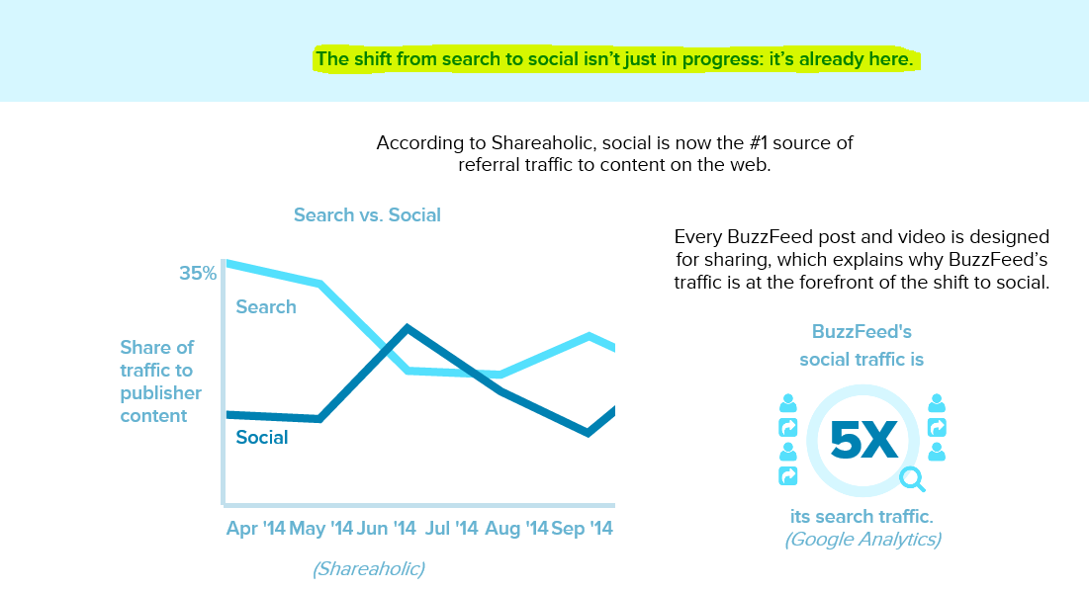
Interesting
What is going on the consumer space
http://insights.buzzfeed.com/industry-trends-2014/

