Slide 1
First considerations on HEB beam transfer
W. Bartmann, B. Goddard, M. Barnes, E. Gianfelice, V. Kain, M. Meddahi, F. Velotti
FCC-FHI WG meeting, 4-March-2014

Slide 2
HEB extraction and transfer
Limited by machine protection
Define maximum energy that can be transferred
  Damage limit of protection elements in line and at injection; sacrificial collimators probably not compatible with kicker burst mode
  Quench limit if superconducting magnets used – can following shots be stopped early enough (interlocking chain) before deltaBfield is too big for acceptance
  How to interlock a burst mode kicker
Assuming HL-LHC parameters for 25 ns
  2.3e11, 288 b, 450 GeV → ~5 MJ beam power at transfer

Slide 3
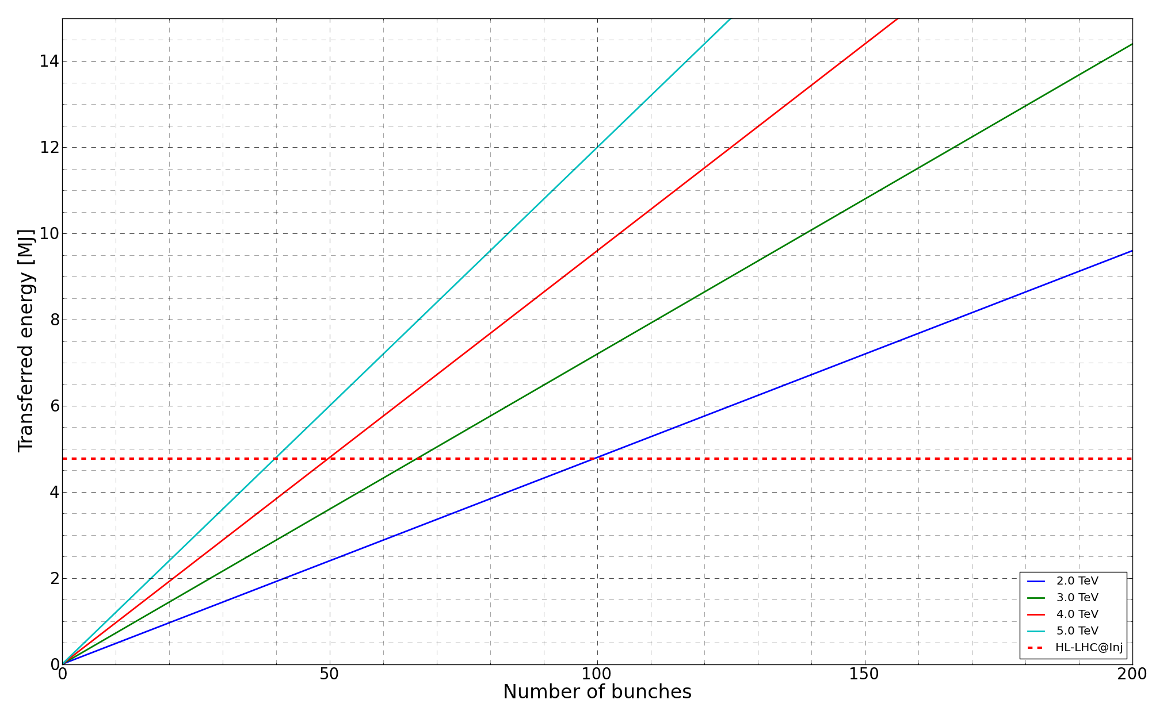
Maximum #bunches@transfer
Can transfer about 50 - 70 bunches assuming HL-LHC@inj as MP limit

Slide 4
“Burst” mode kicker
Can transfer 50-70 bunches
Assuming 25 ns spacing: Flattop of 1.25-1.75 us
Extraction as for LBDS: 0.27 mrad →B.dl of 2.7 - 3.6 T.m
Frequency of burst ~ n x 11 kHz (LHC revolution frequency), regular pattern advantageous for energy which needs to be switched, can use reflections
Semiconductor switches for lifetime
Rise time: …

Slide 5
Kicker rise time specification
80% of FCC shall be filled →10670 bunches
66 us left for kicker gaps
MP limit and beam energy define maximum #bunches@transfer and number of required injections
Available kicker gap (56 us)/#injections gives the maximum rise time

Slide 6
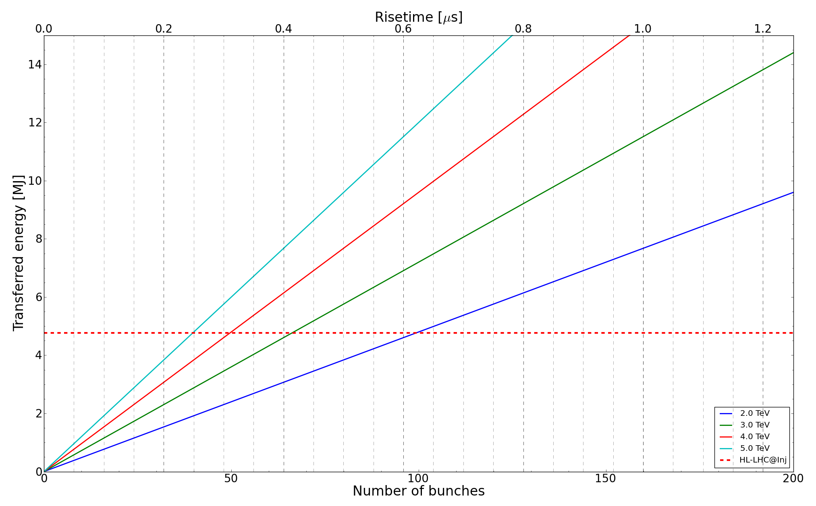
Kicker rise time specification
MP limit X Beam energy → #bunches@transfer → rise time
At 4 TeV:
~ 50 bunches per transfer which requires a risetime of 0.28 us to reach 80% filling of FCC (No abort gap included)

Slide 7
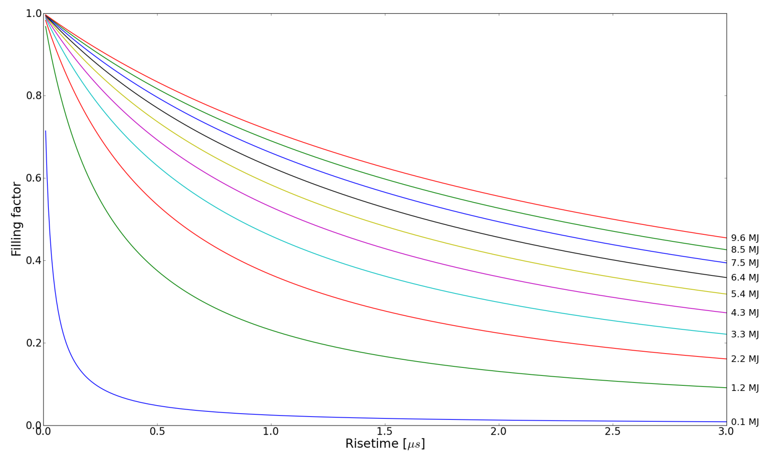
FCC filling factor vs rise time @ 4TeV
At HL-LHC@inj beam energies (5 MJ) a filling of 80% is reached for a rise time of 0.28 us

Slide 8
Conclusions
Beam transfer from HEB to FCC is machine protection limited
Within 5-10 years HL-LHC parameters seem to be a limit for damage of protection devices in terms of energy density
  Assuming this limit 50 – 70 bunches at transfer
  Parameter stretch to be studied (search for new material, new protection concept)
Kicker with short rise/fall time in “burst” mode locked to HEB revolution frequency
  80% FCC filling with HL-LHC damage limit requires 0.3 us rise/fall time (existing MKD: 2.8 us)
  Demanding B.dl of 2.7 - 3.6 T.m → kicker installation length
  Existing LHC dump kickers not to scale due to different system requirements

