Slide 1
  CMS Phase 1 Upgrade Status
  LHCC Upgrade Session March 4, 2014
  J. Mans

Slide 2

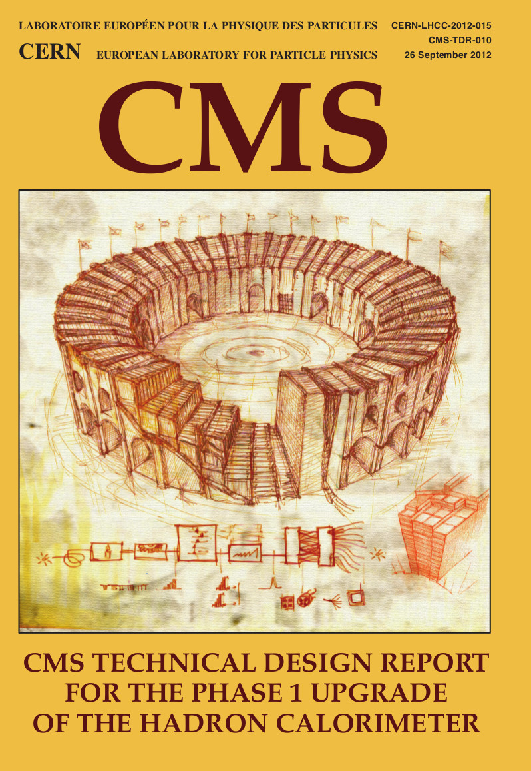

Reminder: CMS Phase 1 Upgrade Scope
Upgrade goals are to provide strong physics performance for luminosities up to twice the original design (2 x 1034) and manage radiation-damage effects up to 500 fb⁻¹
Upgrades planned to three subsystems of CMS
  Pixel tracker : four-layer barrel and 3 forward-disk pixel tracker with new readout chip (ROC) capable of higher hit rate
  Hadron calorimeter : Installation of SiPM devices into barrel/endcap calorimeters and new electronics in the forward calorimeter allowing timing-based background rejection
  Trigger : upgrade to the muon and calorimeter Level-1 trigger systems and global trigger processor to handle higher luminosities without loss of efficiency for key physics channels

Slide 3
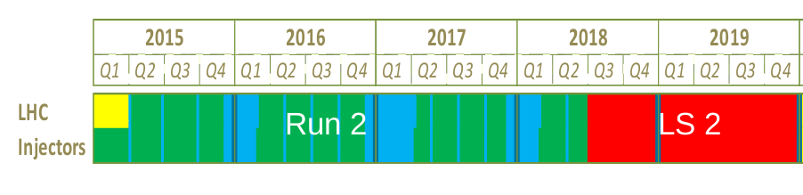
Schedule of the Installations
L1 Trigger Installation
and Commissioning
Pixel Installation
HCAL Barrel and Endcap
Installation
HF Electronics Installation

Slide 4
Level 1 trigger upgrade

Slide 5
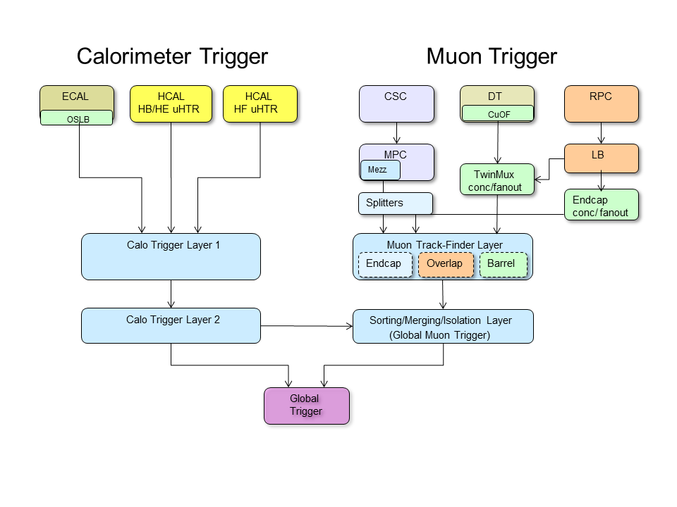
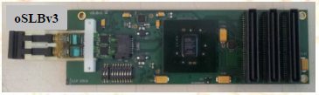
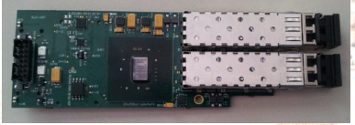
Trigger Upgrade Strategy and Architecture
Trigger rates are driven by the
increase in luminosity, PU, and √s
Mitigate by improving:
  e/γ isolation
  τ id
  muon pT resolution
  muon isolation
  jets with PU sub.
  L1 menu sophistication
Build and commission upgrade in parallel with
current trigger system in 2015 to safeguard
physics, decouple from LHC schedule
Target deployment: 2016
  Installation begins during LS1 with electronics
  upgrades to provide parallel optical data paths
  to current and upgrade electronics
oSLB (Calo Trigger)
oRM (Calo Trigger)

Slide 6
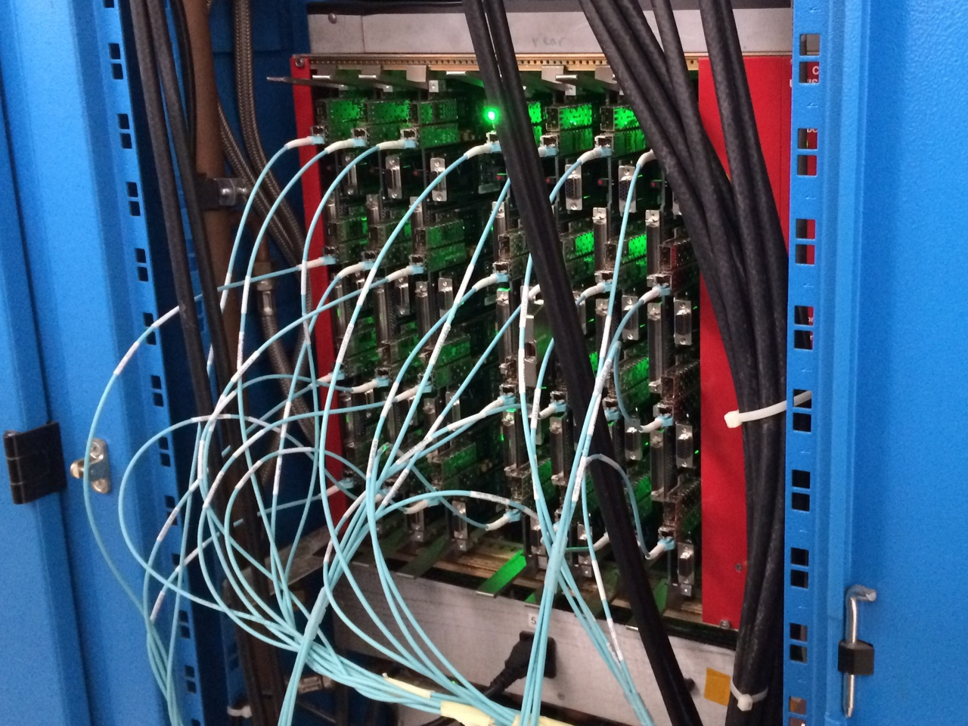
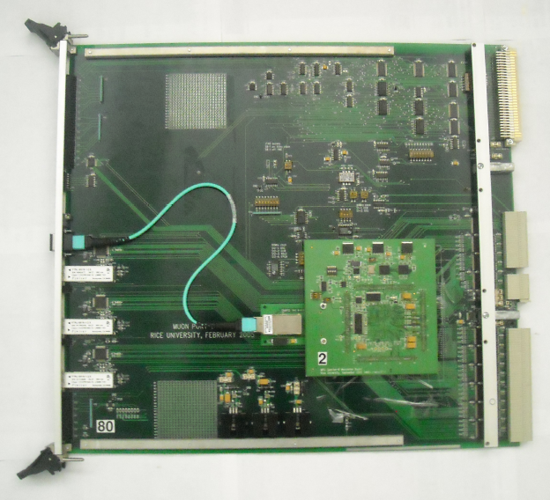
Optical infrastructure upgrade status
Optical SLB and RM mezzanine boards (ECAL)
  All oSLB and oRM cards (650 each) have been delivered and are currently under production testing.
    All oSLBs and 439 oRMs have passed JTAG tests
      Only 1 oRM found faulty so far
    340 oSLB have passed optical link pattern tests as well as 28 oRMs validated in an RCT crate
  Expect installation and commissioning by July
Muon Port Card mezzanine boards (CSC muon system)
  All 85 mezzanine cards are complete and under test → on track
  8 are at CERN ready to be installed for commissioning
  Integration tests to legacy CSC Track-Finder and to prototype upgraded Muon Track-Finder successful
DT “TwinMux” concentrator and fan-out
  Prototype expected this month

Slide 7
uTCA Architecture and Common Cards
A “7” in the names of
modules indicate the use of
Xilinx Virtex 7 FPGAs
L1 Trigger upgrades are based
on uTCA electronics
architecture and make
substantial use of common
cards
  AMC13 card for timing and DAQ
  MP7 card used in second layer of both calo
  and muon trigger, as well as global trigger
  Common muon track finder electronics
  across the full detector
Firmware for different functions is substantially different, with some reuse of code modules
  Reconciling requirements across different users takes time and engineering resources, but will have operational and support benefits for future operation
MTF7
CTP7
MP7
MP7
MP7

Slide 8
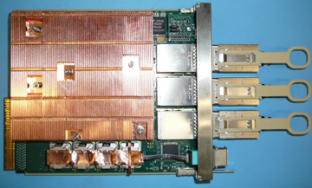
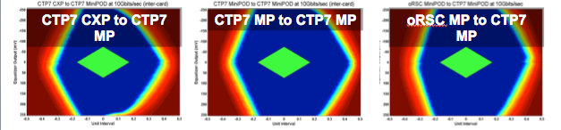
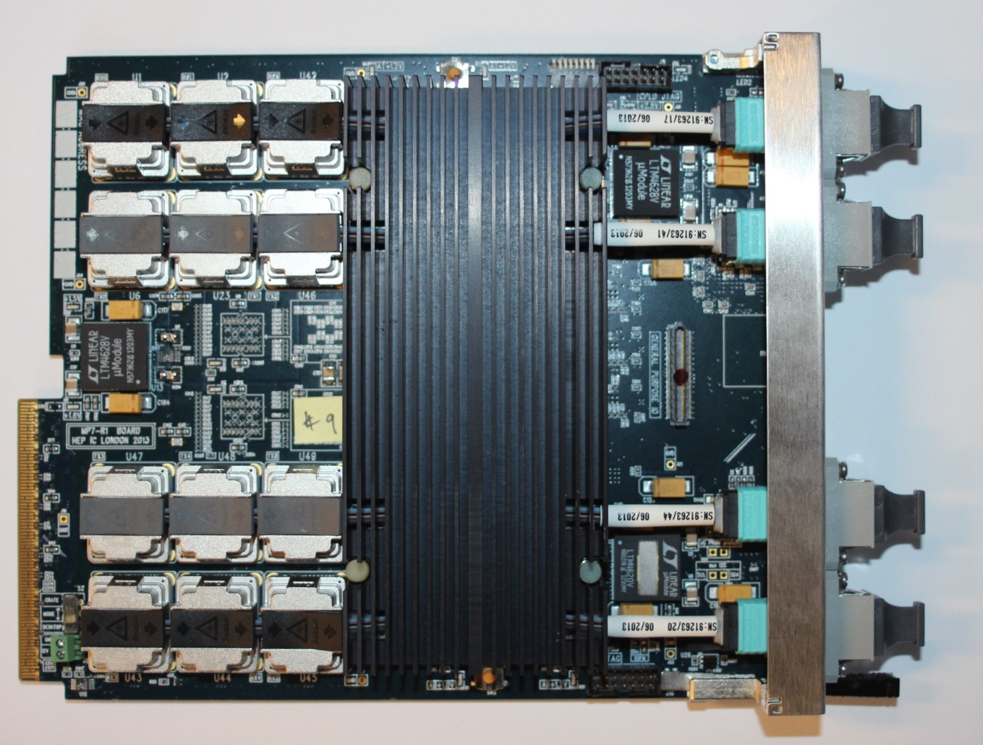
CTP7 and MP7 Status
CTP7 Status (Calo Layer 1)
  Two assembled boards under test since Jan.
  Eye scans taken during 134-link run show excellent margins @ 10 Gbps
MP7 Status (Calo layer 2 and GT/GMT)
  Cards have been delivered to other groups for firmware development
  (GT, GMT, and barrel muon)
Full vertical slice in Bat.904 since Sept.including algorithms & emulators

Slide 9
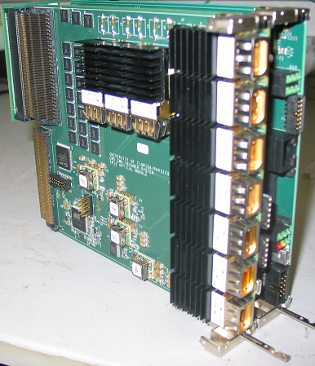
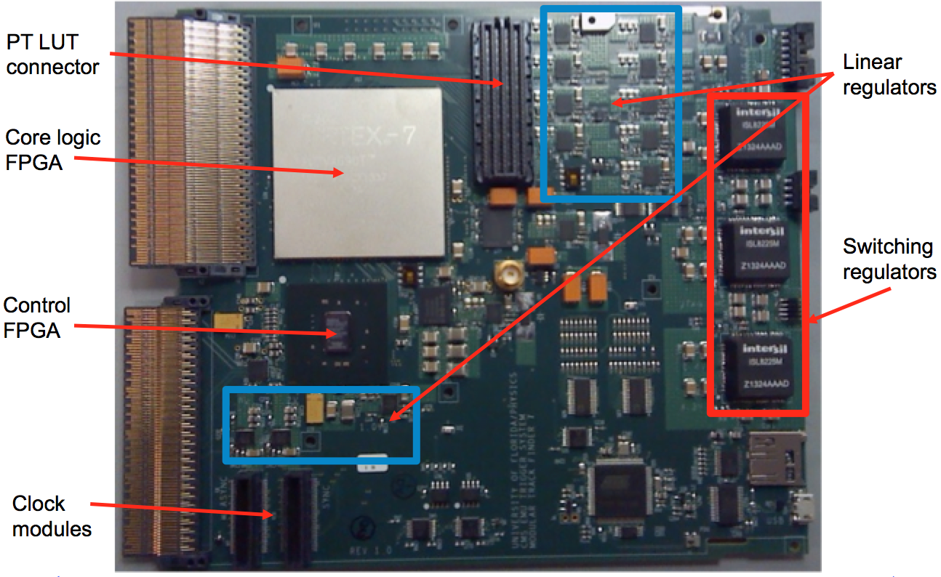
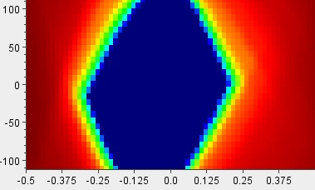
Muon Modular Track Finder Status
Modular Track-Finder prototype →
Hardware successfully tested:
  FPGA base card - Virtex-6 version
  1GB RLDRAM mezzanine card (for PT assign)
  Optical links card (range: 1.6 Gbps - 10 Gbps)
  Backplane connector (up to 10 Gbps)
“MTF7” Virtex-7 base card
  Under test now
  All 80 receivers and 28
  transmitters working in loop
  back thru backplane @ 10Gbps

Slide 10
Global Muon Trigger and Global Trigger Firmware Status
Hardware platform is the MP7 processor for both
μGMT algorithm logic has been developed:
  Sorting all 108 muons from Track-Finders to final 8 muons
  Cancel-out logic for duplicates
  Calorimeter-based isolation (incl. extrapolation + pile-up subtraction)
  Estimated FPGA resource usage at 55% + DAQ logic
  FPGA firmware compilation is in progress
  Algorithm development on track
μGT
  Object interfaces and data formats defined
  Input patch panel design has been defined
  Gaining experience with 10 Gbps links
  First version of μGT menu is available

Slide 11
Trigger Work Upcoming
A few upcoming integration tests (TDR)
  Calo Layer 1 and Layer 2 integration test completed - Mar 2014
    Electrical “IBERT” test only
  ECAL, HCAL, Calo (both layers), GMT and GT integration test completed - July 2014
    On track
  Endcap TF, GMT and GT integration test completed - Sep 2014
    On track
Production of modules is on track
  AMC13, MP7 module component procurement underway
  CTP7 and MTF7 production later this year
  Isolated small delays are well-within planned margin

Slide 12
Pixel upgrade Status

Slide 13
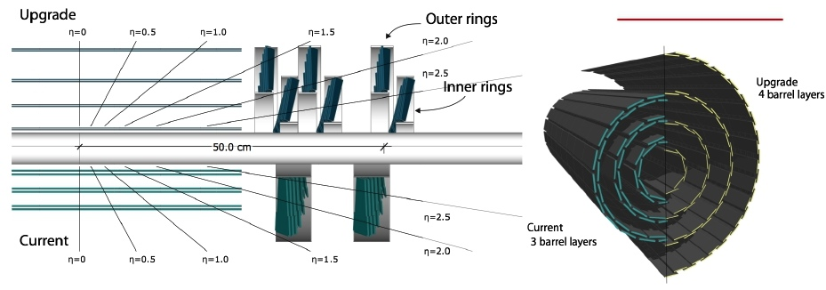
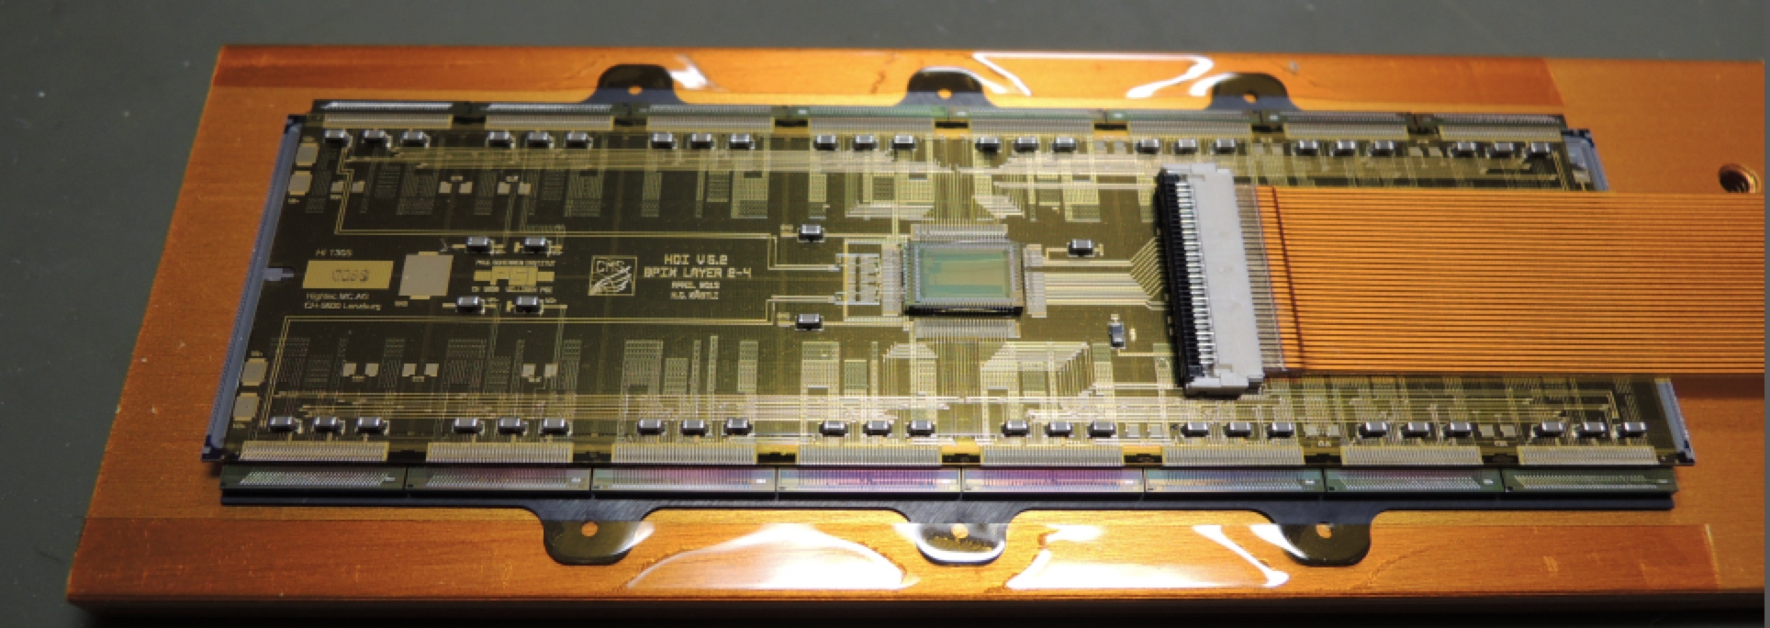
Pixel Phase I Detector
TDR: CMS-­‐TDR-­‐011
• 4 layers / 3 disks
– One more space point: smaller inner radius (3 cm)
• New readout chip
– Recovers inefficiency at high rate and PU
• CO2 cooling, new cabling and powering scheme (DC–DC)
– Less material
• Longevity
– Tolerate 100 PU and survive to 500 fb-1, with exchange of innermost layer

Slide 14
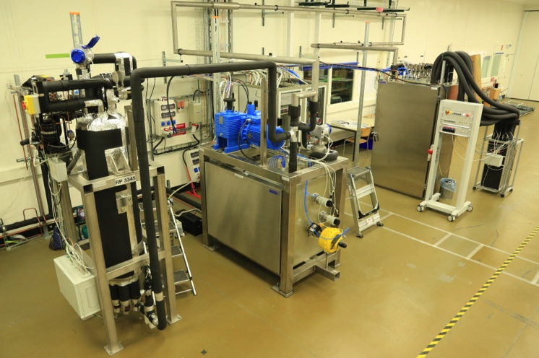
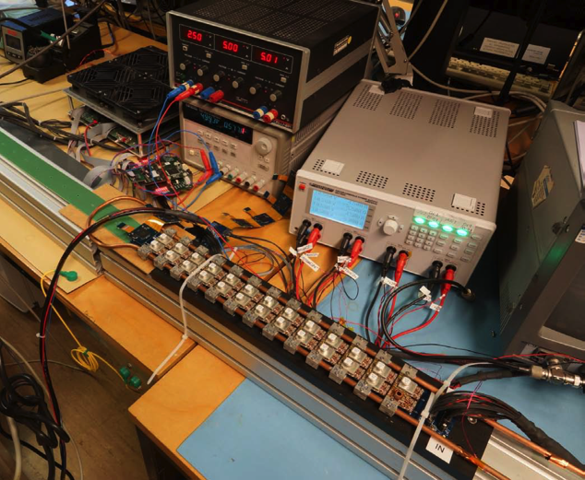
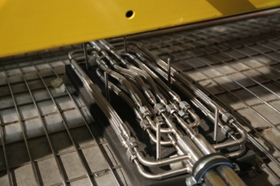
Pixel Phase I - General
Project PASSSED a 2-day Engineering Design Review EDR 5th and 6th of December – organized by Technical Coordination
Eng. wafers of the final PSIdigV2.1 ROC IN HAND
  All tests VERY GOOD; modules have been built
  These chips will be used for the pilot blade detectors
Good progress on Token Bit Manager (TBM) chip design
  Last ingredient for module construction
DC-DC chip (FEAST2) submitted in December,
expected back in March
  Progressing on integration studies
CO2 plant at the Tracker Integration Facility
fully commissioned
  Vacuum jacketed CO2 transfer lines INSTALLED onto CMS
  Construction of final manifolds started
CO2 @ Meyrin
DC-DC integration study
CO2 vacuum transfer lines
- Connection box

Slide 15
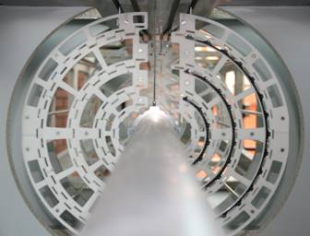
Barrel Pixels (BPIX)
1:1 cooling BPIX cooling lines at CERN
Good modules produced and testing specified
  Starting a pre-production campaign (with V2 ROC chips) to qualify production chain and all production centers
High density interconnects - pre-production in hand
First batches of final production sensors received
Work on supply tube progressing well
  Electronics and mechanics
  Cabling mock-up done
Cooling piping replicate now at CERN for testing
BPIX Mechanics mock-up ready for trial installation this year
Installation ‘print’
Cable Mockup

Slide 16
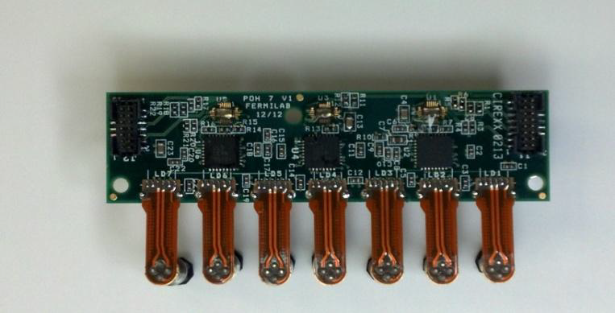
Forward Pixels (FPIX)
First FPIX modules built and tested in the US production centers
  Exercise of Production and QA protocols
Pilot Blade preparation on track
  Will use final ROC
Sensors from new 6” wafer production connected to chips, irradiated 1.2E15 1MEV_N_equiv. and are at the beam test right now
Prototypes on Opto-hybrids look good
Had some problems with current FPIX High-Density Interconnects
  Good progress on solutions
FPIX Mechanics mock-up ready for trial installation this year
Good progress on mechanics in general
  and on thermal management
Prototype Pixel Opto Hybrid
Prototype half-cylinder

Slide 17
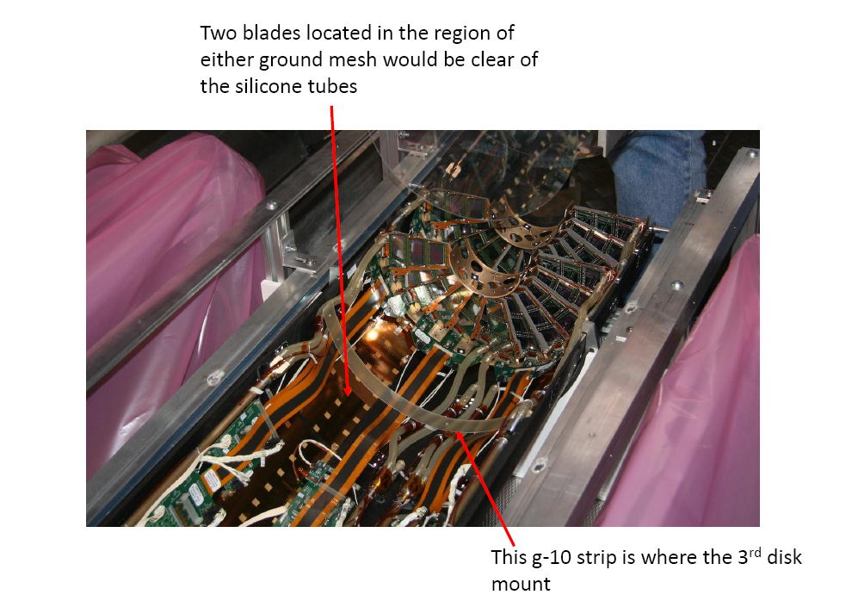
Pilot Detector and Ongoing Work
CMS has benefitted greatly from
pre-installation of small sections
of upgrade hardware into the
detector during operations
  E.g. SiPMs in outer HCAL
Pilot pixel detectors will be installed
during LS1 including both DC-DC and
linear-powered modules
  Study performance of ROC in-situ
  Head-start on DCS integration
  Testbench for uTCA FED testing
Plans for the pixel over the next six months
  Launch DC-DC converter production after FEAST2 validated
  Sensor, optohybrid production continues
  TBM chip validation, engineering run
  Module production beginning in August
FPIX with space for 3rd disk

Slide 18
HCAL upgrade Status

Slide 19
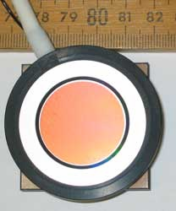
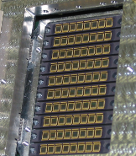
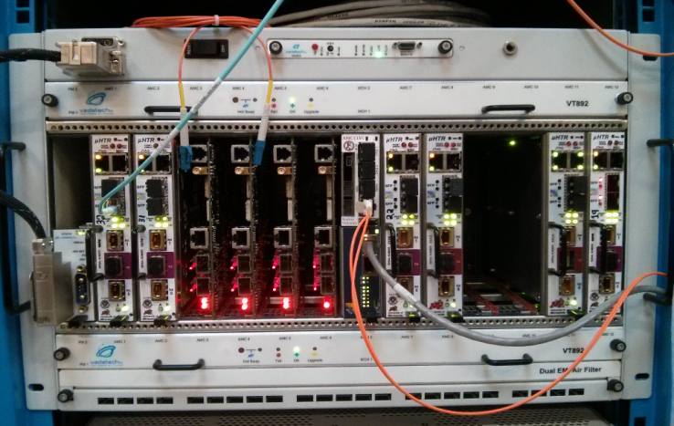
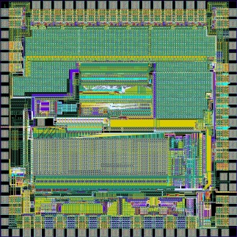
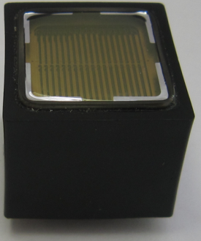
HCAL Phase 1 Upgrade Primary Components
Improved photodetectors
  HB/HE: HPD → SiPM (allows longitudinal segmentation of readout)
  HF: single-anode PMT → dual-anode readout PMTs (improved discrimination of anomalous signals)
New front-end electronics, including TDC
New back-end electronics (μTCA) to support larger data volumes
HPDs
SiPMs
QIE10 (HF)
QIE11 (HBHE)
New µTCA Back-end
Single to dual readout PMTs
A
B
A
B

Slide 20
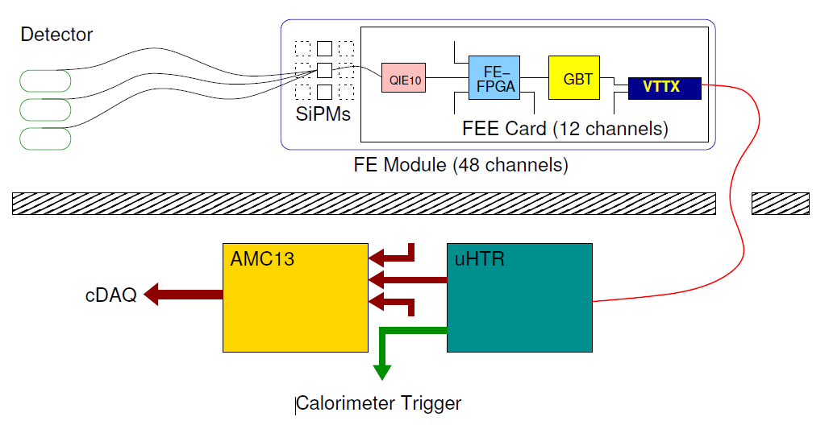
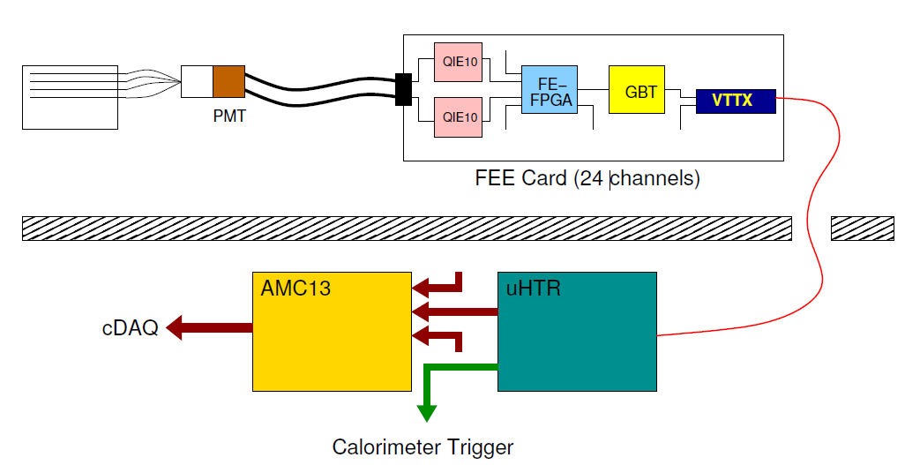
HCAL Phase-1 Upgrade: Timeline
HB
HE
Front-end
2019 (LS2)
QIE11
Back-end
2015-2016
HF
Front-end
Feb 2016
(YETS)
Back-end
2014 (LS1)

Slide 21
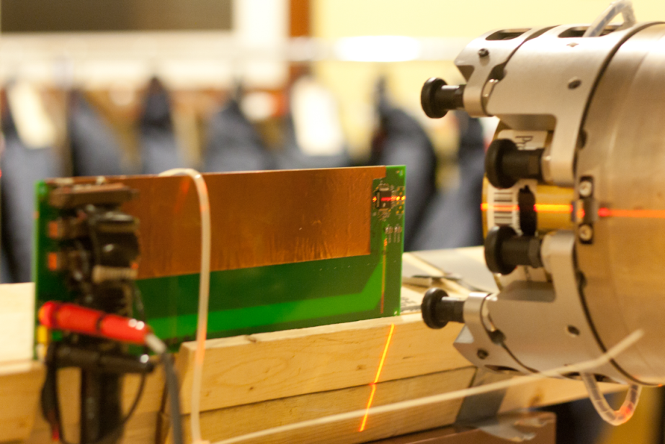
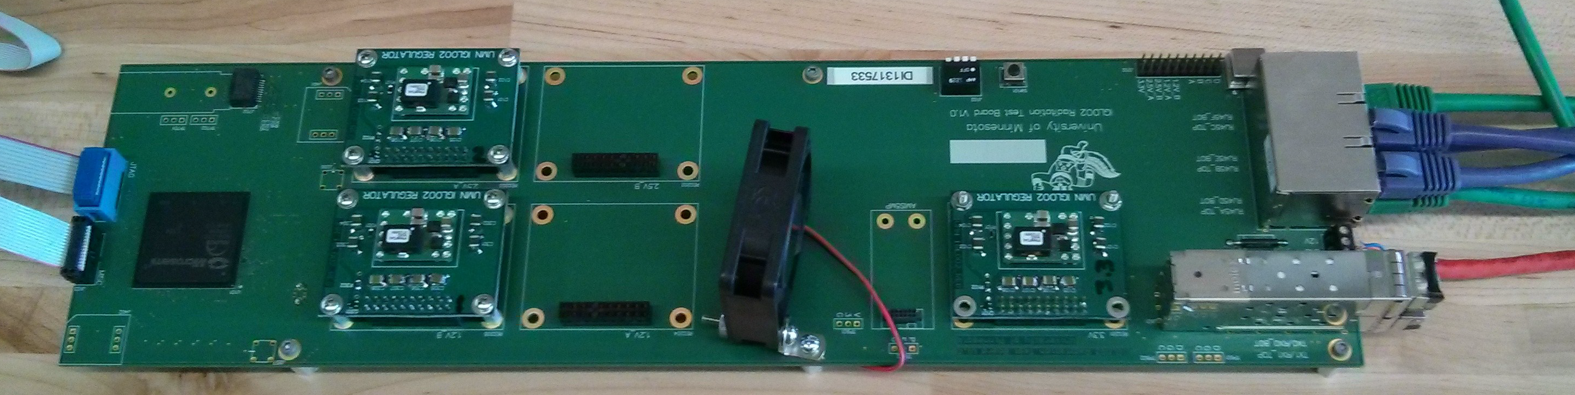
Key Electronics Components
QIE10 provides integrating ADC and TDC functionality for the HF upgrade
  Prototypes show excellent performance
  Radiation tests show acceptable SEU rate,
  device function beyond 6 x 10¹² n/cm²,
  250 kRad (expected 2 x10¹² n/cm², 3 kRad)
First prototypes of QIE11 for HB/HE, which
provide a programmable current shunt to
handle leakage current growth in irradiated
SiPMs, are performing as expected
GBTX serializer has been of concern, particularly for HF upgrade
  Alternative solution: Microsemi Igloo2 FPGAs which allow the combination of the data formatting function (ProASIC3L) and serialization function (GBTX)
  Device is able to stably transmit at 5 Gbps
  Initial radiation tests show acceptable
  SEU performance (primarily in PLLs),
  tests on high-speed serializer still to
  be done

Slide 22
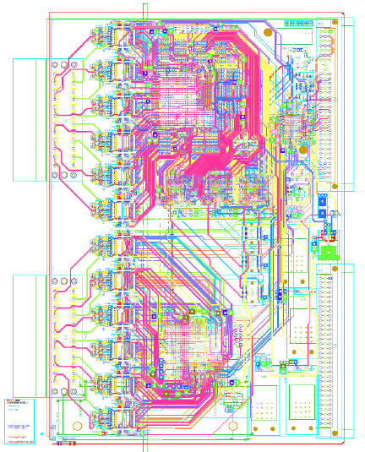
HF Upgrade Electronics Status
uHTRs and AMC13s making good progress
  Delayed by 6 months relative to TDR schedule, mostly due to funding issues
  On track for first full production crate in April/May
  Successful integration testing with oRM
Prototype Front-End Electronics under manufacture
  HF QIE readout card designed to test
  both Igloo2 and GTBX
  Control system (ngCCM) matching QIE
  readout card schedule
  After bench and beam (FNAL) testing,
  pre-production cards will be prepared
  by Turkey and Brazil
  Production readiness review expected by
  mid Fall 2014
FPGA + GBTX
IGLOO2
QIEcard layout (18 layers)

Slide 23
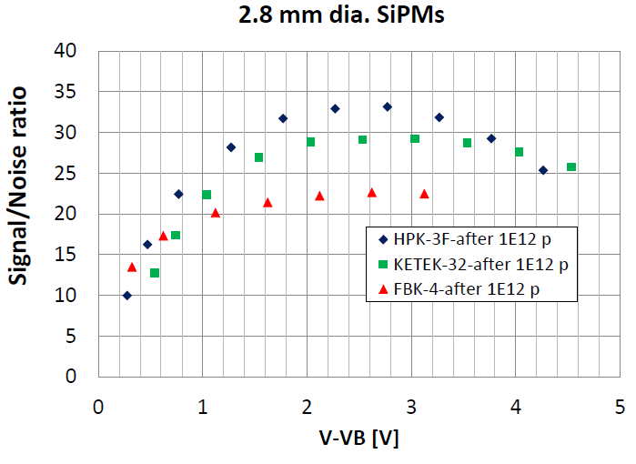
HB/HE Status
Prototype SiPM devices irradiated to 10¹² p/cm² equivalent, with excellent performance after testing
Pre-production cycle is being prepared now, with final-specification packaging
Development of bias-board circuitry is ongoing
Design of QIE card will follow path set out by HF QIE card, later in the year
uHTRs and AMC13 modules for the HB/HE backend will begin production over the next six months (April for AMC13)

Slide 24
Conclusions
Three TDR projects continue to make good progress
Technical requirements are being met by prototypes and pre-production components
Management focus is moving to execution of production, quality assurance testing, and preparations for installation for many parts of the upgrade
Phase 1 Upgrades should be on-time to deliver physics performance for CMS

