Slide 1
WLCG and the India-CERN Collaboration
David Collados
CERN - Information technology
David.Collados@cern.ch
27 February 2014

Slide 2
Overview
The WLCG Project
India-CERN Collaboration

Slide 3
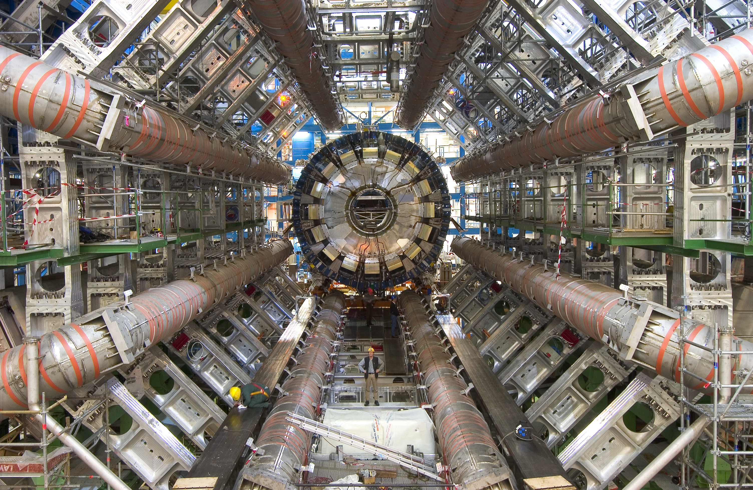
The ATLAS experiment
7000 tons, 150 million sensors
generating data 40 millions times per second
producing 1 petabyte per second
Notes:
700 tons,
150 million sensors,
generating data 40 Million times per second,
producing 1 PB of data per second

Slide 4

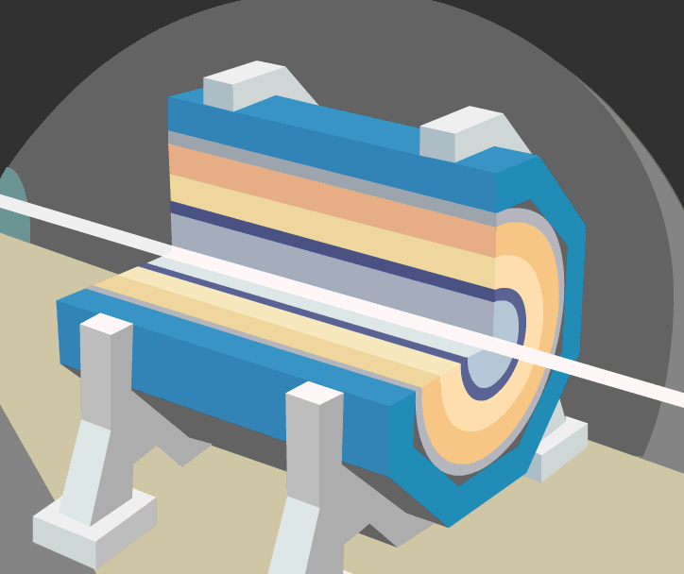
A collision at LHC
ATLAS Experiment
LHC Beam
4
Notes:
4
Collide two opposing particle beams of either protons at up to 7 TeV per nucleon, or lead nuclei 2.76 TeV per nucleon-pair, with energies to be doubled to around 14 TeV collision energy after LS1.
Protons collide 40 M times per second, generating 1 PB of data per second

Slide 5
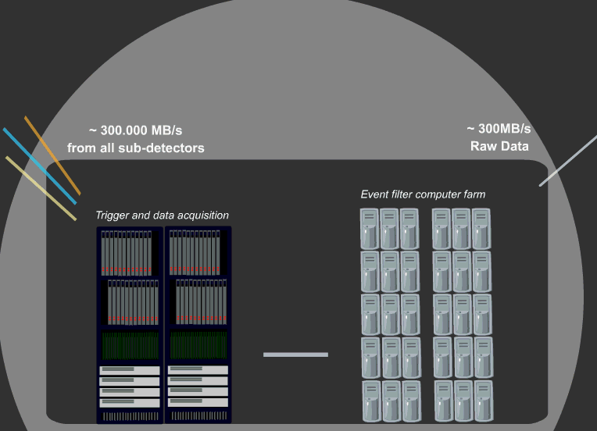
The Data Acquisition
Data from ATLAS
Reduction factor of 1 million.
1 PB/sec from all
sub-detectors
1 GB/sec raw data sent to Data Centre
Ian.Bird@cern.ch
5
Notes:
5

Slide 6
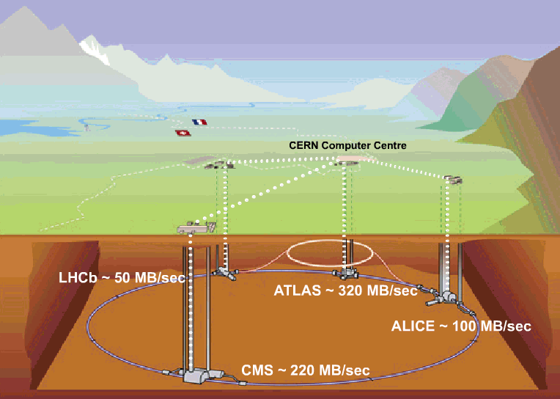
CERN Computer Centre (Tier-0):
Acquisition, First pass reconstruction, Storage & Distribution
LHCb ~50 MB/sec
2012: ~300 MB/sec
ATLAS ~320 MB/sec
2012: ~1 GB/sec
ALICE 1.25 GB/sec (ions)
CMS ~220 MB/sec
2012: ~4GB/sec
2012: ~1 GB/sec
Notes:
Red boxes: indicate the planning figures before LHC startup
Green boxes: indicate the actual figures prior to LS1

Slide 7
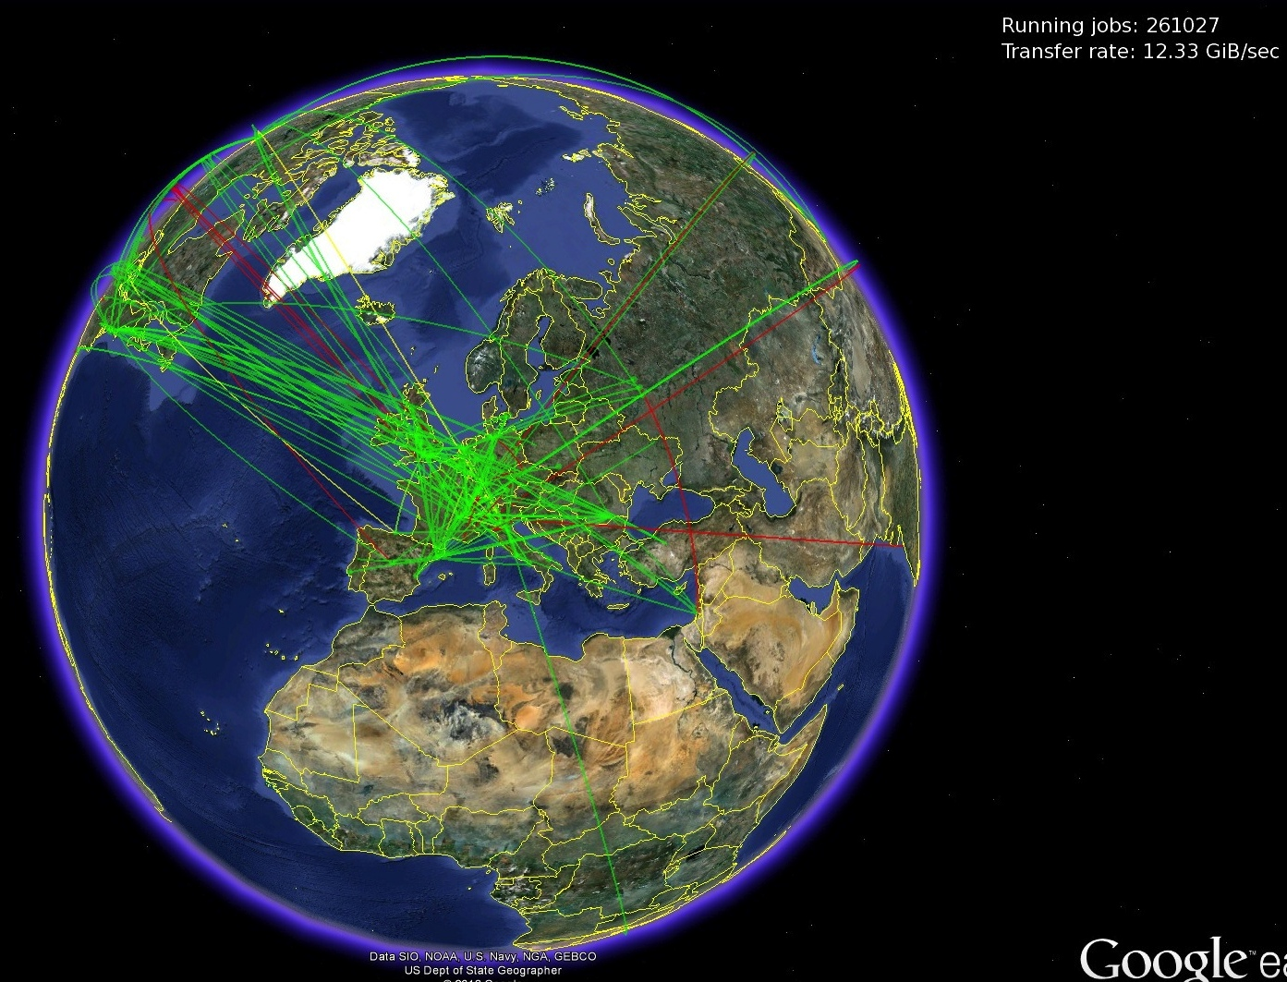
WLCG: Worldwide LHC Computing Grid
Typical simultaneous jobs: more than 250,000
Global Transfer rate: 12-15 billion bytes per second
Notes:
Managed and operated by a worldwide collaboration between the experiments and the participating computer centres. The resources are distributed – for funding and sociological reasons.
Our task was to make use of the resources available to us – no matter where they are located
CERN Council approval in September 2001 following the initiative to develop a distributed computing infrastructure to provide the production and analysis environments for the LHC experiments.
LCG Project began in 2002, with support from several countries – including significant funding from UK & Italy and several others
First small grid deployments late 2002/early 2003
Real production use and program of data challenges started in 2004

Slide 8
WLCG: Worldwide LHC Computing Grid
Tier 0 (CERN)
  Data recording
  Initial data reconstruction
  Data distribution
Tier 1 (12 centres)
  Permanent storage
  Re-processing
  Analysis
  10 Gbit/s links
  Tier 2 (~140 centres)
  Simulation
  End-user analysis
  Overall
  ~150 sites, 39 countries
  250,000 cores
  173 PB of storage
  2 million jobs/day
Tier-2 sites
(about 140)
Tier-1 sites
- - - - 10 Gbit/s links
Notes:
The Tier 0 centre at CERN stores the primary copy of all the data. A second copy (of RAW data + Event Summary Data) is distributed from CERN to the 12 so-called Tier 1 centres in real time, over dedicated network connections. The T1s are large computer centres in different geographical regions of the world, that also have a responsibility for long term guardianship of the data.
In order to keep up with the data coming from the experiments this transfer must be capable of running at around 1.3 GB/s continuously. This is equivalent to a full DVD every 3 seconds.
The Tier 1 sites also provide the second level of data processing and produce data sets which can be used to perform the physics analysis. These data sets are sent from the Tier 1 sites to the around 140 Tier 2 sites.
A Tier 2 is typically a university department or physics laboratories and are located all over the world in most of the countries that participate in the LHC experiments. Often, Tier 2s are associated to a Tier 1 site in their region. It is at the Tier 2s that the real physics analysis is performed.

Slide 9
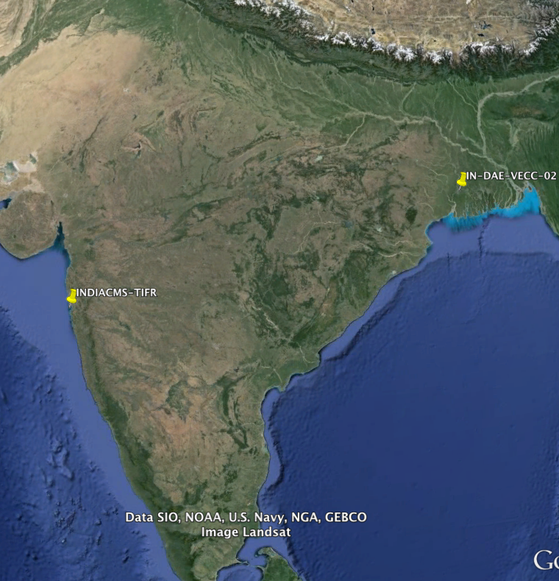
WLCG sites in India
2 WLCG T2 sites in India
  VECC (Kolkata)
  TIFR (Mumbai)
Used by ALICE & CMS experiments
Notes:
VECC: Variable Energy Cyclotron Centre
TIFR: Tata Institute of Fundamental Research

Slide 10
India-CERN Collaboration
Cooperation agreement signed in 1991
Research & Development for accelerators, detectors, computing, and high energy physics
Around 30 Addenda have been completed
In the last years on LHC and NAT projects (CTF3, CLIC, LINAC4, Computing) with RRCAT & BARC
Solid State Modulator for Linac4
Vacuum chambers and magnets development, CTF3 controls software development
Notes:
CLIC: Compact Linear Collider to collide electrons and positrons at energies up to several TeV.
LINAC4 – linear accelerator to replace Linac2 as injector to the PS Booster. It will increase the beam brightness by a factor of 2, making possible an upgrade of the LHC injectors for higher intensity and eventually increase of the LHC luminosity.
RRCAT: Raja Ramanna Centre for Advanced Technology
ISOLDE - Radioactive Ion Beam facility

Slide 11
Collaboration in Computing
Protocol P060/LHC (2002-2016), Computing and Grid Technology for LHC
76 FTE involved since 2002 (26 since 2008)
Wide range of computational areas:
  Fabric Management
  Databases
  Grid Monitoring
  Visualization
  Reporting
  Cloud Infrastructure Management

Slide 12
Computing area (last 2 years)
Visualisation of Grid Monitoring data
  Status, availability, reliability of Grid services and sites
  Tools for WLCG management
Cloud Computing
  Graphical management portal for OpenNebula and OpenStack backends
  Identify CERN and WLCG quota management requirements
  Integration of WLCG accounting schema
Notes:
OpenStack: Open source computing platform for public and private clouds.

Slide 13
Computing (starting now)
Projects between BARC and CERN – 2 FTEs each
Centralised Multi-level User Quota Management System for OpenStack
OpenStack Enhancements for Physics
Geant-V Optimisations
Notes:
Quota Managemet for OpenStack, OpenSource also in collaboration with HP, Delegation of Computational Resources inside a project, experiment, etc.
OpenStack Enhancements for Physics: Identify and implement the additional OpenStack functionality required by the physics community like better compatibility of OpenStack and Amazon EC2, improve scalability in areas such as security, virtual machine placement, and efficiency
Geant4: platform for "the simulation of the passage of particles through matter," using Monte Carlo methods
Geant5: development of open source, all particle generic transport code for HEP, for both fast and full simulation, optimised for parallel and vector CPU architectures. Optimisation of geometry and physics methods on GPUs.

Slide 14
Conclusions
Major Indian participation in LHC
Very valuable collaboration in areas of common interest
We want to continue this in the future
Notes:
Major Indian participation in LHC both technologically and scientifically, providing a lot of support in building, commissioning, and operating the facility

