Slide 1
Project Status Report
Ian Bird
WLCG Overview Board;
CERN, 9th May 2014

Slide 2
Outline
WLCG Collaboration & MoU update
Brief status report
  Ongoing activities & preparation for Run 2
  Status of Wigner
  Site availability and various testing activities
  Need for ongoing middleware support
Summary from RRB
Computing model update
HEP Software collaboration
Summary

Slide 3
WLCG MoU Topics
KISTI (Rep. Korea)
  Status as full Tier 1 for ALICE approved at WLCG Overview Board in November 2013
    Agreed that all milestones met; performance accepted by ALICE;
    Upgrade of LHCOPN link to 10 Gbps planned and funded
Latin America: Federation (CLAF), Tier 2 for all 4 experiments – initially CBPF (Brazil) for LHCb and CMS
  Since last RRB, new sites added:
    UNIANDES Colombia (CMS), UNLP Argentina (ATLAS), UTFSM Chile (ATLAS), SAMPA Brazil (ALICE), ICM UNAM Mexico (ALICE), UERJ Brazil (CMS)
Pakistan: COMSATS Inst. Information Technology (ALICE): MoU in preparation
Update on progress with Russia Tier 1 implementation
  → this meeting

Slide 4
Brief summary of progress

Slide 5
WLCG: Ongoing work
Continuing heavy activity:
  Data analysis, simulations, reprocessing of Run 1 data;
  Simulation in preparation for Run 2
Resources continue to be fully used at the levels anticipated (→)
Data challenges planned for new/updated software/services
  Coordination via the WLCG Operations activity
  But no need for large-scale combined challenge
HLT farms in production for simulation, reprocessing
  Plan to use during LHC running also; up to ~30% of time
  ATLAS, CMS use cloud software to dynamically (re-)configure

Slide 6
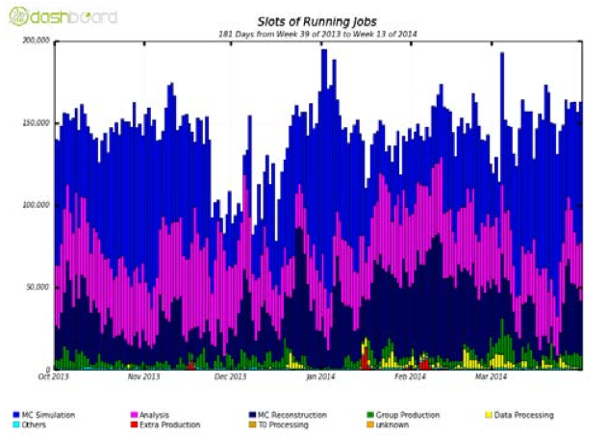
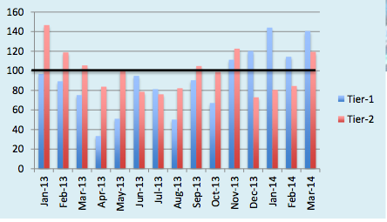
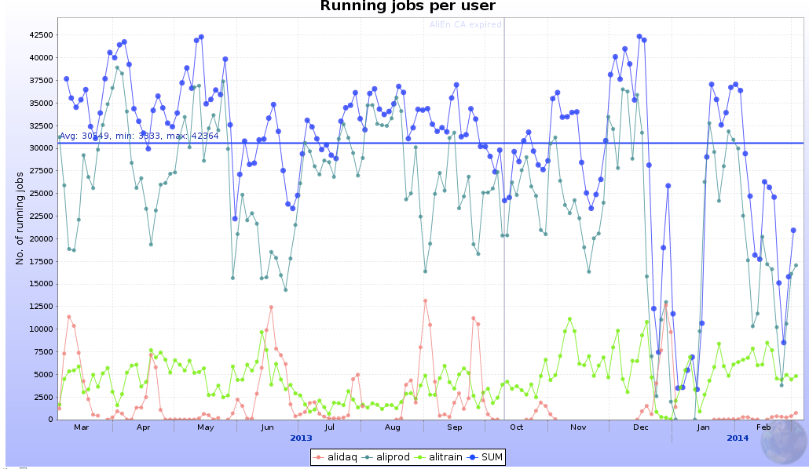
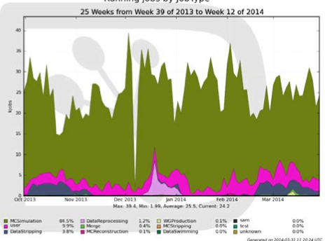
Ongoing activities
ATLAS Running jobs
Consistent above-pledge performance
Saturation most of the time
MC Simulation
User Analysis
MC Reco
Group Prod
CMS usage
ALICE jobs
LHCb activity – Simulation dominates
Notes:
Examples of use during recent months:
ATLAS – shows tasks running at Tier 1s, also shows use well above pledged resources
CMS – usage consistent with pledges – plot shows Tier1s
ALICE – continual heavy load of jobs – dominated by simulations
LHCb – example of incremental stripping – preparing physics data sets

Slide 7
Status of Wigner centre
In production;
  >1000 worker nodes installed
  Disk cache (EOS) scaled with CPU capacity
Some network problems:
  One link was unstable every few days
  Some firmware incompatibilities between NICs, switches and cables (!)
    Hopefully now resolved
Some anecdotal job inefficiencies; a systematic performance analysis was done
  Building some additional monitoring for longer term management
    Dedicated perfsonar testing (as deployed in WLCG)
  Uncovered some issues with pilot jobs
  Clear difference in efficiency between AMD and Intel – depending on workload (not new)
  Must use correct caching algorithm in ROOT, or performance suffers for I/O bound jobs; continuing study of data transfer performance
No significant difference in efficiency between Geneva and Wigner
  Monitoring much improved
  Detailed performance studies will benefit all remote I/O situations

Slide 8
Changes to availability/reliability reporting
We have now changed the tests used as the basis for reporting availability/reliability
  From: generic testing
  To: experiment-specific tests better reflecting how experiments use sites
This means that there are now 4 reports each month
  More meaningful metrics
Note: while vital for getting WLCG sites to good performance, generic testing is not so useful now:
  Have tests of services needed by experiments
  Reporting on those is more meaningful and useful

Slide 9
Pre-production deployment etc
Experience shows need sites to offer to:
  Test new/updated services in pre-deployment
  Be early adopters in production
No other way to test at scale
Main uses:
  Validate new middleware releases using experiments’ frameworks
  Early deployment/feedback of new releases
  Deployment of (e.g.) IPV6 at sites
But:
  Sites were concerned that offering such community services would affect their reported reliabilities

Slide 10
Pre-production – 2
Since such volunteer sites are essential for the long-term evolution as well as for deployment testing; agreed:
  Experiments will accept some level of instability at those sites
  Sites encouraged to volunteer
  Volunteer sites would be listed in RRB reports and WLCG reports
All coordinated via the operations coordination (experiments, sites, ops team)
  Approved by the MB
  Minimize impact on production activities

Slide 11
EMI Middleware Support
Status 2014
One year after end of EMI
  Middleware support pledges limited to one year
Cristina Aiftimiei (INFN /EGI) report at May GDB
  contacted all Product Teams
  preliminary (incomplete) status:
    ARGUS – SWITCH, bug fixes on best effort basis only
      needs support for evolution ( identify feds, clouds, etc.)
    gLite security products need clarification
    INFN supported products will be supported
    CERN products will be supported
    NDGF products will be supported

Slide 12
Criticality | TP Name | Leader | Product(s) | Institute(s)
1 | AMGA | Soonwook Hwang | AMGA, AMGA manager | KISTI
2 | APEL | Alison Packer | APEL | STFC
3 | NORDUGRID-ARC | Balazs Konya | all ARC components both on server and client side, CANL-C++ | NorduGrid
4 | ARGUS | Valery Tschopp | ARGUS | SWITCH
5 | CREAM | Lisa Zangrando | CREAM CE | INFN-Padova
6 | EMIR | Shiraz Memon | EMIR, EMIR-SERP | JUELICH, NIIF
7 | gLite MPI | Enol Fernandez | gLite MPI including mpi-start, MPI_utils | CSIC
8 | gLite security | John White | Delegation Java, gLExec, LCAS, LCMAPS, LCMAPS-plugins-c-pep, ARGUS-EES, Hydra, Trustmanager, STS, Pseudonymity | NIKHEF (?), HIP, (?)
9 | dCache | Patrick Fuhrmann | dcache (server and clients) | DESY, FERMIlab
10 | CERN Data | Oliver Keeble | FTS, DPM, LFC, GFAL/lcg_util | CERN
11 | L&B | Zdenek Sustr | L&B | Cesnet
12 | VOMS-StoRM | Andrea Ceccanti | VOMS, StoRM | INFN-CNAF
13 | UNICORE | Bernd Schuller | all UNICORE components, CANL-JAVA | JUELICH, CINECA, TUD, UWAR
14 | SAGA | Antony Wilson (?) | all SAGA products including the service discovery modules | STFC (?)
15 | NGI_CZ | Zdenek Sustr | Gridsite, proxyrenewal, CANL-C | NGI_CZ
16 | CERN BDII | Maria Alandes | Resource, Site and Top BDII, | CERN
17 | WMS | Alvise Dorigo | WMS | INFN
18 | WNoDeS | Elisabetta Ronchieri | WNoDeS | INFN-CNAF
19 | (UI & WN) | Cristina Aiftimiei | UI & WN | INFN
Unknown, Supported, Problematic (need clarification)

Slide 13
Summary of RRB held on 29 April 2014

Slide 14
LHC roadmap: schedule beyond LS1
LS2 starting in 2018 (July) => 18 months + 3 months BC
LS3 LHC: starting in 2023 => 30 months + 3 months BC
Injectors: in 2024 => 13 months + 3 months BC
Physics
Shutdown
Beam commissioning
Technical stop
(Extended) Year End Technical Stop: (E)YETS
30 fb⁻¹
YETS
EYETS
YETS
LS 2
YETS
Run 2
Run 3
Run 2
LS 2
Run 3
PHASE 1
YETS
LS 3
Run 4
YETS
LS 3
Run 4
300 fb⁻¹
PHASE 2
LS 4
Run 5
LS 5
LS 4
Run 5
LS 5
3’000 fb⁻¹

Slide 15
Summary of RSG report

Slide 16
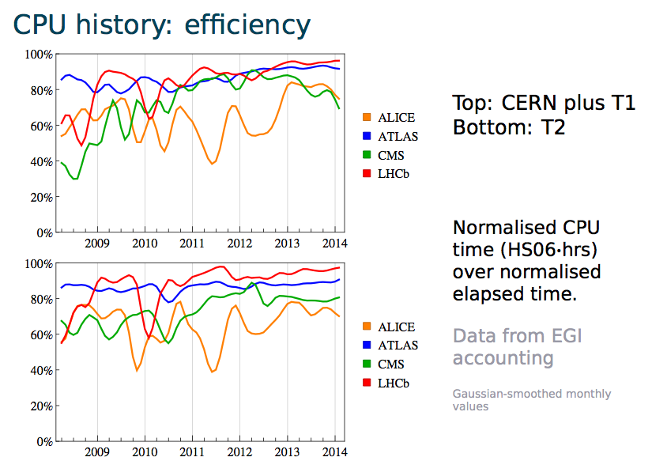
Efficiencies

Slide 17
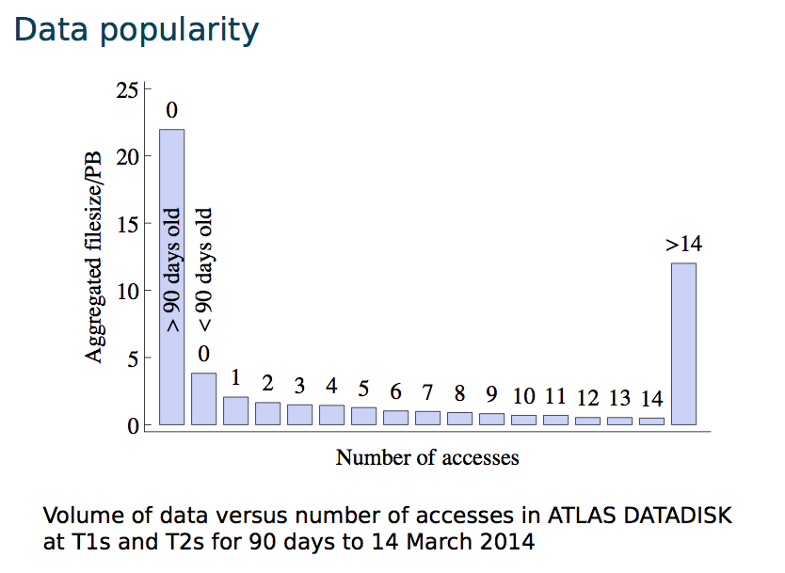
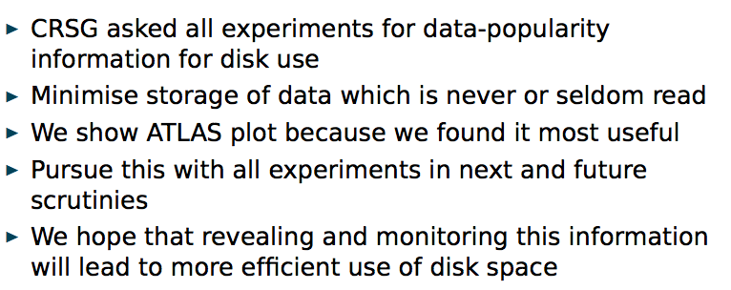

Slide 18
Scrutiny of 2015 requests

Slide 19
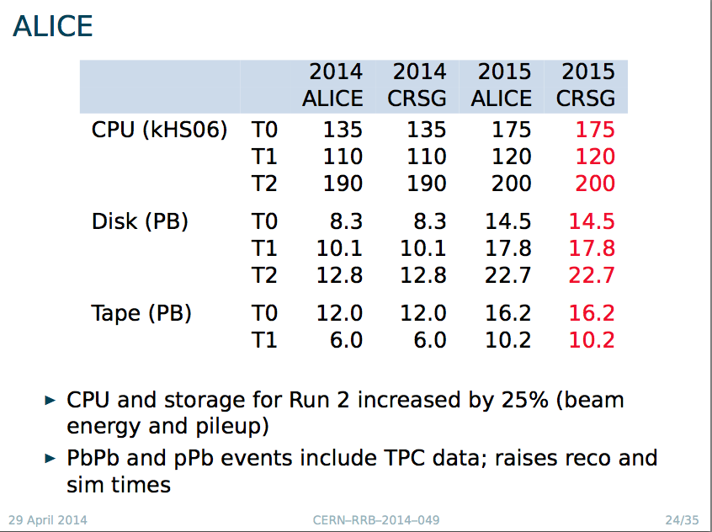

Slide 20
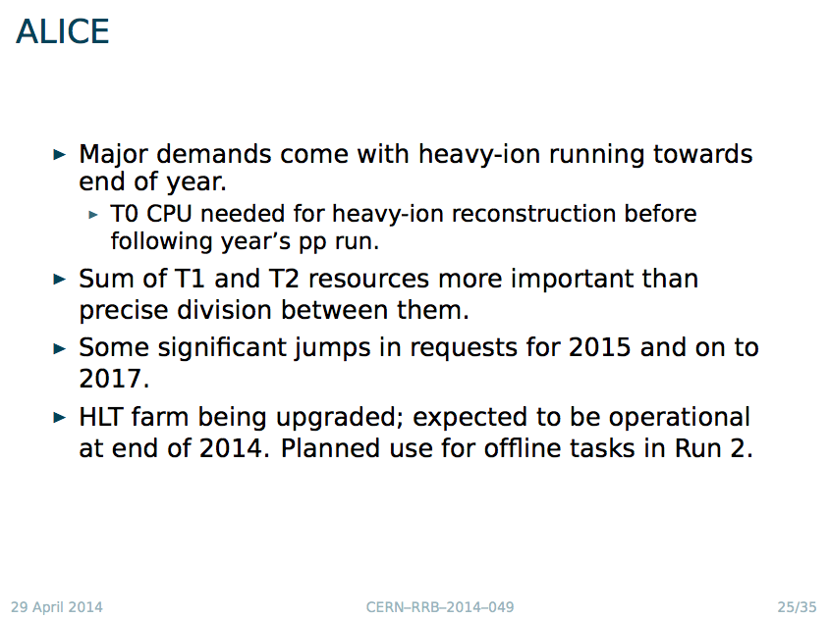

Slide 21
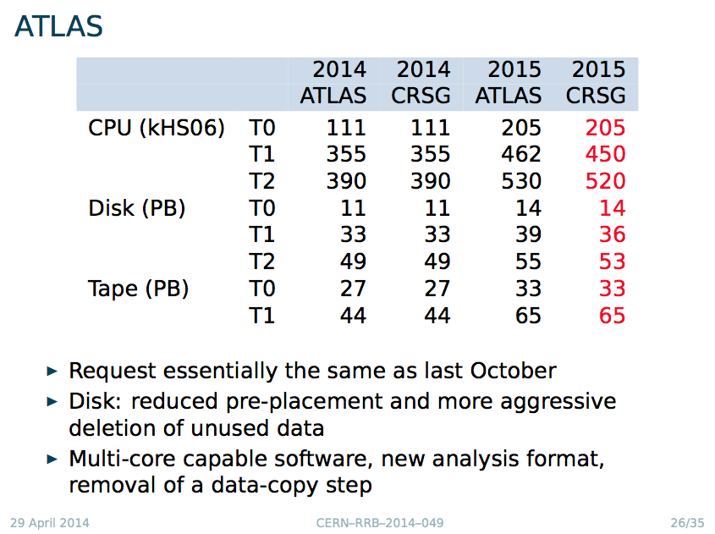

Slide 22
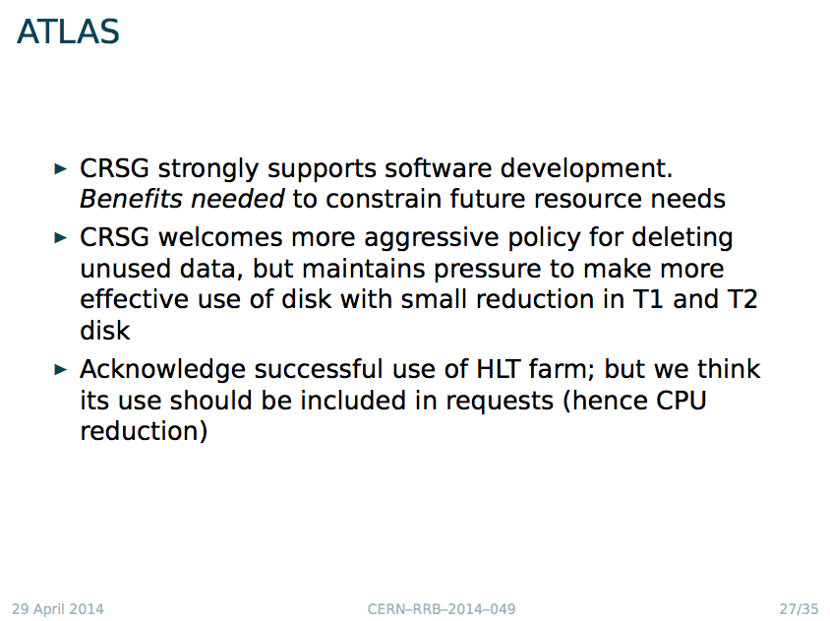

Slide 23
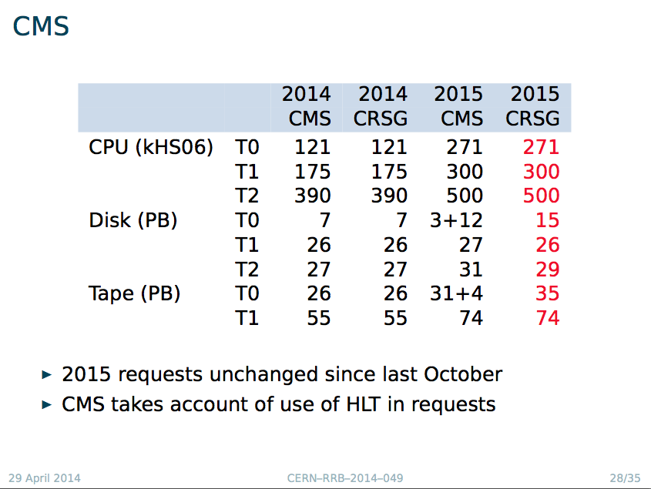

Slide 24
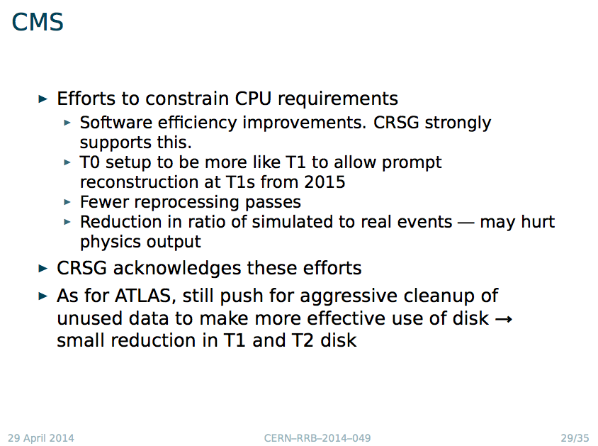

Slide 25
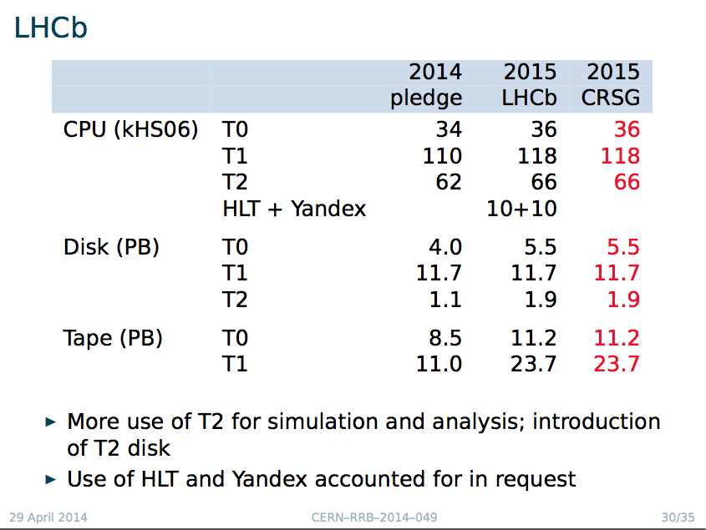

Slide 26
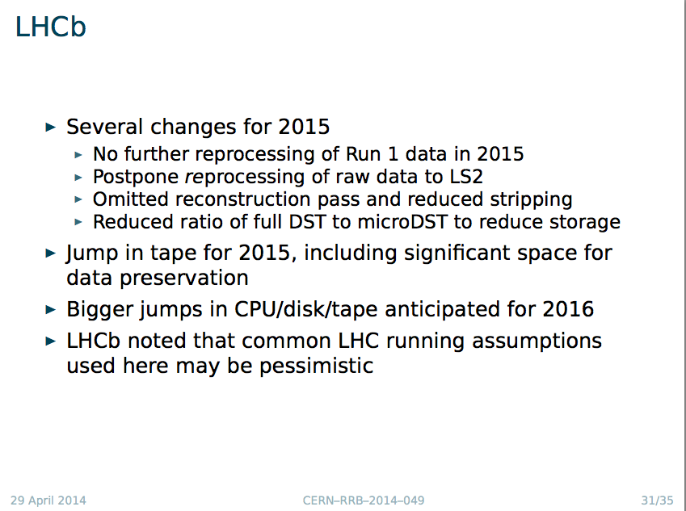
This led to a question about the assumptions for 2015 runnning in general:
Main driver is livetime
What about delayed improvements (e.g in triggers)
Conclusion was that current assumptions for 2015 are conservative – all factors conspire to make need for resources larger

Slide 27
C-RSG comments
Run 2 requests made with assumption of flat budgets
Data preservation: distinguish ability to read/analyse old data from requirements for open/public access (both tech + effort)
  Former should be included in cost of computing
  Latter is additional cost?
C-RSG acknowledges use of HLT farms in LS1 and plans to use in Run 2.
  C-RSG does not consider this to be opportunistic
  Under control of experiment
  Adjusted request where this had not been done by the experiment

Slide 28
C-RSG comments – 2
Improving software efficiency is essential to constrain growth in requests.
  (Some of) The resulting gains are already assumed.
  C-RSG strongly supports and recommends that sufficient effort is funded
Effectiveness of disk use only partly captured by occupancy
  C-RSG welcomes experiments’ efforts to purge obsolete/unused data, and thanks them for popularity information
Good networking has been exploited to reduce disk use (fewer pre-placed copies) and move processing between tiers.
  Danger that poorly networked sites will be underused and possible cost implications of providing network capacity

Slide 29
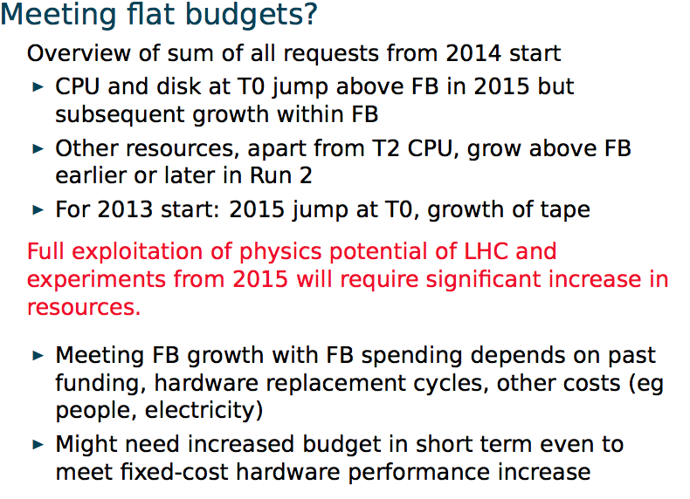
Flat budgets? (C-RSG view)

Slide 30
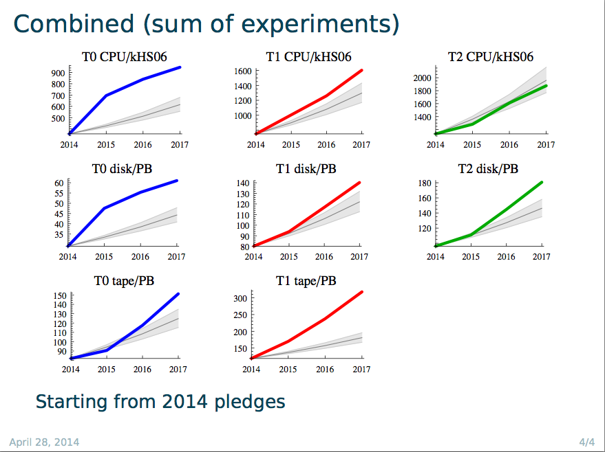

Slide 31
Budgets and pledges
“Flat budget” scenario was guidance of the RRB in April 2013, reinforced in October
Reflected in the computing requirements growth of the computing model updates (2015-17)
  BUT: this is very gross average – we do not know the details of every site, funding agency
    Growth figures based on understanding of market, experience at CERN and other large sites
  Actual ability to grow strongly depends on history
    Replacement cycle, past growth, local purchase costs and rules, etc
Thus it is clear that the real potential growth even with flat budgets is not simple to model without feedback from sites/countries/funding agencies

Slide 32
Budgets and pledges
Feedback is via the pledge process
  Not sure what other mechanism is feasible
Problems:
  Pledges are given “just in time” (actually at the last minute)
  Pledges only given in October for following year
    For some FA’s even this is a guess and actual budgets only known later
We really need a multi-year “estimated pledge” to match the 3-year resource outlook
  Only with this can we model/adjust the planning
  If some analysis has to be delayed now, can it ever be caught up?
How can this be achieved / approached / estimated?

Slide 33
Computing model update

Slide 34
Computing model update
Document has been published
  http://cds.cern.ch/record/1695401
  CERN-LHCC-2014-014
Scope:
  In preparation for the data collection and analysis in LHC Run 2, the LHCC and Computing Scrutiny Group of the RRB requested a detailed review of the current computing models of the LHC experiments and a consolidated plan for the future computing needs. This document represents the status of the work of the WLCG collaboration and the four LHC experiments in updating the computing models to reflect the advances in understanding of the most effective ways to use the distributed computing and storage resources, based upon the experience gained during LHC Run 1

Slide 35
Computing model – executive summary
The next physics run at LHC will build upon the extraordinary physics results obtained in Run 1.
  The scientific objectives, imply a desire for an uncompromised acceptance to physics from electroweak mass scales to very high mass topologies.
  Significant changes in the trigger output rates and detector occupancy at higher energies and luminosities, as expected for Run 2, the computing at LHC will face new challenges and will require new technical solutions.
There are changes in the computing models in each experiment, which represent significant efforts for the collaborations
  Significant efforts invested in core software to improve the overall performance, and
  Optimising reprocessing passes, number of data replicas stored, etc., is essential to ensure the desired level of physics analysis with a reasonable level of resources.
The computing at the LHC is mature; the reliability of resource predictions is continually improving, the largest uncertainties being the LHC running conditions.
  The predictions are guided by the current understanding of how technology will evolve in the next few years. That is summarised in the technology survey in this document although there are large uncertainties in estimating costs and likely technical evolutions.
In Run 1 the experiments have consistently used all of the pledged resources, and indeed have benefitted from the availability of additional resources above the pledges.
  effort is being invested to easily use non-dedicated resources (such as the HLT farms, external HPC resources, etc.). That work is also beneficial in simplifying the overall grid system, making it easier to maintain.

Slide 36
Executive summary - 2
Many changes in the Grid and its services, reflecting on-going efforts:
  the experiments are working to make the best use of the facilities available at each Grid site, moving away from the strict role-based functionality of the Tiers in the original model.
  significant evolutions of the data management models and services, in particular the introduction into most experiments of the capability of accessing data remotely when necessary. The network has proved to be an invaluable resource and appropriate use of network access to data allows a cost optimisation between networking, storage, and processing. This optimisation will be on-going during Run 2.
the community is investing significant effort in software development,
  adapting HEP software for modern CPU architectures. This will be important for helping to ensure efficient use of available resources.
There is a need to plan for the detector upgrades: phases I and II during LS2 and LS3.
  The channel count will dramatically increase in some areas. The role of the hardware trigger will diminish in some cases, and significantly more data may be recorded.
  It is unlikely that simple extrapolations of the present computing models will be affordable, and work must be invested to explore how the models should evolve.
  It is clear that sufficient investment in computing on that timescale is essential in order to be able to fully exploit the improved detector capabilities.
Finally, it should be noted that there is often a difficulty to hire and keep the necessary skills for software and computing development

Slide 37
HEP Software Collaboration
Summary of the workshop held at CERN on April 3-4 2014

Slide 38
HEP SW: Context
Experiment requests for more resources (people, hardware) to develop and run software for next years physics;
Prospect that lack of computing resources (or performance) will limit the physics which can be accomplished in next years;
Potential for a small amount of additional resources from new initiatives, from different funding sources and collaboration with other fields;
Large effort required to maintain existing diverse suite of experiment and common software, while developing improvements.
  Constraints of people resources drive needs for consolidation between components from different projects, and for reduction of diversity in software used for common purposes.

Slide 39
HEP SW: Goals
Goals of the initiative are to:
  better meet the rapidly growing needs for simulation, reconstruction and analysis of current and future HEP experiments,
  further promote the maintenance and development of common software projects and components for use in current and future HEP experiments,
  enable the emergence of new projects that aim to adapt to new technologies, improve the performance, provide innovative capabilities or reduce the maintenance effort
  enable potential new collaborators to become involved
  identify priorities and roadmaps
  promote collaboration with other scientific and software domains.

Slide 40
HEP SW: Model
Many comments suggested the need for a loosely coupled model of collaboration. The model of the Apache Foundation was suggested: it is an umbrella organisation for open-source projects that endorses projects and has incubators for new projects.
Agreed aim is to create a Foundation, which endorses projects that are widely adopted and has an incubator function for new ideas which show promise for future widespread use.
  In the HEP context, a Foundation could provide resources for life-cycle tasks such as testing etc.
Some important characteristics of the Foundation :
  A key task is to foster collaboration;
  developers publish their software under the umbrella of the ‘foundation’; in return their software will become more visible, be integrated with the rest, made more portable, have better quality etc
  it organizes reviews of its projects, to identify areas for improvement and to ensure the confidence of the user community and the funding agencies.
  a process for the oversight of the Foundation's governance can be established by the whole community;

Slide 41
HEP SW: Next Steps
First target is a (set of) short white paper / document describing the key characteristics of a HEP Software Foundation. The proposed length is up to 5 pages.
  Goals
  Scope and duration
  Development model
  Policies: IPR, planning, reviews, …
  Governance model
  …
It was agreed to call for drafts to be prepared by groups of interested persons, within a deadline of ~ four weeks ( i.e. May 12th. ) The goal is a consensus draft, to be used as a basis for the creation of the Foundation, that can be discussed at a second workshop some time in the Fall 2014.

Slide 42
Summary
During LS1 activities continue at a high level
  Preparations for Run 2 ongoing
Evolution of the computing models & distributed computing infrastructure
  Computing Model Document is published
  HEP Software Collaboration – workshop started the discussion
Concerns: levels of funding likely to be available for computing in Run 2 – situation is very unclear but worrying messages

Slide 43
Backup

Slide 44
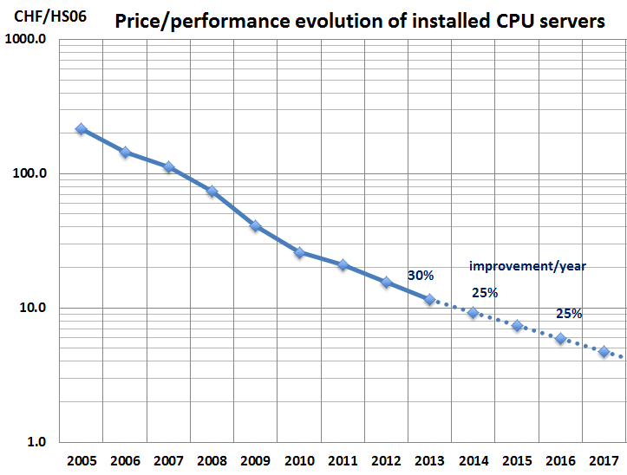
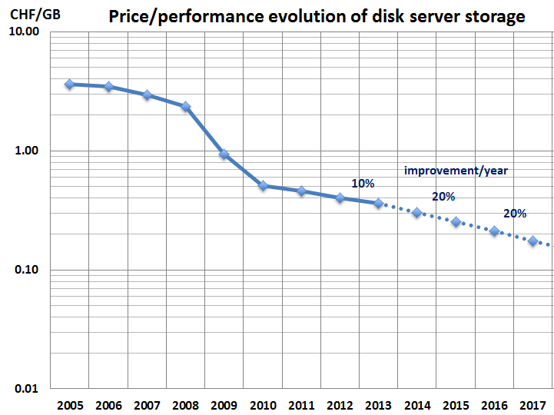
Technology outlook
Effective yearly growth: CPU 20%, Disk 15%, Tape 15%
Assumes:
  75% budget additional capacity, 25% replacement
  Other factors: infrastructure, network & increasing power costs

Slide 45
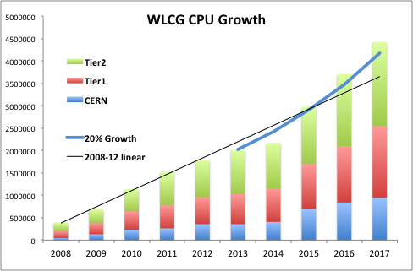
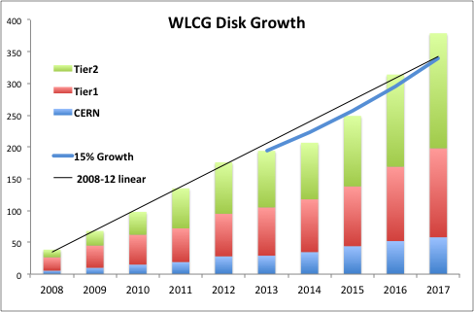
Evolution of requirements
Higher trigger (data) rates driven by physics needs
Based on understanding of likely LHC parameters;
Foreseen technology evolution (CPU, disk, tape)
Experiments work hard to fit within constant budget scenario
Estimated evolution of requirements 2015-2017 (NB. Does not reflect outcome of current RSG scrutiny)
2008-2013: Actual deployed capacity
Line: extrapolation of 2008-2012 actual resources
Curves: expected potential growth of technology with a constant budget (see next)
CPU: 20% yearly growth
Disk: 15% yearly growth

